Slide 1
HeartTrialTwin
Human Design, AI Design and Human–AI Co-Design
Evidence-grounded trial exploration with Neo4j and MiniLM
A separate, supervised GraphSAGE association-ranking experiment
Obed Akwasi Aning
University of Missouri Kansas City
October 26, 2026 submission
https://github.com/akwasianing/HeartTrialTwin
1 CS 5588 Challenge 3 final evidence through October 25, 2026
Notes:
Source: CS 5588 Challenge 3 final evidence through October 25, 2026. Full evidence, references, safeguards, and exact provenance are in the accompanying 20-page report. No new model training or benchmark evaluation was performed for this presentation. Original assignments: October 5, 12, 15 and 22. Full-cohort extensions through October 25 are labeled separately. Git remote verified; local full-cohort extensions are not claimed published. Credential rotation remains required before publication.

Slide 2
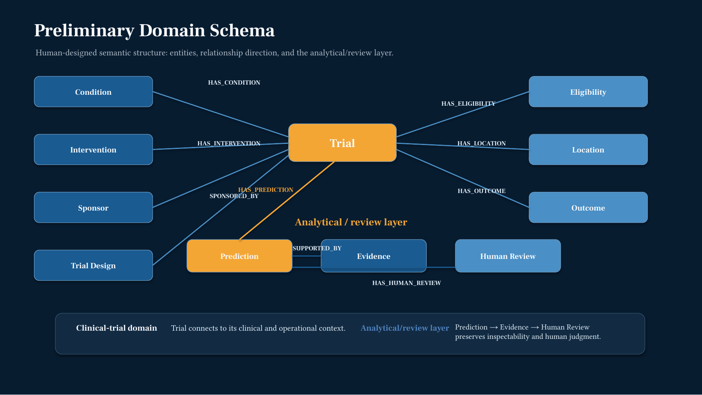
Human Design on October 5
Broad design included prediction and review concepts. Later implementation retained only verified entities.
2 Original semantic-model presentation, slide 6
Notes:
Source: Original semantic-model presentation, slide 6. Full evidence, references, safeguards, and exact provenance are in the accompanying 20-page report. No new model training or benchmark evaluation was performed for this presentation. Eleven proposed concepts included eight clinical concepts and Prediction, Evidence and Human Review. The original diagram is reproduced authentically. Prediction was separated from GraphRAG and unsupported node types were deferred.

Slide 3
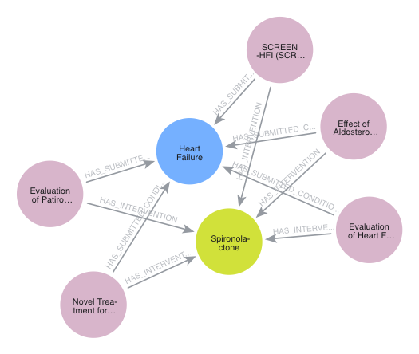
AI Design and the pinned knowledge graph
Original illustration
5 trials, 26 nodes, 65 relationships
Full-cohort extension
2,824 trials
28,777 nodes
79,125 relationships
19,740 registered planned outcomes
Six labels and seven relationship types
HTT-P1-AACT-20260905
Snapshot September 5, 2026
3 October 12 materials and full-cohort manifest
Notes:
Source: October 12 materials and full-cohort manifest. Full evidence, references, safeguards, and exact provenance are in the accompanying 20-page report. No new model training or benchmark evaluation was performed for this presentation. The screenshot is the original five-trial shared-condition/intervention subgraph, not a 28,777-node visualization. Labels: Trial, ConditionTerm, Intervention, Sponsor, PlannedOutcome, SourceDataset. Submitted and browse conditions are distinct. Full graph prepared October 22 beyond the submitted hands-on prototype.

Slide 4
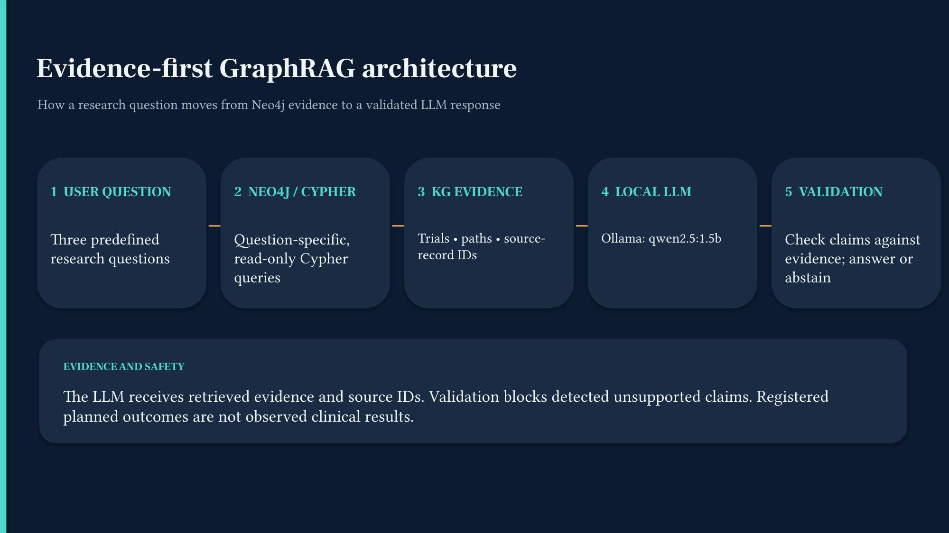
GraphRAG on October 15
Q1 profile
Grounding passed
Prose was incomplete
Q2 multi-hop
Retrieval passed
Incomplete prose blocked
Q3 comparison
Unsupported generalization blocked
4 Submitted GraphRAG presentation and actual October 15 JSON traces
Notes:
Source: Submitted GraphRAG presentation and actual October 15 JSON traces. Full evidence, references, safeguards, and exact provenance are in the accompanying 20-page report. No new model training or benchmark evaluation was performed for this presentation. Local Ollama qwen2.5:1.5b. Q2 retrieved ten planned outcomes across five trials; Q3 did not justify claims of effectiveness. This is structured Cypher-based graph grounding, not the complete Edge et al. community summarization pipeline. Registered planned outcomes are not observed clinical results.

Slide 5
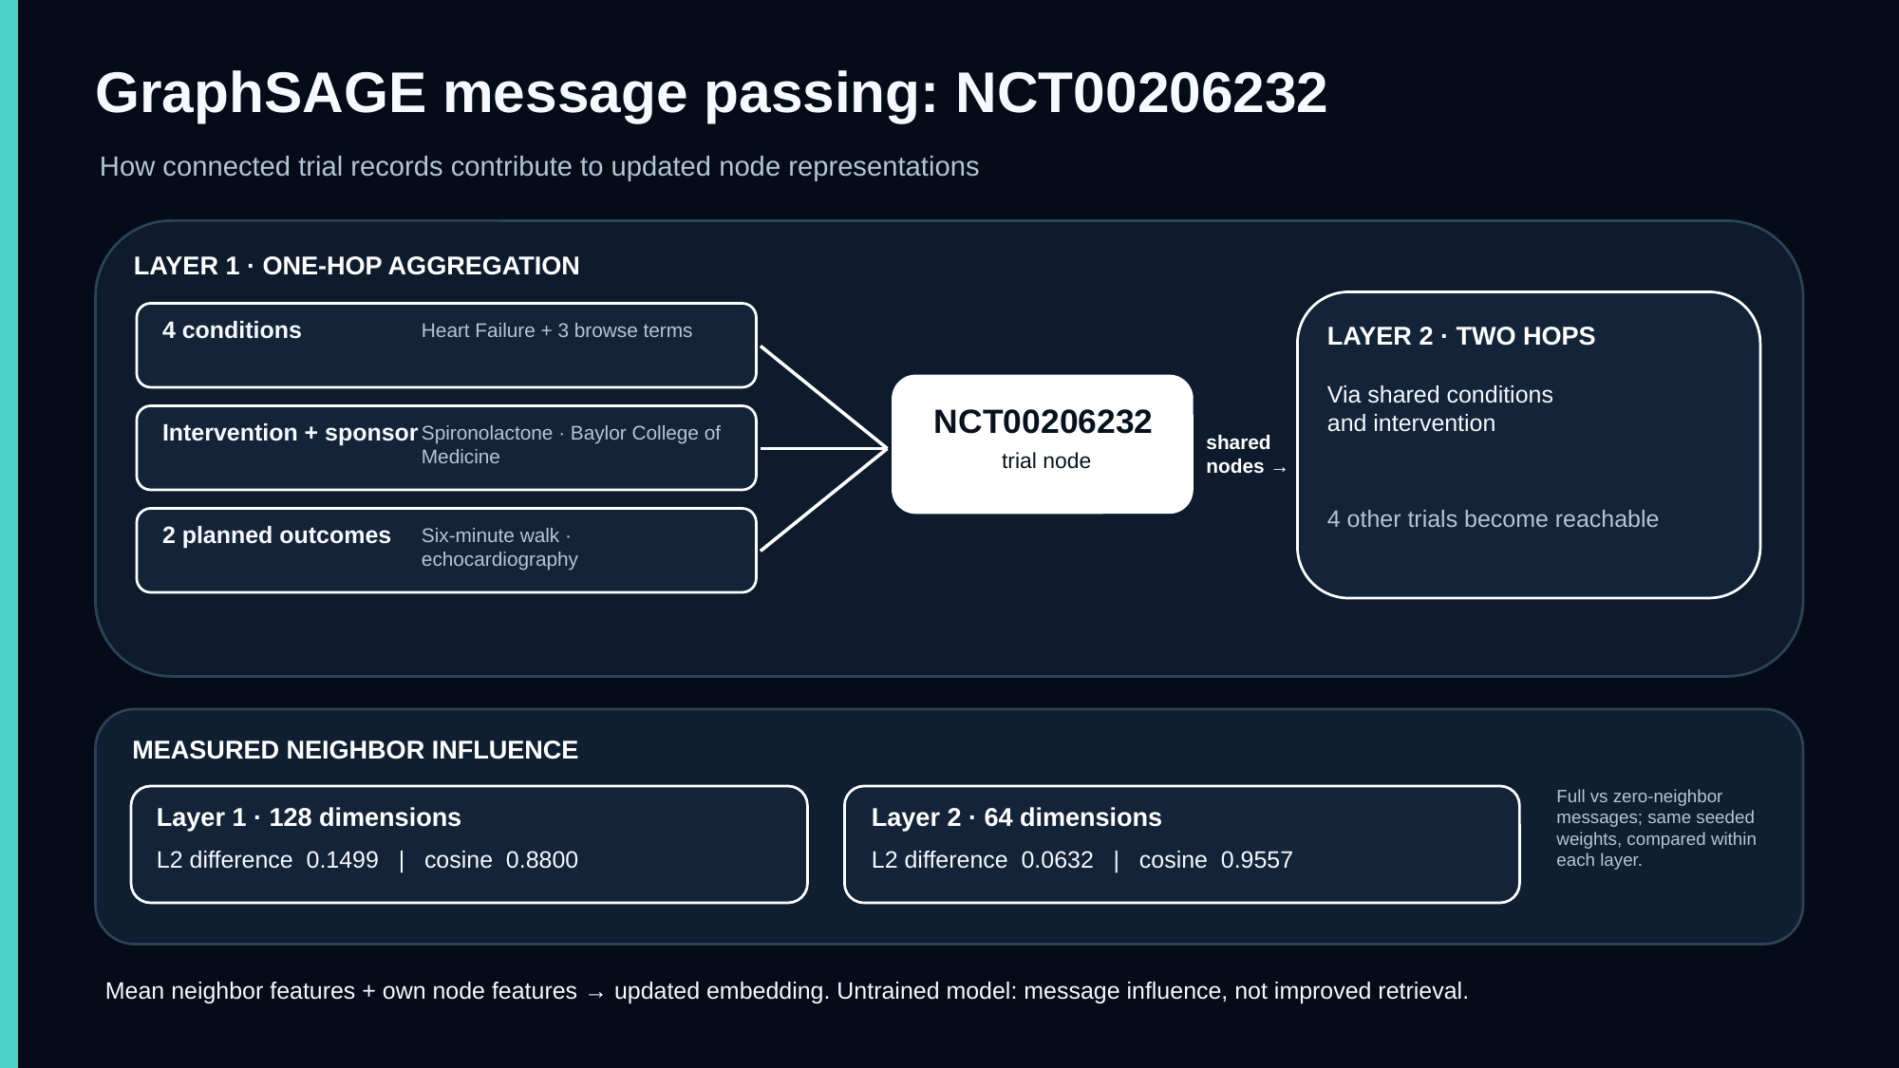
GraphSAGE on October 22
Seeded and untrained
390 → 128 → 64
80 message edges
21 passing GNN tests
Hit@1 / MRR
MiniLM: 0.20 / 0.53333
Layer 1: 0.30 / 0.53000
Layer 2: 0.10 / 0.47500
Target edges visible
In-graph sanity check only
5 Original message-passing and trial-ranking diagnostic reports
Notes:
Source: Original message-passing and trial-ranking diagnostic reports. Full evidence, references, safeguards, and exact provenance are in the accompanying 20-page report. No new model training or benchmark evaluation was performed for this presentation. Ten query outcomes and five trial candidates. Provenance remained in the source graph but provenance hubs were excluded from computational messages by human decision. No training, held-out retrieval improvement, clinical effect, or generalization was established by this prototype.

Slide 6
Later full-cohort training protocol
1,976
424
424
training trials
validation trials
test trials
All 2,824 candidates remain in fixed order
19,740 source associations and 61,218 permitted computational edges
Context features
MiniLM plus six type slots
GraphSAGE
390 → 128 → 64
Trial vectors
64 dimensional ranking space
Query embeddings use a separate trainable 384 → 64 projection into this ranking space.
Target edges and reverses removed. Family quarantine and query embargoes retained.
Held-out trial context remains visible. Unseen-trial induction is not evaluated.
6 Frozen HTT-GNN-ASSOC-PROTOCOL-v2 and authorized execution record
Notes:
Source: Frozen HTT-GNN-ASSOC-PROTOCOL-v2 and authorized execution record. Full evidence, references, safeguards, and exact provenance are in the accompanying 20-page report. No new model training or benchmark evaluation was performed for this presentation. Query projection and graph encoder meet in the same ranking space through a cosine score. Six type slots are appended to graph semantic features. 9,036 context nodes. Revision 1110a243fdf4706b3f48f1d95db1a4f5529b4d41, effective 256 tokens. External approvals preserve internal training_permitted=False guards. Sixty-nine weak-family endpoints are quarantined from held-out query evaluation; unresolved relatedness is not adjudicated.

Slide 7
Frozen association-ranking results
Test Recall@10
TF-IDF 0.11492
MiniLM 0.12078
Pooling 0.12100
Untrained 0.00361
Trained 0.02208
GraphSAGE remains experimental
7 HTT-GNN-ASSOC-RUN-v1 saved test results, descriptive comparison
Notes:
Source: HTT-GNN-ASSOC-RUN-v1 saved test results, descriptive comparison. Full evidence, references, safeguards, and exact provenance are in the accompanying 20-page report. No new model training or benchmark evaluation was performed for this presentation. Epoch 60 selected on validation after 80 full-graph updates. Validation MRR: TF-IDF .08519, MiniLM .08115, context pooling .07935, untrained GNN .00307, trained GNN .02180. No selection or tuning follows these test results. Context pooling versus MiniLM superiority is not statistically established. All metrics describe registered association ranking, not clinical prediction.

Slide 8
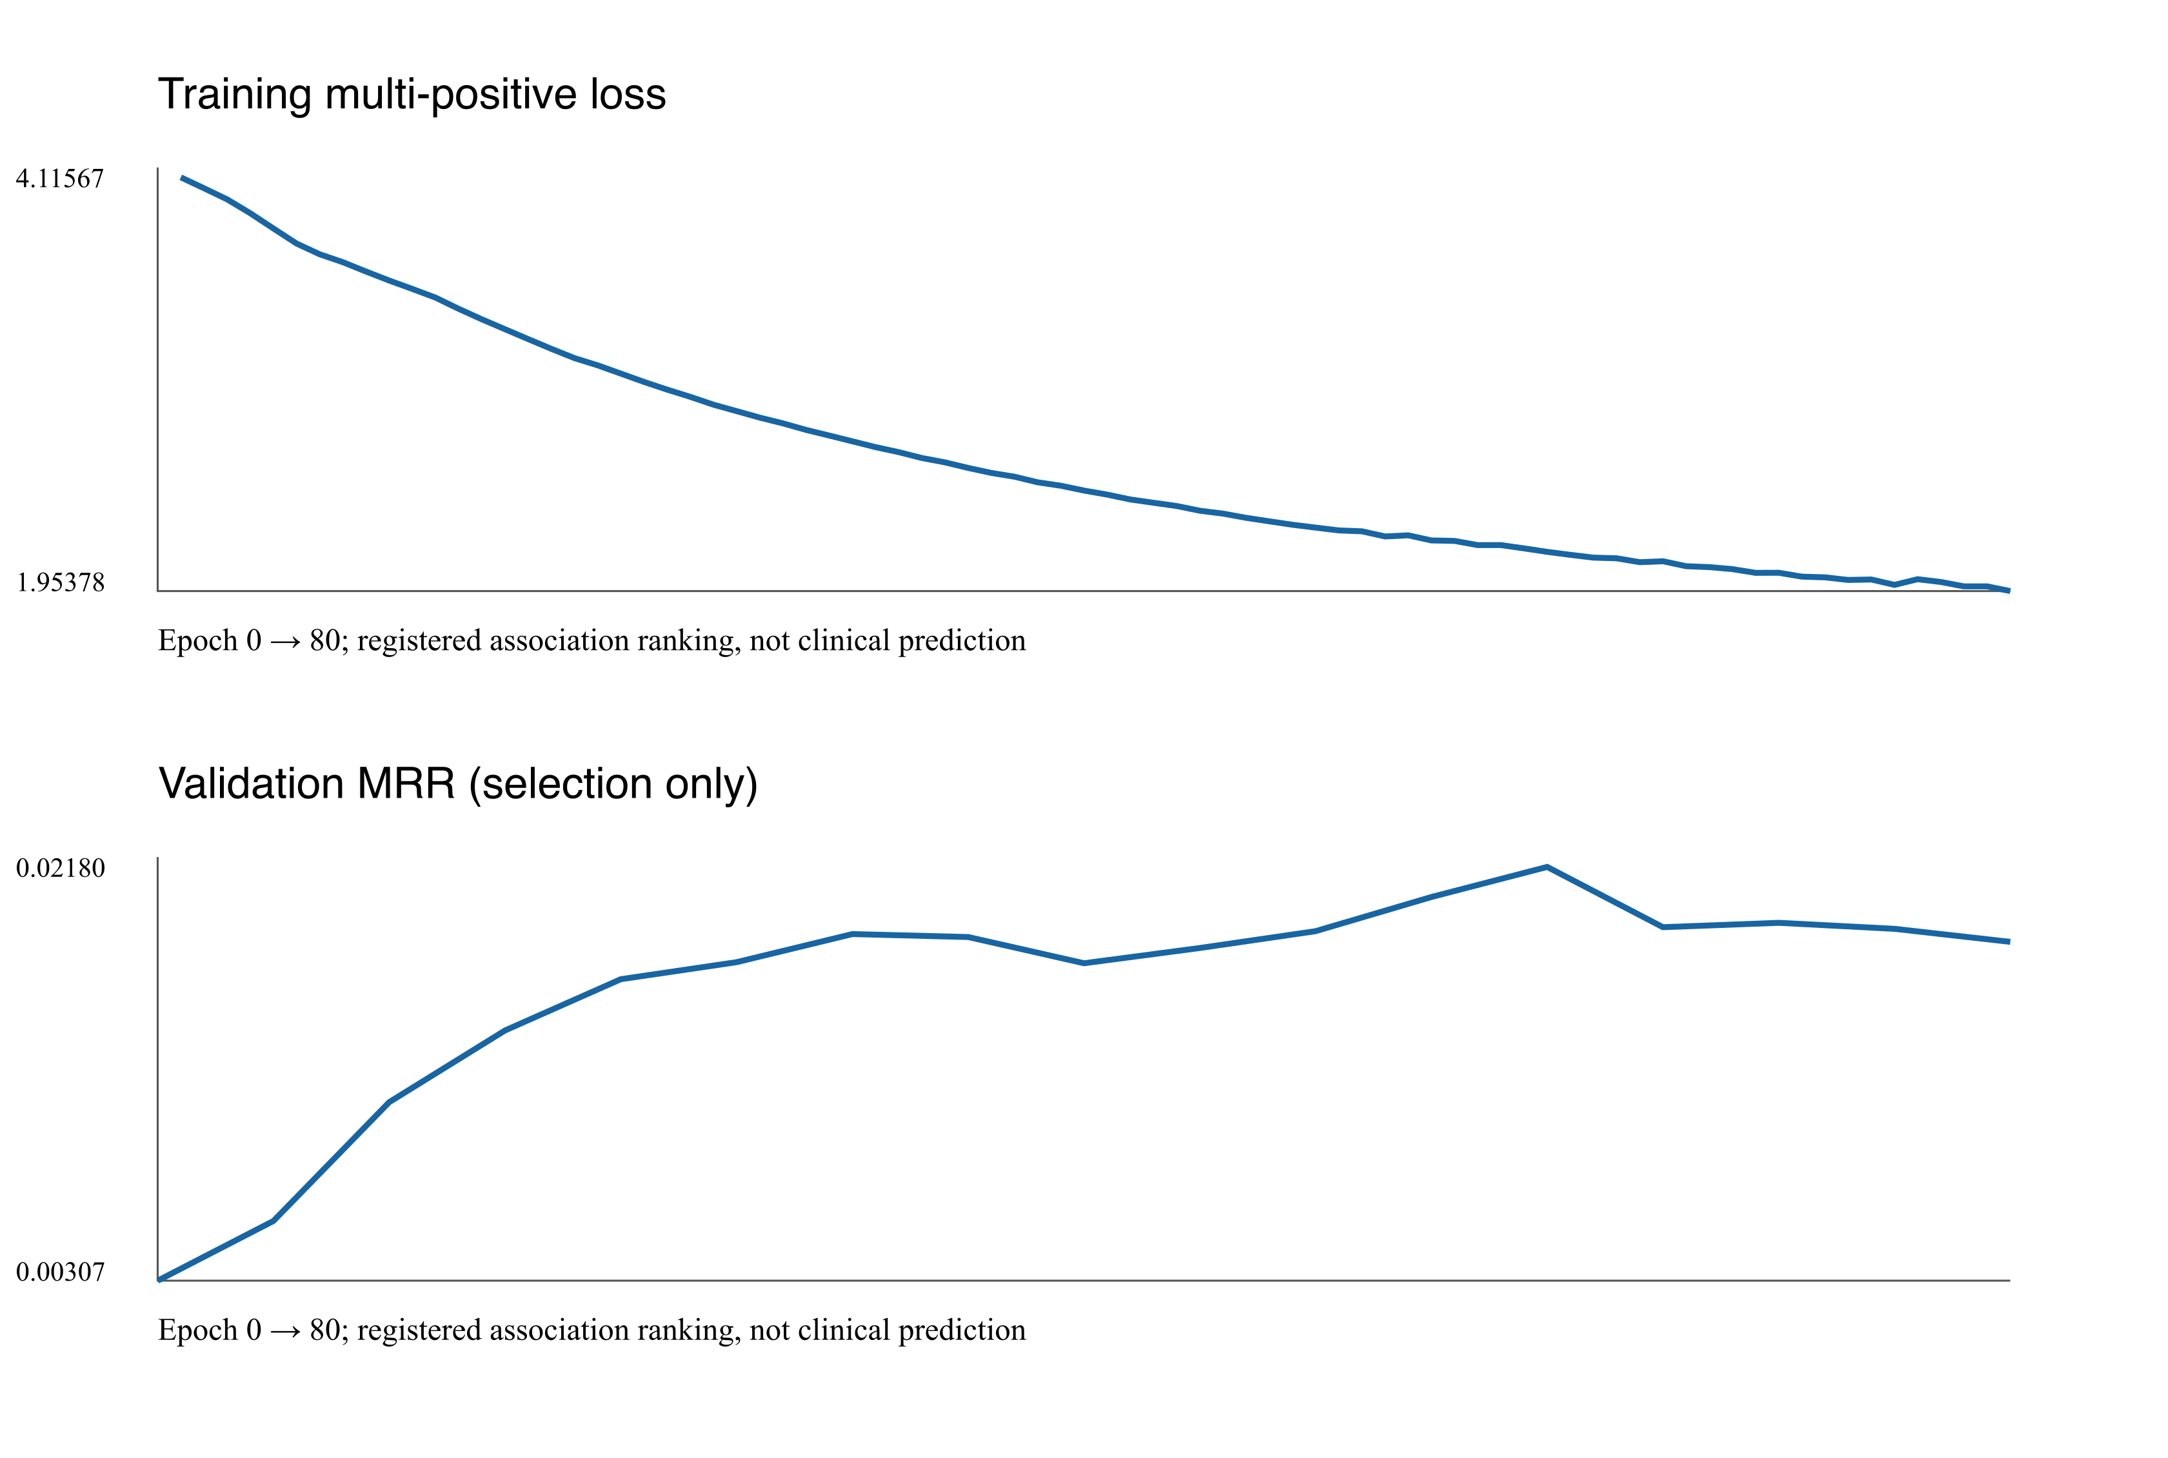
GraphSAGE diagnosis
Selected training MRR 0.20386
Validation MRR 0.02180
No confirmed graph, ordering or loss implementation defect
No complete embedding collapse
Weak generalization is the leading explanation
Removing messages under fixed trained weights reduced validation MRR to 0.01319
8 Training history and STEP_66G_1_DIAGNOSTIC_REPORT.md
Notes:
Source: Training history and STEP_66G_1_DIAGNOSTIC_REPORT.md. Full evidence, references, safeguards, and exact provenance are in the accompanying 20-page report. No new model training or benchmark evaluation was performed for this presentation. Fixed-weight message removal is not a separately trained no-message ablation. Tiny training-only overfitting reached MRR 1.0, which verifies capacity rather than generalization. Checkpoint and benchmark results are preserved. No exposed-test retuning was performed.

Slide 9
Final MiniLM plus GraphRAG application
IMPLEMENTED
User question
Exact NCT
or MiniLM candidates
Read-only
Neo4j evidence
Citation and
completeness checks
Cited answer
or abstention
Deterministic facts and complete planned-outcome listings use zero model attempts
Optional Ollama uses a bounded, citation-validated catalog selection
EXPERIMENTAL
GraphSAGE ranking could propose NCT candidates before the same authoritative evidence gate.
The trained GraphSAGE checkpoint is not used by the final application.
9 Implemented demo_v2 path and separate experimental GNN lane
Notes:
Source: Implemented demo_v2 path and separate experimental GNN lane. Full evidence, references, safeguards, and exact provenance are in the accompanying 20-page report. No new model training or benchmark evaluation was performed for this presentation. Semantic discovery keeps original cosine scores and examines a bounded ranked prefix for required evidence. Defaults: five examined, two selected; hard bounds ten and three. Exact NCT scope never silently changes. Unsupported effectiveness questions abstain. Neo4j data are unchanged and read-only.

Slide 10
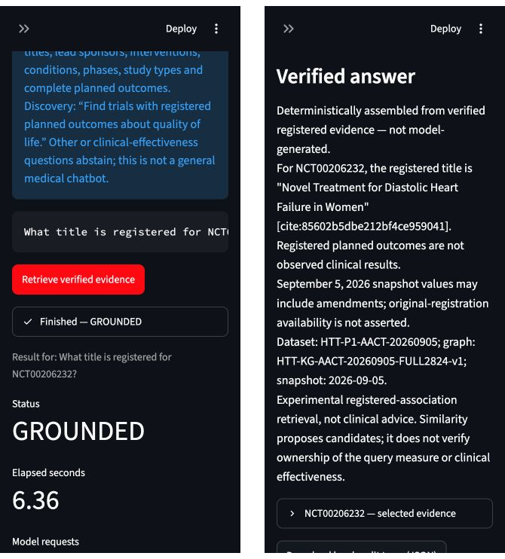
Verified demonstration cases
NCT00206232
Lead sponsor
Baylor College of Medicine 0.63 s
Registered intervention
Spironolactone 0.76 s
Complete planned-outcome listing
Seven verified records 2.28 s
Title capture: 6.36 s. All four paths used zero model attempts.
220 offline tests passed.
Planned measures are not observed clinical results.
10 Saved live smoke traces and authentic October 25 browser captures
Notes:
Source: Saved live smoke traces and authentic October 25 browser captures. Full evidence, references, safeguards, and exact provenance are in the accompanying 20-page report. No new model training or benchmark evaluation was performed for this presentation. These are individual saved functionality timings, not repeated latency benchmarks. Sponsor citation cite:3db774038cf4618ff9294543 binds sponsors.txt 381715287; intervention cite:21f56031bbf8289fe76bfdcb binds interventions.txt 392379839. Seven outcomes have exact evidence-set validation. Discovery took 25.09 s and explicitly skipped a candidate without outcomes. The final audit recorded 220 offline passes, zero failures/errors/skips; the formal shared RAG benchmark remains NOT RUN.

Slide 11
Human and AI roles
Human decisions
Codex assistance
Verified co-design
Users and scientific scope
Schema approval
Provenance retention
Frozen partitions and safety gates
Source and code inspection
CSV preparation
Training and diagnostic code
Tests and evidence packaging
Six supported node types
Trial-bound citations
Complete outcome listings
Negative GNN results retained
Human review corrected omissions and false positives while retaining clinical-evidence safeguards
11 Original decisions, approval records and verified implementation iterations
Notes:
Source: Original decisions, approval records and verified implementation iterations. Full evidence, references, safeguards, and exact provenance are in the accompanying 20-page report. No new model training or benchmark evaluation was performed for this presentation. Eight schema recommendations: six ACCEPT, two MODIFY. No independent clinical peer review or invented signatures. The human required evidence preservation while excluding provenance hubs from GNN messages. Deterministic citations did not certify irrelevant or incomplete generated claims; field relevance and exact-set completeness remain separate controls.

Slide 12
Lessons and Challenge 4
Evidence quality limits answer quality
Snapshot amendments, incomplete family screening and bounded retrieval remain explicit limitations.
Revised models need independent confirmation data
The current test is exposed. Future GNN improvements need prespecified training-only development.
Controlled RAG comparison remains future work
Use the frozen Q1–Q10 specification, transparent budgets and provenance-aware scoring.
Before publication: rotate the exposed credential and review the local full-cohort files.
12 Report Sections 7–8 and consolidated reproducibility guide
Notes:
Source: Report Sections 7–8 and consolidated reproducibility guide. Full evidence, references, safeguards, and exact provenance are in the accompanying 20-page report. No new model training or benchmark evaluation was performed for this presentation. Repository https://github.com/akwasianing/HeartTrialTwin verified from configured origin. Full-cohort extensions remain local. No commit or push. Final PDF contains references for AACT, Neo4j, RAG, GraphRAG, MiniLM, GraphSAGE and Ollama. This presentation does not claim clinical validation, GraphSAGE superiority or unseen-trial generalization.

