Slide 1
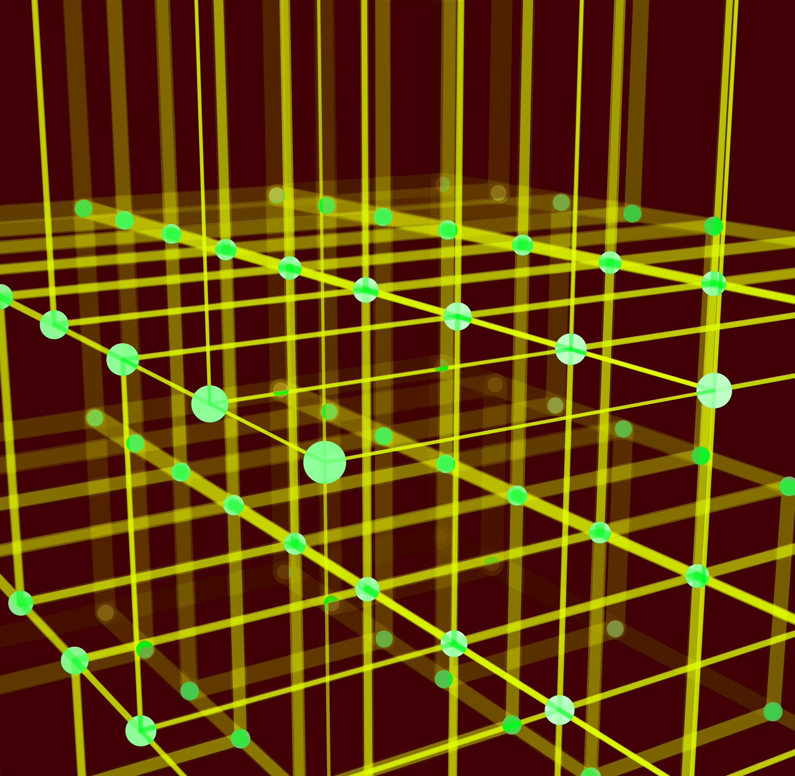
Spatial relation vector
Jingyuan Sha

Slide 2
Important Dates
Abstract submission: 6 March 2023
Paper submission deadline: 13 March 2023 (Anywhere on Earth)
Author Notification: 22 April 2023
Camera-ready paper due: 12 May 2023 (Anywhere on Earth)
NeSy Workshop dates: 3-5 July 2023

Slide 3
Experiments
Learn regular patterns (positional relationship) from training dataset
Reasoning the irregular patterns from test dataset
Suggest new layout to follow regular patterns
Move the objects to change the layout as suggested.

Slide 4
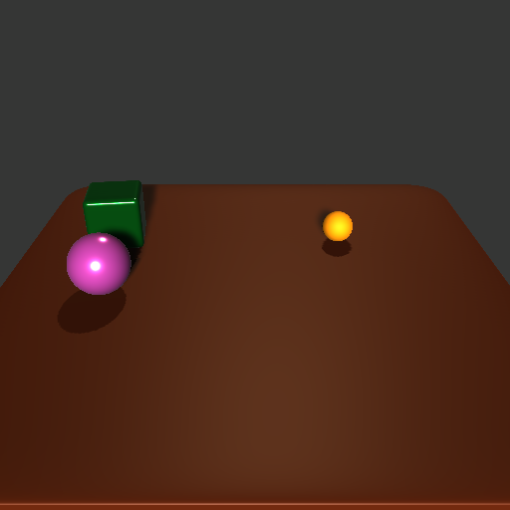
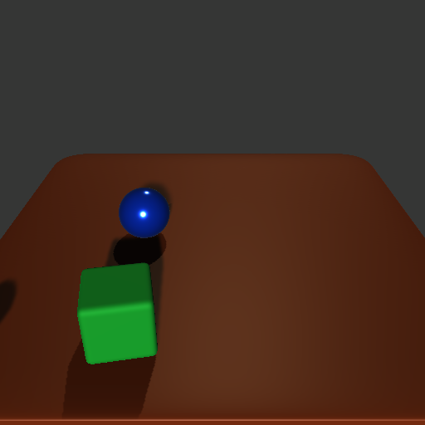
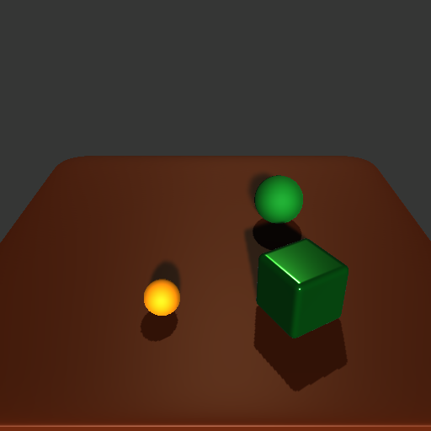
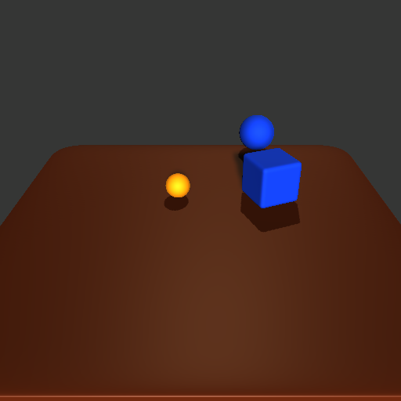
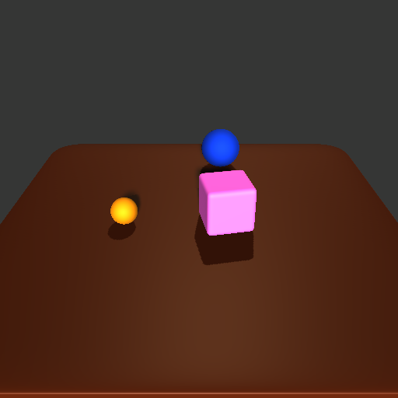
Experiment 1
Learn regular patterns (positional relationship) from training dataset
Notes:
Take the training set more general, small ball on the right side as well.

Slide 5
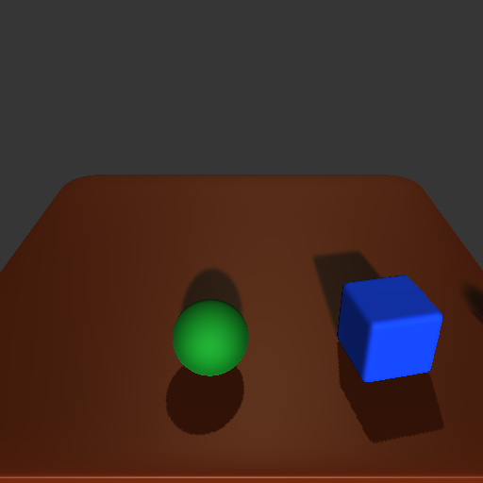
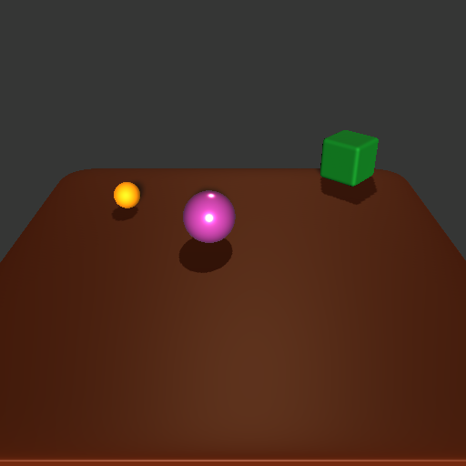
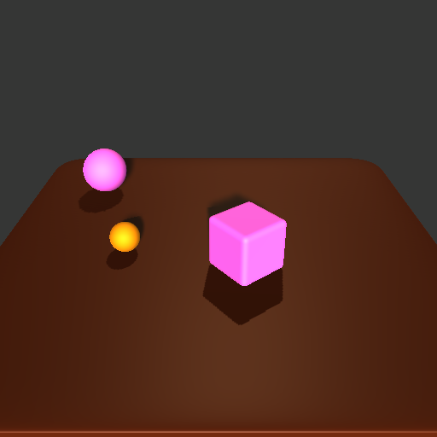
Experiment 2
Reasoning the irregular patterns from test dataset

Slide 6
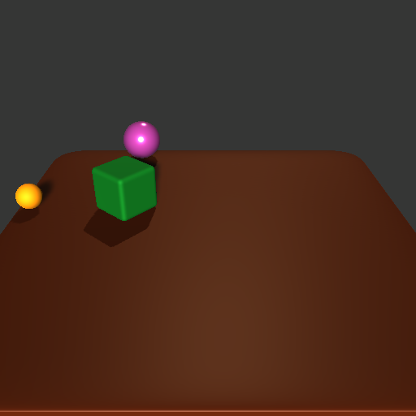
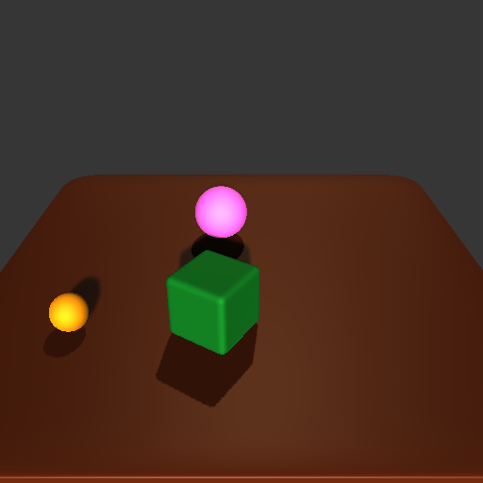
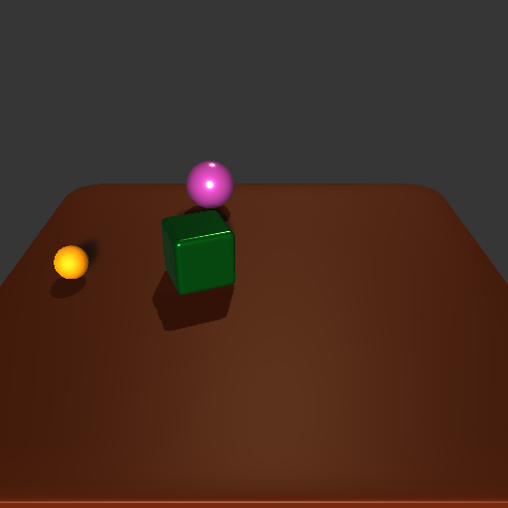
Experiment 3
Suggest new layout to follow regular patterns
Suggest 1
Suggest 2
Suggest 3
Input

Slide 7
Experiment 4
Move the objects to change the layout as suggested.
actions

Slide 8
Experiment 1
Learn regular patterns (positional relationship) from training dataset
Generated by fixed patterns
"size": "small",
"shape": "sphere",
"material": "orange",
"x": 0,
"y": 0,
"z": 0
"size": "big",
"shape": "cube",
"material": "",
"x": 1.5,
"y": 0,
"z": 0
"size": "big",
"shape": "sphere",
"material": "",
"x": 1.5,
"y": 0,
"z": 2
C
A
B
Target_relation_vector AB: [1.5 X 0. 0.29 0.6 0.3 ]
Target_relation_vector AC: [1.5 X 2. 0.15 1. 0. ]

Slide 9
Experiment 1
Learn regular patterns (positional relationship) from training dataset
Learn Spatial Relation Vectors from Scenes
Relation vector: [1.5 0.15 2. 0.15 1. 0. ]
Target_relation_vector: [1.5 X 2. 0.15 1. 0. ]
Relative relation vector: [0. X 0. 0. 0. 0. ]
relation vector: [1.5 0.15 0. 0.29 0.6 0.3 ]
target_relation_vector: [1.5 X 0. 0.29 0.6 0.3 ]
Relative relation vector : [0. X 0. 0. 0. 0. ]

Slide 10
Experiment 1
Learn regular patterns (positional relationship) from training dataset
Devide Dataset to small pieces
D1, D2, …, Dn
For each Di
find rules among Di
[1.5 0.15 0. 0.29 0.6 0.3 ]
[1.5 0.15 2. 0.15 1. 0. ]
[1.5 0.15 0. 0.29 0.6 0.3 ]
[1.5 0.15 2. 0.16 1. 0. ]
[1.5 0.15 0. 0.29 0.6 0.3 ]
[1.5 0.15 2. 0.15 1. 0. ]
[-1.5 -0.15 0. -0.29 0.3 0.6 ]
[1.5 0.15 2. 0.12 1. 0. ]
[1.5 0.15 0. 0.29 0.6 0.3 ]
[1.5 0.15 2. 0.15 1. 0. ]
[1.5 0.15 0. 0.29 0.6 0.3 ]
[1.5 0.13 2. 0.19 1. 0. ]

Slide 11
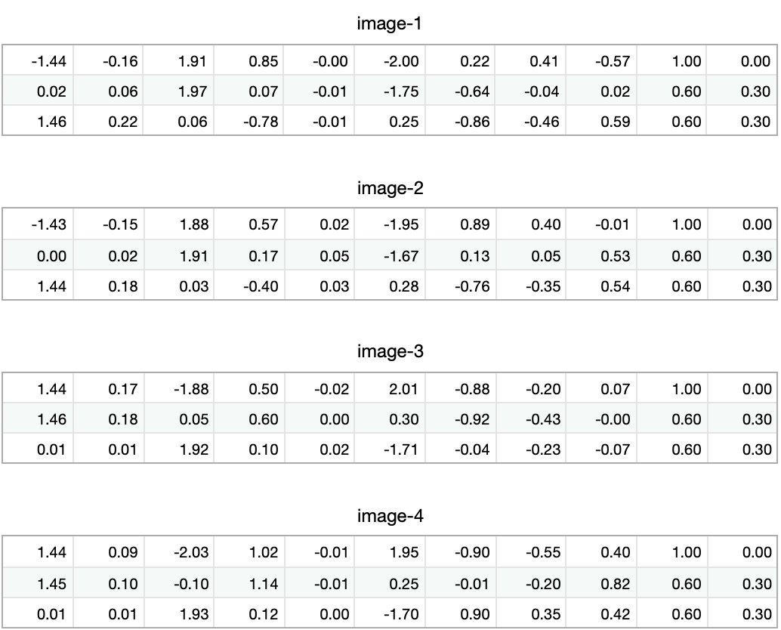
Assumptions:
If one RV occurs more than once in the same image, it is considered only once
Example: Books on the bookshelf
Since each RV in each image is counted at most once, thus
Find similar vectors in 4 images
Problems:
Define similarity
SV might not exist in all images, probability

Slide 12
Scene
Intuitive System
Rational System
There are three Balls
First has size 0.2.
Second has size 0.3.
Third has size 0.8
Small
1.5
2.667
Big
4
Vague, faulty, fast, adapted
Accurate, precise, slow, limited.
Important to have both systems
First think with intuitive system
Then use rational system.

Slide 13
How to implement the first system?
B
Sphere, Small, Red, Left
Sphere, Small, Green, Behind
Cube, Big, Green, Front
A
Shape
Cube Cylinder, Box, shelf, …
Sphere Ball, Apple, …
Size
Small small, tiny,
Large Medium, huge
Color
Red Orange, Rose, Gold
Green
Blue Purple
Black
White
Position
Front
Behind
Left
Right
C
B
Sphere, Small, Red, Left
Sphere, Small, Blue, Behind
Cube, Big, Blue, Front
A
C
B
Sphere, Small, Red, Left
Sphere, Small, Blue, Behind
Cube, Big, Red, Front
A
C

Slide 14
How to implement the first system?
B
Sphere, Small, Red, Left
Sphere, Small, Green, Behind
Cube, Big, Green, Front
A
Shape
Cube Cylinder, Box, shelf, …
Sphere Ball, Apple, …
Size
Small small, tiny,
Large Medium, huge
Color
Red Orange, Rose, Gold
Green
Blue Purple
Black
White
Position
Front
Behind
Left
Right
C
B
Sphere, Small, Red, Left
Sphere, Small, Blue, Behind
Cube, Big, Blue, Front
A
C
B
Sphere, Small, Red, Left
Sphere, Small, Blue, Behind
Cube, Big, Red, Front
A
C

Slide 15
Train
First, search attribute by attribute
Find objects that exist in all images
B
Sphere, Small, Red, Left
Sphere, Big, Green, Behind
Cube, Big, Green, Front
A
Rules can be found (not complete )
Sphere, Big
Big, Behind
Sphere, Behind
Sphere, Big, Behind
Cube, big
Big, Front
Cube, Front
Cube, big, Front
C
B
Sphere, Small, Red, Left
Sphere, Big, Blue, Behind
Cube, Big, Blue, Front
A
C
8 rules
C
Sphere, small, Red, Right
Sphere, Big, Red, Left
Cube, Big, Green, Left
B
A

Slide 16
Train
First, search attribute by attribute
Then, add attributes as priors to each rules
B
Sphere, Small, Red, Left
Sphere, Big, Green, Behind
Cube, Big, Green, Front
A
Sphere, small
red(2)
left(2)
Left, red (2)
Sphere, behind
Cube, big
Front (3)
Green, Front (2)
Big, Front
Cube (3)
Cube, Green (2)
Cube, Front
Cube, Big, Front
C
B
Sphere, Small, Red, Left
Sphere, Big, Blue, Behind
Cube, Big, Blue, Front
A
C
B
Cube, Big, Green, Front
Sphere, Small, Blue, Behind
7 rules
A
Exist Rule/ For All Rule

Slide 17
Train
B
Learn rules relate with multiple objects
Sphere, Small, Red, Left
Sphere, Big, Green, Behind
Cube, Big, Green, Front
If exist
A big cube
A big sphere
small sphere
Then
Small sphere left of cube
A
C
B
Sphere, Small, Red, Left
Sphere, Big, Blue, Behind
Cube, Big, Blue, Front
If exist
A big sphere [1 1]
A small sphere [1 0]
Then
Small sphere left of sphere
[0 0]
[0 1]
A
C
Input: Obj_Num * Property*Num
Output: spatial relation vector
B
Cube, Big, Green, Front
Sphere, Small, Blue, Behind
A
Exist Rule/ For All Rule
Notes:
Use network to learn a rule, then check the correctness.

Slide 18
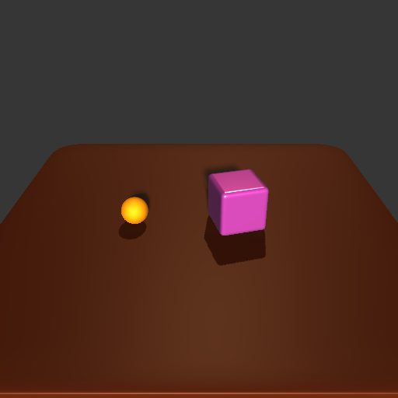
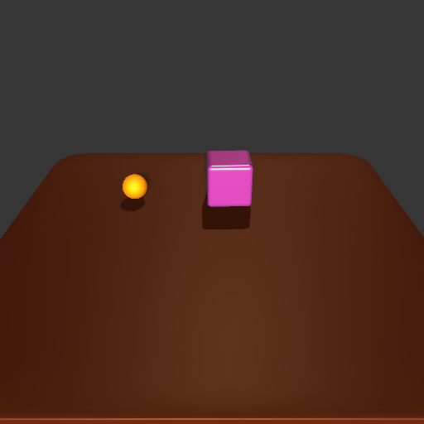
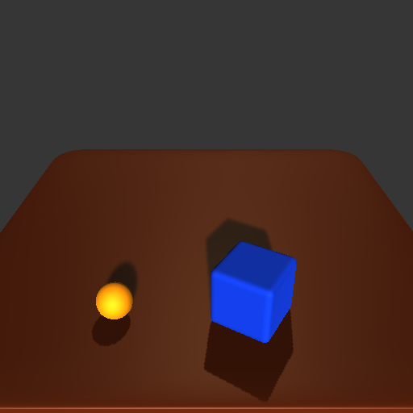
Train
How to use network to predict the rules?
What can NN do?
NN –> classification
Predict A and B
The related feature maps
The feature maps A and B
Learn correct relation vector.
Image-> objects, shift vector
Shifted Feature Maps to predict directions
Existed objects & Relations
Rule relation vector
Rules could be learned:
If exist, then
Predict a feature map, which related with a rules, and then explain the feature maps with some probabilistic models
Predict Feature maps
F1: Sphere left of big sphere
F2: Sphere left of big cube
F1 != F2, but they can be summarized as one same rule
Just consider the size for now
Predict F1 –> rules:
small orange ball left, big blue cube right
Small orange ball left, big pink cube right
Predict F2 ->

Slide 19
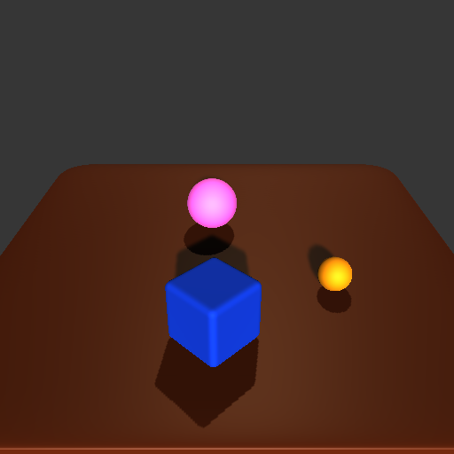
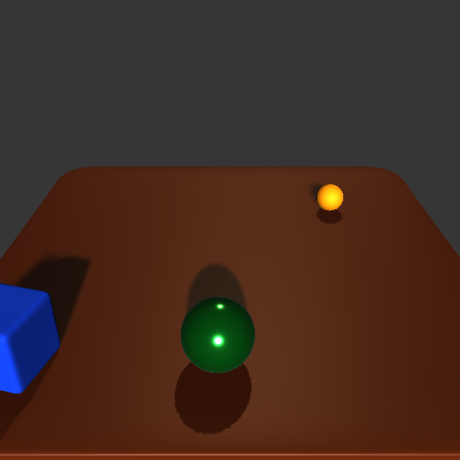
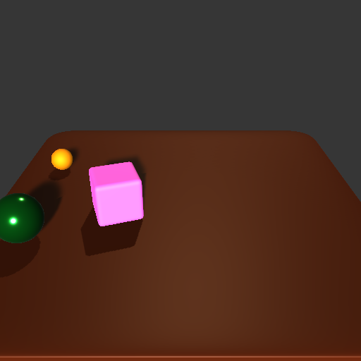
Train
First, search attribute by attribute
Then, add attributes as priors to each rules
Cube, Big, Blue, Front
Sphere, Big, Red, Behind
Sphere, Small, Red, Right
B
C
Rules can be found
Big, Cube
Blue (2)
Blue Front (1)
Big, Sphere
Sphere, Behind
Red, Behind
Sphere, Red, Behind
Sphere, Small
Sphere, Red
Small (3)
Small Right (1)
Small Red
Sphere, Right (1)
Sphere, Small, Red
A
B
Cube, Big, Blue, Left
Sphere, Small, Red, Behind
Sphere, Big, Green, Front
A
C
C
B
Sphere, Big, Green, Front
Cube, Big, Red, Right
Sphere, Small, Red, Behind
A
5 rules

Slide 20
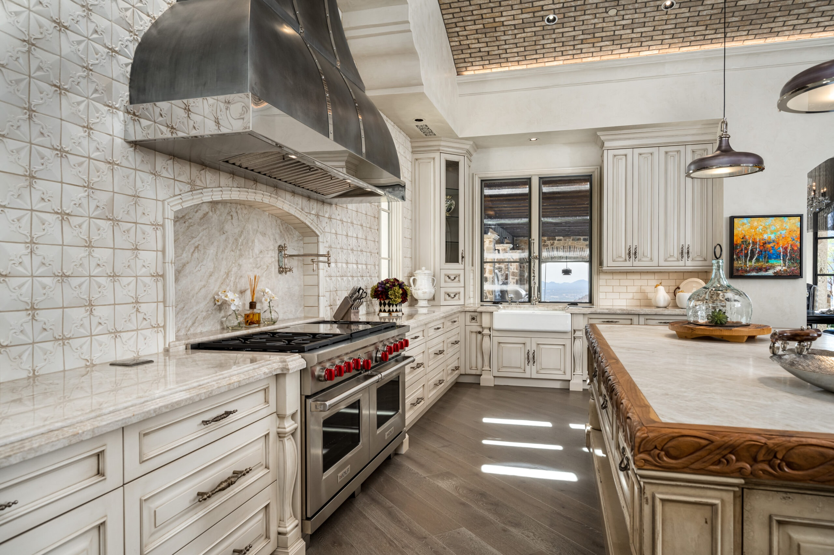
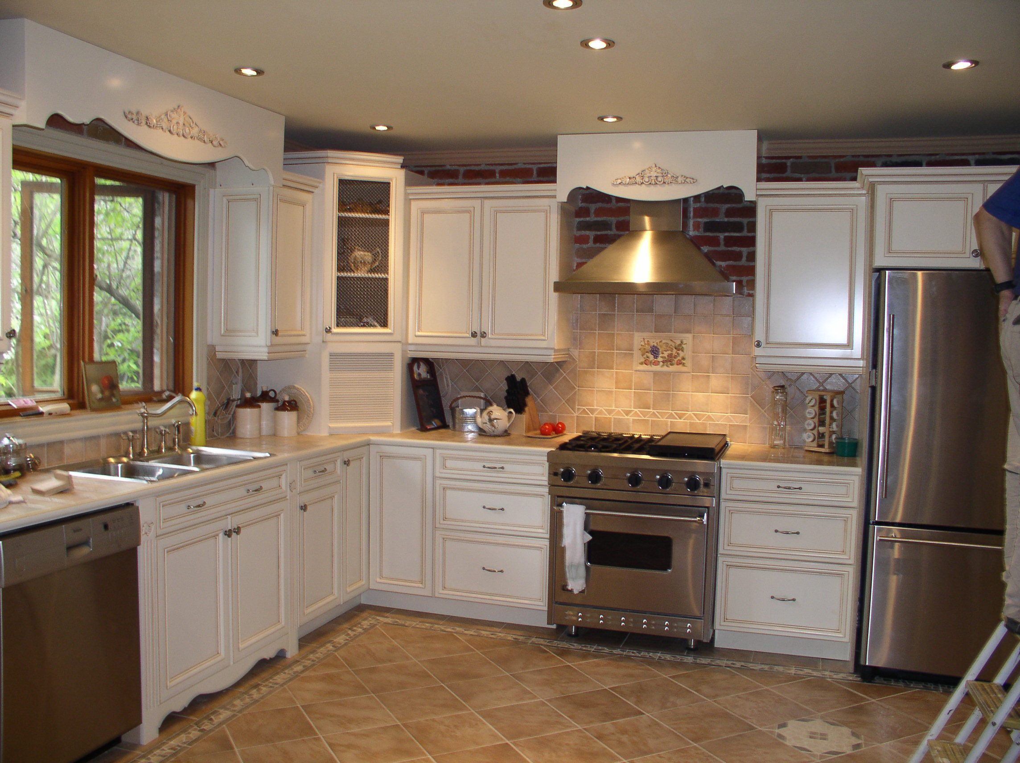
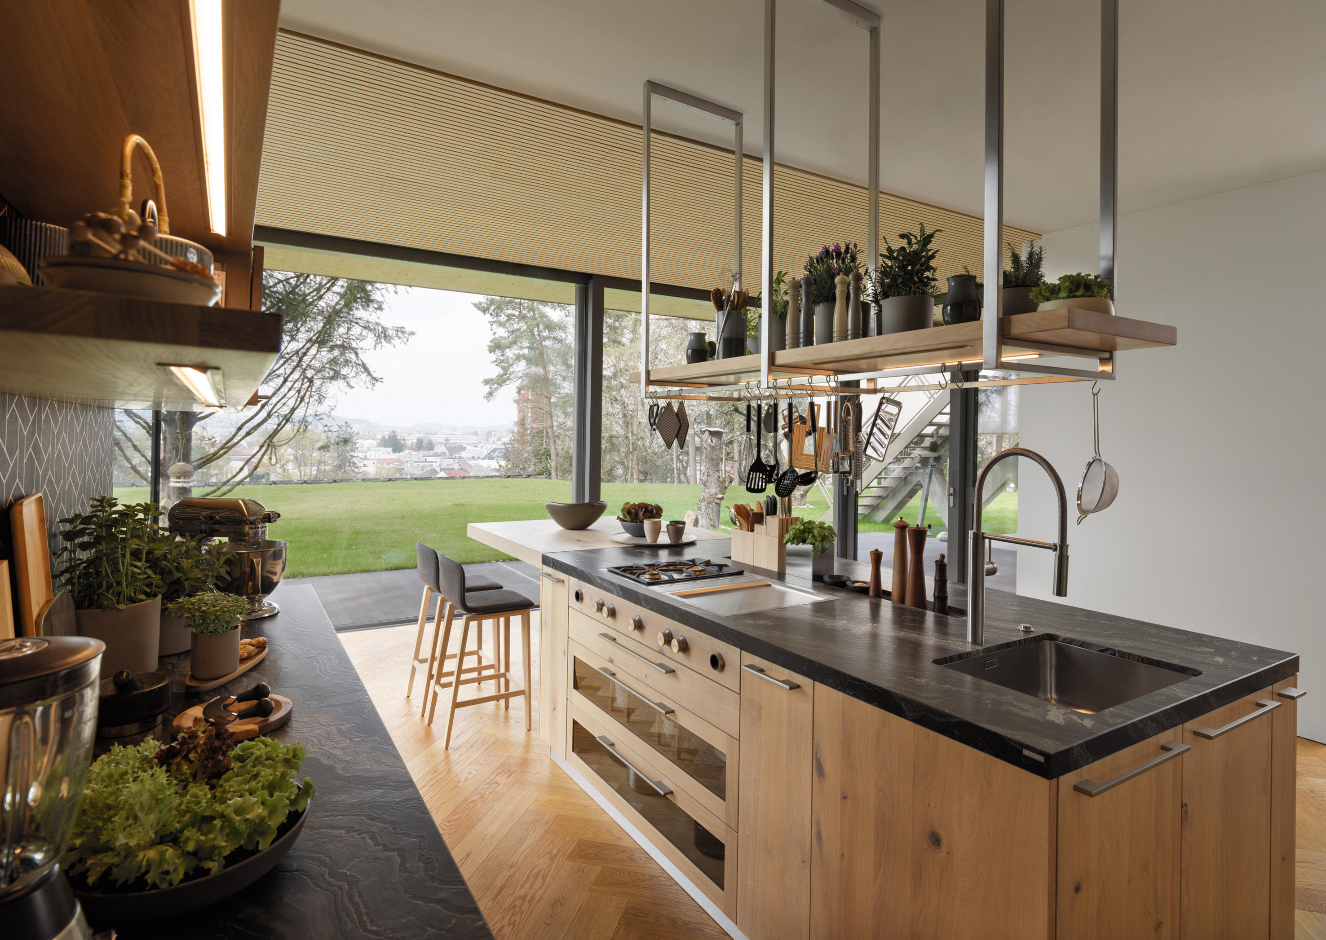
C
First, search attribute by attribute
Cube, Big, Blue, Front
Sphere, Big, Red, Behind
Sphere, Small, Red, Right
B
Rules can be found
Big, Cube
Big, Sphere
Sphere, Behind
Red, Behind
Sphere, Red, Behind
Sphere, Small
Sphere, Red
Small Red,
Sphere, Small, Red
A
C
Cube, Big, Blue, Left
Sphere, Small, Red, Behind
Sphere, Big, Green, Front
A
B
9 rules
C
Sphere, Big, Green, Front
Cube, Big, Red, Right
Sphere, Small, Red, Behind
B
A

Slide 21
First, search attribute by attribute
Cube, Big, Blue, Front
Sphere, Big, Red, Behind
Sphere, Small, Red, Right
B
C
Rules can be found
Big, Cube
Big, Sphere
Sphere, Behind
Red, Behind
Sphere, Red, Behind
Sphere, Small
Sphere, Red
Small Red,
Sphere, Small, Red
A
B
Cube, Big, Blue, Left
Sphere, Small, Red, Behind
Sphere, Big, Green, Front
A
C
9 rules
C
B
Sphere, Big, Green, Front
Cube, Big, Red, Right
Sphere, Small, Red, Behind
A

Slide 22
Imagine there is a new vacant bedroom,
Now, we put some furniture inside
A bed
A wardrobe
An armchair
A carpet
Two bedside tables
How to automatically decide the positions of these objects?
Crazier, if there is a bedroom, how should it look like.
Possibly, there is a bed, a wardrobe, some paintings, lights, carpets.
Can AI think about with it and place everything properly?
A
B
C

Slide 23
How to automatically decide the positions of these objects?
Training image
phone, bed (phone on the bed)
phone, desk (phone on the desk)
phone, desk, bed (phone on the desk)
5 relations
Left
Right
Front
Behind
Above
On
Phone, Bed
Phone, Desk
Phone, Desk, Bed
Find Common Objs
Phone
Given priors
Phone
Desk, OnDesk
A
B
C

Slide 24
Table, belong here
Shelf, not belong here
Dust Bin, useless things

Slide 25
Train
Test
B
Sphere, Small, Red, Left
Sphere, Big, Green, Behind
Cube, Big, Green, Front
A
A
Cube, Big, Green, Left
Sphere, Big, Red, Front
Sphere, Small, Red, Right
C
C
B
B
Sphere, Small, Red, Left
Sphere, Big, Blue, Behind
Cube, Big, Blue, Front
First, search attribute by attribute
Then, add attributes as priors to each rules
A
C
Sphere, small
red(2)
left(2)
Left, red (2)
Sphere, behind + big(2)
Cube, big + green(2) + front(2)
Big, Front
Cube, Front + Green(2) + big(2)
Cube, big, Front + Green(2)
B
Cube, Big, Green, Front
Sphere, Small, Blue, Behind
A

