Slide 1
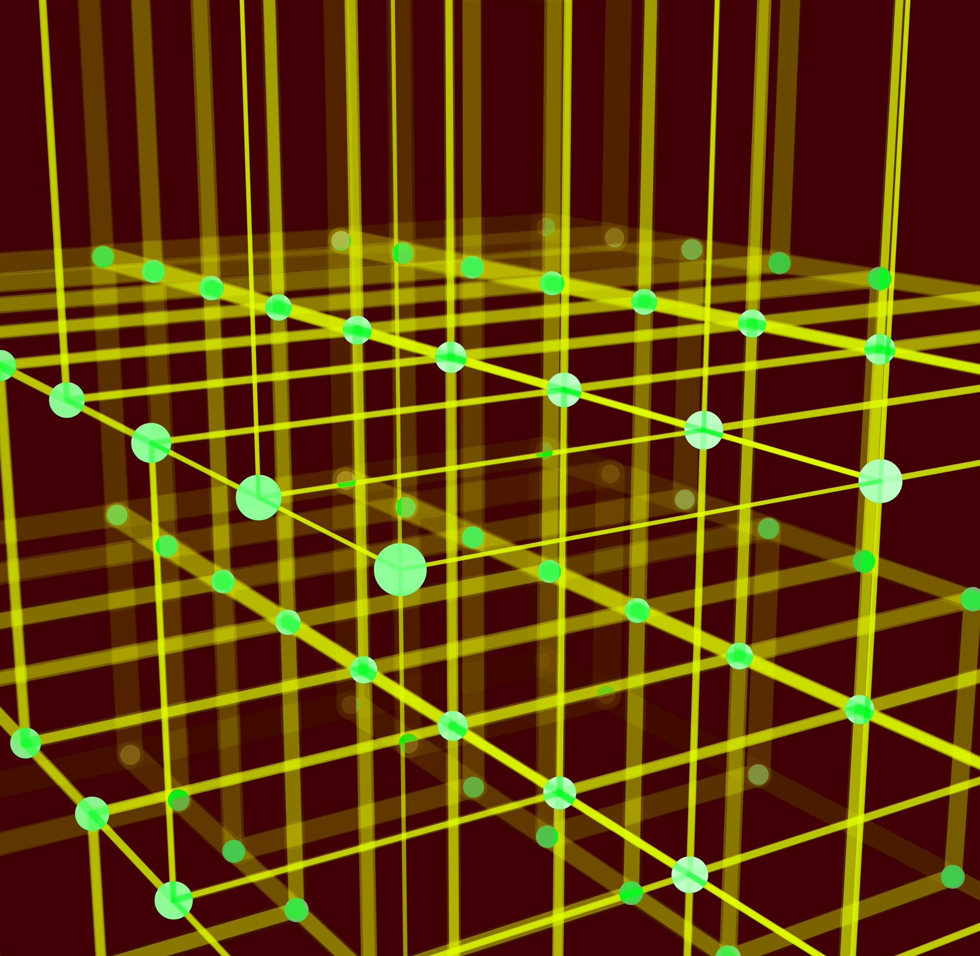
Spatial relation vector
Jingyuan Sha

Slide 2
Experiments
Learn regular patterns (positional relationship) from training dataset
Reasoning the irregular patterns from test dataset
Suggest new layout to follow regular patterns
Move the objects to change the layout as suggested.

Slide 3
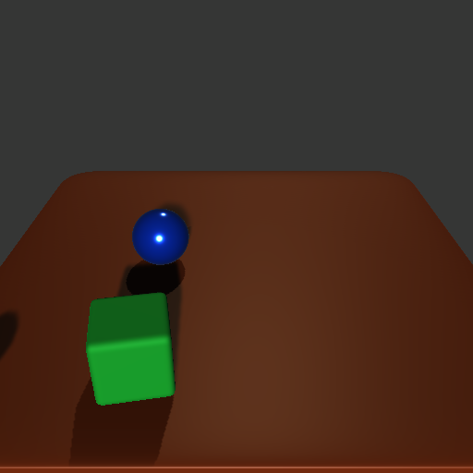
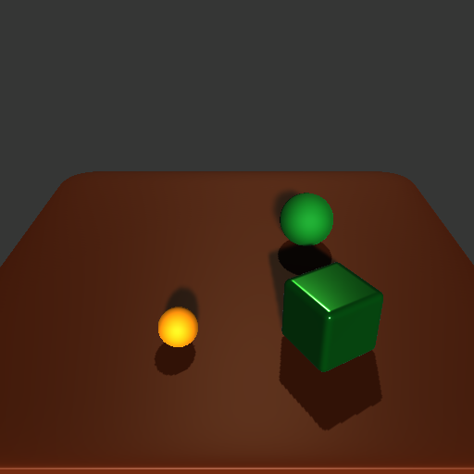
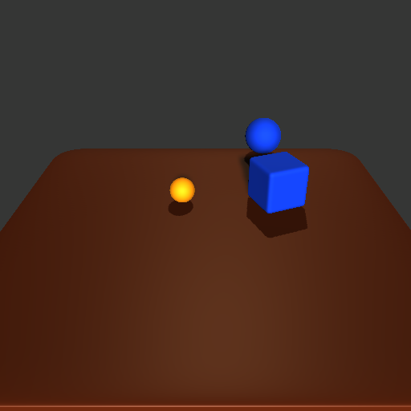
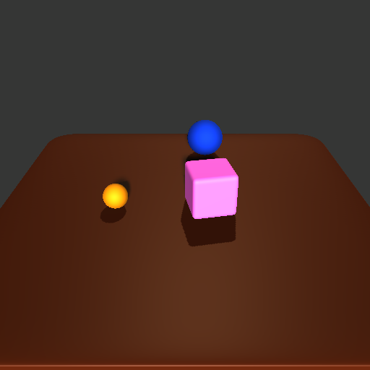
Experiment 1
Learn regular patterns (positional relationship) from training dataset

Slide 4
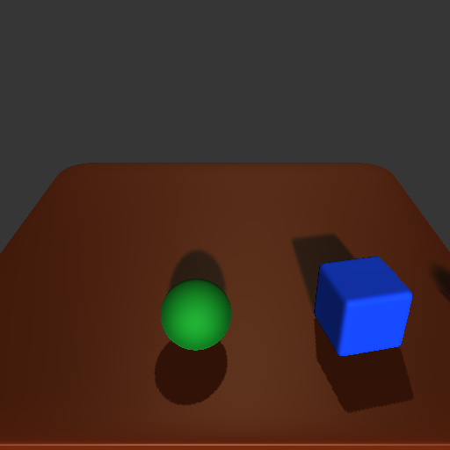
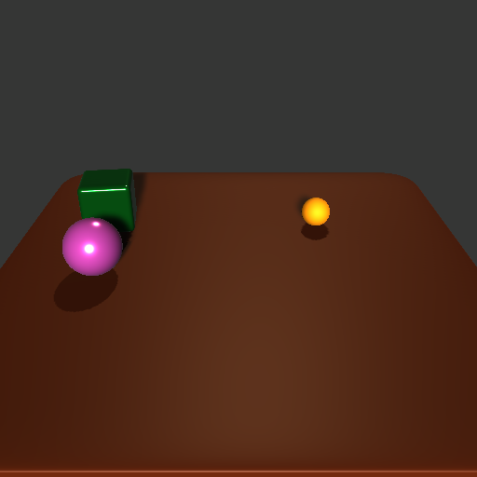
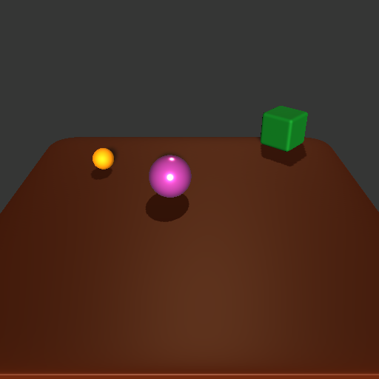
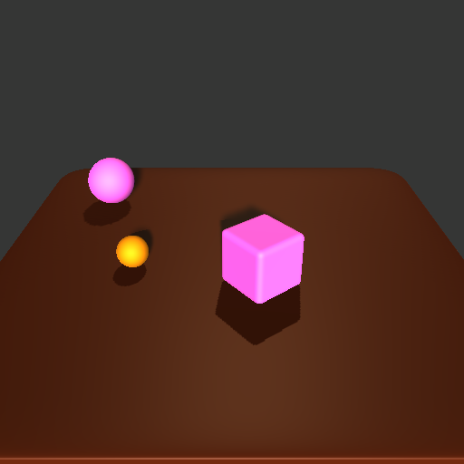
Experiment 2
Reasoning the irregular patterns from test dataset

Slide 5
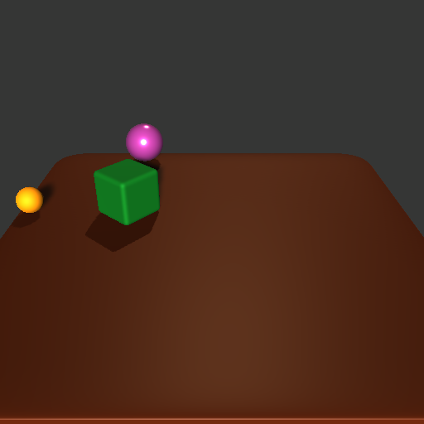
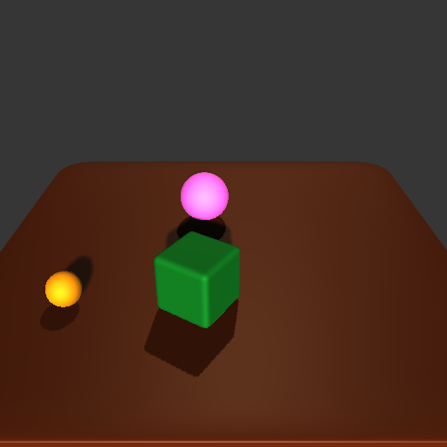
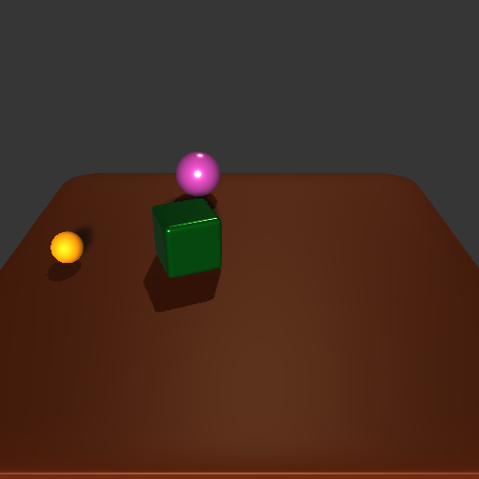
Experiment 3
Suggest new layout to follow regular patterns
Suggest 1
Suggest 2
Suggest 3
Input

Slide 6
Experiment 4
Move the objects to change the layout as suggested.
actions

