Slide 1
A Presentation for Summer Internship Assessment
Internship Project : Banking System
Given By:
………………………..
……………………
…………………….

Slide 2
Table of contents :
About the Internship
Company Overview
Sectors in which the Company Works
Internship Domain
Overview of Java
Introduction to Project
Project Features
Project goal
Project Implementation
Use case Daigram
Modules
Graphical User Interface
Visual Examples / Snapshots
References

Slide 3





About The Internship :
Company Name
…………………………..
Duration
4 Weeks training Program from 8 July to 10 Aug.
Internship Domain
Java Windows Application Developer Intern (Java Standard Edition)
Objective
Select from various Industrial services and develop a portal company
Selection Of Major Project
Choice of Project was to be made based on companies services offered in various industrial sectors .
Project Selected
Banking System.

Slide 4




Sectors in which the Company Works:
.
Banking
Governance
Helath Care
Digitizing transaction processing and financial management
Efficiency in citizen engagement.
Transforming Patient care with Technology
Travel and Tourism
Manufacturing
Redefining travel experiences with digital innovation
Boosting efficiency, quality, and profitability in manufacturing.

Slide 5
Internship Domain : Java Standard Edition (JSE)
Core Libraries: Extensive API libraries for building various applications, including:
java.lang: Basic language features (e.g., Strings, Math, Threads).
java.util: Data structures (e.g., Lists, Maps), utilities, and collections.
java.io : File handling, input/output for scalable I/O operations.
java.net: Networking capabilities for building networked applications.
java.sql: Database connectivity with JDBC.
Integrated Development Environments (IDEs): Support for popular IDEs like IntelliJ IDEA, Eclipse, and NetBeans.

Slide 6
OVERVIEW OF JAVA TECHNOLOGY
Java is a programming language developed by Sun Microsystems in 1995. It is designed to be platform-independent, meaning that Java programs can run on any device with a Java Virtual Machine (JVM).
Some of its key features include:
Object-oriented .
Platform-independent : write once, run anywhere (WORA)
Fast .
Multithreading .

Slide 7
Java was developed to achieve mainly 5 features :
It should be simple and easy to learn .
It should be robust and secure.
It should be independent .
It should be secure .
It should be object oriented to visualize program in real life.

Slide 8
INTRODUCTION TO PROJECT
The "Banking Management System" project aims to develop a comprehensive software solution using Core Java that facilitates the management of banking operations in an effective and user-friendly manner .
This system is designed to handle essential banking functions such as account management, transaction processing, balance inquiries .
By leveraging the robust features of Core Java, the system ensures a high level of security, reliability, and performance.
Further ,we will detail the development process, system architecture, and the key features of the Banking Management System, along with the benefits it offers to the banking sector.

Slide 9
Project features
User Authentication: Secure login and registration process for customers and bank employees. Password encryption and user role management (admin, customer).
Account Management: Ability to open new savings or checking accounts. Display account balance, account type, and account number. Modify personal details like address, phone number, and email.
Transaction Management: Allows customers to deposit money into their accounts. Enables customers to withdraw money while ensuring sufficient balance. Facilitates transfer of funds between different accounts within the bank. Provides a detailed view of past transactions, including deposits, withdrawals, and transfers .
Balance Inquiry: Real-time balance checking for customers to view their available funds.

Slide 10
Project goals:
User-Friendly Interface: Easy navigation and task management.
Scalability: Ensure seamless real-time collaboration among team members.
Security: Protect user data and manage access.
Performance : Optimize database queries and transactions.
User Friendliness : Provide clear and informative error messages .

Slide 11
Project Implementation :
The implementation of the Banking Management System is carried out using Core Java, focusing on object-oriented principles, modular design, and efficient use of Java’s standard libraries. The system is divided into several layers.
Presentation Layer: Handles the user interface, which can be a console-based UI or a basic GUI using Java Swing. This layer interacts with the user and captures inputs like account details, transaction types, etc.
Business Logic Layer: Implements the core functionalities such as account management, transaction processing, and interest calculations. This layer contains the main business logic classes and methods.

Slide 12
Data Access Layer: Manages the storage and retrieval of data using file handling or a simple relational database (using JDBC). This layer ensures data persistence across sessions.

Slide 13
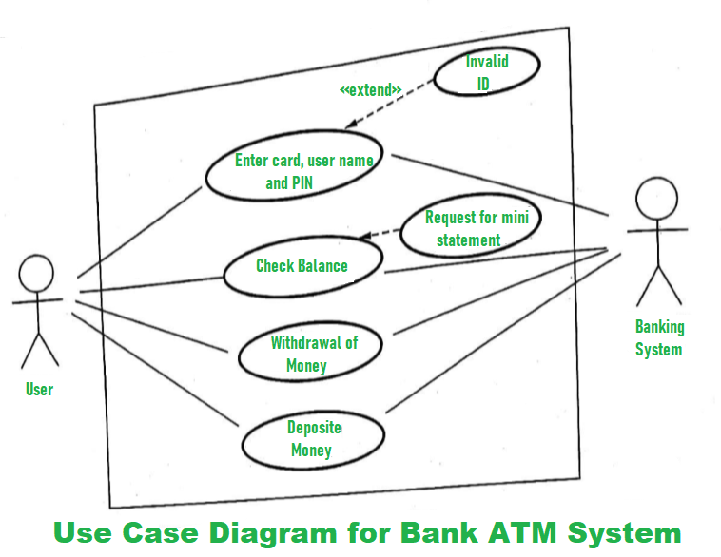
Fig . Use Case Daigram

Slide 14
Modules :
Login Class: The Login class is responsible for managing the authentication process of users, whether they are customers or administrators. It validates user credentials against stored data to ensure secure access to the system.
SignUp Class: The SignUp class facilitates the registration process for new customers. It collects personal details and account preferences to create a new user profile.
BalanceEnquiry Class: The BalanceEnquiry class allows users to check their current account balance. It retrieves the account balance from the database and displays it to the user

Slide 15
Deposit Class: The Deposit class handles the process of depositing money into the user's account. It updates the account balance and records the transaction.
Withrwal Class: The Withdrawal class manages the withdrawal of funds from the user's account. It checks for sufficient balance before allowing the transaction and updates the account balance accordingly.
Transaction Class: The Transaction class records all financial operations performed by the user, such as deposits, withdrawals, and transfers. It maintains a detailed transaction history that can be accessed by the user or admin .

Slide 16
FastCash Class: The FastCash class provides a quick withdrawal option for predefined amounts, allowing users to withdraw a set amount with a single click .
MiniStatement Class: The MiniStatement class provides a summary of the most recent transactions in the user's account. It is a quick way for users to review their recent account activities .
PinChange Class: The PinChange class allows users to update their account's PIN (Personal Identification Number). It includes security checks and ensures the new PIN meets security criteria .

Slide 17
Graphical User Interface:
A GUI in Java is a visual component that allows users to interact with an application through elements like buttons, text fields, labels, and more. It enhances user experience by providing an intuitive and visually appealing interface.
A well-designed GUI is crucial for a banking management system to provide a user-friendly experience. Here are some key components
Key Components:
Containers: JFrame , JPanel , JDailog,etc.
Controls: JButton , JTextfield , JCheckbox , JList , etc.
Layout Managers: BorderLayout , FlowLayout , GridLayout , etc.

Slide 18
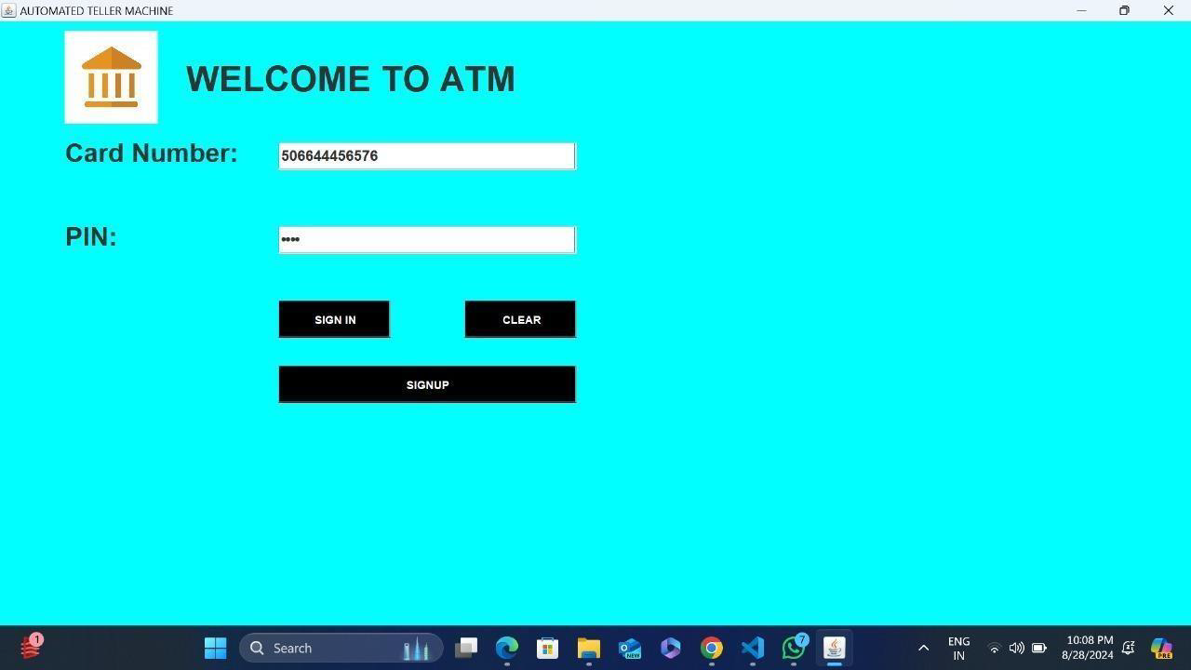
Visual Examples:
Fig 1. Login Page

Slide 19
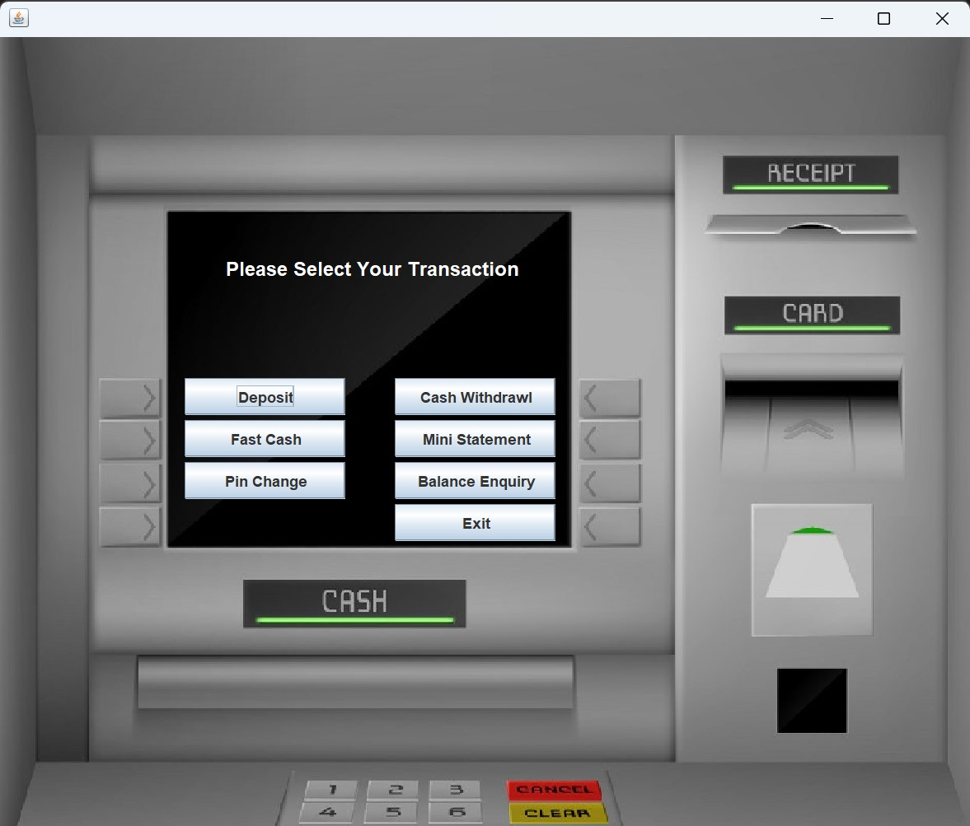
Fig 2. Transactions Page

Slide 20
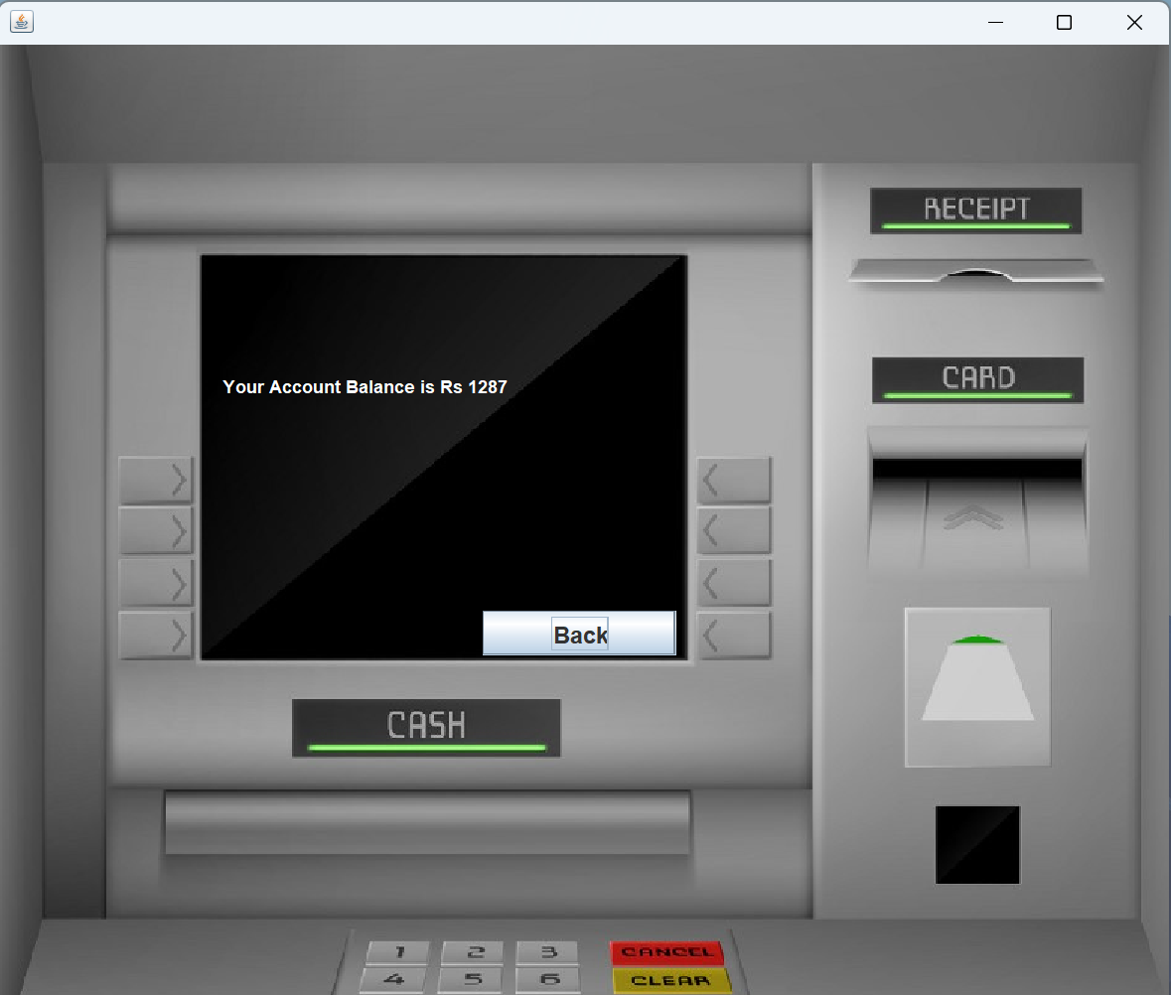
Fig. 3 Deposit Amount Page

Slide 21
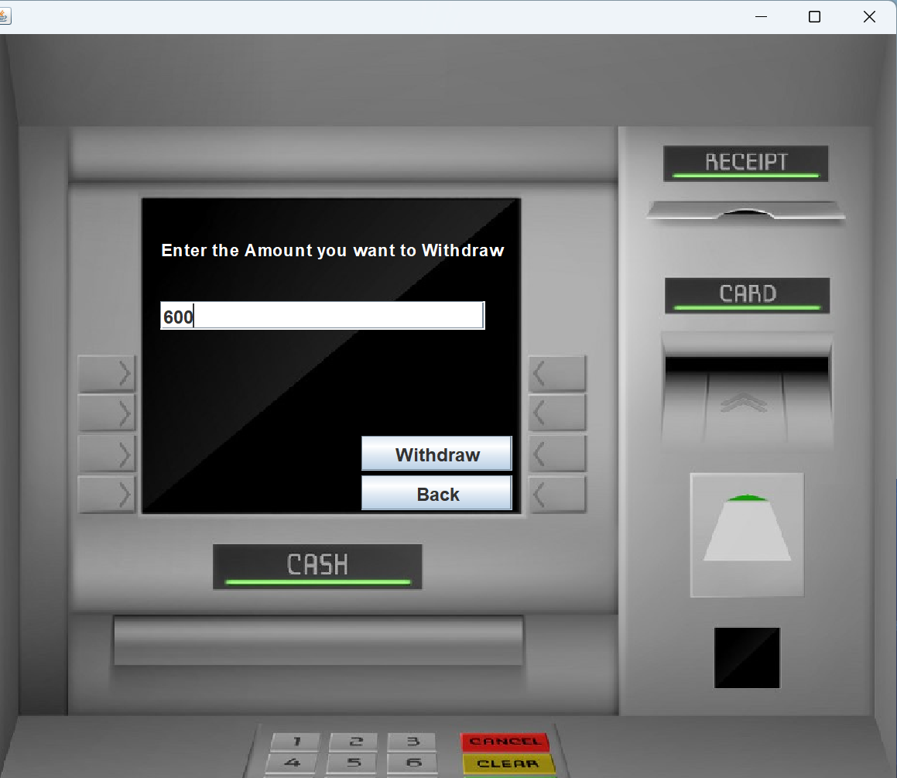
Fig. 4 Withdrawal Page

Slide 22
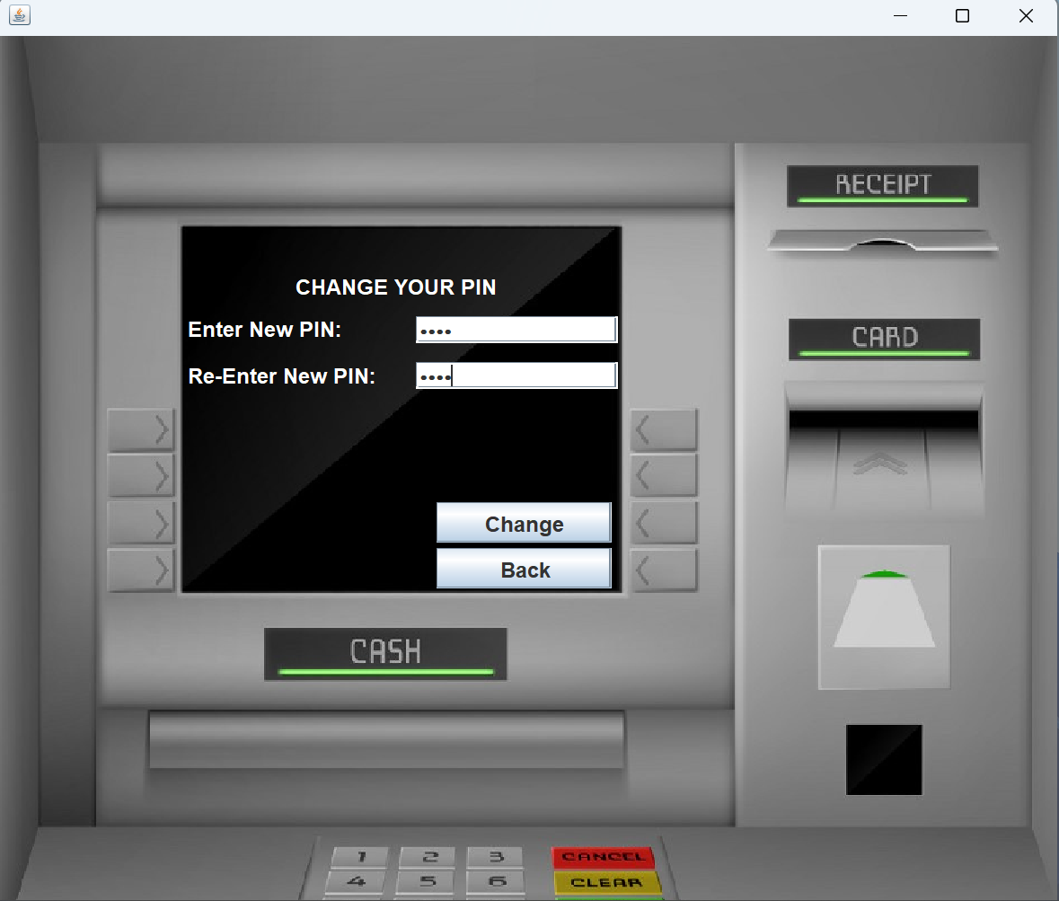
Fig. 5 Change Pin Page

Slide 23
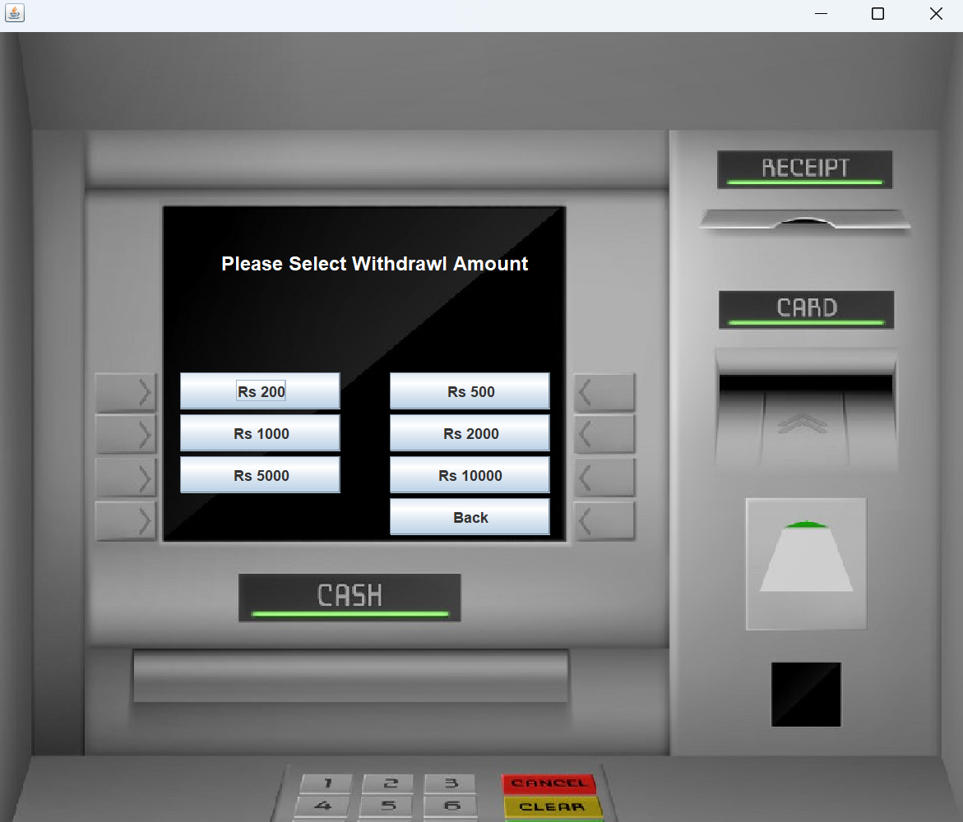
Fig. 6 Fast Cash Page

Slide 24
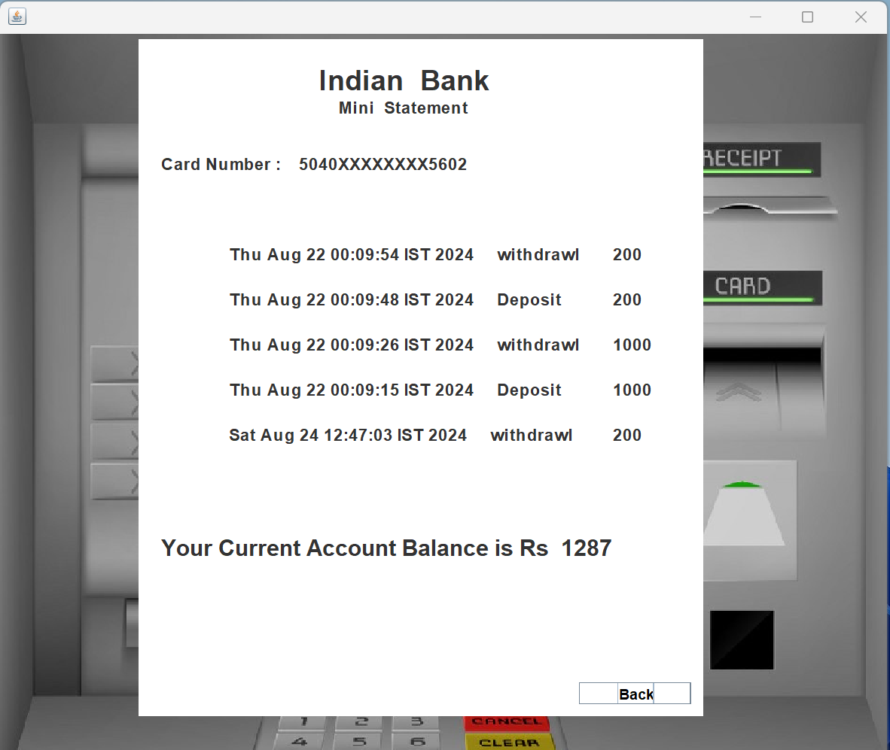
Fig. 7 Mini Statement Page

Slide 25
References
Head First Java Book by Bert Bates and Kathy Sierra
Pressman, R. S. (2014). Software Engineering: A Practitioner’s Approach (8th Ed.). McGraw-Hill Education.

Slide 26
Thank You

