Slide 1
Logistic Regression.

Slide 2
What Is Classification?
Supervised machine learning algorithms define models that capture relationships among data. Classification is an area of supervised machine learning that tries to predict which class or category some entity belongs to, based on its features.

Slide 3
Independent variables, also called inputs or predictors, don’t depend on other features of interest (or at least you assume so for the purpose of the analysis).
Dependent variables, also called outputs or responses, depend on the independent variables.

Slide 4
The nature of the dependent variables differentiates regression and classification problems. Regression problems have continuous and usually unbounded outputs. An example is when you’re estimating the salary as a function of experience and education level.
the other hand, classification problems have discrete and finite outputs called classes or categories. For example, predicting if an employee is going to be promoted or not (true or false) is a classification problem.

Slide 5
There are two main types of classification problems:
Binary or binomial classification: exactly two classes to choose between (usually 0 and 1, true and false, or positive and negative)
Multiclass or multinomial classification: three or more classes of the outputs to choose from

Slide 6
Logistic Regression is used when the dependent variable(target) is categorical.
For example,
To predict whether an email is spam (1) or (0)
Whether the tumor is malignant (1) or not (0)

Slide 7
Logistic Regression can be used for various classification problems such as spam detection. Diabetes prediction, if a given customer will purchase a particular product or will they churn another competitor, whether the user will click on a given advertisement link or not, and many more examples are in the bucket.

Slide 8
Logistic Regression is one of the most simple and commonly used Machine Learning algorithms for two-class classification. It is easy to implement and can be used as the baseline for any binary classification problem. Its basic fundamental concepts are also constructive in deep learning. Logistic regression describes and estimates the relationship between one dependent binary variable and independent variables.

Slide 9
Logistic Regression
Logistic regression is a statistical method for predicting binary classes. The outcome or target variable is dichotomous in nature. Dichotomous means there are only two possible classes. For example, it can be used for cancer detection problems. It computes the probability of an event occurrence.
It is a special case of linear regression where the target variable is categorical in nature. It uses a log of odds as the dependent variable. Logistic Regression predicts the probability of occurrence of a binary event utilizing a logit function.

Slide 10



Linear Regression Equation:
Where, y is dependent variable and x1, x2 ... and Xn are explanatory variables.
Sigmoid Function:
Apply Sigmoid function on linear regression:

Slide 11
Linear Regression Vs. Logistic Regression
Linear regression gives you a continuous output, but logistic regression provides a constant output. An example of the continuous output is house price and stock price. Example's of the discrete output is predicting whether a patient has cancer or not.

Slide 12
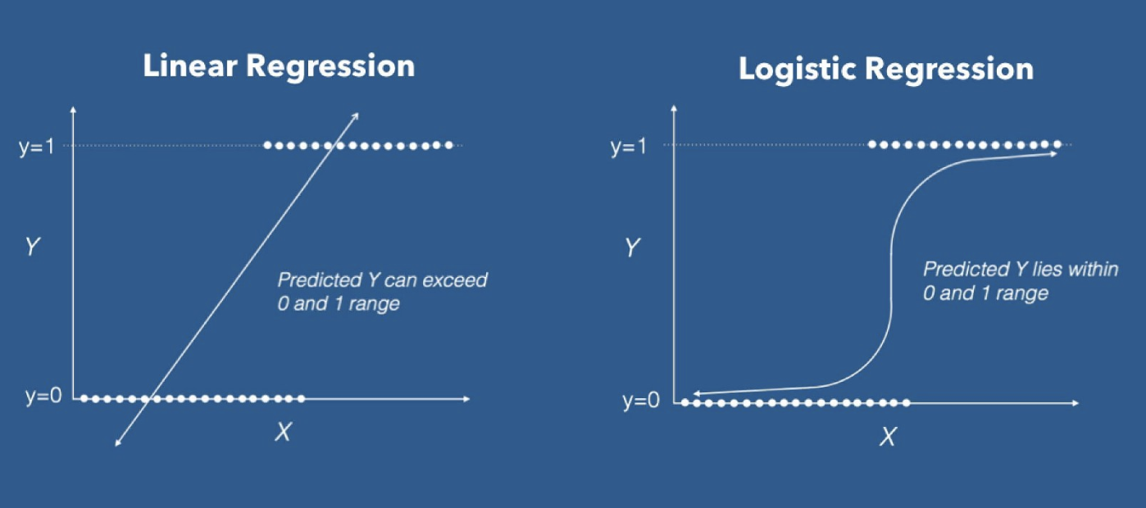

Slide 13
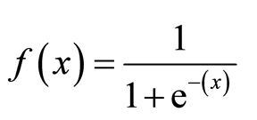
Sigmoid Function

Slide 14
sigmoid function, also called logistic function gives an ‘S’ shaped curve that can take any real-valued number and map it into a value between 0 and 1. If the curve goes to positive infinity, y predicted will become 1, and if the curve goes to negative infinity, y predicted will become 0. If the output of the sigmoid function is more than 0.5, we can classify the outcome as 1 or YES, and if it is less than 0.5, we can classify it as 0 or NO.

Slide 15
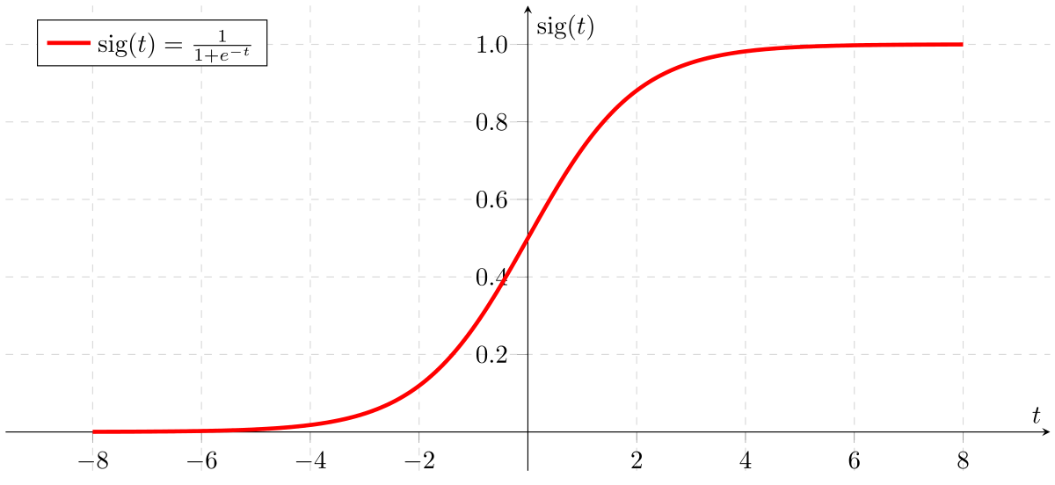

Slide 16
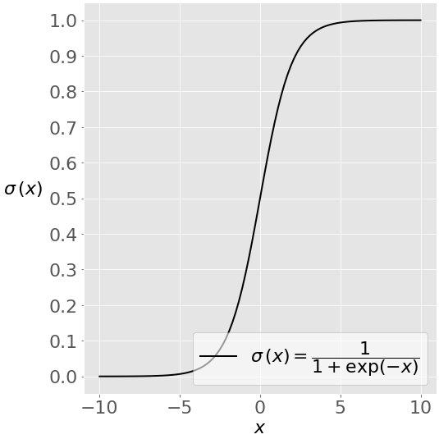

Slide 17
The most straightforward indicator of classification accuracy is the ratio of the number of correct predictions to the total number of predictions (or observations). Other indicators of binary classifiers include the following:
The positive predictive value is the ratio of the number of true positives to the sum of the numbers of true and false positives.
The negative predictive value is the ratio of the number of true negatives to the sum of the numbers of true and false negatives.
The sensitivity (also known as recall or true positive rate) is the ratio of the number of true positives to the number of actual positives.
The specificity (or true negative rate) is the ratio of the number of true negatives to the number of actual negatives.

