Slide 1
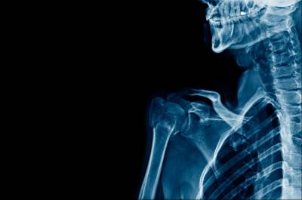

Anatomy of Hip Joint Hybrid-approach
AJIT YADAV

Slide 2
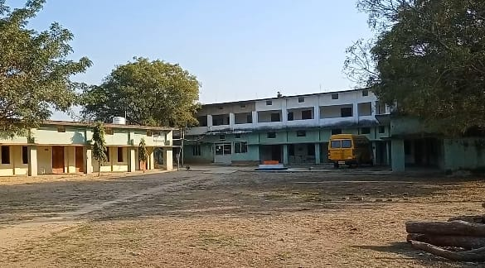
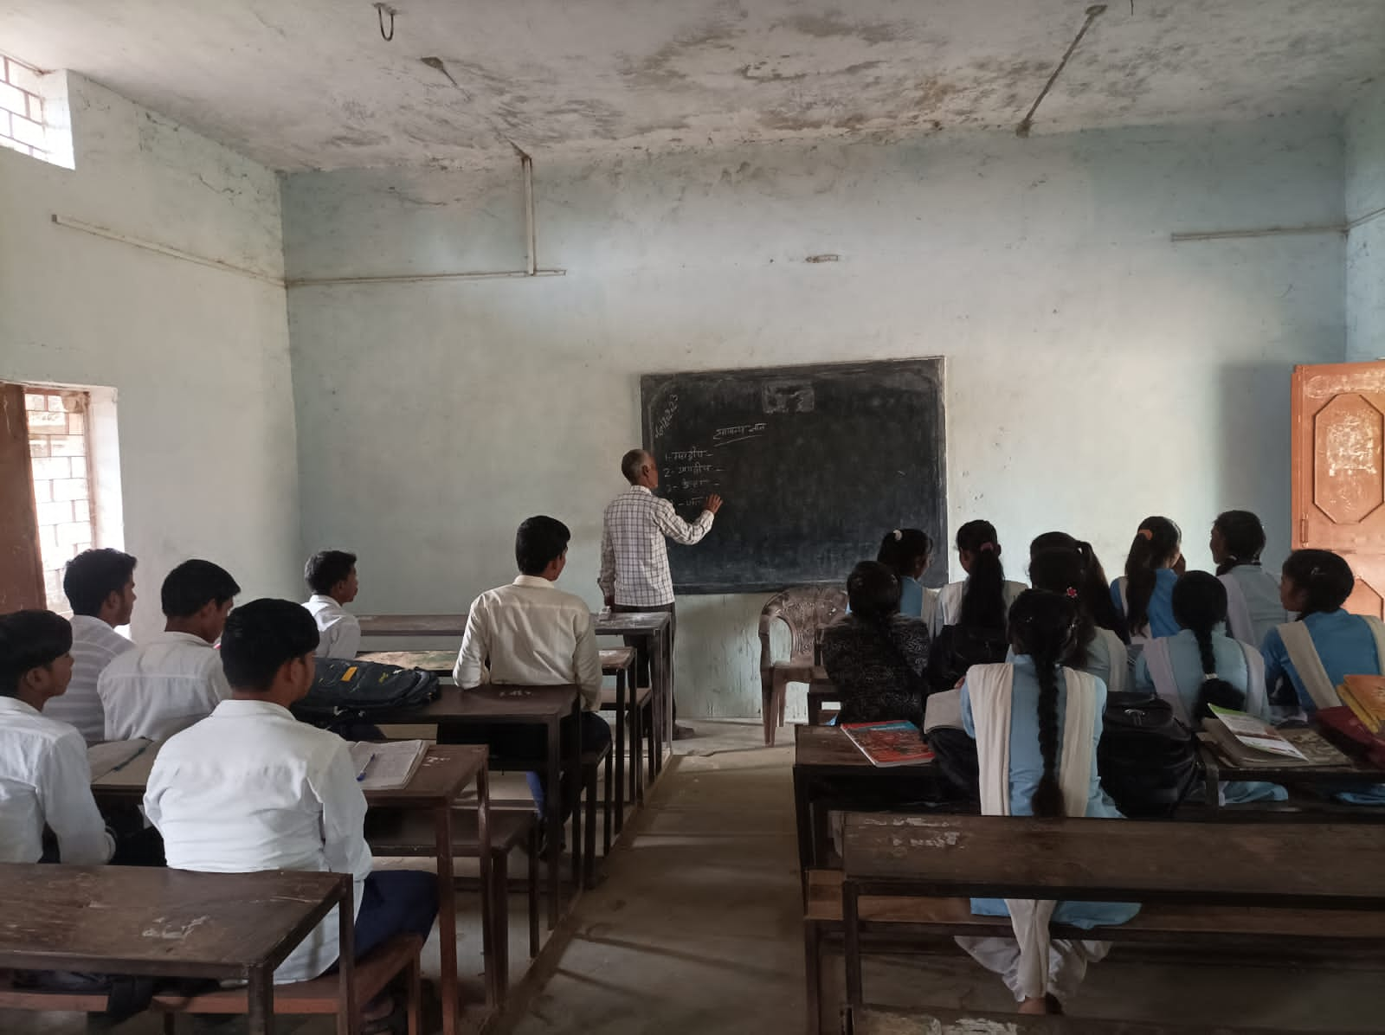
Local Context & Classroom

Slide 3
Project Justification and Background
Synthesized result from previous studies
Multimedia and video enhance student’s engagement and curiosity with Course Contents(Denis, 2014). [student survey suggest the same]
Working Memory can retain the visuals for longer duration (Patchara, 2020)
E-Learning platforms facilitate collaborative approach to the task(Jill, 2015; Bosch, 2020) [Canvas for this project]
Student prefer content with real world application(Arthur et al.,2018)
Course Requirement
Project Based or Enquiry Driven Content for more collaborative and active participation
Technology Enhanced Content to infuse motivation and curiosity

Slide 4
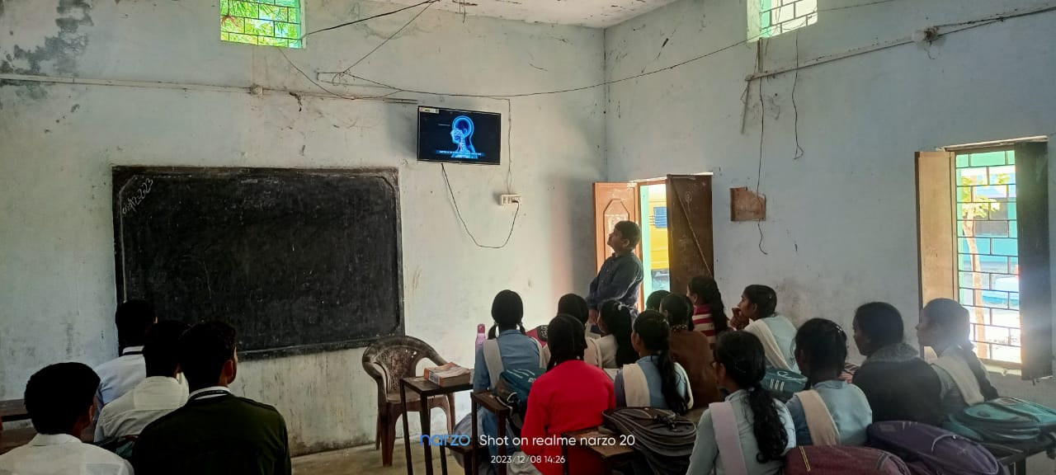
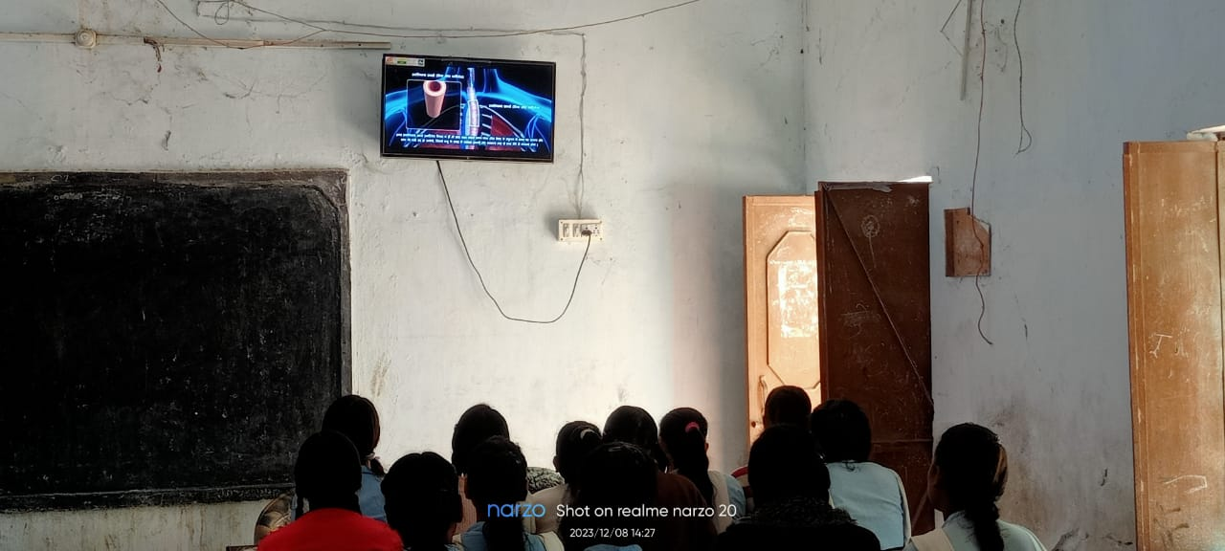
Hybrid Approach

Slide 5
SUPPORTED Pedagogical TheoryFOR Course Design: “Bosch’online framework” & Bloom’s taxonomy
CONTINUED…NEXT SLIDE

Slide 6
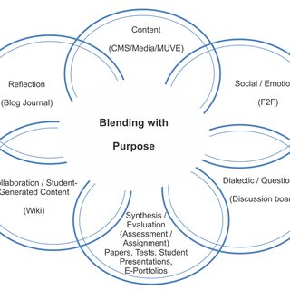
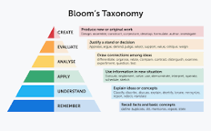
Online Delivery Framework Bloom’s Higher Order Thinking Model

Slide 7
Course Introduction
Project Based High School k12 Biology Course (as per CBSE/ISCE syllabus)
Individual Assessment and Team Competition
Tools Used
Canva to trim video contents
Filmora to Voice Over videos in local language
Video-Oder to download video lectures
YouTube for hosting videos
Canvas for organizing modules and quizzes

Slide 8

Course Overview
Pre-Test
Modules: Lectures (Videos and Text format)
Individual Quiz
Team Based Activity
Course End Test
Exit Survey
Intro to Hip Joint
Hip Disorders
Course Section
Project based activity
Treatment & Rehabilitation

Slide 9
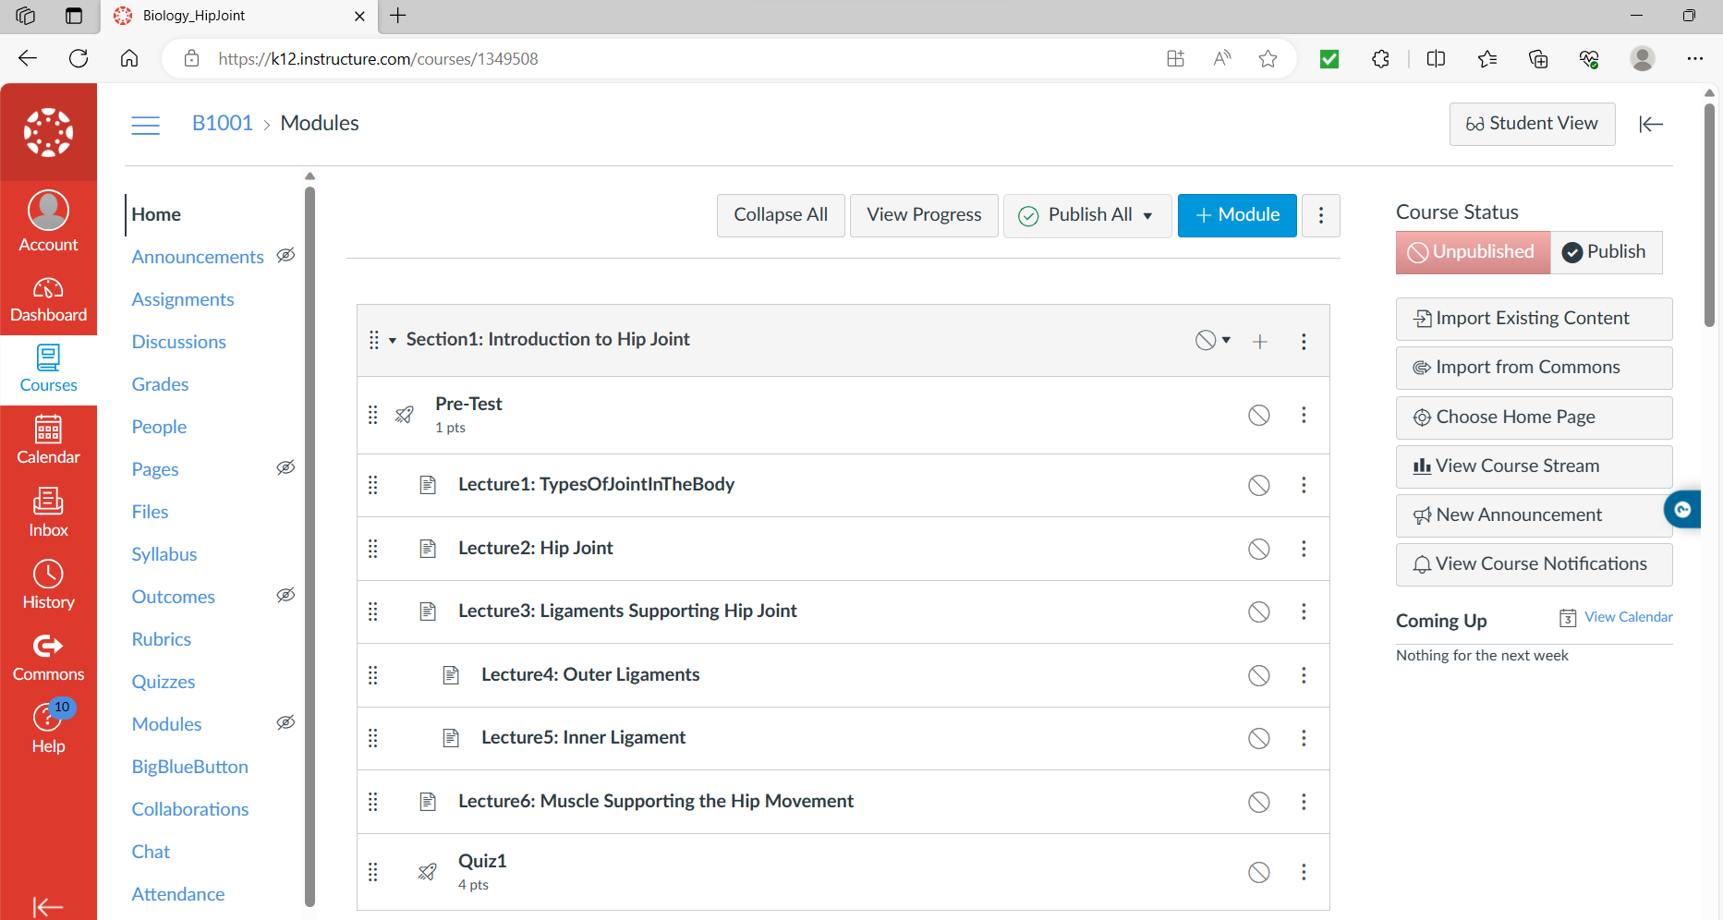
Content Hosting (Canvas Section:1)

Slide 10
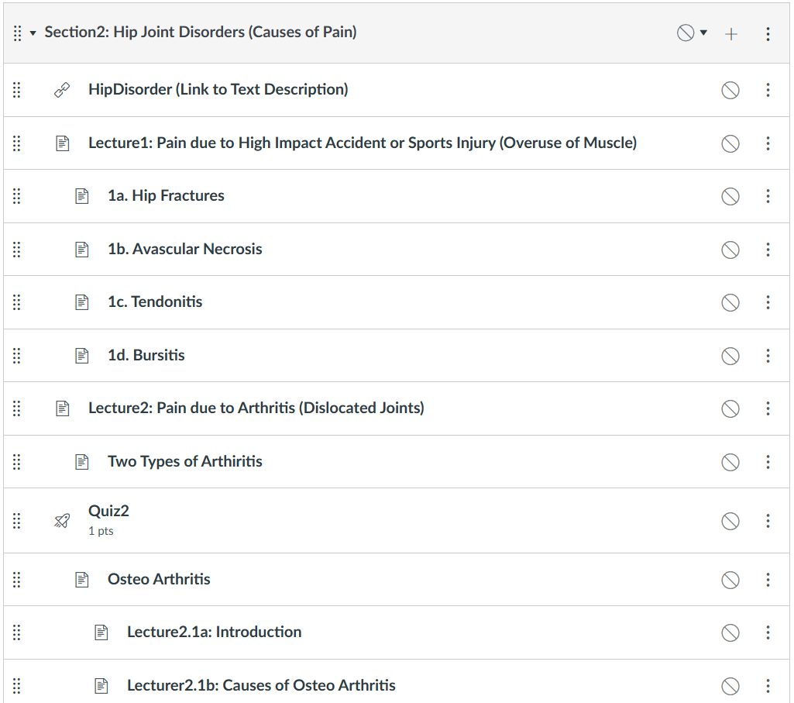
Content Hosting (Canvas Section:2)

Slide 11
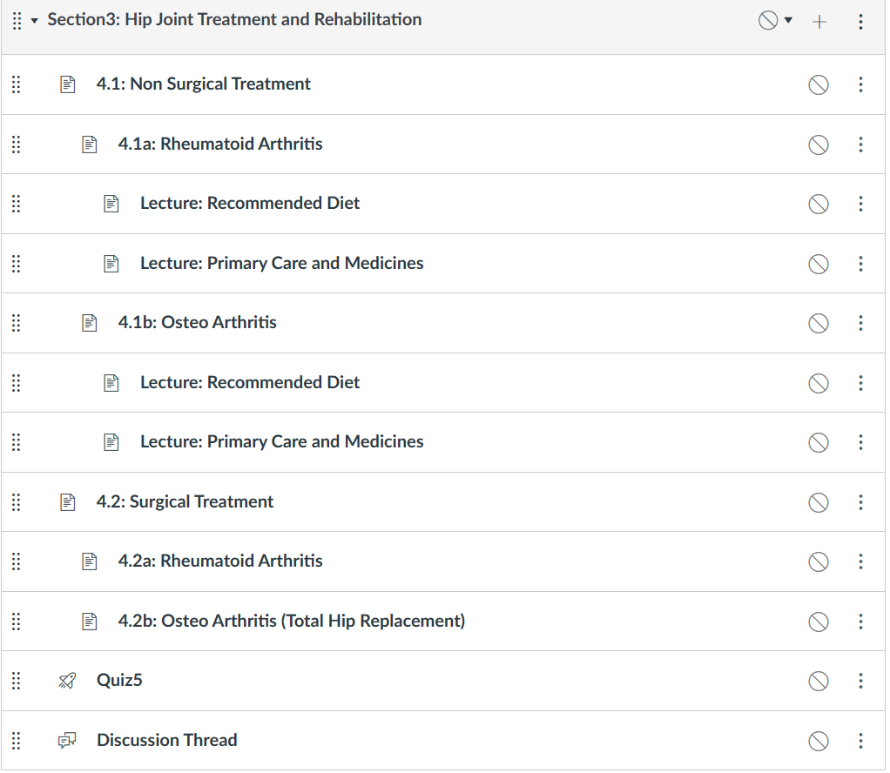
Content Hosting (Canvas Section:3)

Slide 12
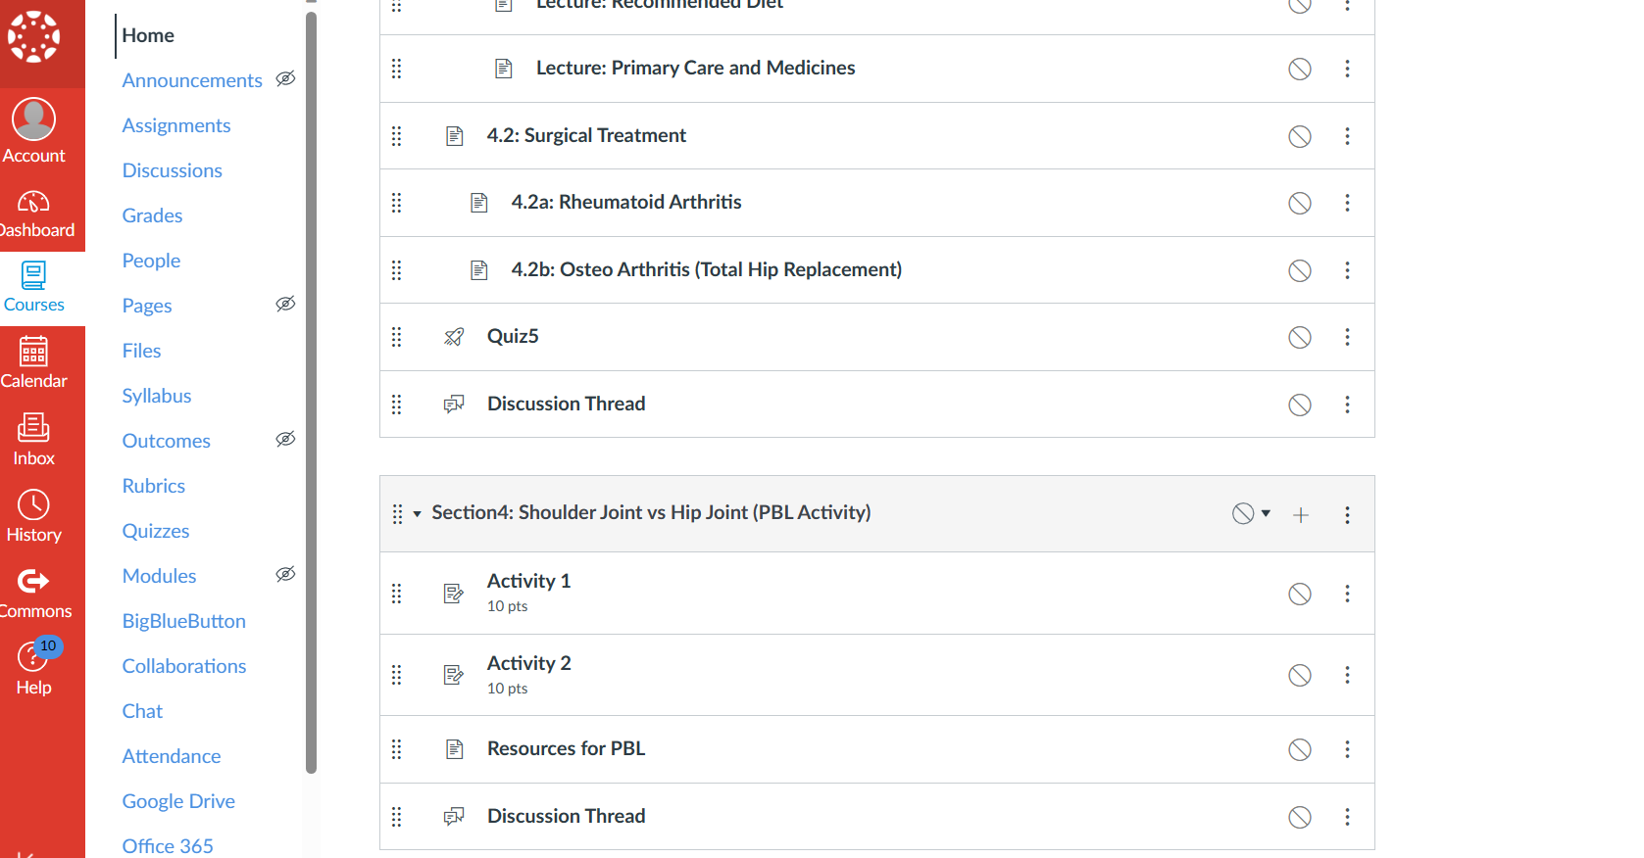
Content Hosting (Canvas Section:4)

Slide 13
Sample questionnaire list (for Survey on Effectiveness of the Course Contents (actual student in classroom)
Questionnaire Link [English Version]:
https://forms.gle/2Nub1eZnAdaAEw518
Questionnaire Link [Hindi Version-local language]
https://forms.gle/z8hzXL5ToqQ2hFb86

Slide 14
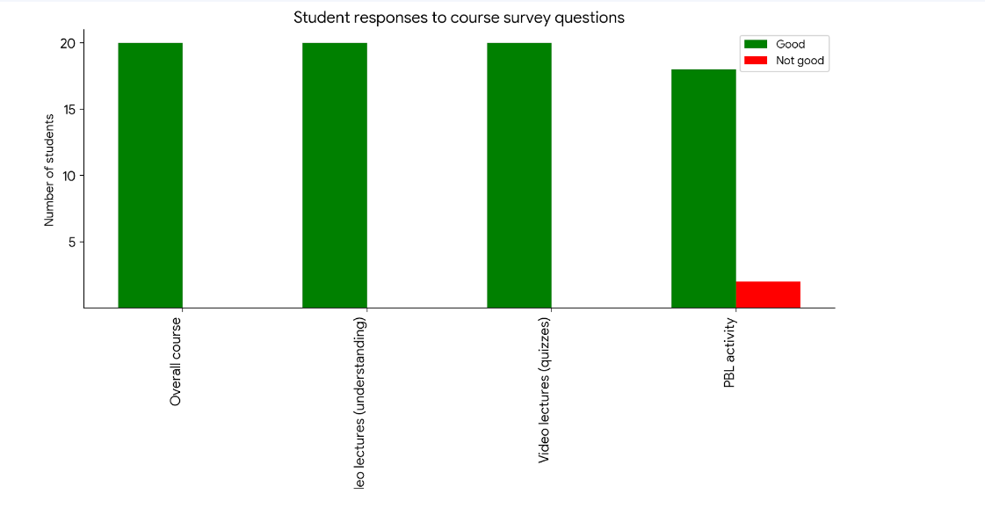
Course Content Survey Result (with actual student)

Slide 15
Reflection on Course Development
Pros:
It would be a great enhancement towards learning resources as being applied into rural school
Developing each module in full swing using cyclical process
Integrating YouTube video with Canvas was seamless
Working on something I am passionate about
Cons:
Voice-over lectures in local language was difficult to produce (synchronizing facial expression with animated contents)
Solution: find animation only videos and record your voice over
Finding content hosting platform was struggle
(Edx -> Udemy -> Canvas)
Solution: strongly recommend Canvas with Canva integration for school contents

Slide 16
Future Work
Expand module offerings and convert it to a full Human Muscle Anatomy Course
Complete the survey with larger group of students to judge effectiveness of contents by applying standard statistical methods
Some website was found to perform Virtual Reality Labs on surgery part but requires more time and subscription

Slide 17
References
Rudd, D. P. (2014). The value of video in online instruction. Journal of Instructional Pedagogies, 13.
Bryant, J., & Bates, A. J. (2015). Creating a constructivist online instructional environment. TechTrends, 59, 17-22.
Arthur, Y. D., Owusu, E. K., Asiedu-Addo, S., & Arhin, A. K. (2018). Connecting mathematics to real-life problems: A Teaching quality that improves student s’ mathematics interest. IOSR Journal of Research & Method in Education, 8(4), 65-71.
Vanichvasin, P. (2021). Effects of Visual Communication on Memory Enhancement of Thai Undergraduate Students, Kasetsart University. Higher Education Studies, 11(1), 34-41.

