Slide 1
Perceptron
Descriptions by Mayank Banoula
Example by Koray Açıcı

Slide 2
Perceptron
A neural network link that contains computations to track features and uses Artificial Intelligence in the input data
This neural links to the artificial neurons using simple logic gates with binary outputs
An artificial neuron invokes the mathematical function and has node, input, weights, and output equivalent to the cell nucleus, dendrites, synapse, and axon, respectively, compared to a biological neuron

Slide 3
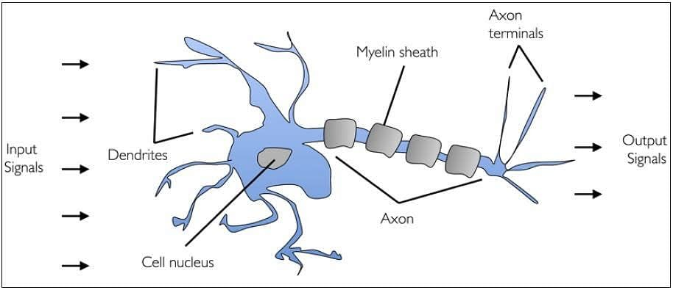
Perceptron – Biological Neuron
A human brain has billions of neurons.
Neurons are interconnected nerve cells in the human brain that are involved in processing and transmitting chemical and electrical signals.
Dendrites are branches that receive information from other neurons.

Slide 4
Perceptron – Biological Neuron
Cell nucleus or Soma processes the information received from dendrites.
Axon is a cable that is used by neurons to send information.
Synapse is the connection between an axon and other neuron dendrite

Slide 5
Perceptron – Artificial Neuron
Researchers Warren McCullock and Walter Pitts published their first concept of simplified brain cell in 1943. This was called McCullock-Pitts (MCP) neuron. They described such a nerve cell as a simple logic gate with binary outputs.
Multiple signals arrive at the dendrites and are then integrated into the cell body, and, if the accumulated signal exceeds a certain threshold, an output signal is generated that will be passed on by the axon.

Slide 6
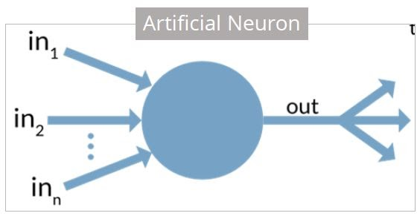
Perceptron – Artificial Neuron
An artificial neuron is a mathematical function based on a model of biological neurons, where each neuron takes inputs, weighs them separately, sums them up and passes this sum through a nonlinear function to produce output.

Slide 7
Biological Neuron vs. Artificial Neuron
Biological Neuron | Artificial Neuron
Cell Nucleus (Soma) | Node
Dendrites | Input
Synapse | Weights or interconnections
Axon | Output

Slide 8
Artificial Neuron - Characteristics
A neuron is a mathematical function modelled on the working of biological neurons
It is an elementary unit in an artificial neural network
One or more inputs are separately weighted
Inputs are summed and passed through a nonlinear function to produce output
Every neuron holds an internal state called activation signal
Each connection link carries information about the input signal
Every neuron is connected to another neuron via connection link

Slide 9
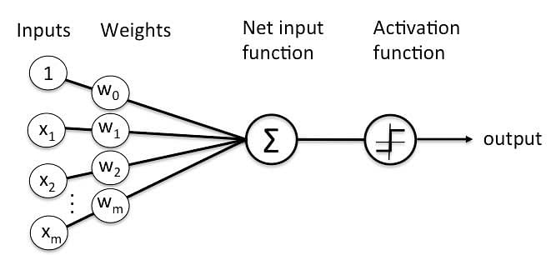
Perceptron
Perceptron was introduced by Frank Rosenblatt in 1957.
He proposed a Perceptron learning rule based on the original MCP neuron.
A Perceptron is an algorithm for supervised learning of binary classifiers.
This algorithm enables neurons to learn and processes elements in the training set one at a time.

Slide 10
Types of Perceptron
Single layer: Single layer perceptron can learn only linearly separable patterns.
Multilayer: Multilayer perceptrons can learn about two or more layers having a greater processing power.
GOAL → The Perceptron algorithm learns the weights for the input signals in order to draw a linear decision boundary.

Slide 11
Perceptron
A perceptron model is also classified as one of the best and most specific types of Artificial Neural networks.
Being a supervised learning algorithm of binary classifiers, we can also consider it a single-layer neural network with four main parameters: input values, weights and Bias, net sum, and an activation function.

Slide 12
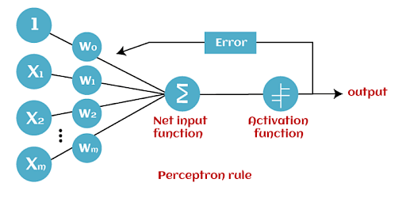
How Does Perceptron Work?
The perceptron model begins with multiplying all input values and their weights,
then adds these values to create the weighted sum.
Further, this weighted sum is applied to the activation function ‘f’ to obtain the desired output.
This activation function is also known as the step function.

Slide 13
How Does Perceptron Work?
The step function or Activation function is vital in ensuring that output is mapped between (0,1) or (-1,1).
Step 1: Multiply all input values with corresponding weight values and then add to calculate the weighted sum. The following is the mathematical expression of it:
∑wi*xi = x1*w1 + x2*w2 + x3*w3+……..x4*w4
Add a term called bias ‘b’ to this weighted sum to improve the model’s performance.
Step 2: An activation function is applied with the above-mentioned weighted sum giving us an output either in binary form or a continuous value as follows:
Y=f(∑wi*xi + b)

Slide 14
Stages in Perceptron
Forward Stage: From the input layer in the on stage, activation functions begin and terminate on the output layer.
Backward Stage: In the backward stage, weight and bias values are modified per the model’s requirement. The backstage removed the error between the actual output and demands originating backward on the output layer. A multilayer perceptron model has a greater processing power and can process linear and non-linear patterns. Further, it also implements logic gates such as AND, OR, XOR, XNOR, and NOR.

Slide 15
Adv. & Disadv. of MLP
Advantages:
A multi-layered perceptron model can solve complex non-linear problems.
It works well with both small and large input data.
Helps us to obtain quick predictions after the training.
Helps us obtain the same accuracy ratio with big and small data.
Disadvantages:
In multi-layered perceptron model, computations are time-consuming and complex.
It is tough to predict how much the dependent variable affects each independent variable.
The model functioning depends on the quality of training.

Slide 16
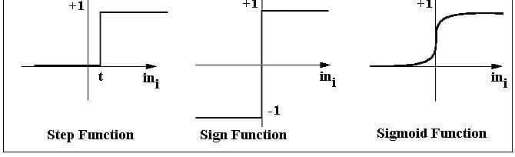
Activation Function
Step function gets triggered above a certain value of the neuron output; else it outputs zero.
Sign function outputs +1 or -1 depending on whether neuron output is greater than zero or not.
Sigmoid function is the S-curve and outputs a value between 0 and 1.

Slide 17

EXAMPLE – let’s try to teach a perceptron how AND gate works!
Input 1
INPUT 1 | INPUT 2 | OUTPUT
0 | 0 | 0
0 | 1 | 0
1 | 0 | 0
1 | 1 | 1
0.3
$f(∑w_{0}x_{0}+w_{1}x_{1}+w_{2}x_{2}$)
THRESHOLD FOR THE STEP FUNCTION = 0.2 (θ)
Assume that bias equals to 0
Learning rate equals to 0.1 (α)
-0.1
Input 2
OUTPUT

Slide 18
EXAMPLE – let’s try to teach a perceptron how AND gate works!
0*0.3 + 0*(-0.1) = 0 → 0<0.2 → Predicted Output =0
Since Pr. Output=Desired Output no need to update weights!
INPUT 1 | INPUT 2 | DESIRED OUTPUT
0 | 0 | 0
0 | 1 | 0
1 | 0 | 0
1 | 1 | 1

Slide 19
EXAMPLE – let’s try to teach a perceptron how AND gate works!
INPUT 1 | INPUT 2 | DESIRED OUTPUT
0 | 0 | 0
0 | 1 | 0
1 | 0 | 0
1 | 1 | 1
0*0.3 + 1*(-0.1) =-0.1<0.2 → Pred. output=0
Since Pr. Output=Desired Output no need to update weights!

Slide 20
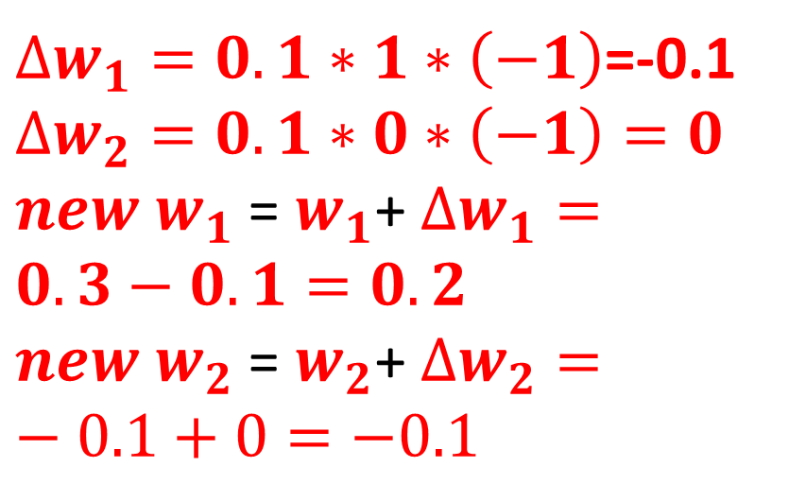
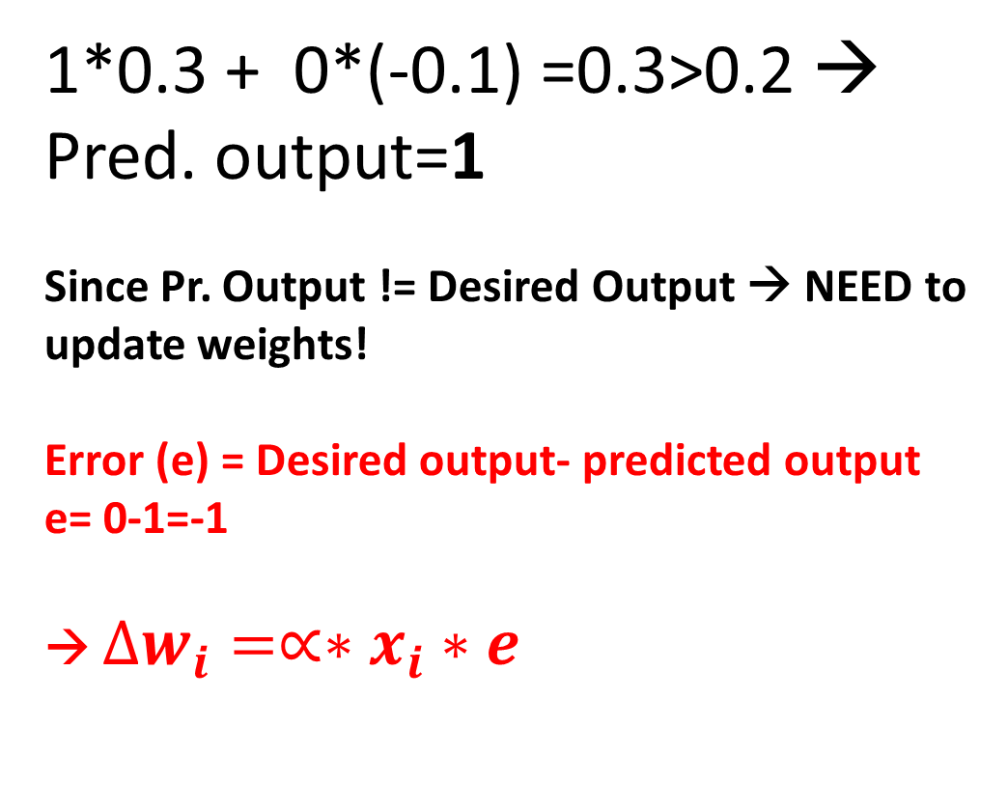
EXAMPLE – let’s try to teach a perceptron how AND gate works!
INPUT 1 | INPUT 2 | DESIRED OUTPUT
0 | 0 | 0
0 | 1 | 0
1 | 0 | 0
1 | 1 | 1
1*0.3 + 0*(-0.1) =0.3>0.2 → Pred. output=1
Since Pr. Output != Desired Output → NEED to update weights!
Error (e) = Desired output- predicted output
e= 0-1=-1
→ $∆w_{i}=∝∗x_{i}∗e$
$∆w_{1}=0.1∗1∗\left(−1\right)$=-0.1
$$∆w_{2}=0.1∗0∗\left(−1\right)=0$$
$new w_{1}$ = $w_{1}$+ $∆w_{1}=0.3−0.1=0.2$
$new w_{2}$ = $w_{2}$+ $∆w_{2}=−0.1+0=−0.1$

Slide 21
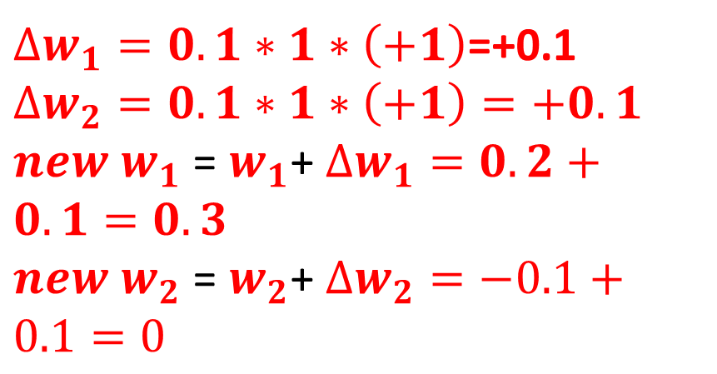
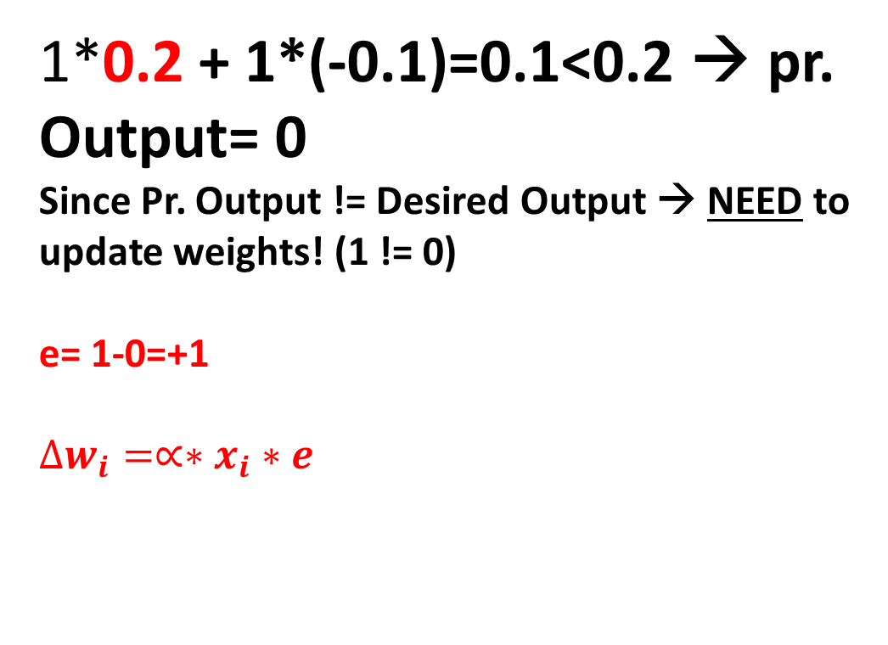
EXAMPLE – let’s try to teach a perceptron how AND gate works!
INPUT 1 | INPUT 2 | DESIRED OUTPUT
0 | 0 | 0
0 | 1 | 0
1 | 0 | 0
1 | 1 | 1
1*0.2 + 1*(-0.1)=0.1<0.2 → pr. Output= 0
Since Pr. Output != Desired Output → NEED to update weights! (1 != 0)
e= 1-0=+1
$$∆w_{i}=∝∗x_{i}∗e$$
$∆w_{1}=0.1∗1∗\left(+1\right)$=+0.1
$$∆w_{2}=0.1∗1∗\left(+1\right)=+0.1$$
$new w_{1}$ = $w_{1}$+ $∆w_{1}=0.2+0.1=0.3$
$new w_{2}$ = $w_{2}$+ $∆w_{2}=−0.1+0.1=0$

Slide 22
EXAMPLE – let’s try to teach a perceptron how AND gate works!
INPUT 1 | INPUT 2 | DESIRED OUTPUT
0 | 0 | 0
0 | 1 | 0
1 | 0 | 0
1 | 1 | 1
All samples in the data set were given to the perceptron! → THIS IS CALLED ONE EPOCH!
New weights:
w1 = 0.3
w2= 0
FEED THE ALGORITHM UNTIL ALL DESIRED OUTPUTS EQUAL TO PREDICTED OUTPUTS!!!
EPOCH 2, EPOCH 3, EPOCH 4, EPOCH 5

Slide 23
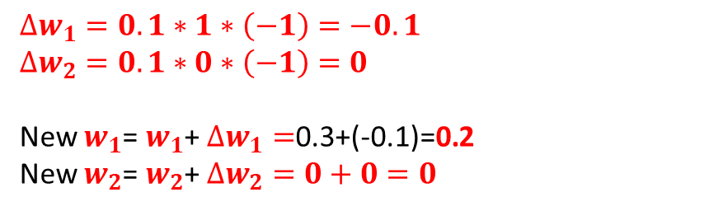
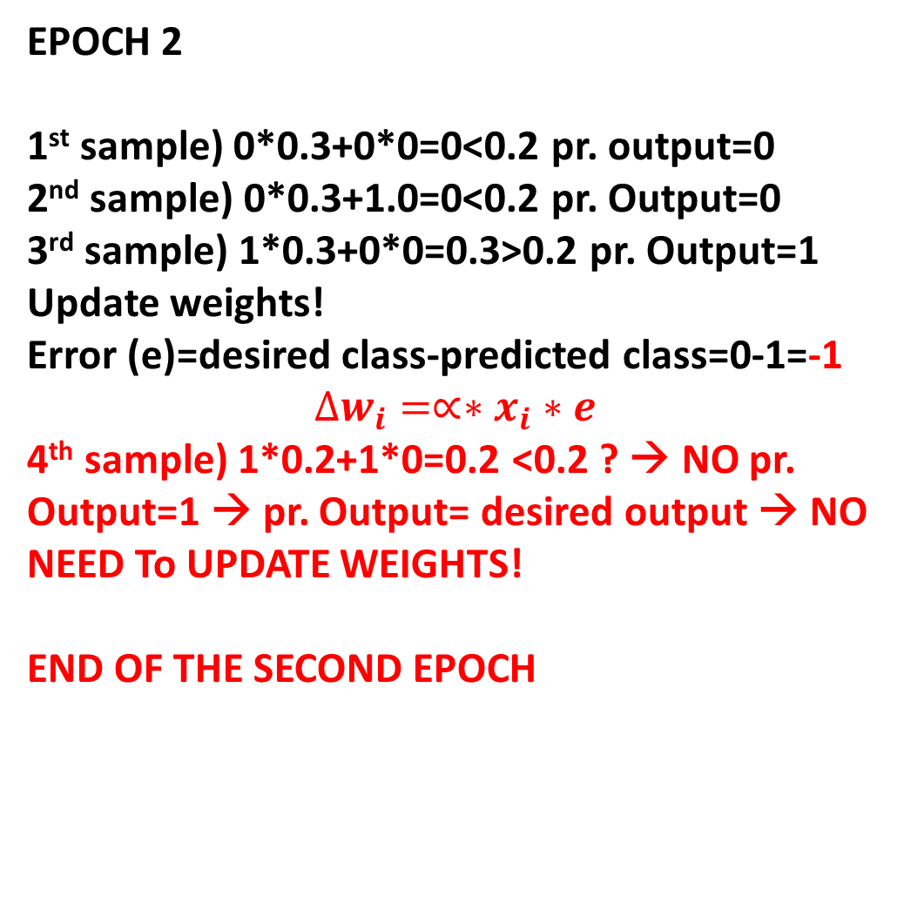
EXAMPLE – let’s try to teach a perceptron how AND gate works!
INPUT 1 | INPUT 2 | DESIRED OUTPUT
0 | 0 | 0
0 | 1 | 0
1 | 0 | 0
1 | 1 | 1
EPOCH 2
1st sample) 0*0.3+0*0=0<0.2 pr. output=0
2nd sample) 0*0.3+1.0=0<0.2 pr. Output=0
3rd sample) 1*0.3+0*0=0.3>0.2 pr. Output=1
Update weights!
Error (e)=desired class-predicted class=0-1=-1
$$∆w_{i}=∝∗x_{i}∗e$$
4th sample) 1*0.2+1*0=0.2 <0.2 ? → NO pr. Output=1 → pr. Output= desired output → NO NEED To UPDATE WEIGHTS!
END OF THE SECOND EPOCH
$$∆w_{1}=0.1∗1∗\left(−1\right)=−0.1$$
$$∆w_{2}=0.1∗0∗\left(−1\right)=0$$
New $w_{1}$= $w_{1}$+ $∆w_{1}=$0.3+(-0.1)=0.2
New $w_{2}$= $w_{2}$+ $∆w_{2}=0+0=0$

