Slide 1
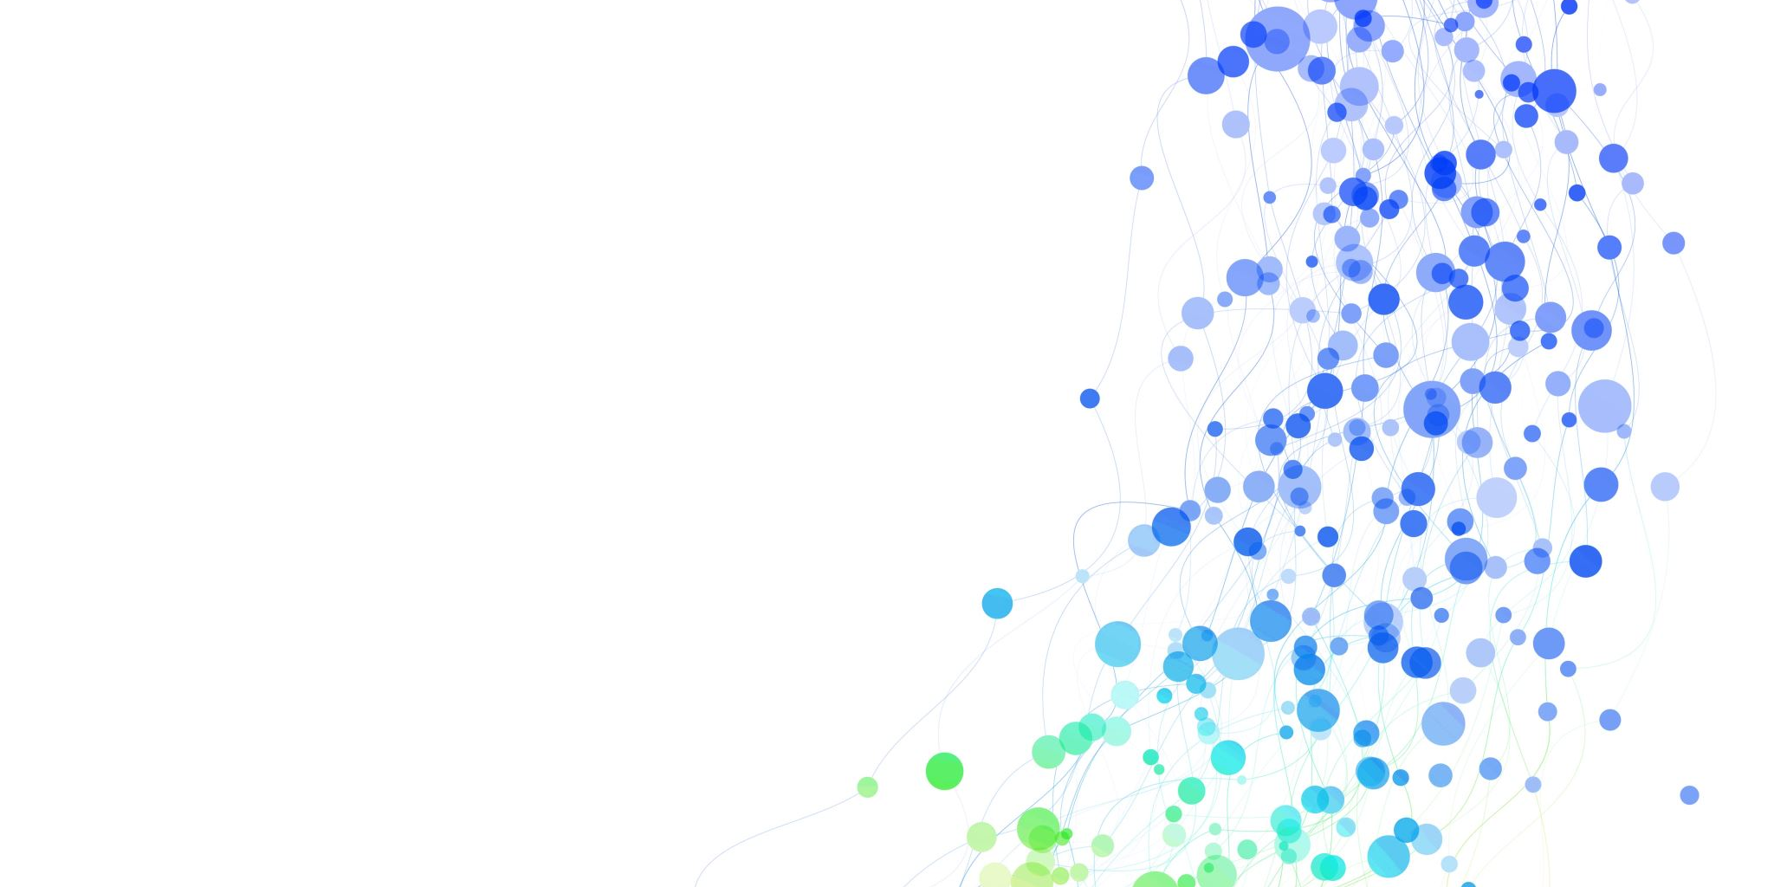
DSA 210 Project Representation
Mobile Online Game Statistics
Egemen Yağız Akyüz
29156

Slide 2
What is the Project Topic
This Project is about analyzing the data of an online mobile game stats that I played for a while.
The game (Dream League Soccer- First Touch Games) enables users to see their online history by providing a web site that keeps the game data. (https://tracker.ftgames.com/?idx=slp70xzc)

Slide 3
First Step – Web Scraping
First I sent a mail to First Touch Game because sometimes scrapping can be a problem for a website and they allowed me to get my games data.
I implemented a code using Selenium for scraping data, in repository you can find it as scrapping_via_selenium.py
I took the data and stored it into a .csv file. (In repo: match_data_20250110_164426.csv)

Slide 4
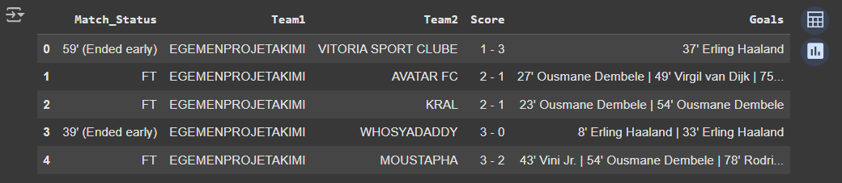
Google Collab – Data Visualization
I uploded my .csv file to Google Collab and began to get my data visualized
In next pages you can see what did I get.

Slide 5
Structure of Data
Match_Status: This part reflects the status of our matches either as (ended early, the minute shows how many minutes the game played till a connection error occurs) or FT (game is played 90 minutes).
Team1: Shows my team, I changed my team to prevent some conflicts hence there would be more team having same name.
Team2: Opponent teams' name
Score: Shows the game score with an order where the first one is my teamscore,ore and the second score is the opponent's.
Goals: Shows my players' score contribution. It does not count the opponent's one.

Slide 6

Total Time Spent to Play
Assuming one match spends 5 minutes (90 minutes in game = 5 minutes real time) I tried to calculate an approximate amount of time I spent on game so far. To do that for the matches resulted in FT I add 5 minutes otherwise I added the proportional time according to time spent.

Slide 7
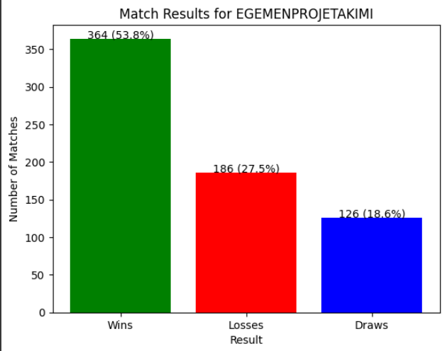
Win rate for my team
This bar chart illustrates the match results for my team. The team achieved victory in 53.8% of matches, totaling 364 wins. Meanwhile, 27.5% of matches resulted in losses (186), and 18.6% were draws (126). The chart visually emphasizes the team's success rate in their matches.

Slide 8
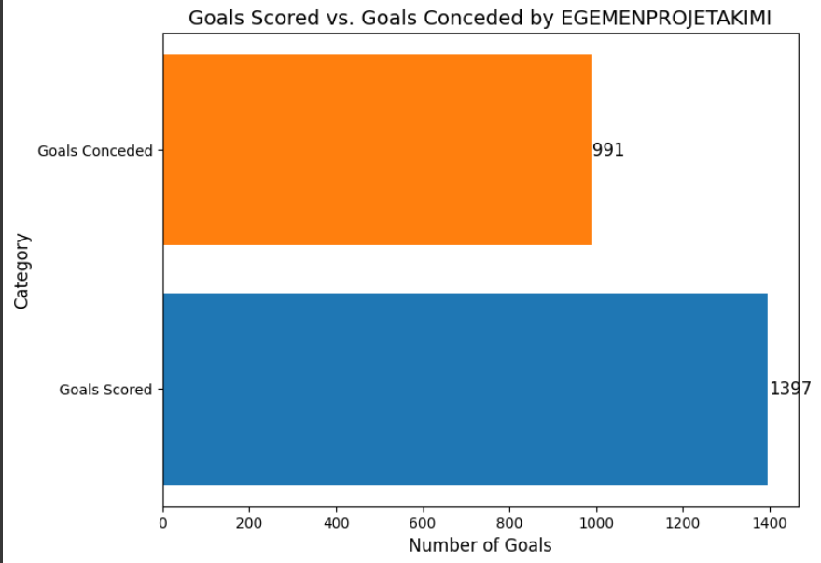
Goals scored vs Goals conceded
This horizontal bar chart compares the goals scored and conceded by my team. The team scored a total of 1397 goals, significantly outscoring their opponents who managed 991 goals. The chart highlights the team's offensive strength and positive goal difference over their matches.

Slide 9
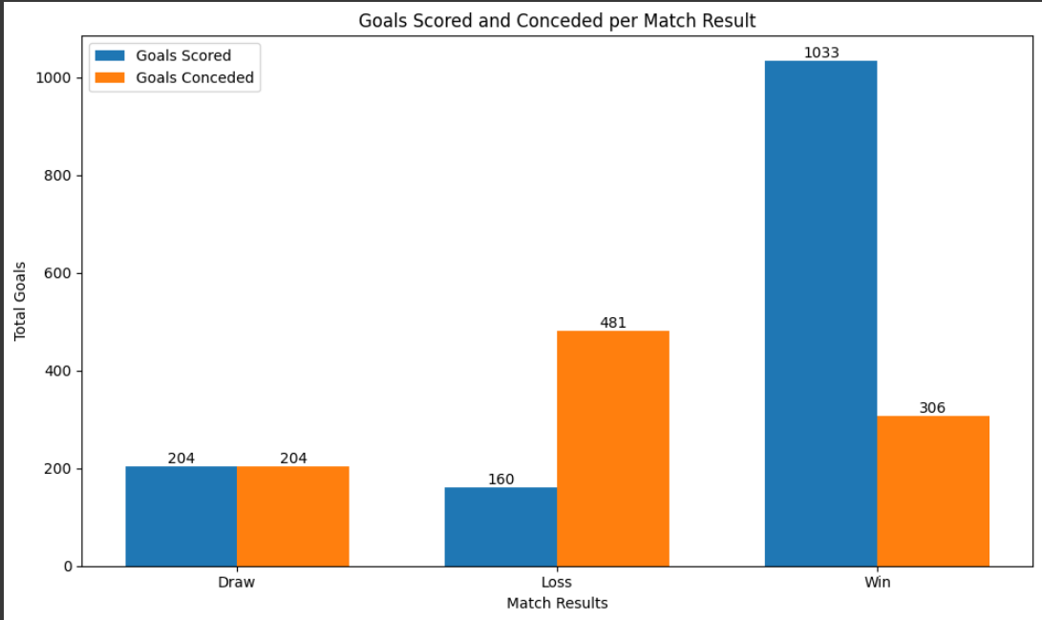
Goals scored and conceded per match
This grouped bar chart illustrates the distribution of goals scored and conceded by my team

Slide 10
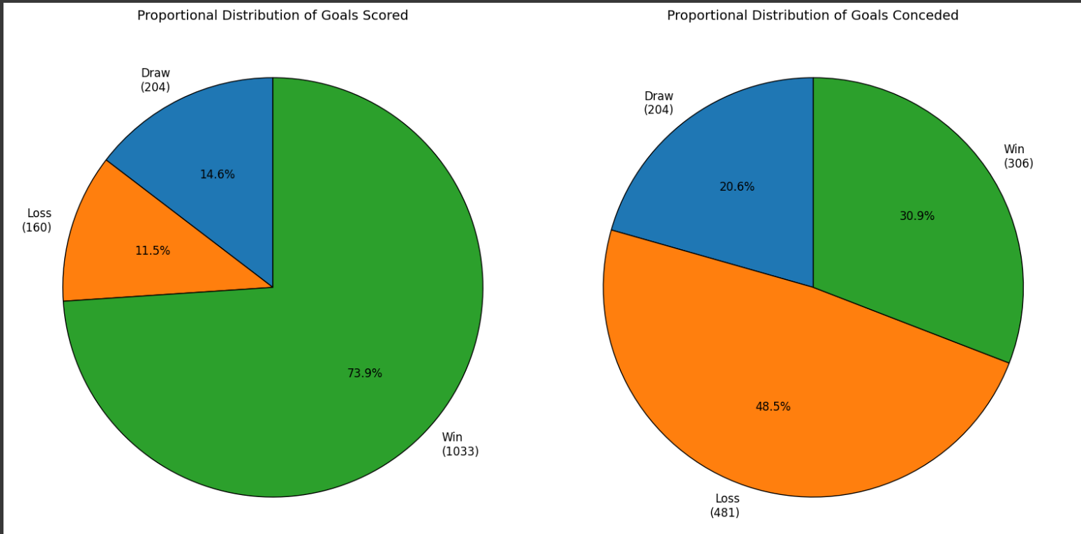
Proportional distribution of goals
These pie charts display the proportional distribution of goals scored and conceded by my team:
Goals Scored:
A significant majority (73.9%) of goals were scored in matches the team won.
Only 11.5% of goals were scored in losses, and 14.6% in draws.
Goals Conceded:
Almost half (48.5%) of the goals conceded occurred in losses.
In contrast, 30.9% of goals were conceded in wins, and 20.6% in draws.

Slide 11
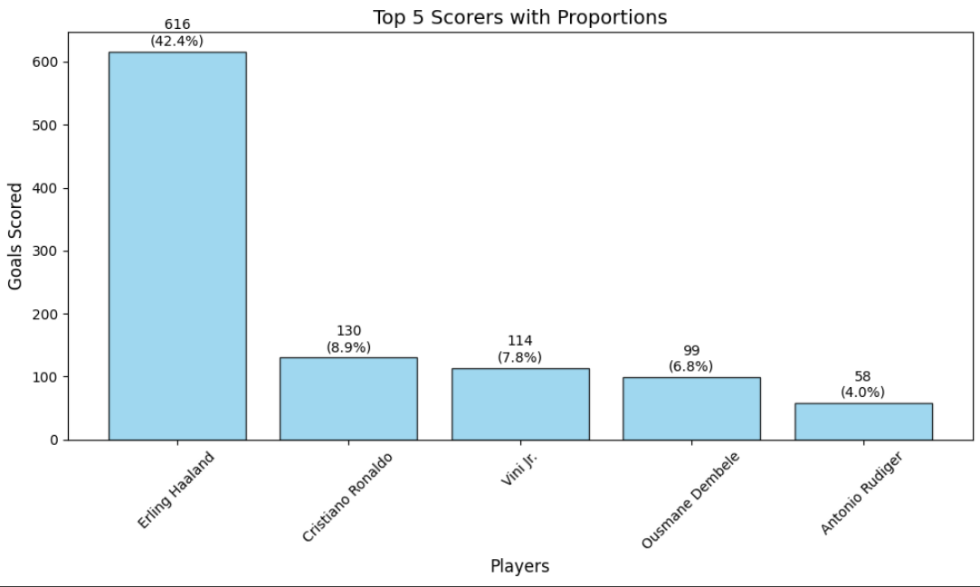
Top scorers and proportions
This bar chart represents the Top 5 Scorers with Proportions for my team:
e.g. Erling Haaland scored 616 goals, accounting for 42.4% of the team's total goals.
This visualization highlights Haaland's significant impact on the team's offensive performance, far surpassing his teammates.

Slide 12
END
Thanks for your time

