Slide 1
CS21003: Algorithms 1
19EC10002: Akshat Sharma
19EC10005: Ammar Husain Ansari
19EC30006: Arsh Agarwal

Slide 2
Motivation
Solving Sudoku seemed to be a really intuitive problem that could be solved within the bounds of our course and even extended further by integrating this within an app or applying Computer Vision and Machine Learning to get the the input of the Sudoku matrix.
The concepts taught in our course by professors Partha Pratim Chakraborty and Palash Dey were very versatile and explained with a practical approach that enabled us to apply them to real life problems with ease.

Slide 3
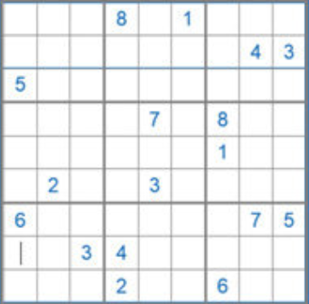
Formal Problem Definition
Definition: Given a partially filled 9×9 2D array ‘grid[9][9]’, the goal is to assign digits (from 1 to 9) to the empty cells so that every row, column, and subgrid of size 3×3 contains exactly one instance of the digits from 1 to 9.
Input: In a text file, the user is required to enter
a 9x9 Sudoku matrix with blank spaces represented
by a Zero(0).
Eg:

Slide 4
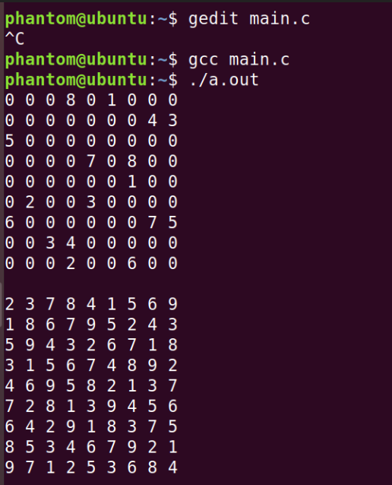
Formal Problem Definition
Output: The output is a 9x9 Sudoku matrix with all values filled with numbers from 1-9, hereby exhibiting a solved Sudoku problem.

Slide 5
Pseudocode of the algorithm
findc{
if(0 <= c <= 2) return 1;
if(3 <= c <= 5) return 2;
if(6 <= c <= 8) return 2;
}
isValid{
for each element in row:
if(ith element = number){
return 0;
}
for each element in row:
if(ith element = number){
return 0;
}
for each element in block:
if(ith element = number){
return 0;
}
return 1;
}
whenDone{
for each row in matrix
if(rowSum != 55){
return;
}
printGrid(grid);
}
solve{
for each element in grid
if (element = 0){
for each i in 1 to 9
if(isValid(grid,i,x,y)){
element = i;
whenDone(grid);
solve(arr);
element = 0;
}
if(i = 9){
grid[i][j] = 0;
return;
}
}
if (no element is valid){
grid[i][j] = 0;
return;
}
printGrid(grid);
exit(0);
}

Slide 6
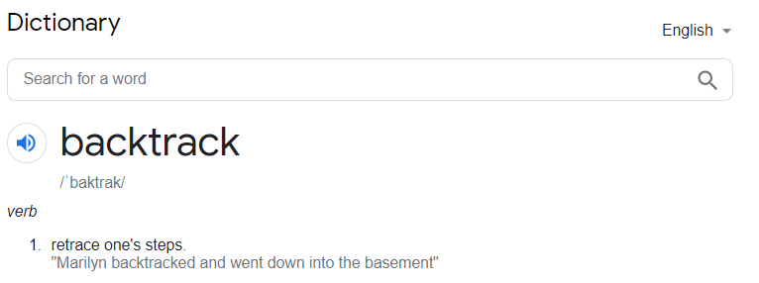
Analysis of Algorithm
Backtracking
Backtrack in layman’s terms refers to the retracing of steps.
In the world of computer science, backtracking is an algorithmic paradigm aimed at improving the time complexity of the exhaustive search technique if possible. Backtracking does not generate all possible solutions first and checks later. It tries to generate a solution and as soon as even one constraint fails, the solution is rejected and the next solution is tried.
A backtracking algorithm tries to construct a solution incrementally, one small piece at a time. It's a systematic way of trying out different sequences of decisions until we find one that works.

Slide 7
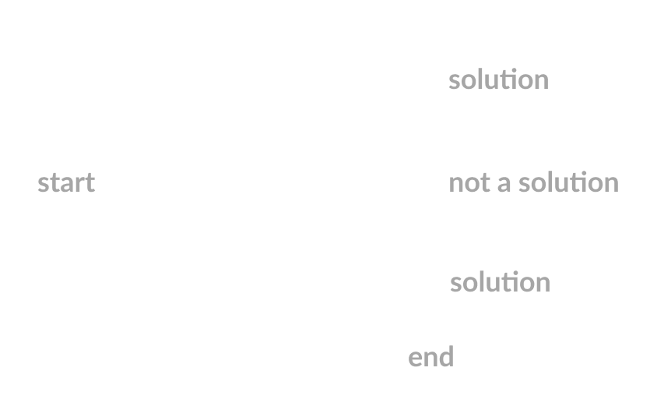
Analysis of Algorithm
Backtracking
How do we normally solve this problem?
We select one way and try to move forward towards the destination.
What if we reach a point where we can’t move towards the destination?
We backtrack on our path and try to explore other paths.
This is the main idea of Backtracking!

Slide 8
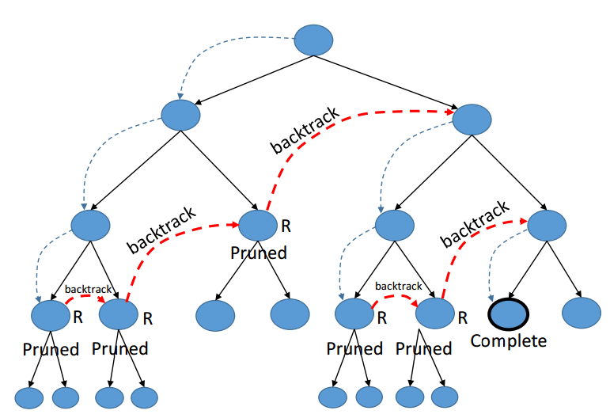
Analysis of Algorithm
Like all different Backtracking problem statements, Sudokus are often solved using one by one assignment of numbers to empty cells. Before assignment variety, check whether or not it's safe to assign, make certain constant variety isn't present within the current row, current column and current 3X3 subgrid. After checking for safety, assign the quantity and then recursively check whether or not this assignment results in an answer. If the assignment doesn’t lead to an answer, then attempt succeeding number for the present empty cell. And if none of the numeric values (1 to 9) results in an answer, the algorithm returns false and print no resolution exists.

Slide 9
Analysis of Algorithm
Complexity Analysis:
Time complexity: O(9^(n*n)).
For every unassigned index there are 9 possible options so the time complexity is O(9^(n*n)).
Space Complexity: O(n*n).
To store the output array a matrix is needed.

Slide 10
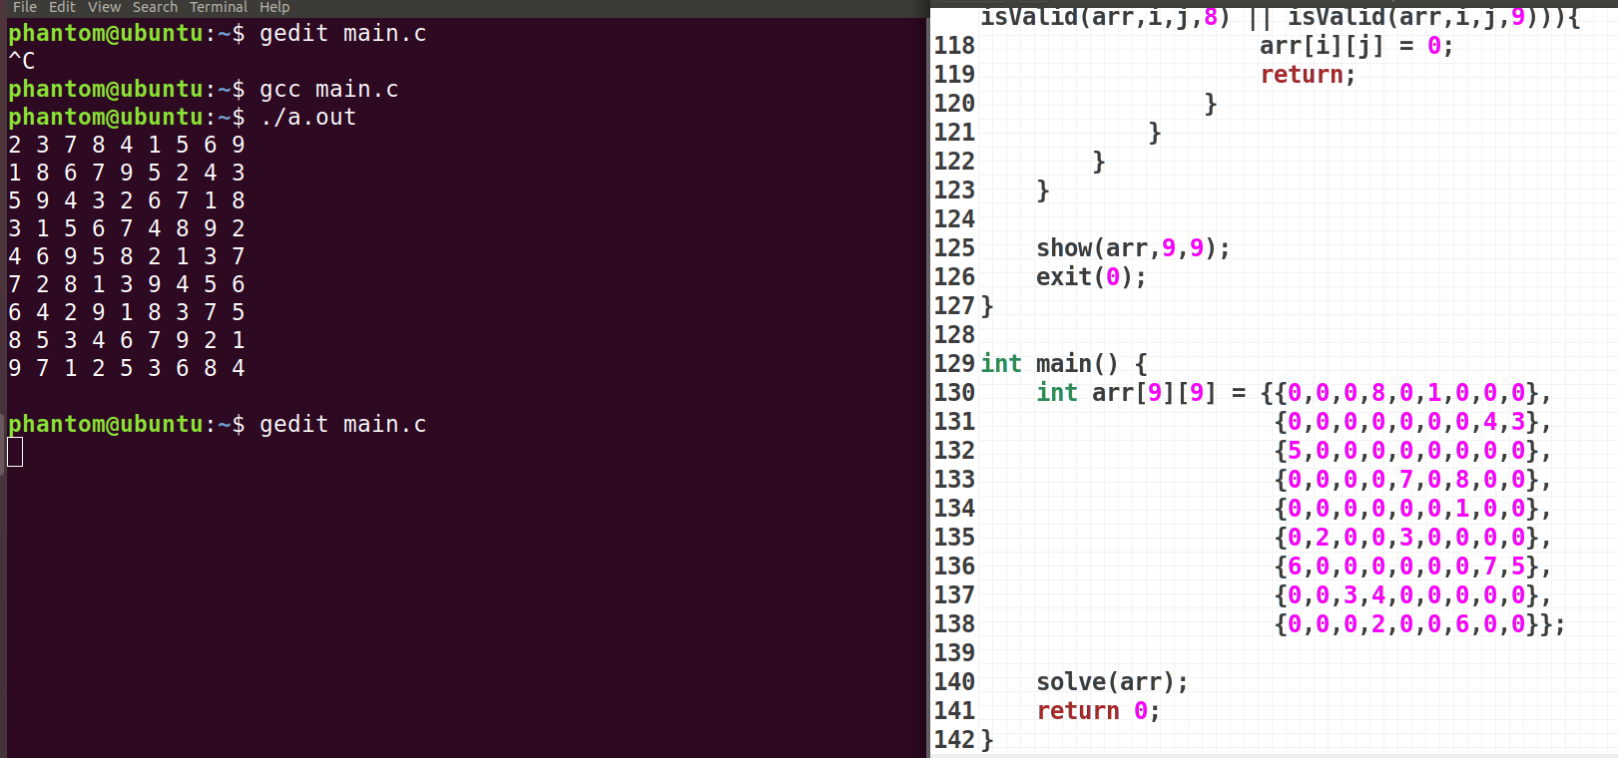
Implementation in C

Slide 11
#include <stdio.h>
#include <stdlib.h>
void show(int x[][9] , int m , int n){
for (int i = 0; i < 9; ++i) {
for (int j = 0; j < 9; ++j) {
printf("%d ",x[i][j]);
}
printf("\n");
}
printf("\n");
}
void findc(int* c){
switch (*c) {
case 0:
case 1:
case 2:
*c = 1;
return;
case 3:
case 4:
case 5:
*c= 4;
return;
case 6:
case 7:
case 8:
*c = 7;
return;
}
}
//0 for false ; 1 for true
int isValid(int arr[9][9],int x, int y,int num){
int check = 1;
int i,j;
//row checking
for ( i = 0; i < 9 ; ++i) {
if(i == x){
continue;
}
if(arr[i][y] == num){
check = 0;
return check;
}
}
// column check
for (j = 0; j < 9; ++j) {
if(j == y){
continue;
}
if(arr[x][j] == num){
check = 0;
return check;
}
}
// block checking
i = x;
j = y;
findc(&i);
findc(&j);
for (int k = i-1; k < i+2; ++k) {
for (int l = j-1; l < j+2 ; ++l) {
if(k == x && l == y){
continue;
}
if(arr[k][l] == num){
check = 0;
return check;
}
}
}
return check;
}
void whenDone(int arr[9][9]){
for (int i = 0; i < 9; ++i) {
int sum = 0;
for (int j = 0; j < 9; ++j) {
sum = sum + arr[i][j];
}
if(sum != 55){
return;
}
}
show(arr,9,9);
}

Slide 12
void solve(int arr[9][9]){
for (int i = 0; i < 9; ++i) {
for (int j = 0; j < 9; ++j) {
if(arr[i][j] == 0){
for (int k = 1; k <= 9; ++k) {
if(isValid(arr,i,j,k)){
arr[i][j] = k;
whenDone(arr);
solve(arr);
arr[i][j] = 0;
}
if(k == 9){
arr[i][j] = 0;
return;
}
}
if(!(isValid(arr,i,j,1) || isValid(arr,i,j,2) || isValid(arr,i,j,3) || isValid(arr,i,j,4) || isValid(arr,i,j,5) || isValid(arr,i,j,6) || isValid(arr,i,j,7) || isValid(arr,i,j,8) || isValid(arr,i,j,9))){
arr[i][j] = 0;
return;
}
}
}
}
show(arr,9,9);
exit(0);
}
int main() {
int arr[9][9];
for (int i = 0; i < 9; ++i) {
for (int j = 0; j < 9; ++j) {
scanf("%d",&arr[i][j]);
}
}
printf("\n");
solve(arr);
return 0;
}

