Slide 1
Emeris Pulse
Campus gym platform — Task 2 product walkthrough for Emeris management

Slide 2
What we built
Three role-specific apps: Member (phone PWA), Instructor, Admin / Facility
One Express API and Azure SQL — membership, QR access, classes, equipment, challenges, notices
Hosted on Azure App Service (HTTPS) with CI/CD from GitHub
Demo accounts use password Pulse123! — screenshots from the live sites

Slide 3
Architecture
Member → https://emeris-pulse-member.azurewebsites.net
Instructor → https://emeris-pulse-instructor.azurewebsites.net
Admin → https://emeris-pulse-admin.azurewebsites.net
API → https://emeris-pulse-api.azurewebsites.net (JWT access + refresh tokens)

Slide 4
Member experience

Slide 5
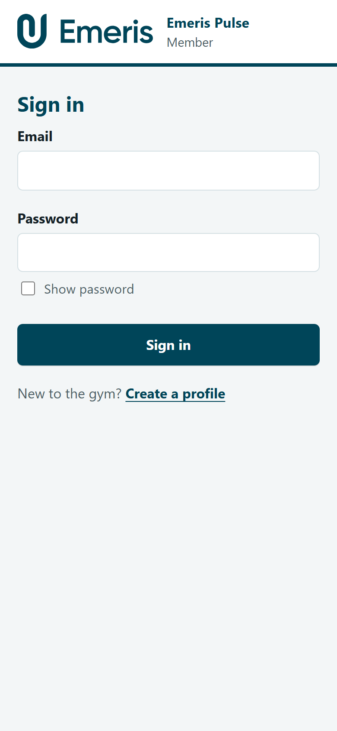
Member sign-in
Email and password. Show password available. Create a profile for new students and staff.

Slide 6
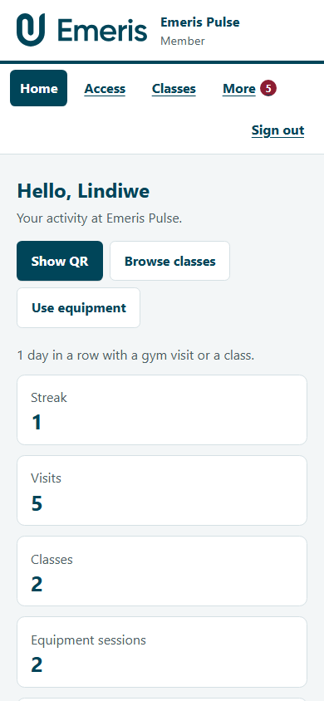
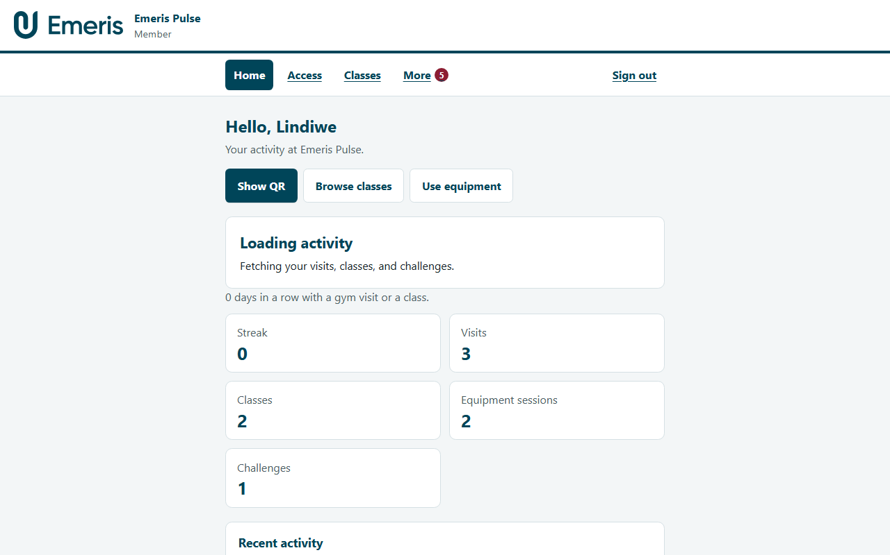
Member Home — phone and desktop
Phone
Desktop
Greeting, quick actions (Show QR, Browse classes, Use equipment), streak and activity.

Slide 7
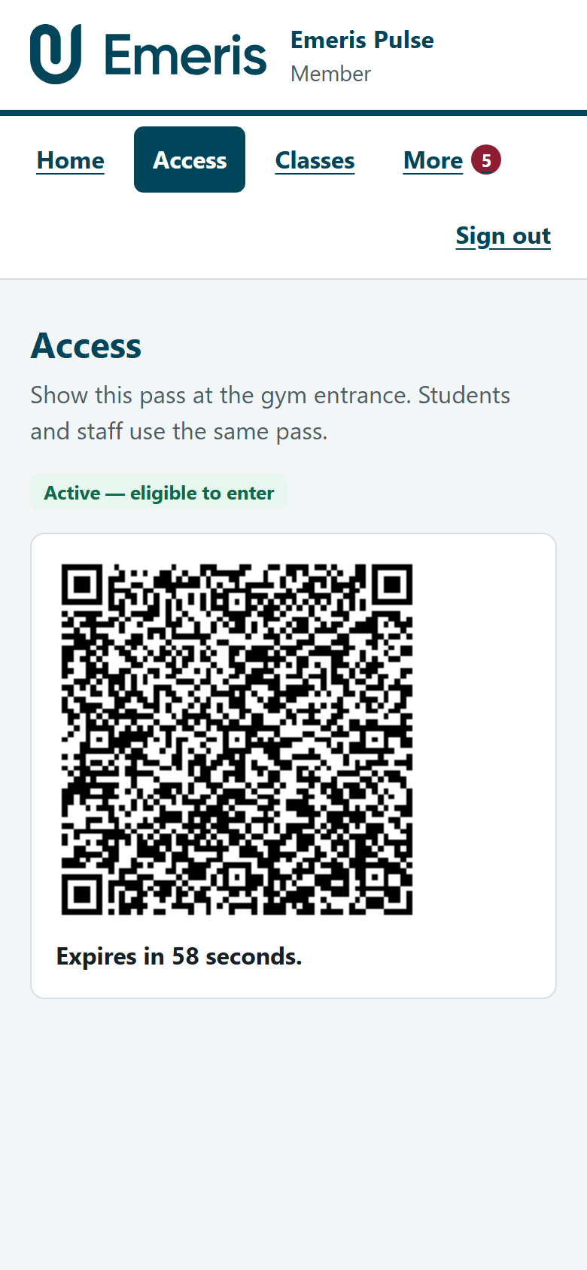
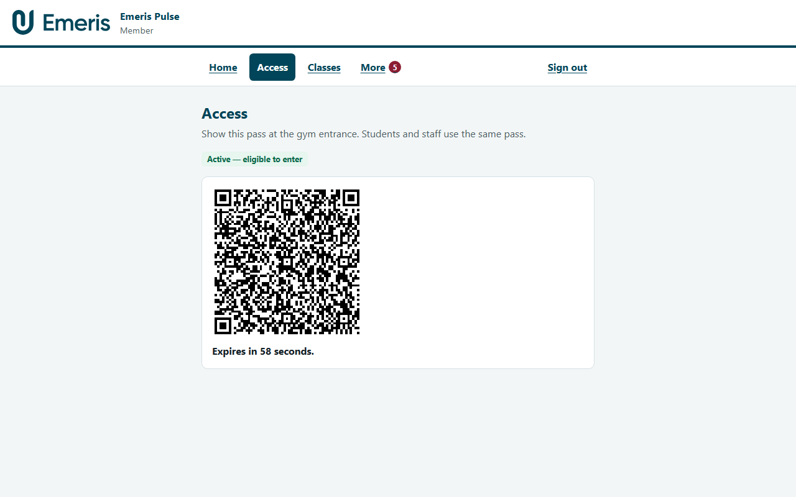
Access — QR pass
Phone
Desktop
Short-lived signed QR. Active membership required. Same pass for students and staff.

Slide 8
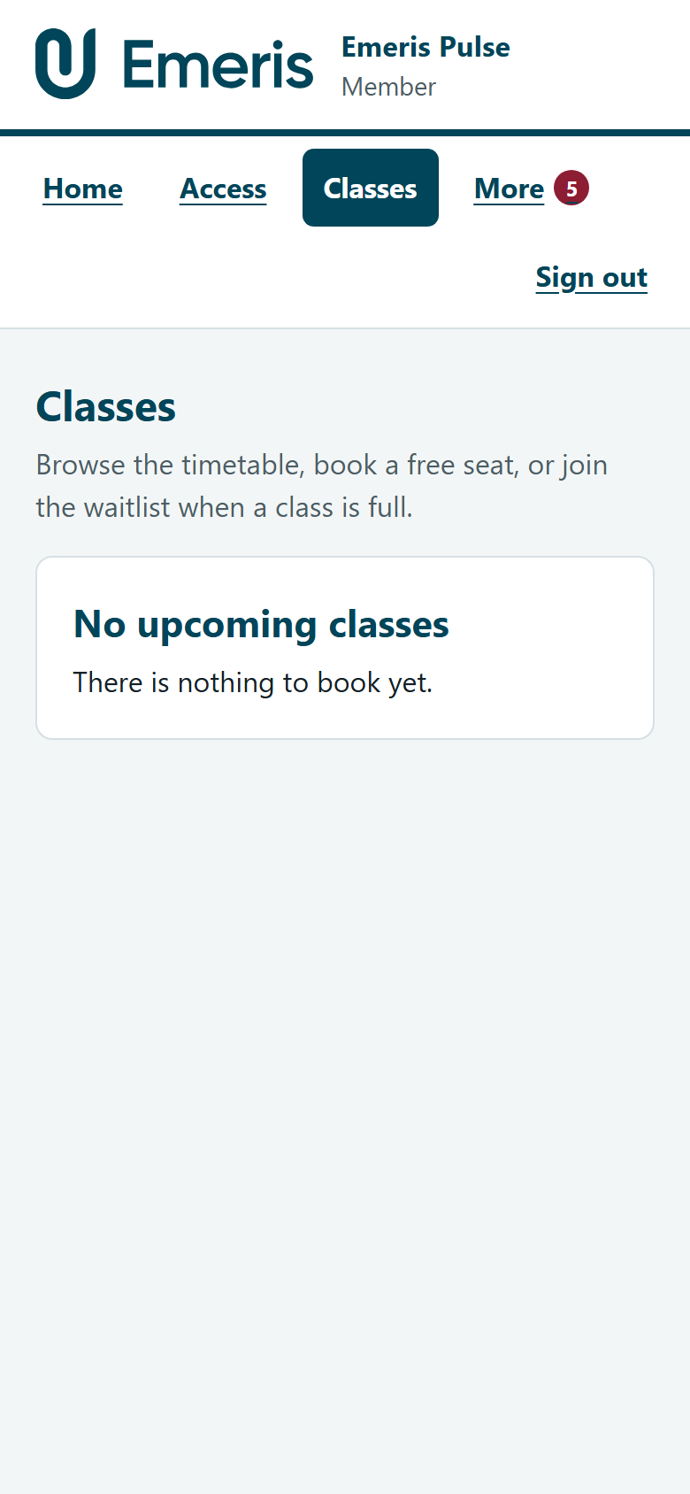
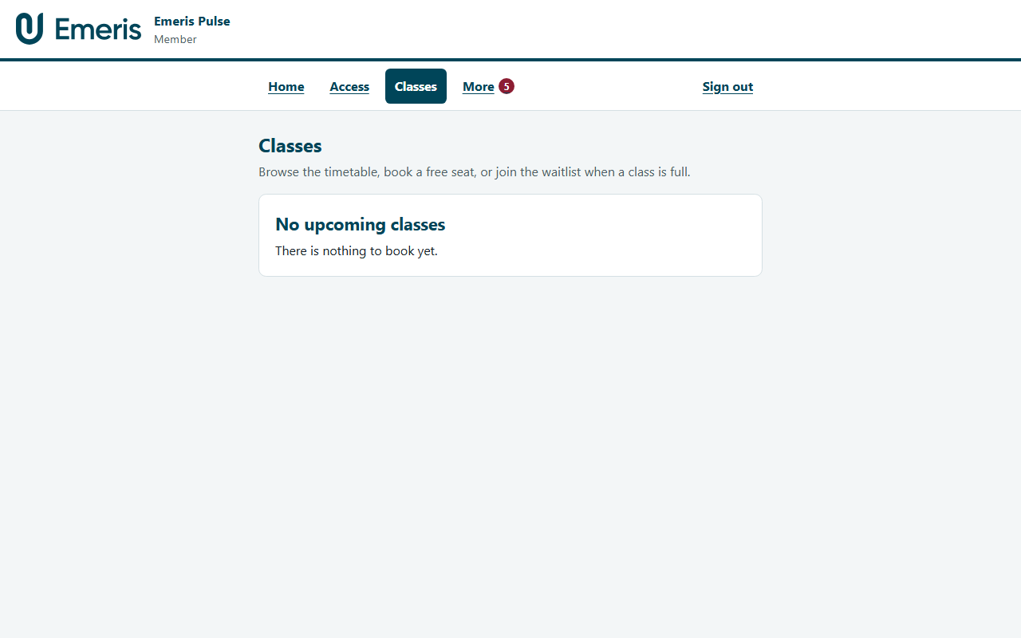
Classes — timetable and booking
Phone
Desktop
One screen: day chips, seats, Book / Waitlist / Cancel (with confirmation).

Slide 9
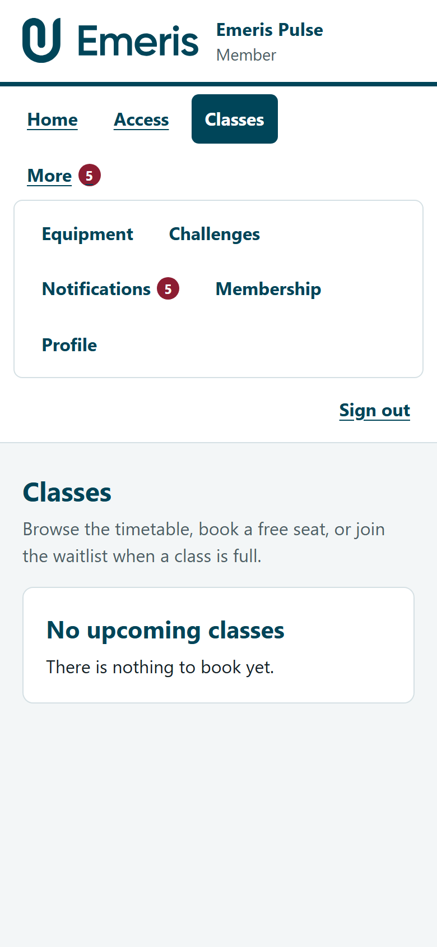
More menu
Equipment, Challenges, Notifications, Membership, and Profile.

Slide 10
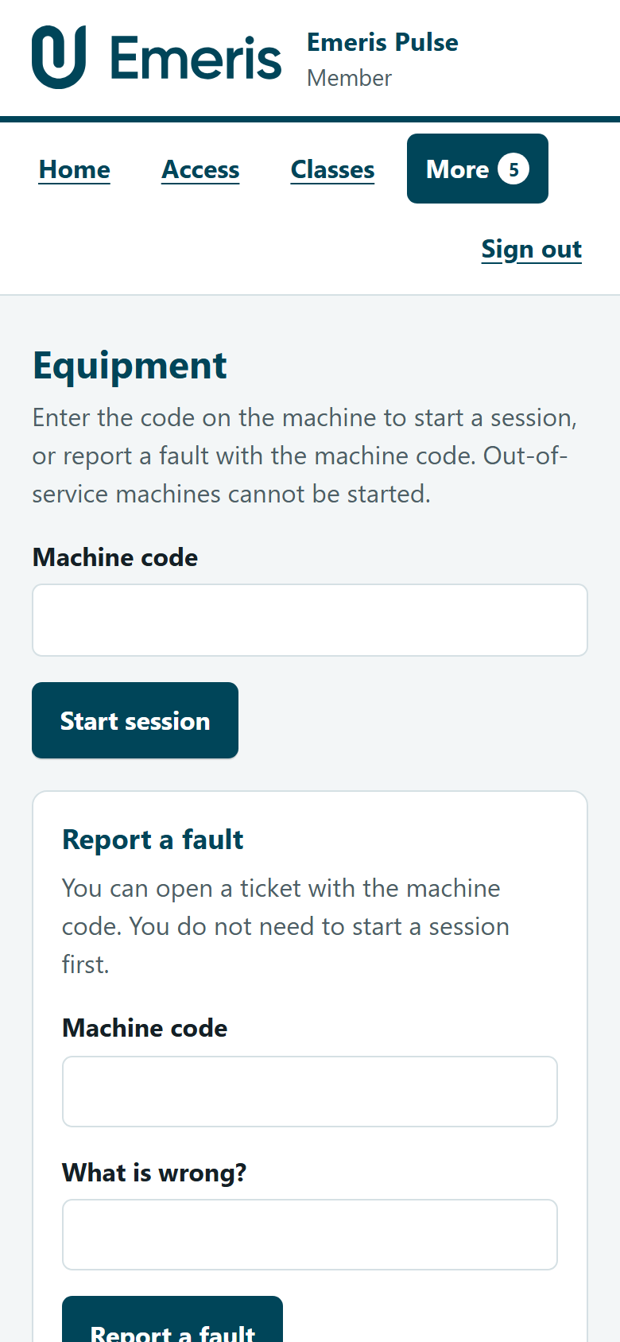
Equipment
Start a session by machine code. Out-of-service machines are refused.

Slide 11
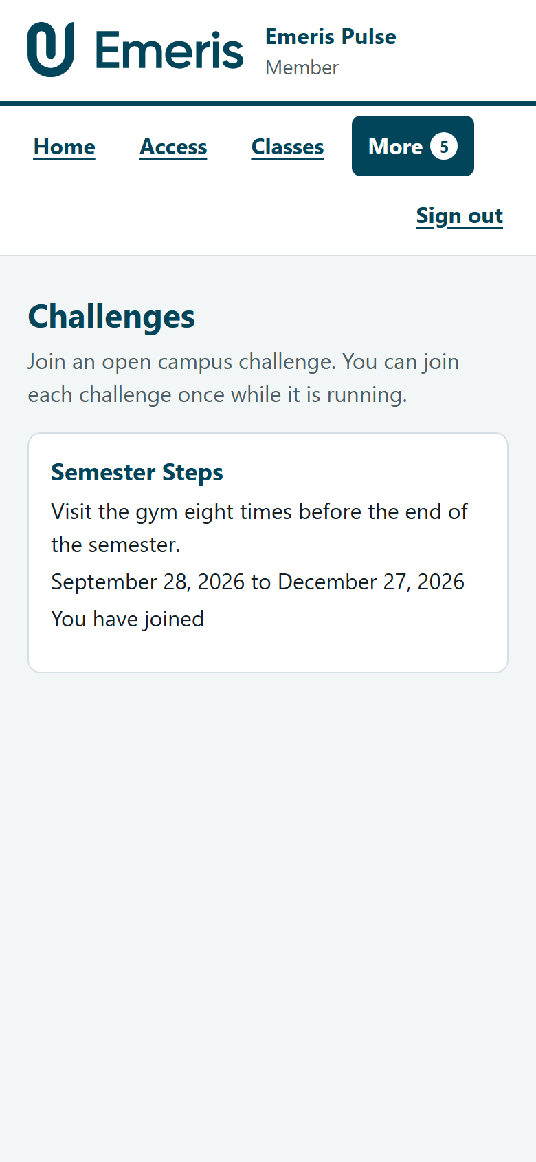
Challenges
Campus wellness challenges — join once while open.

Slide 12
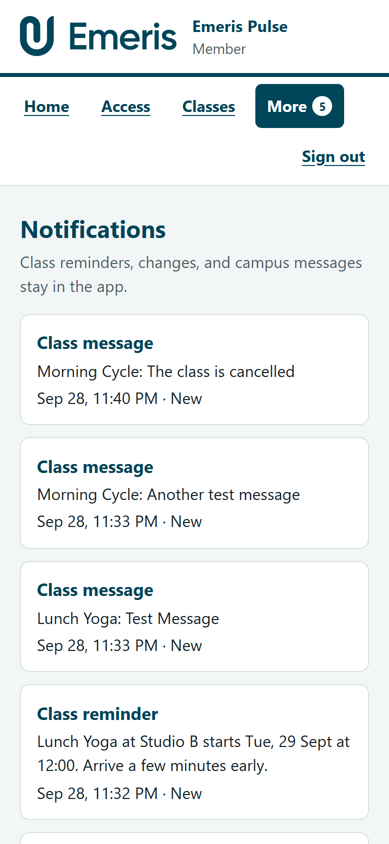
Notifications
In-app only: reminders, class changes, instructor notes, closures, broadcasts.

Slide 13
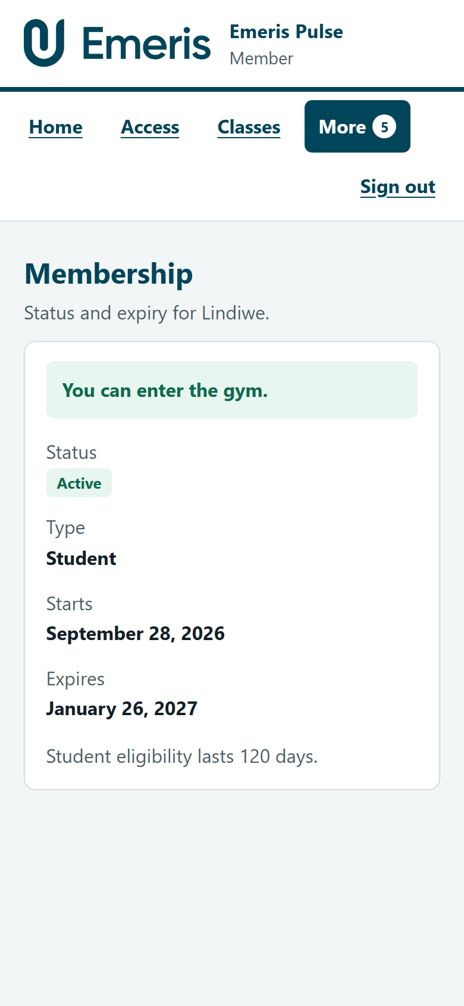
Membership
Status, type, dates, and whether entry is allowed.

Slide 14
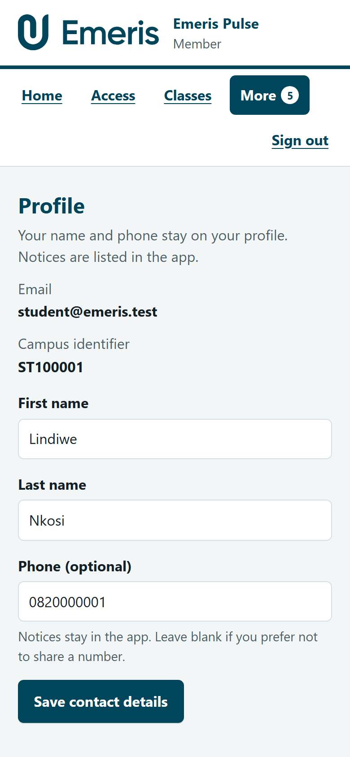
Profile
Update name and optional phone. Email and campus ID stay fixed.

Slide 15
Membership gates

Slide 16
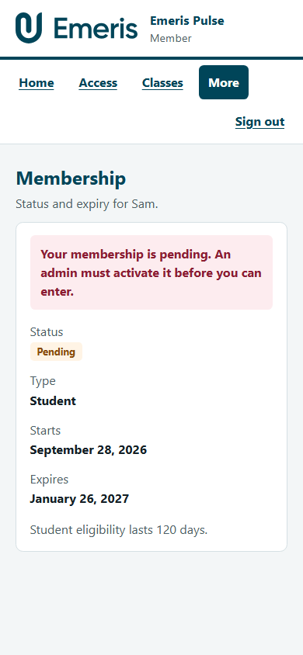
Pending member
Sam Patel waits for admin activation before entry or booking.

Slide 17
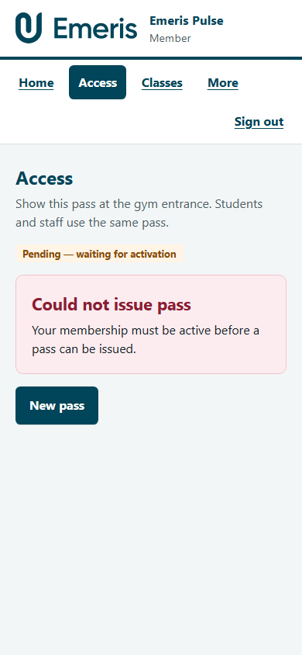
Pending — Access refused
No QR pass until membership is Active.

Slide 18
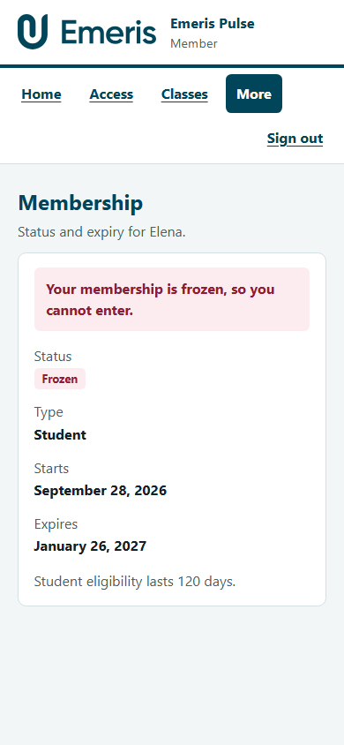
Frozen member
Frozen also blocks entry until an administrator activates again.

Slide 19
Instructor

Slide 20
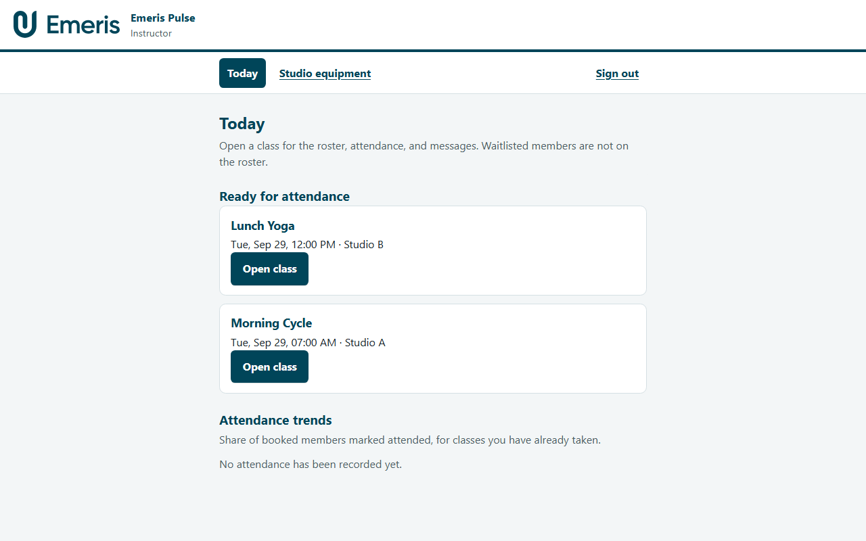
Today
Today’s and upcoming classes. Open a class for roster, attendance, and messages.

Slide 21
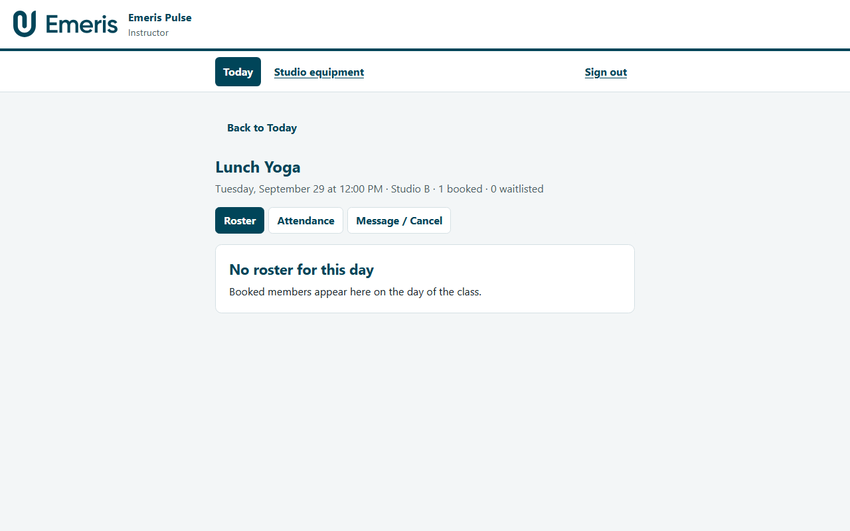
Class — Roster
Booked members only. Waitlisted people are not on the roster.

Slide 22
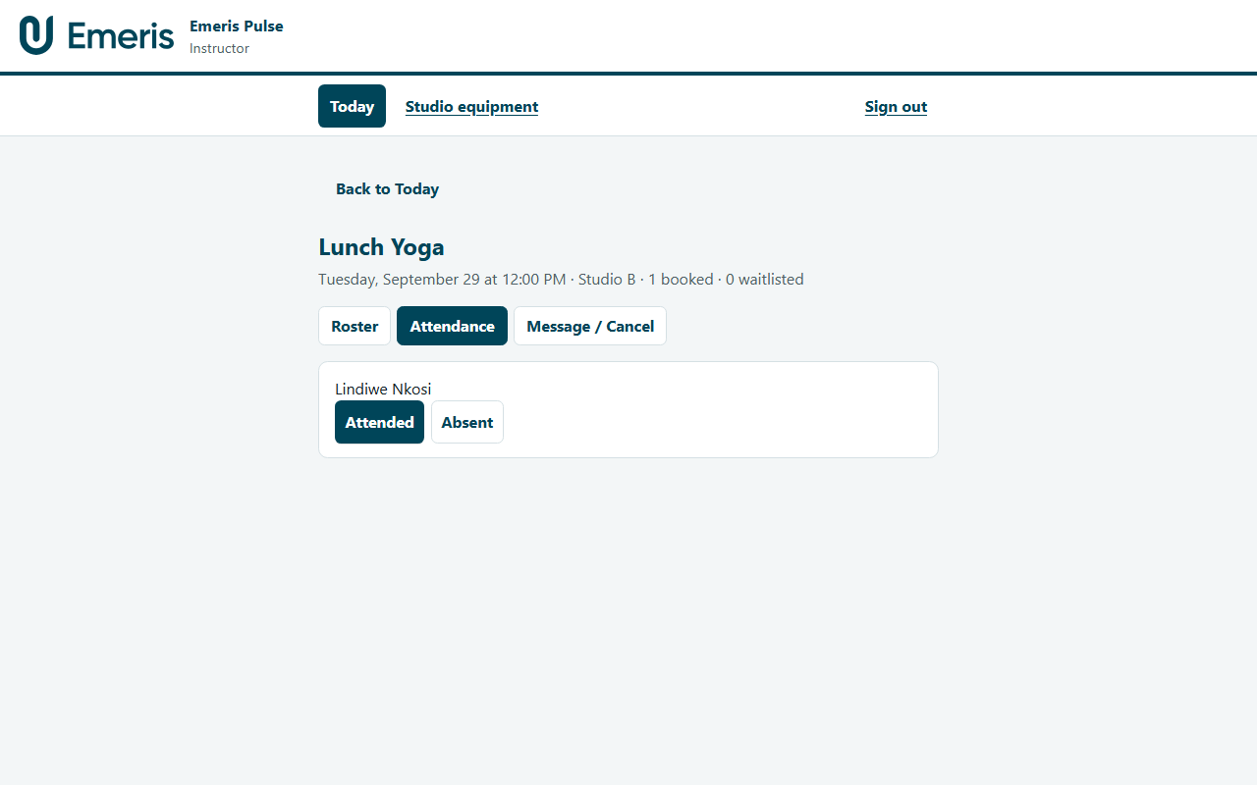
Class — Attendance
Mark attended or absent after the class has started.

Slide 23
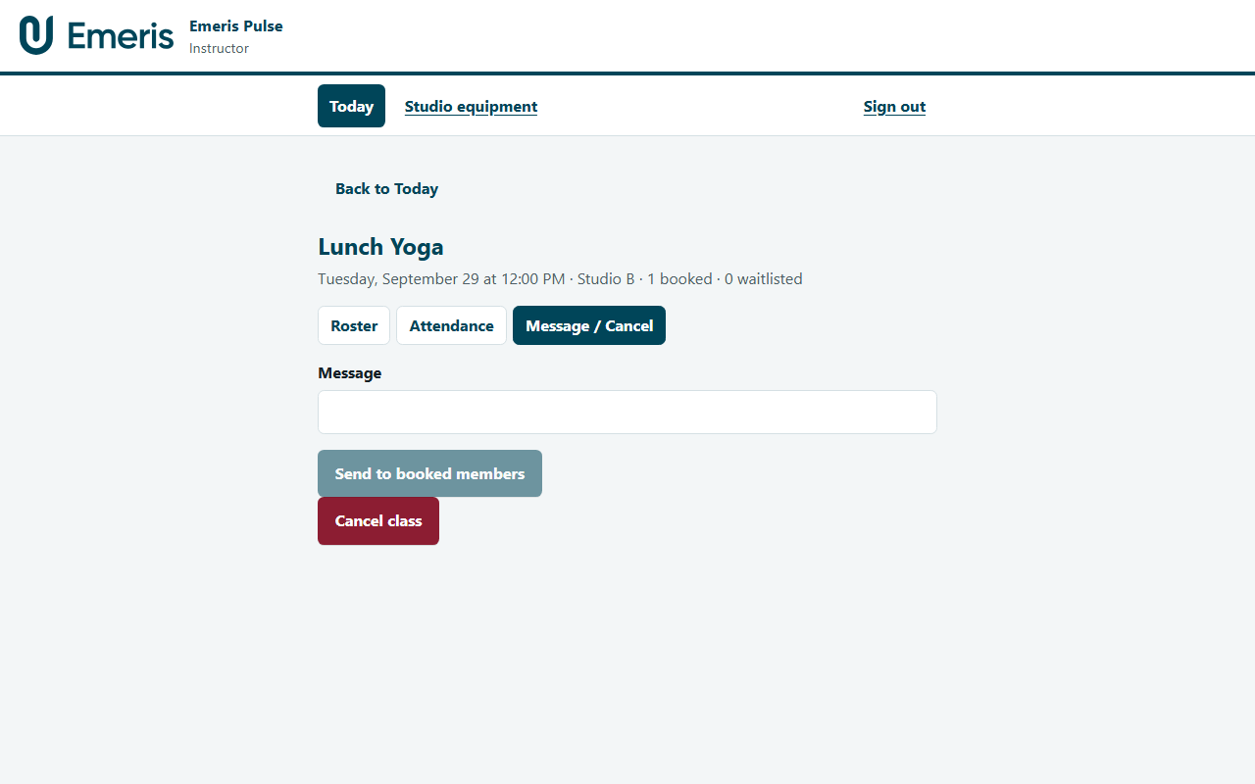
Class — Message
Notes go to booked members only — not the waitlist.

Slide 24
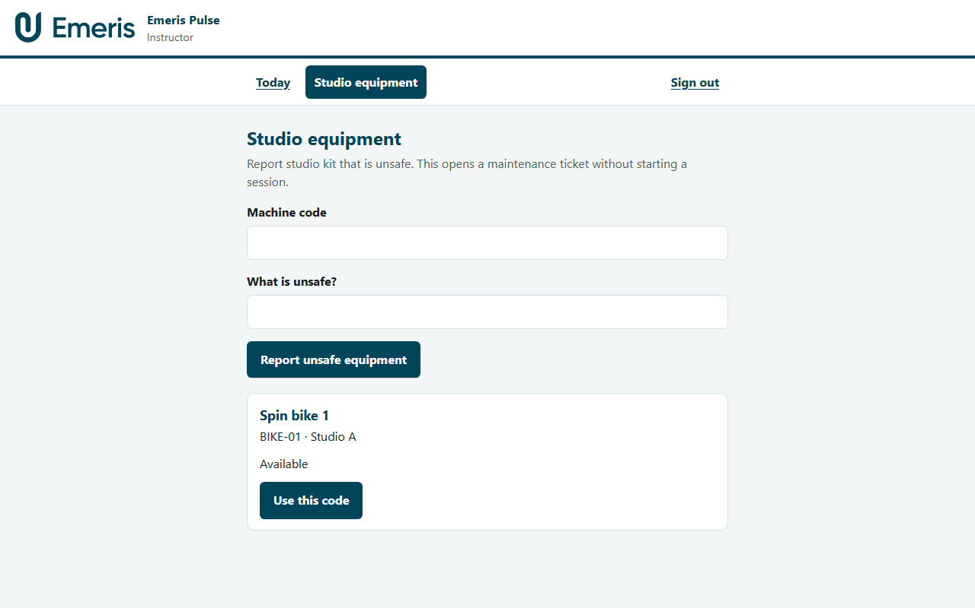
Studio equipment
Report unsafe studio kit without starting a member session.

Slide 25
Desk entry — QR scan

Slide 26
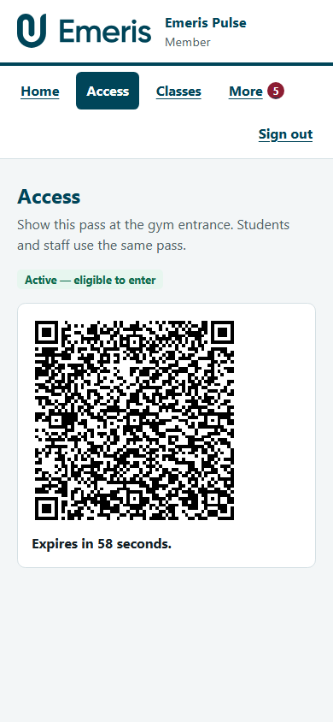
Member shows QR
Live pass on the phone — expires in about 60 seconds, single use.

Slide 27
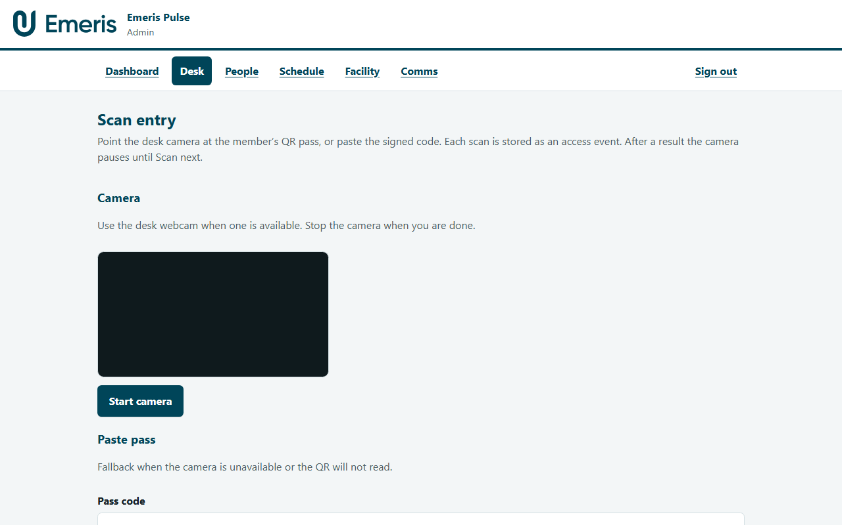
Admin Scan entry
Camera or paste. Detection pauses after a result; Scan next for the following member.

Slide 28
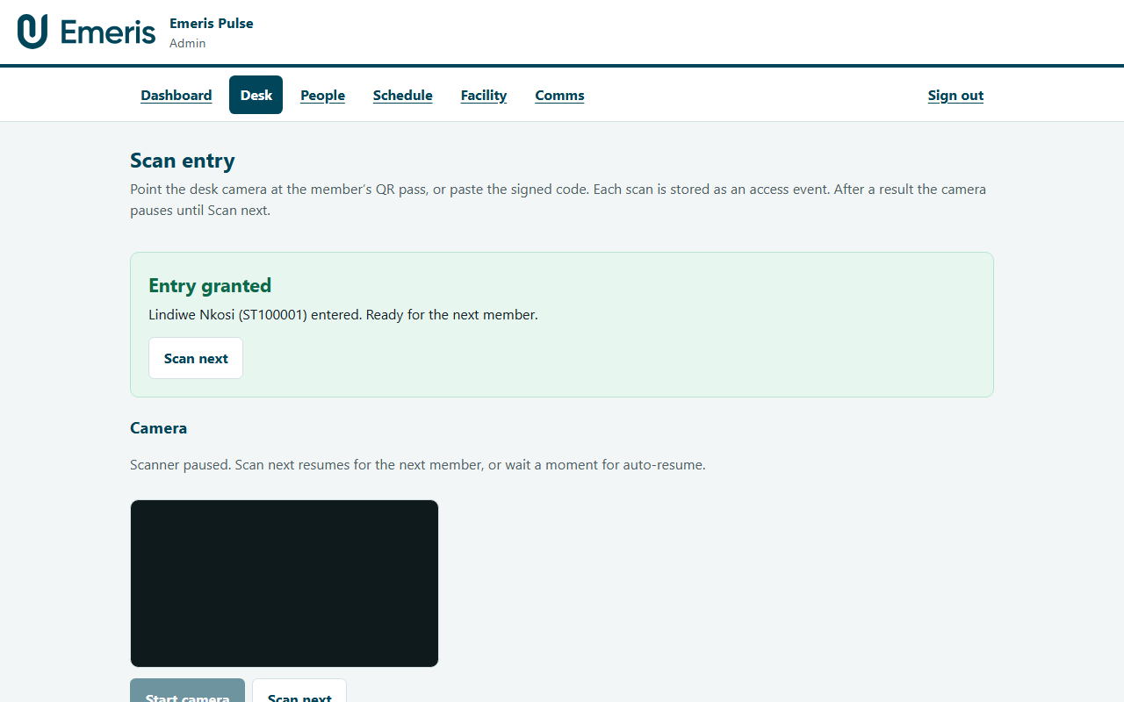
Entry granted
Desk records a granted access event. Banner names the member when available.

Slide 29
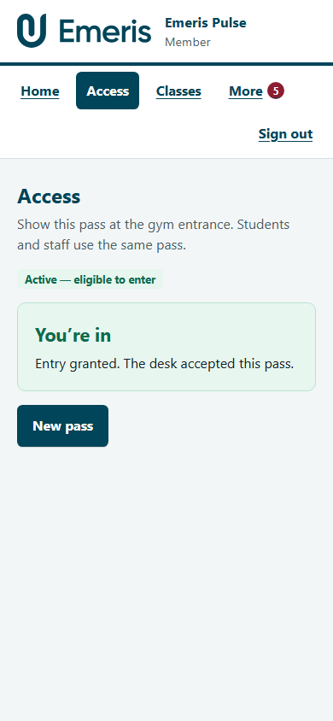
Member — You’re in
Phone learns the pass was redeemed and confirms entry.

Slide 30
Gym administration

Slide 31
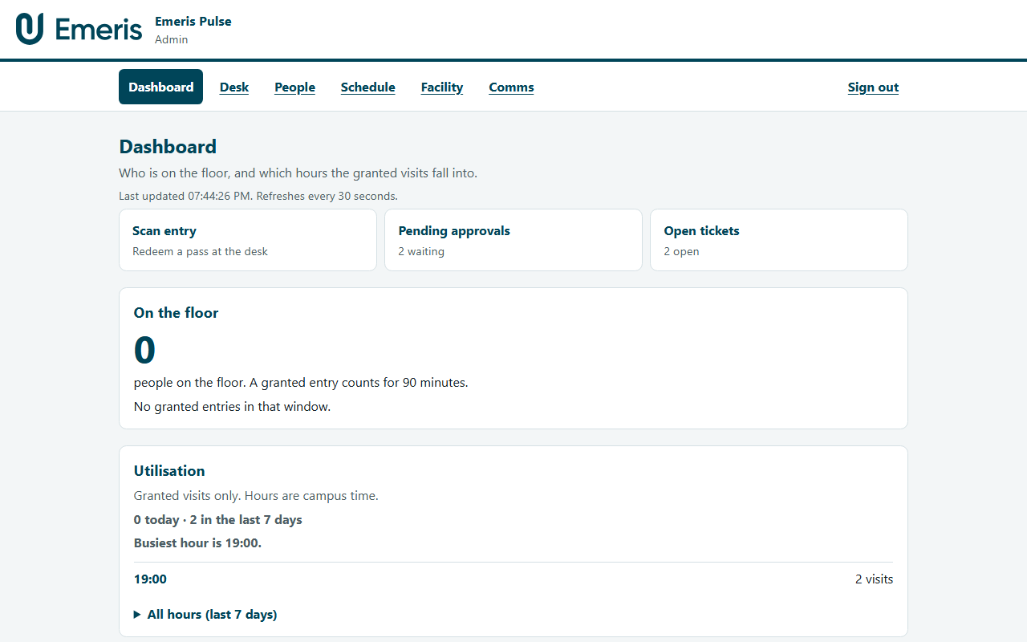
Dashboard
On-floor occupancy, utilisation peaks, quick actions, gym closure (with confirm).

Slide 32
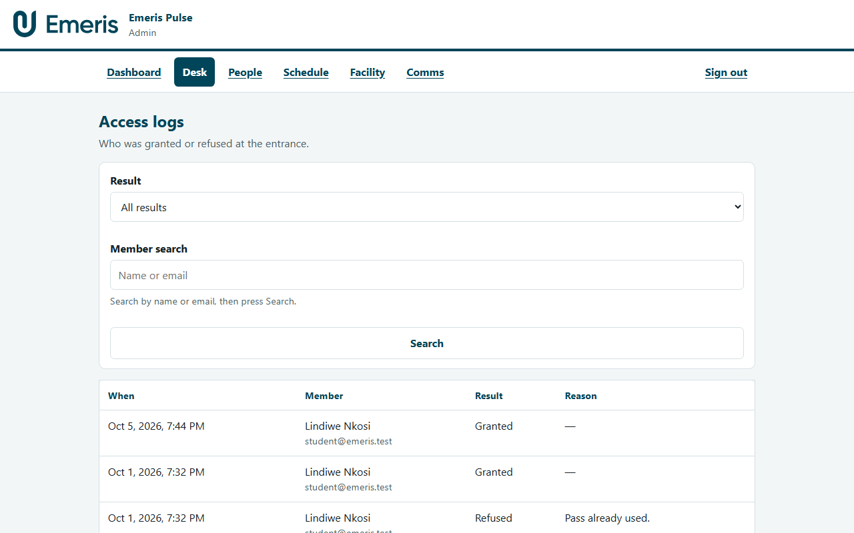
Access logs
Granted and refused scans, paged, with filters.

Slide 33
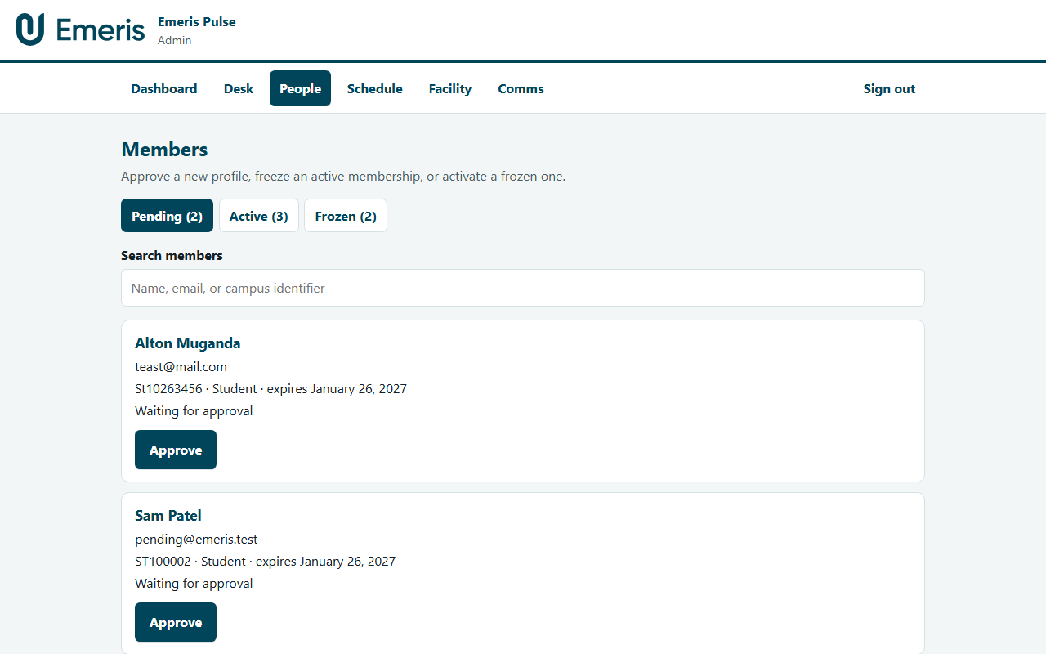
Members
Pending / Active / Frozen tabs, search, approve and freeze with confirmation.

Slide 34
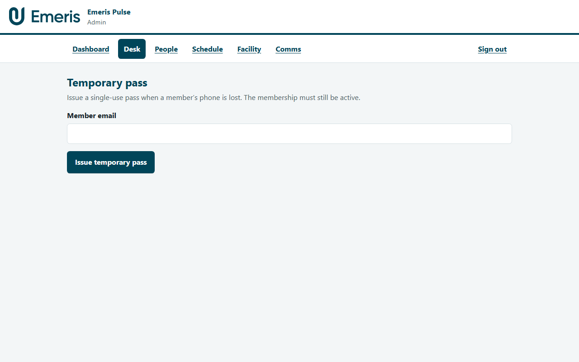
Temporary pass
Lost-phone desk pass — 15 minutes, single use, active membership only.

Slide 35
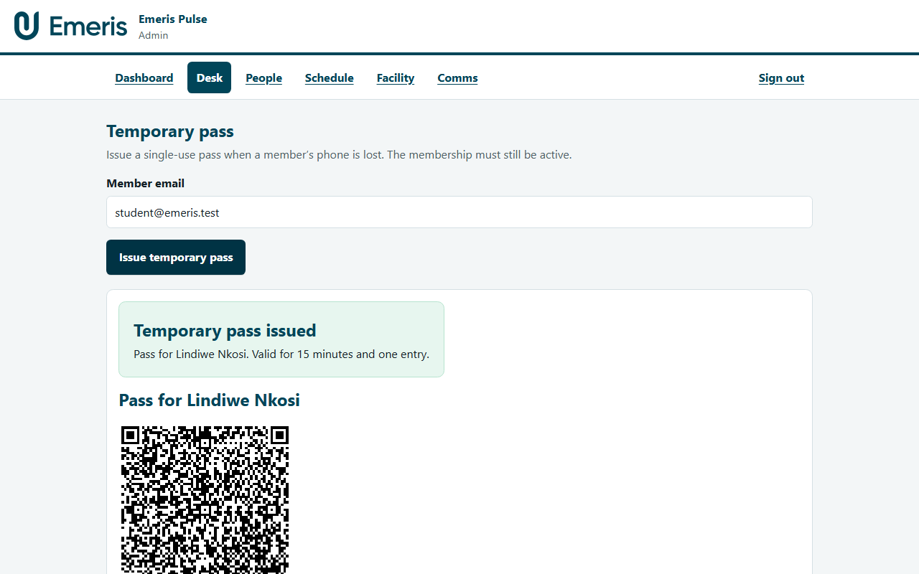
Temporary pass issued
QR shown at the desk for the member who lost their phone.

Slide 36
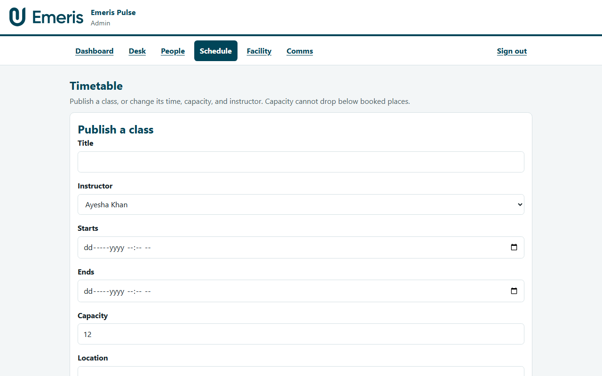
Timetable
Publish and edit classes. Capacity cannot fall below booked places.

Slide 37
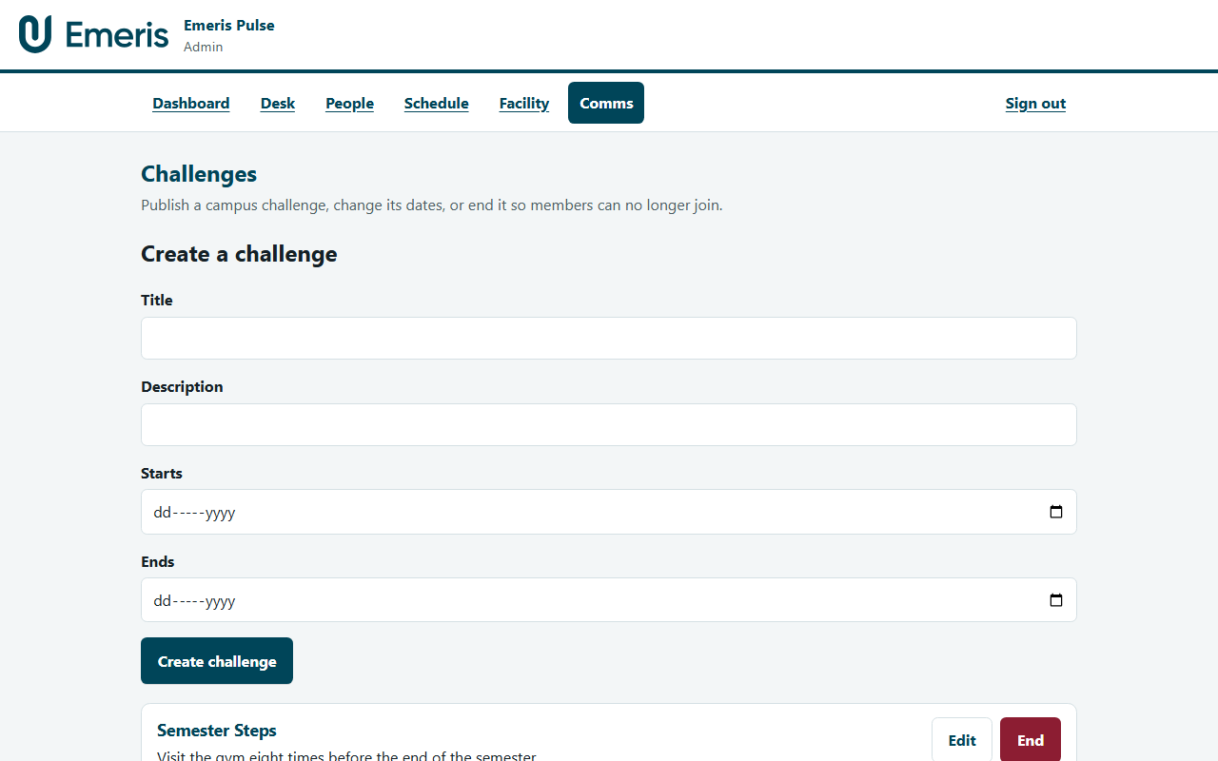
Challenges (admin)
Create and manage campus challenges; join counts visible.

Slide 38
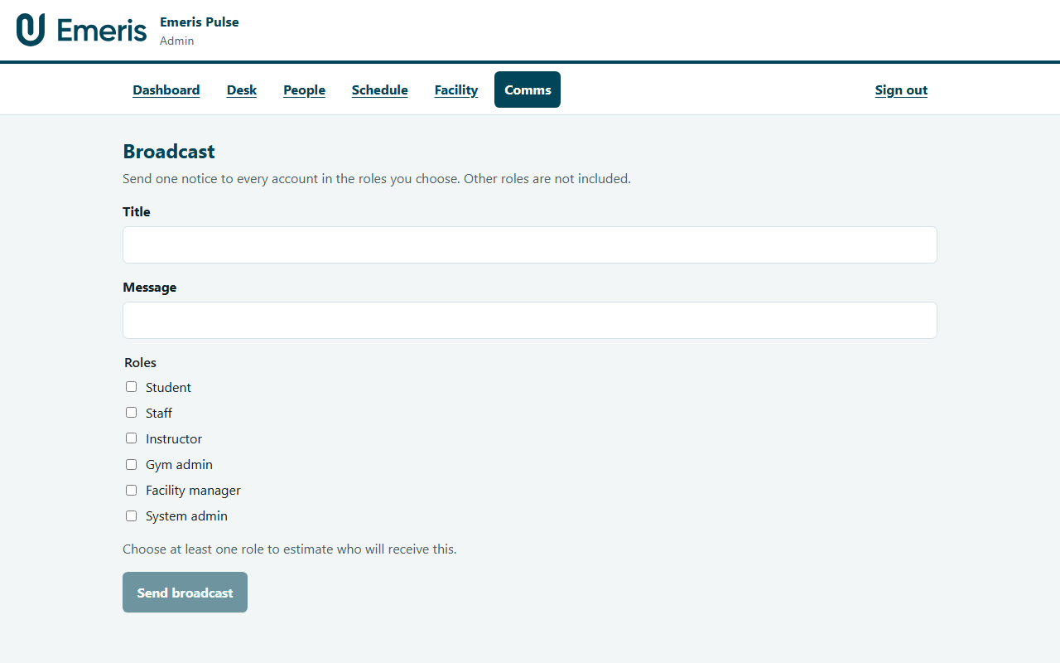
Broadcast
Role-targeted in-app notices. Confirm summarises the audience before send.

Slide 39
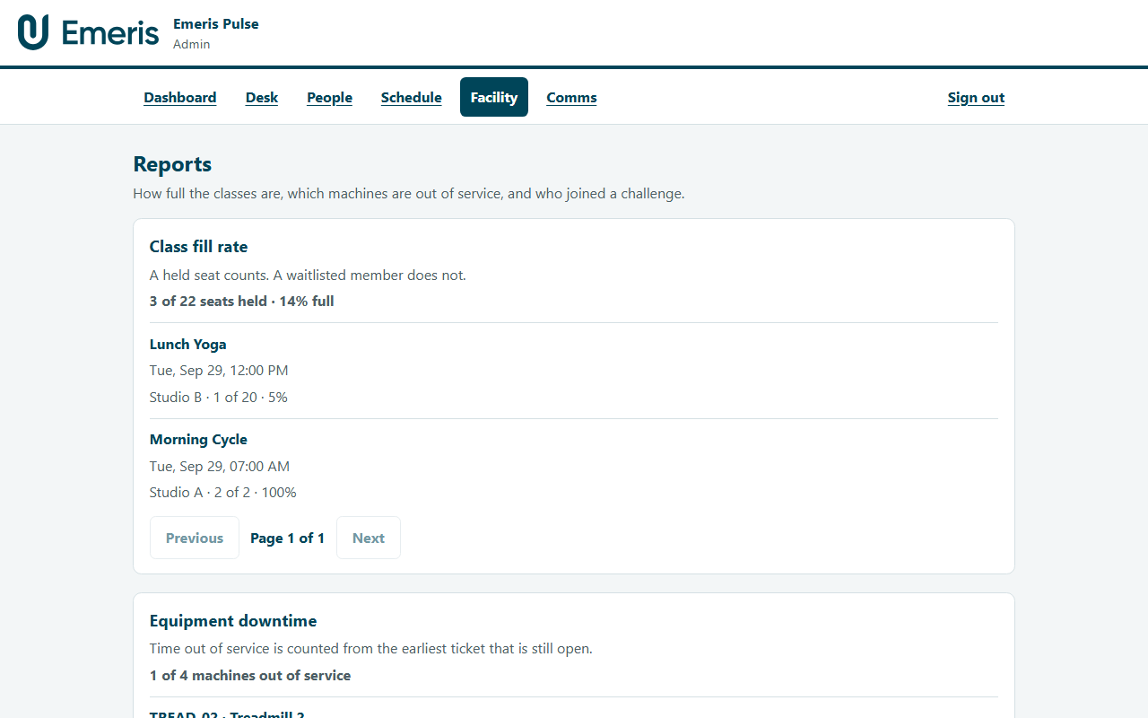
Reports
Class fill, equipment downtime, wellness participation.

Slide 40
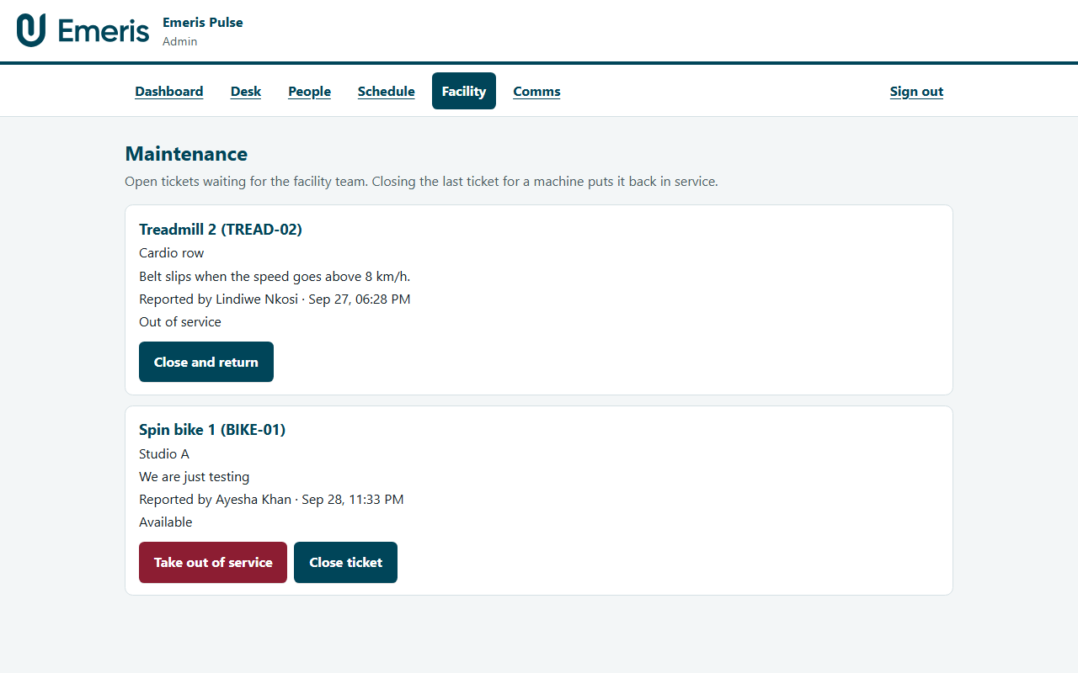
Maintenance
Open tickets; take out of service or close with confirmation.

Slide 41
Facility manager & system admin

Slide 42
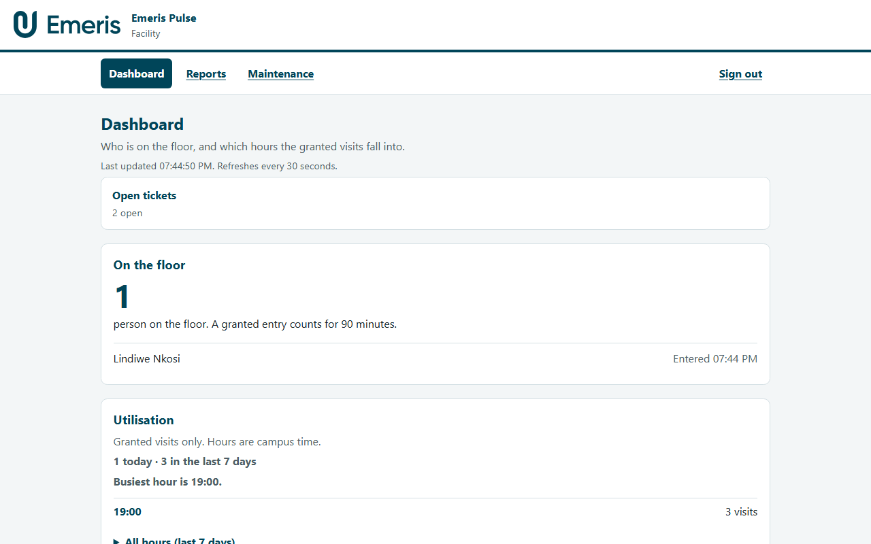
Facility dashboard
Facility managers see Dashboard, Reports, and Maintenance only.

Slide 43
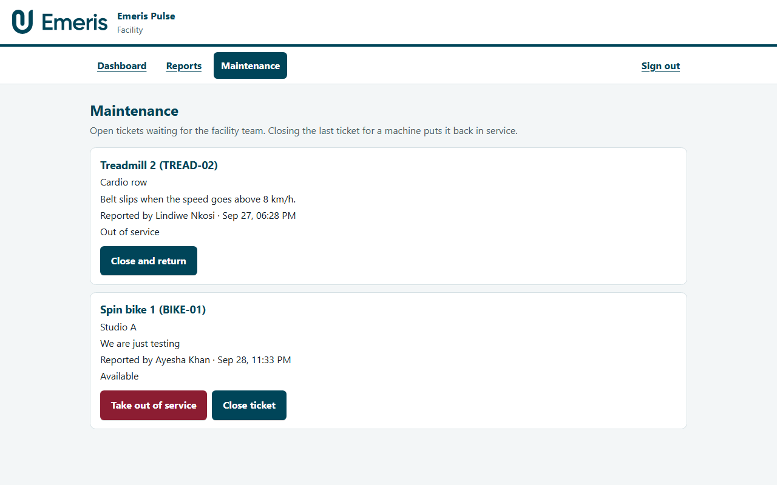
Facility maintenance
Same ticket queue — desk actions stay with gym administrators.

Slide 44
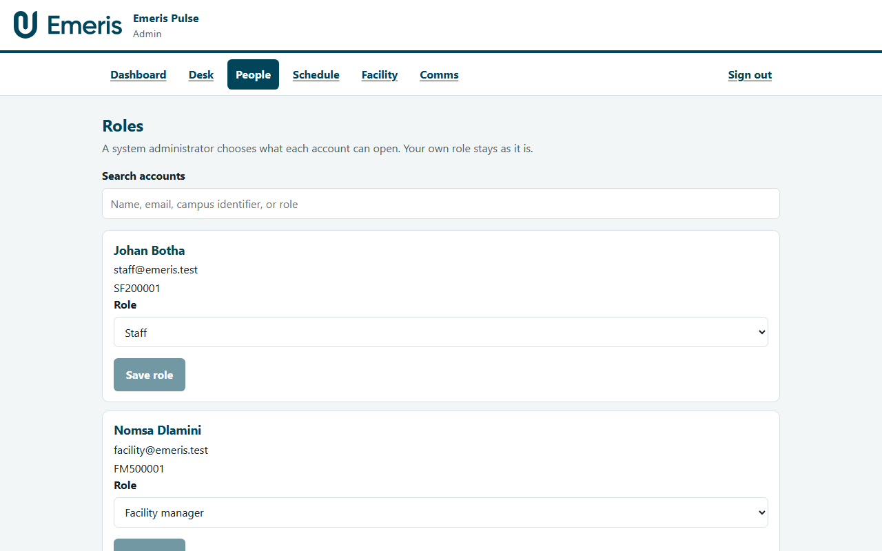
Roles
System admin assigns roles. They cannot change their own role.

Slide 45
Data model (ERD)
Users hold Memberships, AccessPasses, Bookings, EquipmentSessions, ChallengeEnrolments, Notifications
AccessEvents link passes to granted or refused door scans
ClassSessions have Bookings; Equipment has MaintenanceTickets
Full diagram: docs/erd.md in the repository

Slide 46
Security & POPIA
Passwords hashed with bcrypt; short-lived JWT + rotating refresh tokens
Role checks on every protected route; Zod validation on bodies
HTTPS on all hosted sites; Helmet CSP; CORS allow-list for the three apps
Rate limits on login and pass redeem
Membership, access, and wellness data used only for gym operations — not marketing

Slide 47
Delivery
Pull requests into develop and main run typecheck, domain tests, and API tests
Merge to main builds and deploys API + three web apps to Azure
Source and README: GitHub repo (ARC hand-in is the GitHub link)

Slide 48
Thank you
Questions — Emeris Pulse · member · instructor · admin

