Slide 1
Predicting Biodegradability of Chemicals
Aleksander Piciga, Vid Hanžel

Slide 2
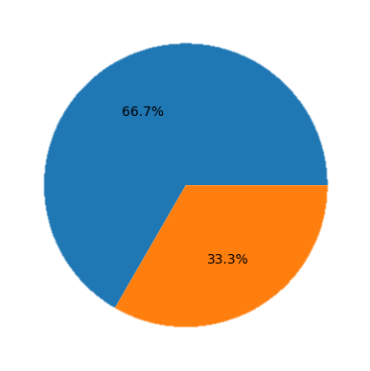
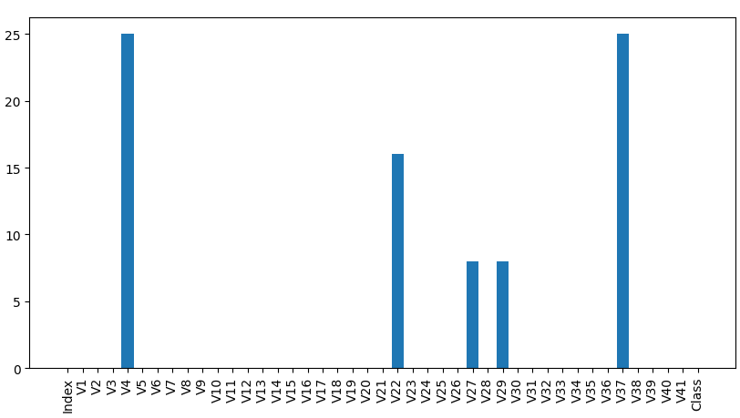
Exploration
1
2
Target value distribution
NaNs in columns

Slide 3

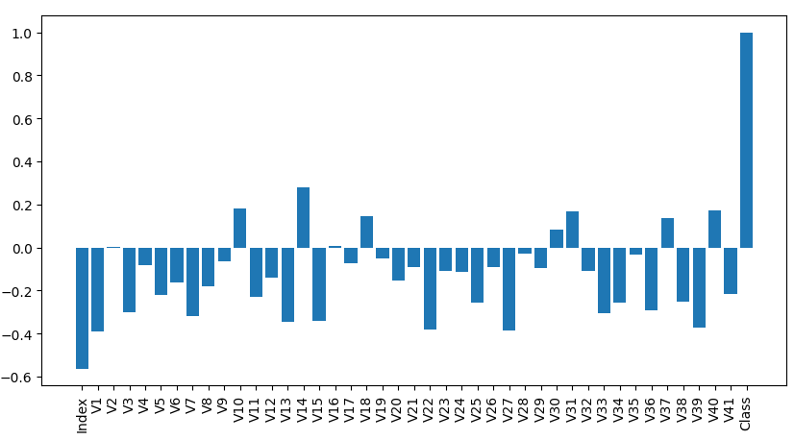
Correlation to class variable

Slide 4
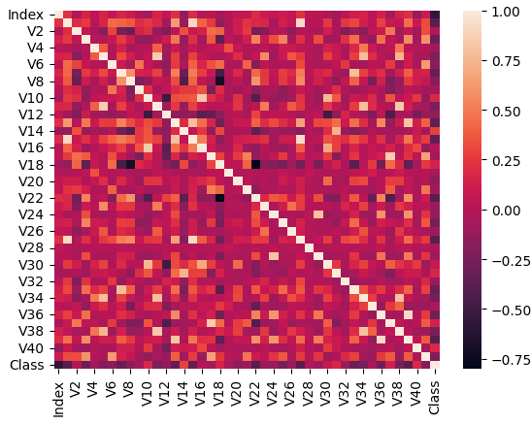
Data correlation heatmap

Slide 5
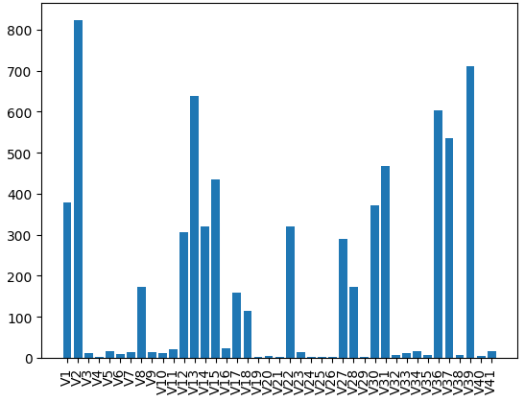
Number of unique values per column

Slide 6
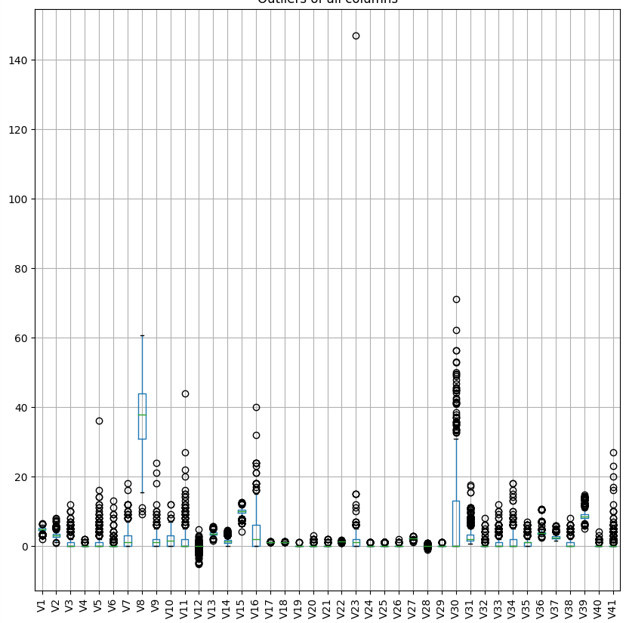
Outliers in data

Slide 7
Data preprocessing
Drop rows with NaN values
Replaced NaNs with mean
Remove outliers in data
Polynomial feature transformation

Slide 8
Classifiers
Random
Majority
Naïve Bayes
Logistic regression
Decision tree

Slide 9
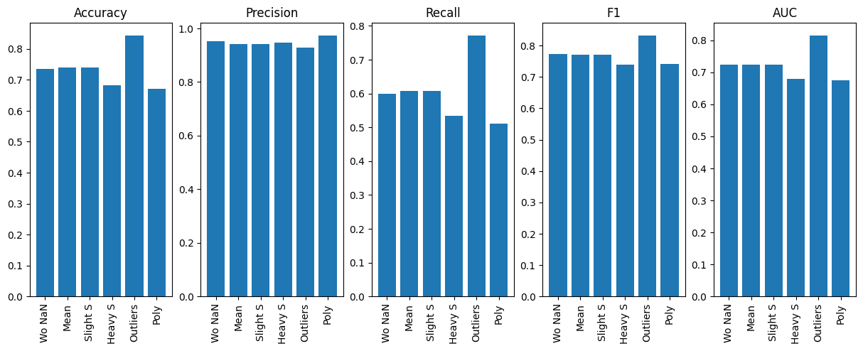
Naïve bayes
Without NaN values
NaNs replaced with mean
Slight variance smoothing
Heavy variance smoothing
Remove outliers in data
Feature construction using Polynomial Transform

Slide 10
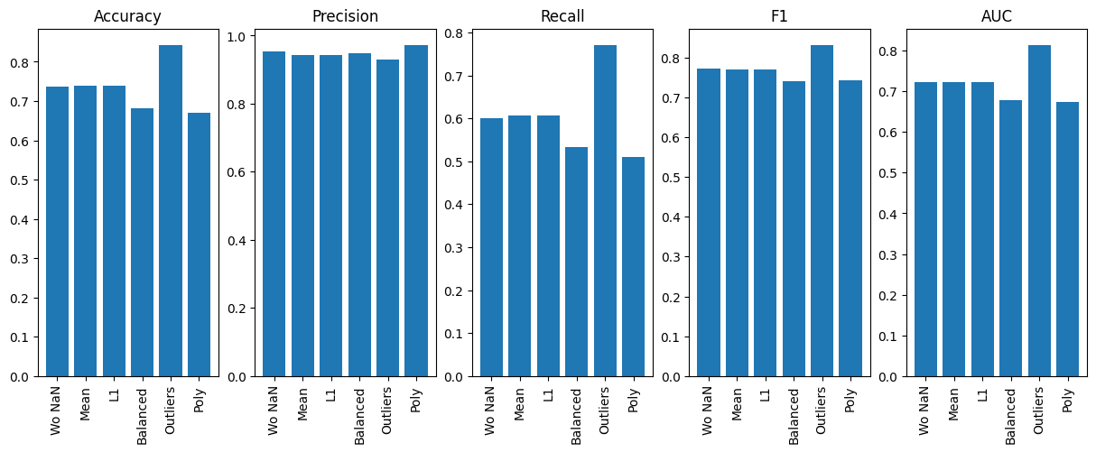
Logistic regression
Without NaN values
NaNs replaced with mean
Using L1 penalty and liblinear solver
Balanced class weights
Remove outliers in data
Feature construction using Polynomial Transform

Slide 11

Decision tree
Without NaN values
NaNs replaced with mean
Limited height
Pruning enabled
Remove outliers in data
Feature construction using Polynomial Transform

Slide 12
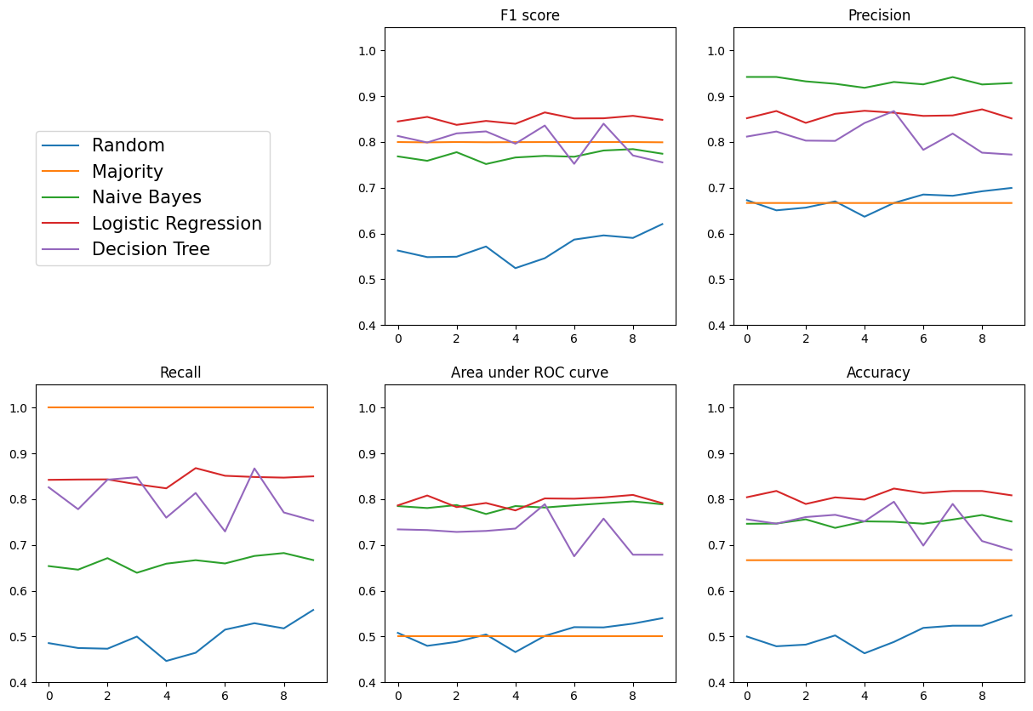
Evaluation

Slide 13
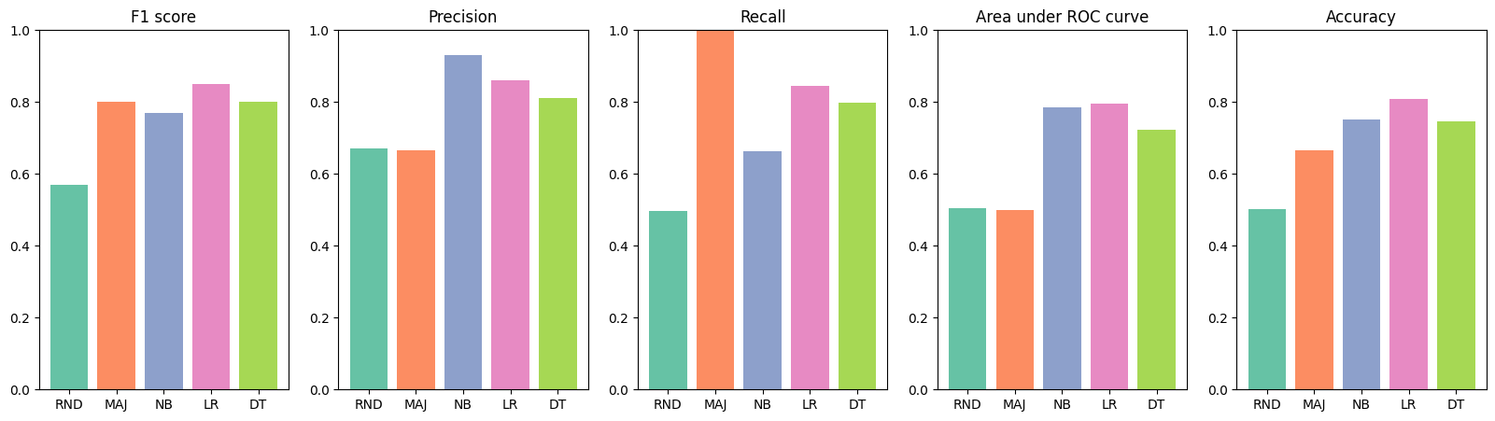
Mean results of all runs

Slide 14
Conclusion
Logistical regression
F1: 0.9
Precision: 0.9
Recall: 0.9
AUC: 0.86
Accuracy: 0.88
Naïve Bayes
F1: 0.8
Precision: 0.98
Recall: 0.67
AUC: 0.82
Accuracy: 0.78

