Slide 1
STATISTICAL PROJECT REPORT
Digital Behaviour
Archetypes
Clustering, PCA, and Classification Analysis
Dataset: 500 observations
Purpose
Identify digital behaviour profiles and assess their relationship with wellbeing.

Slide 2
DIGITAL BEHAVIOUR ARCHETYPES
02
Project overview and objectives
The study moves from clean data to interpretable behavioural segments and model evaluation.
1
2
3
4
5
6
→
→
→
→
→
Data Quality
EDA
Feature Engineering
K-Means
PCA
Classification
Objectives
•
Assess data quality and relationships with digital wellbeing.
Key result
•
Identify exploratory digital behaviour archetypes.
Three archetypes were selected. Random Forest distinguished them with 93.88% test accuracy.
•
Visualise and classify the resulting clusters.

Slide 3
DIGITAL BEHAVIOUR ARCHETYPES
03
Dataset and data quality
500 records · 9 numeric variables · 0 missing values · 0 duplicate records
Digital exposure | Cognitive / wellbeing
Daily screen time | Focus score
App switches | Mood score
Sleep hours | Anxiety level
Notifications | Digital wellbeing
Social-media time
Data readiness
All variables were complete and numeric, supporting a clean exploratory modelling workflow.

Slide 4
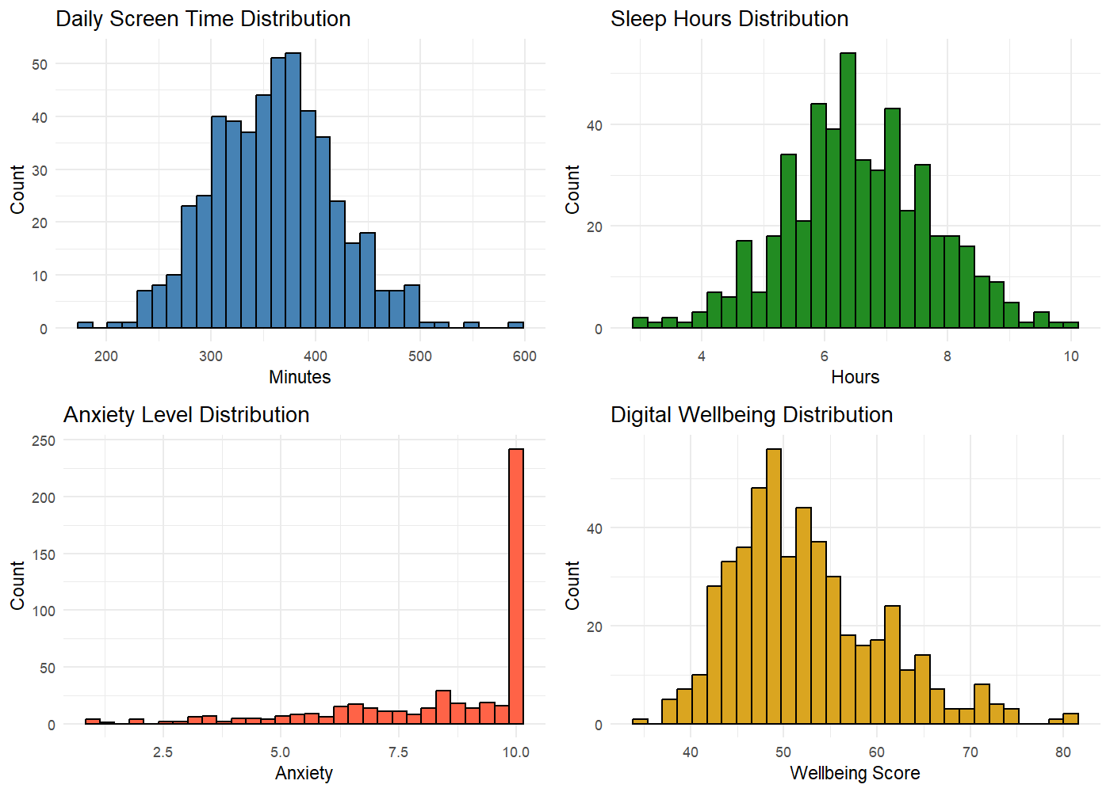
DIGITAL BEHAVIOUR ARCHETYPES
04
Descriptive statistics and distributions
Screen time
360.44 min average
Sleep
6.56 hours average
Anxiety
8.45 average
Wellbeing
52.31 average
Anxiety values are concentrated toward the upper end of the scale.

Slide 5
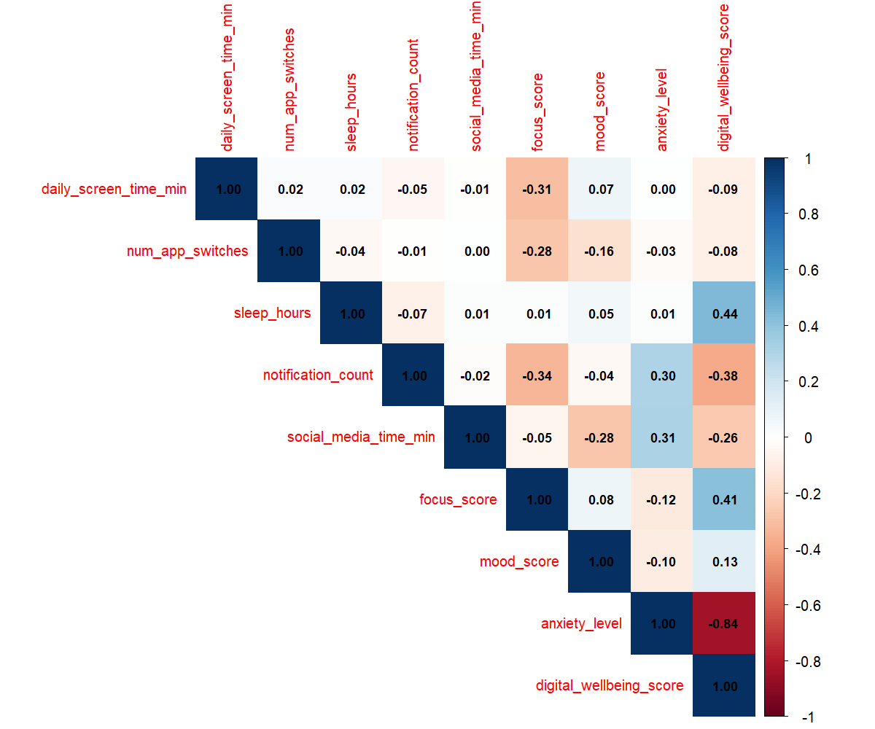
DIGITAL BEHAVIOUR ARCHETYPES
05
Correlation analysis: what relates to wellbeing?
Strongest associations with digital wellbeing
Variable | r
Anxiety level | -0.836
Sleep hours | 0.440
Focus score | 0.411
Notification count | -0.380
Social-media time | -0.263
Takeaway
Anxiety is by far the strongest negative correlate of digital wellbeing.

Slide 6
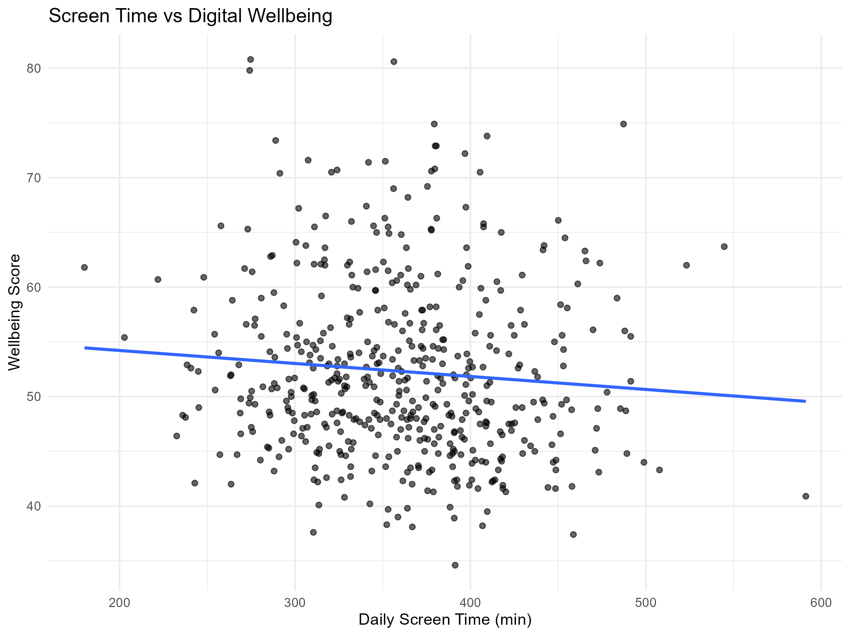
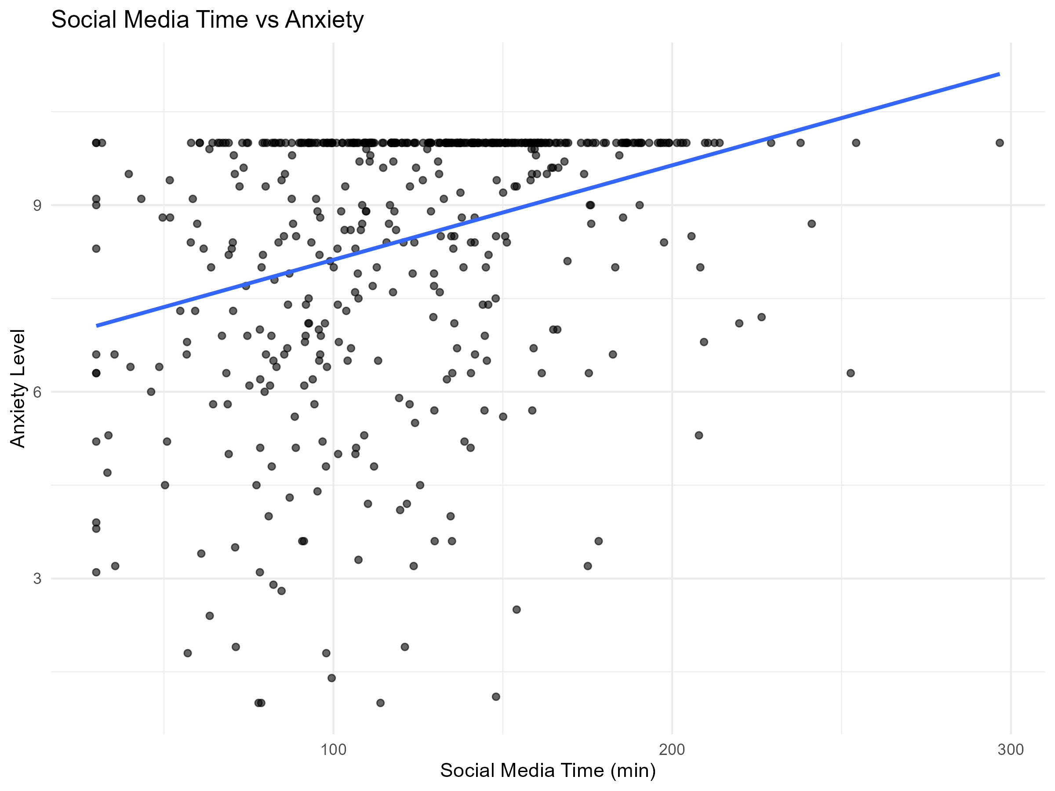
DIGITAL BEHAVIOUR ARCHETYPES
06
Key behaviour-wellbeing relationships
Screen time
Social media
Weak negative relationship with wellbeing.
Positive relationship with anxiety.
Interpret as descriptive associations; the analysis does not establish causation.

Slide 7
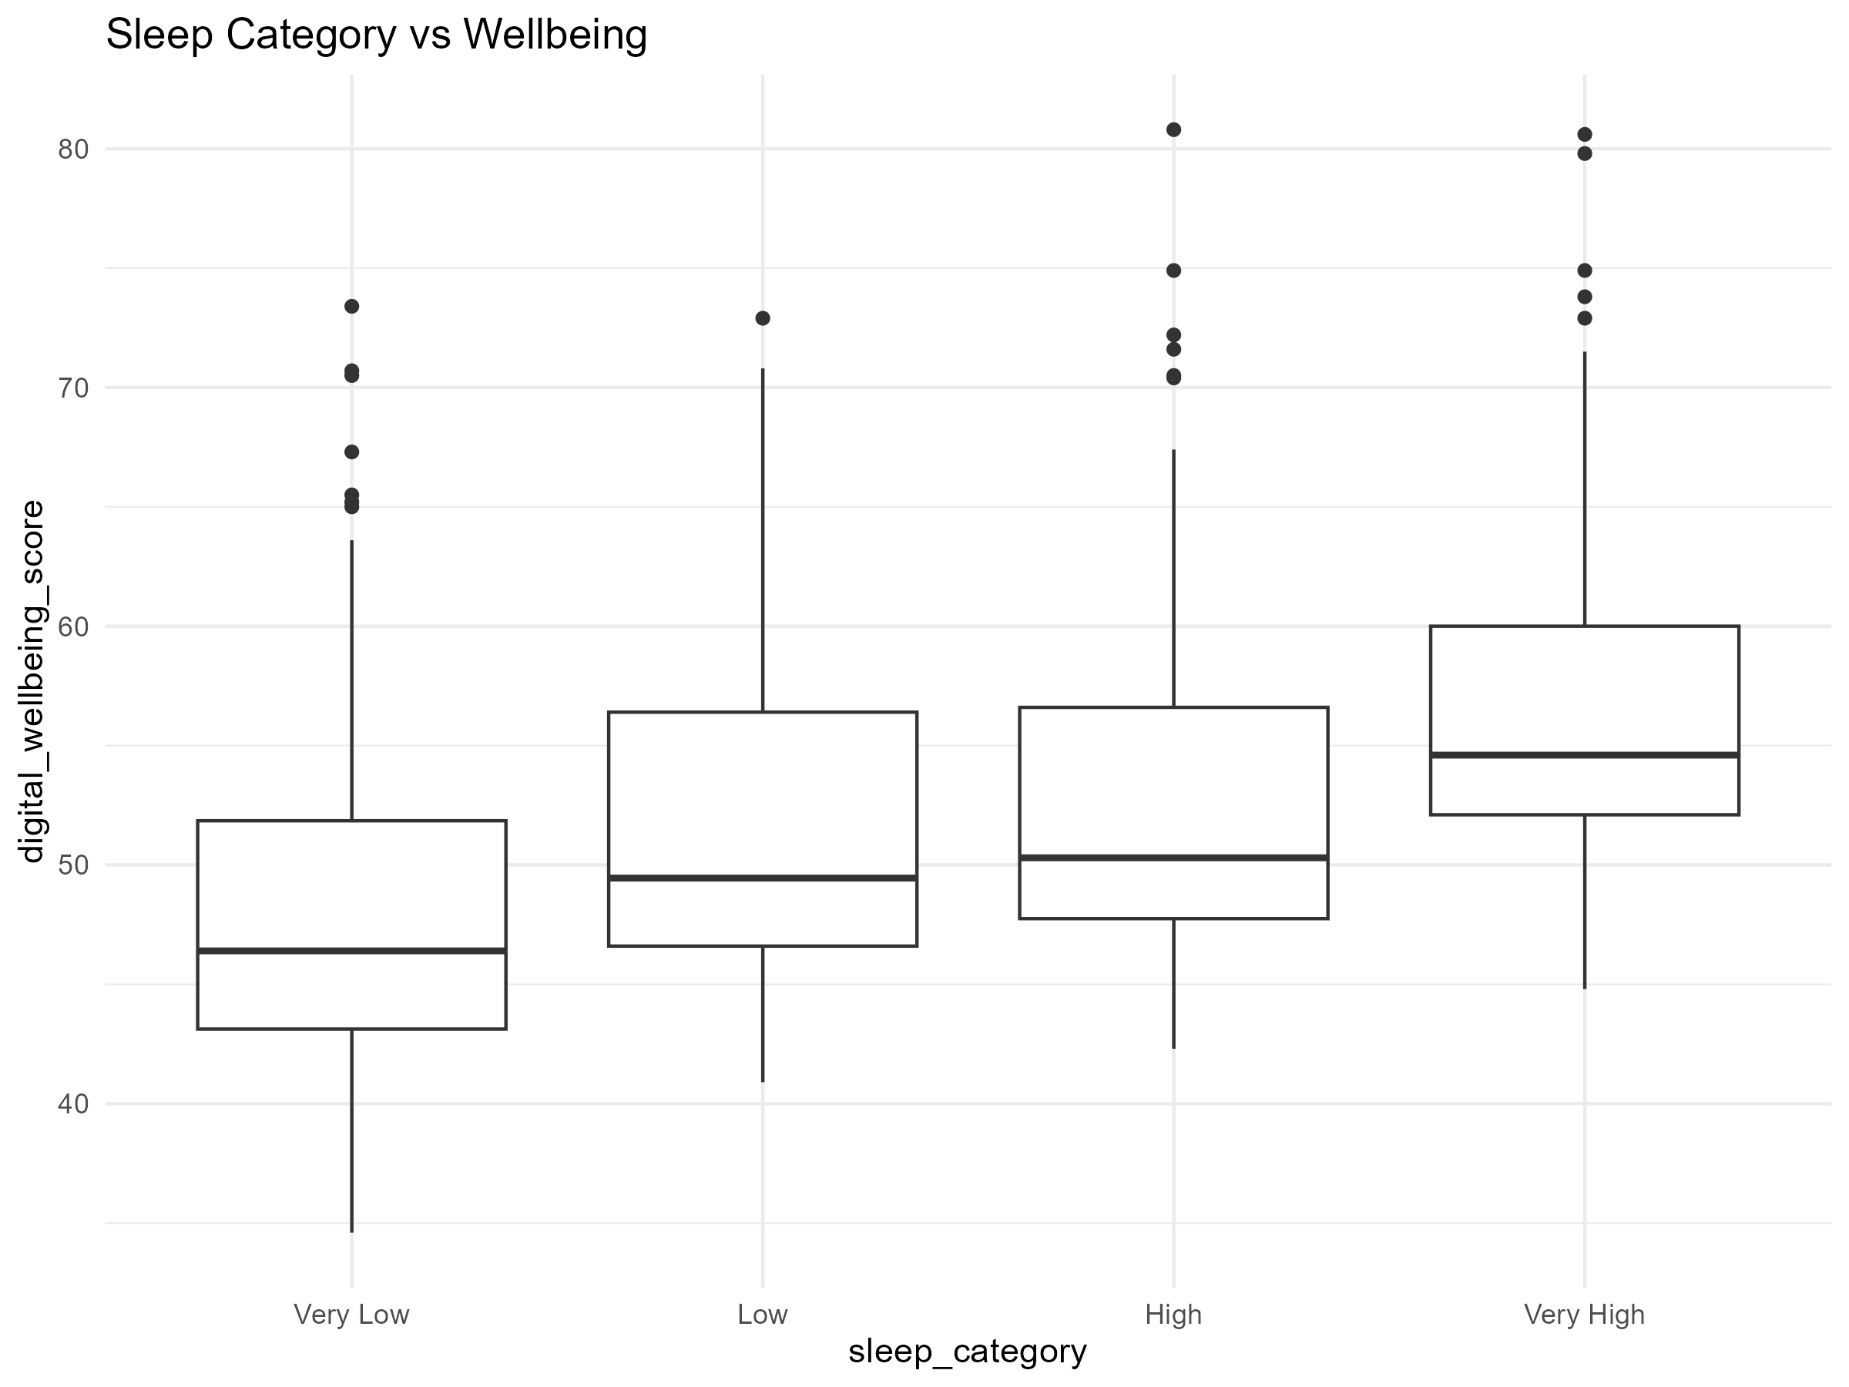
DIGITAL BEHAVIOUR ARCHETYPES
07
Sleep and digital wellbeing
Pattern
Median wellbeing rises across higher sleep categories.
Evidence
Sleep hours have a moderate positive correlation with wellbeing: r = 0.440.
Interpretation
Sleep is one of the strongest positive wellbeing-related variables in this dataset.

Slide 8
DIGITAL BEHAVIOUR ARCHETYPES
08
Feature engineering and scaling
Derived behavioural indicators make usage patterns easier to compare.
df <- df %>%
mutate(
social_media_share = social_media_time_min / daily_screen_time_min,
screen_sleep_ratio = daily_screen_time_min / sleep_hours
)
Social-media share
Average: 0.347
Screen-to-sleep ratio
Average: 56.993
Notification intensity
Average: 13.634
Standardisation
All clustering inputs were scaled to mean approximately 0 and standard deviation approximately 1.

Slide 9
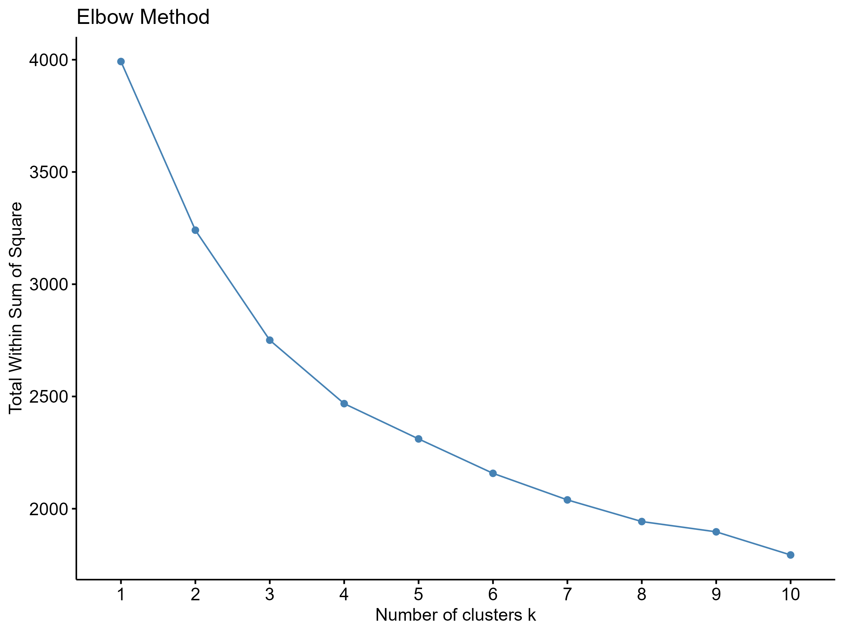
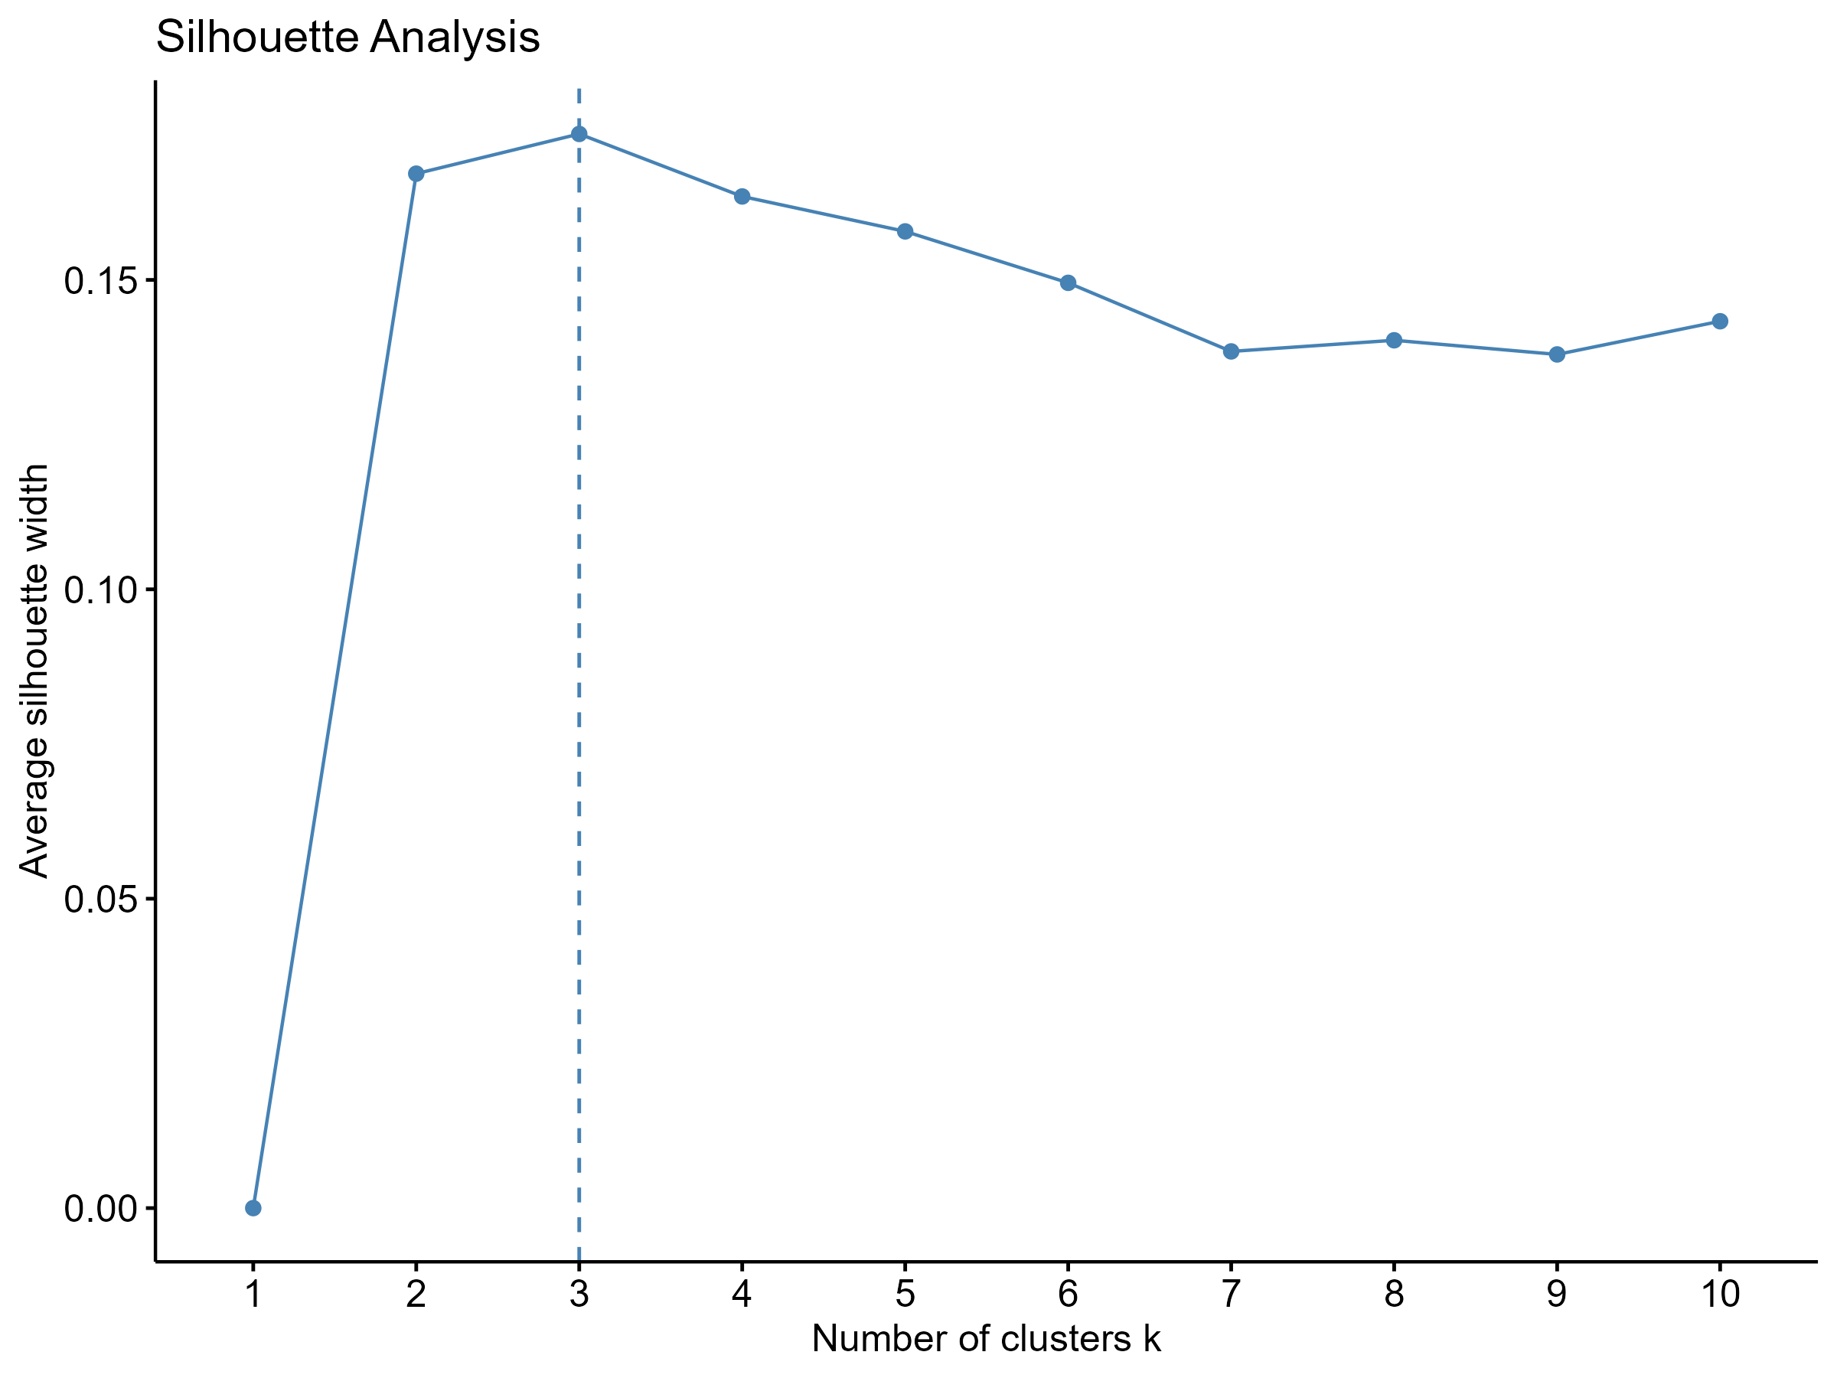
DIGITAL BEHAVIOUR ARCHETYPES
09
Selecting the number of clusters
Decision
k = 3 produced the highest tested silhouette score: 0.1736.
Caution: the score is modest, so the clusters are exploratory segments rather than sharply separated natural groups.

Slide 10
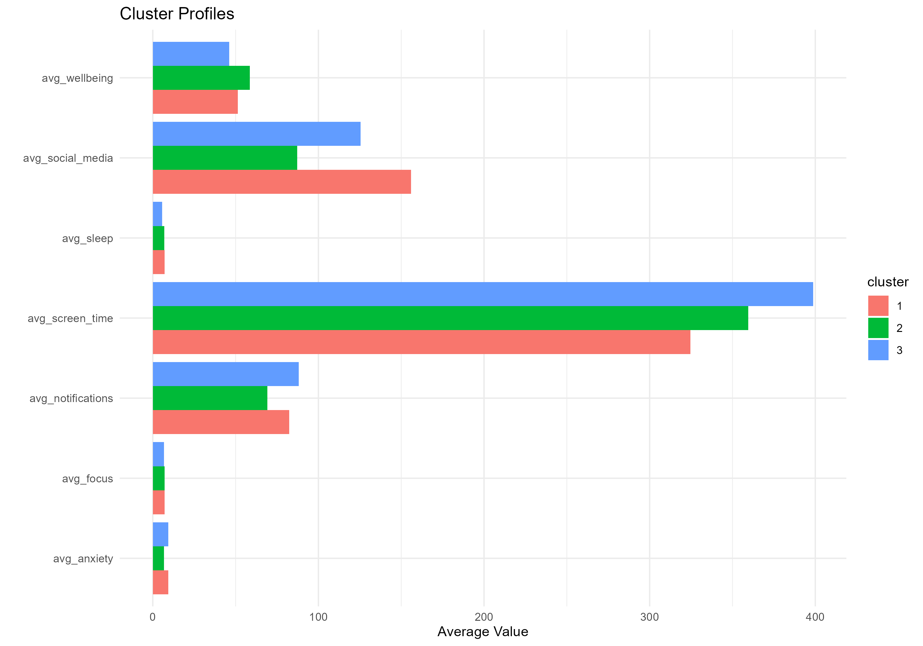
DIGITAL BEHAVIOUR ARCHETYPES
10
Three digital behaviour archetypes
Cluster | Profile | Wellbeing | Anxiety | Sleep
1 | High social media | 51.41 | 9.42 | 7.06
2 | Higher wellbeing | 58.58 | 6.85 | 6.90
3 | High screen, low sleep | 46.10 | 9.27 | 5.65
Cluster sizes: 1 = 164 · 2 = 179 · 3 = 157
Times are minutes except sleep, measured in hours.

Slide 11
DIGITAL BEHAVIOUR ARCHETYPES
11
Interpreting the three archetypes
Cluster 1
Cluster 2
Cluster 3
High social-media, high-anxiety users
• Social media: 155.84 min
• Anxiety: 9.42
• Wellbeing: 51.41
Lower social-media, higher-wellbeing users
• Social media: 87.25 min
• Anxiety: 6.85
• Wellbeing: 58.58
High screen-time, low-sleep users
• Screen time: 398.81 min
• Sleep: 5.65 hours
• Wellbeing: 46.10
Cluster names are descriptive labels for exploratory segments, not clinical diagnoses.

Slide 12
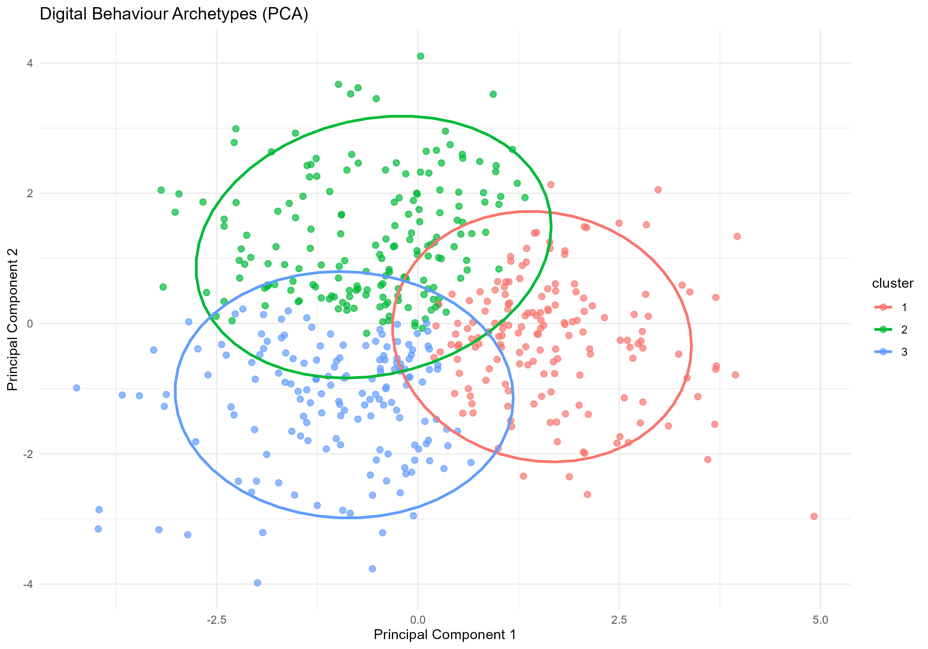
DIGITAL BEHAVIOUR ARCHETYPES
12
PCA visualisation of the archetypes
PC1
29.24% of variation
PC2
23.73% of variation
PC1 + PC2
52.97% together
The two-dimensional view separates the broad profiles, while visible overlap aligns with the modest silhouette score.

Slide 13
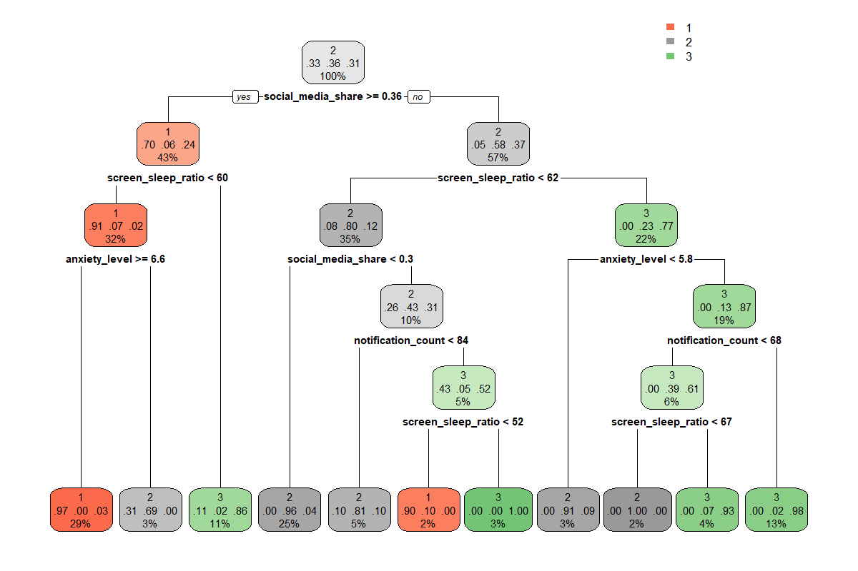
DIGITAL BEHAVIOUR ARCHETYPES
13
Classification models
A stratified 80/20 split was used to predict K-Means cluster membership.
Model | Accuracy | Kappa | F1 score
Decision Tree | 87.76% | 0.8161 | 0.8794
Random Forest | 93.88% | 0.9081 | 0.9383
Best model
Random Forest achieved the strongest performance across all reported metrics.
Decision Tree rules used to predict cluster membership.

Slide 14
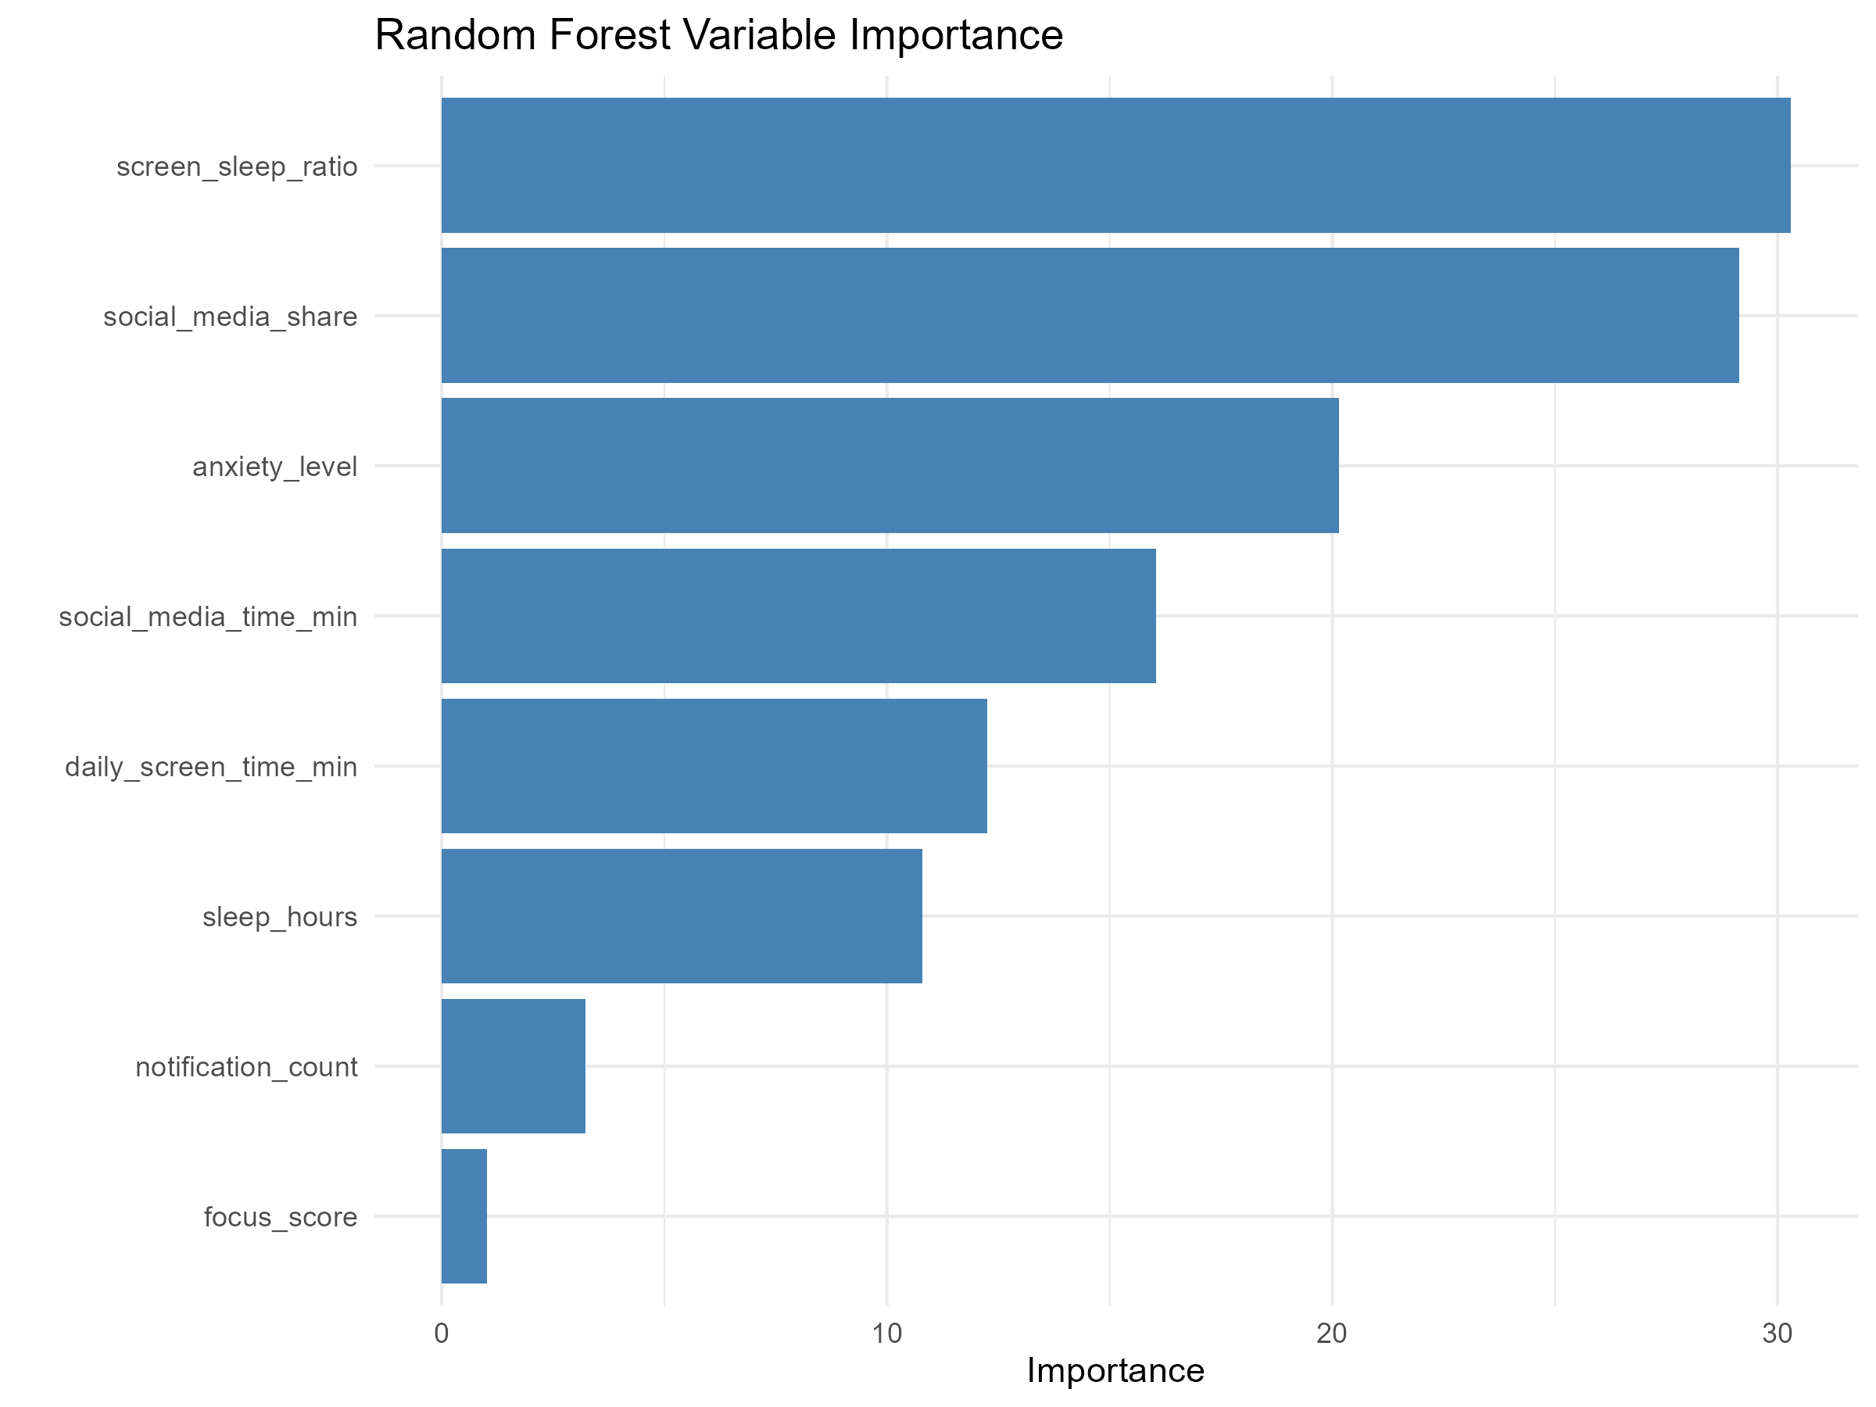
DIGITAL BEHAVIOUR ARCHETYPES
14
What most distinguishes the clusters?
Top predictors
1. Screen-to-sleep ratio
2. Social-media share
3. Anxiety level
4. Social-media time
5. Daily screen time
Method note
High accuracy reflects internal cluster distinguishability, not independent real-world prediction.

Slide 15
CONCLUSION
Three patterns,
one clear message.
Wellbeing
Archetypes
Model
Lower anxiety, adequate sleep, and reduced social-media intensity align with better wellbeing.
Three exploratory behavioural profiles capture distinct combinations of sleep, screen time, social media, and anxiety.
Random Forest best distinguished the profiles, achieving 93.88% accuracy.
Limitations: observational design, modest cluster separation, and no causal conclusions.
Thank you

