Slide 1
Determination of the required Power Response of Inverters to provide fast Frequency Support in Power Systems with low Synchronous Inertia
Alejandro Rubio
15.04.2019

Slide 2





Determination of the required Power Response of Inverters to provide fast Frequency Support in Power Systems with low Synchronous Inertia
Motivation
“Energiewende”, contemplates to achieve a share in electricity consumption from renewables of 80 percent. As part of it, the renewable energy act, “Erneuerbare Energien Gesetz”, regulates the expansion of renewables and convectional generation decommissioning.

Slide 3






Challenges: More complicated as it sounds!
Technical
Social-Political
Economic

Slide 4
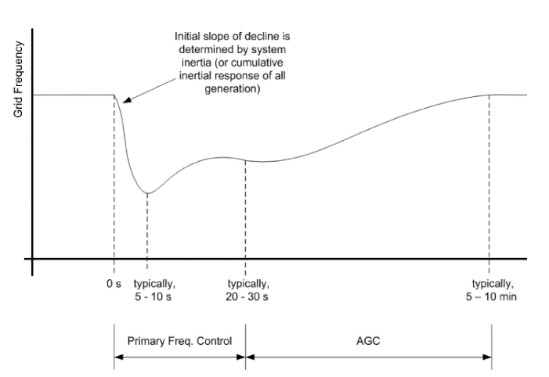
Technical Challenges
Frequency Stability
In conventional power systems, power balancing and frequency regulation is establish through the control of synchronous machines power output.
The balance between generation and load must be maintained so rotor speed and electric frequency are kept constant

Slide 5





Technical Challenges
Low Inertia grids
PV does not have rotating components
Low inertia from fixed speed wind turbines
Variable speed wind turbines are decoupled from grid dynamics due to the employment of power electronics converters.

Slide 6
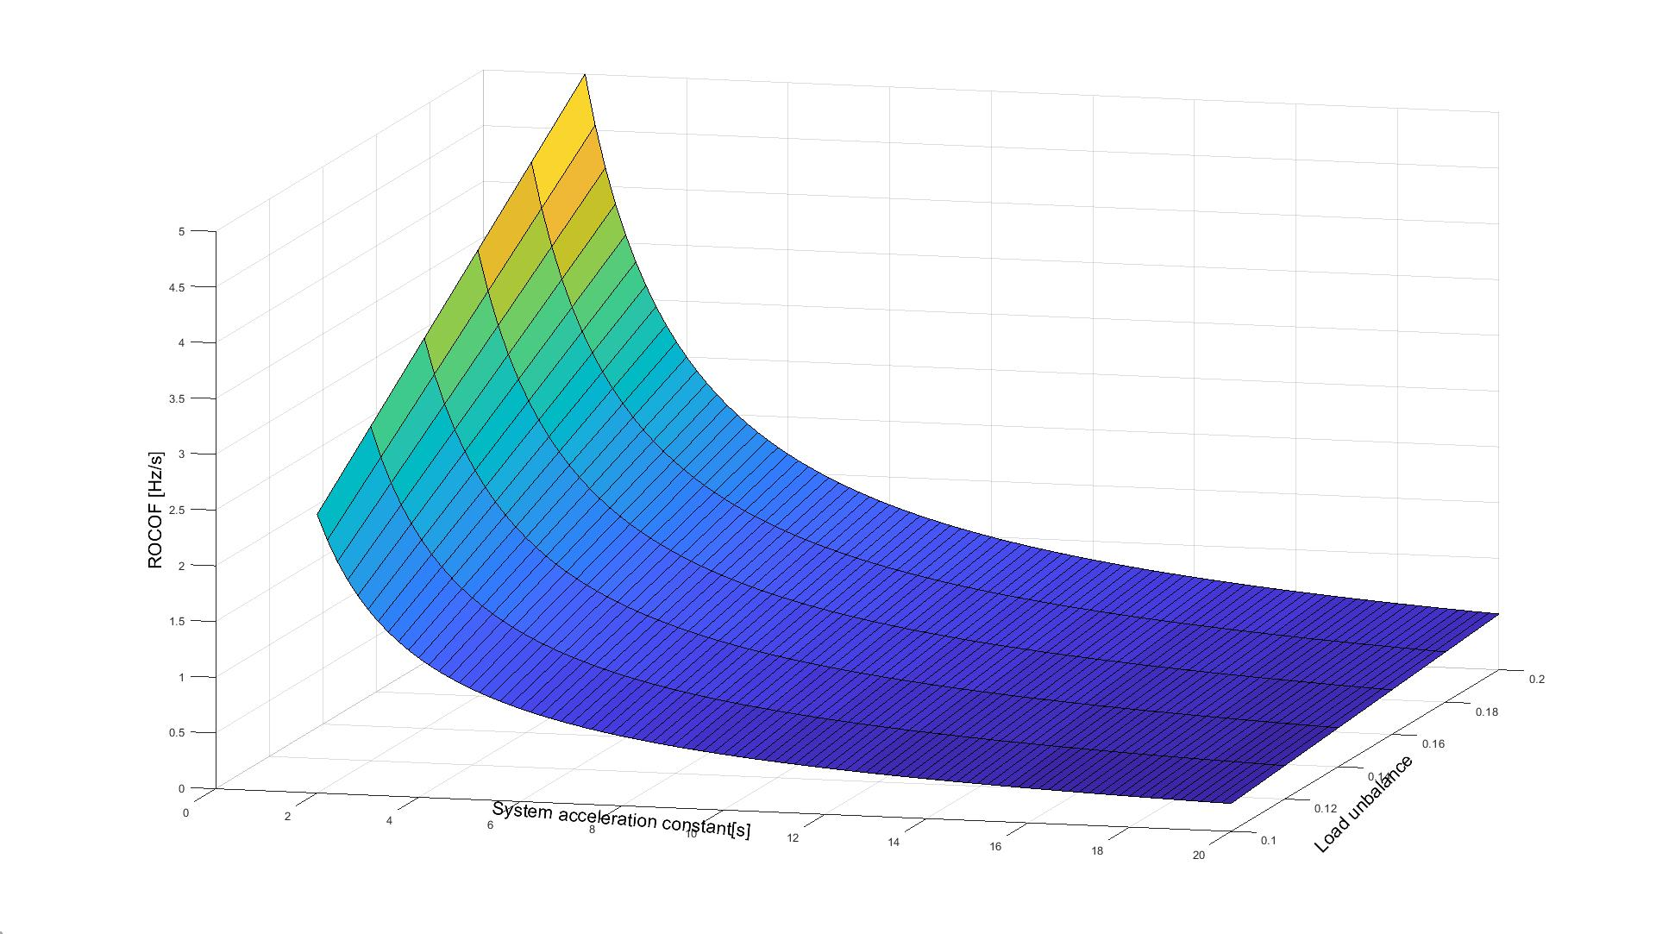
Fast Power Reserve
Max ROCOF for different system inertias and unbalances

Slide 7
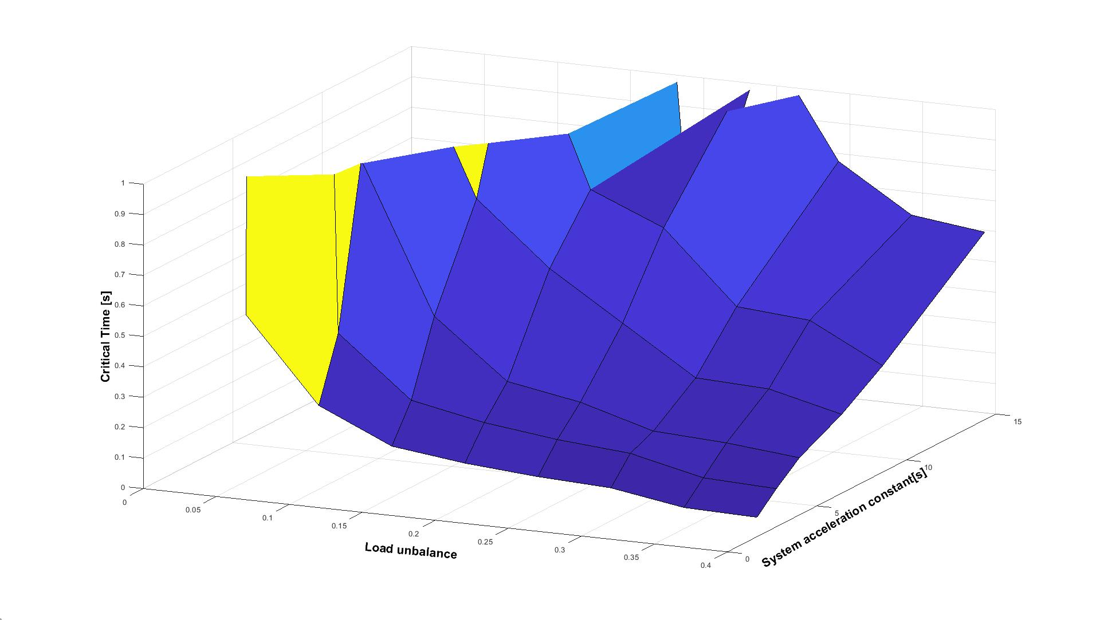
Fast Power Reserve
Critical Time (frequency collapse)

Slide 8
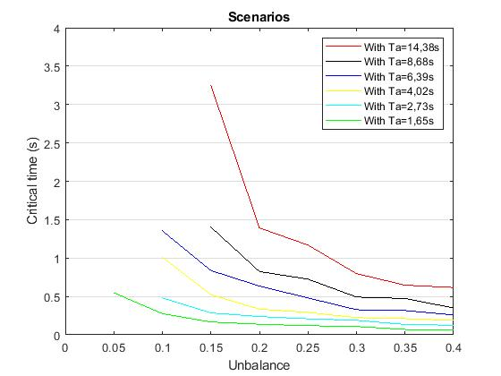
Fast Power Reserve
Critical Time (frequency collapse)

Slide 9
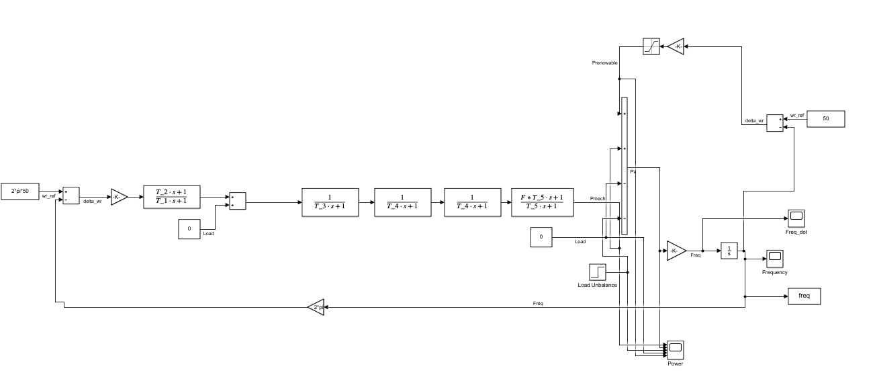
Fast Power Reserve
Control Block Diagram

Slide 10
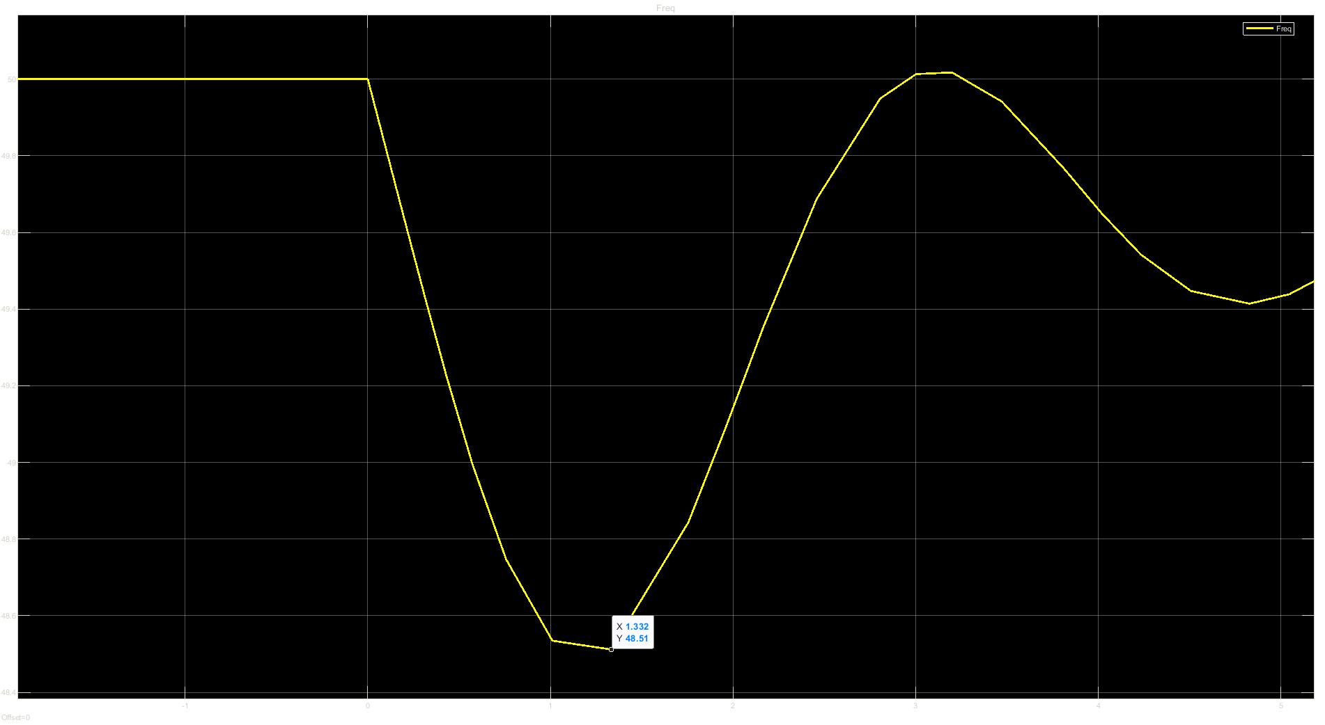
Fast Power Reserve
Frequency-10% unbalance and 2,736s of inertia

Slide 11
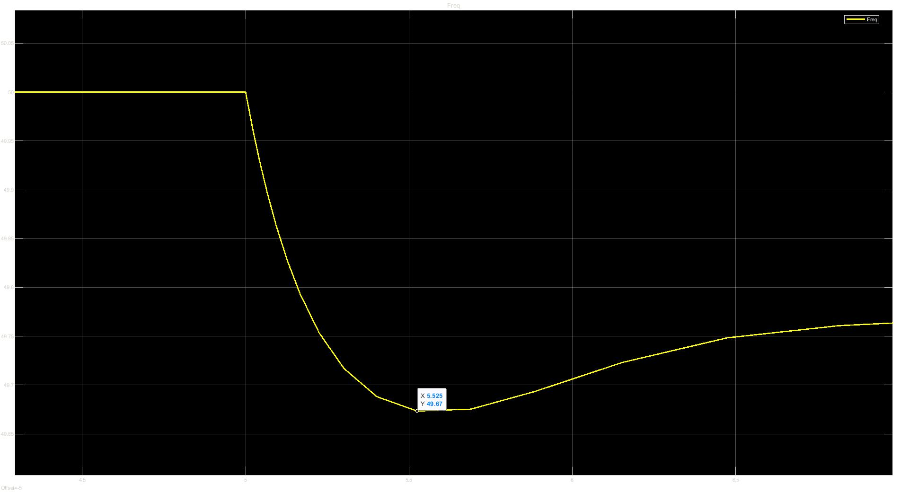
Fast Power Reserve
Frequency-10% unbalance and 2,736s of inertia with fast reserve (proportional control)

Slide 12
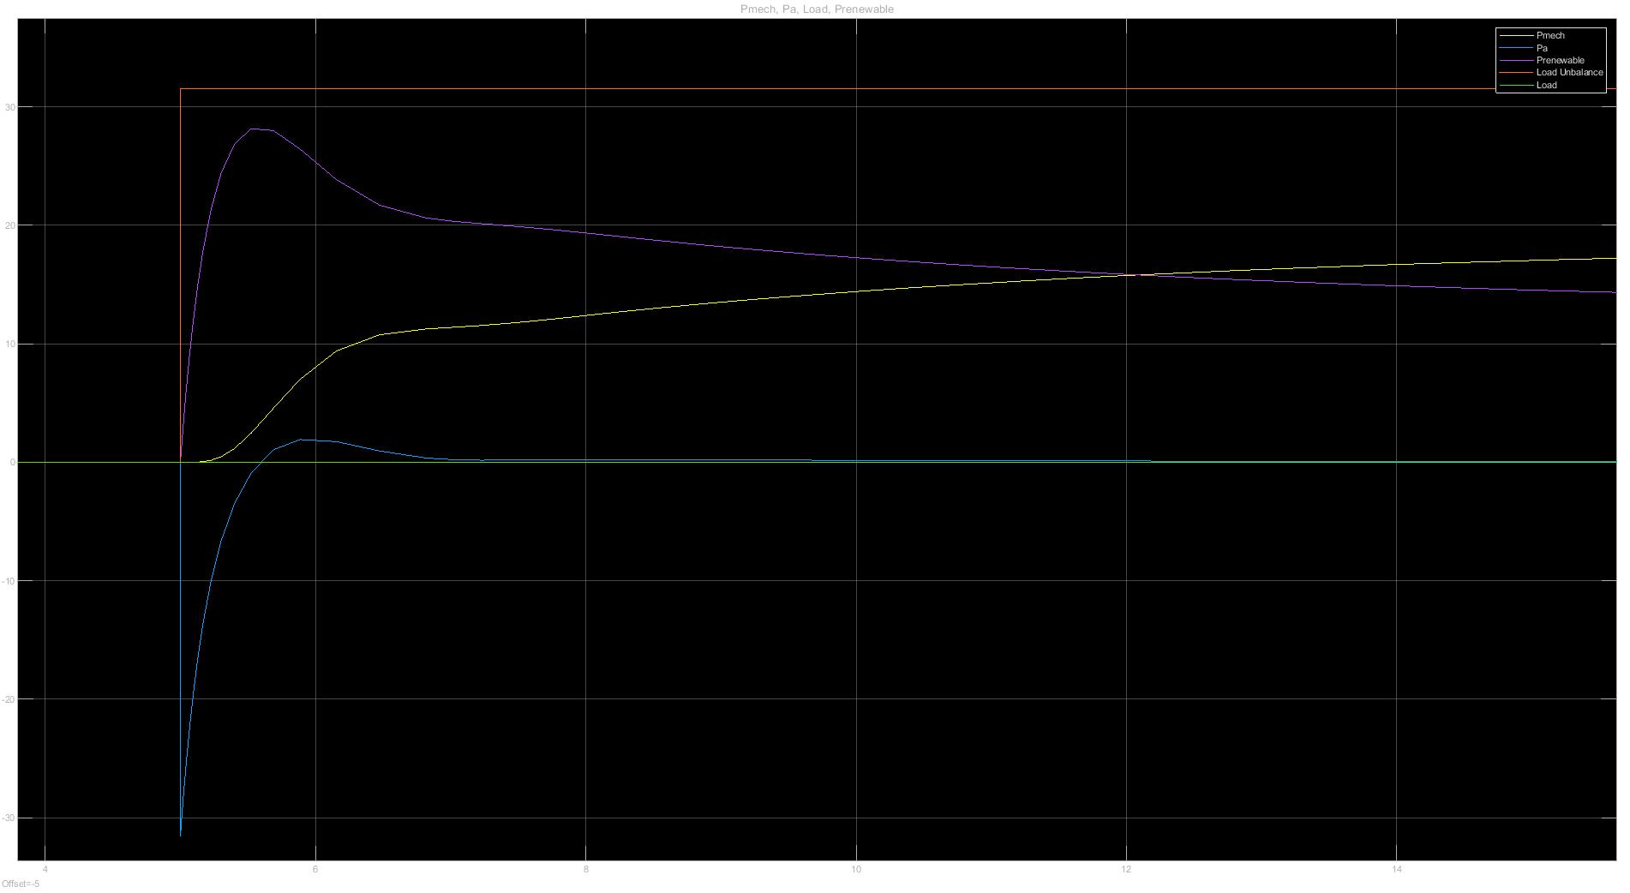
Fast Power Reserve
Power10% unbalance and 2,736s of inertia with fast reserve (proportional control)

