Slide 1
Determination of the required Power Response of Inverters to provide fast Frequency Support in Power Systems with low Synchronous Inertia
Alejandro Rubio
28.06.2019

Slide 2
Determination of the required Power Response of Inverters to provide fast Frequency Support in Power Systems with low Synchronous Inertia
Achievements
Institutskolloquium was good
In Progress
Synthetic inertia from wind in model
Next Steps
Challenges
Wrap up of results and analysis
Optimum share for RE reserve?

Slide 3
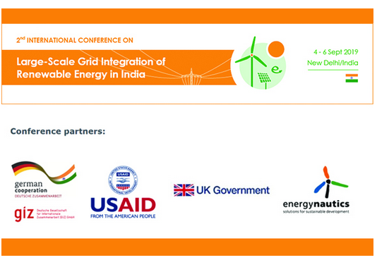
Determination of the required Power Response of Inverters to provide fast Frequency Support in Power Systems with low Synchronous Inertia
If it is of any interest…

