Slide 1

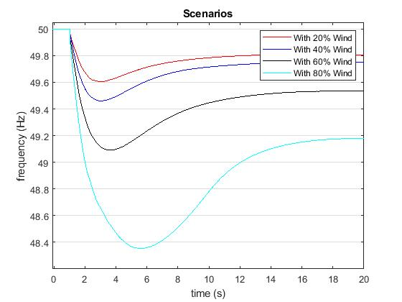
Determination of the required Power Response of Inverters to provide fast Frequency Support in Power Systems with low Synchronous Inertia
Alejandro Rubio
Oldenburg University
Abstract
State of the Art
Decommissioning of conventional power plants and the installation of inverter-based renewable energy technologies decreases overall power system inertia. This reduction in system inertia has an impact in the power system frequency response when an unbalance between generation and load occurs, increasing the rate of change of frequency of the system. In a future scenario where renewables are predominant in power systems and due to the natural variability of the resource, unbalances of 40 percent or more are prompt to happen, which combined with low inertia may lead to frequency collapse. The requirements of inverters to provide an effective fast reserve response are investigated. In this way, inverters are intended to reduce the rate of change of frequency so enough time is provided to activate the primary power reserve. Needed power rate under different inverter time responses and different rates of change of frequency is analyzed.
Power balancing- Synchronous generators
Lack of inertia to the system from RE
During normal operation frequency can change between 49.8Hz and 50.2Hz.
Load shedding starts at 49Hz.
Conventional system rely on inertial response, primary and secondary synchronous reserve for frequency and power balancing control.
On the other hand, some control techniques have been developed in order to allow renewables to participate in frequency regulation. This techniques are:
Synthetic Inertia
Fast Power reserve
De-loading
Droop-Characteristics
Figure 1. Frequency response under a 20% power unbalance.

Slide 2
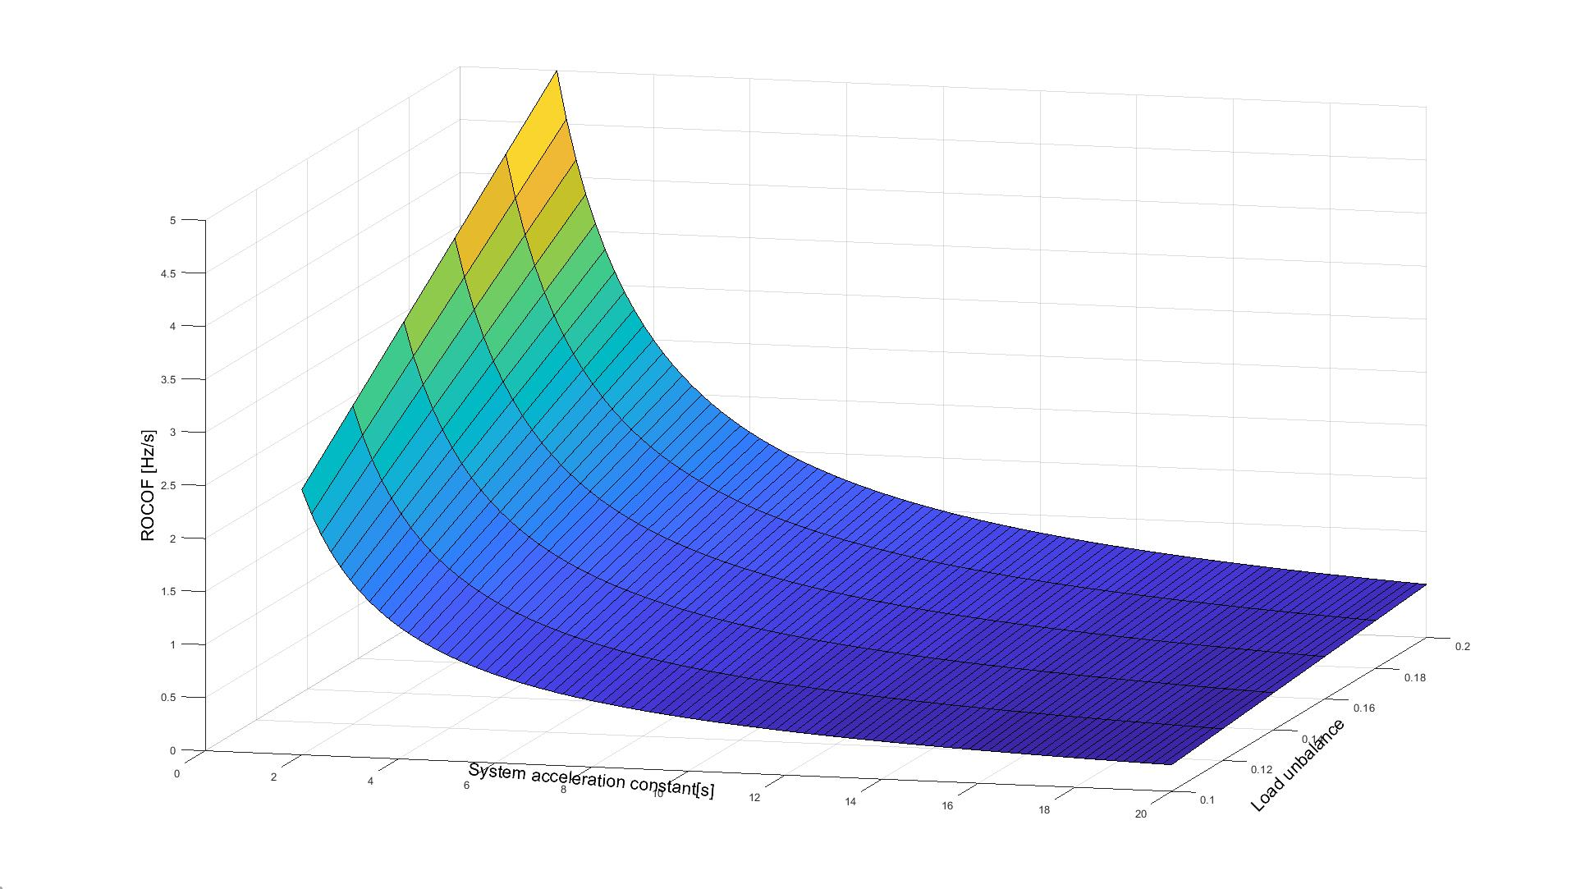

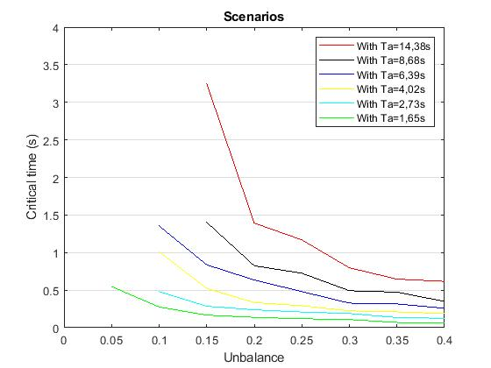
Determination of the required Power Response of Inverters to provide fast Frequency Support in Power Systems with low Synchronous Inertia
Alejandro Rubio
Oldenburg University
Preliminary Results
ROCOF reaches values between 3 and 5 Hz/s with combinations of acceleration constants in the range of 2 to 4s and system unbalance between 15 and 20%.
Preliminary Results
The inverters must be able to supply the power unbalance in less than 500ms.
Figure 2. Rate of Change of Frequency
Figure 3. Critical time to reach load shedding frequency

Slide 3
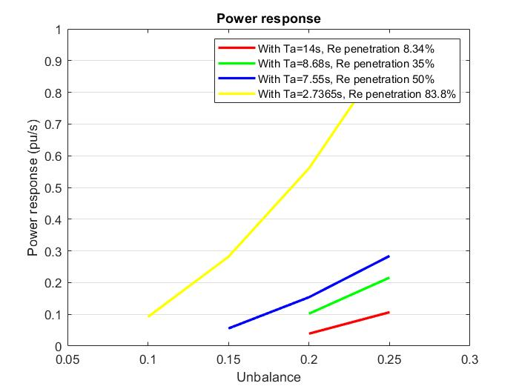
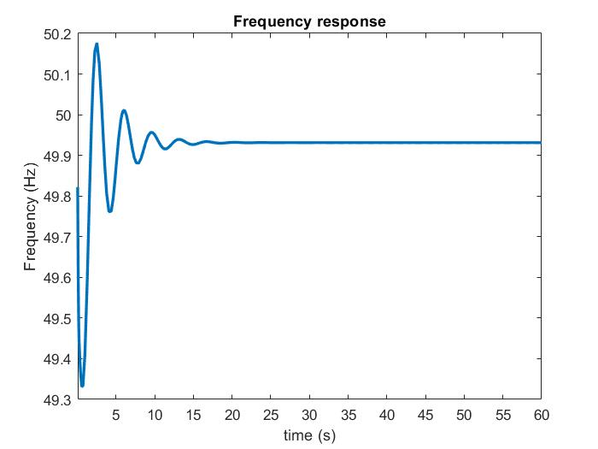
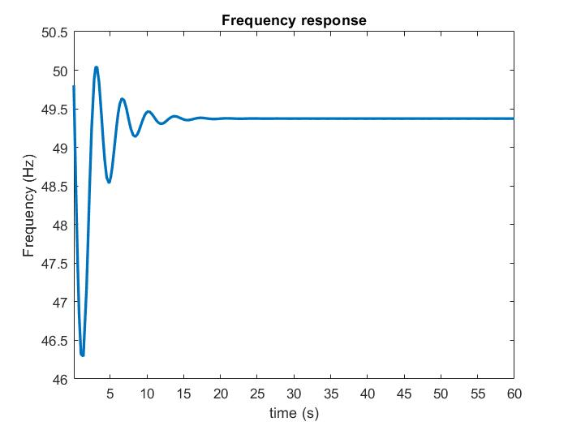

Determination of the required Power Response of Inverters to provide fast Frequency Support in Power Systems with low Synchronous Inertia
Alejandro Rubio
Oldenburg University
Preliminary Results
With the linearization of the system equation 1 was obtained and implemented in the model in order to prove its validity.
Where:
P(t): Power response
ΔP: Power unbalance
tcr: Critical time to reach shedding load frequency
tlm: Time of mechanical limit.
Figure 5 shows that a nadir frequency of 46.3Hz would be reached and a stable state frequency of 49.3Hz would be achieved when no power back up is given from renewables. On the other hand, figure 6 depicts the frequency response of the system with the fast power reserve from renewables. A considerable improvement in frequency nadir and stable state frequency can be noticed with values of 49.3Hz and 49.93Hz respectively.
P(t)$=\frac{∆P∗(1−\frac{t_{cr}}{t_{lm}})∗t}{t_{cr}}$
Eq 1.
Figure 4. Required power response from renewables.
Figure 6. Frequency response with reserve support from renewables with power unbalance of 25%.
Figure 5. Frequency response without reserve support from renewables with power unbalance of 25%.

Slide 4
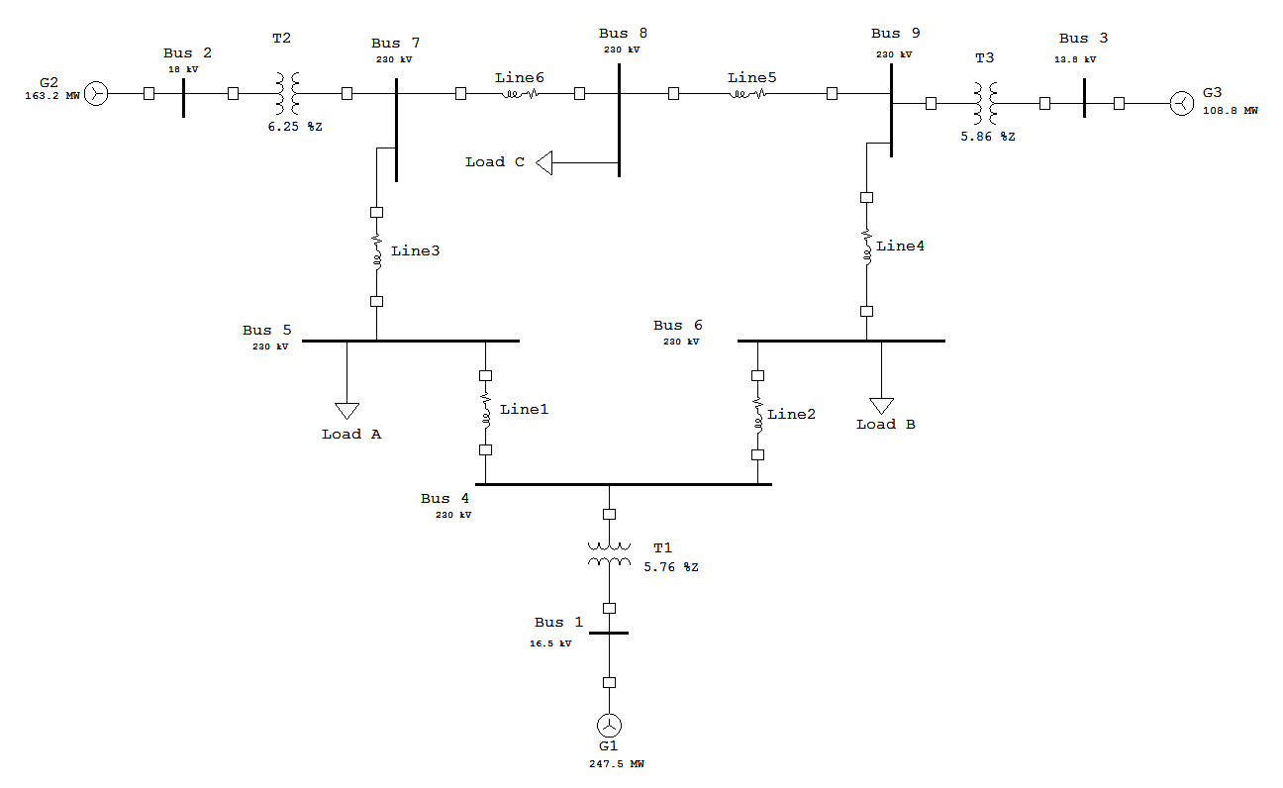
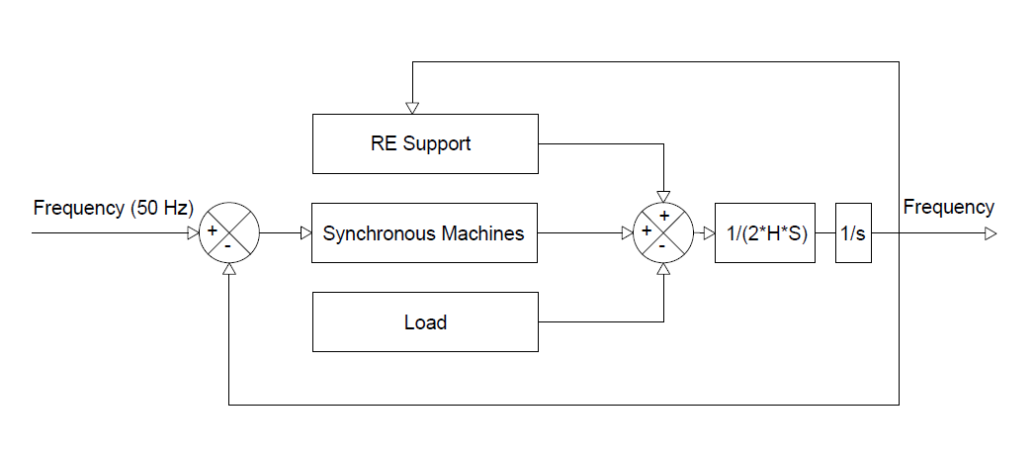
Determination of the required Power Response of Inverters to provide fast Frequency Support in Power Systems with low Synchronous Inertia
Alejandro Rubio
Oldenburg University
IEEE 9 bus System
Installed capacity 910.5MW
Total load 315MW.
Transformers 3
Transmission lines 6
Figure 8. IEEE 9 bus model Western System Coordinating Council (WSCC)
Figure 7. Simplified frequency control system
Next Steps
The obtained result provide an insight about the total required system response. As part of the research the implications of such results will be investigated from the technical and economical point of view. The assessment of current synthetic inertia techniques and fast power response will be performed in order to determine if they are able of providing frequency reserve service. Additionally the results will be proven in a real time system.

Slide 5
Determination of the required Power Response of Inverters to provide fast Frequency Support in Power Systems with low Synchronous Inertia
Alejandro Rubio
Oldenburg University
References
Aho, J.; Buckspan, A.; Laks, J.; Jeong, Y.; Dunne, F., Pao, L.; Fleming, P. et al. (2012): Tutorial of Wind Turbine Control for Supporting Grid Frequency through Active Power Control: Preprint. Available online at www.nrel.gov.
Anderson, P. M.; Fouad, A. A.: Power System Control and Stability.
Dreidy, Mohammad; Mokhlis, H.; Mekhilef, Saad (2017): Inertia response and frequency control techniques for renewable energy sources: A review. In Renewable and Sustainable Energy Reviews 69, pp. 144–155. DOI: 10.1016/j.rser.2016.11.170.
ENTSOE (2016): Frequency Stability Evaluation Criteria for the Synchronous Zone of Continental Europe. Available online at www.entsoe.eu.
ENTSOE (2018): Rate of Change of Frequency (RoCoF) withstand capability. Available online at www.entsoe.eu.
Gevorgian, Vahan; Zhang, Yingchen : NREL (2017): Wind Generation Participation in Power System Frequency Response. Available online at www.nrel.gov.
Hansen, Anca Daniela; Sørensen, Poul Ejnar; Zeni, Lorenzo; Altin, Müfit (2016): Frequency Control Modelling Basics.
Hoke, Andy (2018): Fast Grid Frequency Support from Distributed Inverter-Based Resources. Available online at www.nrel.gov.
IEEE Guide for Abnormal Frequency Protection for Power Generating Plants.
Jayawardena, A. V.; Meegahapola, L. G.; Perera, S.; Robinson, D. A. (2012): Dynamic Characteristics of a Hybrid Microgrid with Inverter and Non-inverter interfaced Renewable Energy Sources: A case study.
Kroposki, Benjamin; Johnson, Brian; Zhang, Yingchen; Gevorgian, Vahan; Denholm, Paul; Hodge, Bri-Mathias; Hannegan, Bryan (2017): Achieving a 100% Renewable Grid: Operating Electric Power Systems with Extremely High Levels of Variable Renewable Energy. In IEEE Power and Energy Mag. 15 (2), pp. 61–73. DOI: 10.1109/MPE.2016.2637122.
Kundur, Prabha: Power System Stability and Control.

