Slide 1
Determination of the required Power Response of Inverters to provide fast Frequency Support in Power Systems with low Synchronous Inertia
Alejandro Rubio
Academic Supervisor: Prof. Dr. Carsten Agert
Second Supervisor: Dr. Stefan Geißendörfer
27.9.2019

Slide 2
Agenda
Motivation
Theory
Methodology
Results
Conclusion

Slide 3

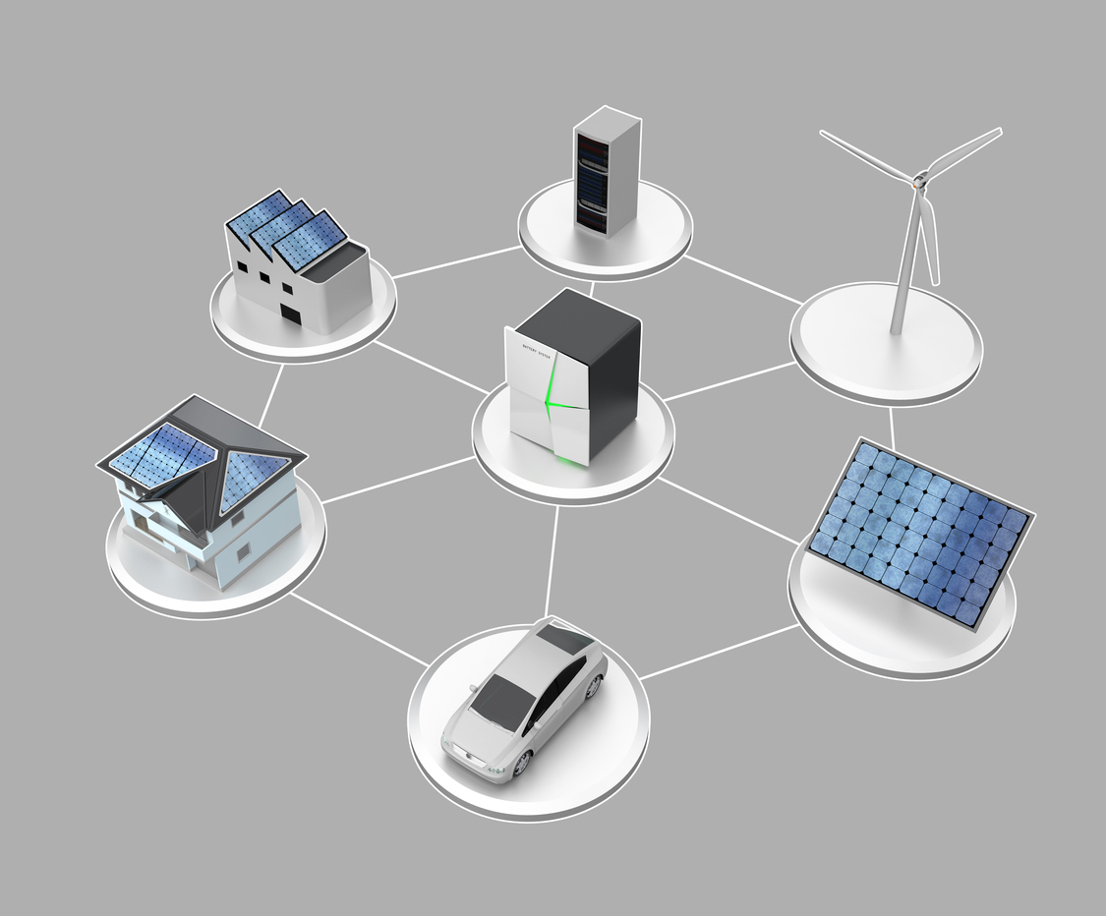
Motivation
International and regional efforts for reduction of CO2 emissions.
Increase of Distributed Energy Resources (DER) share.
Development of new techniques in the Grid Technologies group in DLR-VE institute.
Research started as reaction time from inverters as synthetic inertia
Results provide conditions for inverters in future grids
Results would enable to develop the required techniques to provide ancillary services
Notes:
International and regional efforts for reduction of CO2 emissions.
Energiewende-Erneuerbare energien geseztz 80% by 2050
Increase of Distributed Energy Resources (DER) share.
Reduction of conventional generation-synchronous generators
Freq and voltage from synch. Machines (now)
Uncertainty for balancing power in future
Development of new techniques in the Grid Technologies group in DLR-VE institute.
Similar as a synch. Machines inverters intended to provide synthetic inertia
Future grid will have other conditions, components and requirements.
Inverters must be able to contribute to grid stability.

Slide 4







Scientific Question
What is the power reserve response required in future scenarios where inverter based generation is predominant?
Will conventional primary reserve be capable of avoid frequency collapses?
How much time would be required by inverters to supply power reserve?
How effective are some developed methods such as synthetic inertia?

Slide 5
Agenda
Motivation
Theory
Methodology
Results
Conclusion

Slide 6
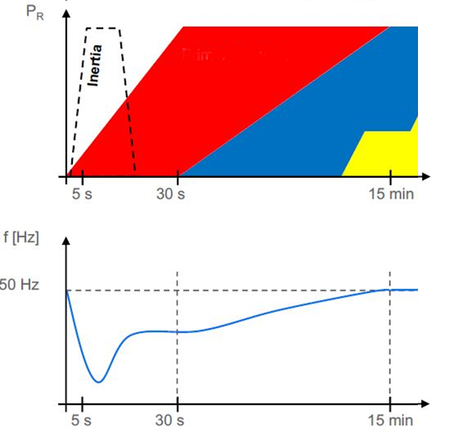


Theory Definition of Fast Power Reserve
Definition
Current system operation based on synchronous machines
Power balancing made through synchronous machines
Inertia provides an inherent response to changes in frequency
Synthetic Inertia is provided only by wind turbines
Fast Power Response either from PV, ESS or wind
Acceleration time constant: Two times the stored kinetic energy in the rotating masses of turbine-generators
RoCoF: Rate of Change of Frequency
Primary Reserve
$$\frac{df}{dt}=\frac{f_{0}∗ΔP}{2∗E_{k}}$$
$$E_{k}=\frac{Jω^{2}}{2}$$
Notes:
Current system operation based on synchronous machines
Power balancing-dispatchability and droop charact.
Inertia first measure against freq change./ measure of system robustness / how fast freq changes.
Synthetic Inertia through controls- DFIG
Fast Power Response
RoCoF: Rate of Change of Frequency how step or fast freq changes. Depends imbalance and kinetic energy(inertia)(accel time constant)
Acceleration time constant: Two times the stored kinetic energy in the rotating masses of turbine-generators

Slide 7
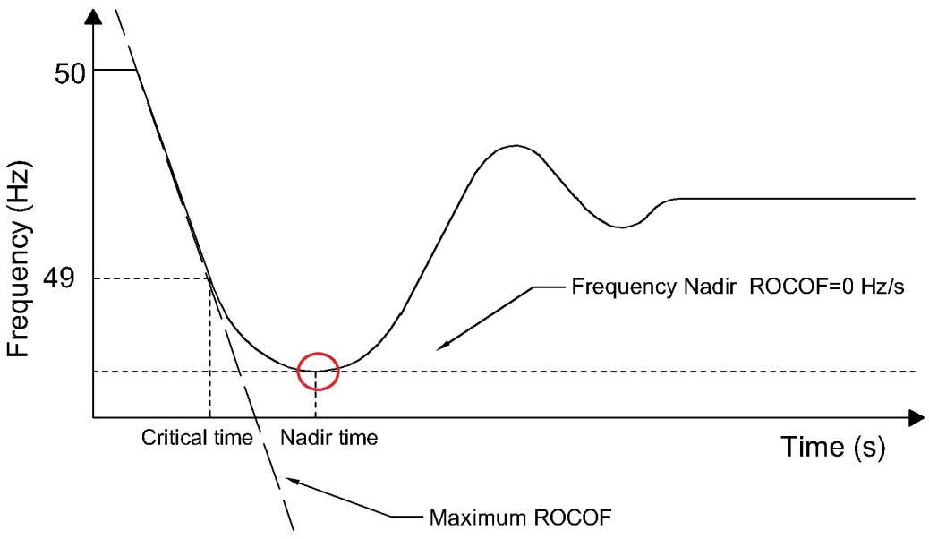
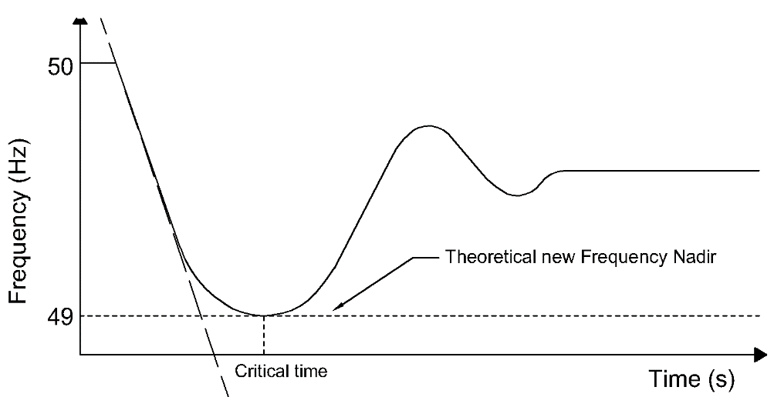
Theory
Critical time: Time at which frequency deviates 1 Hz from nominal
Nadir time: Time at which the lowest value of frequency is reached
Frequency limits
Transitory frequency values within 49-51 Hz.
System black out for frequency values under 47.5 and above 51.5 Hz
Assumptions
Initial frequency value is 50 Hz
Power responses and activation times are valid for over and under-frequency cases.
Inverter fast power reserve will take place just for imbalances that would result in frequency deviation out of the defined transient limit

Slide 8
Agenda
Motivation
Theory
Methodology
Results
Conclusion

Slide 9
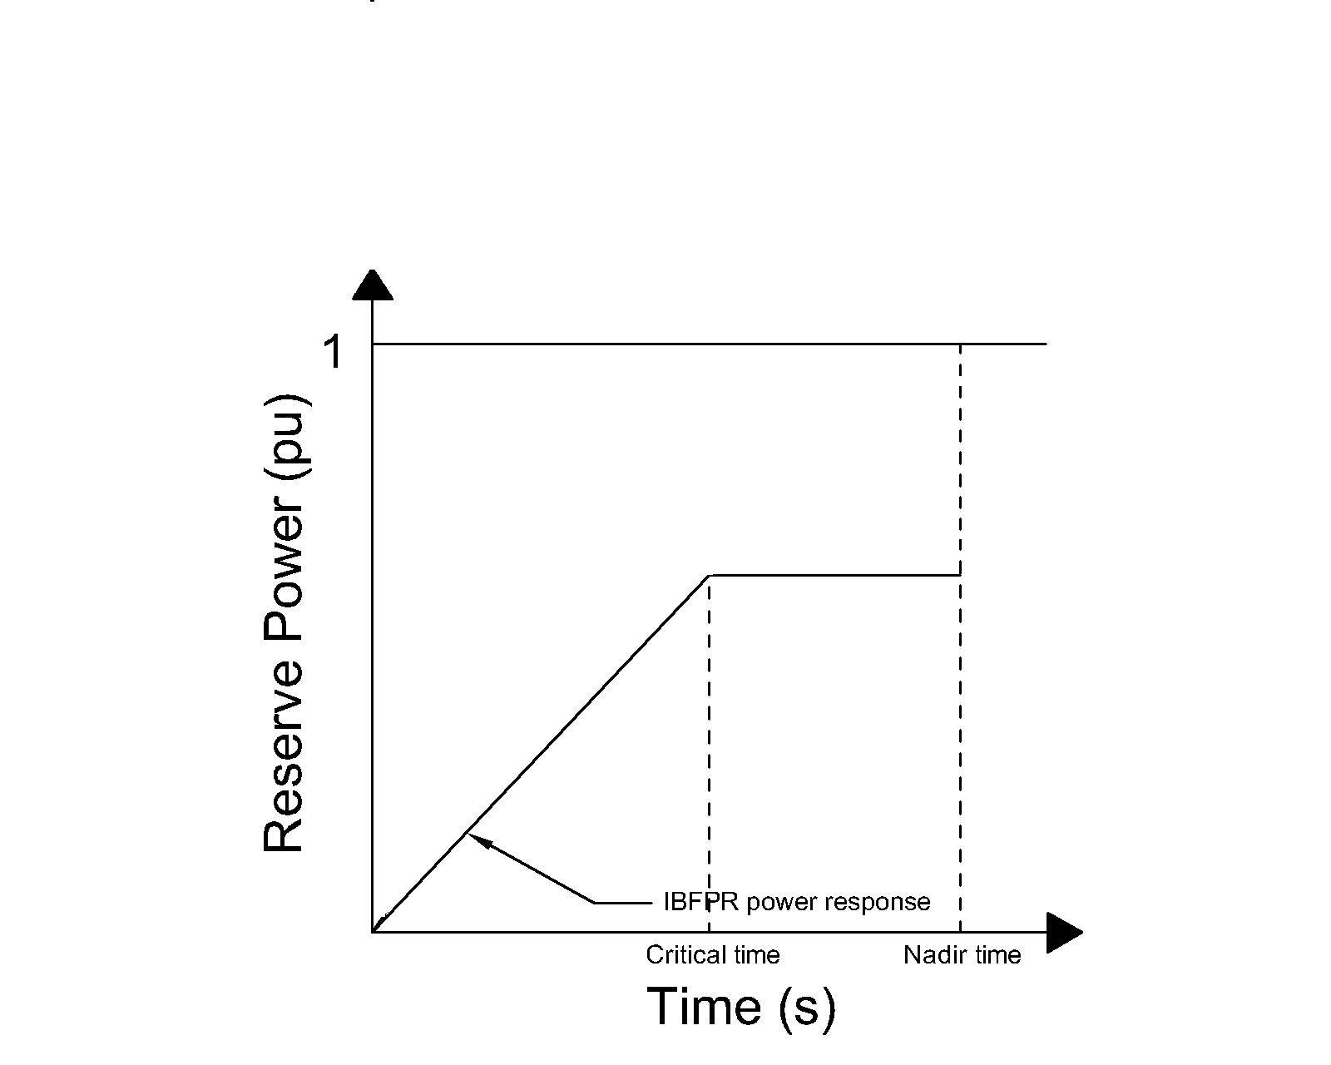
Methodology Inverter Based Fast Power Reserve
Inverter based fast power reserve must balance the power system.
An initial ramping period is assumed before the critical time
IBFPR just in cases leading to deviations larger than 1 Hz
Response based on critical time
Critical time estimation from measured RoCoF

Slide 10
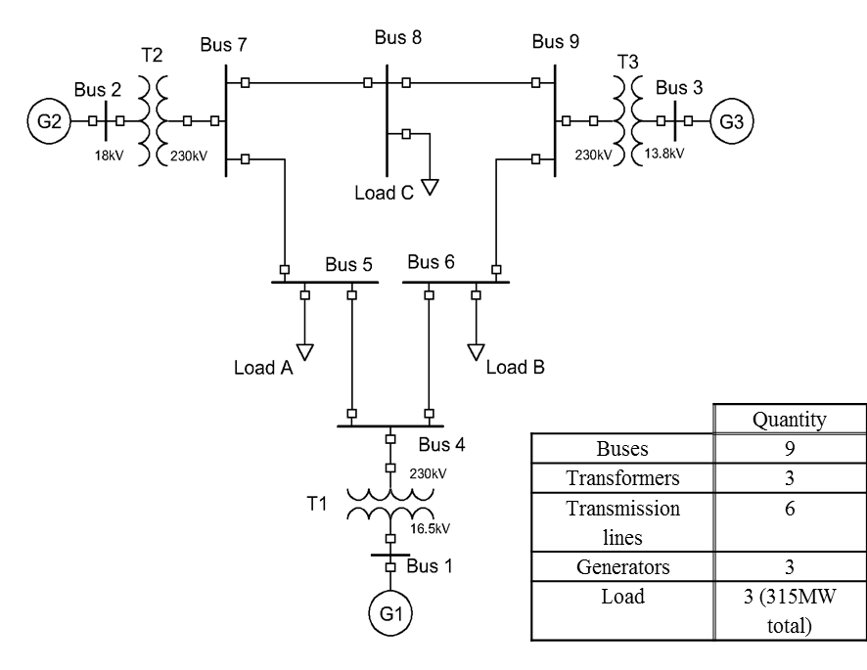
Methodology Simulation scenarios
Simplified IEEE 9 bus model
Power losses neglected
Reduction of the system components
Governor response
Extended IEEE 9 bus model
Consideration of all components and losses.
Governor response
European electric Island Model
Based on the simplified IEEE 9 bus model
Primary reserve with 30 seconds for deployment
IEEE 9 bus model

Slide 11
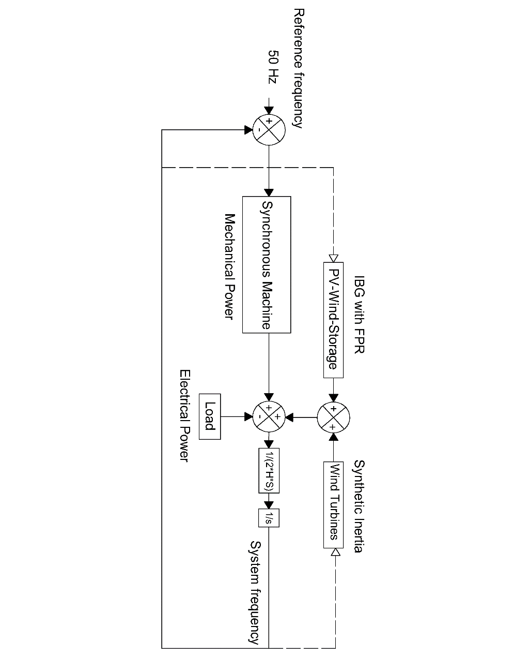
Methodology Simplified IEEE 9 bus model
Why to simplified the grid?
RoCoF equation based on power imbalance
All generation and load reduced to one block respectively
Easier addition of additional power source such as renewables
Added power sources:
IBFPR: Theoretical power response calculated from the critical time, power imbalance and nadir time.
Synthetic Inertia: Approximately 10% additional power over turbine nominal.

Slide 12
Agenda
Motivation
Theory
Methodology
Results
Conclusion

Slide 13
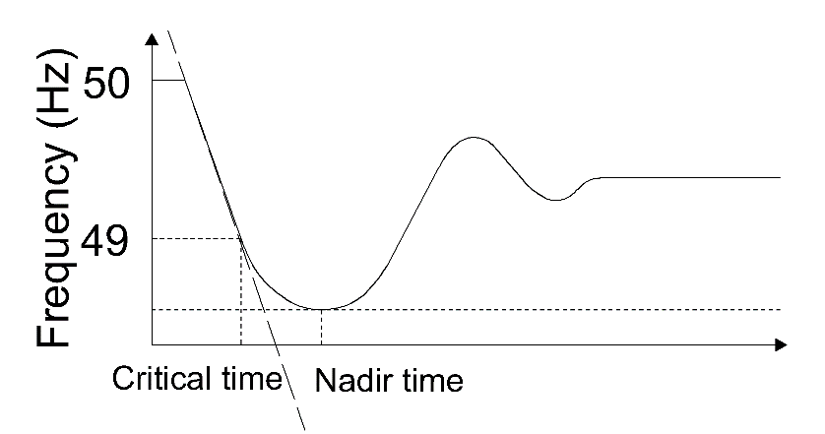
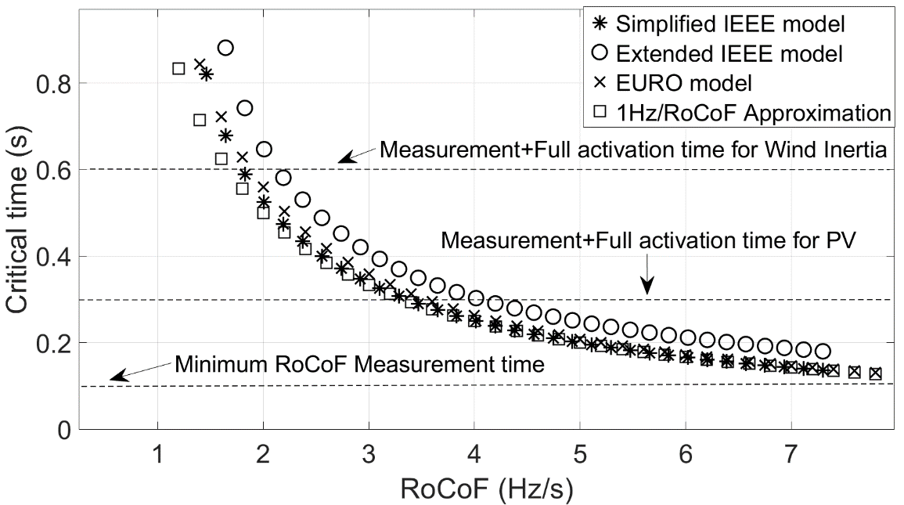
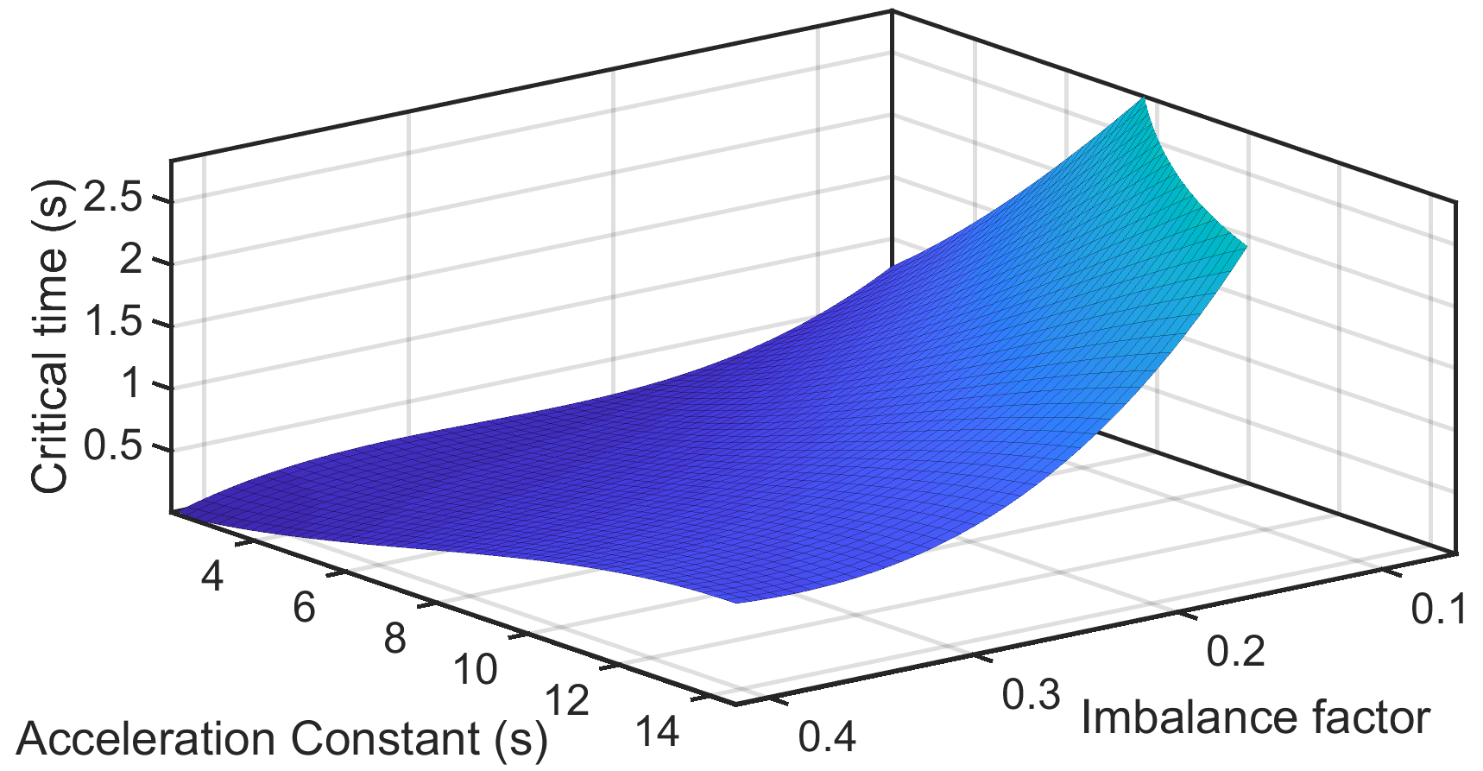
Results Critical time calculations-Simplified IEEE model
Critical time summary for comparison (80% IBG)
Simulations: Critical time estimation under different combination of power imbalances and acceleration time constants in the system.
Depending on critical time; the required fast power reserve is calculated
Critical time calculations
All scenarios follow the same trend
Longer critical time when the extended IEEE model is considered
1Hz/RoCoF represents a very good approximation
For most of scenarios current IBG deployment time is enough to avoid load shedding.

Slide 14
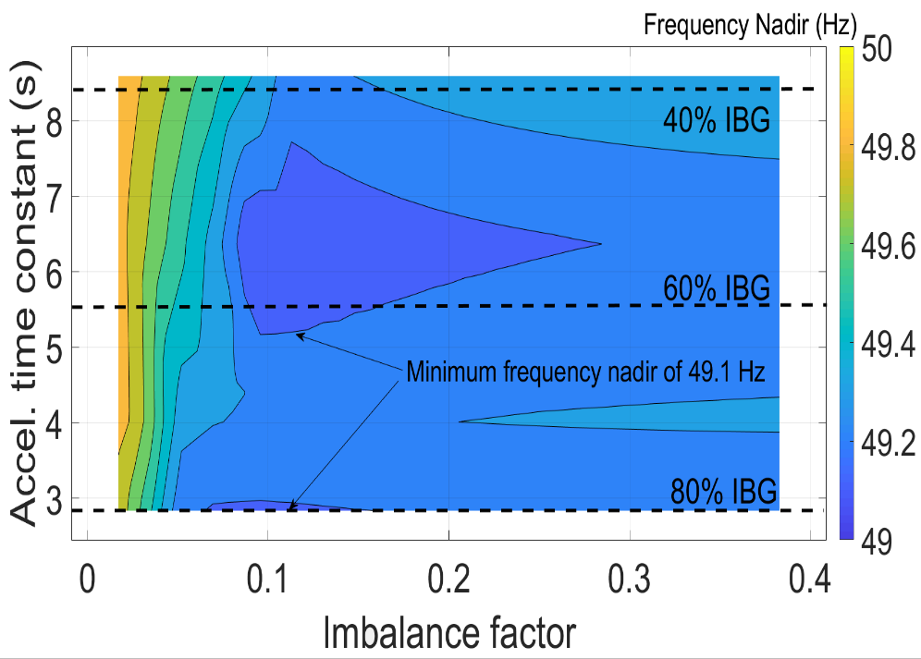
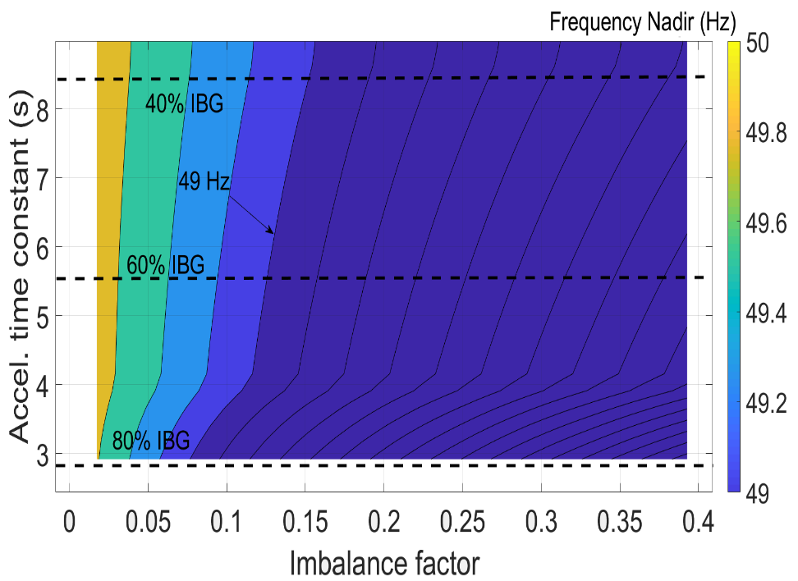
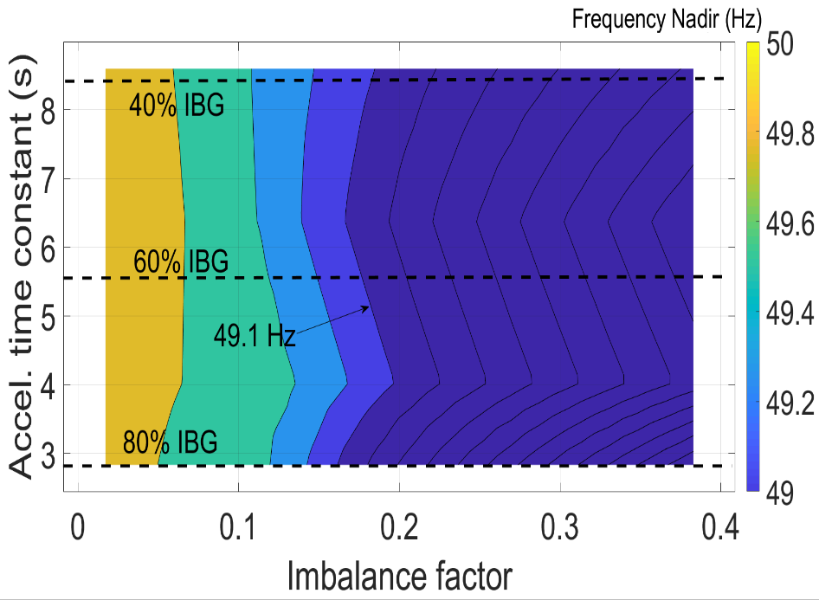
Results Including FPR and SI in Simplified Model
IBFPR Basic model Synthetic inertia
Load shedding is avoided for all the possible combination of power imbalance and penetration of IBG.
Improvement in frequency nadir although load shedding is not avoided in all possible combination of power imbalance and penetration of IBG

Slide 15

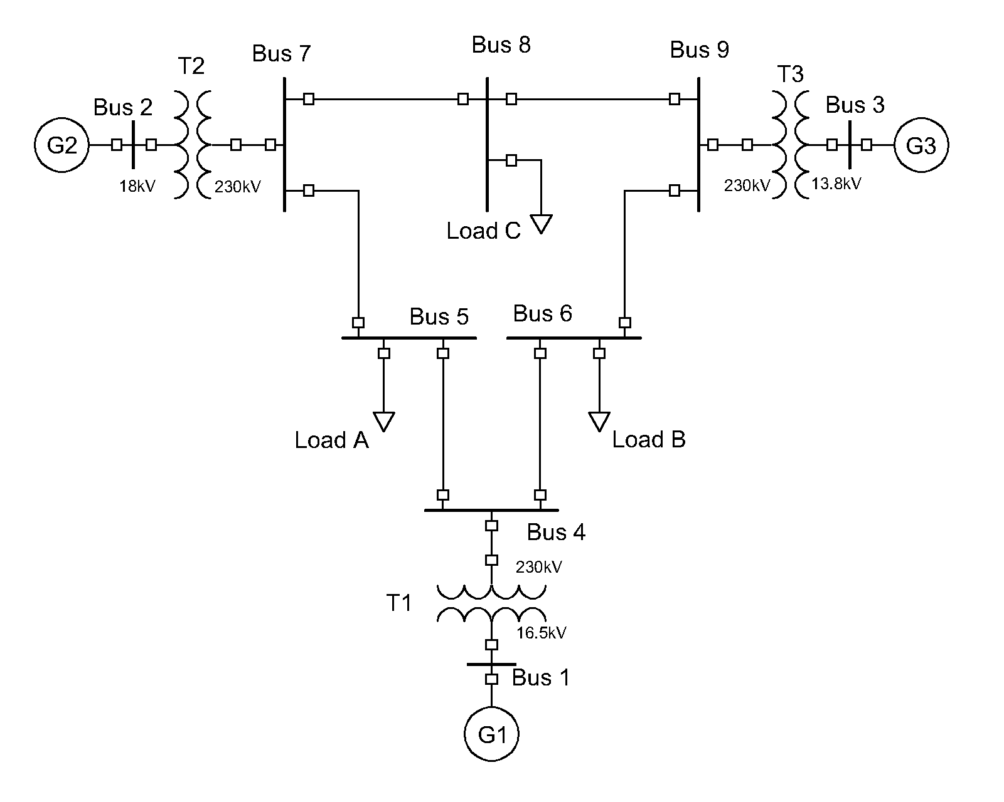
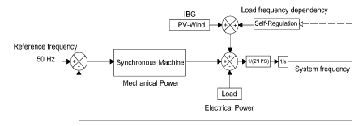

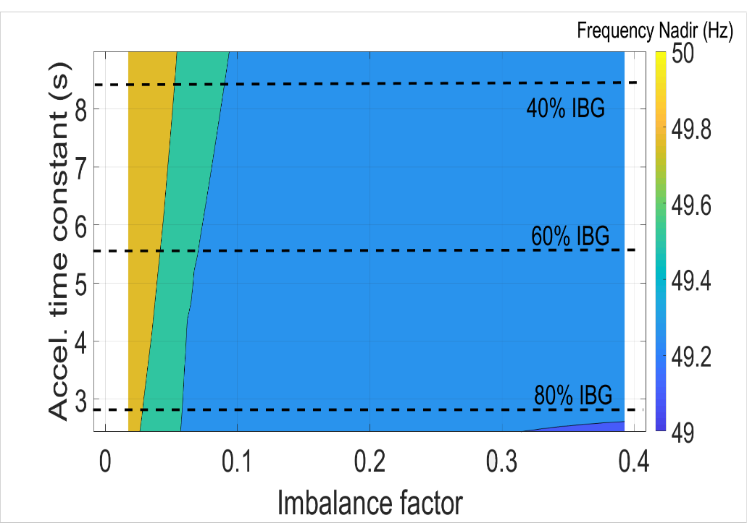
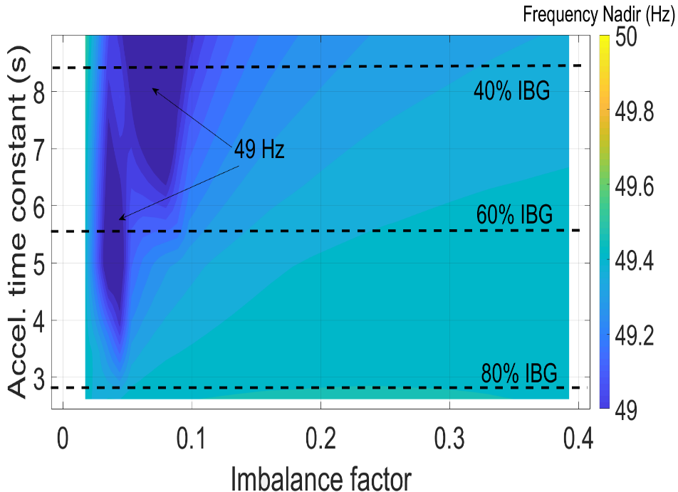
Results Including FPR in all three model scenarios
Simplified Extended European case
dsf
dsf
dsf

Slide 16

Results European scenario
ENTSOE Reference Model:
Load: 150 GW
Self-regulation: 2%
Imbalance of 3 GW (2% of load)
It was modeled from the simplified IEEE model modifying the deployment time of the synchronous machine representation to 30 seconds independently of imbalance.
What’s about the areas below 49 Hz?
What does it mean in terms of grid stability of the European network?

Slide 17
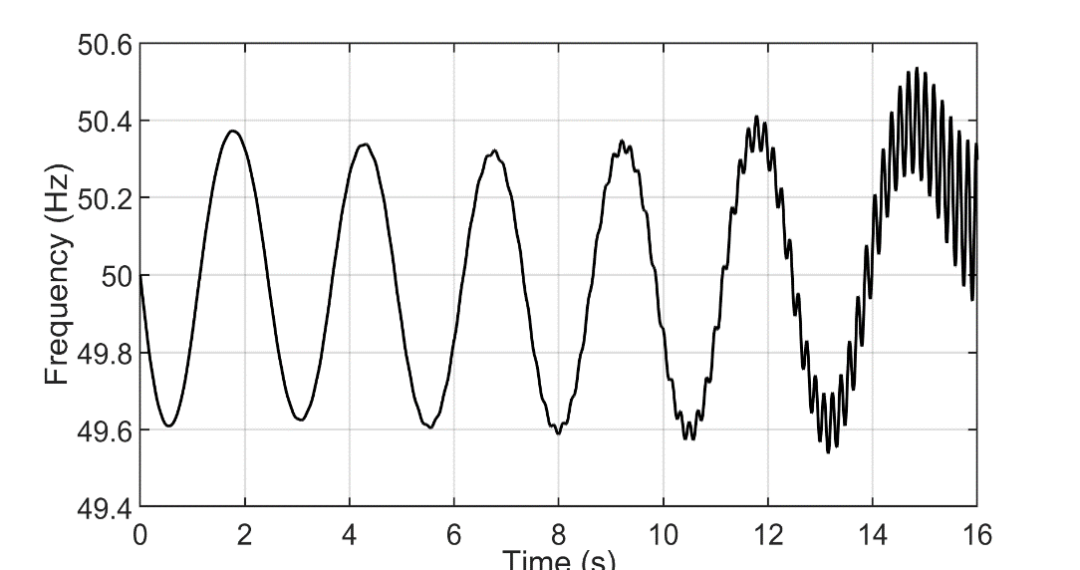
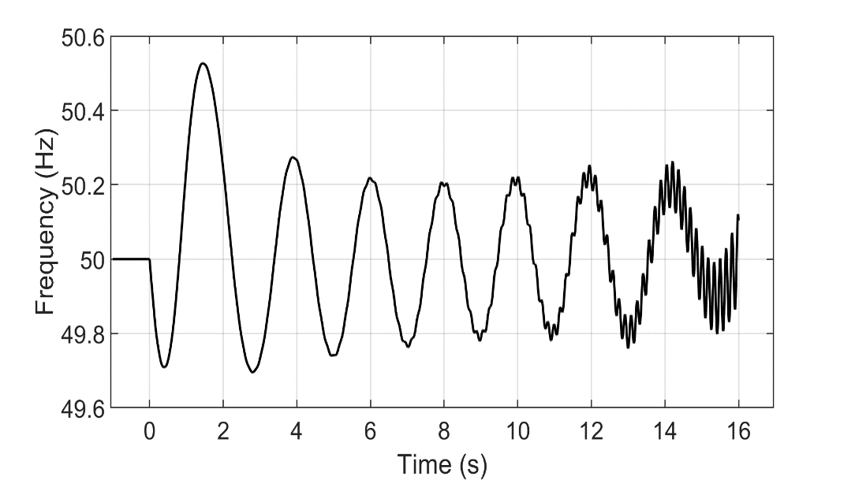
Results What happens above 80% IBG?
Frequency response with 2% imbalance without IBFPR (95% IBG)
Scenario with 95% IBG simulated
Undamped oscillations for imbalances in the order of 2%
Lack of damping torque (small signal stability problem)
IBFPR not able to stabilize the system
Usually related to exciter dynamics
Frequency response with 2% imbalance with IBFPR (95% IBG)

Slide 18
Agenda
Motivation
Theory
Methodology
Results
Conclusion

Slide 19
Conclusion
Critical time depends on the conditions of imbalance and inertia in the system. Nevertheless the approximation 1Hz/RoCoF was found to be best expression to relate all the possible scenarios. When high values of RoCoF are considered, the values approximat

