Slide 1

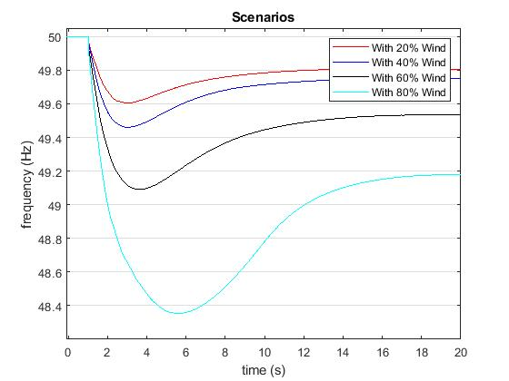
Determination of the required Power Response of Inverters to provide fast Frequency Support in Power Systems with low Synchronous Inertia
Alejandro Rubio
Oldenburg University
Abstract
State of the Art
Decommissioning of conventional power plants and the installation of inverter-based renewable energy technologies decreases overall power system inertia. This reduction in system inertia has an impact in the power system frequency response when an unbalance between generation and load occurs, increasing the rate of change of frequency of the system. In a future scenario where renewables are predominant in power systems and due to the natural variability of the resource, unbalances of 40 percent or more are prompt to happen, which combined with low inertia may lead to frequency collapse. The requirements of inverters to provide an effective fast reserve response are investigated. In this way, inverters are intended to reduce the rate of change of frequency so enough time is provided to activate the primary power reserve. Needed power rate under different inverter time responses and different rates of change of frequency is analyzed.
Power balancing- Synchronous generators
Lack of inertia to the system from RE
During normal operation frequency can change between 49.8Hz and 50.2Hz.
Load shedding starts at 49Hz.
Conventional system rely on inertial response, primary and secondary synchronous reserve for frequency and power balancing control.
On the other hand, some control techniques have been developed in order to allow renewables to participate in frequency regulation. This techniques are:
Synthetic Inertia
Fast Power reserve
De-loading
Droop-Characteristics
Figure 1. Frequency response under a 20% power unbalance.

Slide 2
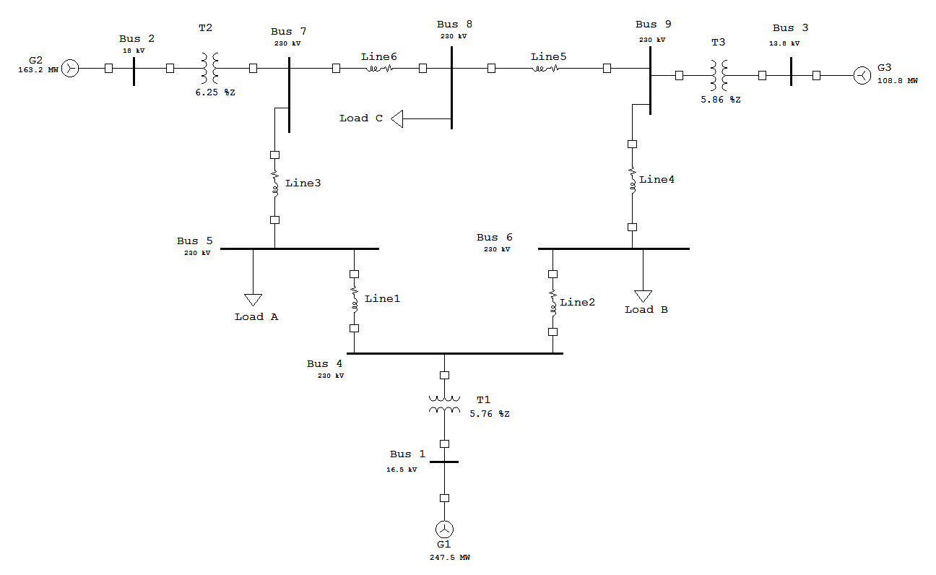
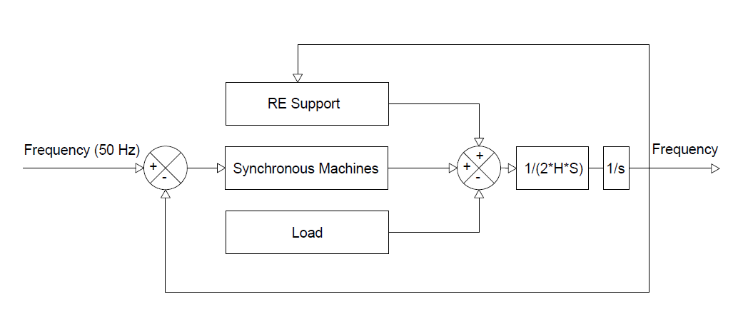
Determination of the required Power Response of Inverters to provide fast Frequency Support in Power Systems with low Synchronous Inertia
Alejandro Rubio
Oldenburg University
BASE CASE
IEEE 9 bus System
Installed capacity 910.5MW
Total load 315MW.
Transformers 3
Transmission lines 6
Figure 3. IEEE 9 bus model Western System Coordinating Council (WSCC)
Figure 2. Simplified frequency control system

Slide 3
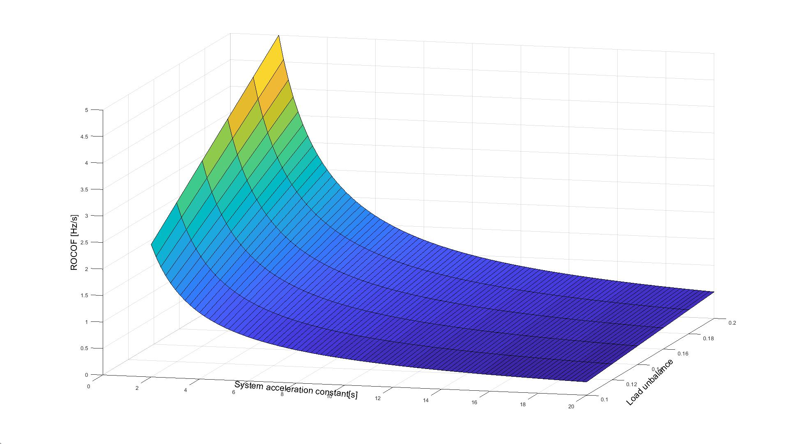

Determination of the required Power Response of Inverters to provide fast Frequency Support in Power Systems with low Synchronous Inertia
Alejandro Rubio
Oldenburg University
Rate of Change of Frequency (ROCOF)
Preliminary Results
ROCOF reaches values between 3 and 5 Hz/s with combinations of acceleration constants in the range of 2 to 4s and system unbalance between 15 and 20%. Values of ROCOF 0.5Hz/s and 1Hz/s combined with unbalances of 20% are the limit for current power plant capabilities.
Figure 2. Rate of Change of Frequency
Figure 3. Critical time to reach load shedding frequency

Slide 4
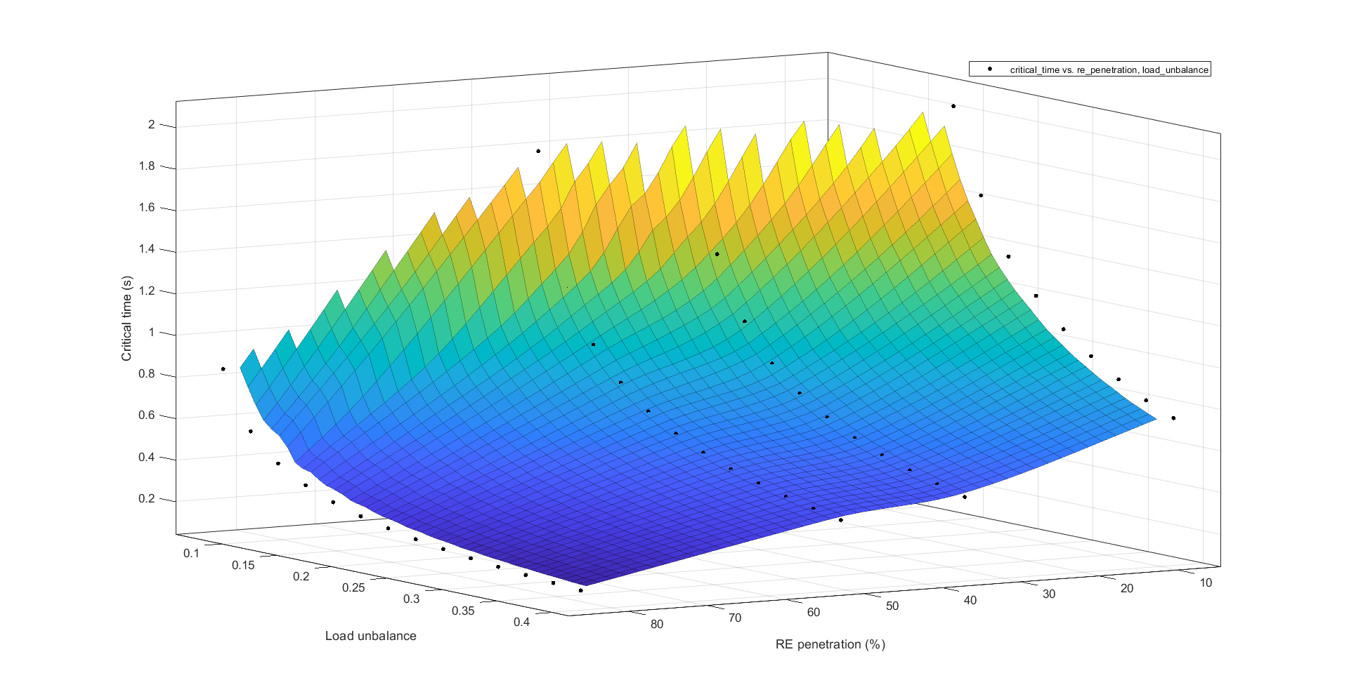
Determination of the required Power Response of Inverters to provide fast Frequency Support in Power Systems with low Synchronous Inertia
Alejandro Rubio
Oldenburg University
Critical time to reach low frequency shedding (49Hz)
Figure 4. Critical time to reach load shedding frequency as function of unbalance and RE penetration

Slide 5
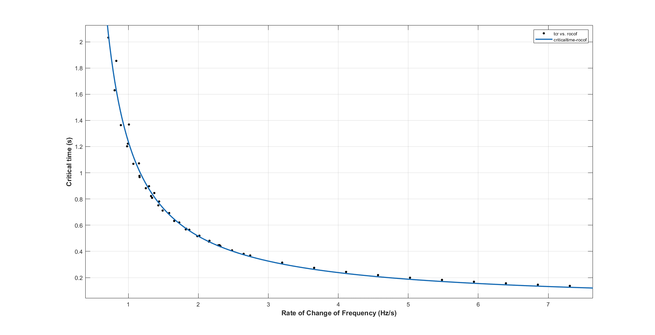
Determination of the required Power Response of Inverters to provide fast Frequency Support in Power Systems with low Synchronous Inertia
Alejandro Rubio
Oldenburg University
Critical time to reach low frequency shedding (49Hz)
Figure 5. Critical time to reach load shedding frequency as function of ROCOF

Slide 6
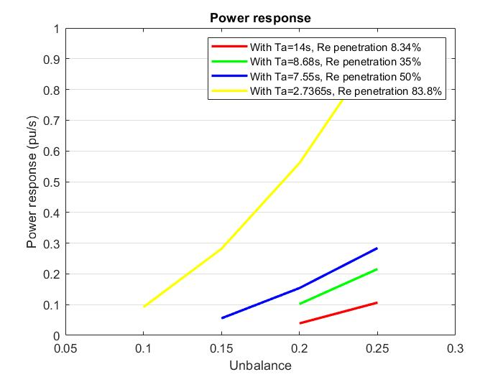
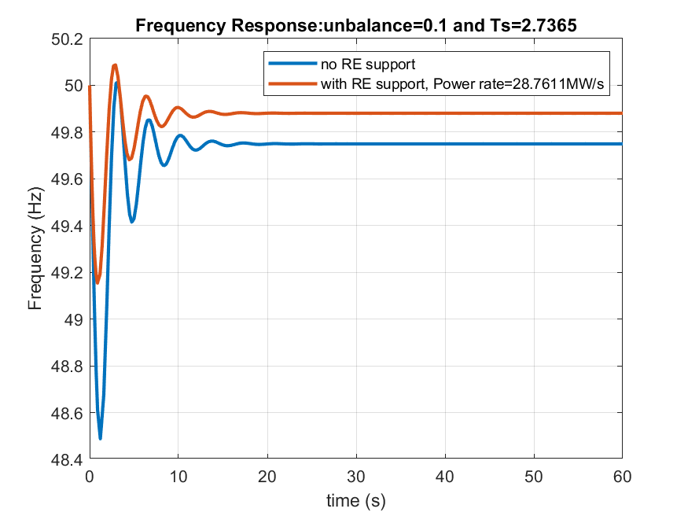

Determination of the required Power Response of Inverters to provide fast Frequency Support in Power Systems with low Synchronous Inertia
Alejandro Rubio
Oldenburg University
Preliminary Results
With the linearization of the system equation 1 was obtained and implemented in the model in order to prove its validity.
Where:
P(t): Power response
ΔP: Power unbalance
tcr: Critical time to reach shedding load frequency
tlm: Time of mechanical limit.
Figure 5 shows that a nadir frequency of 46.3Hz would be reached and a stable state frequency of 49.3Hz would be achieved when no power back up is given from renewables. On the other hand, figure 6 depicts the frequency response of the system with the fast power reserve from renewables. A considerable improvement in frequency nadir and stable state frequency can be noticed with values of 49.3Hz and 49.93Hz respectively.
P(t)$=\frac{∆P∗(1−\frac{t_{cr}}{t_{lm}})∗t}{t_{cr}}$
Eq 1.
Figure 6. Required power response from renewables.
Figure 7. Frequency response with 84% of renewable penetration. RE support is only given by inverters fast power response

Slide 7
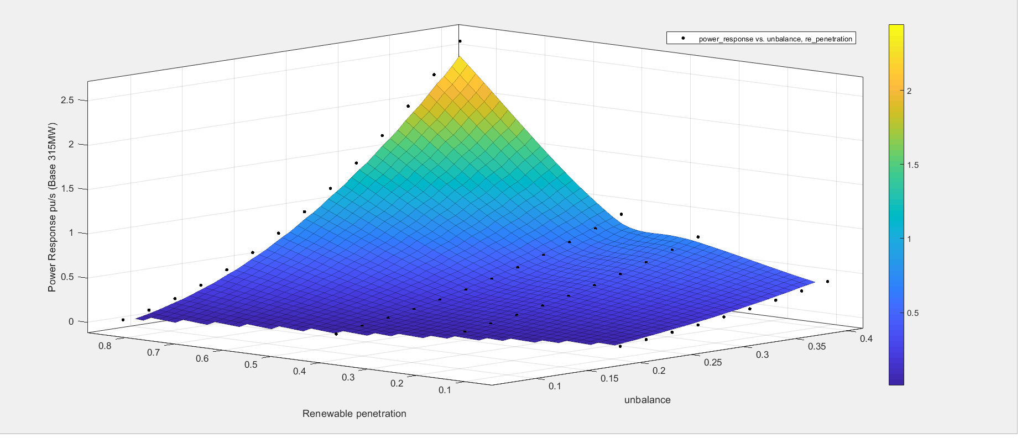
Determination of the required Power Response of Inverters to provide fast Frequency Support in Power Systems with low Synchronous Inertia
Alejandro Rubio
Oldenburg University
Power response for different combination of RE penetration and unbalance
Figure 8. Required fast power response from inverters to avoid load shedding.

Slide 8
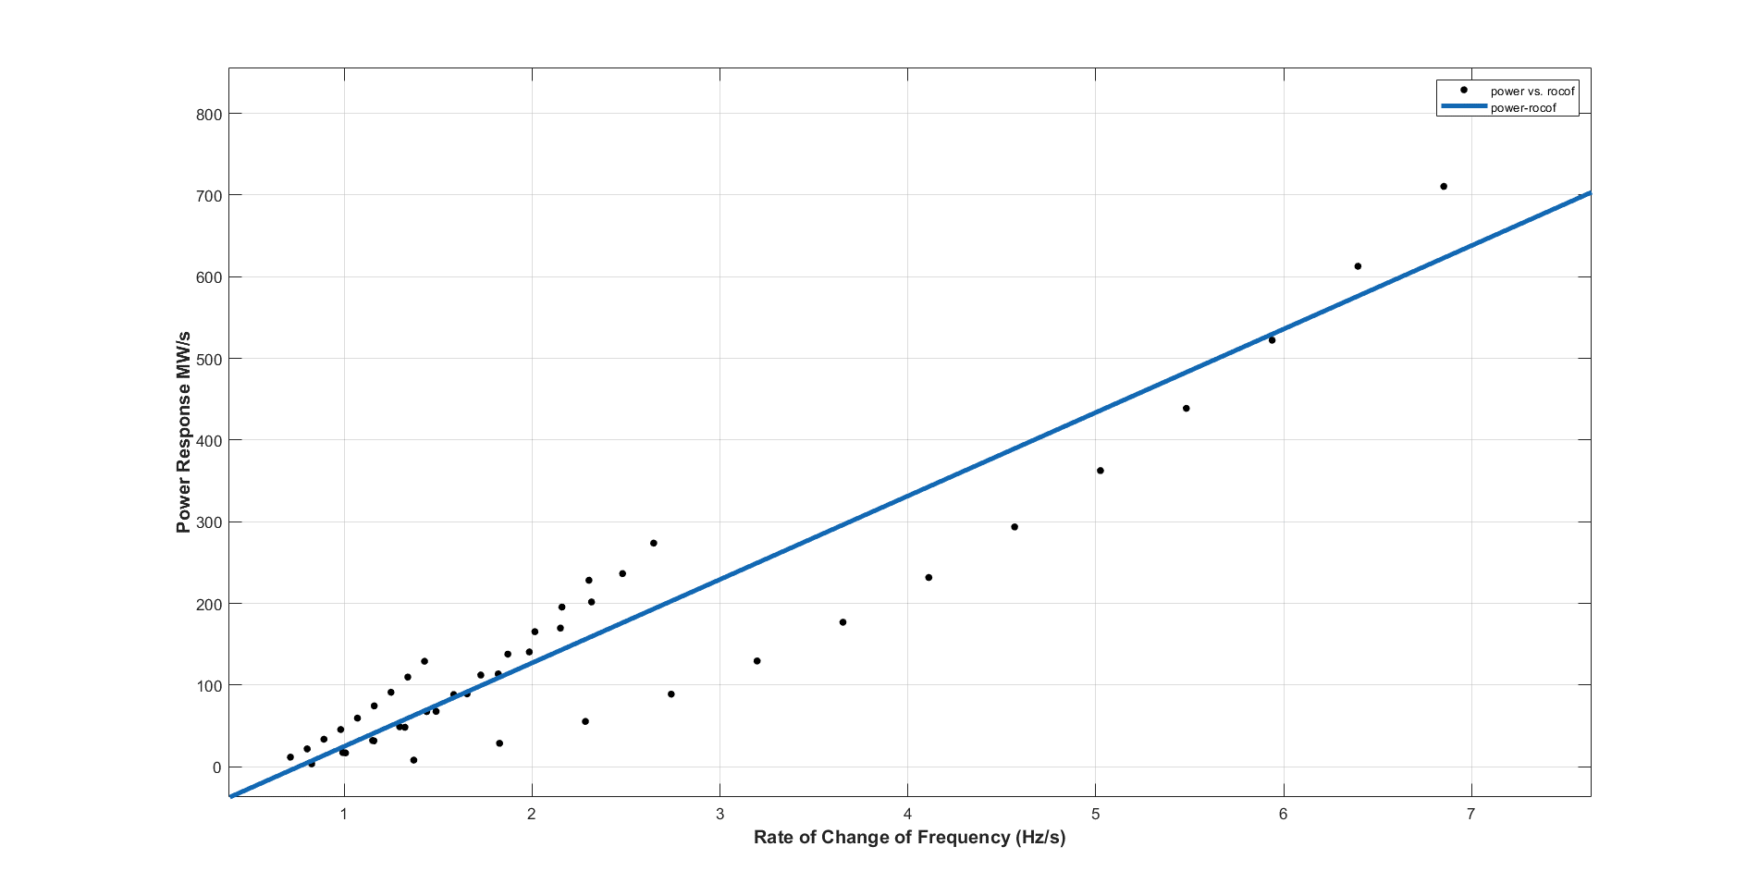
Determination of the required Power Response of Inverters to provide fast Frequency Support in Power Systems with low Synchronous Inertia
Alejandro Rubio
Oldenburg University
Required Power response as function of ROCOF for the Case Study grid
Figure 9. Required power response from inverters

Slide 9
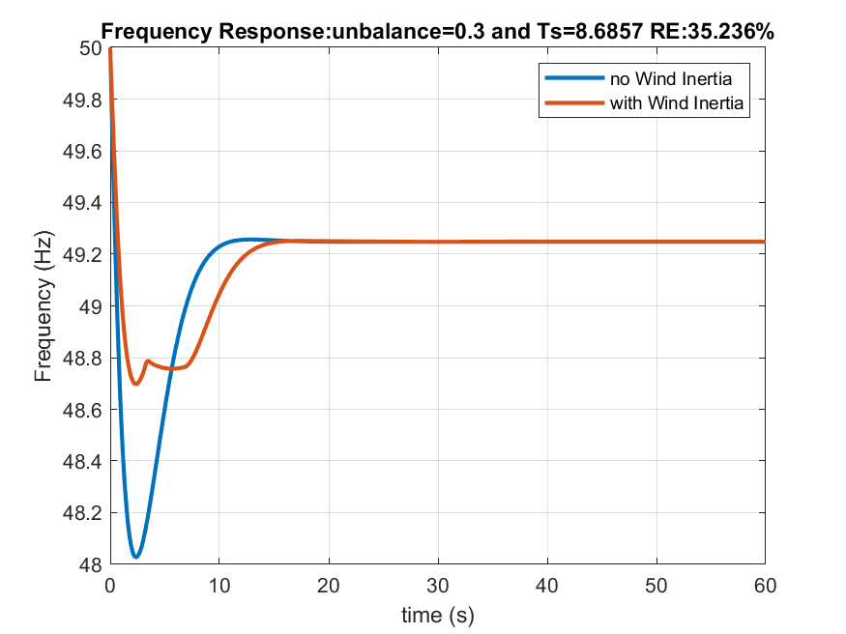
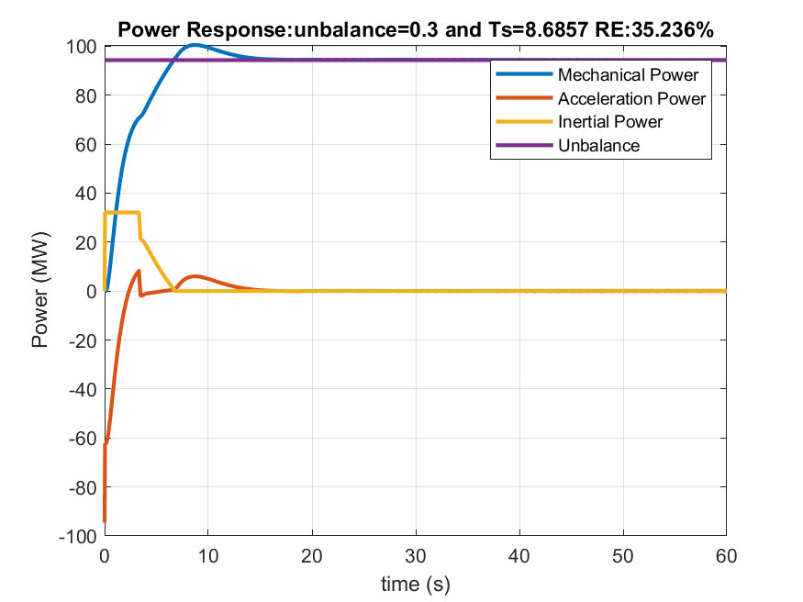
Determination of the required Power Response of Inverters to provide fast Frequency Support in Power Systems with low Synchronous Inertia
Alejandro Rubio
Oldenburg University
SYNTHETIC INERTIA
Mechanical power shown in Fig. 10, represents the additional power provided by the turbine after the disturbance in the system. Similarly Inertial power represents only the extra power extracted from the blades of wind turbines. Wind inertial power is limited for 10s and to 10% of the nominal turbine power.
Figure 10 Frequency response with support of inertia of WT blades and n o fast power response from inverters
If considered 100% of renewable as wind turbine, it could help to avoid load shedding due to low frequency but only at some levels of ROCOF. (to be determined from the performed simulations)
Figure 11. Power response with inertia power contribution

Slide 10
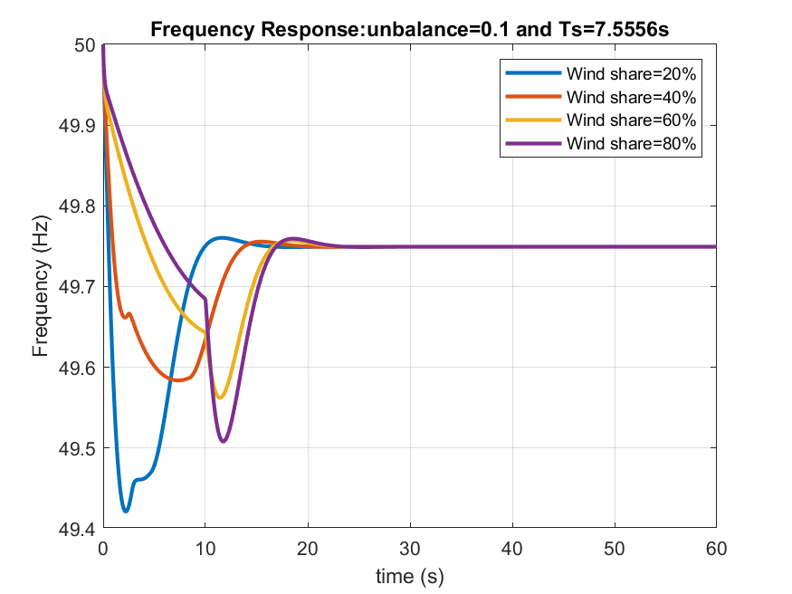
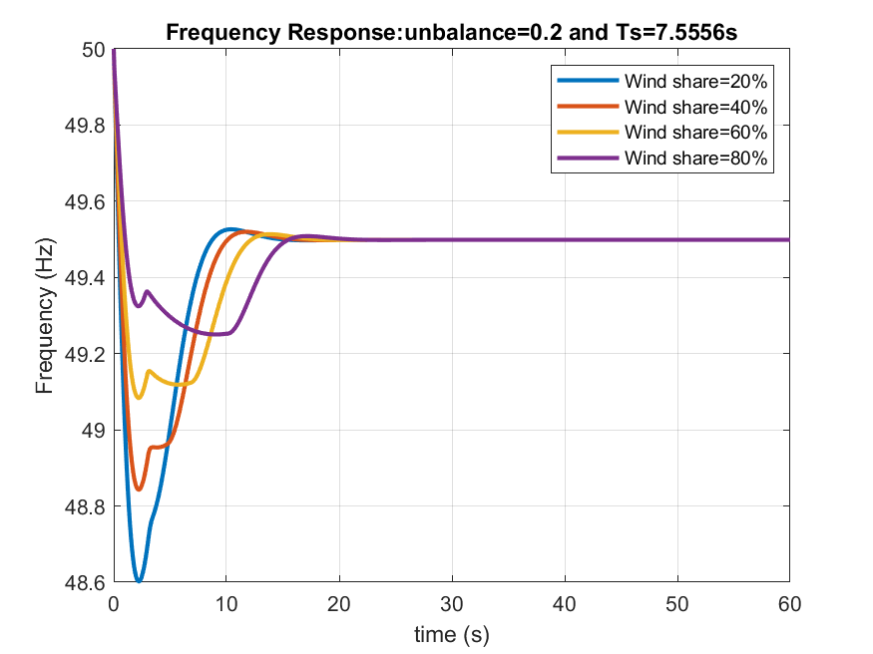
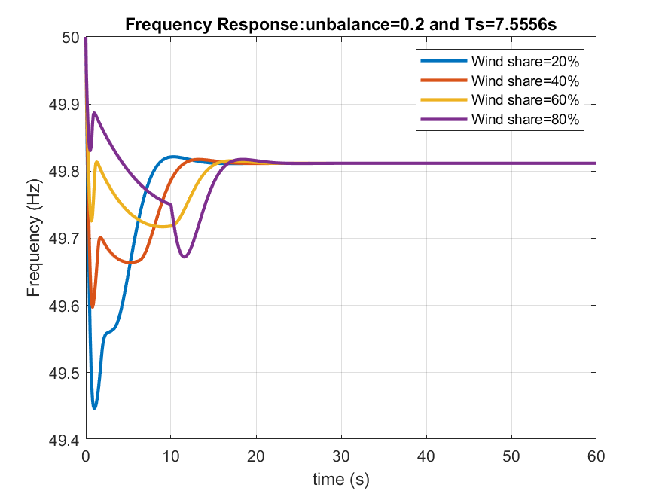
Determination of the required Power Response of Inverters to provide fast Frequency Support in Power Systems with low Synchronous Inertia
Alejandro Rubio
Oldenburg University
SYNTHETIC INERTIA-Considering different shares of Wind
Figure 12. Frequency response with 50% RE penetration and 10% unbalance. Only Synthetic inertia considered.
Figure 13. Frequency response with 50% RE penetration and 20% unbalance. Only Synthetic inertia considered.
In Figures 12 and 13 it can be observe that Synthetic inertia can provide a solution to avoid load shedding only for unbalances up to 10% when a share of 50% of renewables is achieve. In the case of a unbalance of 20%, there is only enough store kinetic energy in the cases of being wind energy more than 60% of the RE share.
Figure 14 depicts the combination of the synthetic inertia from wind and the inverter fast power response. In any case shedding frequency is avoided.
Figure 14. Frequency response with 50% RE penetration and 20% unbalance. Synthetic inertia considered plus Inverter fast power response considered

Slide 11
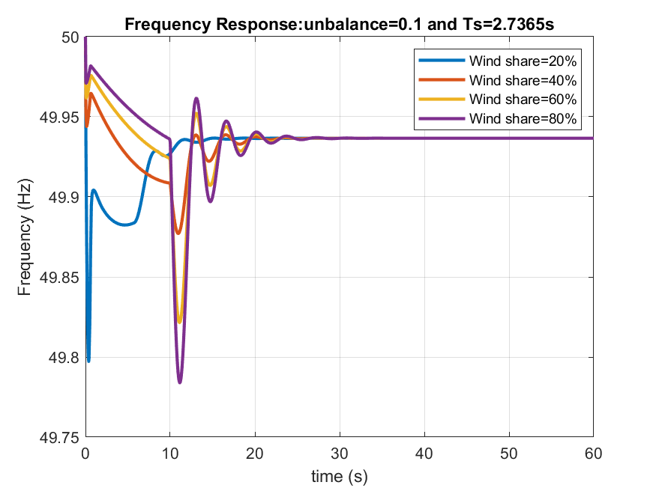
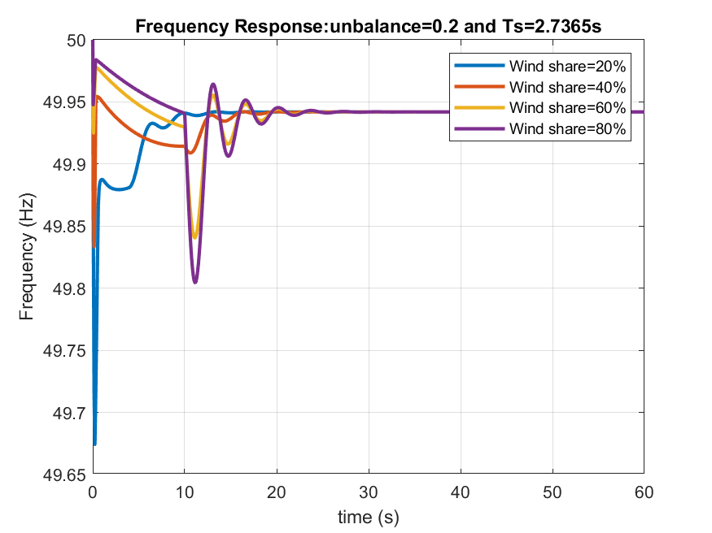
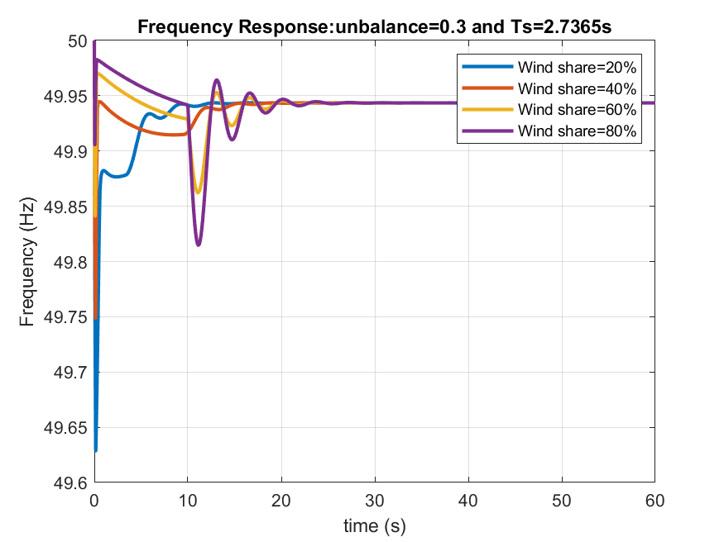
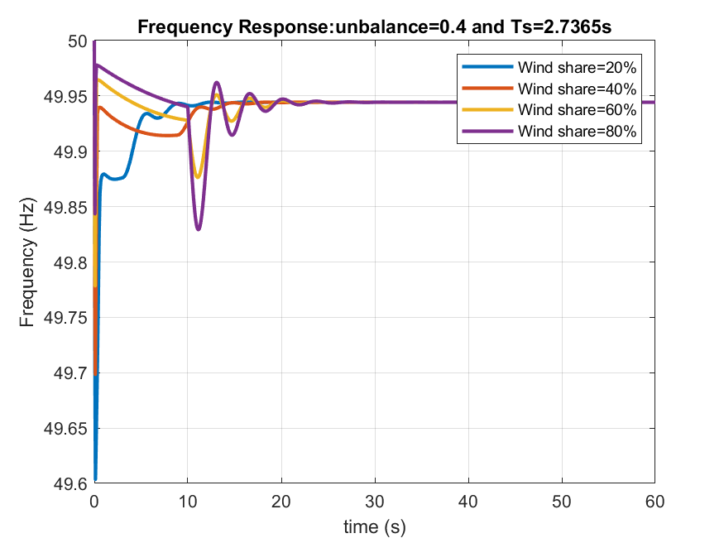
Determination of the required Power Response of Inverters to provide fast Frequency Support in Power Systems with low Synchronous Inertia
Alejandro Rubio
Oldenburg University
SYNTHETIC INERTIA + INVERTER FAST POWER RESPONSE
Figure 15. Frequency response with 84% RE penetration, 10% unbalance
Figure 16. Frequency response with 84% RE penetration, 20% unbalance
Figure 17. Frequency response with 84% RE penetration, 30% unbalance
Figure 18. Frequency response with 84% RE penetration, 40% unbalance

Slide 12
Determination of the required Power Response of Inverters to provide fast Frequency Support in Power Systems with low Synchronous Inertia
Alejandro Rubio
Oldenburg University
References
Aho, J.; Buckspan, A.; Laks, J.; Jeong, Y.; Dunne, F., Pao, L.; Fleming, P. et al. (2012): Tutorial of Wind Turbine Control for Supporting Grid Frequency through Active Power Control: Preprint. Available online at www.nrel.gov.
Anderson, P. M.; Fouad, A. A.: Power System Control and Stability.
Dreidy, Mohammad; Mokhlis, H.; Mekhilef, Saad (2017): Inertia response and frequency control techniques for renewable energy sources: A review. In Renewable and Sustainable Energy Reviews 69, pp. 144–155. DOI: 10.1016/j.rser.2016.11.170.
ENTSOE (2016): Frequency Stability Evaluation Criteria for the Synchronous Zone of Continental Europe. Available online at www.entsoe.eu.
ENTSOE (2018): Rate of Change of Frequency (RoCoF) withstand capability. Available online at www.entsoe.eu.
Gevorgian, Vahan; Zhang, Yingchen : NREL (2017): Wind Generation Participation in Power System Frequency Response. Available online at www.nrel.gov.
Hansen, Anca Daniela; Sørensen, Poul Ejnar; Zeni, Lorenzo; Altin, Müfit (2016): Frequency Control Modelling Basics.
Hoke, Andy (2018): Fast Grid Frequency Support from Distributed Inverter-Based Resources. Available online at www.nrel.gov.
IEEE Guide for Abnormal Frequency Protection for Power Generating Plants.
Jayawardena, A. V.; Meegahapola, L. G.; Perera, S.; Robinson, D. A. (2012): Dynamic Characteristics of a Hybrid Microgrid with Inverter and Non-inverter interfaced Renewable Energy Sources: A case study.
Kroposki, Benjamin; Johnson, Brian; Zhang, Yingchen; Gevorgian, Vahan; Denholm, Paul; Hodge, Bri-Mathias; Hannegan, Bryan (2017): Achieving a 100% Renewable Grid: Operating Electric Power Systems with Extremely High Levels of Variable Renewable Energy. In IEEE Power and Energy Mag. 15 (2), pp. 61–73. DOI: 10.1109/MPE.2016.2637122.
Kundur, Prabha: Power System Stability and Control.

