Slide 1

LinearMind
Interactive AI-Powered Learning for Linear Regression
Neural Networks Course Project
Submitted To: Dr. Mohsen Rashwan Dr. Mohamed Abd-ElGhany Group14. Zeyad Antar Othman Abu-Zaid ID:9220331
Abd-Elrahman Hatem Nasr ID:9220461
Abdallah Essam Mohamed ID:9220479
LinearMind
1
Notes:
Welcome to LinearMind. This deck has two parts: PART A covers the core concepts of Linear Regression — what it is, how it works mathematically, and where it can go wrong. PART B introduces the LinearMind platform and shows how it teaches every one of those concepts through interactive tools. Key takeaway: By the end you'll understand both the theory and how our platform makes it learnable by anyone.

Slide 2


Agenda
PART A — The Concept
PART B — The Platform
• Linear Regression overview
• Best-fit line & predictions
• Error / residuals
• Loss / cost function (MSE)
• Gradient descent & learning rate
• Training process & convergence
• Failure cases
• Multivariable regression
• Evaluation metrics
• What is LinearMind?
• Platform scope (verified stats)
• 13-module curriculum map
• 15 interactive visualizations
• Playground workbench
• AI Tutor (Gemini)
• Quizzes & code examples
• Gamified progress tracking
• Cloud sync, security & tech stack
LinearMind
2
Notes:
This deck is split into two halves. The first half gives everyone — technical or not — a solid mental model of what Linear Regression is and why it matters. The second half shows how LinearMind delivers that understanding through interactive tools. Key takeaway: Concept first, product second. You'll see exactly how the platform maps onto the theory.

Slide 3
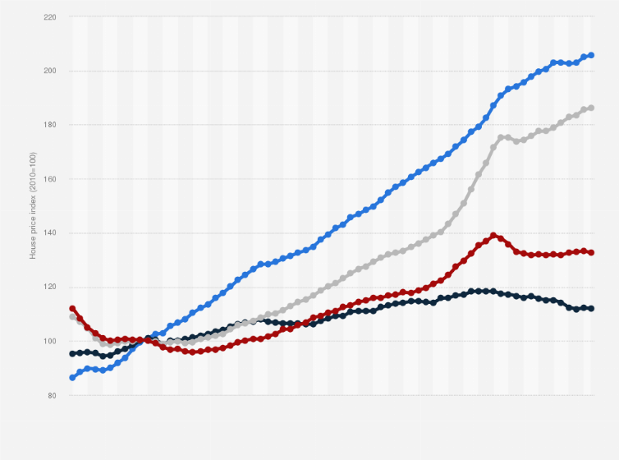
Why Linear Regression Matters
The Simplest Useful Predictive Model
Interpretable — every coefficient tells you exactly
how much X affects Y. No black box.
Foundational — the weighted-sum idea reappears
in neural networks, logistic regression, and beyond.
Practical — house prices, energy usage,
sales forecasting, health outcomes.
LinearMind
3
Notes:
Linear Regression isn't just an academic exercise. It's the first model you should understand because: 1. It's transparent — you can read off the effect of each variable from the coefficients. 2. The 'weighted sum + bias' pattern is literally the computation inside every neuron. 3. Real applications: predicting house prices from size, estimating patient risk scores, forecasting energy demand. Key takeaway: Mastering this one model gives you the intuition needed to understand far more complex systems.

Slide 4
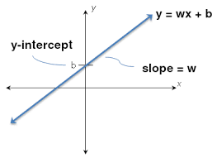
The Core Idea: Best-Fit Line
We have data points (x, y).
We want a line that best fits them.
Model form:
ŷ = w·x + b
w = slope — how much ŷ changes per unit of x
b = intercept — the baseline (value when x = 0)
LinearMind
4
Notes:
Walk through the notation carefully. x is the input (e.g. size of house in sq ft). ŷ (y-hat) is our prediction (estimated price). w controls the slope — steeper w means a bigger effect of x. b is the y-intercept — it shifts the whole line up or down. The 'best' line is one that gets as close as possible to all the data points simultaneously. We haven't defined 'close' yet — that's the next slide. Key takeaway: Linear regression is just a line; the challenge is finding the right slope and intercept.

Slide 5
Predictions (Inference)
Predicting is simple:
Input x → compute ŷ = w·x + b
The learning problem is choosing w and b that
work well across many data points.
Practical note: Once trained, prediction is
extremely fast — just one multiply + one add.
Input
Model
Output
LinearMind
5
Notes:
This is an important conceptual split: prediction vs. learning. Once w and b are fixed, making a prediction is trivial arithmetic. The hard part is deciding which w and b to use. The 'learning problem' is: given a dataset, find the w and b such that ŷ is as close to the true y as possible for all examples. Key takeaway: Inference is O(1) arithmetic; all the complexity is in the training phase.

Slide 6
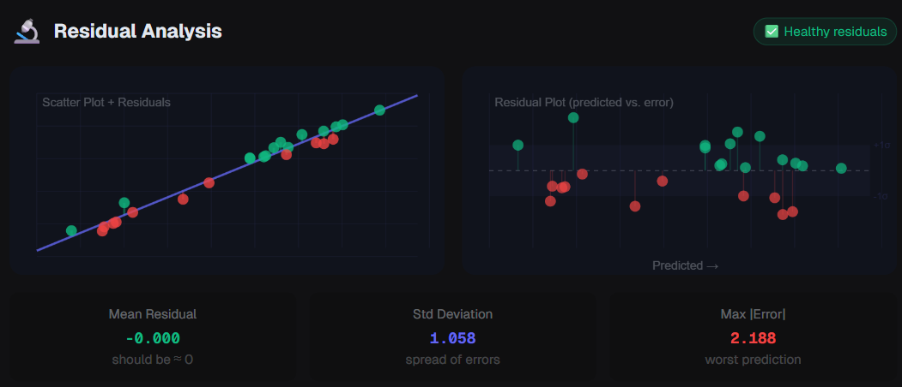
Error & Residuals — What the Model Gets Wrong
For each data point i:
residual = yᵢ − ŷᵢ
(true value minus predicted value)
Residuals show where the line
under- or over-estimates.
Residual patterns reveal problems:
• Curved patterns → nonlinearity
• Systematic bias → missing features
• Outliers → potential data issues
LinearMind
6
Notes:
A residual is simply the vertical distance between a data point and the model's prediction. Positive residual: the model underestimated. Negative residual: the model overestimated. If you look at the residuals together and they form a curve, that's a sign that a straight line isn't the right model for this data. Key takeaway: Residuals are how we measure individual errors; we need to combine them into one summary number to optimize — that's the loss function.

Slide 7
Loss / Cost Function — Measuring Overall Wrongness
MSE = (1/n) · Σ (yᵢ − ŷᵢ)²
We need one number summarising all residuals.
Common choice for regression:
Mean Squared Error (MSE)
Why square?
Big penalty
Smooth surface
Prevents + and − residuals from cancelling each other out.
Large errors are penalised much more heavily than small ones.
Squaring creates a differentiable bowl — perfect for calculus-based optimisation.
LinearMind
7
Notes:
MSE stands for Mean Squared Error. Breaking down the formula: — n is the number of data points — yᵢ is the true value, ŷᵢ is our prediction — We square the difference to keep it positive and to punish large mistakes more — We average so the scale doesn't depend on dataset size Why not just use absolute value? Squaring is differentiable everywhere, which is essential for gradient descent to work. Key takeaway: MSE converts many residuals into a single optimisation target — minimize this number.

Slide 8
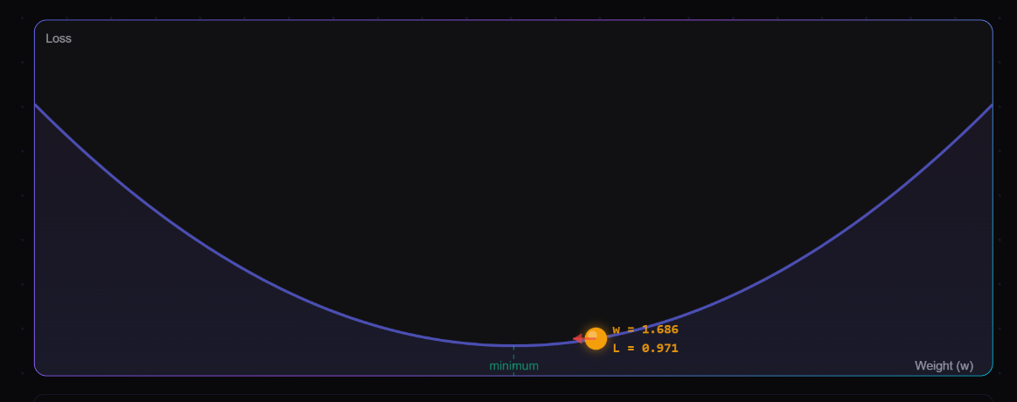
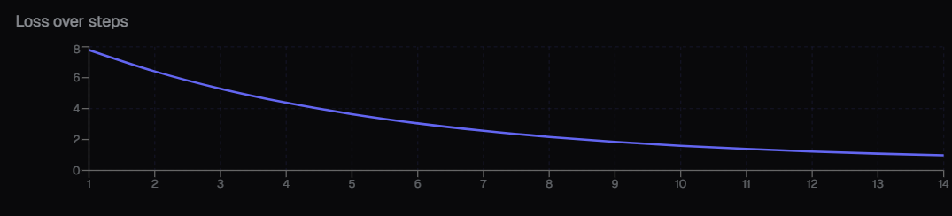
Optimization — Finding the Best w and b
Goal: choose parameters w and b that
minimize the loss function.
Two ways to think about it:
① Search on a loss landscape
The loss forms a bowl-shaped surface; we want the lowest point.
② Adjust the line to reduce error
Tweak w and b step by step
until predictions improve.
LinearMind
8
Notes:
For linear regression with MSE, the loss surface is always a convex bowl — there's only one minimum. This is a special property that makes things simpler. For most real models (neural networks, etc.), the surface is highly non-convex with many local minima. Key takeaway: Optimization is about navigating the loss landscape to the minimum; gradient descent is the algorithm we use to do this.

Slide 9
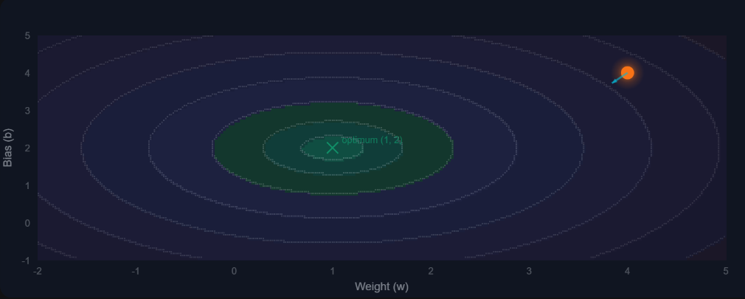
Gradient Descent — The Update Rule
w ← w − α · (∂L/∂w)
b ← b − α · (∂L/∂b)
α = learning rate (controls step size)
∂L/∂w = gradient — slope of loss w.r.t. w
The update moves parameters in the opposite direction of the gradient
(downhill on the loss surface).
LinearMind
9
Notes:
Gradient descent is the workhorse of machine learning optimisation. The key insight: the gradient (partial derivative) tells us which direction is uphill on the loss surface. So we step in the opposite direction. We repeat this many times (once per epoch or per batch) until the parameters converge to values that minimize the loss. Key takeaway: Each step of gradient descent slightly improves our parameters; over many iterations we reach a minimum.

Slide 10
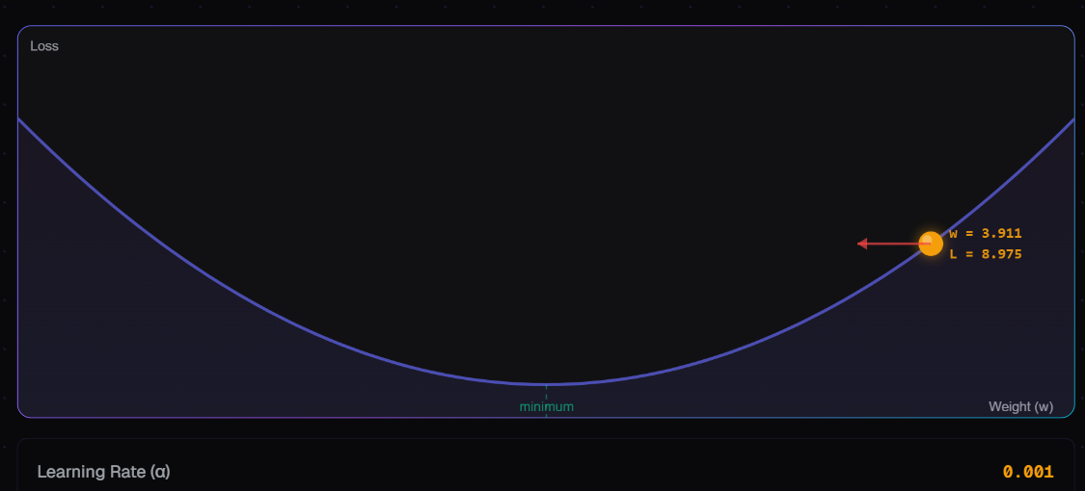
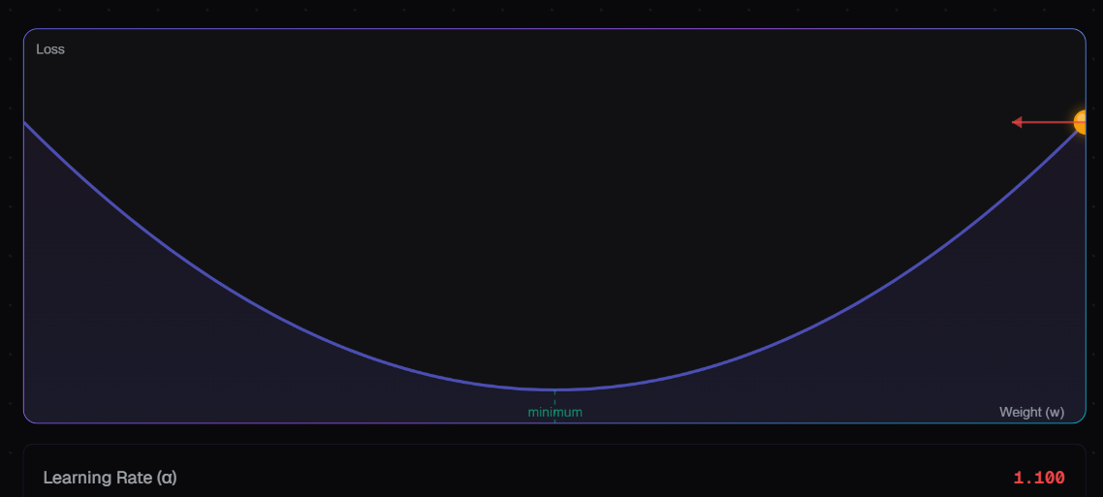
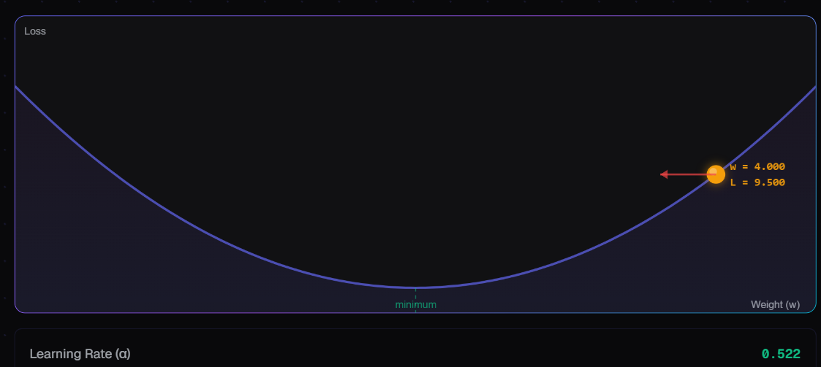

Learning Rate — Why Step Size Matters
🐢
💥
✓
α too small
α too large
α just right
Slow convergence
Overshoots / unstable
Fast, stable convergence
The model learns but takes many more steps than necessary. Training is inefficient.
Steps are so big the algorithm bounces past the minimum. Loss may never converge.
Loss decreases steadily each step and reaches a minimum efficiently.
LinearMind
10
Notes:
The learning rate α is often called the most sensitive hyperparameter in gradient-based optimisation. Too small: you'll get there, just painfully slowly. Too large: the algorithm may oscillate wildly or diverge. Just right: stable, efficient learning. In practice, techniques like learning rate schedules, Adam optimizer, and learning rate finders automate this selection. Key takeaway: Choosing a good learning rate is essential — LinearMind's gradient descent visualisation lets you experiment with this interactively.

Slide 11
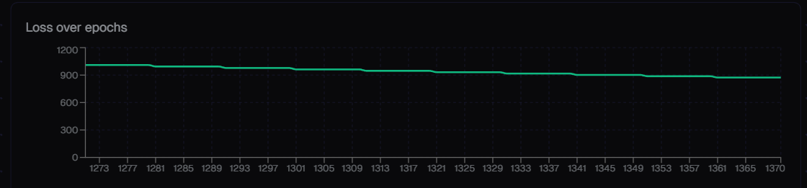
Training Process — Epochs & Convergence
The Training Loop:
1
Predict —
Compute ŷ = w·x + b for all inputs
2
Loss —
Compute MSE over all predictions
3
Gradient —
Compute ∂L/∂w and ∂L/∂b
4
Update —
Apply gradient descent step
5
Repeat —
Loop until convergence (epochs)
Convergence: loss stops improving meaningfully.
One full pass through data = one epoch
LinearMind
11
Notes:
Training is an iterative loop, not a single calculation. Each complete pass through the training data is called an epoch. In each epoch (or batch), we make predictions, measure error, compute gradients, and update the parameters. Convergence happens when the loss decreases by less than some threshold, or we reach a maximum number of epochs. Key takeaway: Training is repetition — the model gradually improves with each epoch.

Slide 12
Failure Cases — When a Line Isn't Enough
Outliers
Nonlinearity
A single extreme point can drag the regression line significantly, distorting predictions for all other data.
If the true relationship curves, a straight line will systematically under- or over-predict in different regions.
Heteroscedasticity
Multicollinearity
When the spread of residuals increases with x, standard linear regression becomes unreliable.
In multi-feature setups, highly correlated inputs cause unstable, unreliable coefficient estimates.
LinearMind
12
Notes:
Linear regression has clear assumptions. When they're violated, predictions suffer. Outliers: Use robust regression or identify/remove data quality issues. Nonlinearity: Add polynomial features or switch to a nonlinear model. Heteroscedasticity: Use weighted regression or transform the target variable. Multicollinearity: Use regularisation (Ridge/Lasso) or remove correlated features. Key takeaway: Always inspect residuals and check assumptions — LinearMind has a dedicated 'Failure Cases' module and interactive explorer for this.

Slide 13
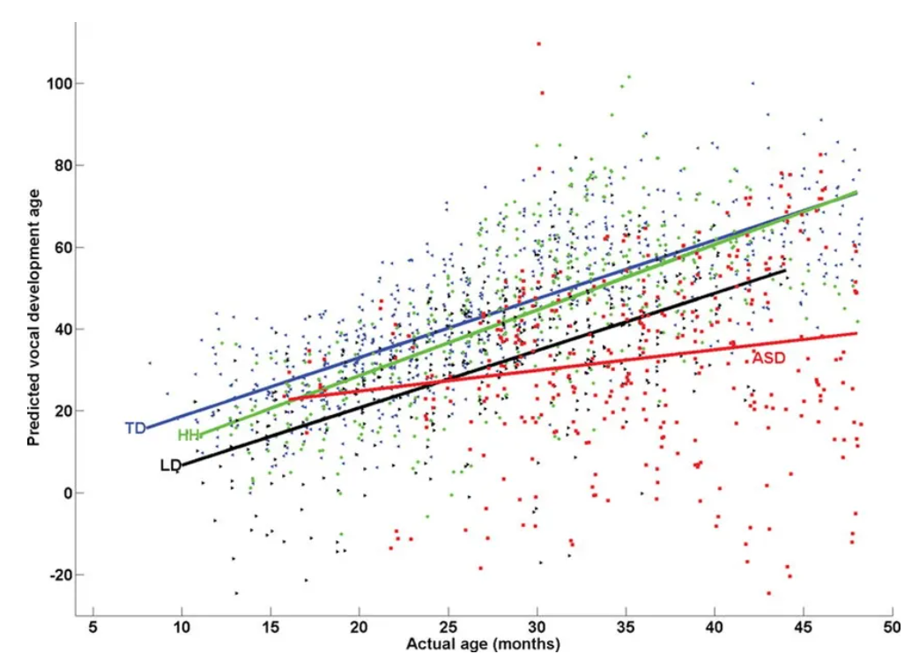
Multivariable Regression — More Features
ŷ = w₁x₁ + w₂x₂ + … + wₙxₙ + b
Each weight wᵢ reflects feature xᵢ's contribution
to the prediction, holding all others constant.
More power — but also more responsibility:
• Careful evaluation needed
• Feature scaling matters
• Risk of overfitting increases
• Interpretability can decline
LinearMind
13
Notes:
The jump from one input to many inputs is straightforward algebraically — we just add more terms. But the implications are significant: 1. Feature scaling: if x₁ is in thousands and x₂ is a fraction, the weights will be on completely different scales, distorting gradient descent. 2. Interpretability still holds — wᵢ = 'effect of feature i, holding everything else constant.' 3. This is directly the bridge to logistic regression and neural networks, where you add nonlinearities on top. Key takeaway: Multivariable regression is linear regression with a vector input — powerful but requiring careful data preparation.

Slide 14
Evaluation Metrics — Beyond MSE
MAE
Mean Absolute Error
MSE
Mean Squared Error
MAE = (1/n) · Σ|yᵢ − ŷᵢ|
MSE = (1/n) · Σ(yᵢ − ŷᵢ)²
Use when: When large errors are not disproportionately worse; more interpretable units.
Use when: Optimisation target; penalises large errors more.
RMSE
Root Mean Squared Error
R²
Coefficient of Determination
RMSE = √MSE
R² = 1 − (SS_res / SS_tot)
Use when: Same units as target variable — easier to interpret than MSE.
Use when: Fraction of variance explained; 1.0 is perfect, 0 is no better than mean.
R² = 0.85 means the model explains 85% of variance
LinearMind
14
Notes:
Different metrics reveal different things: MAE: easy to explain to non-technical stakeholders ('on average we're off by $5,000'). MSE: the standard optimisation target; sensitive to outliers. RMSE: the square root brings it back to the original scale — compare directly to the target's standard deviation. R²: tells you how much better you are than just predicting the mean every time. Always compare your model against this baseline. Key takeaway: Use RMSE for interpretability, R² for model quality assessment, and MAE when outliers shouldn't dominate the score.

Slide 15
PART B
The Product: LinearMind Platform
How we teach Linear Regression interactively
LinearMind
15
Notes:
This is the transition slide. Now that everyone understands what Linear Regression is — how it works mathematically, what can go wrong, and how to evaluate it — we can show exactly how LinearMind was designed to teach each of these concepts. Key takeaway: Every feature of the LinearMind platform maps directly onto a concept we just covered.

Slide 16

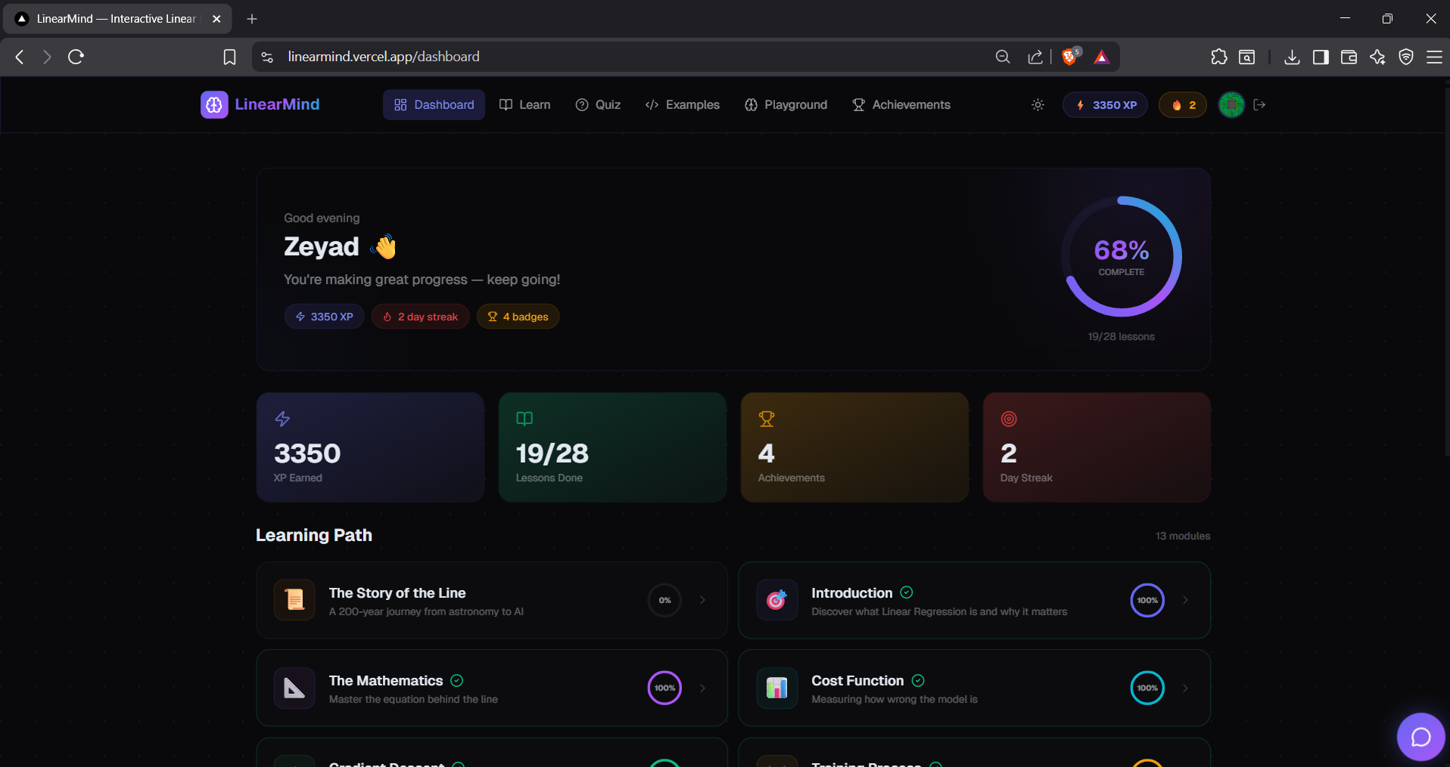





What is LinearMind?
An interactive web platform for
mastering Linear Regression.
Structured Curriculum
Interactive Visualizations
Hands-on Playground
AI Tutor (Gemini)
Quizzes & Code Examples
Progress & Achievements
LinearMind
16
Notes:
LinearMind is not a video course or a textbook. It is a browser-based platform that combines every learning modality: - Structured modules that build on each other - Visualisations you can interact with (drag, adjust, observe) - A playground for free experimentation - An AI tutor that explains concepts in your preferred style - Quizzes to reinforce knowledge - Progress tracking that motivates consistency Key takeaway: LinearMind is designed as an end-to-end learning experience, not just a reference tool.

Slide 17

Platform Scope — Verified Content & Features
13
28
15
Modules
Lessons
Interactive Visuals
82
8
10
Quiz Questions
Code Examples
Achievements
LinearMind
17
Notes:
These are real, implemented numbers — not roadmap targets. 13 modules, 28 lessons, 15 interactive visualization components, 82 quiz questions, 8 code examples across Python/JS/TS, and 10 achievement badges. Every one of these is live in the platform. We're presenting facts, not forecasts. Key takeaway: LinearMind is a complete, fully built product — not a prototype.

Slide 18
Curriculum Map — History to Neural Networks
01
The Story of the Line
08
Comparison
02
Introduction
09
Multivariable Regression
03
The Mathematics
10
Data Intuition
04
Cost Function
11
Bias-Variance Tradeoff
05
Gradient Descent
12
Evaluation Metrics
06
Training Process
13
Into Neural Networks
07
Failure Cases
LinearMind
18
Notes:
The curriculum is carefully sequenced: — Modules 1–2: Historical context and big-picture intuition — Modules 3–6: The mathematical machinery (notation, loss, gradient descent, training) — Module 7: Failure modes (critical for real-world use) — Modules 8–10: Comparisons, multivariable, data intuition — Modules 11–12: Advanced evaluation concepts (bias-variance, metrics) — Module 13: Bridge from linear regression directly into neural networks Key takeaway: The progression isn't arbitrary — each module builds on the last, ending with a bridge to deep learning.

Slide 19
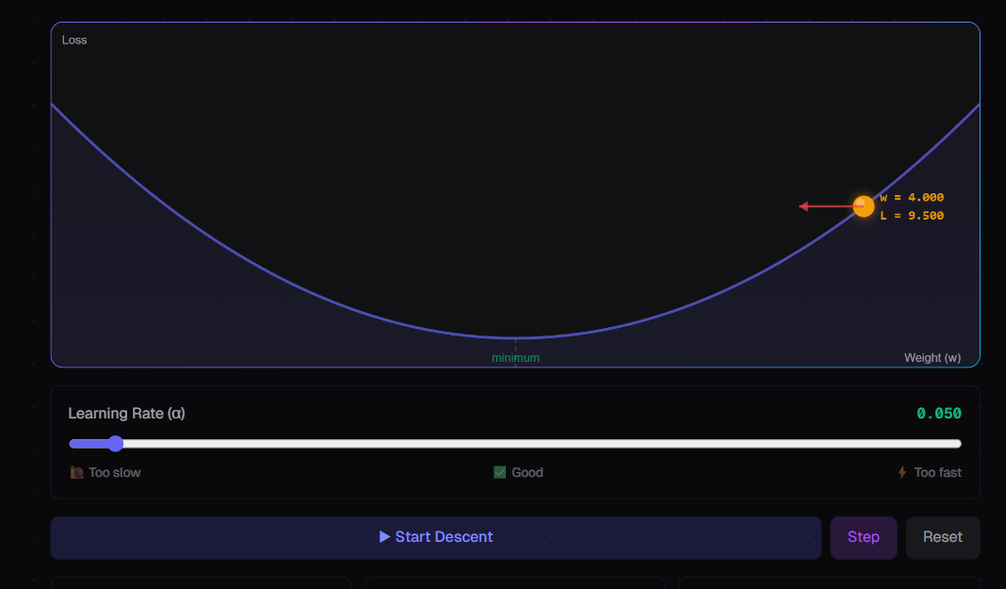
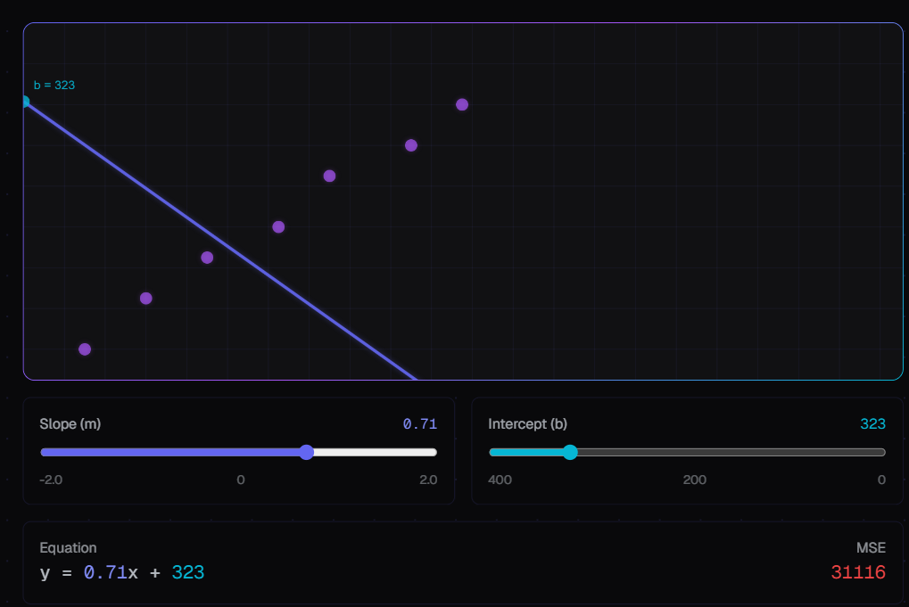
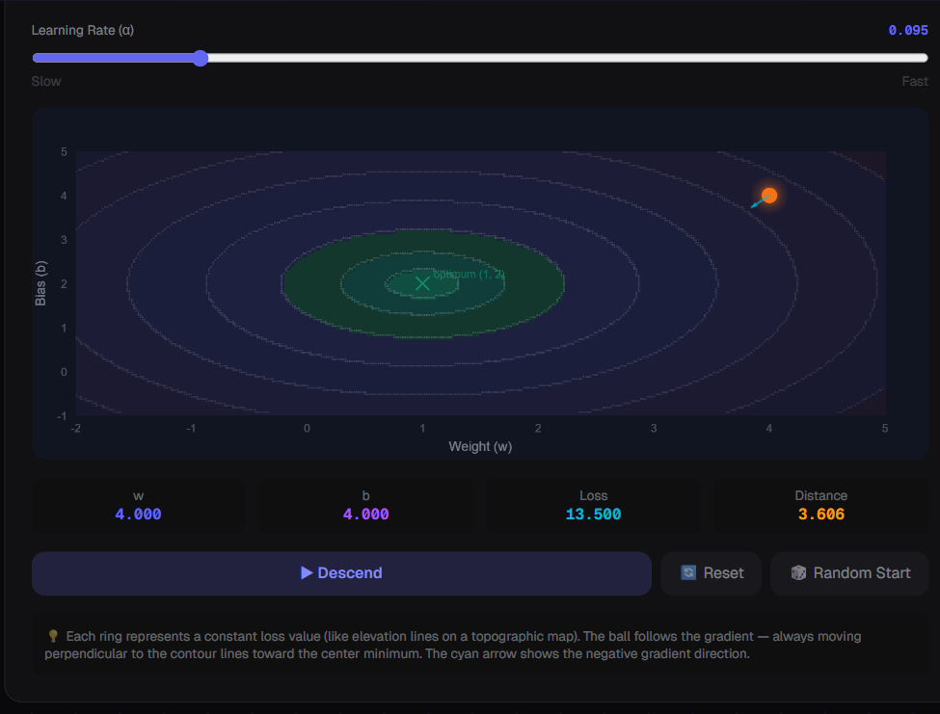
Interactive Visualizations — 15 Components
Learn by manipulation — not passive reading.
Regression Canvas
Multivariate Explorer
Slope–Intercept Explorer
Feature Scaling Demo
Cost Function (MSE) Visualizer
Correlation Explorer
Gradient Descent (2D)
Bias–Variance Demo
Gradient Descent (3D)
Metrics Explorer
Training Visualization
Neuron Bridge
Failure Cases Explorer
Residuals Visualization
Comparison View
LinearMind
19
Notes:
Each of the 15 visualization components corresponds to a specific concept in the curriculum. For example: the Gradient Descent 3D visualizer lets you watch the loss surface and see the optimizer's path in real time. The Bias-Variance Demo lets you drag a complexity slider and watch underfitting and overfitting happen live. The Neuron Bridge is especially interesting — it shows the mathematical equivalence between a linear regression model and a single artificial neuron, which directly motivates the neural networks module. Key takeaway: Interactivity is the core learning mechanic — every major concept has a hands-on component.

Slide 20
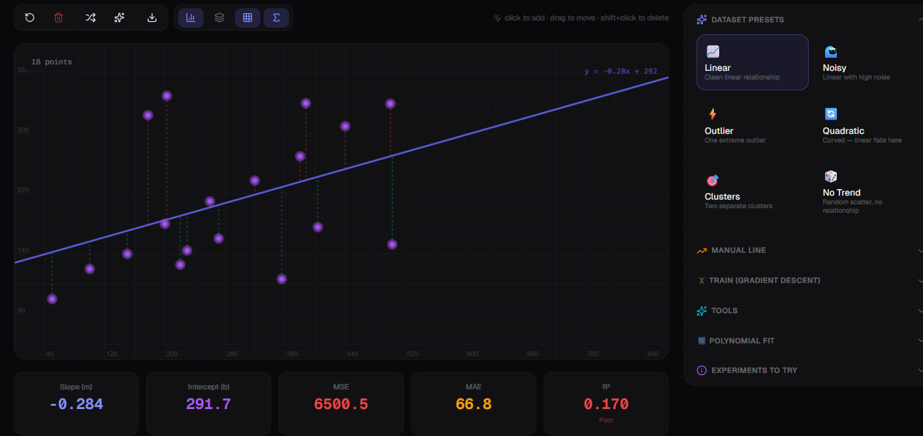
The Playground — Experiment Like a Lab
Regression Workbench
Point controls:
Add & drag points — fit updates in real time.
Presets:
Linear · Noisy · Outlier · Quadratic · Clusters · No Trend
Overlays:
Residuals · Equation · Grid · Confidence Band · Residual Histogram
"This turns abstract math into something you can feel."
LinearMind
20
Notes:
The Playground is a free-form regression workbench. Users can: — Click to add data points, drag them to new positions — Watch the regression line refit immediately — Load one of 6 presets to explore specific scenarios (outliers, quadratic data, clusters, etc.) — Toggle overlays: show residuals as vertical lines, display the equation, add a confidence band, or open a residual histogram This is the most exploratory part of the platform — it has no 'lesson' framing, just pure experimentation. Key takeaway: The Playground lets learners build intuition through direct manipulation of data, not by reading about it.

Slide 21
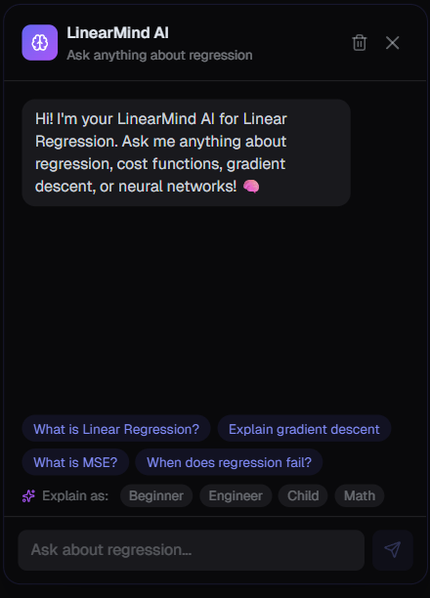
AI Tutor — Gemini-Powered Chat
Floating Chatbot — always available
Focused on Linear Regression questions.
Powered by Gemini via a secure server-side API route.
4 Explanation Styles:
Beginner
Plain language, no assumed math background
Engineer
Technical depth, implementation focus
Child
Analogies and everyday examples
Math
Rigorous notation and derivations
LinearMind
21
Notes:
The AI Tutor is accessible from anywhere in the platform via a floating chat button. It uses the Gemini API through a Next.js server route at /api/chat — the API key never leaves the server. The four explanation modes are genuinely different: selecting 'Child' gets analogies and everyday examples, selecting 'Math' gets partial derivatives and formal notation. It also renders LaTeX-style math in the response for the Math and Engineer modes. Key takeaway: The AI tutor adapts to the user's background, not the other way around — the same question can be explained four different ways.

Slide 22
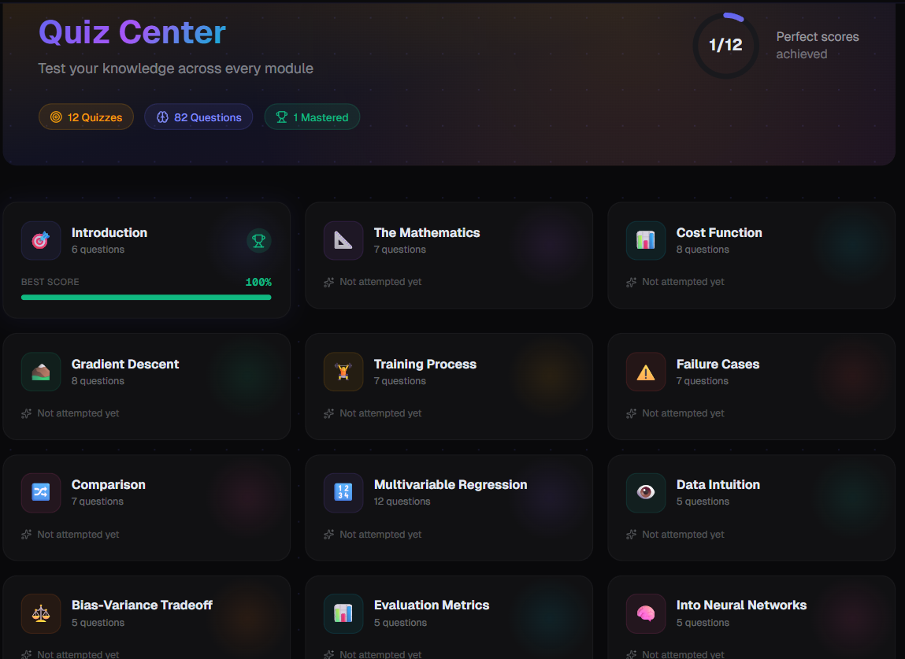
Quizzes — Knowledge Checks
82 Questions Across All Modules
Structure:
• Each quiz is tied to a specific module
• Questions reinforce the lesson content
• Scores are tracked per-module in Firestore
Purpose:
• Immediate knowledge validation
• Surfaces gaps before moving on
• Contributes to XP and achievements
Complements the visuals by testing
comprehension, not just recall.
LinearMind
22
Notes:
Quizzes serve a different learning function from the visualizations. While the visuals build intuition, quizzes test whether the learner can correctly apply a concept — is this a situation where MSE is the right metric? What happens to the gradient when we're at the minimum? Scores are stored per-module in Firestore under quizScores: Record<string, number>, so learners can see which modules need more work. Key takeaway: Quizzes close the feedback loop — you don't just see the concept, you prove you understand it.

Slide 23
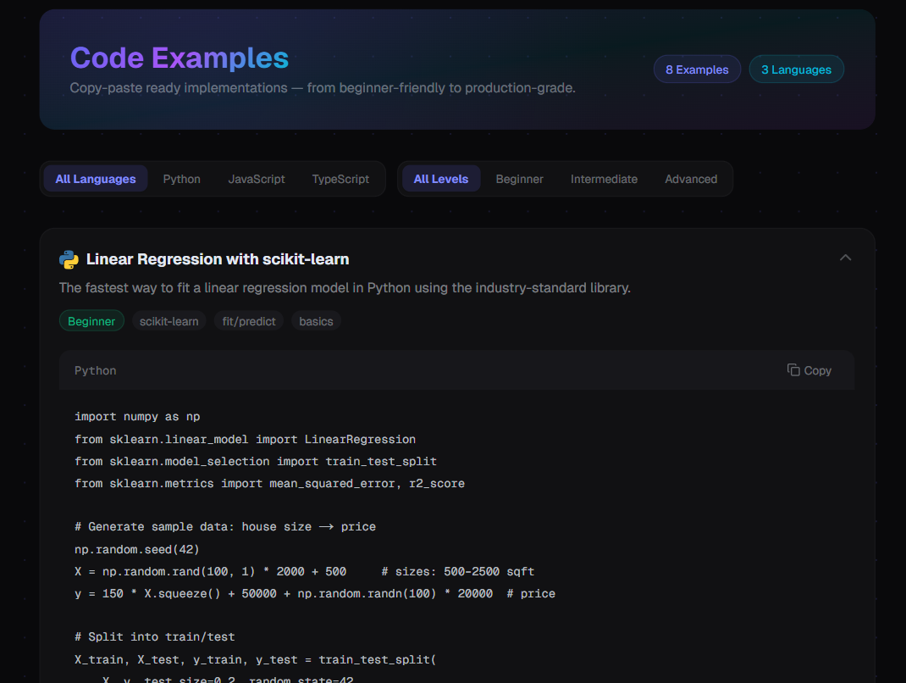
Code Examples — Concept to Implementation
8 Practical Code Examples
Languages covered:
Python
JavaScript
TypeScript
Example topics:
• Linear fit / predict from scratch
• Gradient descent implementation
• Multivariable + feature scaling
• Evaluation metrics (MSE, RMSE, R²)
• Pattern examples across all concepts
LinearMind
23
Notes:
The code examples page bridges the gap between mathematical understanding and practical implementation. A learner who's just mastered gradient descent conceptually can now immediately see how to write it in Python or JavaScript — with proper gradient computations, learning rate, and iteration loop. Three languages are supported to accommodate different audiences: Python (data science), JavaScript (web developers), TypeScript (typed JS for those who prefer it). Key takeaway: LinearMind doesn't stop at intuition — it shows you how to build it yourself.

Slide 24

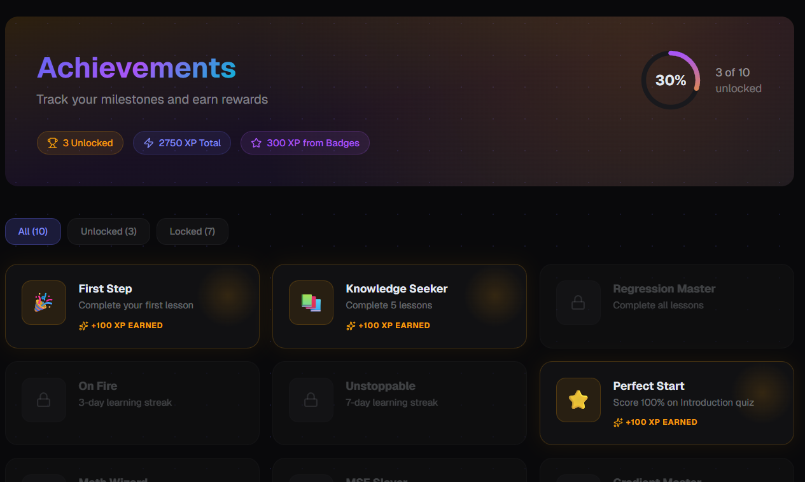

Gamified Progress — XP, Streak & Achievements
XP Points
Earned by completing lessons and quizzes
Streak Tracking
Daily engagement measured by lastActiveDate
10 Achievements
Unlockable badges for milestones
Stored in Firestore: xp · streak · lastActiveDate · achievements[]
LinearMind
24
Notes:
The gamification layer is designed to encourage consistency, not just one-off visits. XP accumulates as lessons are completed and quizzes are passed. The streak tracks how many consecutive days the user has been active. The 10 achievements reward specific milestones (completing a module, achieving a perfect quiz score, etc.). All of this is persisted to Firestore under the user's document, so it syncs across devices automatically. Key takeaway: Progress tracking isn't cosmetic — it's a mechanism for sustaining long-term engagement.

Slide 25

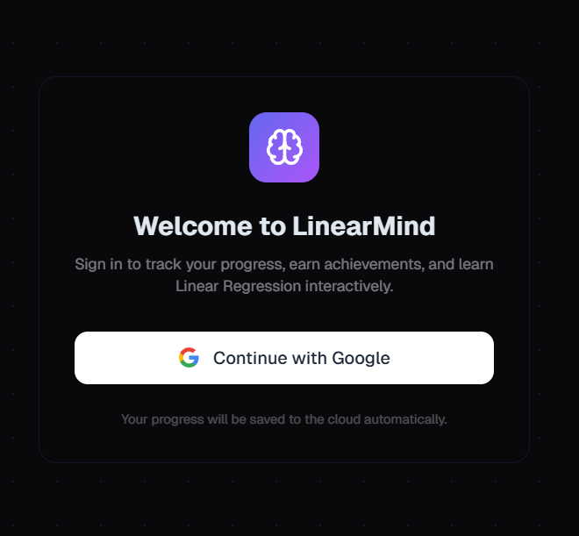
Cloud Sync + Security — Firebase
Authentication & Storage
Auth: Google Sign-In via Firebase Authentication
— one-click, no password management
Storage: Cloud Firestore at path:
users/{uid}
Security rules — principle of least privilege:
✓ Users may read/write only their own document
(request.auth.uid == userId)
✗ All other access
denied
LinearMind
25
Notes:
Security is enforced at the Firestore rules layer — not just in application code. Even if someone obtains another user's UID, they cannot read or modify that user's progress document because the rule requires request.auth.uid to match the document path. All analytics tracking is conditional — Firebase Analytics is only initialised 'when supported', respecting browser privacy settings. Key takeaway: User data is protected by database-level security rules, not trust in the frontend.

Slide 26

Architecture & Tech Stack
Frontend
API Layer
Firebase
· Next.js 16.2.6 (App Router)
· /api/chat server route
· Firebase Auth (Google Sign-In)
· React 19.2.4
· Gemini API (gemini-3-flash-preview)
· Cloud Firestore (progress sync)
· TypeScript 5
· generateContent endpoint
· Firebase Analytics (conditional)
· Tailwind CSS 4
· API key stays server-side
· Version 12.13.0
· Zustand (persisted state)
A cohesive system: content + visuals + AI support + cloud persistence
LinearMind
26
Notes:
This is the full technical picture. Frontend: Next.js with the App Router handles server and client components. React 19 with concurrent features. Tailwind CSS 4 for styling with the dark glassmorphism design. Zustand with local storage persistence for UI state that doesn't need cloud sync. API: The AI chat is routed through a Next.js server route so the Gemini API key is never exposed to the browser. Firebase: handles authentication (no passwords to manage), progress persistence (syncs across devices), and optional analytics. Key takeaway: LinearMind is a modern, well-architected full-stack application — content, interaction, AI assistance, and cloud sync all working together.

Slide 27
THANK YOU ! Any Questions??
LinearMind
27
Notes:
This is the full technical picture. Frontend: Next.js with the App Router handles server and client components. React 19 with concurrent features. Tailwind CSS 4 for styling with the dark glassmorphism design. Zustand with local storage persistence for UI state that doesn't need cloud sync. API: The AI chat is routed through a Next.js server route so the Gemini API key is never exposed to the browser. Firebase: handles authentication (no passwords to manage), progress persistence (syncs across devices), and optional analytics. Key takeaway: LinearMind is a modern, well-architected full-stack application — content, interaction, AI assistance, and cloud sync all working together.

