Slide 1
Design Thinking Toolkit
Design Spec

Slide 2
Intro
The Design Thinking Toolkit is a simple(ish) series of applications, designed to support Design Thinking workshops.
The initial focus is on image processing; taking the walls of post-its generated in Design Thinking workshops and digitising the output.
If successful, it is likely that other applications will be identified

Slide 3
Architecture / technologies overview
All apps are built as web apps, using Python’s Django framework for the web server code.
The sticky-note search and text extraction are implemented using Azure services.
Webdev libraries used include Bootstrap; jQuery (required for Bootstrap); d3.js (for the sticky-note editor).
Each app includes a comprehensive test-set to ensure (as far as possible) that it works as expected.
Tests are implemented using Django’s test runner, via Travis CI’s build process (i.e. on each Github commit, all tests are run). Functional tests are implemented in Selenium.
Apps are deployed using Heroku as the web server. This also allows the Azure subscription keys to be hidden, as environment variables.
Apps are developed to be responsive, but the best UX is likely to be on a laptop, desktop or tablet.
Apps will work on a phone, but features like image editing are likely to be fiddly.

Slide 4








Web Server
Web Server
User Devices

Slide 5
Overall Design
[Logo] Design Thinking Toolkit
1
1
Logo and title bar
TODO: decide on logo design, title font, back-colour / image
Events: clicking on logo / title takes user to home page
2
Home About [Other options?]
3
App#1 Icon
App#2 Icon
App#3 Icon
2
Navigation bar
TODO: decide on navbar options. E.g. “Home” and “About” only, or others?
Events: clicking on options takes user to relevant page
App#1 Name
App#1 Description
App#2 Name
App#2 Description
App#3 Name
App#3 Description
3
Application summary cards
TODO: work out how many apps, what each will do, names and logos.
Events: clicking on each card takes user to relevant app
App#4 Icon
App#5 Icon
App#6 Icon
App#4 Name
App#4 Description
App#5 Name
App#5 Description
App#6 Name
App#6 Description

Slide 6
App#1: Sticky Note Information Processor (SNIP)

Slide 7
Overview
The Sticky Note Information Processor (SNIP) is the first app in the Design Thinking Toolkit
It works in the following way:
The user selects an image from their local computer filesystem
The image is processed to identify believed sticky notes (if the user wishes)
The results are displayed to the user, who can then edit; create more regions, update (move, resize) existing regions, delete wrong regions.
If the user didn’t want to discover stickies, they can assign regions manually in this way
The image is then analysed to find text (printed and/or handwritten). The text found is matched to the boxes provided by the user
The result is outputted in some way (e.g. printed JSON; JSON file; PowerPoint slide)

Slide 8
User Workflow
Summary
User browses to app homepage, selects image from local machine.
User has option to discover post-its via Azure service, displayed as boxes on-screen. User can add, change or delete boxes to create regions.
User sends image for text extraction, results are displayed, options to download output as JSON and/or PowerPoint.
Detail: see Workflow.pub, https://1drv.ms/u/s!Ai4BesQlrm_xiINv9I3qeD7yHmkq3Q?e=e371y1

Slide 9
Results of workflow
Three ‘app’ pages required:
“Home”; user browses to this, and uploads image
“Set Regions” page; user discovers post-its, sets regions on the image
“Text Analysis & Output” page; user views text output, can download as files
Two (four?) ‘other’ pages to include:
“About”; contains information about the app / project (what?)
“FAQ”; contains info about how the app works, if / where the images are stored, accuracy of the prediction, files that can be analysed, cookies / privacy etc.
Overall “Home” page, explaining what the app is for?!
“How to use” page, with some instructions?
Considerations:
Pages should use a very consistent look-and-feel throughout (i.e. templating)
For app pages, should be very clear to users where they are in the process
When using the app, need to consider – if a user leaves the main app flow, and then comes back again, what happens?
Cases: stays “within” overall app (e.g. FAQ page); leaves app altogether (e.g. browse to Google)
Overall: what behaviour is catered-for, in terms of going back and forth between pages?
E.g. going back steps in the flow – what happens? Warning to users that results will be binned?

Slide 10
Pages and Wireframes

Slide 11
Home Page
Overview, wireframe, div structure, tests

Slide 12
Home page
Has the following functionality:
Navbar, with icon, “About”, “FAQ” ← also other app pages?
Progress stepper bar, showing progress through the app process (step 1)
Explanatory text of some sort
“?” icons and/or tooltips, to provide info on controls
Button to browse to image file on computer
Space for a preview of the selected image (whether portrait or landscape)
“Next” button, to progress to step 2

Slide 13
[icon]
1
Notes
Item (1) should be templated across all pages
Item (2) should be templated across all app pages (i.e. steps 1, 2, 3 in the item)
Item (7) could be template across all app pages, with some logic to display (and similarly for the “previous” button)
When the “choose image” button is clicked, no information needs to be sent to the server. Instead, the filename can be cached locally for the next screen.
Ultimately though, the image will need to be sent to server, iot process text – do it now?
The shadow under the navbar is purposeful, but may need a rethink?
Currently a bit lacking in colour. Some options:
Patterned navbar? See this
Patterned / jumbotron <body>?
Trying to keep the ‘green’ theme running throughout
Tooltips currently not shown, but can be added easily (I think!)
About
FAQ
1
2
3
2
CHOOSE AN IMAGE TO PROCESS
SET REGIONS IN THE IMAGE
FIND TEXT IN THE IMAGE, AND OUTPUT
3
Choose an image from your computer to process
5
Choose image
7
→
NEXT
[image pane]
6

Slide 14
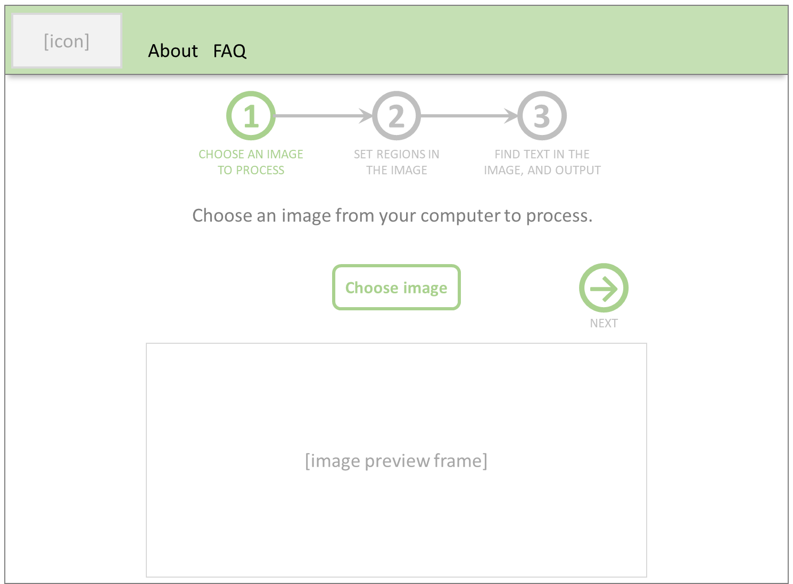
<nav class=“navbar navbar-expand-lg (etc.)”>
<div class=“container”>
<div class=“row”>
<div class=“col-12” id=“nav-app-steps”>
<div class=“row”>
<div class=“col-12” id=“txt-step-description”>
<div class=“row”>
<div class=“col-2” id=“btn-previous>
<div class=“col-8” id=“btn-image-selector”>
<div class=“col-2” id=“btn-next>
<div class=“row” >
<div class=“col-12” id=“img-selected-image”>

Slide 15
Set Regions page
Has the following functionality:
Navbar, with icon, “About”, “FAQ” ← also other app pages?
Progress stepper bar, showing progress through the app process (step 2)
Explanatory text of some sort
“?” icons and/or tooltips, to provide info on controls
Space to show the selected image (whether portrait or landscape)
“Find sticky notes” button
“Add region” button
“Next” button, to progress to step 3
“Back” button, to go back to step 1 (e.g. choose a different image)

Slide 16
[icon]
1
Notes
Item (1) should be templated across all pages
Item (2) should be templated across all app pages (i.e. steps 1, 2, 3 in the item)
If the “Find sticky notes” button is clicked, information will need to be sent to the web server, and then onto the Azure image processing server.
When boxes are added, this information could be sent to the server – but does it need to be? Or, is it better to send it now (i.e. before the text processing is done)?
Item (5) will include the various box editing features (move, resize, delete), as JavaScript.
Items (6) and (7) will probably require quite a detailed explanation around what they’re doing, and why. Or, could add it to item (3) as a “?” button?
Useful to show a warning if item (8) is clicked without any regions added?
If item (9) is clicked, the previous page should render and the currently-selected image should be displayed.
About
FAQ
1
2
3
2
CHOOSE AN IMAGE TO PROCESS
SET REGIONS IN THE IMAGE
FIND TEXT IN THE IMAGE, AND OUTPUT
Click “Find sticky notes” to use image detection to find sticky notes in the image. This will add a series of ‘regions’ to the image. To add new regions manually, click “Add region”. To move a region, click and drag inside it. To resize a region, click and drag on one of the handles (top-left and bottom-right corners of each region). To delete a region, double-click inside it.
3
←
9
Find sticky notes
Add region
→
6
7
8
PREVIOUS
[image pane]
NEXT
5

Slide 17
<nav class=“navbar navbar-expand-lg (etc.)”>
<div class=“container”>
<div class=“row”>
<div class=“col-12” id=“nav-app-steps”>
<div class=“row”>
<div class=“col-12” id=“txt-step-description”>
<div class=“row”>
<div class=“col-2” id=“btn-previous>
<div class=“col-8” id=“btn-image-selector”>
<div class=“col-2” id=“btn-next>
<div class=“row” >
<div class=“col-12” id=“img-selected-image”>

Slide 18
Text Analysis page
Has the following functionality:
Navbar, with icon, “About”, “FAQ” ← also other app pages?
Progress stepper bar, showing progress through the app process (step 3)
Explanatory text of some sort
“?” icons and/or tooltips, to provide info on controls
Space to show the image and output (whether portrait or landscape)
“Analyse text” button
“Output as JSON” button(?)
“Output as PowerPoint” button(?)
“Back” button, to go back to step 2 (e.g. choose a different regions)

Slide 19
[icon]
1
Notes
Item (1) should be templated across all pages
Item (2) should be templated across all app pages (i.e. steps 1, 2, 3 in the item)
If the “Analyse text” button is clicked, information will need to be sent to the web server, and then onto the Azure OCR server.
Item (5) will include the various box editing features (move, resize, delete), as JavaScript.
Item (6) will probably require quite a detailed explanation around what it’s doing (or “?” button next to Item (3)?)
NOTE: method used should be consistent with Step 2.
After item (6) is clicked, the results need to be displayed in some way. Tooltips on the SVG boxes, showing the extracted text? Also, colour the SVGs to show confidence in OCR results?
Items (7) and (8) will need some explanation, but probably not much(?).
Is some sort of preview useful for these two?
If item (9) is clicked, the previous page should render and the currently-selected image should be displayed, together with the regions that the user specified.
About
FAQ
1
2
3
2
CHOOSE AN IMAGE TO PROCESS
SET REGIONS IN THE IMAGE
FIND TEXT IN THE IMAGE, AND OUTPUT
Click “Analyse text” to find printed or handwritten text from the image. Once the text has been analysed, click “Save as JSON” to save the output as JSON text, or “Save as PowerPoint” to save the output as a PowerPoint slide.
3
←
9
Analyse text
Save as JSON
Save as PowerPoint
6
7
8
PREVIOUS
[image pane]
5

Slide 20
About page
Largely static text content (potentially some images)
Provides the following information:
Navbar, with icon, “About”, “FAQ”
Introduction to the tool – what it’s for, how it works (briefly), known limitations etc.
Bit about the architecture / technologies used? [E.g. arch diagram?]
Link github repo(?)
Version information (e.g. log for future changes)

Slide 21
[icon]
1
Notes
Item (1) should be templated across all pages
Put collapses on each of the headers? Or a list of items at the top, with links to each paragraph?
May not be useful if the text is visible easily on one page
About
FAQ
2
Introduction
What the tool is for, bit on how it works (“uses AI and Machine Learning techniques”) etc.
Technologies and Architecture
Related to earlier slide; Django for the server code, Python to access Azure APIs, Selenium for functional testing, d3.js for the image editor, Bootstrap for the web design, Travis CI for the CI/CD pipeline, Heroku for deployment, Azure for the Obj Detection and OCR – anything else??
Limitations
Uses Azure’s Object Detection and OCR services; these are generally good, but I can’t influence their development. Also, bit about updates (i.e. they’ll be a bit ad-hoc, as it’s a personal project)
Development and Feedback
Link to Github repo, instructions for feedback (bugs and issues, improvements)
Version information
Version num, date and release / change summary
3
4
5
6

Slide 22
FAQ page
Largely static text content
Main questions list; either hyperlinked at top to more info, or collapsible paragraphs
Some areas to cover:
Storage of images – Heroku doesn’t, but Azure (probably) does
Limitations on Azure services (e.g. number of images / day?)
Slow load-time on Heroku
Use on mobile devices (can be done, but not designed for this)
Quality of Azure services (e.g. OCR is very good, Post-it finder is so-so)
Cookies (i.e. there aren’t any)
Browser compatibility (e.g. won’t work properly on older browsers)
Support (e.g. “best effort”; how to raise a bug, provide feedback etc.)
…what else?

Slide 23
[icon]
1
Notes
Item (1) should be templated across all pages
Put collapses on each of the headers? Or a list of items at the top, with links to each paragraph?
May not be useful if the text is visible easily on one page
About
FAQ
2
Introduction
What the tool is for, bit on how it works (“uses AI and Machine Learning techniques”) etc.
Technologies and Architecture
Related to earlier slide; Django for the server code, Python to access Azure APIs, Selenium for functional testing, d3.js for the image editor, Bootstrap for the web design, Travis CI for the CI/CD pipeline, Heroku for deployment, Azure for the Obj Detection and OCR – anything else??
Limitations
Uses Azure’s Object Detection and OCR services; these are generally good, but I can’t influence their development. Also, bit about updates (i.e. they’ll be a bit ad-hoc, as it’s a personal project)
Development and Feedback
Link to Github repo, instructions for feedback (bugs and issues, improvements)
Version information
Version num, date and release / change summary
3
4
5
6

