Slide 1
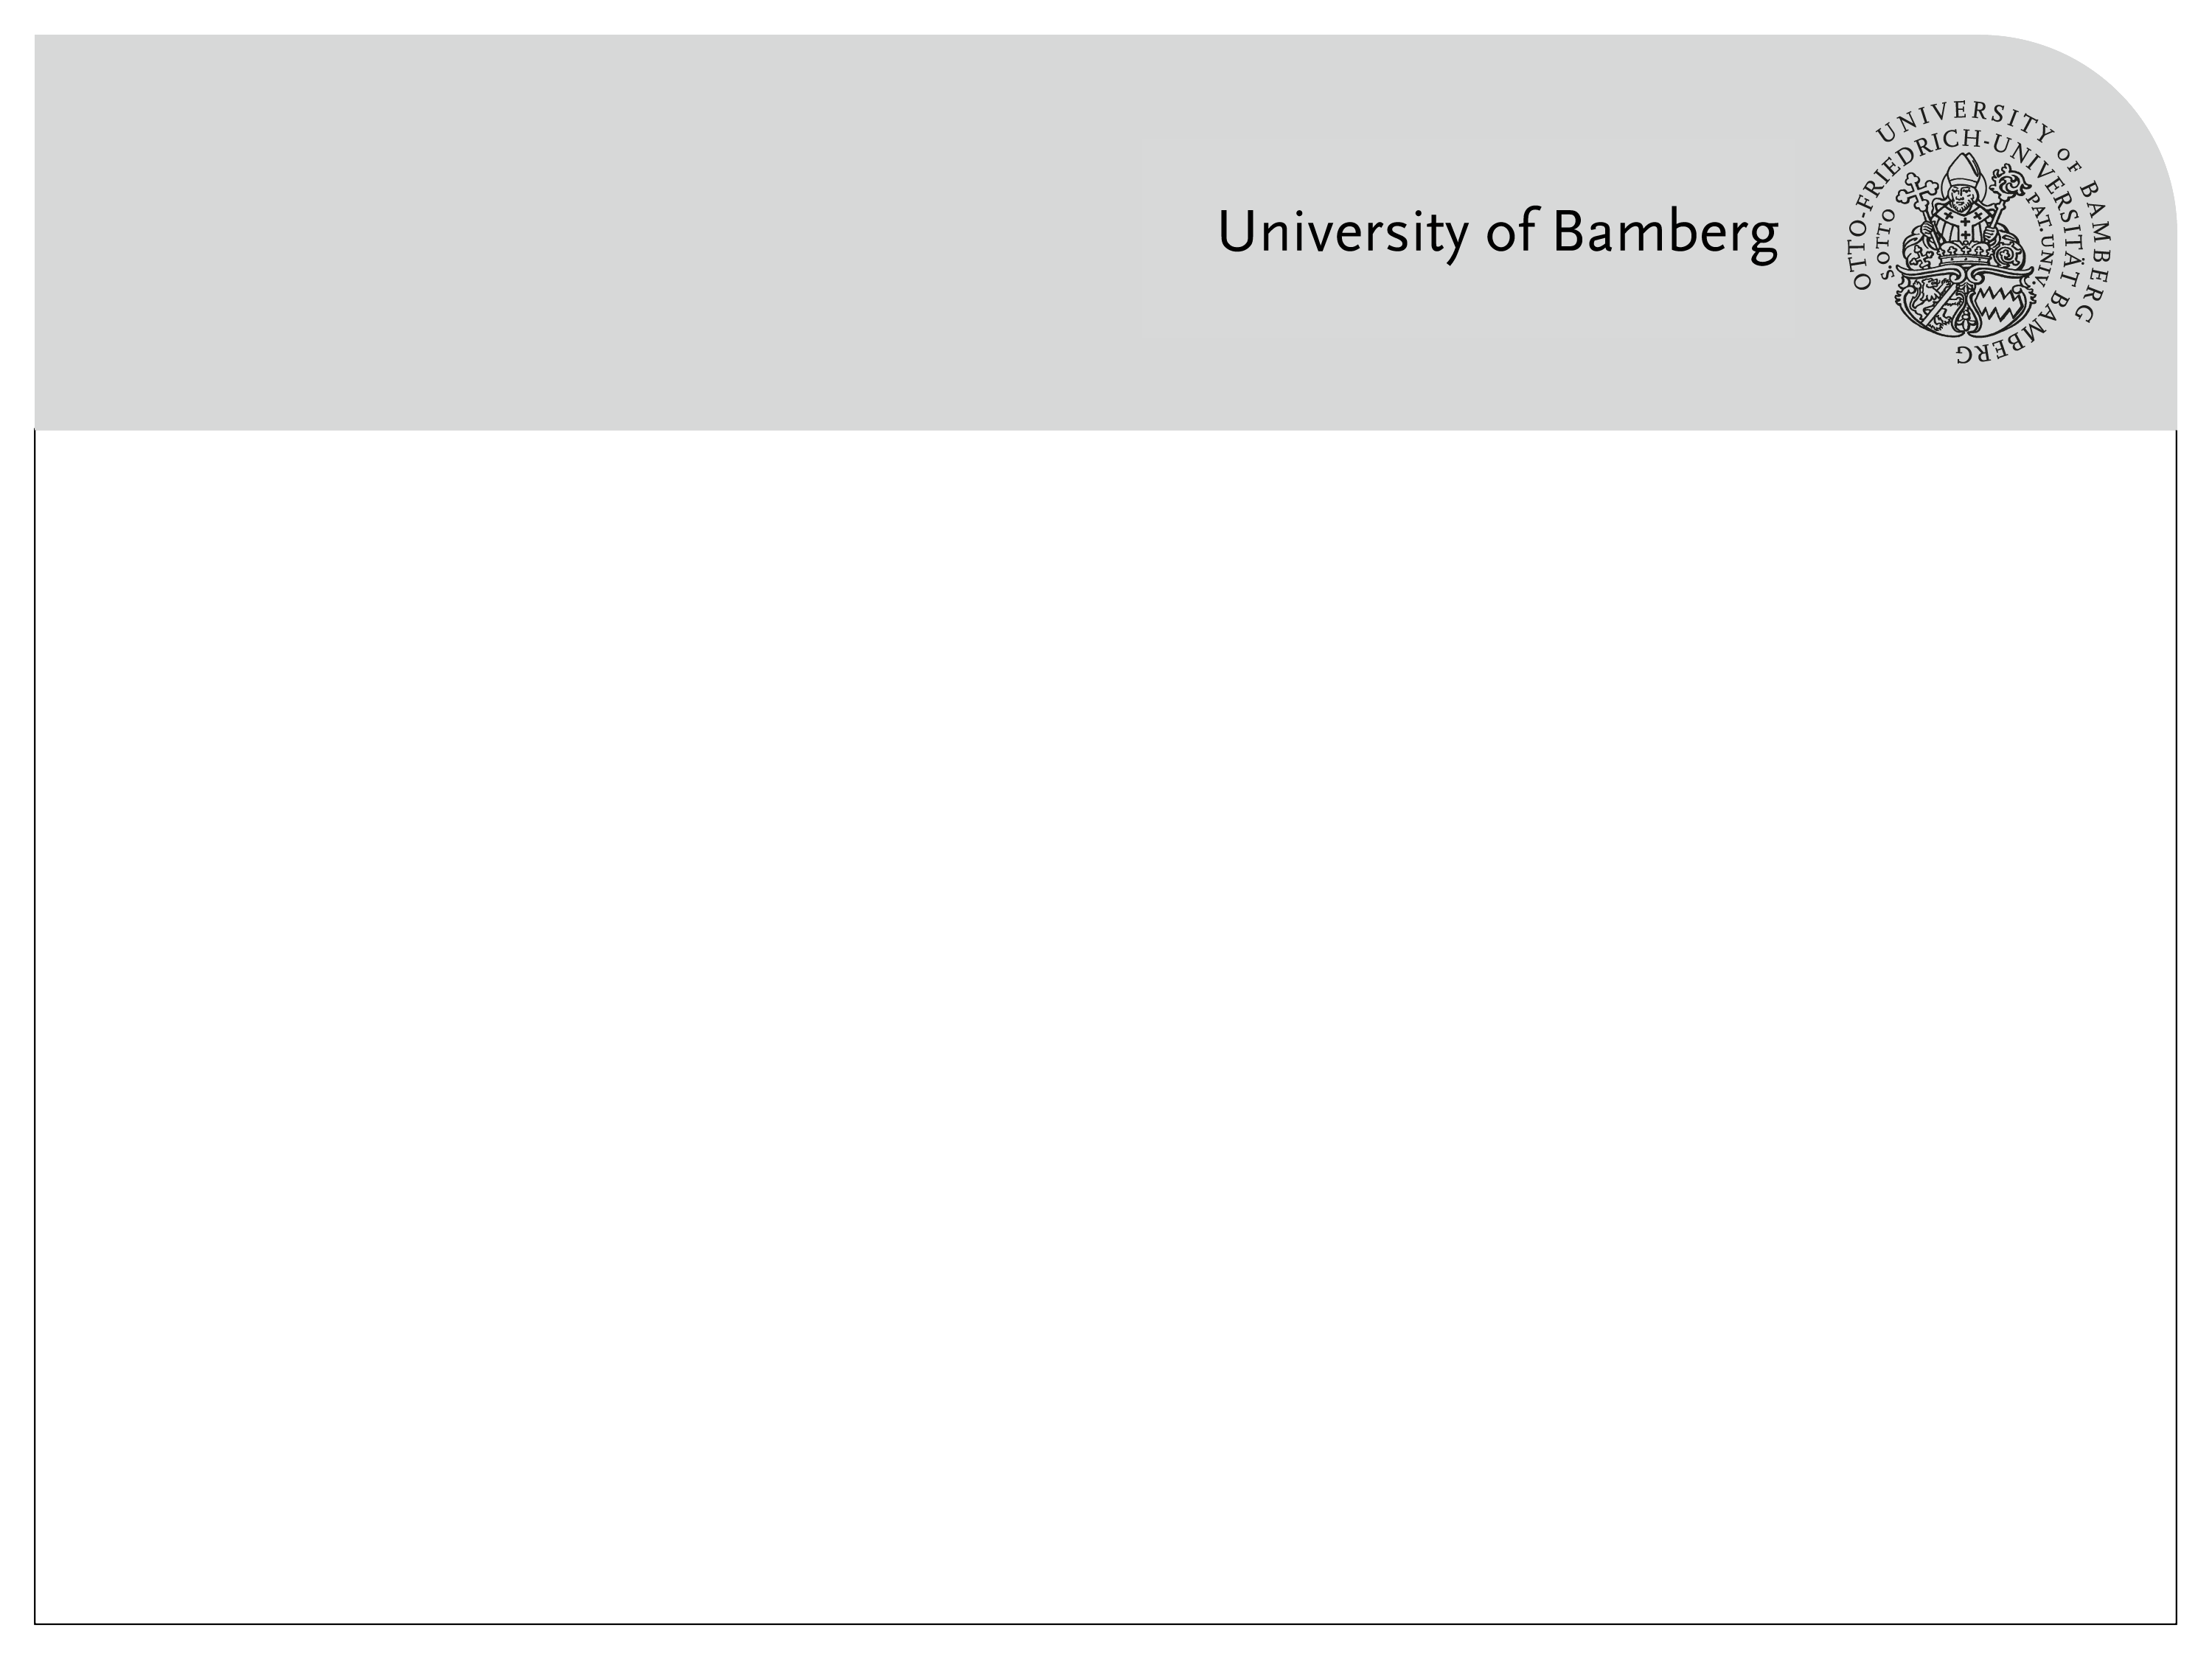
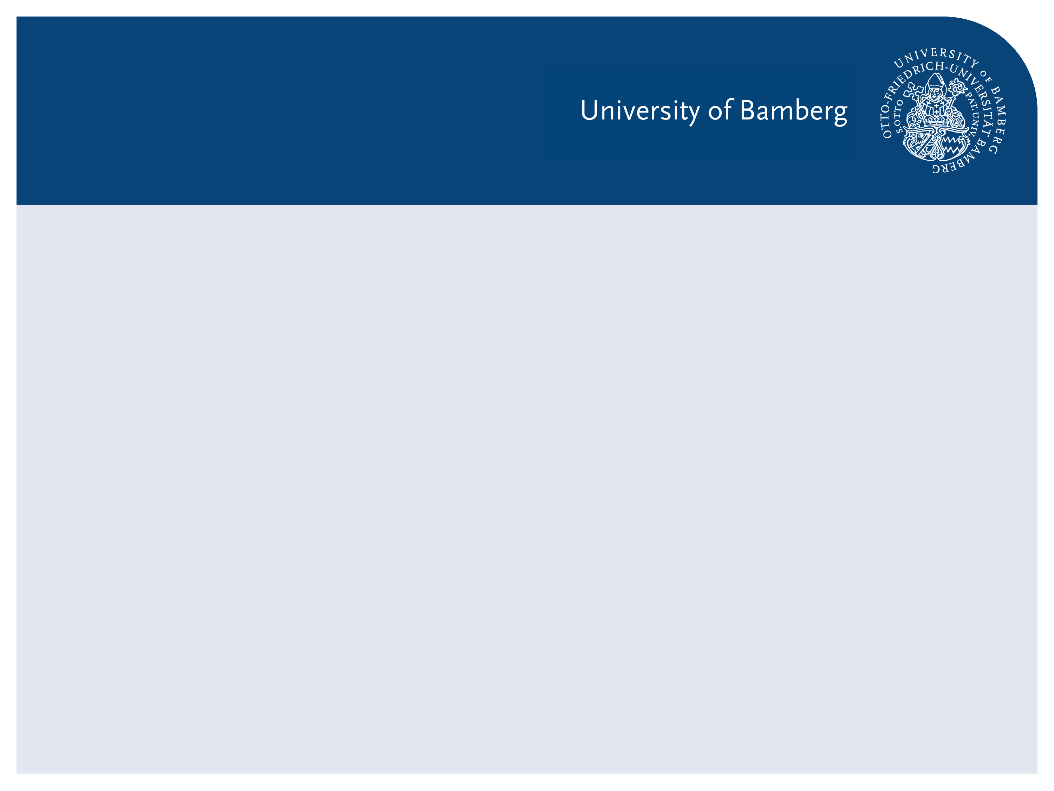
Master thesis: Recognizing Urban Points of Interests with Convolutional Neural Networks
1st presentation
Andriy Zoryk

Slide 2
Agenda
Motivation
What is CNN?
Related works
Datasets

Slide 3
Motivation

Slide 4
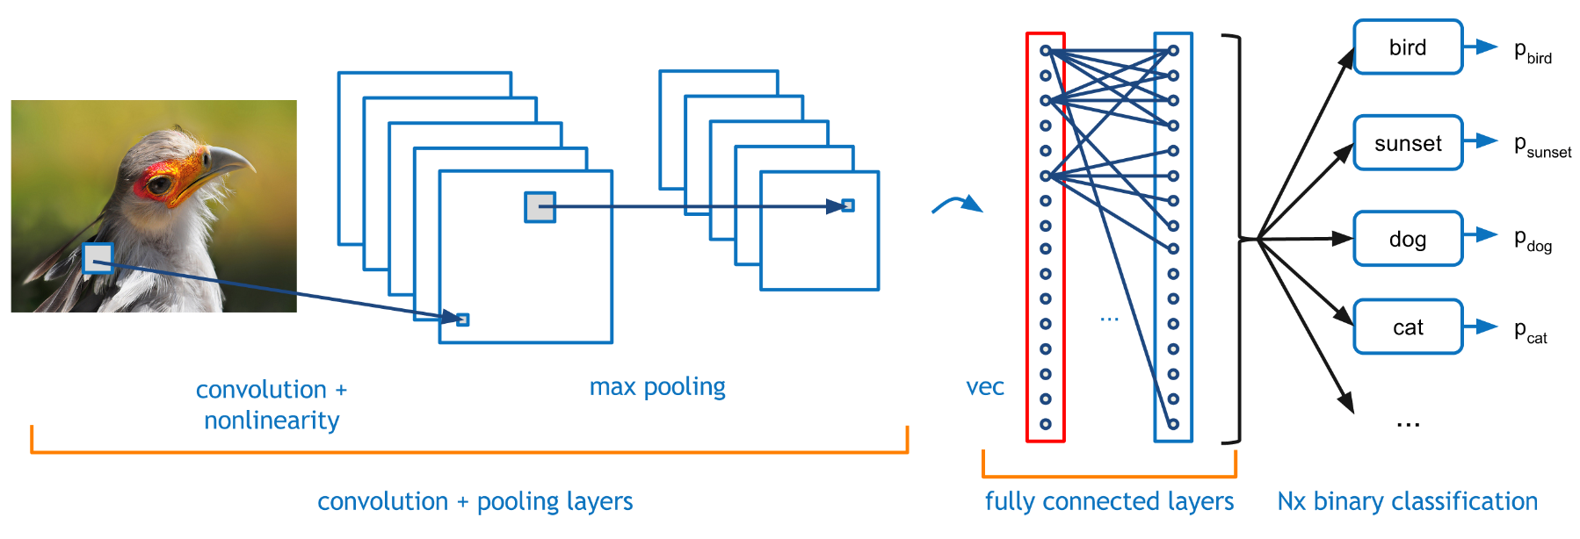
What is CNN?
[source: http://graphics.cs.cmu.edu/]

Slide 5
IM2GPS (2008)
Related works
estimating geographic information from a single image
one of the first approaches to geolocate random pictures
[Hays, Efros, 2008]

Slide 6
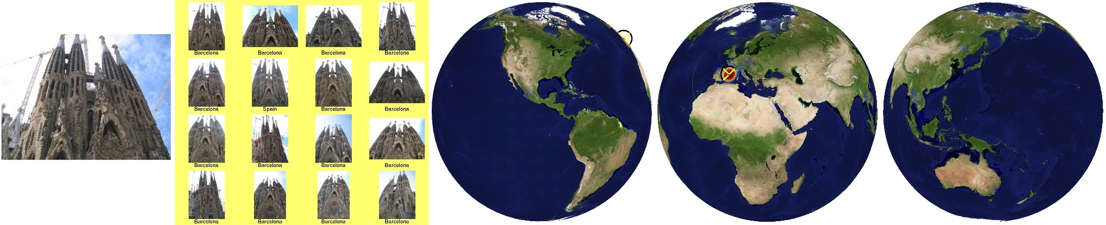
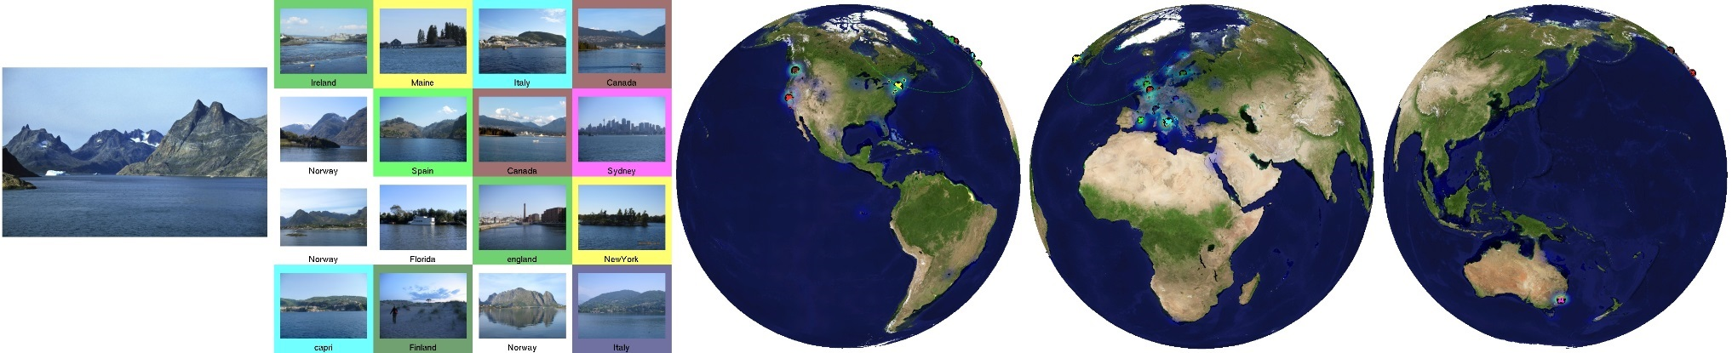
IM2GPS visualisation
Related works
Each result shows the query image, a montage of the top 16 nearest neighbors from the database, and three views of the Earth
[source: http://graphics.cs.cmu.edu/]

Slide 7
PlaNet (2016)
Related works
Photo Geolocation with Convolutional Neural Networks
[Weyand, Kostrikov, Philbin, 2016]

Slide 8
Little PlaNet
Related works

Slide 9
Datasets

Slide 10
Bamberg City Points of Interest
Bamberger Dom
Altes Rathaus
Kloster Michelsberg
Klein Venedig
Altenburg
Neue Residenz

