Slide 1
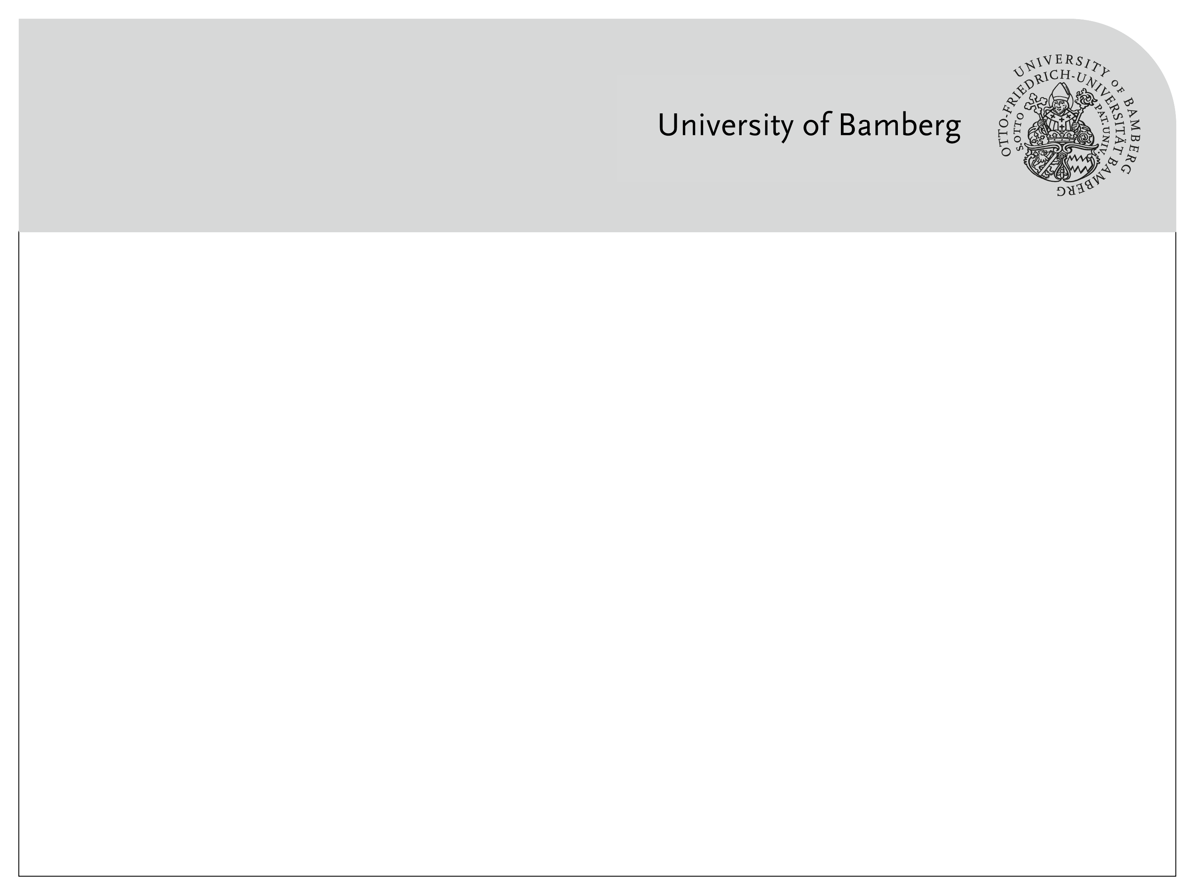
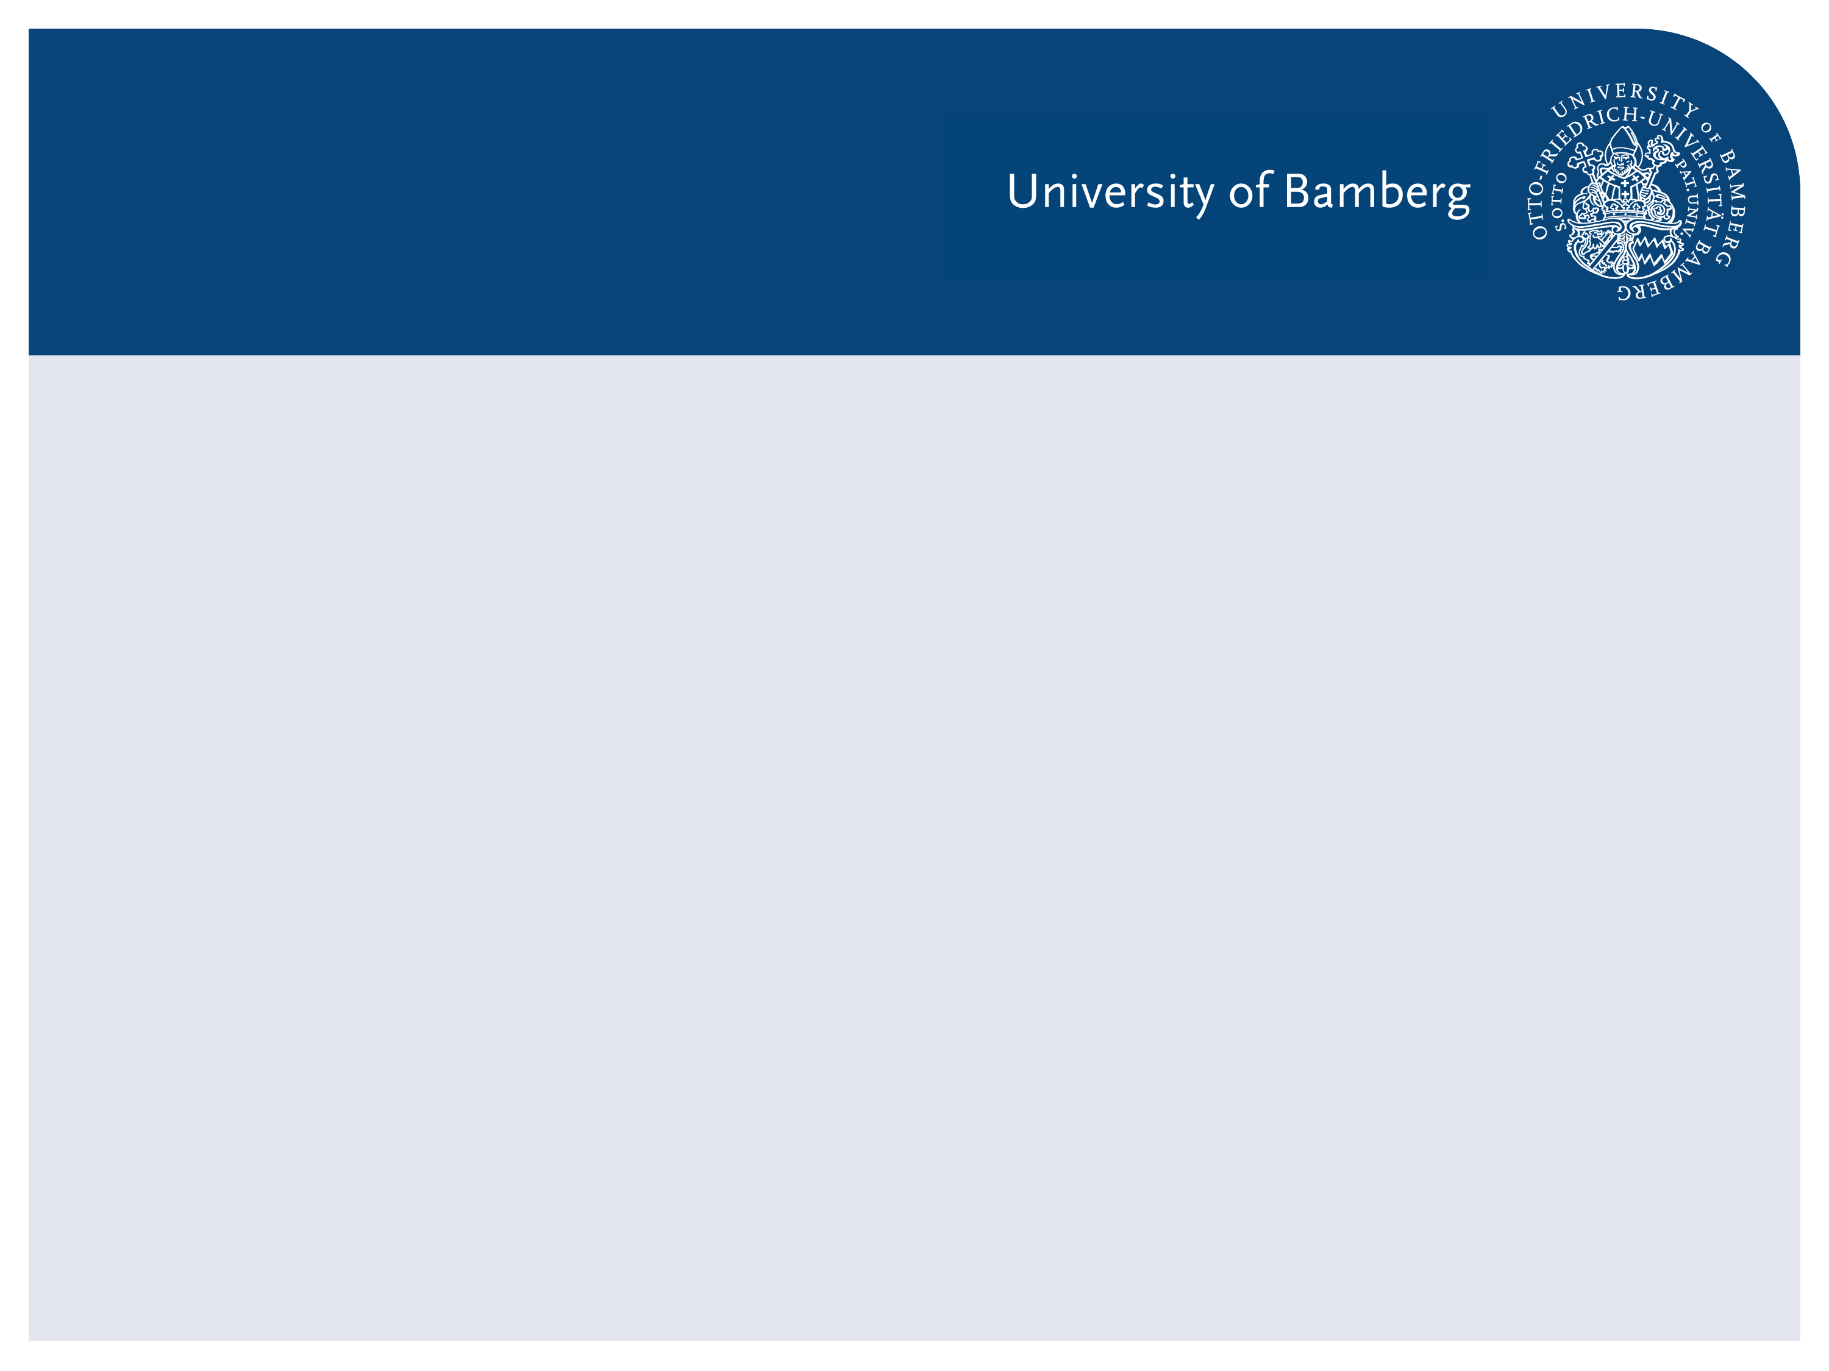
Recognizing Urban Points of Interests with Convolutional Neural Networks
1. Presentation

Slide 2
Agenda
Motivation
What is CNN?
Datasets
Related works

Slide 3
Motivation
Motivation
What is CNN?
Datasets
Related works

Slide 4
Bamberg City Points of Interest
Bamberger Dom
Altes Rathaus
Kloster Michelsberg
Klein Venedig
Altenburg
Neue Residenz

Slide 5
Related works

