Slide 1


Master thesis: Recognizing Urban Points of Interests with Convolutional Neural Networks
1st presentation
Andriy Zoryk

Slide 2
Agenda
Motivation
What is CNN?
Related works
Datasets
References

Slide 3
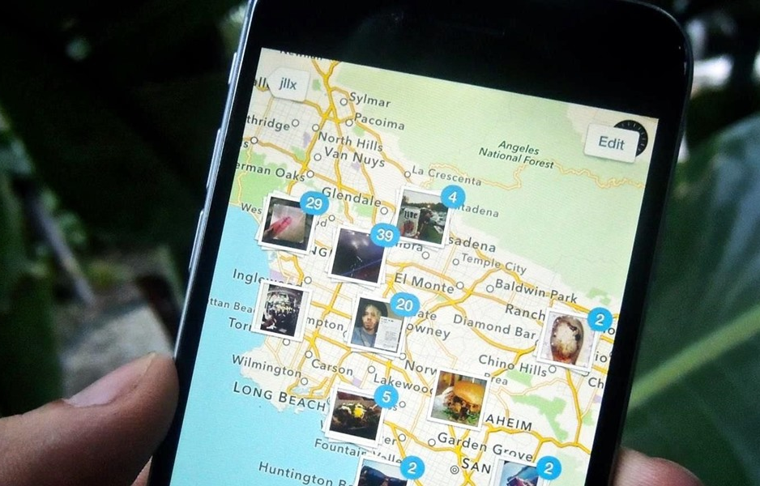
Motivation
In smartphones, additional information is automatically captured, such as longitude and latitude of where the image was taken
[source: ios.gadgethacks.com]

Slide 4
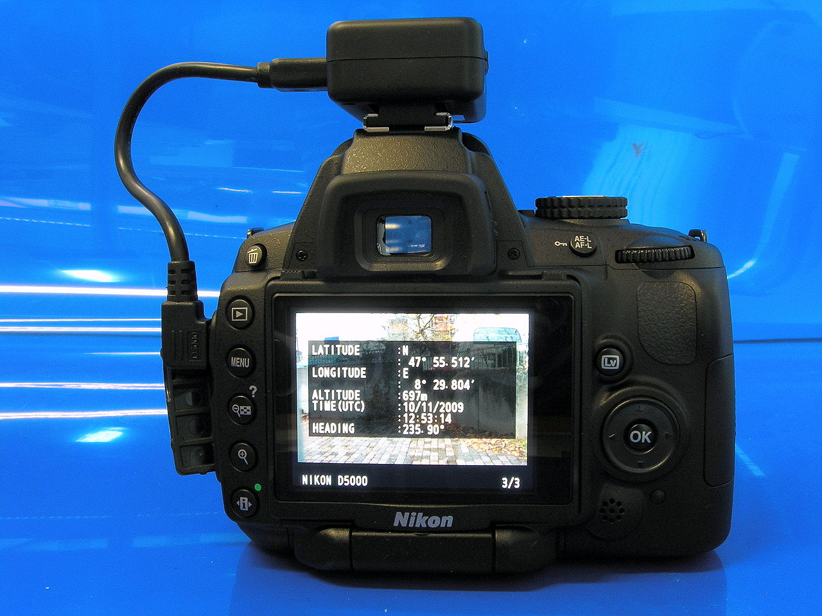
Motivation
Several manufacturers offer cameras with a built-in GPS receiver
Some digital cameras and camera phones support an external GPS receiver connected by cable, or inserted into the memory card slot or flash shoe.
[source: commons.wikimedia.org]

Slide 5
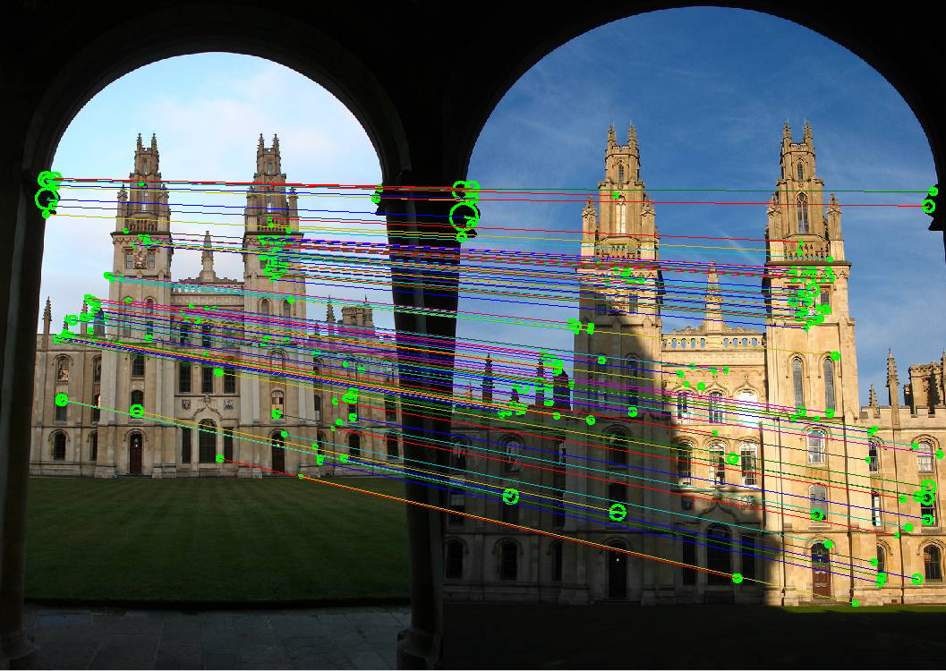
Recognizing Urban Points of Interests with Convolutional Neural Networks
Motivation
[source: robots.ox.ac.uk]

Slide 6
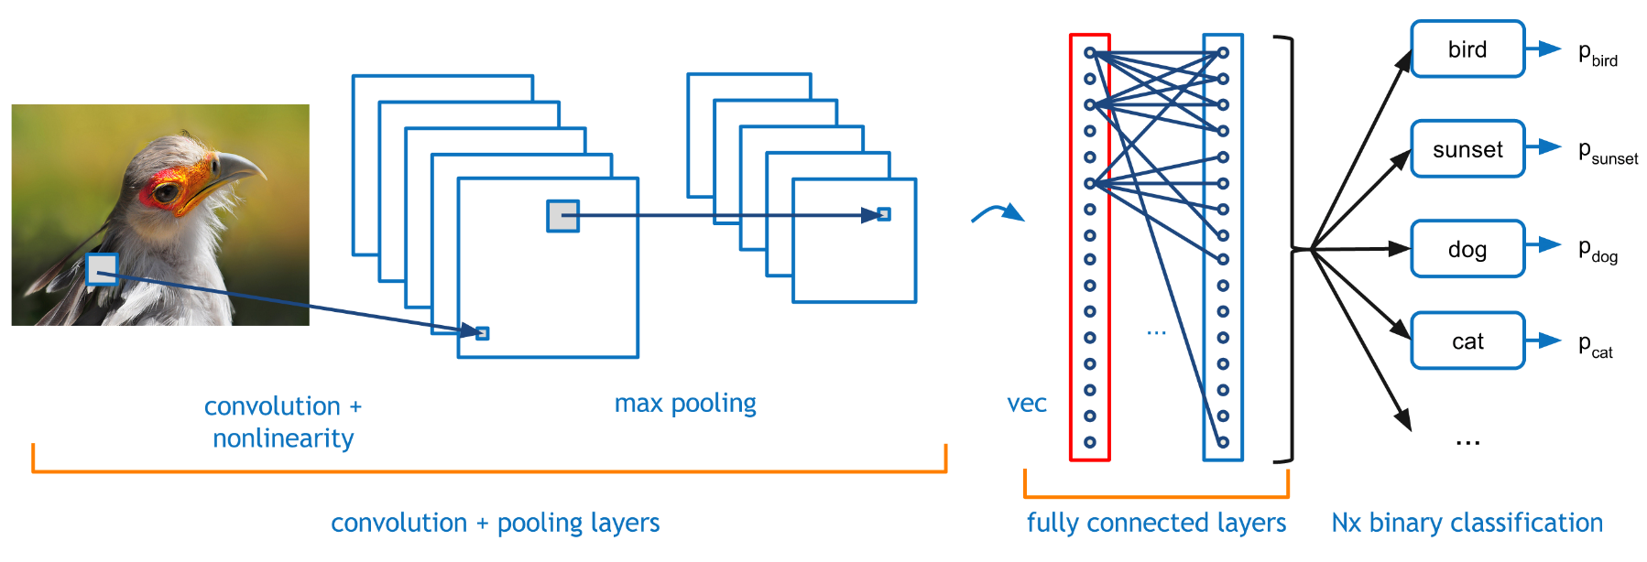
What is CNN?
[source: http://graphics.cs.cmu.edu/]

Slide 7
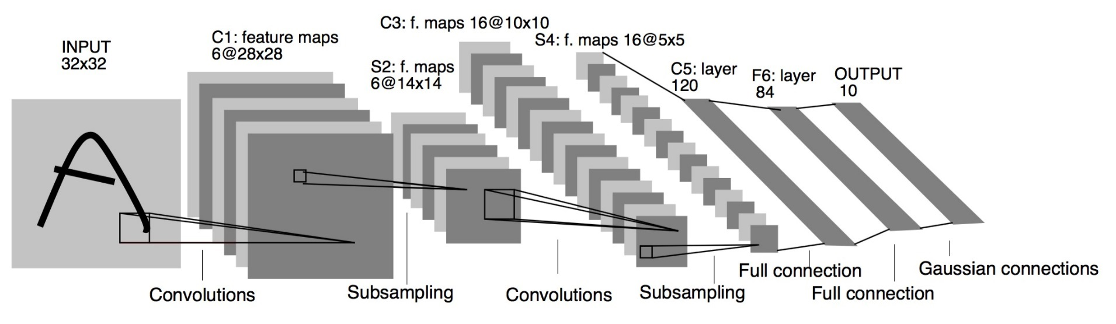
LeNet5 (1994)
What is CNN?
It is the year 1994, and this is one of the very first convolutional neural networks, and what propelled the field of Deep Learning. This pioneering work by Yann LeCun was named LeNet5 after many previous successful iterations since they year 1988!
LeNet: a layered model composed of convolution and subsampling operations followed by a holistic representation and ultimately a classifier for handwritten digits [Yann LeCun; LeNet]
[LeCun et al., 1988]

Slide 8
LeNet (1994)
What is CNN?
LeNet5 features can be summarized as:
convolutional neural network use sequence of 3 layers: convolution, pooling, non-linearity (key feature)
use convolution to extract spatial features
subsample using spatial average of maps
non-linearity in the form of tanh or sigmoids
multi-layer neural network (MLP) as final classifier
sparse connection matrix between layers to avoid large computational cost
In overall this network was the origin of much of the recent architectures, and a true inspiration for many people in the field.

Slide 9
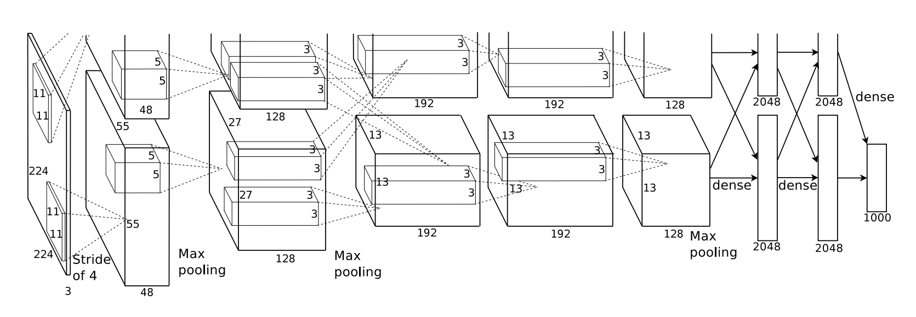
AlexNet (2012
What is CNN?
Bigger model as LeNet (7 hidden layers, 650,000 units, 60 Mio parameters)
More data (10**6 vs. 10**3 images)
GPU implementation (50x speedup over CPU). Trained on two GPU for a week.
[Krizhevsky et al., 2012]

Slide 10
VGG
What is CNN?
The VGG networks from Oxford were the first to use much smaller 3×3 filters in each convolutional layers and also combined them as a sequence of convolutions.
This seems to be contrary to the principles of LeNet, where large convolutions were used to capture similar features in an image. Instead of the 9×9 or 11×11 filters of AlexNet, filters started to become smaller, too dangerously close to the infamous 1×1 convolutions that LeNet wanted to avoid, at least on the first layers of the network.

Slide 11
IM2GPS (2008)
Related works
estimating geographic information from a single image
one of the first approaches to geolocate random pictures
[Hays, Efros, 2008]

Slide 12
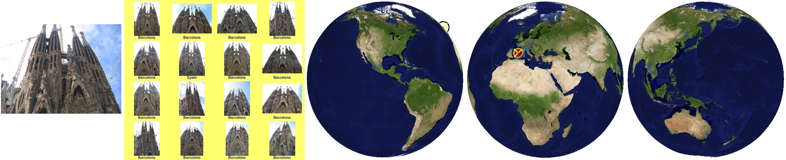
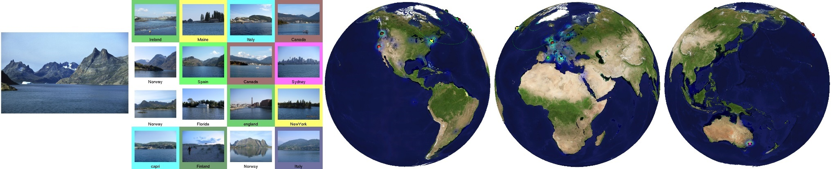
IM2GPS visualization
Related works
Each result shows the query image, a montage of the top 16 nearest neighbors from the database, and three views of the Earth
[source: http://graphics.cs.cmu.edu/]

Slide 13
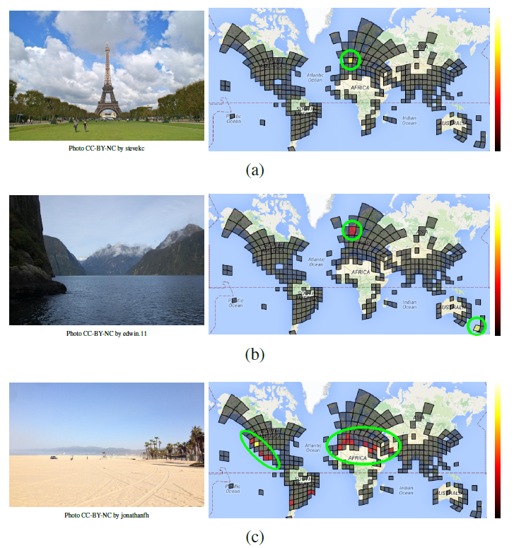
PlaNet (2016)
Related works
Photo Geolocation with Convolutional Neural Networks
[Weyand, Kostrikov, Philbin, 2016]

Slide 14
Little PlaNet
Related works

Slide 15
Datasets
Flickr Yahoo!
Google StreetView

Slide 17
Bamberg City Points of Interest
Bamberger Dom
Altes Rathaus
Kloster Michelsberg
Klein Venedig
Altenburg
Neue Residenz

Slide 18
References

