Slide 1
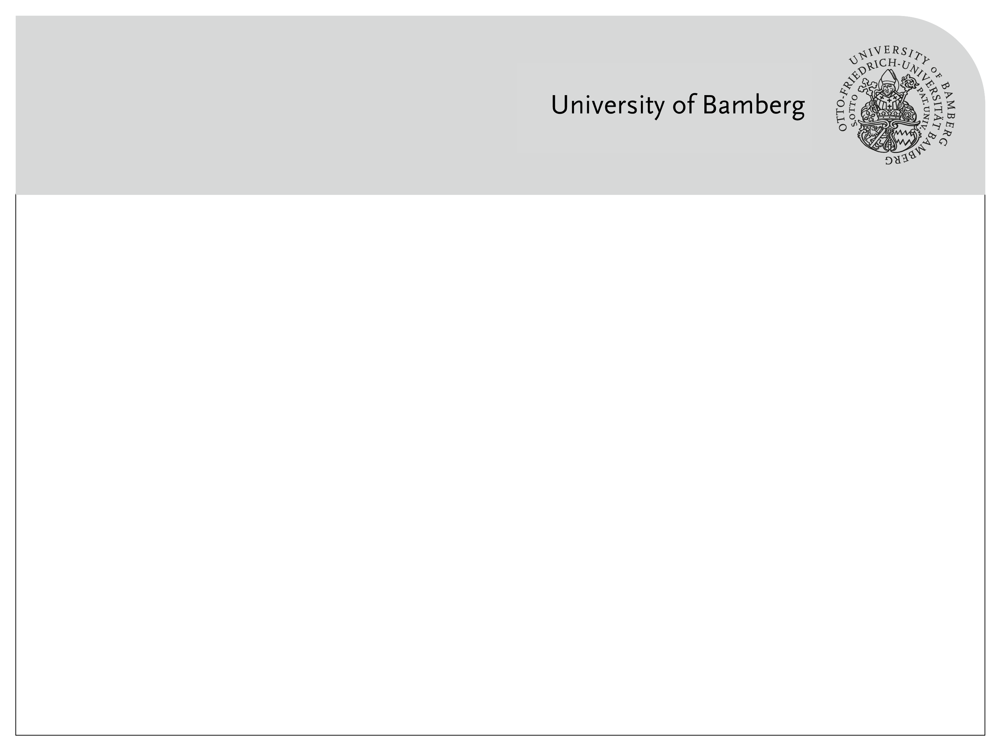
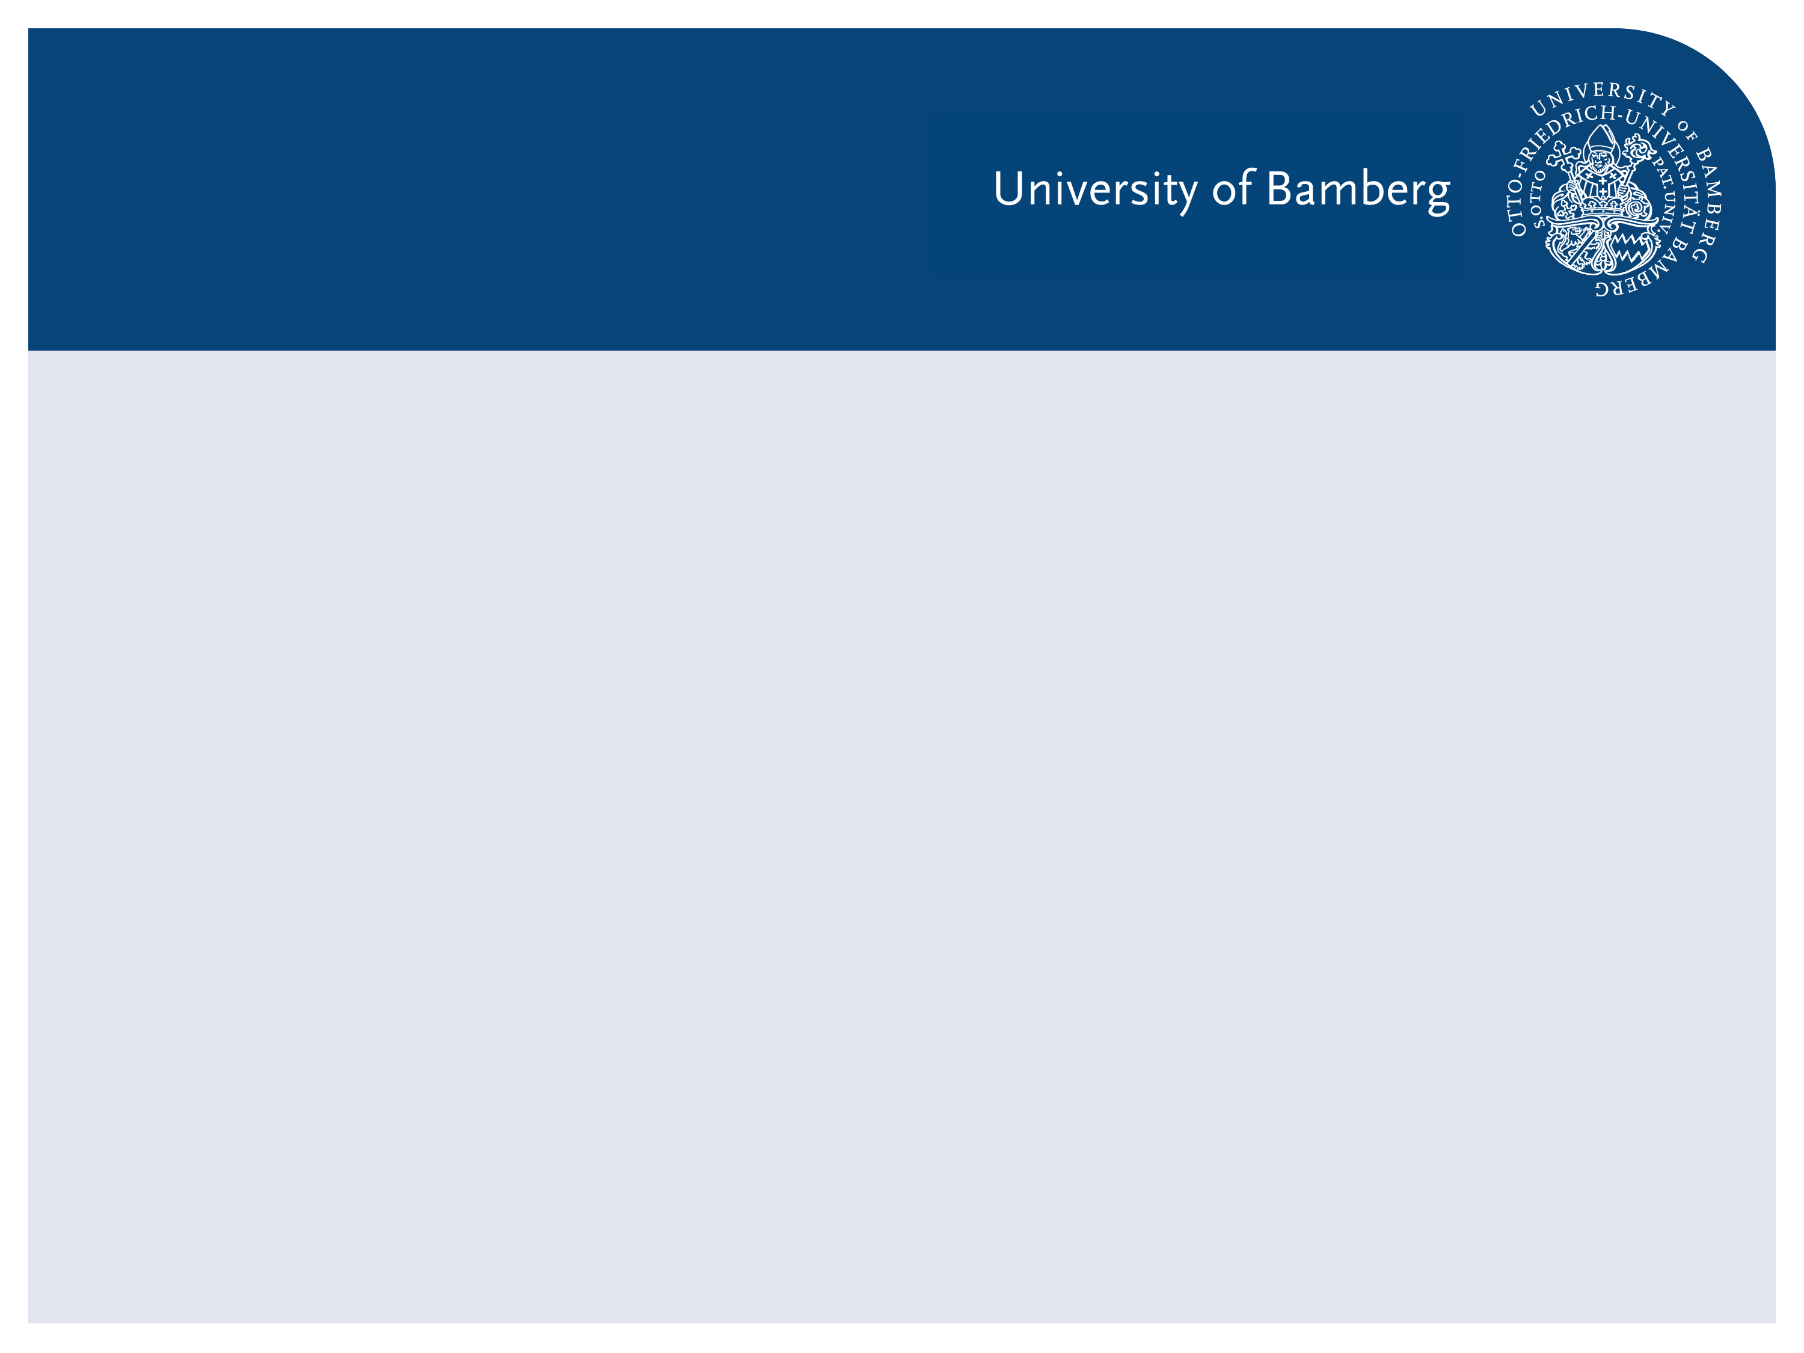
Recognizing Urban Points of Interests with Convolutional Neural Networks
1. Presentation

Slide 2
Agenda
Motivation
What is CNN?
Datasets
Related works

