Slide 1
TT2_PCIE_DEVICES_CHECK
January 23, 2024

Slide 2
TT2_PCIE_DEVICES_CHECK
We have been encountering PCIE_DEVICES_CHECK failures, making it the top failure in the Wiwynn environment. Various actions are being taken following the TSG to help the unit move past the failure point.
Testing Area: L10.5
Model: Teton2P
Time Considered : 01/20/2025 – 01/23/2025
Quantity of failures: 23
Quantity of units affected: 12
Tested units: 276
FR: 4.35%
Count of USN | Column Labels
Row Labels | SLHW_TT2PCIEDEVICESCHECK | Grand Total
Continue failing | 13 | 13
RETEST | 5 | 5
RESEAT | 1 | 1
Swap | 1 | 1
PCIE return from jbog 5 to jbog6 | 1 | 1
fiber change | 1 | 1
Fiber Re-insert | 1 | 1
VPD | 1 | 1
Re-insert | 1 | 1
Reseat Fiber PCIe6 on HN | 1 | 1
Pass | 10 | 10
RETEST | 3 | 3
REINSERT CN43 | 1 | 1
REINSERT K2V4 | 1 | 1
Re-seat JBOG1 PCIe cable by AWS petition (Kevin Lu) | 1 | 1
REPLACE BASEBOARD | 1 | 1
Reseat Fiber PCIe4 on HN | 1 | 1
RESEAT | 1 | 1
Re-insert | 1 | 1
Grand Total | 23 | 23
In other cases that were followed firsthand, units were found to pass after performing a VPD and retest. This was the case for the following two units:
Unit 1: http://10.250.28.120:9882/node/WAA7HN50204MM?api=http%3A%2F%2F10.250.28.68
Final action made: VPD and retest (Pass)
Other actions made: - VPD (Fail) - Retest (Fail)
Unit 2:
http://10.250.28.120:9882/node/WAA7HN4500HYM?api=http%3A%2F%2F10.250.28.68
Final action made: VPD and Retest (pass)
Other actions made:
PCIE Reinsert (Fail)
Retest (Fail)

Slide 3
2nd Level FA Summary
PE will verify if the action carried out by the TE Team is the solution action and will investigate the root causes of the different problems.
Main Issues - TT2_PCIE_DEVICES_CHECK
JBOG_X_K2V5_SX & JBOG_X_MX2_SX LnkSta not found
Actions:
(1) VPD HN & JBOG – PASS
(1) Swap GPU – PASS
JBOG_X_MX2_SX check Failed, expected x8, actual x4
Actions:
(1) Replace GPU - PASS, Screener Status: Screening no cuenta con fixtura funcional de GPU
JBOG_X_ROOT_PORT LnkSta not found
Action:
(1) VPD HN & JBOG - PASS
JBOG_X_ROOT_PORT & JBOG_X_PEX_DSP check Failed, expected: 16GT/s, actual: 5GT/s
Action:
(1) Reinsert PCIE & VPD – PASS
JBOG_X_MX2_SX LnkSta not found (To verify Torque of GPU)
Action:
(1) VPD - PASS

Slide 4
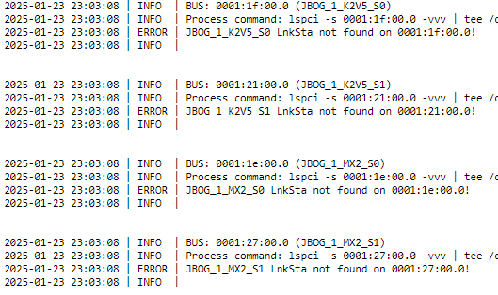
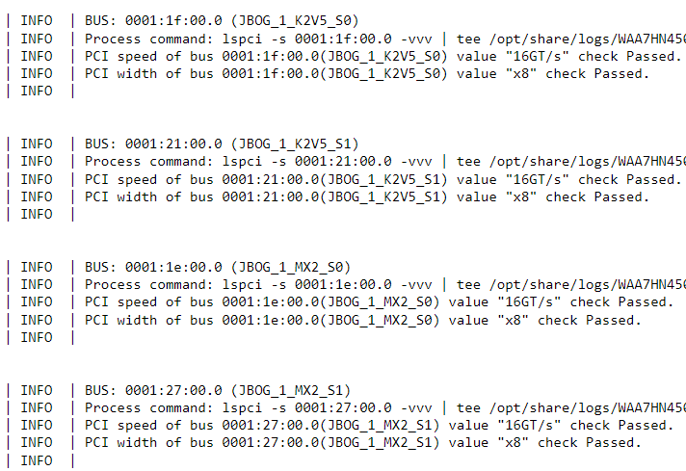
TT2_PCIE_DEVICES_CHECK
Before VPD
UNIT : ​WAA7HN4500DSM
MO: ​000010130626
P/N : ​B91.10D01.000D SYMPTOM : Both K2V5 and both GPUs MODEL: TETON2​
CASE: TT2_PCIE_DEVICES_CHECK​
ID : 62​
STAGE: SJ_HW​
LINK: http://10.250.28.120:9882/node/WAA7HN4500DSM?api=http%3A%2F%2F10.250.28.68
After VPD
Actions PE: 1- VPD HN & JBOG and retest Result: PASS

Slide 5
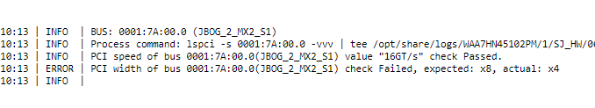
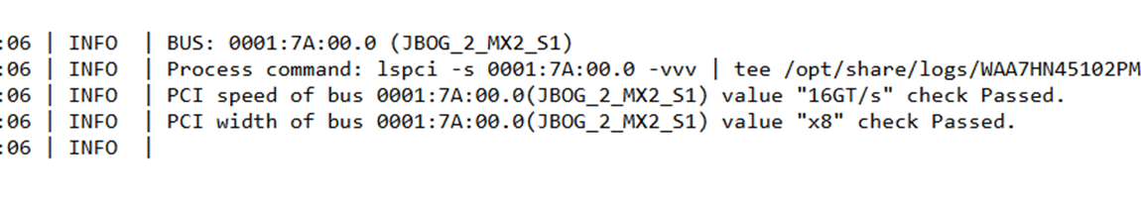
TT2_PCIE_DEVICES_CHECK
Before replace
UNIT : WAA7HN45102PM
MO: ​000010130627
P/N : ​B91.10D01.000D SYMPTOM : GPU GPU OLD SN: C447066324 GPU NEW SN: C449081824 MODEL: TETON2​
CASE: TT2_PCIE_DEVICES_CHECK​
ID : 62​
STAGE: SJ_HW​
LINK: http://10.250.28.120:9882/node/WAA7HN45102PM?api=http%3A%2F%2F10.250.28.68
After replace
Actions PE: 1- VPD HN & JBOG and retest Result: Fail 2- Swap CABLE PCIE Fail 3- Swap GPU Fail 4- Replace GPU Pass 5- Se verificara GPU FAIL con SCREENING Screening no cuenta con fixtura funcional de GPU

Slide 6
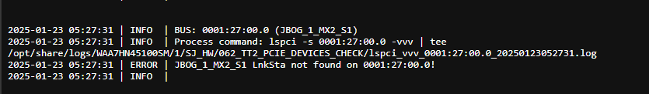
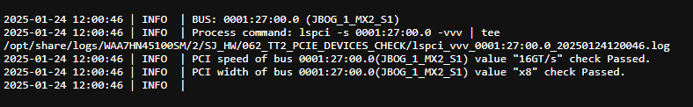
TT2_PCIE_DEVICES_CHECK
UNIT : ​ WAA7HN45100SM
MO: ​000010130627
P/N : ​B91.10D01.000D SYMPTOM : GPU MODEL: TETON2​
CASE: TT2_PCIE_DEVICES_CHECK​
ID : 62​
STAGE: SJ_HW​
LINK:http://10.250.28.120:9882/node/WAA7HN45100SM?api=http%3A%2F%2F10.250.28.68
Before Swap GPU
After Swap GPU
Actions PE: 1- VPD HN & JBOG and retest Result: Fail 2- Swap CABLE PCIE Fail 3- Swap GPU PASS

Slide 7
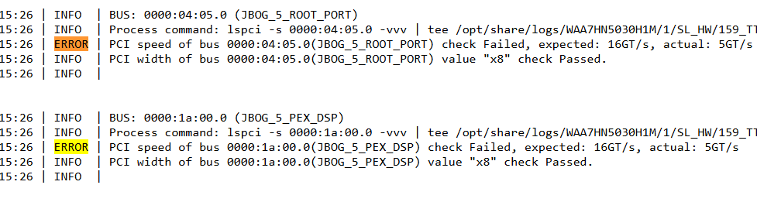
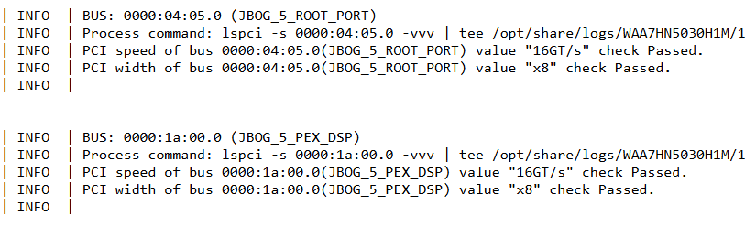
TT2_PCIE_DEVICES_CHECK
UNIT : ​ WAA7HN5030H1M
MO: ​000010133698
P/N : ​B91.10D01.000D SYMPTOM : ROOT_PORT MODEL: TETON2​
CASE: TT2_PCIE_DEVICES_CHECK​
ID : 159
STAGE: SJ_HW​
LINK: http://10.250.28.120:9882/node/WAA7HN5030H1M?api=http%3A%2F%2F10.250.28.68&display_type=rack
Before Reinsert PCIE
After Reinsert PCIE
Actions PE: 1- VPD HN & JBOG and retest Fail
2- Reinsert PCIE and VPD HN & JBOG and retest
Result: Pass

Slide 8
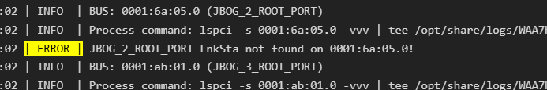
TT2_PCIE_DEVICES_CHECK
UNIT : ​ WAA7HN5030HSM
MO: ​000010133698
P/N : ​B91.10D01.000D SYMPTOM : ROOT_PORT MODEL: TETON2​
CASE: TT2_PCIE_DEVICES_CHECK​
ID : 62​
STAGE: SJ_HW​
LINK:
http://10.250.38.120:9882/node/WAA7HN5030HSM?api=http%3A%2F%2F10.250.38.141
Before Replace BB
After Replace BB
Actions PE: 1- Reinsert PCIE and VPD HN & JBOG and retest Result: Fail 2- Swap CABLE PCIE Fail 3- Swap CABLE GPIO Fail 4- Replace BB Fail 5- Replace IO BOARD HN Pending

Slide 9
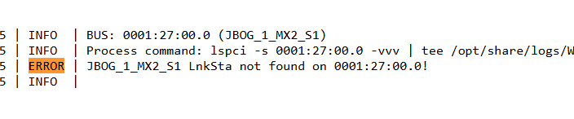
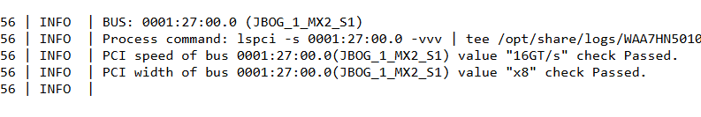
TT2_PCIE_DEVICES_CHECK
UNIT : ​ WAA7HN50107NM
MO: ​000010130629
P/N : ​B91.10D01.000D SYMPTOM : ROOT_PORT MODEL: TETON2​
CASE: TT2_PCIE_DEVICES_CHECK​
ID : 62​
STAGE: SJ_HW​
LINK: http://10.250.28.120:9882/node/WAA7HN50107NM?api=http%3A%2F%2F10.250.28.68
Before VPD
After VPD
Actions PE: 1- VPD HN & JBOG and retest Result: PASS

Slide 10


TT2_PCIE_DEVICES_CHECK
UNIT : ​ WAA7HN4500B0M
MO: ​000010130624
P/N : ​B91.10D01.000D SYMPTOM : ROOT_PORT MODEL: TETON2​
CASE: TT2_PCIE_DEVICES_CHECK​
ID : 159
STAGE: SJ_HW​
LINK: http://10.250.28.120:9882/node/WAA7HN4500B0M?api=http%3A%2F%2F10.250.28.68
Before VPD
After VPD
Actions PE: 1- VPD HN & JBOG and retest PASS

Slide 11
TT2_PCIE_DEVICES_CHECK
UNIT : ​ WAA7HN503002M
MO: ​000010131388 P/N : ​B91.10D01.000D SYMPTOM : ROOT_PORT MODEL: TETON2​
CASE: TT2_PCIE_DEVICES_CHECK​
ID : 62
STAGE: SJ_HW​
LINK: http://10.250.39.120:9882/node/WAA7HN503002M?api=http%3A%2F%2F10.250.39.91
Before Swap GPU
After Swap GPU
Actions PE: 1- Reinsert PCIE and VPD HN & JBOG and retest Result: Fail 2- Swap CABLE PCIE Fail 3- Swap CABLE GPIO Fail 4- Replace BB Pending

Slide 12
TT2_PCIE_DEVICES_CHECK
Check status cables PCIe
Actions for this failure
Check that cable (PCIe) this full assembly >> Run Offline
Reinsert Cable PCIe >> Run Offline
Swap cable PCIe >> Run Offline
Swap GPU >> Run Offline
Reinsert Cables or full assembly
Vpd
Run PCI Offline
Fail
Swap Cable
Swap GPU
Change ID PCIe Failure
Continue ID PCIe Failure
Pass
Replace Cable or GPU
Retest Online
Noted:
In all actions need to run vpd units for update PCIe /opt/mfg/PE+/Tools
./TT2_PCIE_DEVICES_CHECK.sh

Slide 13
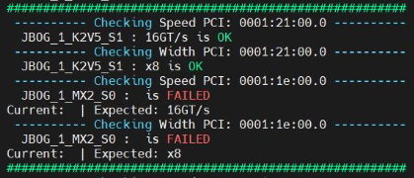
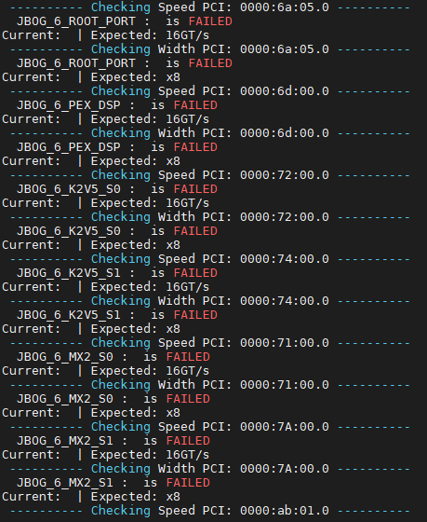

TT2_PCIE_DEVICES_CHECK
Failed ROOT PORT,PEX_DSP,K2V5,MX2_S0 & MX2_S1 = Cable GPIo
ID Components Failures
JBOG 0 to 7 MX2_S0 = GPU0
JBOG 0 to 7 MX2_S1 = GPU1
JBOG 0 to 7 ROOT PORT = Cable GPIo
JBOG 0 to 7 PEX_DSP = Cable GPIo
JBOG 0 to 7 K2V5_S0 = Cable GPIo
JBOG 0 to 7 K2V5_S1 = Cable GPIo
JBOG 0 to 7 MX2_S0 = Cable GPIo
JBOG 0 to 7 MX2_S1 = Cable GPIo
JBOG 0 to 7 ROOT PORT = Cable PCIe
JBOG 0 to 7 PEX_DSP = ?
JBOG 0 to 7 K2V5_S0 = ?
JBOG 0 to 7 K2V5_S1 = ?
Failed MX2_S0 = GPU0
Failed MX2_S0 = GPU0

Slide 14
SCREENER - OFFLINE
Data for the month of January was collected in screener and offline to know which components arrived in the area due to the TT2_PCIE_DEVICES_CHECK failure and to see their status after the review, which leads us to 14.81% of the components passing the tests in the SCREENER – OFFLINE area
NOTE: The databases are only being released as a fault (they are not reviewed)
The IO Boards were only reviewed visually and impedances since the fixture was in validation
The units with a PASS result have not yet carried out the Second Round of testing, we are waiting for this to collect more data

