Slide 1









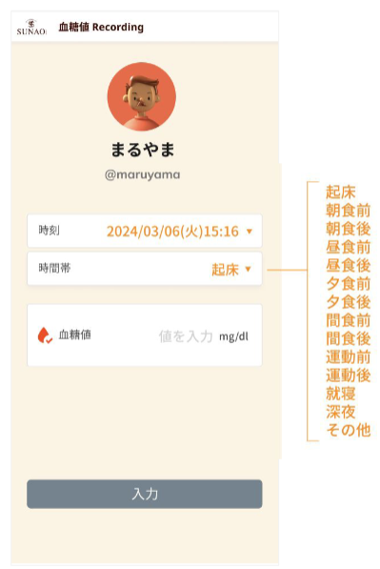


AWS Cloud
Amazon CloudWatch
AWS X-Ray
AWS Identity and Access Management (IAM)
Amazon Route 53
Amazon CloudFront
Amazon API Gateway
AWS Lambda
Amazon DynamoDB
sunao-api-deployment-dev
sunao-frontend-deployment-dev
Amazon Route 53
Amazon CloudFront

