Slide 1





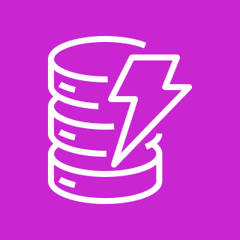
AWS Cloud
Amazon CloudWatch
User
AWS Lambda
Amazon DynamoDB
Amazon API Gateway

