Slide 1








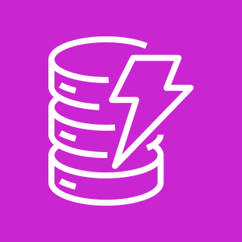
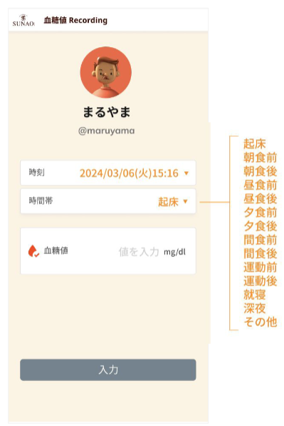


AWS Cloud
CloudWatch
IAM
X-Ray
Route 53
CloudFront
API Gateway
Lambda
DynamoDB
sunao-frontend-deployment-dev
Route 53
CloudFront
sunao-api-deployment-dev
Swagger-viewer-deployment-dev
Route 53
CloudFront

