Slide 1




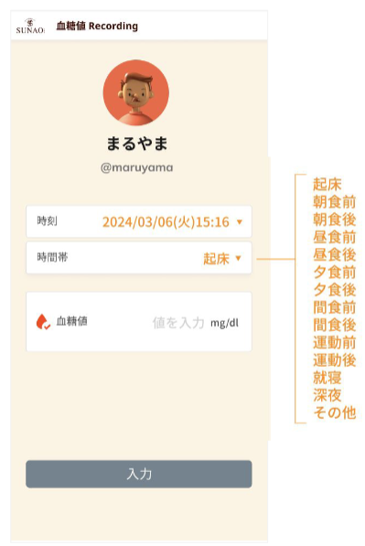


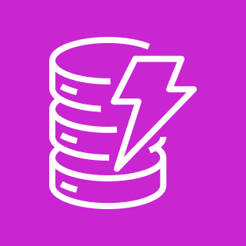
AWS Cloud
Amazon CloudWatch
AWS X-Ray
AWS Identity and Access Management (IAM)
Amazon API Gateway
AWS Lambda
Amazon DynamoDB

