Slide 3
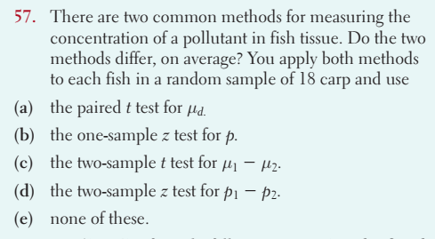
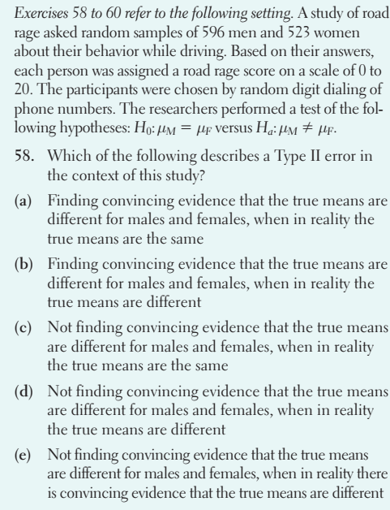

Slide 4
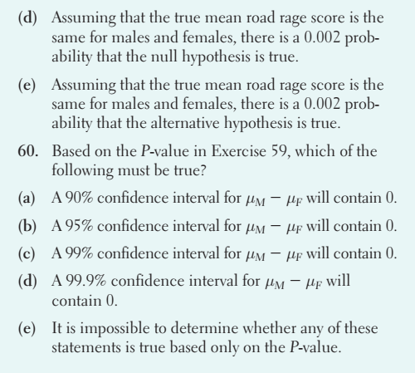
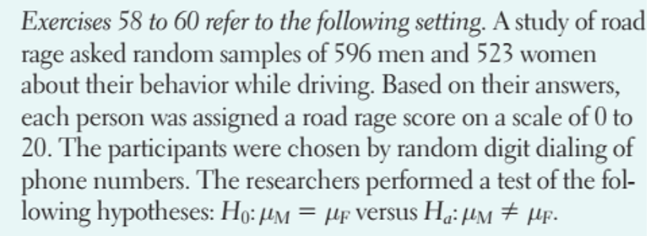
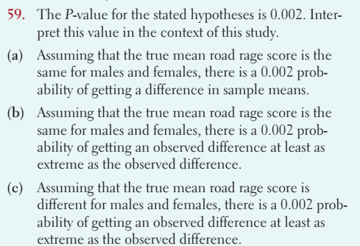

Slide 5
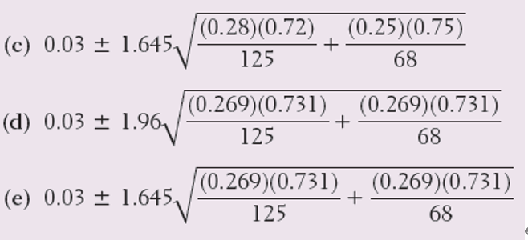
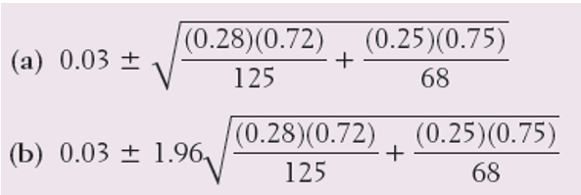
1. A study of road rage asked separate random samples of 596 men and 523 women about their behavior while driving. Based on their answers, each respondent was assigned a road rage score on a scale of 0 to 20. Are the conditions for performing a two-sample t test satisfied?
(a) Maybe; we have independent random samples, but we need to look at the data to check Normality.
(b) No; road rage scores in a range between 0 and 20 can’t be Normal.
(c) No; we don’t know the population standard deviations.
(d) Yes; the large sample sizes guarantee that the corresponding population distributions will be Normal.
(e) Yes; we have two independent random samples and large sample sizes.
2. Thirty-five people from a random sample of 125 workers from Company A admitted to using sick leave when they weren’t really ill. Seventeen employees from a random sample of 68 workers from Company B admitted that they had used sick leave when they weren’t ill. A 95% confidence interval for the difference in the proportions of workers at the two companies who would admit to using sick leave when they weren’t ill is

Slide 6
3. The power takeoff driveline on tractors used in agriculture is a potentially serious hazard to operators of farm equipment. The driveline is covered by a shield in new tractors, but for a variety of reasons, the shield is often missing on older tractors. Two types of shields are the bolt-on and the flip-up. It was believed that the bolt-on shield was perceived as a nuisance by the operators and deliberately removed, but the flip-up shield is easily lifted for inspection and maintenance and may be left in place. In a study initiated by the U.S. National Safety Council, random samples of older tractors with both types of shields were taken to see what proportion of shields were removed. Of 183 tractors designed to have bolt-on shields, 35 had been removed. Of the 136 tractors with flip-up shields, 15 were removed. We wish to perform a test of H₀: p_{b} = p_{f} versus Ha: p_{b} > p_{f}, where p_{b} and p_{f} are the proportions of all tractors with the bolt-on and flip-up shields removed, respectively. Which of the following is not a condition for performing the significance test?
(a) Both populations are Normally distributed.
(b) The data come from two independent samples.
(c) Both samples were chosen at random.
(d) The counts of successes and failures are large enough to use Normal calculations.
(e) Both populations are at least 10 times the corresponding sample sizes.

Slide 7
4. A quiz question gives random samples of n = 10 observations from each of two Normally distributed populations. Tom uses a table of t distribution critical values and 9 degrees of freedom to calculate a 95% confidence interval for the difference in the two population means. Janelle uses her calculator’s two-sample t interval with 16.87 degrees of freedom to compute the 95% confidence interval. Assume that both students calculate the intervals correctly.
Which of the following is true?
(a) Tom’s confidence interval is wider.
(b) Janelle’s confidence interval is wider.
(c) Both confidence intervals are the same.
(d) There is insufficient information to determine which confidence interval is wider.
(e) Janelle made a mistake; degrees of freedom has to be a whole number.

Slide 8
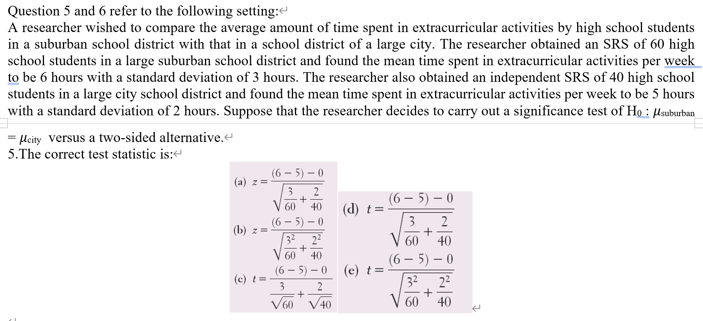

Slide 9
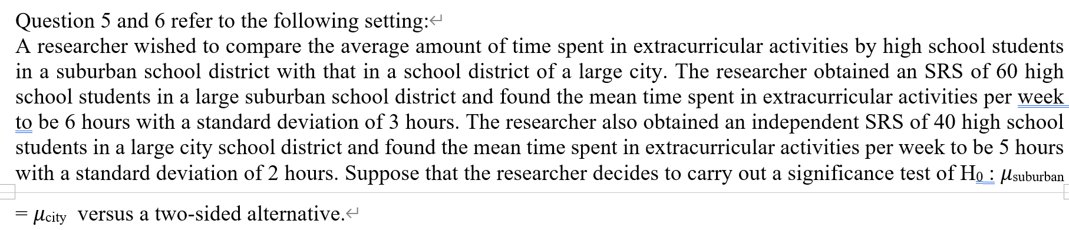
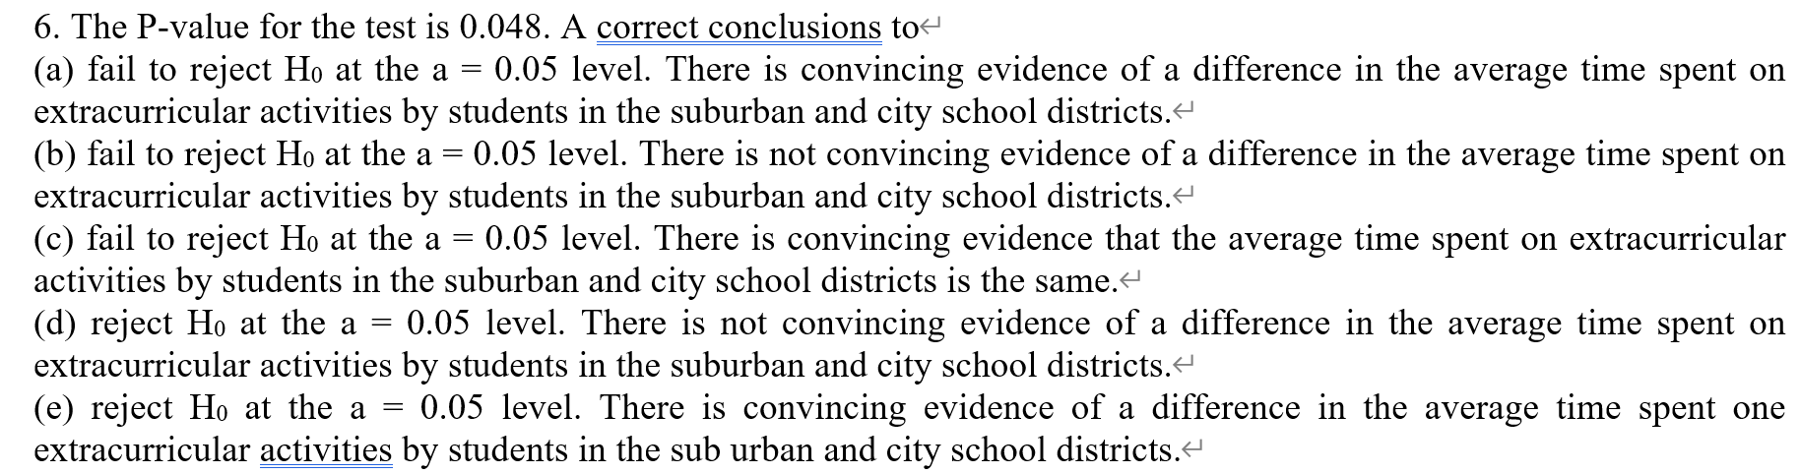

Slide 10
7. At a baseball game, 42 of 65 randomly selected people own an iPod. At a rock concert occurring at the same time across town, 34 of 52 randomly selected people own an iPod. A researcher wants to test the claim that the proportion of iPod owners at the two venues is different. A 90% confidence interval for the difference in population proportions (game − concert) is (−0.154, 0.138). Which of the following gives the correct outcome of the researcher’s test of the claim?
(a) Because the confidence interval includes 0, the researcher can conclude that the proportion of iPod owners at the two venues is the same.
(b) Because the center of the interval is –0.008, the researcher can conclude that a higher proportion of people at the rock concert own iPods than at the baseball game.
(c) Because the confidence interval includes 0, the researcher cannot conclude that the proportion of iPod owners at the two venues is different.
(d) Because the confidence interval includes more negative than positive values, the researcher can conclude that a higher proportion of people at the rock concert own iPods than at the baseball game.
(e) The researcher cannot draw a conclusion about a claim without performing a significance test.

Slide 11
8. An SRS of size 100 is taken from Population A with proportion 0.8 of successes. An independent SRS of size 400 is taken from Population B with proportion 0.5 of successes. The sampling distribution for the difference (Population A – Population B) in sample proportions has what mean and standard deviation?
(a) mean = 0.3; standard deviation = 1.3
(b) mean = 0.3; standard deviation = 0.40
(c) mean = 0.3; standard deviation = 0.047
(d) mean = 0.3; standard deviation = 0.0022
(e) mean = 0.3; standard deviation = 0.0002
9.How much more effective is exercise and drug treatment than drug treatment alone at reducing the rate of heart attacks among men aged 65 and older? To find out, researchers perform a completely randomized experiment involving 1000 healthy males in this age group. Half of the subjects are assigned to receive drug treatment only, while the other half are assigned to exercise regularly and to receive drug treatment. The most appropriate inference method for answering the original research question is
(a) one-sample z test for a proportion.
(b) two-sample z interval for p₁ − p₂.
(c) two-sample z test for p₁ − p₂.
(d) two-sample t interval for 𝜇₁ − 𝜇₂.
(e) two-sample t test for 𝜇₁ − 𝜇₂.

Slide 12
10.Researchers are interested in evaluating the effect of a natural product on reducing blood pressure. This will be done by comparing the mean reduction in blood pressure of a treatment (natural product) group and a placebo group using at wo-sample t test. The researchers would like to be able to detect whether the natural product reduces blood pressure by at least 7 points more, on average, than the placebo. If groups of size 50are used in the experiment, a two-sample t test using a = 0.01 will have a power of 80% to detect a 7-point difference in mean blood pressure reduction. If the researchers want to be able to detect a 5-point difference instead, then the power of the test
(a) would be less than 80%.
(b) would be greater than 80%.
(c) would still be 80%.
(d) could be either less than or greater than 80%, depending on whether the natural product is effective.
(e) would vary depending

Slide 13
1. paired or unpaired? In each of the following settings, decide whether you should use paired t procedures or two-sample t procedures to perform inference. Explain your choice.
(a) To test the wear characteristics of two tire brands, A and B, each brand of tire is randomly assigned to 50 cars of the same make and model.
(b) To test the effect of background music on productivity, factory workers are observed. For one month, each subject works without music. For another month, the subject works while listening to music on an MP3 player. The month in which each subject listens to music is determined by a coin toss.
(c) A study was designed to compare the effectiveness of two weight-reducing diets. Fifty obese women who volunteered to participate were randomly assigned into two equal-sized groups. One group used Diet A and the other used Diet B. The weight of each woman was measured before the assigned diet and again after 10 weeks on the diet.

