Slide 1
Anomaly Detection
Alex Lin

Slide 2
in Time Series
Melissa Yu

Slide 3



Asking the Question
Problem Statement: Given a sequence of random variables , we wish to develop a method for determining the existence of anomalies.
Specifically, as the variables arrive one by one, we test the exchangeability assumption for the sequence , which states that the joint distribution for these variables is invariant under any permutation of the indices.
One method for anomaly detection involves using a Martingale, a sequence of random variables such that
In particular, models the degree to which violates the null hypothesis given by the exchangeability assumption.
Key Questions: How can we appropriately construct Martingales that will successfully detect the existence of different kinds of anomalous data? What is the best Martingale threshold level for rejecting the null hypothesis? Is there a tradeoff between the accuracy and the confidence of our methods?

Slide 4
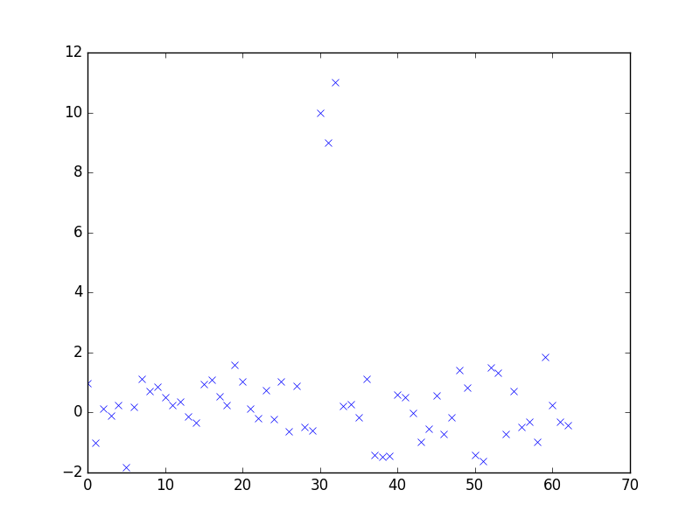
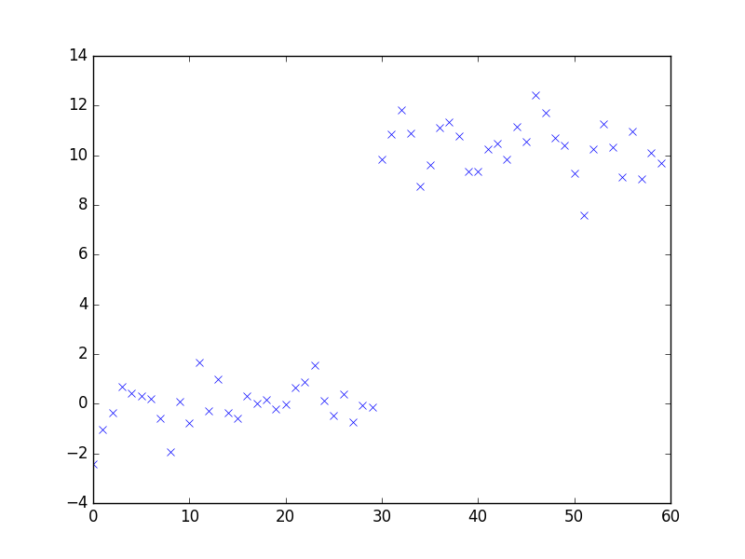
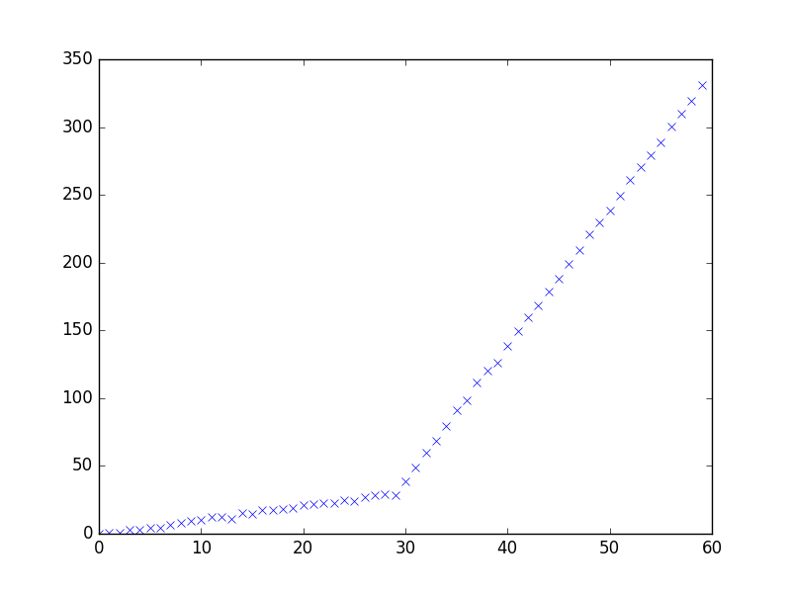
Getting the Data
Anomaly Types: Our study focuses on three general types of anomalies.
I. Random Outliers
II. Sudden Gap
III. Slope Change
We construct various datasets with these three structures to evaluate the efficacy of our methods.
We also examine real-life time series datasets from Twitter giving counts for the number of Tweet mentions of large, publicly-trade companies (e.g. AAPL, AMZN, CVS, FB) over five-minute intervals.

Slide 5

Standardizing the Algorithm
Here is our generalized, two-step procedure for analyzing a dataset, constructing Martingales, and detecting anomalies. We wrap all of our methods in an AnomalyDetector class, whose objects can be instantiated with two main customizable options – (1) a strangeness function and (2) a Martingale construction method.
Part One: Importing the training examples one by one and generating a list of corresponding p-values.
We select a strangeness function that inputs a fixed set of training examples and outputs a list of corresponding, relative alpha values that signify the degree to which each example deviates from the rest.
Different types of strangeness functions can be found in our strange module; these include metrics based on average distance, range percentile, residuals calculated from OLS, and changes in slope/trend calculated from OLS
For each new example , we compute and calculate our new p-value as

Slide 6




where is a random number from the interval [0, 1] and denotes the cardinality of a set.
Thus, lower p-values will be given to unusual examples that do not quite fit the general trend of the data up until that point.
Part Two: Constructing a Martingale from the sequence of p-values.
We select a Martingale construction method that inputs the set of p-values generated in Part One and uses a particular procedure to calculate/plot the Martingales.
Specific methods will employ the use of a betting function, which inputs a p-value and outputs a representative value for Martingale calculation. The array of betting functions can be found in our betting module.
Different types of Martingale construction methods can be found in our martingale module; these include power-based approaches in which we select some exponential , a simple-mixture approach that is independent, and a plug-in approach that estimates the PDF of the sequence of p-values
This general algorithm was first introduced by Vovk et al. in [1]. In this project, we add our own customizations to answer the specific questions we posed.

Slide 7
Asking the Question
Problem Statement: Given a sequence of random variables , we wish to develop a method for determining the existence of anomalies.
Specifically, as the variables arrive one by one, we test the exchangeability assumption for the sequence , which states that the joint distribution for these variables is invariant under any permutation of the indices.
One method for anomaly detection involves using a Martingale, a sequence of random variables such that
In particular, models the degree to which violates the null hypothesis given by the exchangeability assumption.
Key Questions: How can we appropriately construct Martingales that will successfully detect the existence of different kinds of anomalous data? What is the best Martingale threshold level for rejecting the null hypothesis? Is there a tradeoff between the accuracy and the confidence of our methods?

