Slide 1
NLP Business Case: Automated Customers Reviews
Aryam alanazi
Raghad Alkhudair

Slide 2
Project Goal
This project aims to develop a product review system powered by NLP models that aggregate customer feedback from different sources.

Slide 3
Problem Statement
The presence of thousands of reviews across different platforms makes it difficult to analyze manually.
Traditional review analysis consumes time and human resources.
The need for a central and clear view of customer feedback.

Slide 4
The key tasks
Classifying reviews
Clustering product categories
Review Summarization Using Generative AI

Slide 5
Project Workflow:
Datasets :
Amazon reviews datasets
Steps of Exploratory data analysis (EDA) :
1- Download the data
2-Preprocesses it
3-Training and testing
4-Evaluation

Slide 6
Review Classification
Dividing star ratings from (1 to 5) into sentiment categories:
1-2: Negative
3: Neutral
4-5: Positive
Using the model:
"bert-base-uncased"

Slide 7
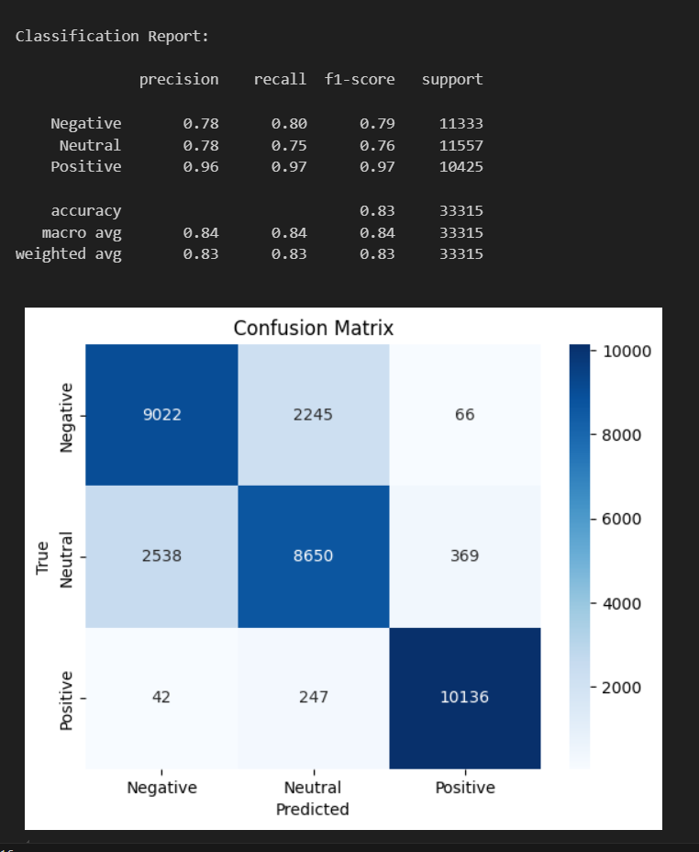
Model Evaluation

Slide 8
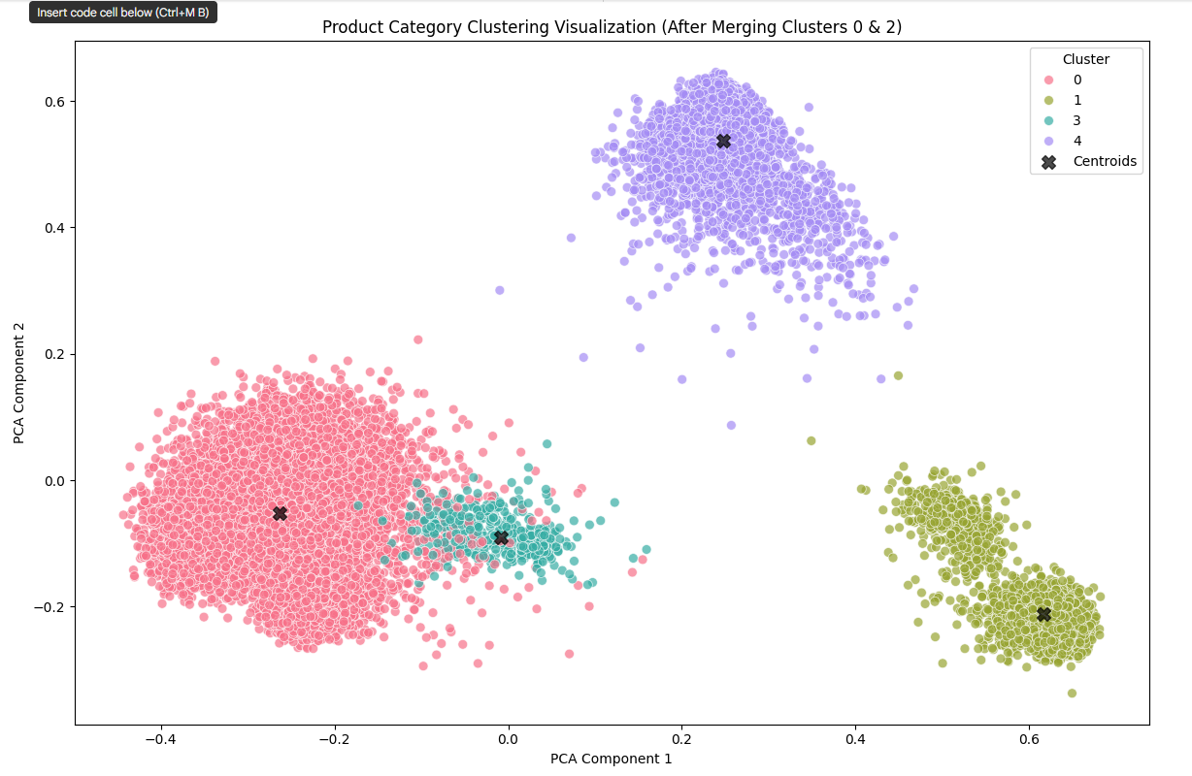
Clustering product categories
Classify product categories:
into 4-6 main categories.
Creating a clustering model:
K-Means
Transformer('all-MiniLM-L6-v2')
Identifying factors affecting categories:
Categories
Review text

Slide 9
Suggested categories based on analysis
Electronics
Household Supplies
Accessories
School supplies

Slide 10
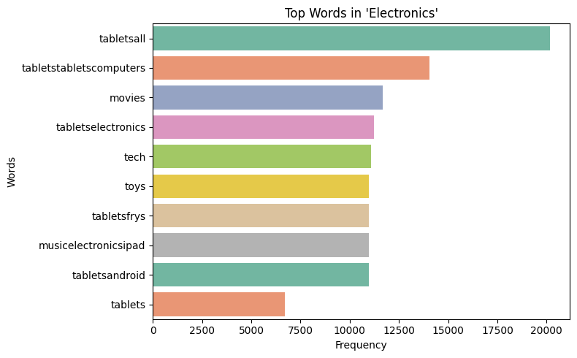
Top words in electronics

Slide 11
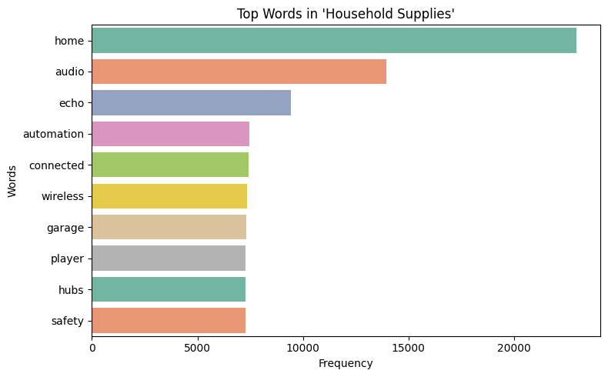
Top words in household supplies

Slide 12
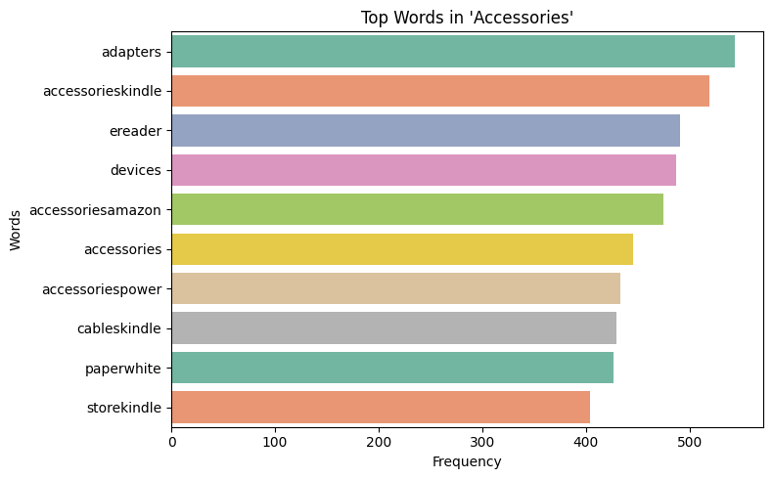
Top words in accessories

Slide 13
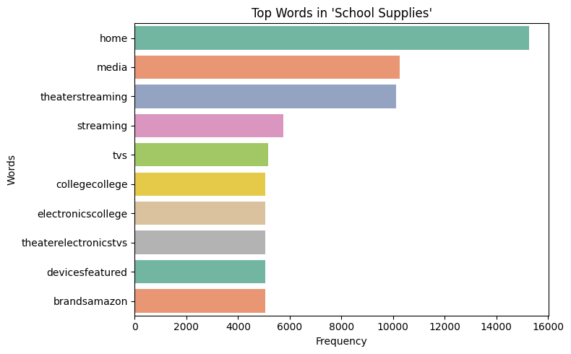
Top words in school supplies

Slide 14
Summarization and Deployed
Using the model:
BART model for Text Generation Using AI
The deployed:
Website with three interfaces(Classification, Categories and Summarization)

Slide 15
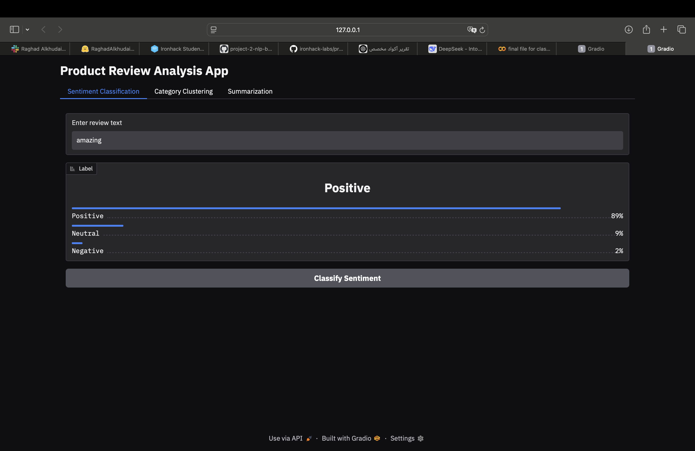
Classification interface

Slide 16
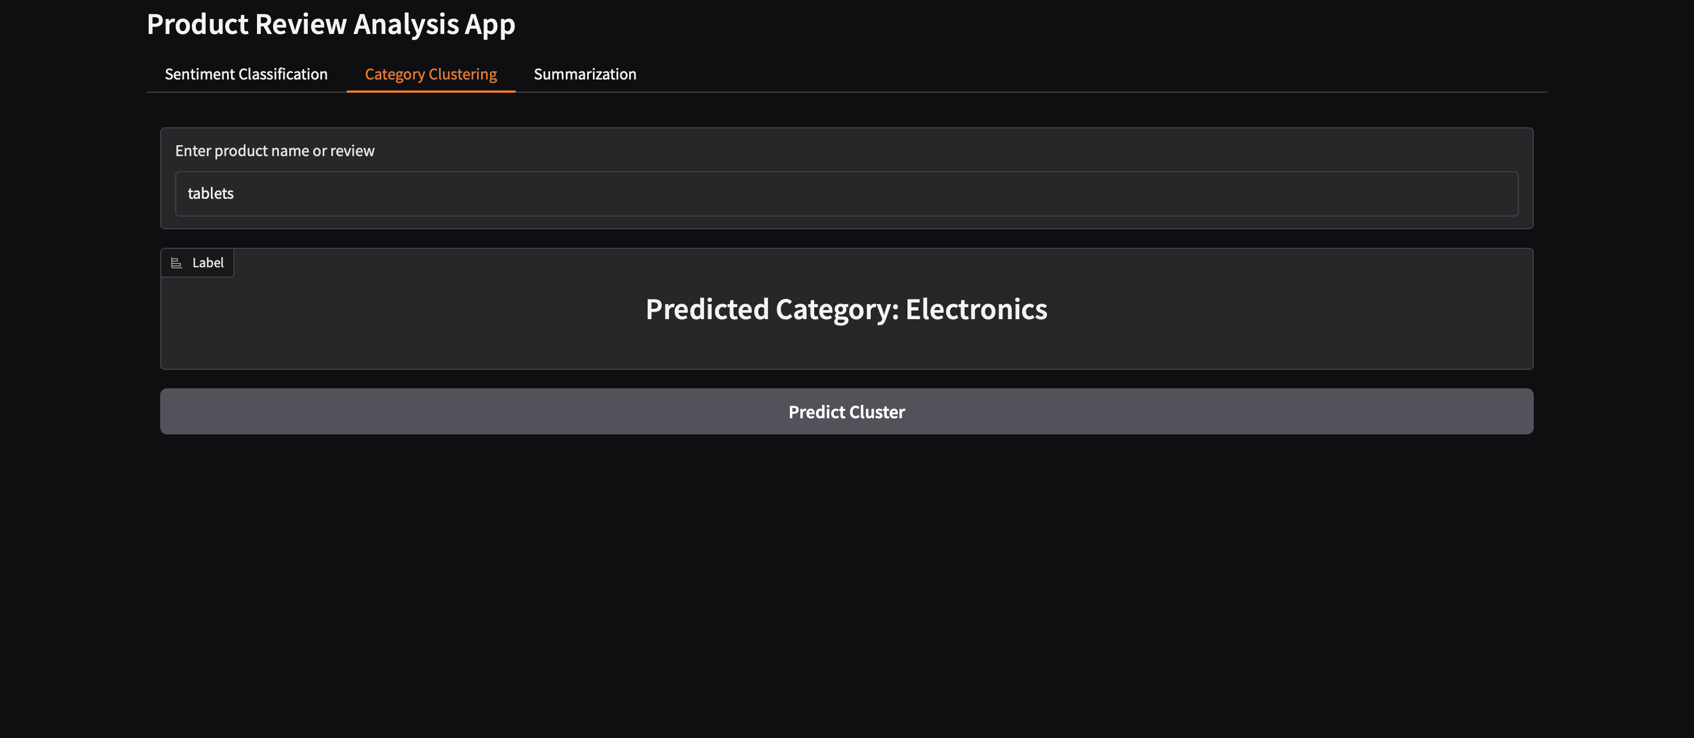
Categories interface

Slide 17
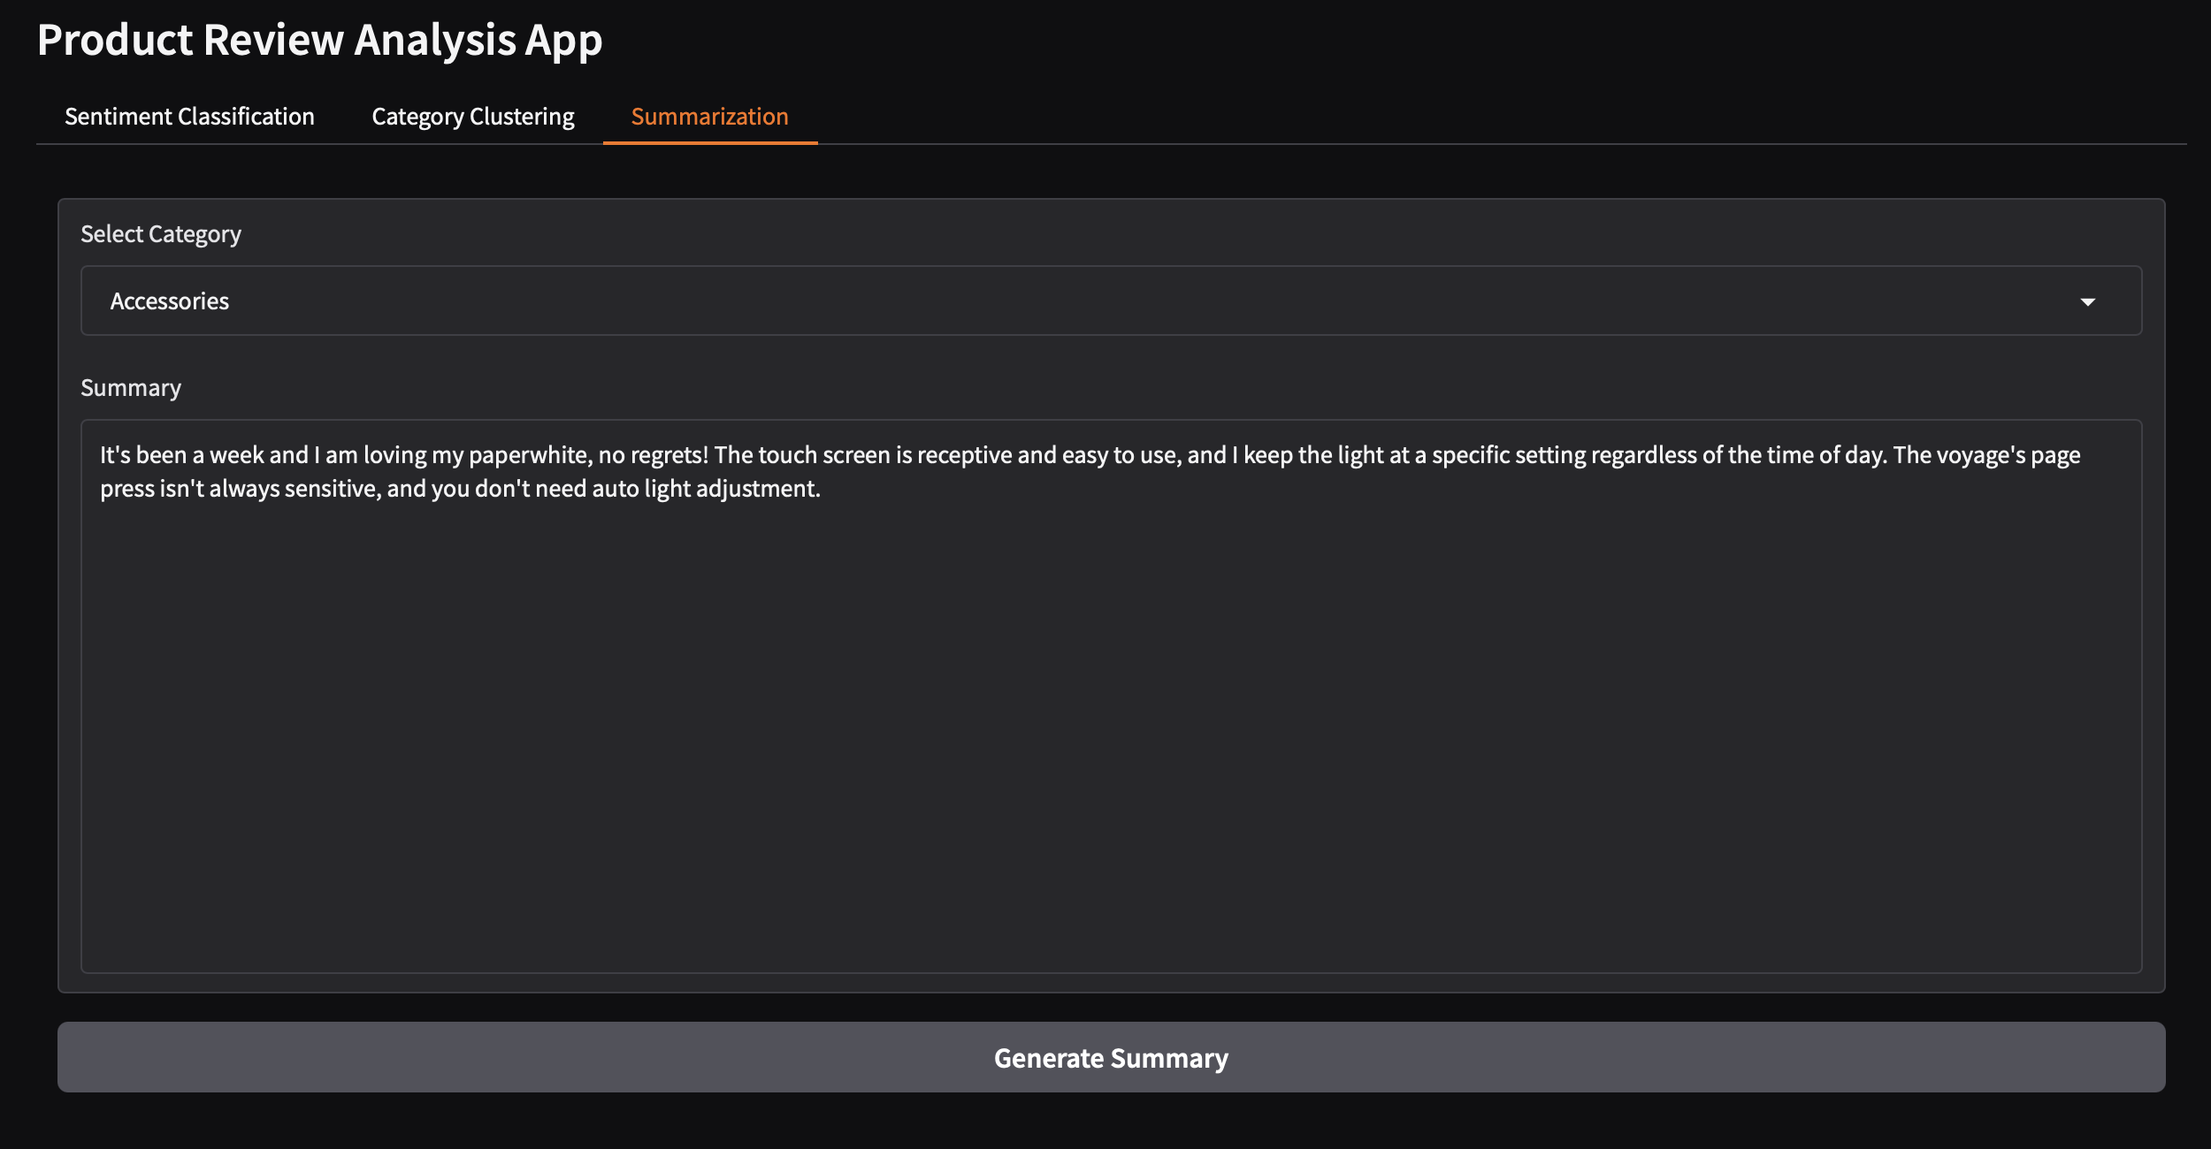
Summarization Interface

Slide 18
Challenges We Faced
Data Quality
Train and test took a long time which resulted in losing more time
Text Generation Using AI

Slide 19
Thank you

