Slide 1
TurboSpeed System Analysis

Slide 2
Requirements Analysis
The TurboSpeed car dealership offers various well-known car brands, including sedans, SUVs and electric cars. A car consists of components such as engine, body and interior. The equipment and vehicle type are identified by a unique number and a description. The customer can buy, lease or finance a car. Each of these processes has an invoice. There can be multiple bookings for a transaction, each with a unique contract number. Every person, whether customer, sales advisor or financing advisor, has a name, age and address. The customer can search and sort cars based on the car brand.
The customer can also search for vehicles that contain a specific trim level or engine type. The customer then has the option of buying the car, leasing it or financing it with a loan. The customer can seek advice from a financing advisor to find the best financing option for their needs. The company works with a partner bank for loan financing. It must be possible to create and manage products and personal data.
Legend
  Noun
  Verb
  Class
  Attribute

Slide 3
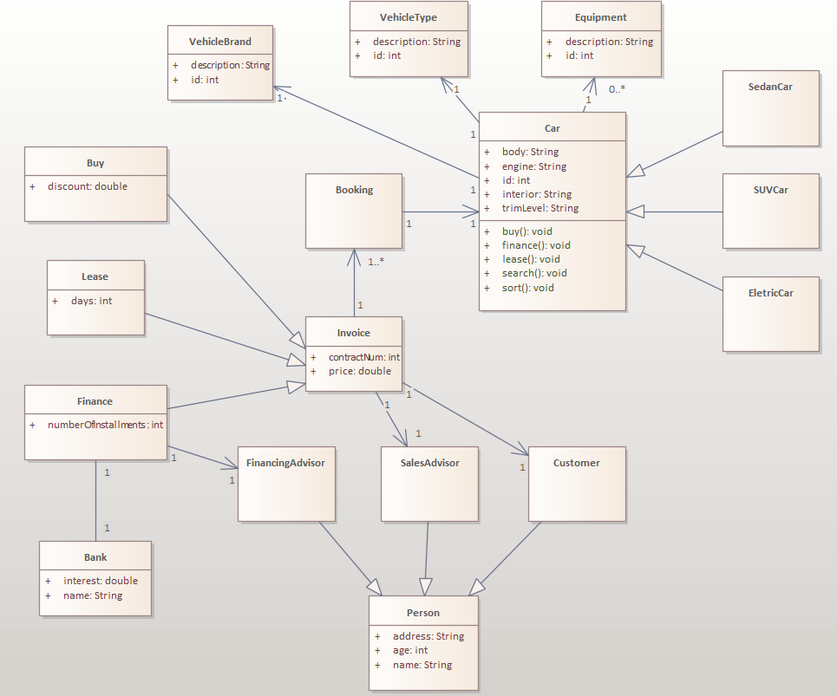
Domain Model

Slide 4
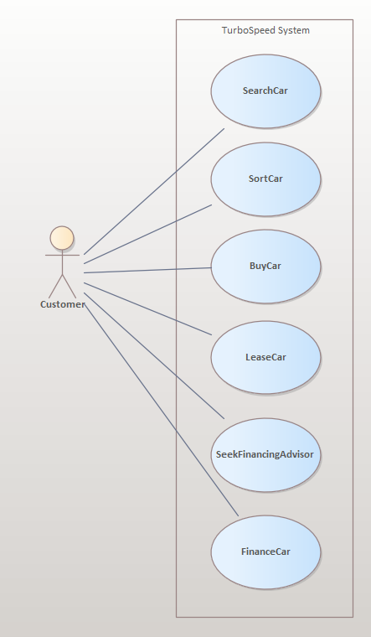
Use Cases Model

Slide 5
Epics
Car Brand Search – Allow Customer to List, Search and Sort for Cars by Brand
Car Buy – Allow Customer to Buy a Car

Slide 6
User Stories of Car Brand Search
Car List Display
Car List Pagination
Car Search by Car Brand
Car Sort by Brand

Slide 7
Story Card: Car List Display
As a customer, I want to list all available cars, so I can pick a car
Acceptance Criteria:
  When I open the system, I want to see the list of available cars
  Each car should be displayed as a card
  Each card should have basic information such as brand and vehicle type

Slide 8
Story Card: Car List Pagination
As a customer, I want to navigate among pages of available cars, so I can pick a car
Acceptance Criteria:
  When I open the system, I want to see the list of available cars
  Should be displayed a “next” button for advance the pages
  When clicked on “next” button, should display the cars for the next page
  Should be displayed a “back” button for advance the pages
  When clicked on “back” button, should display the cars for the previous page

Slide 9
Story Card: Car Search by Car Brand
As a customer, I want to search cars of an specific brand, of all available cars, so I can pick a car
Acceptance Criteria:
  When I open the system, I want to see the list of available cars
  Should be displayed a listbox with the label “Car Brand”
  The listbox should display all possible car brands registered with the system
  When the listbox change, only the cars of that select brand should be displayed

Slide 10
Story Card: Car Sort by Brand
As a customer, I want to sort all available cars alphabetically by brand name, so I can pick a car
Acceptance Criteria:
  When I open the system, I want to see the list of available cars
  Should be displayed a “A-Z Brand” button
  When the button is clicked, the cars should be displayed ordered by Brand name, in alphabetical order

Slide 11
User Stories of Car Buy
Car Buy Offer Detail
Car Buy Sales Advisor Detail
Car Buy Booking
Car Buy Invoice

Slide 12
Story Card: Car Buy Offer Detail
As a customer, I want to be able to check the price of the car and the discount, so I can buy a car
Acceptance Criteria:
  When I am on Car Detail screen, it should appear a “Offer Detail” button
  When the button is clicked, a new screen should be displayed with the information about the price and offered discount
  If the discount is zero, the discount information shouldn’t be displayed

Slide 13
Story Card: Car Buy Sales Advisor Detail
As a customer, I want to be able to check sales advisor information, so I can buy a car
Acceptance Criteria:
  When I am on Car Buy Detail screen, it should appear a “Sales Advisor Detail” button
  When the button is clicked, a new screen should be displayed with the information about the Sales Advisor, including Name and Address
  According to the GDPR regulation, the Age shouldn’t be displayed

Slide 14
Story Card: Car Buy Booking
As a customer, I want to book a car, so I can buy a car
Acceptance Criteria:
  When I am on Car Buy Detail screen, it should appear a “Book the Car” button
  When the button is clicked, a new screen should be displayed with the booking information such as the list of booked cars, individual prices, and total price
  To encourage the customer to book more than a car, should be displayed a button “Search more cars”
  When the button “Search more cars” is clicked, the List of cars should be displayed again

Slide 15
Story Card: Car Buy Invoice
As a customer, I want to generate invoice of booked cars, so I can buy a car
Acceptance Criteria:
  When I am on Car Booking screen, it should appear a “Generate Invoice” button
  When the button is clicked, a new screen should be displayed with the invoice information such as the list of booked cars, individual prices, and total price, and contract number

Slide 16
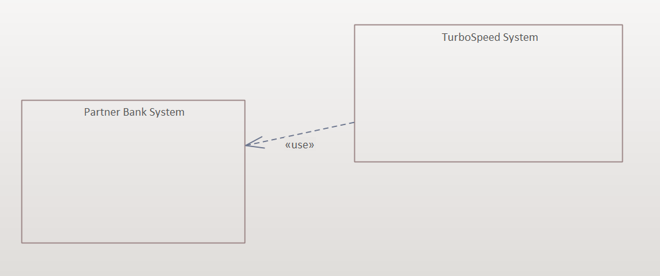
Technical Context View

Slide 17
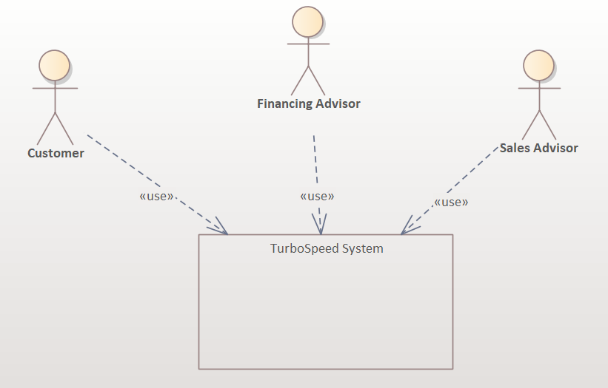
Business Context View

Slide 18
High Level Architecture
Model
View
JavaFX
Database
Controller
JavaFX Events

Slide 19
Two-Level Hierarchical Decomposition of Your System
Turbo Speed System
Car Inventory
Sales
Financing
Car Directory
Car Filtering
Car Buy
Car Lease
Financial Advisor
Car Financing

Slide 20
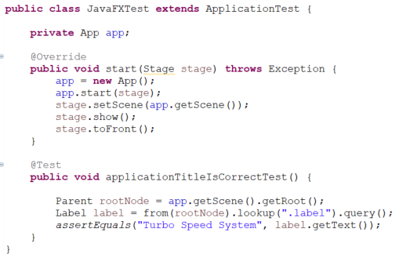
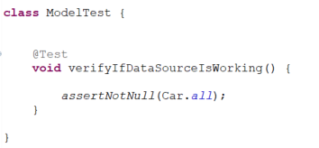
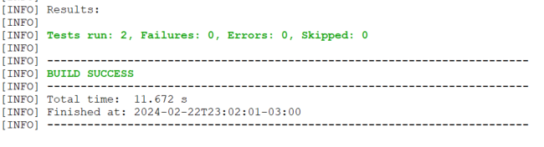
Automated Tests for Car Directory

Slide 21
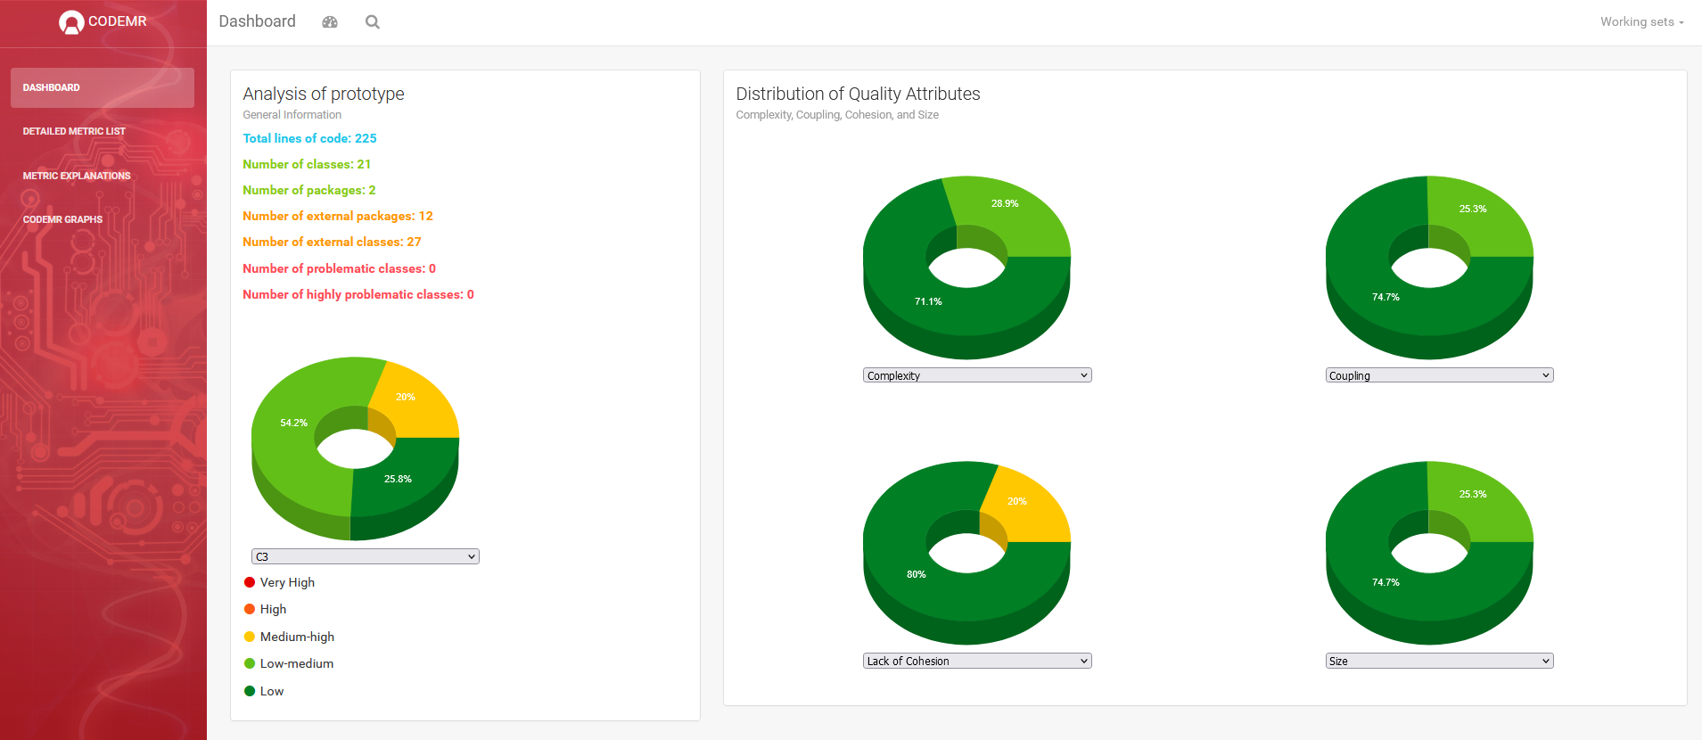
Code Metrics Report (I)

Slide 22
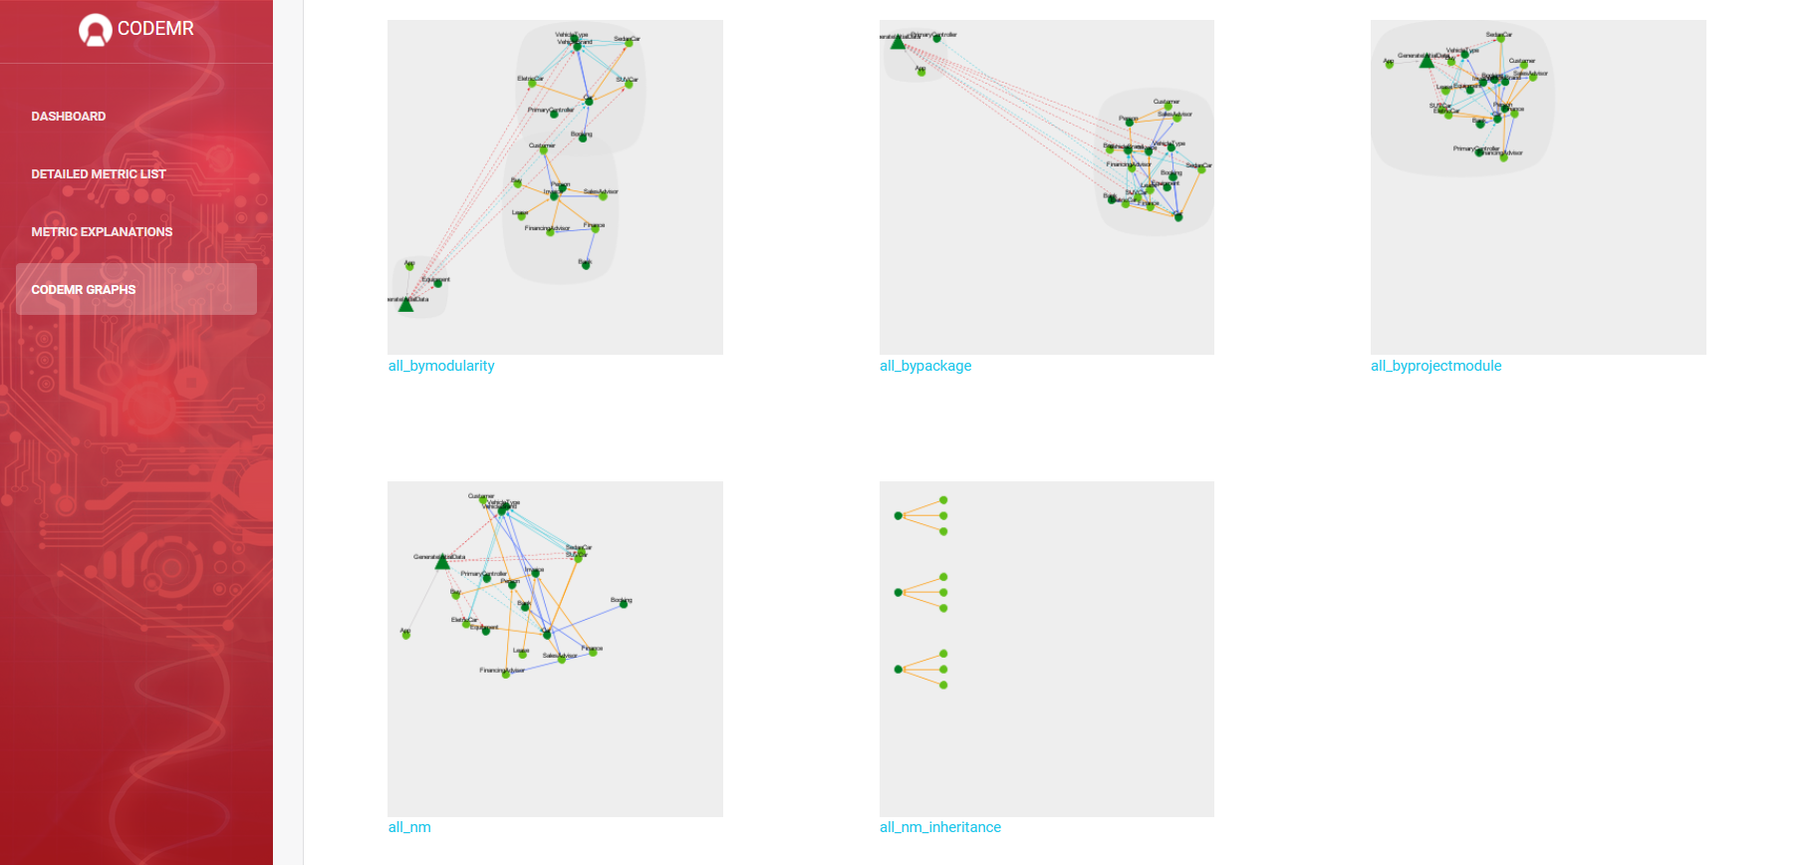
Code Metrics Report (II)

Slide 23
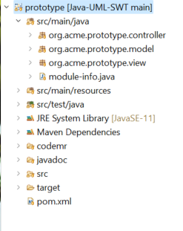
Architecture Code Mapping
Controller
Model
View

Slide 24
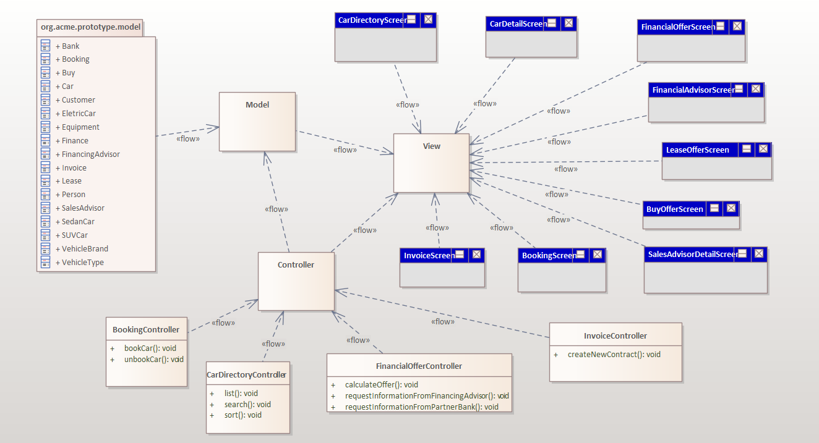
Structural View: Top Level

Slide 25
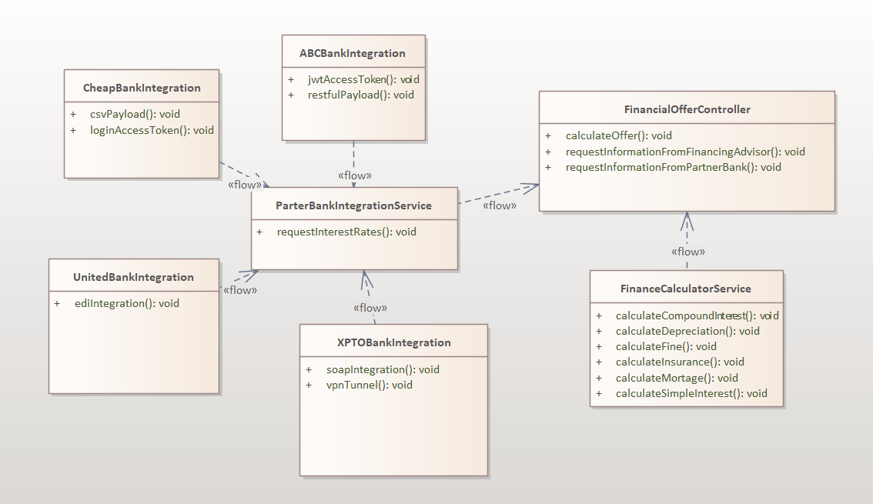
Structural View: Component FinancialOfferController

Slide 26
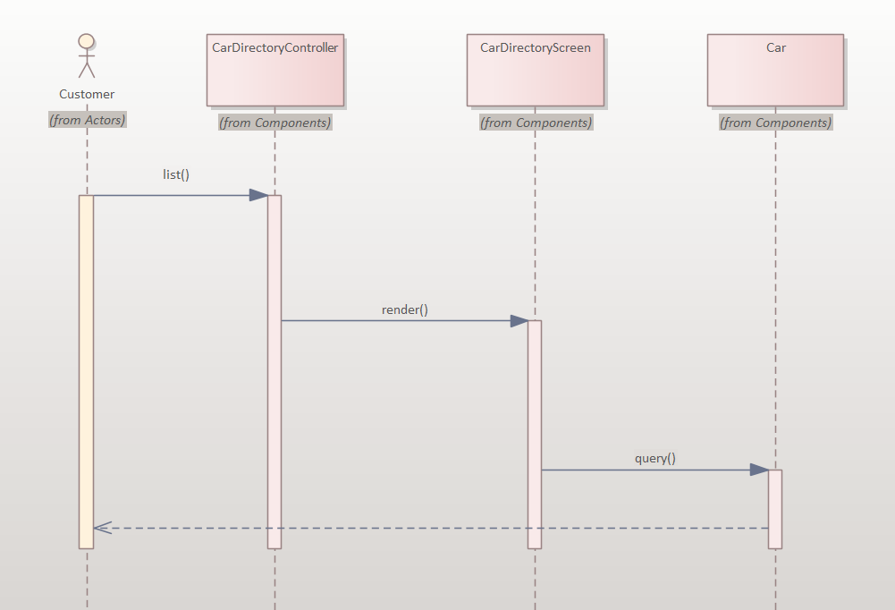
Sequence Diagram of User Story

Slide 27
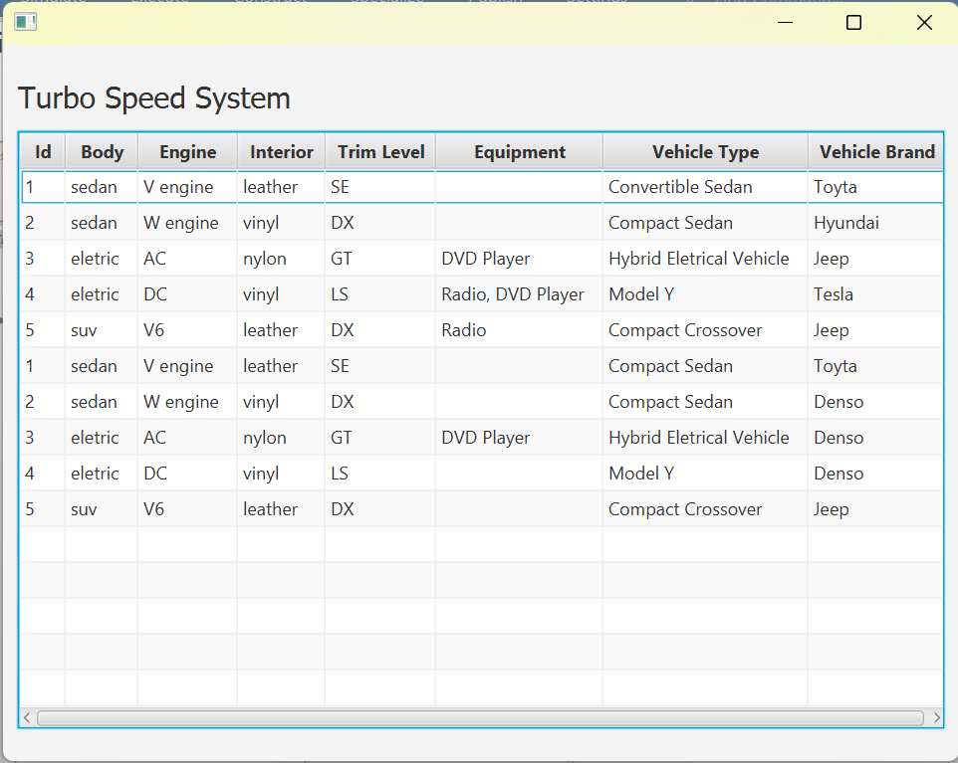
Screen Shoot of Application

Slide 28
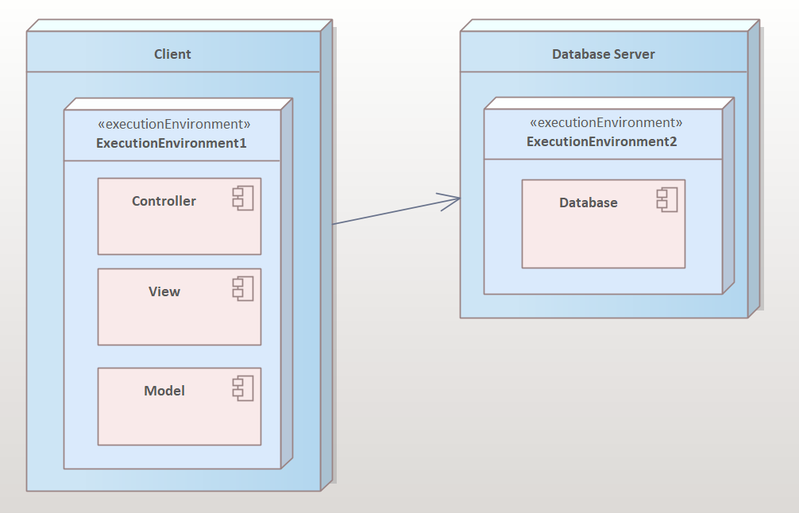
Deployment Diagram

