Slide 1


GREENROOM.AGENCY
CHINA MARKET SNAPSHOT
Vikkstar
Known in China through Alan Walker
Streaming data from NetEase Cloud Music and QQ Music, and short-video data from Douyin.
DATA RECORDED NOVEMBER 2026

Slide 2
01 · STREAMING
QQ MUSIC
NETEASE
Top Tracks on NetEase Cloud Music & QQ Music
Better Off (Alone, Pt. III)
01
Alan Walker, Dash Berlin, Vikkstar
30K+
10K+
02
Better Off (Timmy Trumpet Remix)
1K+
1K+
Alan Walker, Dash Berlin, Vikkstar
Vikkstar's collaborations travel far beyond his own artist pages. Better Off (Alone, Pt. III) has 30,000+ saves on QQ Music and 10,000+ on NetEase Cloud Music, and four more tracks pass 1,000 saves.
03
Barcelona (Vikkstar Remix)
1K+
1K+
Alan Walker, Ina Wroldsen, Vikkstar
04
Better Off (D-Block & S-te-Fan Remix)
1K+
—
Alan Walker, Dash Berlin, Vikkstar
05
Have It All
—
1K+
355
304
Vikkstar, RetroVision, DYSON
NETEASE FOLLOWERS
QQ MUSIC FOLLOWERS
06
Where Do I Go
333
—
Nicky Romero, Vikkstar, Alpharock
The songs are far better known than the artist page: the audience knows the music before it knows Vikkstar.
All This Time
07
Steve Aoki, Vikkstar, Ekko
91
—
Saves (红心). NetEase shows 999+ as a band; tracks marked 999+ are listed as 1K+. “—” = not captured.
VIKKSTAR · CHINA MARKET SNAPSHOT
02

Slide 3
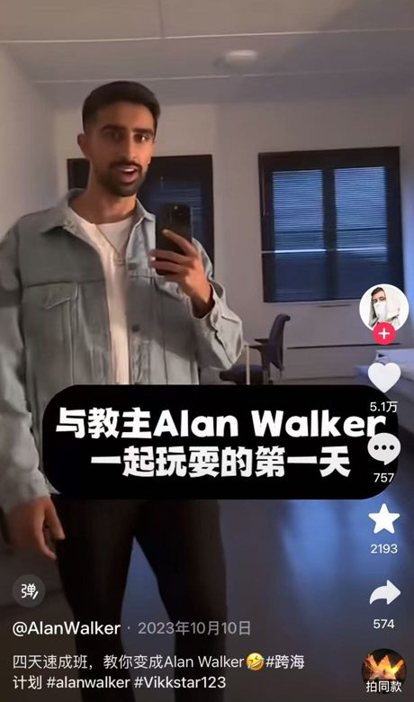
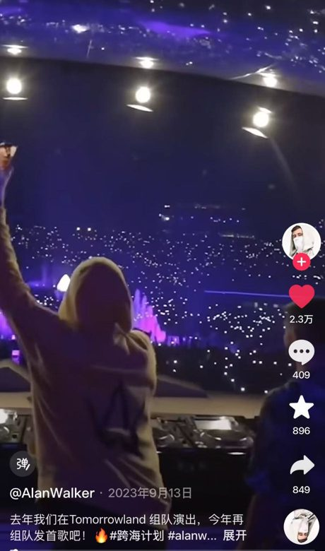

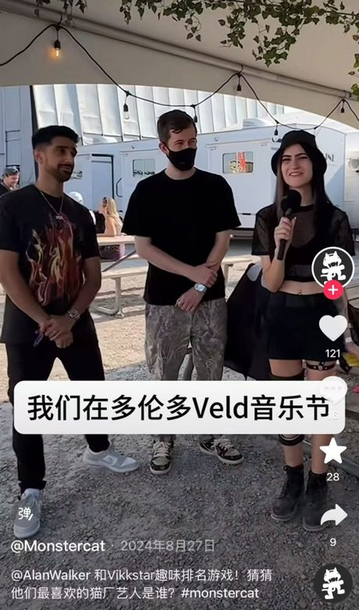
02 · DOUYIN (CHINA'S TIKTOK)
On Douyin with Alan Walker
Alan Walker's official Douyin account featured Vikkstar in its “#跨海计划” series for Better Off (Alone, Pt. III). Four posts reached 78,000+ likes and 3,300+ saves.
#1
#2
#3
#4
@AlanWalker
@AlanWalker
@AlanWalker
@Monstercat
10 Oct 2023 · “Day one hanging out with Alan Walker” · #Vikkstar123
13 Sep 2023 · Performing together at Tomorrowland
19 Sep 2023 · Teasing new single Better Off (Alone, Pt. III)
27 Aug 2024 · Interview with Alan Walker at Veld Festival, Toronto
Likes
51K
Likes
23K
Likes
4,678
Likes
121
Saves
2,193
Saves
896
Saves
260
Saves
28
Comments
757
Comments
409
Comments
196
Comments
16
Shares
574
Shares
849
Shares
97
Shares
9
VIKKSTAR · CHINA MARKET SNAPSHOT
03

Slide 4
03 · MARKET ASSESSMENT
China Market Outlook
30K+ saves
on Better Off (Alone, Pt. III), QQ Music
ASSESSMENT
5 tracks above 1K saves
The music already has an audience
His Alan Walker collaborations rank among his most-saved tracks on both major streaming platforms.
across NetEase Cloud Music and QQ Music
78K+ likes
The artist brand is still untapped
on four Douyin posts with Alan Walker
About 300 followers per platform shows listeners know the songs but not yet Vikkstar himself.
Clear room to grow
Official accounts and local content would turn this Alan Walker–driven exposure into his own fanbase and give promoters evidence for China bookings.
Outlook: early stage, high growth potential
VIKKSTAR · CHINA MARKET SNAPSHOT
04

Slide 5
Thank You
Vikkstar × China
GREENROOM.AGENCY

