Slide 1
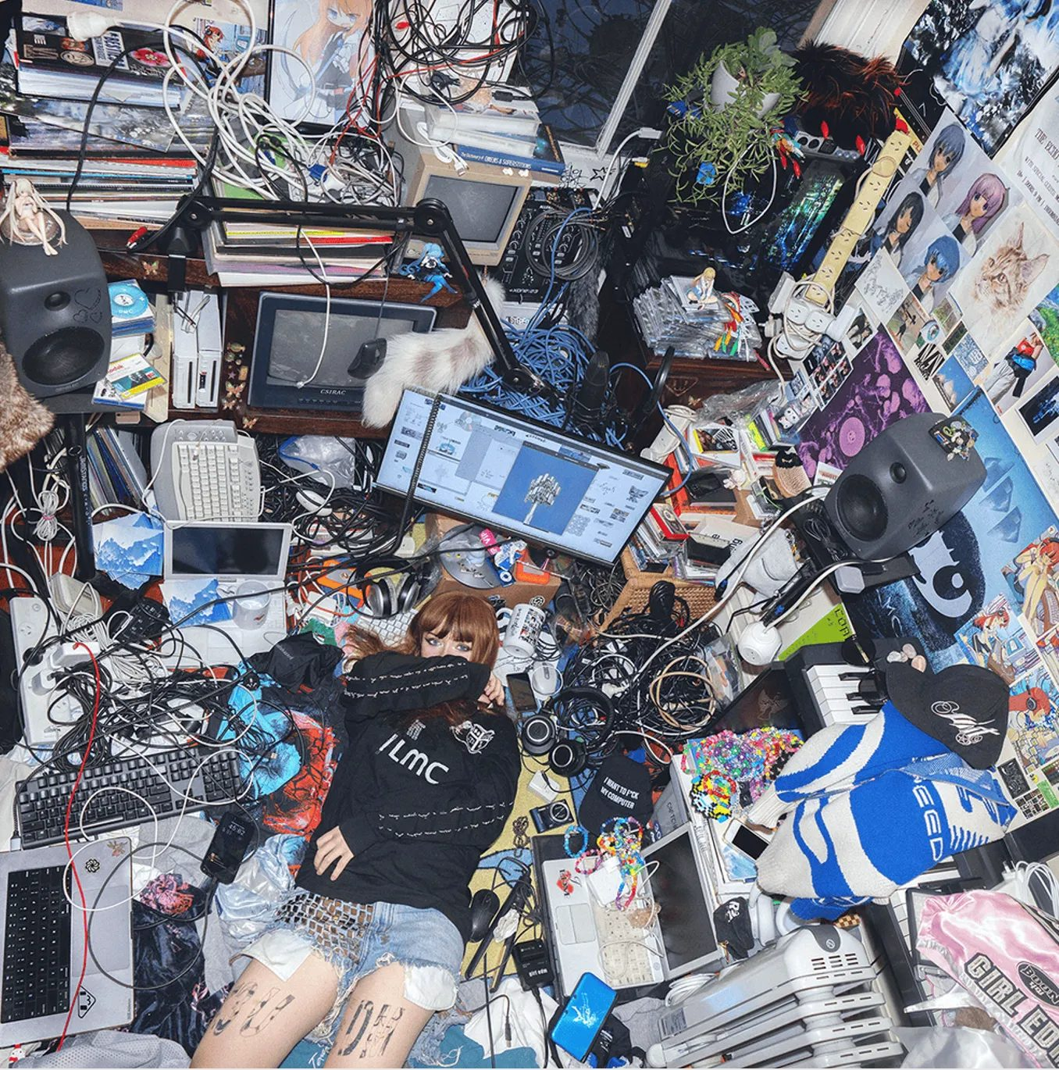

GREENROOM.AGENCY
CHINA MARKET POTENTIAL REPORT
Ninajirachi
How China is already listening
Streaming, short-video and long-video data from NetEase Cloud Music, Douyin and Bilibili.
DATA RECORDED OCTOBER 2026

Slide 2
AT A GLANCE
An audience in China that found her on its own
Listeners, fan pages and music media are already sharing her work across China's three key platforms: NetEase Cloud Music, Douyin and Bilibili.
NETEASE CLOUD MUSIC
NETEASE CLOUD MUSIC
DOUYIN
9 tracks
24,090
1.91M
WITH 10,000+ SAVES
ARTIST-PAGE FOLLOWERS
VIEWS ON #NINAJIRACHI
Pathetic and Pure Luck have passed 100,000 saves each.
Album I Love My Computer saved 18,089 times.
473 creators have posted under the hashtag.
DOUYIN
BILIBILI
FAN DEMAND
4,051
10 / 10
“When?”
LIKES ON THE TOP POST
TOP SEARCH RESULTS ABOVE 10K PLAYS
FANS ASKING FOR A CHINA SHOW
“Nina, when can you come to mainland China…” — top comment, Douyin.
Six posts above 1,000 likes each.
99+ videos; the top 10 add up to 275K plays.
NINAJIRACHI · CHINA MARKET POTENTIAL REPORT
02

Slide 3
01 · NETEASE CLOUD MUSIC
100K+
SAVES
Hot tracks, ranked by saves
01
Pathetic
100K+ saves
999+ comments
Ninajirachi, NaaH
02
Pure Luck
100K+ saves
999+ comments
A save (收藏) means a listener added the track to their own library. Two tracks — Pathetic and Pure Luck — have passed 100,000 saves, and nine tracks have passed 10,000. For an electronic music producer, that is an exceptionally strong result in China.
Ninajirachi, Freya Staer
10K+
SAVES
03
WannaCry
10K+ saves
999+ comments
Ninajirachi, Porter Robinson
04
BiBi
10K+ saves
999+ comments
24,090
18,089
Billionhappy, Ninajirachi
05
CSIRAC
10K+ saves
656 comments
FOLLOWERS
SAVES · I LOVE MY COMPUTER
Ninajirachi
06
iPod Touch
10K+ saves
590 comments
Album released 8 Aug 2025 · 12 tracks · 919 comments · 222 tracks on her NetEase artist page.
Ninajirachi
07
Sisters
10K+ saves
584 comments
Frost Children, Ninajirachi
08
F*** My Computer
10K+ saves
457 comments
Ninajirachi
09
How Could U (Ninajirachi VIP Mix)
10K+ saves
285 comments
Ninajirachi, BRUX
NetEase shows saves in bands (10K+, 100K+). Within a band, tracks are ordered by comment count.
NINAJIRACHI · CHINA MARKET POTENTIAL REPORT
03

Slide 4

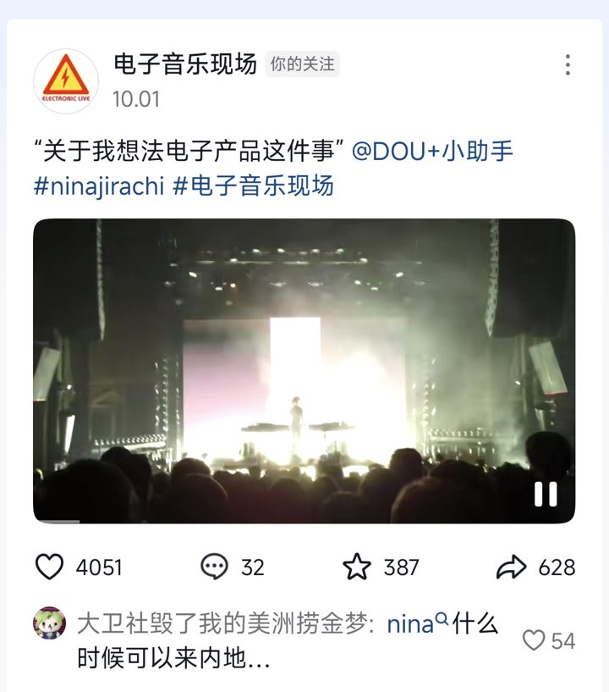
02 · DOUYIN (CHINA'S TIKTOK)
#ninajirachi on Douyin
The hashtag has collected 1.91 million views from 473 posting creators. The posts come from fans, electronic-music media and festival pages sharing live clips, profiles and edits.
1.91M
473
HASHTAG VIEWS
CREATORS POSTING
“Nina, when can you come to mainland China…”
Top comment (54 likes) under the most-liked #ninajirachi post, 1 Oct 2026.
NINAJIRACHI · CHINA MARKET POTENTIAL REPORT
04

Slide 5
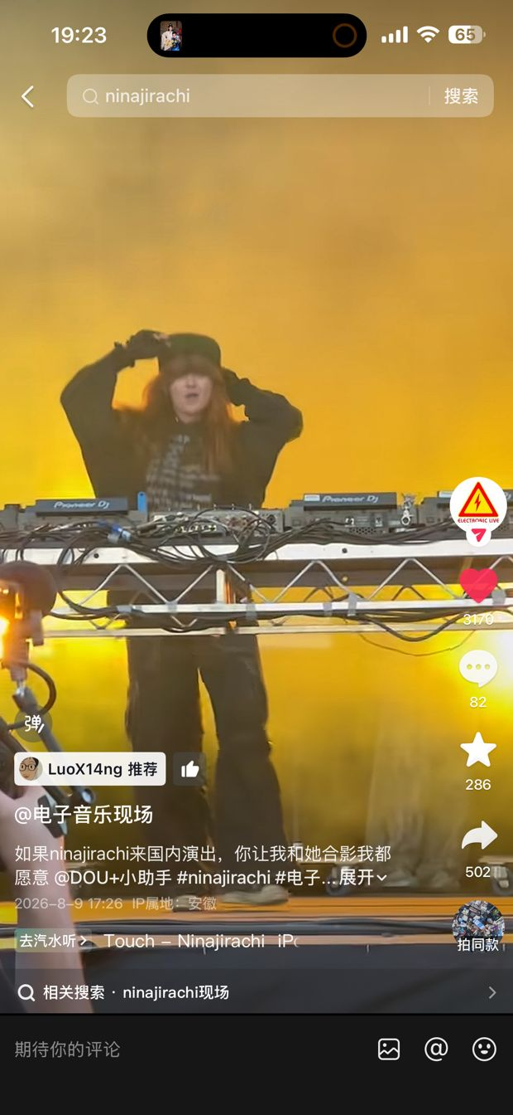
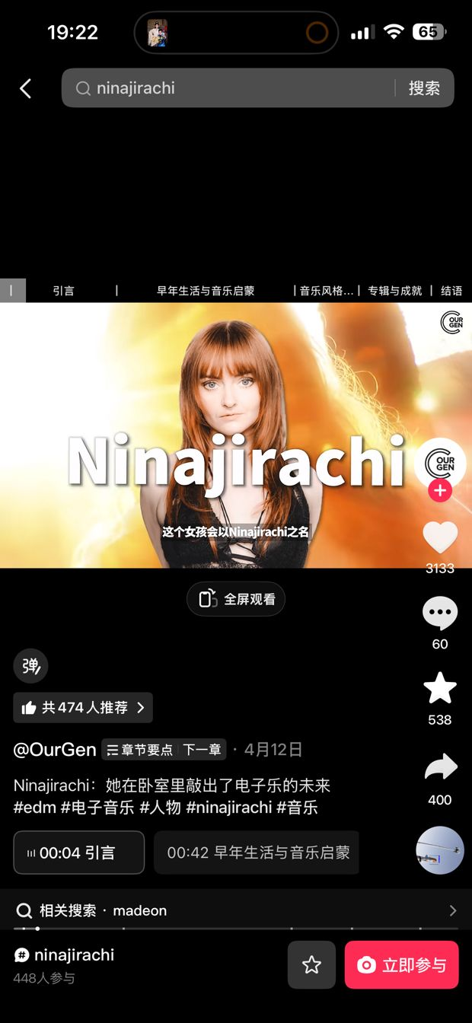
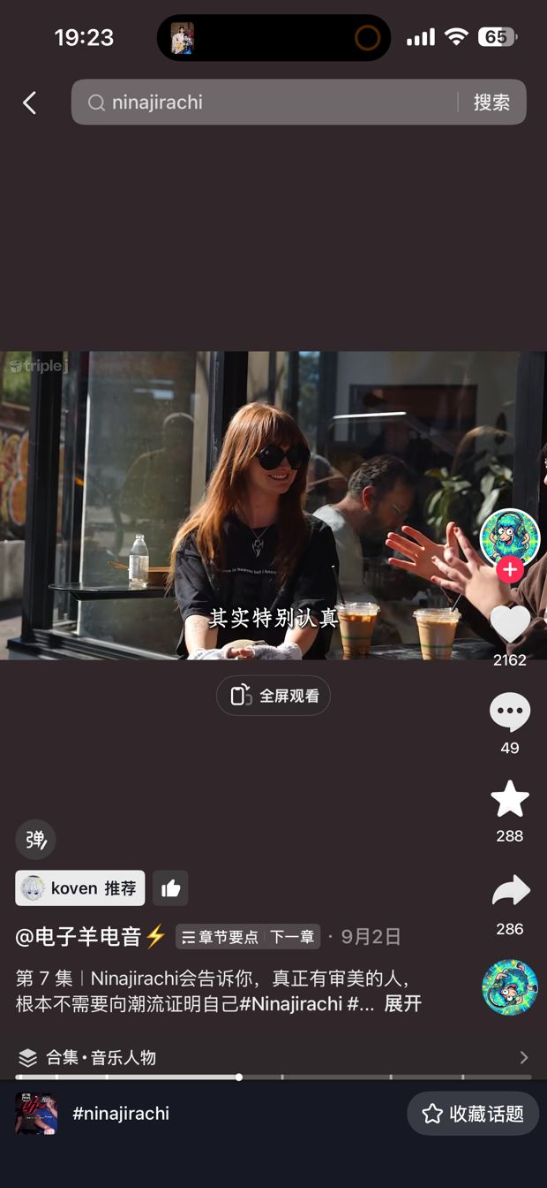
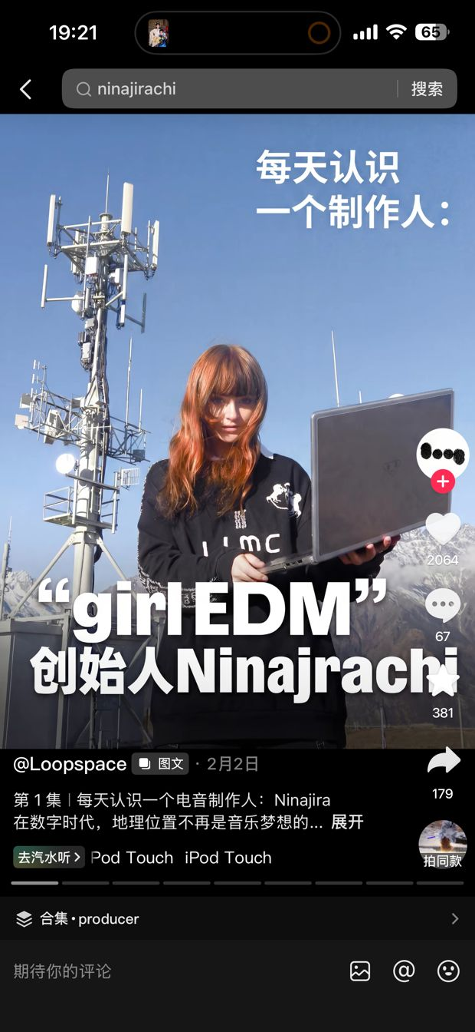
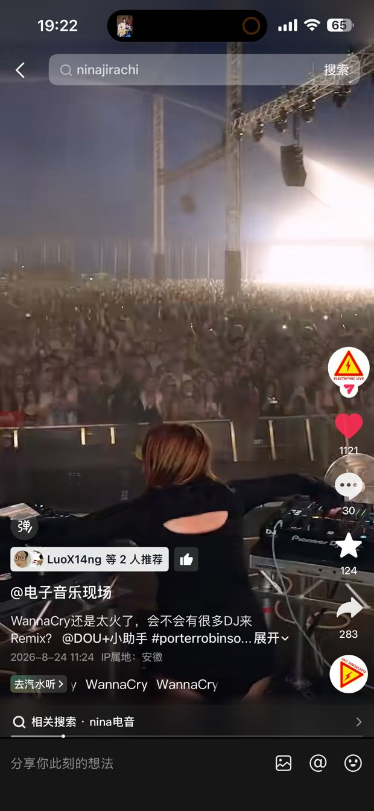
02 · DOUYIN (CHINA'S TIKTOK)
Top posts under #ninajirachi, by likes
#1
#2
#3
#4
#5
#6
Electronic Live · 1 Oct 2026
Electronic Live · 9 Aug 2026
OurGen · 12 Apr
Electric Sheep EDM · 2 Sep
Loopspace · 2 Feb
Electronic Live · 24 Aug 2026
Live clip from a Ninajirachi show
“If Ninajirachi plays in China, I’d love a photo with her”
The girl who built the future of electronic music in her bedroom
Producer series, Ep. 7: Ninajirachi on staying real
“Meet a producer every day”, Ep. 1: Ninajirachi
WannaCry live — “Will lots of DJs remix it?”
Likes
4,051
Likes
3,170
Likes
3,133
Likes
2,162
Likes
2,064
Likes
1,121
Saves
387
Saves
286
Saves
538
Saves
288
Saves
381
Saves
124
Comments
32
Comments
82
Comments
60
Comments
49
Comments
67
Comments
30
Shares
628
Shares
502
Shares
400
Shares
286
Shares
179
Shares
283
Further posts from Vision Electronic, Musikorama, Orynx Audio Recs and other music accounts add 140–750 likes each.
NINAJIRACHI · CHINA MARKET POTENTIAL REPORT
05

Slide 6
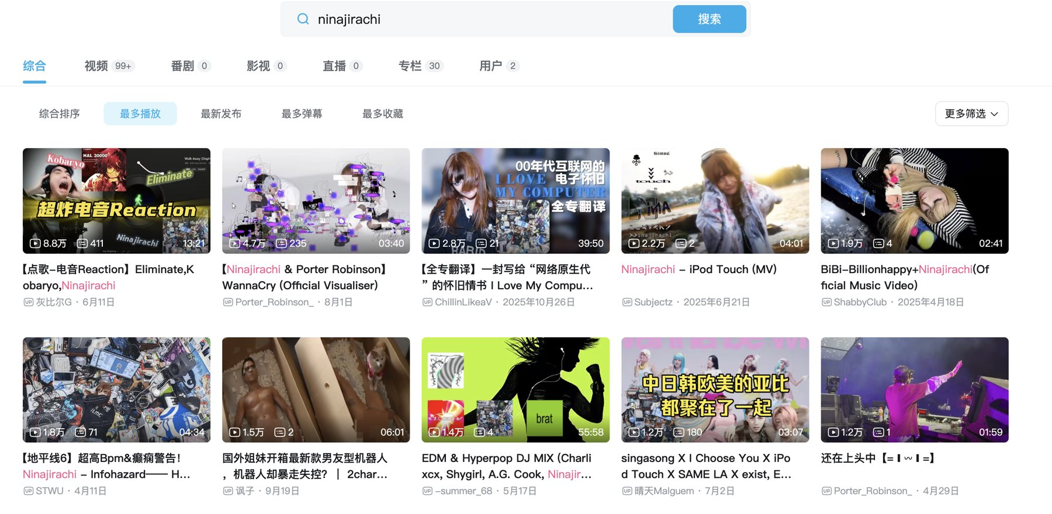
03 · BILIBILI (CHINA'S YOUTUBE)
Every top search result clears 10K plays
Searching “ninajirachi” returns 99+ videos. Sorted by plays, all of the top 10 are above 10,000 — 275K plays combined — from reaction videos and DJ mixes to a full Chinese translation of I Love My Computer.
Eliminate reaction — Kobaryo, Ninajirachi
88K
WannaCry visualiser — Porter Robinson (official)
47K
I Love My Computer — full-album translation
28K
iPod Touch (MV)
22K
BiBi official MV — Billionhappy, Ninajirachi
19K
Infohazard — Forza Horizon 6 edit
18K
Comedy unboxing clip
15K
EDM & hyperpop DJ mix (Charli xcx, A.G. Cook…)
14K
Mashup: I Choose You × iPod Touch
12K
Porter Robinson live clip
12K
Plays as shown on Bilibili (rounded to the nearest thousand).
NINAJIRACHI · CHINA MARKET POTENTIAL REPORT
06

Slide 7
04 · CHINA MARKET POTENTIAL
RECOMMENDED NEXT STEPS
The demand is here. It needs an official home.
1
Open official accounts
Douyin, Bilibili and a verified NetEase Cloud Music artist page, so existing traffic lands on Ninajirachi's own channels.
Fans are already asking for a China show, and the traffic is real. Right now it flows to fan pages and media accounts; official accounts would capture it and show promoters what Ninajirachi can draw.
2
Feed them local content
Chinese-subtitled live clips, studio snippets and a short hello to Chinese fans.
100K+ saves
Show promoters the numbers
on two tracks, nine tracks above 10K saves on NetEase Cloud Music
3
Share this data and follower growth with Chinese festivals and club promoters.
1.91M views
on #ninajirachi across 473 Douyin creators
4
Turn demand into dates
275K plays
Convert promoter interest into a first China club tour or festival booking.
across the top 10 Bilibili results, each above 10K
“If Ninajirachi plays in China, I'd love a photo with her.”
Douyin post by Electronic Live, 9 Aug 2026 · 3,170 likes
NINAJIRACHI · CHINA MARKET POTENTIAL REPORT
07

Slide 8
Thank You
Ninajirachi × China
Ready for a first China tour.
GREENROOM.AGENCY

