Slide 1
Data Presentation
Marketing Analytics Portfolio Project

Slide 2
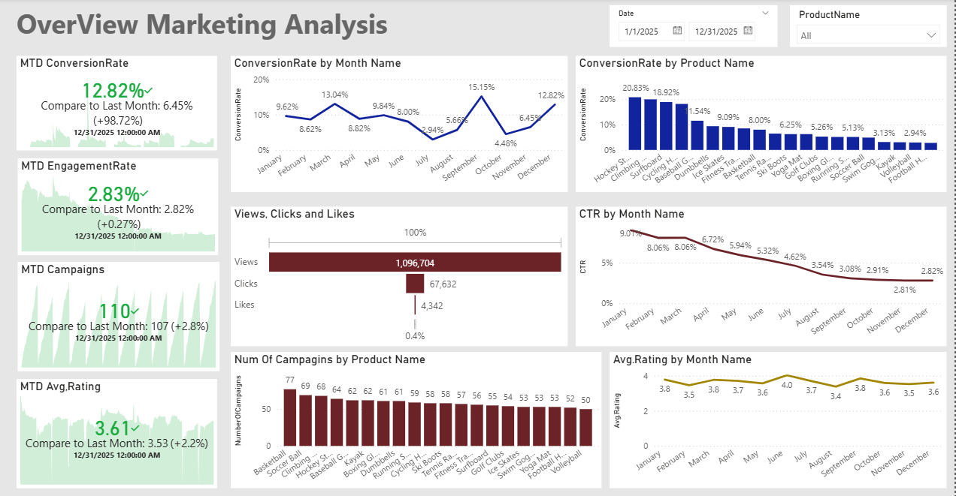
Overview
Decreased Conversion Rates: Monthly trends indicate fluctuations throughout the year, with a strong peak in September (15.15%), dips during mid-year, and a notable recovery in December (12.82%). This suggests more effective customer acquisition strategies toward year-end.
Reduced Customer Engagement:
- While views dominate heavily, the ratio of clicks and likes remains low, suggesting that audiences are seeing the content more than engaging with it.
- The CTR trend, however, remains relatively strong early in the year (9–8%), but gradually declines to 2.82% in December, indicating lower user responsiveness over time.
Customer Feedback Analysis: While consistent, the rating is still below the target of 4.0, and several months fall close to 3.3–3.5, indicating the need for product or service improvements—especially in low-performing categories.

Slide 3
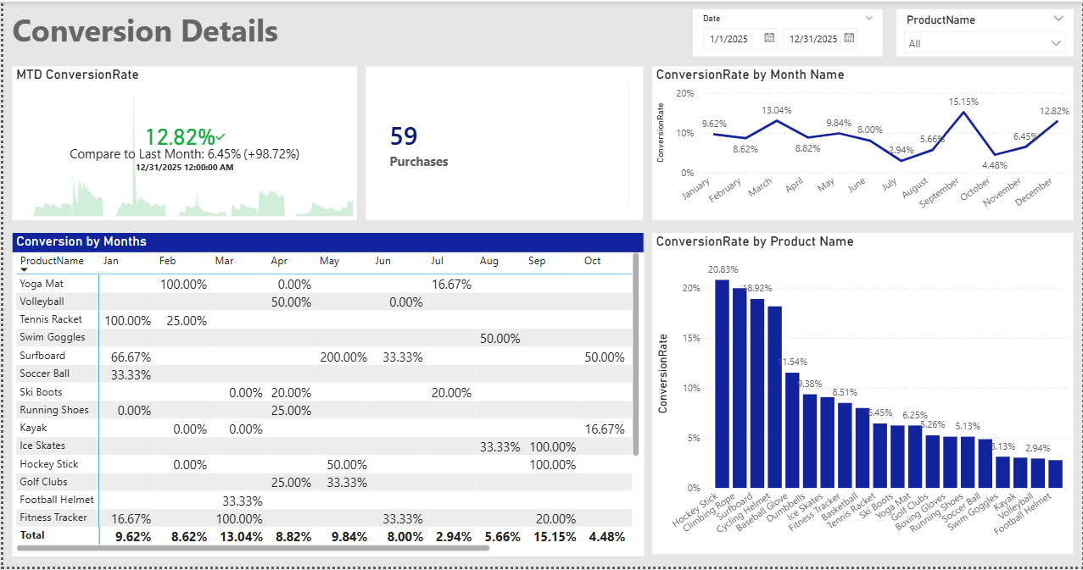
Decreased Conversion Rates
General Conversion Trend:
The dashboard shows that conversion rates fluctuated throughout the year, with noticeable peaks in specific months such as March, September, and December. These variations indicate the presence of seasonal patterns and product-driven spikes. While some months perform consistently well, others show noticeable drops, suggesting opportunities to enhance campaigns or optimize the user journey during weaker periods.
Lowest Conversion Month:
July records the lowest overall conversion rate on the dashboard. This decline is visible across many products, reflecting a broad drop rather than an issue with a specific category. This may indicate reduced seasonal demand or less effective marketing initiatives during this month.
Highest Conversion Rates:
September recorded the highest overall conversion rate at 15.15%, driven significantly by the Ice Skates, Hockey Sticks with a remarkable 100% conversion

Slide 4
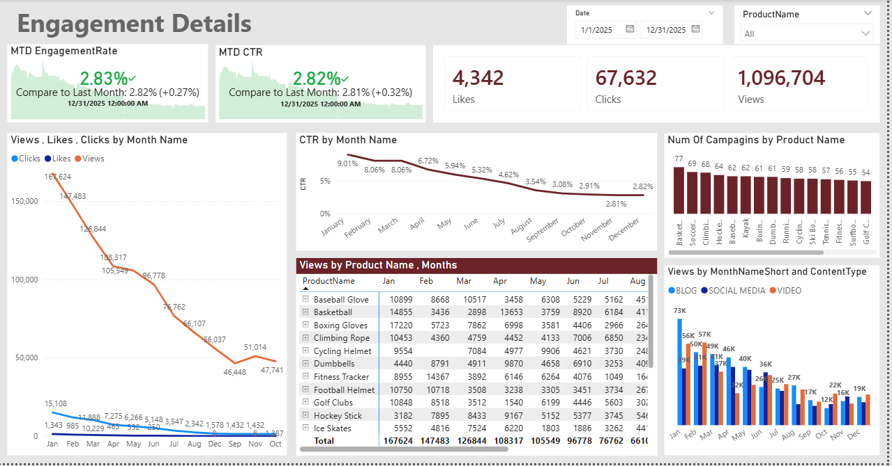
Reduced Customer Engagement
Declining Views:
Views start high in January and February, then continue decreasing month after month, reaching their lowest levels around October–December. This indicates a consistent drop in audience reach and visibility over time.
Low Interaction Rates:
Although total views are high, clicks and likes remain very low in comparison. Clicks hover between 1K–15K, and likes stay below that—far behind the large view counts. This gap suggests that while content is being seen, it is not driving strong interaction, highlighting the need to improve content hooks, CTAs, or relevance.
Content Type Performance:
This indicates that blog content remains the strongest driver of visibility, while other content types could benefit from further optimization to increase engagement.

Slide 5
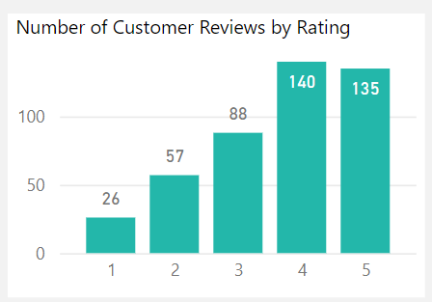
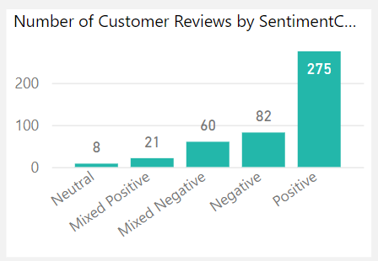
Customer Feedback Analysis
Customer Ratings Distribution:
The majority of customer reviews are in the higher ratings, with 140 reviews at 4 stars and 135 reviews at 5 stars, indicating overall positive feedback. Lower ratings (1-2 stars) account for a smaller proportion, with 26 reviews at 1 star and 57 reviews at 2 stars.
Sentiment Analysis:
Positive sentiment dominates with 275 reviews, reflecting a generally satisfied customer base. Negative sentiment is present in 82 reviews, with a smaller number of mixed and neutral sentiments, suggesting some areas for improvement but overall strong customer approval.
Opportunity for Improvement:
The presence of mixed positive and mixed negative sentiments suggests that there are opportunities to convert those mixed experiences into more clearly positive ones, potentially boosting overall ratings. Addressing the specific concerns in mixed reviews could elevate customer satisfaction.

Slide 6
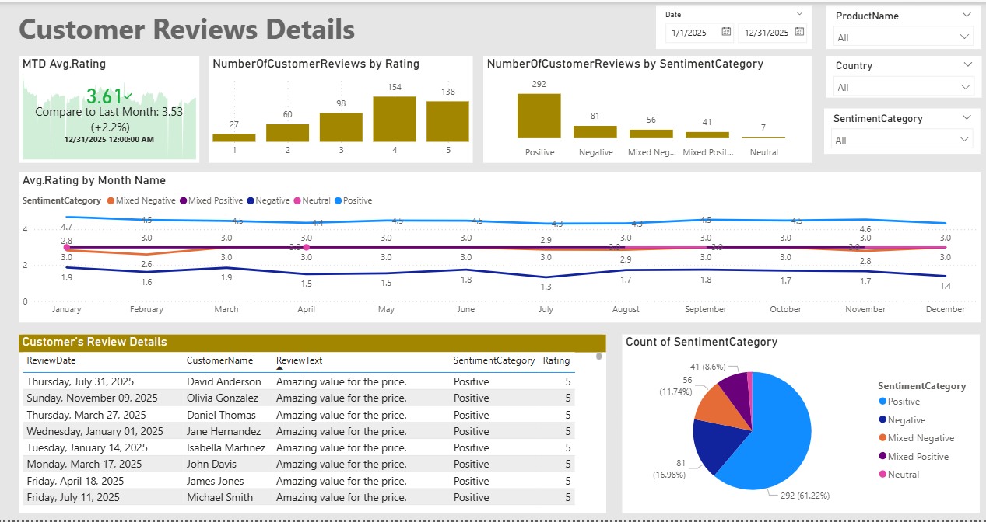
Customer Feedback Analysis
Customer Ratings Distribution:
Customer reviews show a strong positive trend, with the highest volume of ratings in the 4- and 5-star categories.
154 reviews gave a 4-star rating
138 reviews gave a 5-star rating These two categories make up the majority of feedback, confirming consistently high customer satisfaction. Lower ratings (1–2 stars) are significantly fewer, indicating fewer negative experiences overall.
Sentiment Analysis:
292 Positive reviews represent the largest share of customer sentiment.
Negative reviews: 81
Mixed Negative: 56
Mixed Positive: 41
Neutral: 7
With more than 60% of all reviews being positive, the overall sentiment toward your products is clearly strong.
Opportunity for Improvement:
Although negative and mixed-negative categories form a smaller portion of total reviews, they still highlight areas to enhance:
Mixed Negative feedback, while not large, suggests partial dissatisfaction that could be addressed with product improvements or better post-purchase support.
Neutral reviews are relatively few but represent customers who could potentially become promoters with minor enhancements in their experience.
Focusing on the themes in mixed and negative reviews can help shift more customers toward clearly positive sentiments.

Slide 7
Goals & Actions
Actions
Goals
Increase Conversion Rates:
Focus on Products with Strong Conversion Performance: Products such as Hockey Sticks, Climbing Rope, and Baseball Gloves show the highest conversion rates. Allocate more targeted campaigns, retargeting ads, and seasonal promotions to these top converters to maximize ROI.
Optimize Low-Conversion Months: Months such as July, August, and October show noticeable drops in conversion rates. Consider running time-limited offers, bundle discounts, or product-specific campaigns during these weaker periods to stabilize yearly conversion performance.
Enhance Customer Engagement:
Introduce more interactive content, such as quick reels, product demos, or comparison videos.
Strengthen the call-to-action across blog, video, and social media posts.
Increase publishing frequency during historically weak months (September–December) to revive reach.
Prioritize High-Performing Content Types: Blogs generate the highest views across months, especially in April and July. Double down on blog content while optimizing social media and video posts to catch up, possibly by repurposing high-performing blog topics into video formats.
Improve Customer Feedback Scores:
Capitalize on Positive Feedback Trends: The majority of reviews are Positive (292) with strong average ratings throughout the year. Keep reinforcing practices that contributed to this satisfaction—quality responsiveness, product reliability, and clear product descriptions
Increase Conversion Rates:
Goal: Identify factors impacting the conversion rate and provide recommendations to improve it.
Insight: Highlight key stages where visitors drop off and suggest improvements to optimize the conversion funnel.
Enhance Customer Engagement:
Goal: Determine which types of content drive the highest engagement.
Insight: Analyze interaction levels with different types of marketing content to inform better content strategies.
Improve Customer Feedback Scores:
Goal: Understand common themes in customer reviews and provide actionable insights.
Insight: Identify recurring positive and negative feedback to guide product and service improvements.

Slide 8
Actions
Increase Conversion Rates:
Focus on Products with Strong Conversion Performance: Products such as Hockey Sticks, Climbing Rope, and Baseball Gloves show the highest conversion rates. Allocate more targeted campaigns, retargeting ads, and seasonal promotions to these top converters to maximize ROI.
Optimize Low-Conversion Months: Months such as July, August, and October show noticeable drops in conversion rates. Consider running time-limited offers, bundle discounts, or product-specific campaigns during these weaker periods to stabilize yearly conversion performance.
Enhance Customer Engagement:
Introduce more interactive content, such as quick reels, product demos, or comparison videos.
Strengthen the call-to-action across blog, video, and social media posts.
Increase publishing frequency during historically weak months (September–December) to revive reach.
Prioritize High-Performing Content Types: Blogs generate the highest views across months, especially in April and July. Double down on blog content while optimizing social media and video posts to catch up, possibly by repurposing high-performing blog topics into video formats.
Improve Customer Feedback Scores:
Capitalize on Positive Feedback Trends: The majority of reviews are Positive (292) with strong average ratings throughout the year. Keep reinforcing practices that contributed to this satisfaction—quality responsiveness, product reliability, and clear product descriptions
Negative (81) and Mixed Negative (56) feedback points reveal improvement areas. Recommended actions:
Perform sentiment clustering to identify recurring issues (e.g., delivery time, product defects, sizing).
Respond proactively to dissatisfied customers through follow-up emails or support tickets.

