Slide 1
An online store ala javafx
Alaa Alajmy 201700095
Moemen Gaafar 201700873

Slide 2

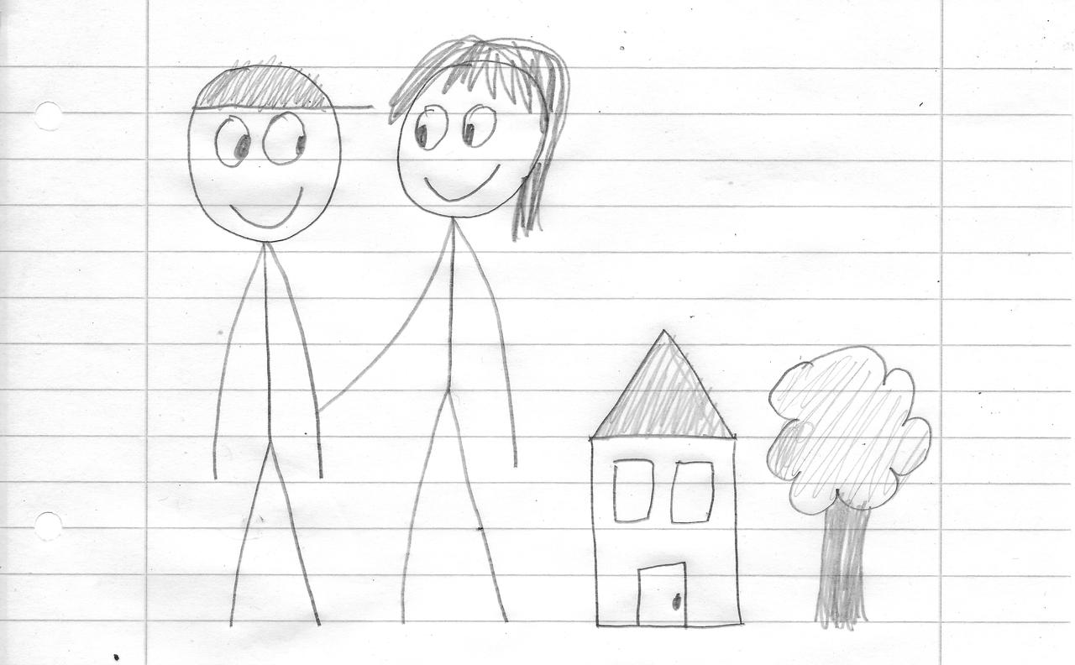
Three Types of Users
Store Owner
Hi, I’m Freddie. I sell online and onsite products to make money.
Buyers
Hi, we’re Natalie and Drake. We buy shiny things with our green money.
Administrator
Hi, I’m Jake. I manage this system to make money.

Slide 3
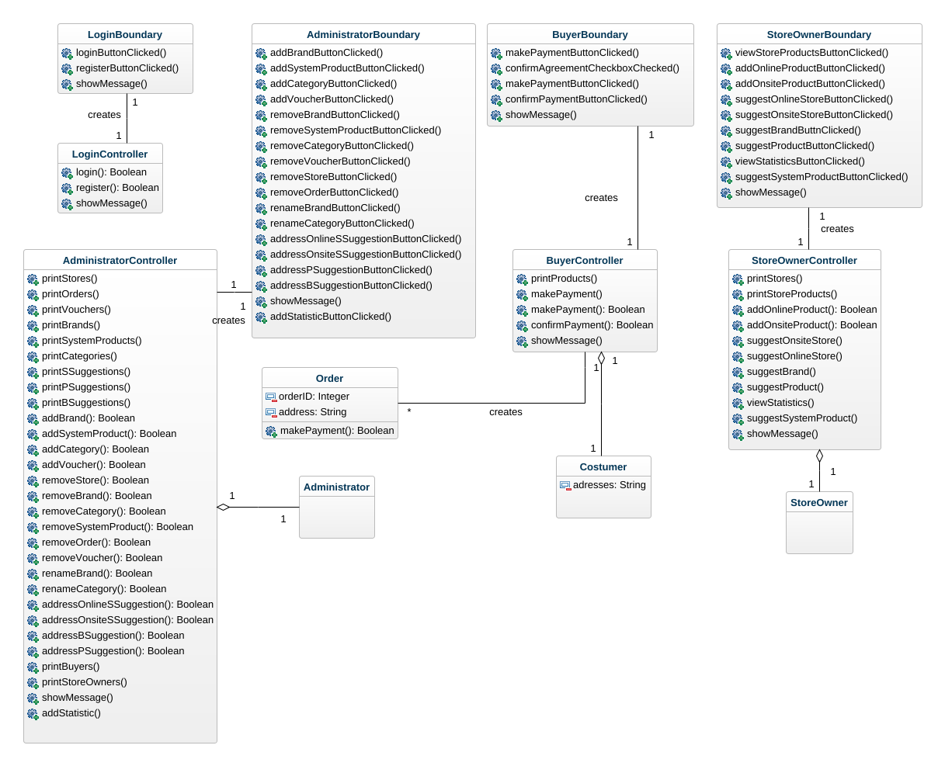
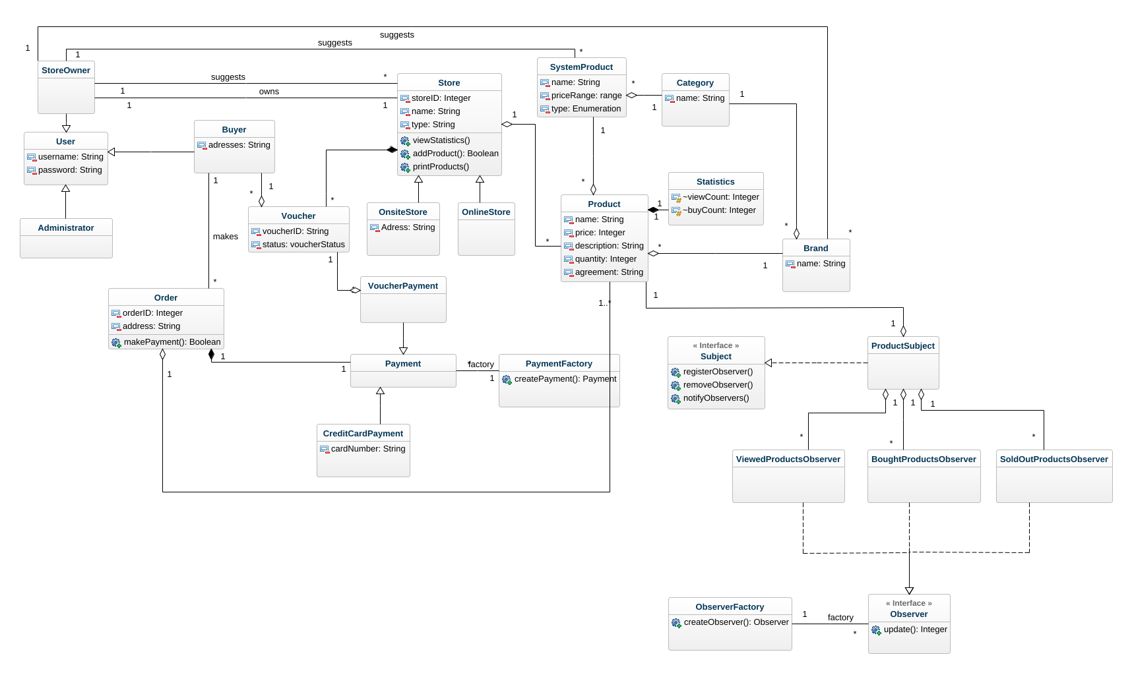


A whole big mess…

Slide 4

Disentangling the mess with administrators
As a user, I want to be able to login, so that I can employ the platform’s functionalities.
As an administrator, I want to be able to add products to the platform, so that I can ensure the platform’s growth and sustainability.
As an administrator, I want to be able to add new brands to the platform, so that I can ensure the platform’s growth and sustainability.
As an administrator, I want to be able to accept or reject store addition requests, so that I can ensure only stores that meet our standards will display items on the platform.
As an administrator, I want to be able to add new statistics to the system, so that store owners can have more insights about their stores.

Slide 5

Disentangling the mess with Store Owners
As a store owner, I want to be able to register online, so that I can exhibit and sell my stores’ products.
As a user, I want to be able to login, so that I can employ the platform’s functionalities.
As a store owner, I want to be able to add my onsite and online stores to the platform, so that I can exhibit their products.
As a store owner, I want to be able to view live statistics about my stores, so that I can monitor the purchases of my products.

Slide 6
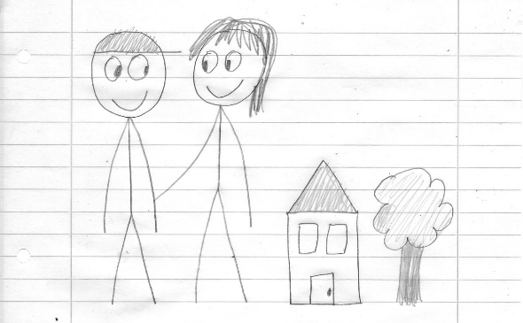
Disentangling the mess with Buyers
As a buyer, I want to be able to register online, so that I can start shopping online.
As a user, I want to be able to login, so that I can employ the platform’s functionalities.
As a buyer, I want to be able to make an order, so that I can buy a product.
As a buyer, I want to be able to make payments using visa cards, cash, or vouchers, so that I can comfortably complete orders.

Slide 7
Which maps to controllers and boundaries

Slide 8
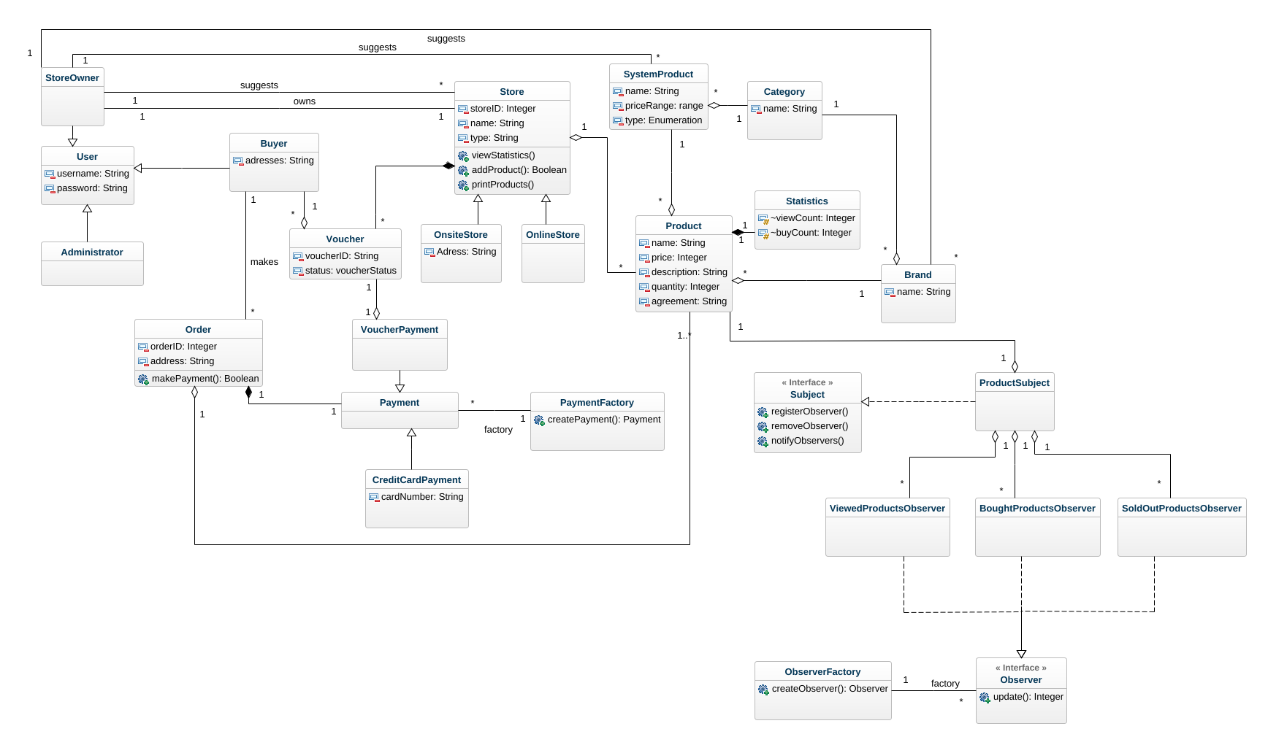
… And an entities class diagram

Slide 9
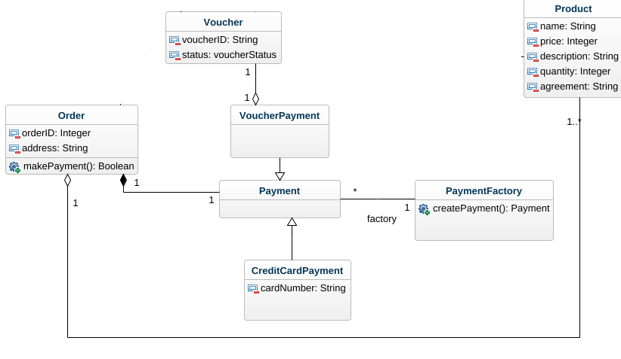
Zooming in on payments… a factory design pattern

Slide 10
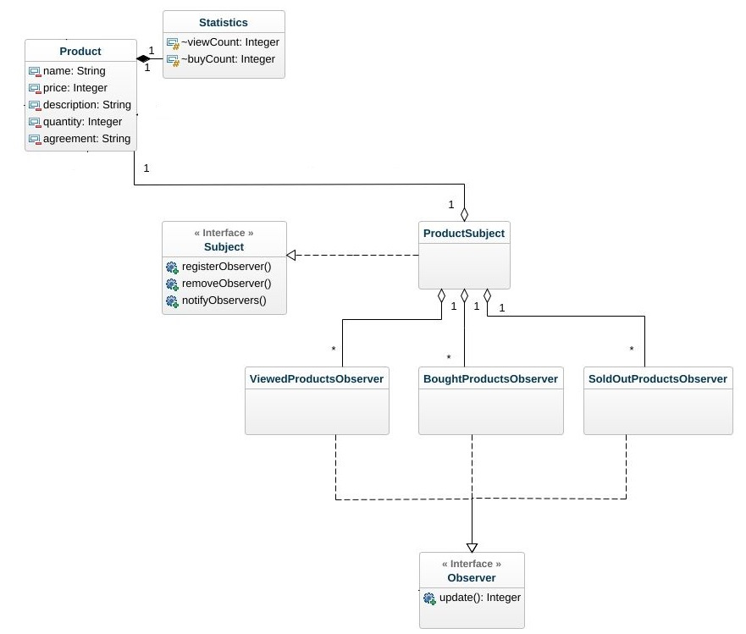
Zooming in on statistics… an observer design pattern

Slide 11
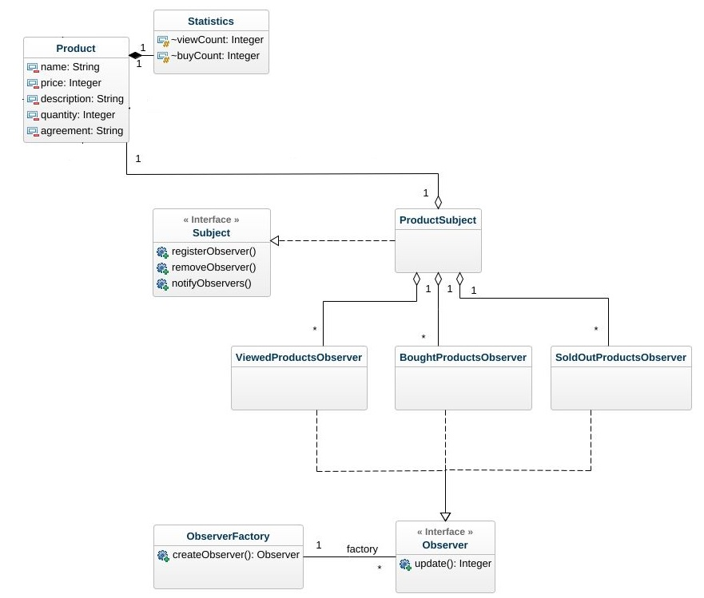
Zooming in on statistics… another factory

Slide 12
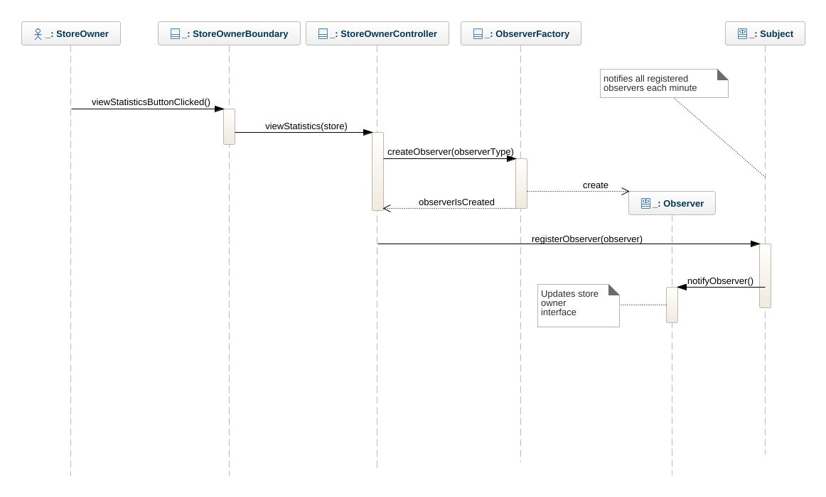
A look on how Statistics work pt. 1

Slide 13
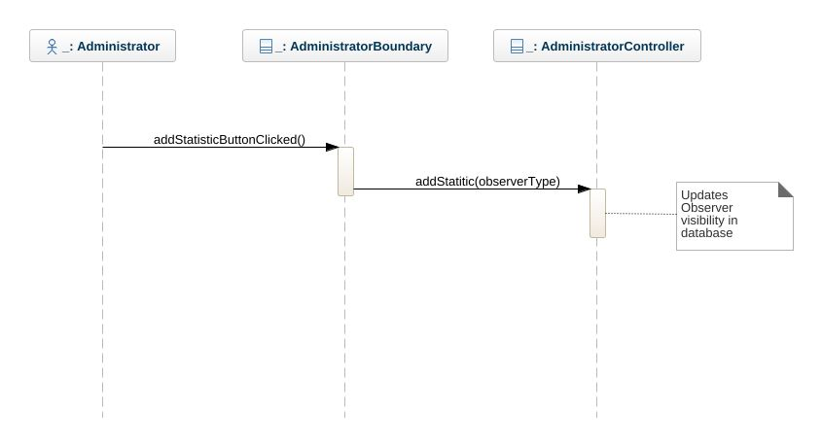
A look on how statistics work pt. 2

Slide 14
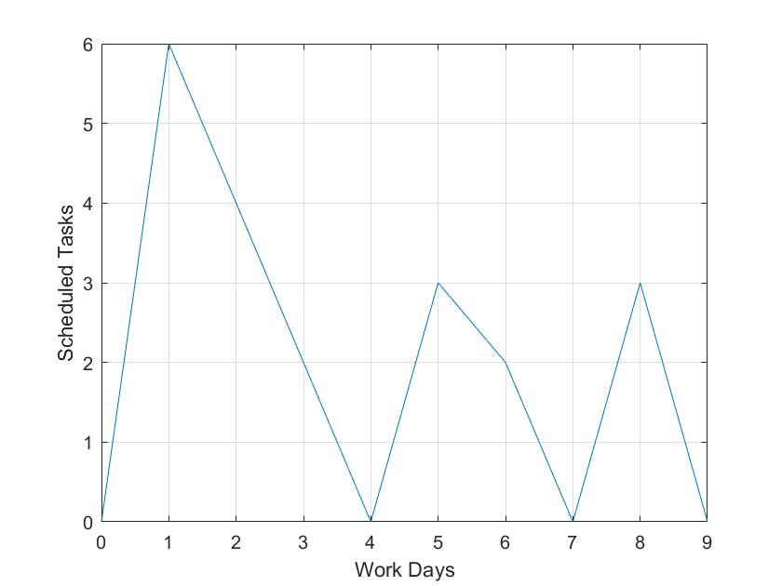

Burning down 3 sprints of online store ala javafx

