Slide 1
GT Tool
Development Manger : Marwan Farah
Developer : Alaa Amasha

Slide 2
The Problems :
Working with GT include some challenges :
Development
Deploying
Testing

Slide 3
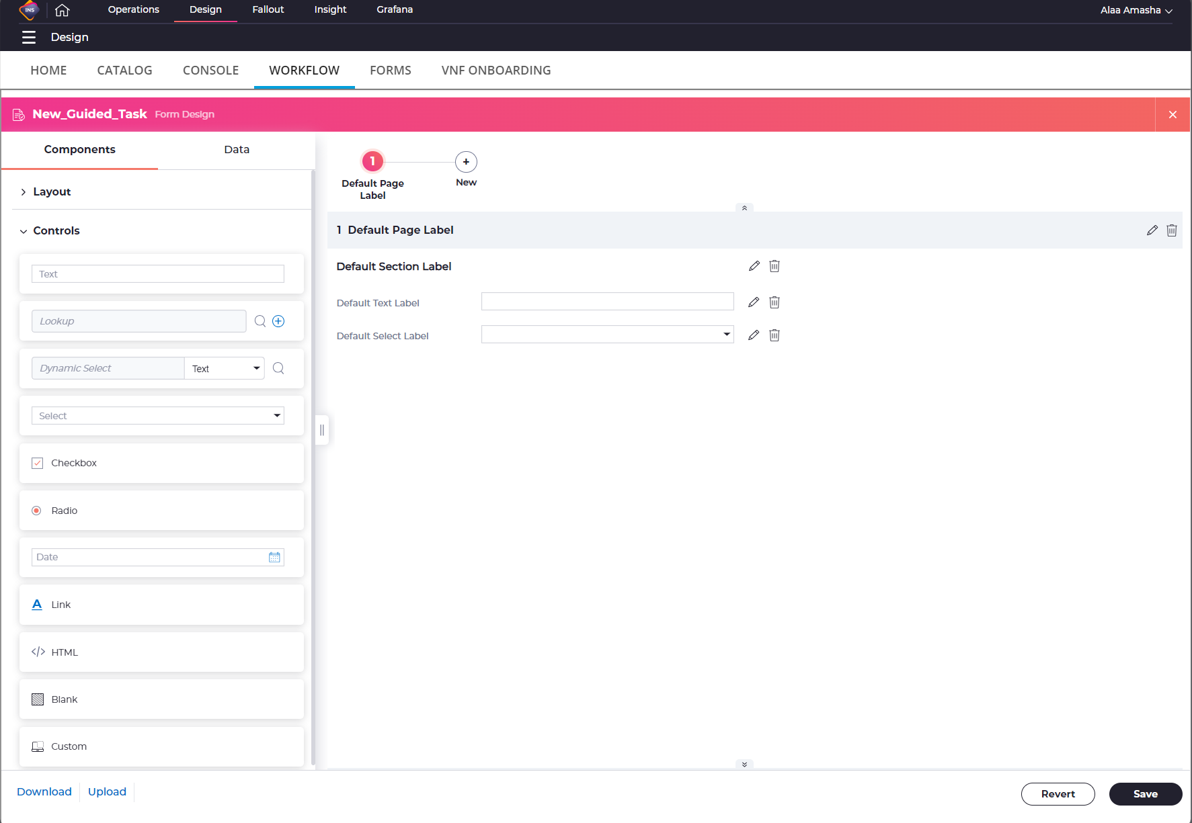
Development
For creating / editing a guided task we have the Form Design at the OND
It’s a good tool that we can use which give us a full control of the GT controls , attributes , values , order
There is only one missing thing that we can’t see how it really looks like at the SVO environment

Slide 4
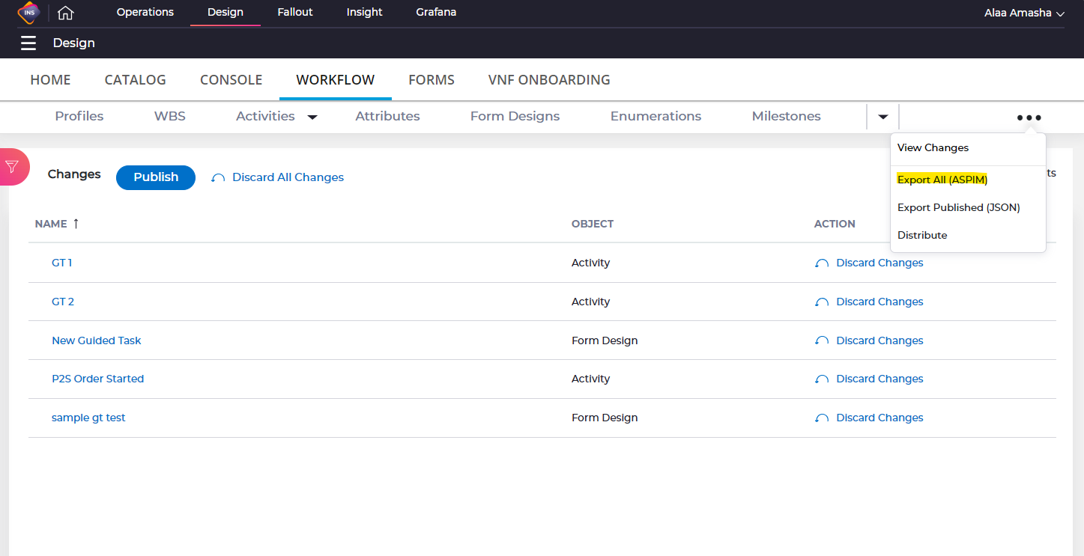
Deploying
Deploying Is the a very simple process to do which is :
Extracting the zip file from the OND environment which will contain all the changes .
Distribute the Zip File via Soap UI / Thunder Client etc..

Slide 5
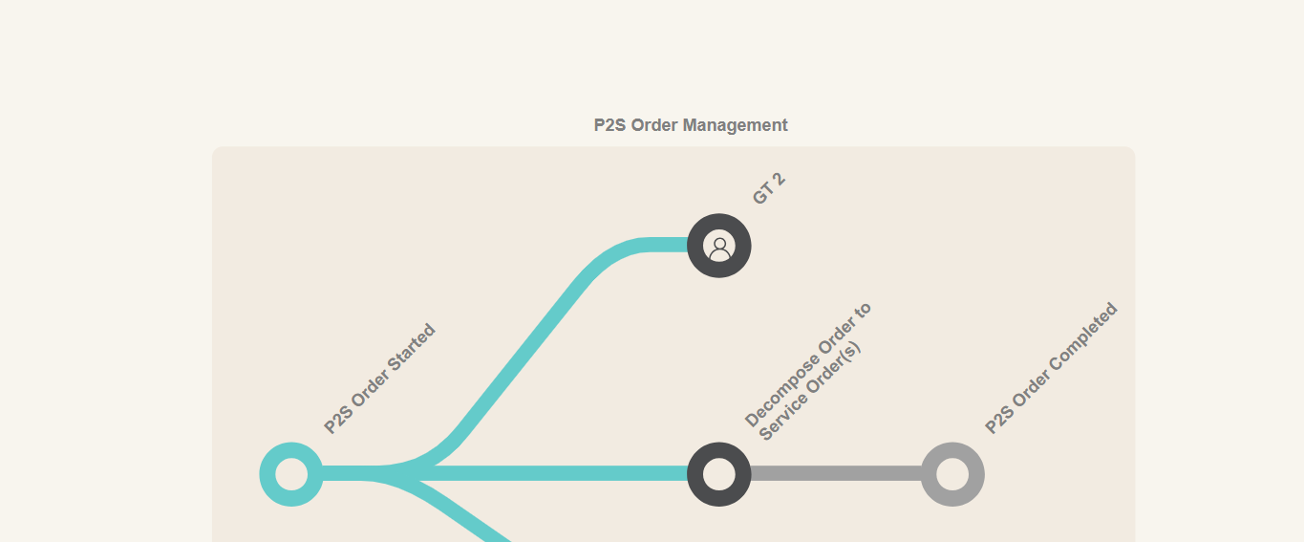
Testing
This is the Part that take most of the time
It happens by sending an order to the SVO environment , and reach the GT in the flow
And here we have some challenges that we need to handle them

Slide 6
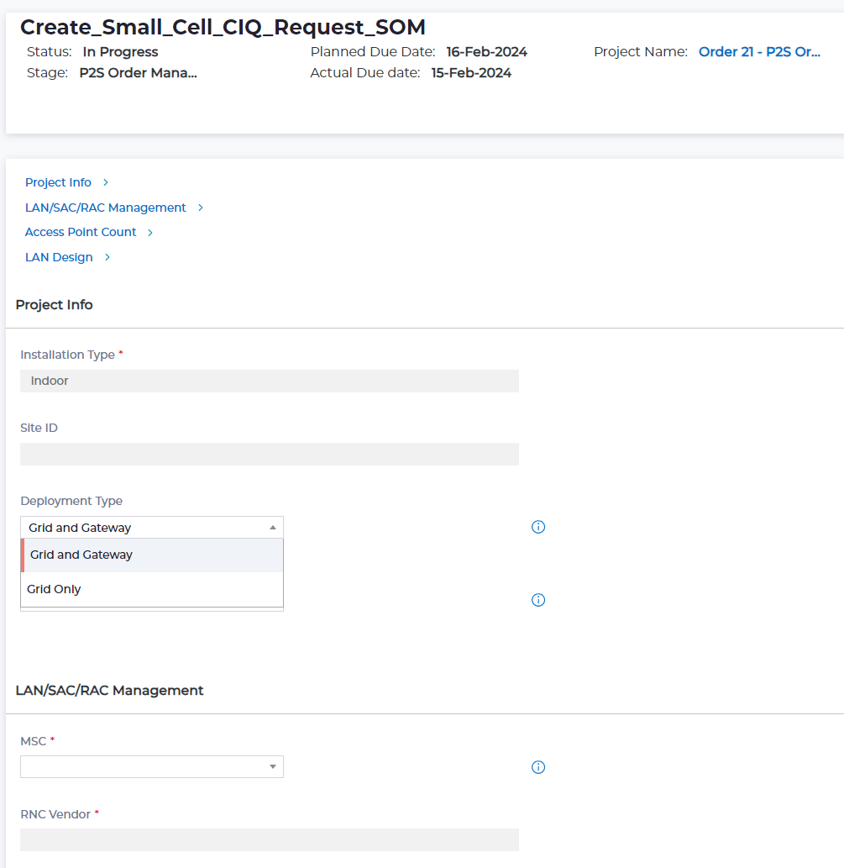
Issues we have at Testing GT
Creating the GT Layout incorrectly example:
site ID should be above Installation Type
Incorrectly initialize/store/view values example :
Development Type should contain another value
Site ID should start with some default value
Installation Type value should be stored in both CS and PS
Incorrect behavior example :
Input should be read-only
Input should be hidden until some value gets changed
Input is mandatory or should be mandatory only after marking some checkbox
Code issues :
Saving failed at PS , CS
Groovy error
Etc ….

Slide 7
The Solution
What is common with all the issues we mentioned before ?
In each case of them we need to do the change at the OND or at the Code and then do the Deploying
After that we need to send the order again and reach the GT again at the Workflow This process is the time that we want to save, which can take very long time
let's take an example that we are working on the GT number 10 so, its doesn’t make sense that every time we face some issue, we need to do the previous 10 GT’s again and again
Doing them again didn’t give us everything , because the change isn’t at them the change is only at our GT .

Slide 8

GT Tool
Gt Tool can provide us two services which can really help us and reduce the Testing time of the GT
Delete Records For GT at the Database.
Rework a GT .

Slide 9
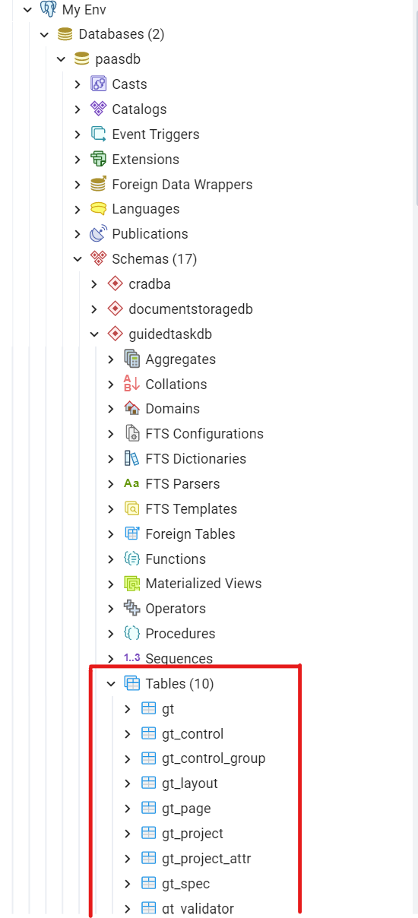
Delete Records
There are a 9 tables for the GT in the Database
All the GT information is getting saved at this tables
All the information about the GT itself is getting initialized at this table at the first time we open the GT from the SVO env
That’s why even after distributing a new WF zip file at the environment and then open the GT again we cannot see the changes .
We figure out that if we delete all the information about a specific GT form these tables . And the open it again those tables will get initialized again.
This means that we can do the distribution at the SVO environment and then delete the records of GT at the Database and then we reopen the same order, and we will get the Updated Version of the GT , without sending a new order

Slide 10
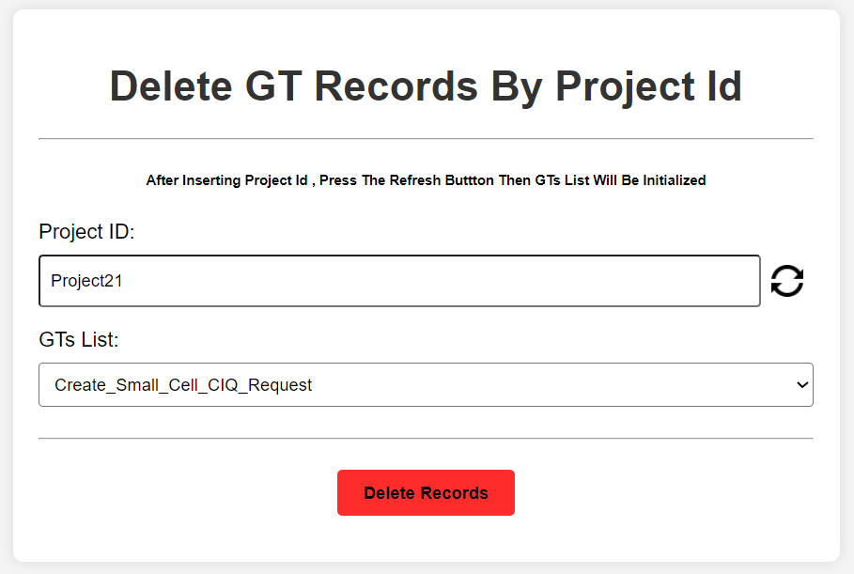
we have the ability to do this with the GT Tool
we need to add the project id and then select the GT that we want to remove their records

Slide 11

Rework Project ( specific GT )
Deleting the records and then reopen the GT is a good way to test the GT behavior .
What if we need to test behavior of the GT after pressing complete and closing the GT example:
Checking if some input value get saved at the Context Store
Check if there are a notification just sent with some input value from the GT
Check if there are another activity is still waiting that the GT is completed then it can be released and move to InProgress state etc…
That’s why we thought of using the rework project
So if we sent a rework Project call with a specific reason code for the activity then we will be able to open the GT again even after being completed

Slide 12
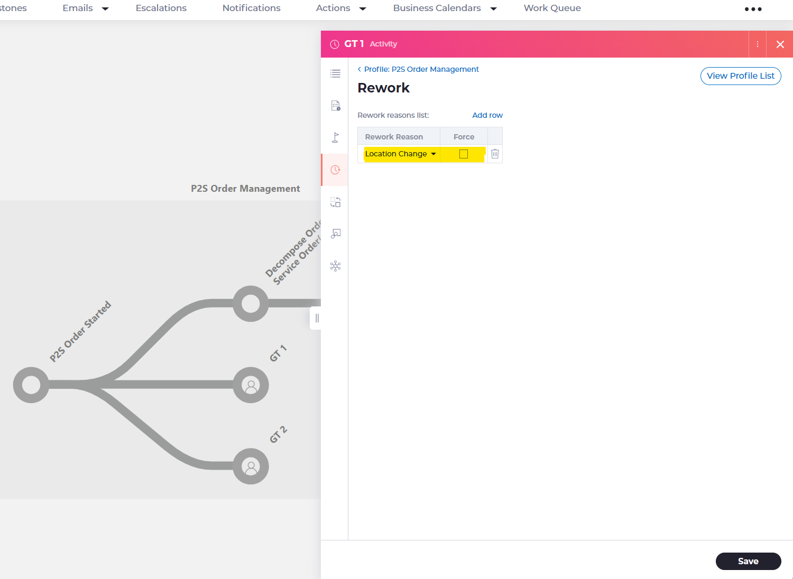
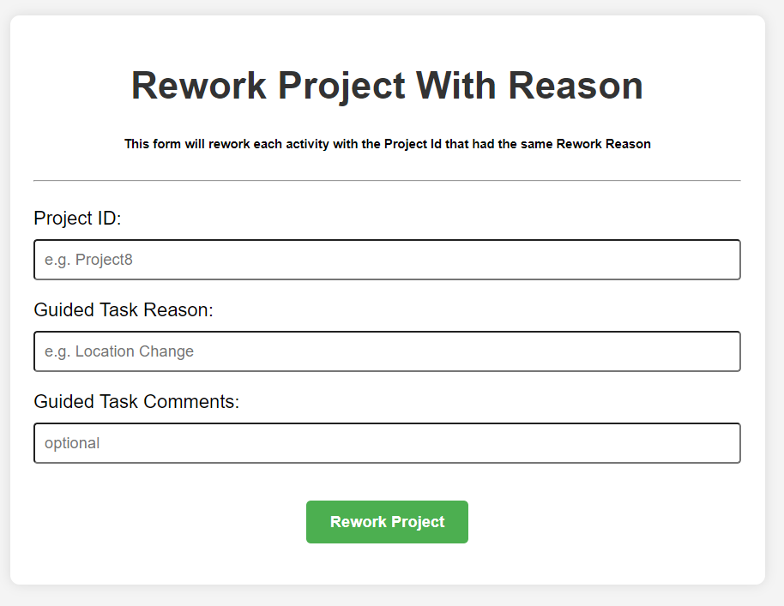
First, we need to add a rework reason for the activity from the OND
Here for example: I add a rework reason “Location Change “ for this activity
We need to complete the GT before sending the rework .
To send the rework:
Project ID
Rework Reason ( That we add it from the OND)
Rework Comments ( Optional )

Slide 13
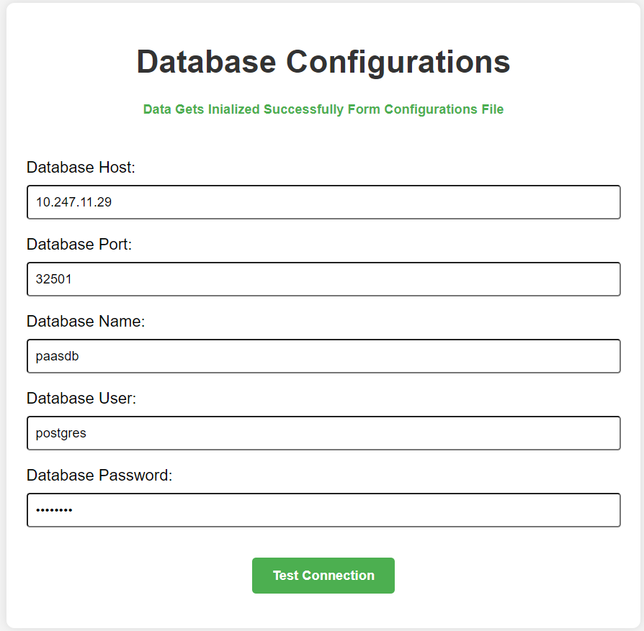
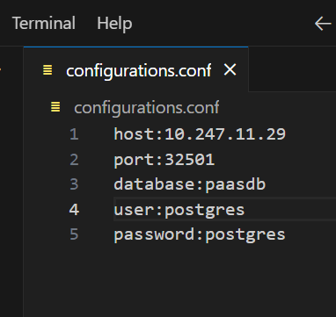
How it works ?
This is the main page .
It contains all these inputs which related to the Database connection .
We can add them directly from the UI
We have a file called configurations.conf which we can add all the environment details there , and then they will get initialized automatically to the inputs
Then we need to Test Connection to make sure that it connected to the ip with the correct port, user , password

Slide 14
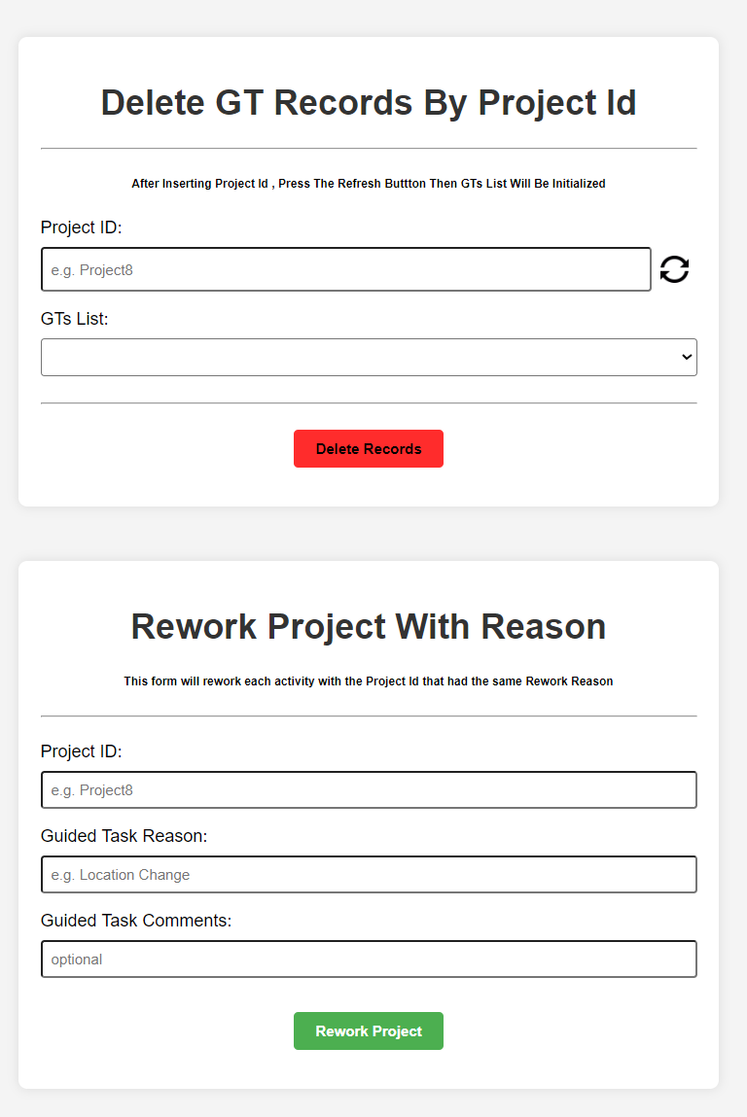
How it works ?
After adding the DB details and verify the Connection is correct and stable.
We have this page which contain the two thing that’s we mentioned before
Delete Records
Rework Project

Slide 15
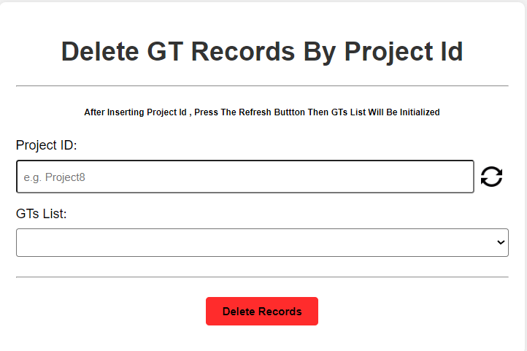
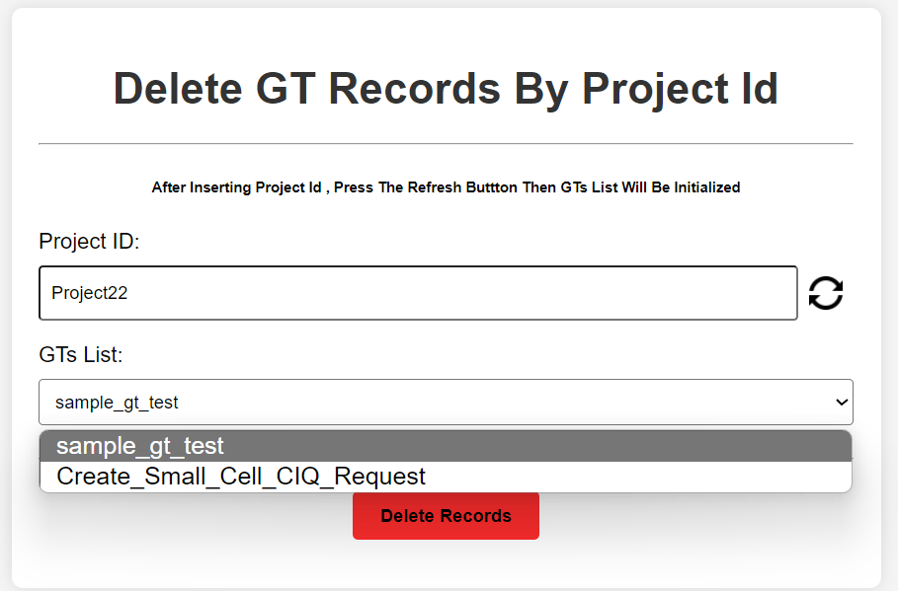
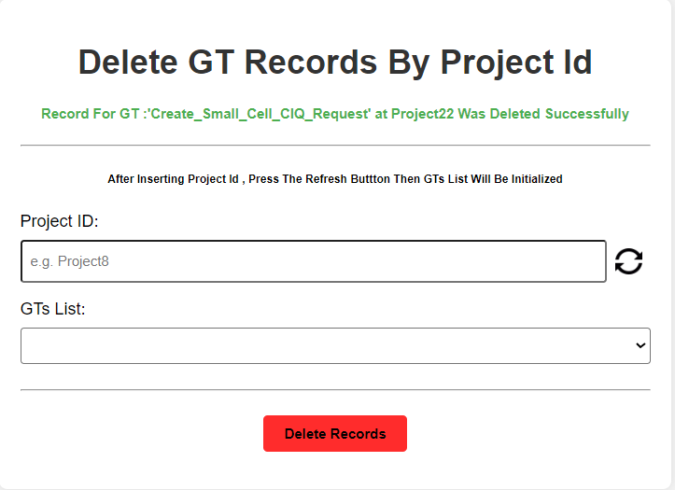
How it works ? Delete Records
We have two inputs :
projectId
Gt’s List
We see that GT List is empty.
That because we need to insert the Project Id and then click on the refresh button at the right .
It will fill the Gt List dropdown with all the GT’s that under this project ID .
Then we can select the GT spec . And click on the Delete Records button
A massage will appear after that if the deletion was executed successfully or not

Slide 16
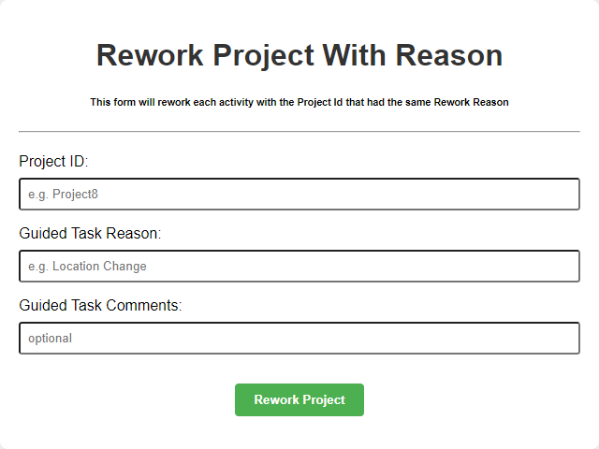
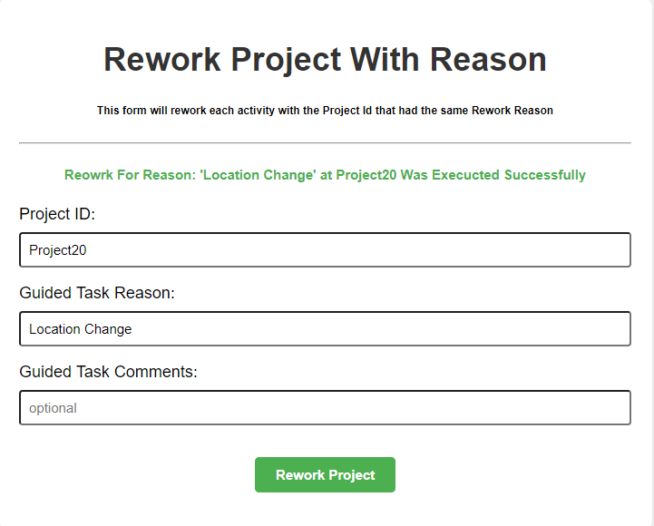
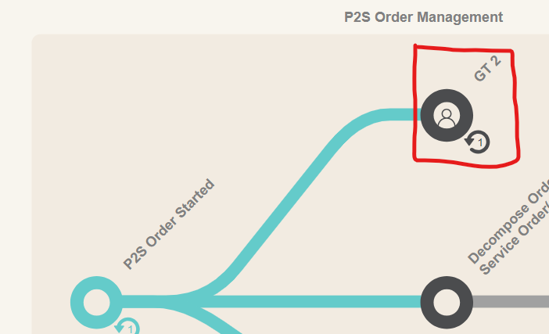
How it works ? Rework Project
We have two required inputs and one optional input
We need to fill the inputs with the projectID, rework reason and Comments
We have a file called rework-request-sample.conf that will contain a sample of the request . With 3 attributes declared there ( reworkProjectRequestProjectId, reworkProjectRequestReasonCode , reworkProjectRequestReasonComments)
After clicking on Rework Project, the attributes will be replaced by the value we insert at the inputs.
A massage will appear after that if the rework was executed successfully or not
This is how the activity will look like after the rework call

