Slide 1
Loan Target Prediction
By:
Naresh Peta
Ala
Teja

Slide 2
Business Concept
The AllLife bank core strategy focuses on building long-term customer relationships and increasing profitability through interest income.
loans generate higher interest income, expanding the personal loan portfolio is critical for sustainable growth.
To improve loan conversions, the bank aims to shift from basic demographic targeting to a data-driven strategy based on customer spending behavior.

Slide 3
Project Objective
Predict customers’ expected monthly credit card spending.
Use spending predictions and financial data to identify customers most likely to accept a personal loan offer.

Slide 4
Data Cleaning and Data Finding
There are no null values and Duplicates in the Dataset.
Invalided rows (Experience column containing negative values).
i.e : [-1,-2,-3] found by using unique.

Slide 5
Resolving invalid rows
Instead of dropping the invalid rows we are filling the negative values with median.
Reason:
Most of the negative value audience ages range between 20 to 30.
There are 51 invalid rows even though it is 1% of the data. We choose the filling option because if we drop we might lose the data of the ages from 20 to 30.

Slide 6
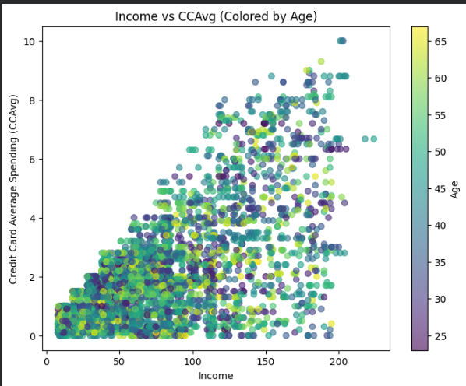
Insights
Spending Variability Increases After Income = 100
Below Income = 100, most CCAvg values stay under 4.
Above Income = 100, spending spreads widely from 2 up to 10.
Insight: Income above 100 marks a behavioral shift toward higher and more variable spending.
High-Potential Loan Target Segment
Customers with:
Income > 120
CCAvg > 6
represent a premium financial activity segment.
Business Conclusion:
Income combined with high credit card spending strongly indicates financially active
customers who may have higher probability of accepting personal loan offers.

Slide 7
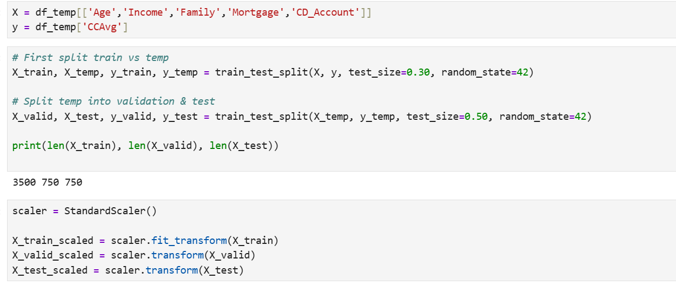
Modeling Setup: Target, Features, Splits, Scaling
Stage 1 (Regression): Problem Setup & Data Preparation
Target (y): CCAvg (monthly credit card spending)
Predictors (X): Age, Income, Family, Mortgage, CD_Account
Data split:
Train: 70% (n=3500)
Validation: 15% (n=750)
Test: 15% (n=750)
Standardization:
Fit StandardScaler on training set only
Transform validation/test using the fitted scaler (prevents data leakage)
Notes:
In stage 1, our goal is to predict monthly credit card spend (CCAvg) as a behavioural signal. we selected a set of financial and demographic predictors that are plausible drivers of spending. We used a three-way split — train, validation, and test — so that model selection happens only on the validation set, and the test set remains untouched for final performance. Since some algorithms are scale-sensitive, we standardized features with StandardScaler. Importantly, Wefitted the scaler only on the training data and then applied it to validation and test sets to avoid leakage.
‹#›

Slide 8
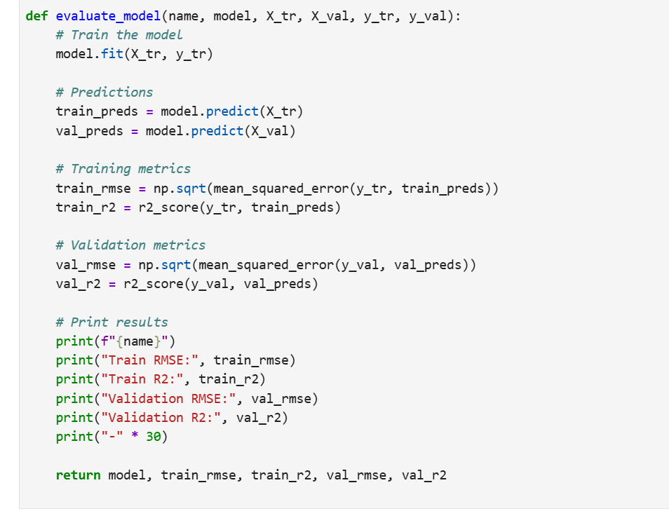
Evaluation Design: RMSE & R² + Train vs Validation
Evaluation Framework (Reusable Function)
Trained each model on training set
Computed performance on:
Train set → detect fitting behaviour
Validation set → compare generalization
Metrics:
RMSE (error magnitude in target units)
R² (variance explained)
Purpose:
Identify overfitting / underfitting
Select best model objectively
Notes:
To compare models fairly, Webuilt a reusable evaluation function. It trains each model, predicts on training and validation sets, then reports RMSE and R² for both. RMSE tells me the typical prediction error in the same units as CCAvg, while R² tells me how much variance is explained. Comparing training vs validation metrics is critical — it shows whether a model is overfitting (very good train, poor validation) or underfitting (poor on both). This gave me a consistent, scientific basis for model selection.
‹#›

Slide 9
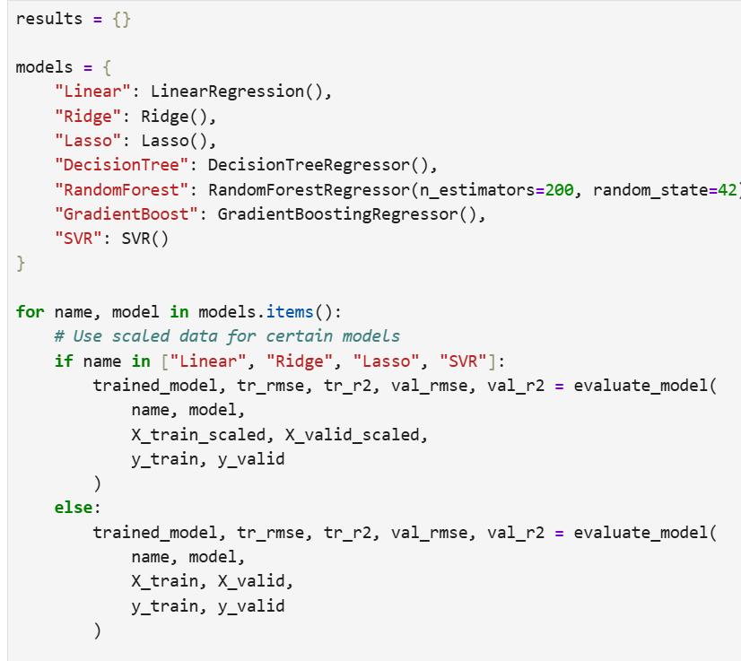
Model Benchmarking: Linear, Regularised & Non-linear
Models Benchmarked
Linear family (scaled inputs):
Linear Regression, Ridge, Lasso
Non-linear / tree-based:
Decision Tree, Random Forest, Gradient Boosting
Kernel-based (scaled inputs):
SVR
Scaling rule applied:
Scaled: Linear/Ridge/Lasso/SVR
Unscaled: Tree-based models
Notes:
We tested a range of regression models to ensure Wewasn’t assuming linearity. Linear and regularised models provide interpretable baselines. Tree ensembles capture non-linear patterns and interactions. SVR can model complex relationships using kernels but requires standardized features. We handled scaling carefully: only models that require scaling were trained on scaled data, while tree-based models used raw values. This prevents unfair performance comparisons.
‹#›

Slide 10
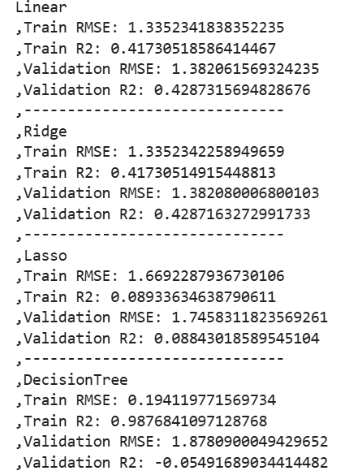
Regression Results: Generalization + Overfitting Evidence
Regression Results (Train vs Validation) Key observations:
Decision Tree overfit heavily
Train R² ≈ 0.99 vs Validation R² < 0
Lasso underfit
Low R² on both train and validation
Best generalization performance:
SVR achieved the best validation metrics
Validation RMSE ≈ 1.35
Validation R² ≈ 0.455
spending behaviour is non-linear, and
model selection must prioritize validation performance.
Notes:
These results show why train-only performance is misleading. The Decision Tree achieved nearly perfect training metrics, but validation performance collapsed, even producing a negative R² — a classic sign of overfitting. Lasso performed poorly on both train and validation, suggesting underfitting. The best generalization came from SVR, which achieved the lowest validation RMSE and the highest validation R² among the tested models. This indicates that the relationship between predictors and spending is not purely linear and benefits from a more flexible model.
‹#›

Slide 11
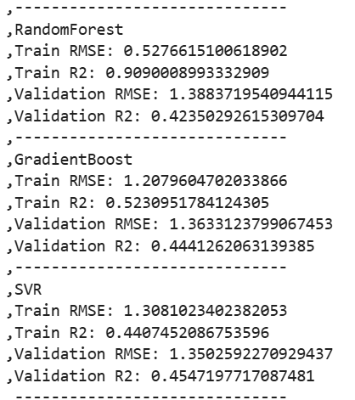
Regression Results: Generalization + Overfitting Evidence
Regression Results (Train vs Validation) Key observations:
Decision Tree overfit heavily
Train R² ≈ 0.99 vs Validation R² < 0
Lasso underfit
Low R² on both train and validation
Best generalization performance:
SVR achieved the best validation metrics
Validation RMSE ≈ 1.35
Validation R² ≈ 0.455
spending behaviour is non-linear, and
model selection must prioritize validation performance.

Slide 12
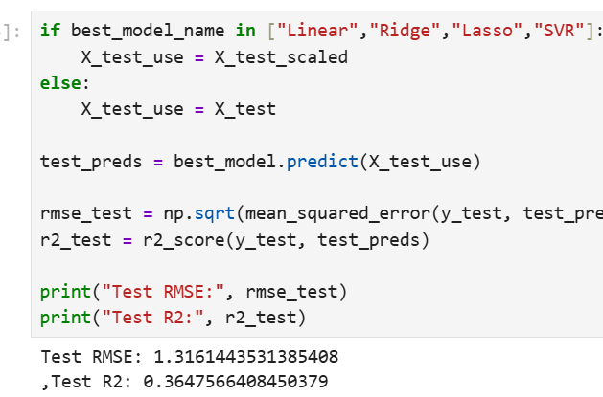
Final Regression Choice + Test Performance + Feature Engineering
Selected Regression Model & Behaviour Feature
Best model selected by lowest validation RMSE
Best Model: SVR
Final evaluation on held-out test set:
Test RMSE ≈ 1.316
Test R² ≈ 0.365
Notes:
We selected the final regression model using validation RMSE as the selection criterion, which identified SVR as the best generalizing model. Then We evaluated it once on the untouched test set to estimate real-world performance. While R² on test is moderate, this is expected in behavioural prediction where many unobserved factors influence spending. The key outcome is that the model produces a consistent behavioural estimate. We then generated predictions for the full dataset and stored them as a new feature, CCPred. This feature becomes an input to stage 2, where we predict personal loan acceptance using both customer attributes and predicted behavioural spending.
‹#›

Slide 13
Classification
Independent variables = df[['Age', 'Experience', 'Income', 'Family', 'Education',
'Mortgage', 'Securities_Account',
'Online', 'CreditCard', 'CCPred']]
Target Variable = df['Personal_Loan']

Slide 14
Imbalance Data
Before SMOTE: Personal_Loan
0 3616
1 384
After SMOTE: Personal_Loan
0 3616
1 3616

Slide 15
Models used
"Logistic Regression" (S)
"Decision Tree"
"Random Forest"
"Gradient Boosting"
"K-Nearest Neighbors"(S)
"Support Vector Machine"(S)
"Naive Bayes"
"Neural Network"(S)

Slide 16
Initial results
Model Accuracy F1 Score ROC AUC
2 Random Forest 0.969 0.851675 0.981298
3 Gradient Boosting 0.944 0.764706 0.984502
7 Neural Network 0.942 0.750000 0.977795
1 Decision Tree 0.938 0.732759 0.914500
5 Support Vector Machine 0.929 0.710204 0.981333
4 K-Nearest Neighbors 0.906 0.620968 0.939580
0 Logistic Regression 0.866 0.562092 0.945013
6 Naive Bayes 0.859 0.525253 0.871405

Slide 17
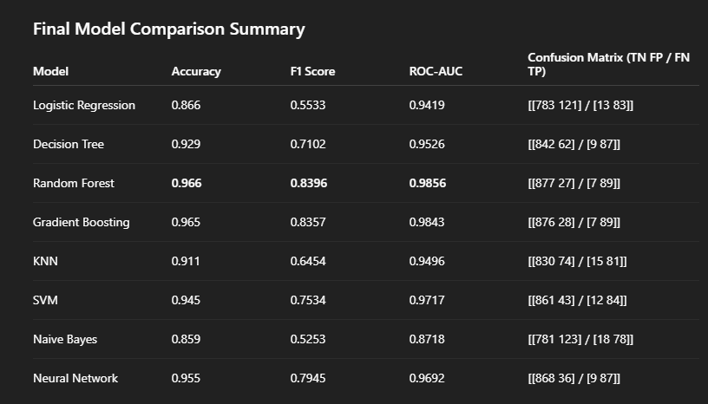
Tuning Results

Slide 18
Understanding Results
Random Forest has the lowest combined False Positives (27) and False Negatives (7), indicating strong balance.
Gradient Boosting performs nearly identically to Random Forest.
Logistic Regression and Naive Bayes show higher False Positives and lower F1 scores.
Ensemble methods clearly outperform simpler linear and probabilistic models.
Random Forest is the strongest overall model for predicting personal loan acceptance.

Slide 19
Conclusion
Income-driven spending behavior is a strong predictor of loan acceptance.
Random Forest is the most reliable model for targeting high-probability personal loan customers.
Using predicted credit card spending as an additional feature significantly improved classification performance.
This data-driven approach enables the bank to optimize marketing efforts, reduce acquisition costs, and increase overall loan conversion rates.

Slide 20
Thank you

