Slide 1

Body Language in Public Speaking
Body language is just as important as the words you speak when delivering a speech. A confident and engaging presence can captivate your audience and enhance the impact of your message. Today, we'll explore how to use your body language to appear confident and connect with your audience, even when you're feeling nervous.

Slide 2
Body Language Signals
Nervous Habits
Lack of Confidence
Fidgeting, avoiding eye contact, and speaking too quickly can indicate nervousness. These habits can make you seem unprepared and lacking confidence.
Slouching, looking at your feet, and speaking in a monotone voice can convey a lack of self-assurance. These cues can make your audience question your credibility.

Slide 3

Mastering Confidence
Posture
Stance
Stand tall with your shoulders back and chin up. This posture conveys confidence and authority.
Keep your feet shoulder-width apart for a balanced and grounded stance. This helps you feel more stable and confident.

Slide 4
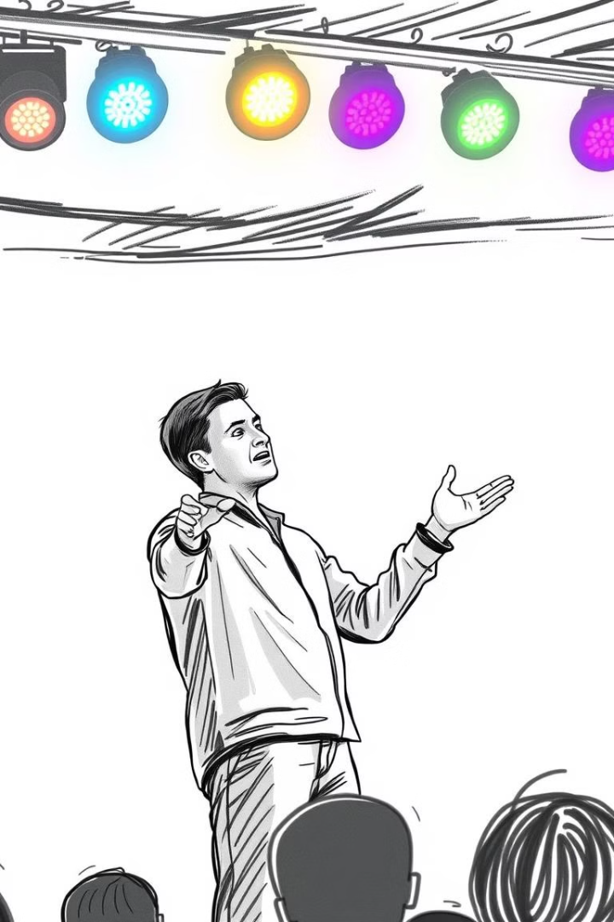


Hand Gestures
Emphasis
Openness
Pointing gestures can highlight important points and direct attention to specific areas.
Open hand gestures convey sincerity and trustworthiness, building rapport with the audience.

Slide 5
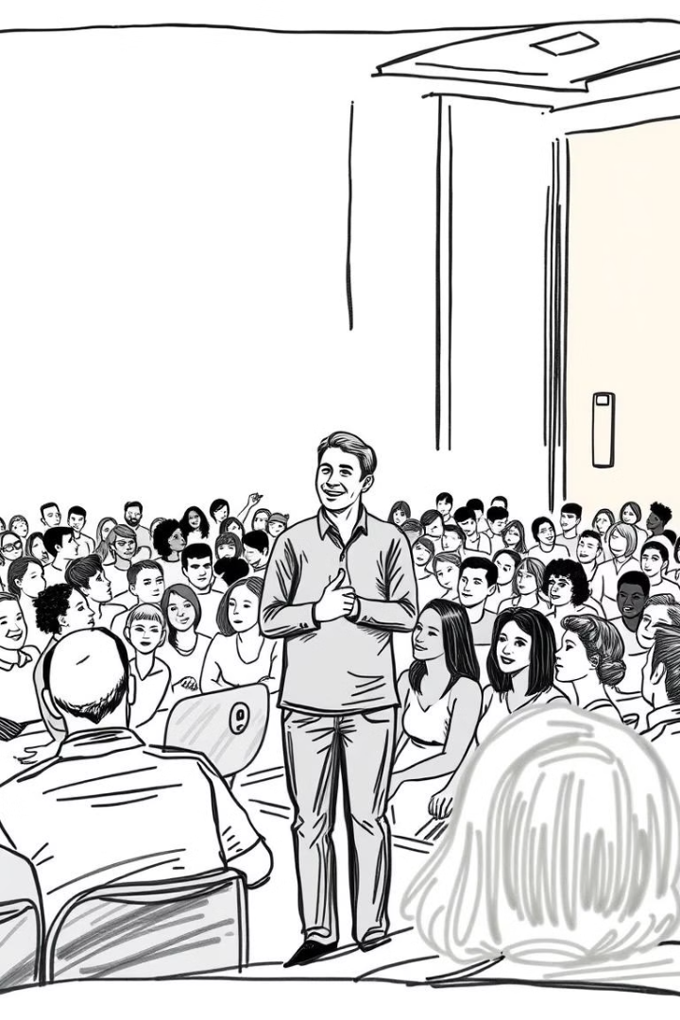
Eye Contact
1
Make eye contact with different people in the audience, pausing for a moment to acknowledge each person.
2
Avoid staring at one person or looking over the heads of the audience. This can make you seem distant or uncomfortable.

Slide 6




Controlling Nervous Habits
Practice your speech beforehand. Familiarity will help reduce nerves and minimize fidgeting.
Keep a water bottle nearby for hydration and to take breaks during your speech.
Use note cards for reminders, but avoid reading directly from them, as it can break eye contact.

Slide 7



Projecting Authority
Vocal Delivery
1
Speak clearly and confidently, using a steady pace and appropriate volume.
Body Language
2
Maintain an open posture, make eye contact, and use confident hand gestures.
Content Knowledge
3
Thorough preparation and understanding of the topic will project confidence and credibility.

Slide 8

Powerful Delivery
By mastering confident body language, you can create a powerful and engaging presentation that resonates with your audience. Remember to practice, be mindful of your body language cues, and connect with your listeners through eye contact and gestures. This will help you project an air of confidence and deliver a memorable speech that leaves a lasting impression.

