Slide 1
Monte Carlo : Pandemic Simulation Parallelization Project
Performance Analysis using Java and Python

Slide 2
Overview
Simulates the spread of infection using SIR model
Implements sequential and parallel versions
Uses Java ExecutorService and ForkJoinPool for multithreading
Generates performance graphs using Python and Matplotlib

Slide 3
Tools Used
Programming Language: Java
Libraries Used: java.concurrent , matplotlib & pandas (visualization) .
Tools : IntelliJ IDE

Slide 4
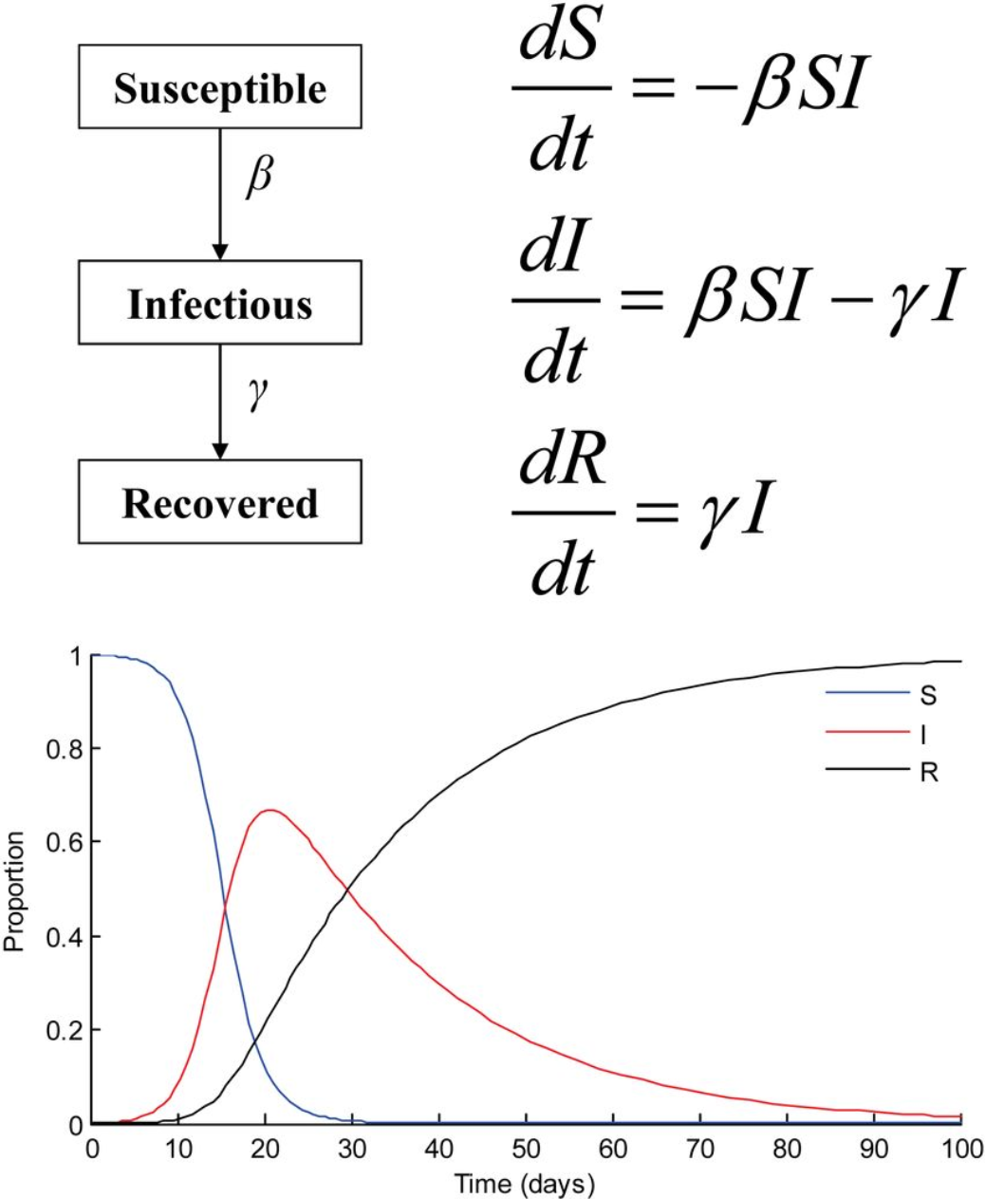
SIRSimulation.java
Simulates infection spread in a population
Fields: S, I, R (Susceptible, Infected, Recovered)
Methods:
- reset(): initialize state
- run(): simulate daily spread with beta and gamma probabilities
- getDuration(), getPeakInfected()

Slide 5
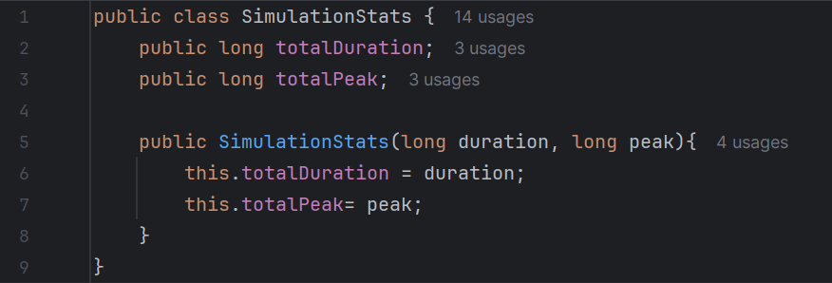
SimulationStats.java
Data holder class for simulation results
Fields:
- totalDuration: total days simulated
- totalPeak: total peak infected over simulations
Used to accumulate and return results from threads

Slide 6
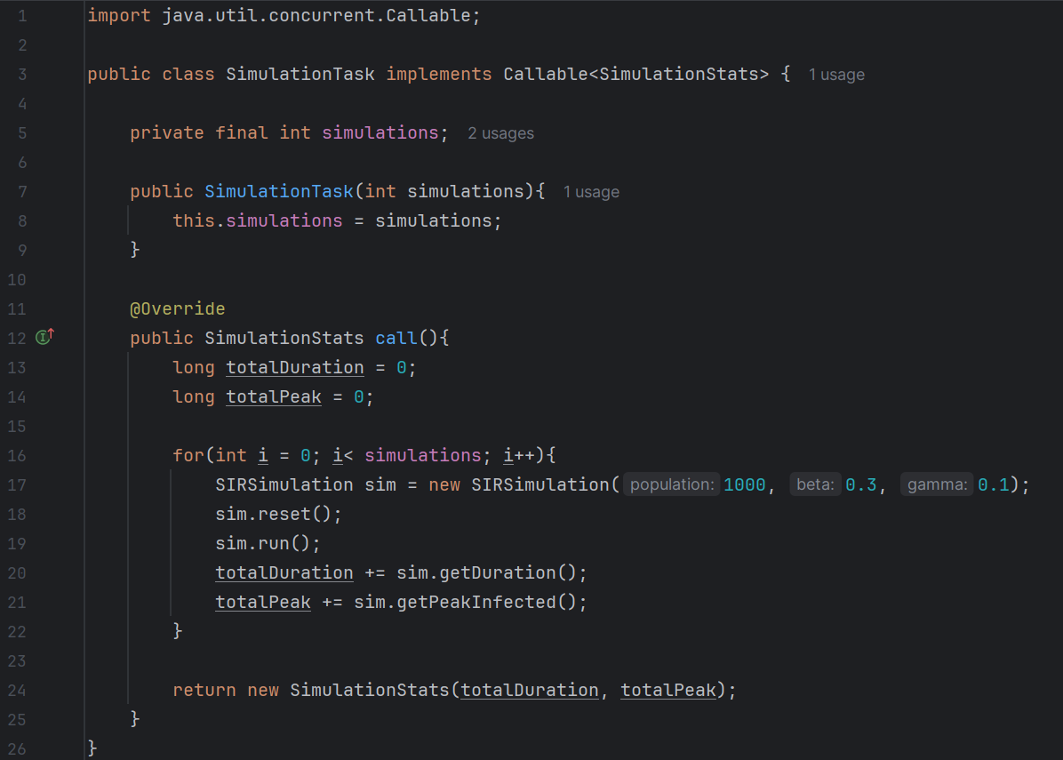
SimulationTask.java
Implements Callable<SimulationStats>
Runs simulations in a single thread
Used with ExecutorService to parallelize simulation runs
Returns total duration and peak from its assigned simulations

Slide 7
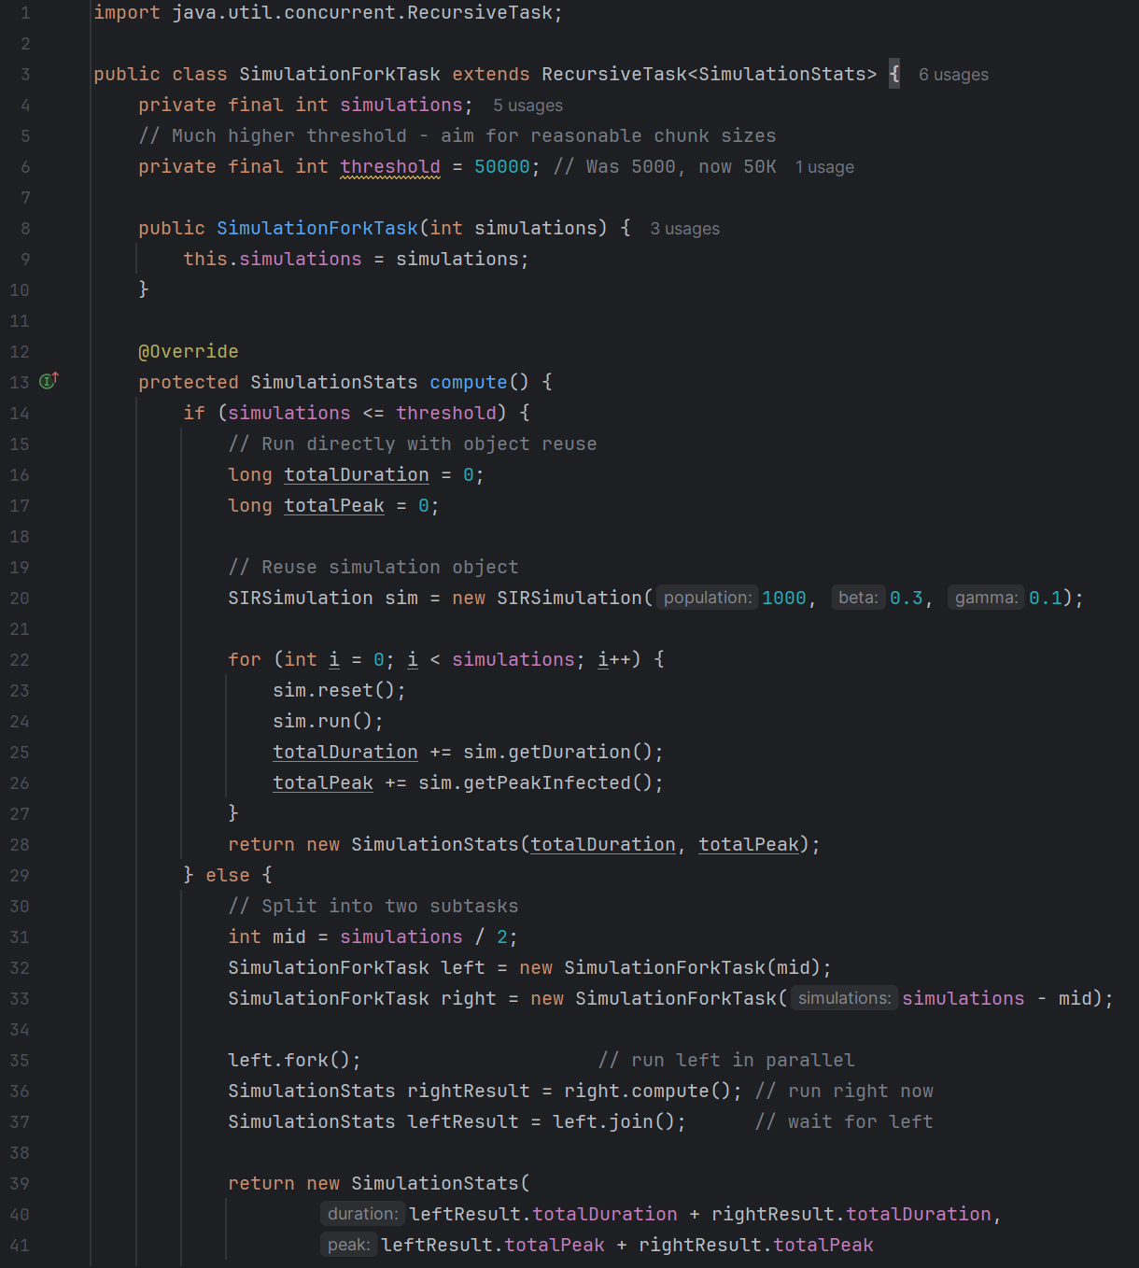
SimulationForkTask.java
Extends RecursiveTask<SimulationStats>
Implements divide-and-conquer using ForkJoinPool
If below threshold, runs directly
Else, splits into left/right tasks and combines results

Slide 8
Main.java
Runs sequential and parallel simulations
Measures execution time, speedup, and efficiency
Tests with multiple thread counts
Writes results to CSV and generates Python plot script

Slide 9
Python Plot Script
Reads results.csv using pandas
Plots speedup, efficiency, and execution time using matplotlib
Subplots: Speedup, Efficiency, Execution Time, Best Speedup
Saves output as performance_analysis.png

Slide 10
Summary
Java: Efficient use of multithreading with ExecutorService and ForkJoinPool
Python: Clear performance visualization using Matplotlib
Fork/Join is more scalable for large simulations
Project demonstrates parallel computing and performance evaluation

