Slide 1
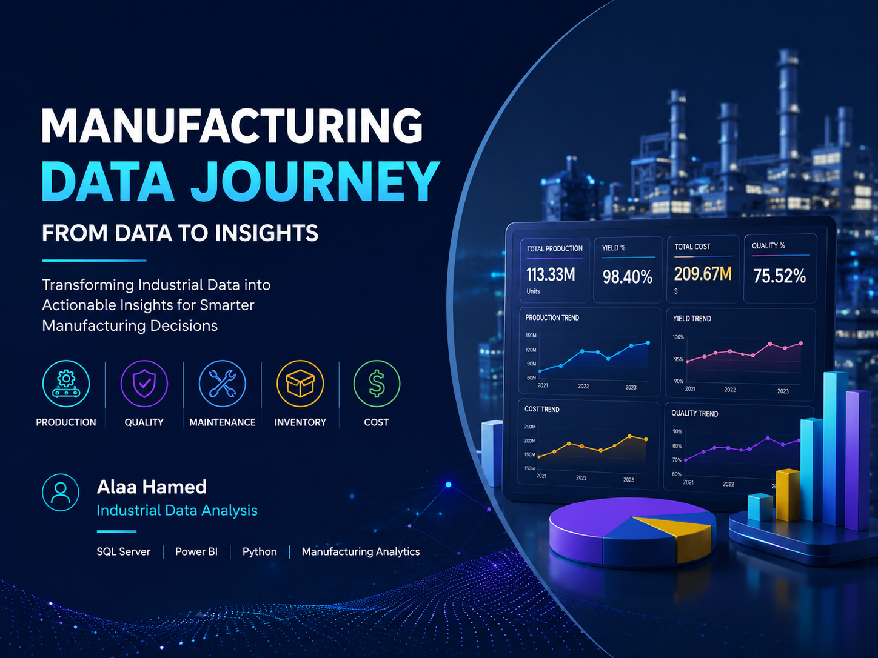

Slide 2
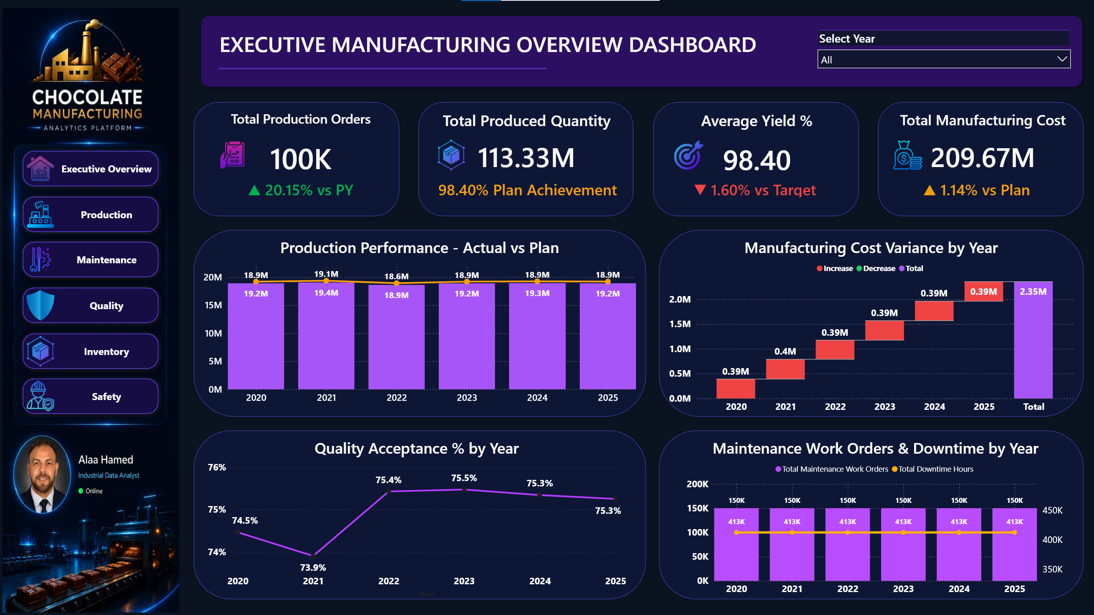
KEY PERFORMANCE INDICATORS
KEY PERFORMANCE INDICATORS
EXECUTIVE MANUFACTURING OVERVIEW
Management-Level Manufacturing Performance
KEY PERFORMANCE INDICATORS
1. Production Orders 100K
2. Produced Quantity 113.33M
3. Average Yield 98.40%
4. Manufacturing Cost 209.67M

Slide 3
EXECUTIVE INSIGHTS
What the Manufacturing Data Tells Us
01 PRODUCTION PERFORMANCE
98.40% Plan Achievement
Production reached 113.33M units, achieving 98.40% of the production plan.
Business Meaning:
Production performance is strong, but there is still a small gap to the planned output.
02 YIELD PERFORMANCE
1.60% Below Target
Overall yield reached 98.40%, remaining 1.60% below the target.
Business Meaning:
There is an opportunity to reduce production losses and improve process efficiency.
03 MANUFACTURING COST
1.14% Above Plan
Total manufacturing cost reached 209.67M, approximately 1.14% above plan.
Business Meaning:
Cost control should be monitored alongside production performance to protect manufacturing margins.
04 QUALITY PERFORMANCE
73.9% → 75.5%
Quality acceptance improved from approximately 73.9% in 2021 to around 75.5% in 2023, then remained relatively stable.
Business Meaning:
The improvement indicates better quality performance, while recent stabilization creates an opportunity for further optimization.

Slide 4
MANAGEMENT RECOMMENDATIONS
Turning Manufacturing Insights into Action
01 CLOSE THE PRODUCTION PLAN GAP
Production achieved 98.40% of the planned output.
Recommended Action:
Investigate the recurring gap between actual and planned production and identify the main operational constraints affecting output.
Focus Areas:
Production scheduling • Line capacity • Downtime • Material availability
02 IMPROVE YIELD PERFORMANCE
Overall yield reached 98.40%, remaining 1.60% below target.
Recommended Action:
Analyze production losses, scrap, rework, and process deviations to identify the main drivers of yield loss.
Focus Areas:
Scrap reduction • Process stability • Root Cause Analysis • Continuous Improvement
03 STRENGTHEN MANUFACTURING COST CONTROL
Manufacturing cost reached 209.67M, approximately 1.14% above plan.
Recommended Action:
Monitor cost variance by period, production line, product, and major cost drivers to identify opportunities for cost reduction.
Focus Areas:
Material cost • Production efficiency • Energy consumption • Maintenance cost
04 SUSTAIN QUALITY IMPROVEMENT
Quality acceptance improved from approximately 73.9% in 2021 to around 75.5% in 2023, then remained relatively stable.
Recommended Action:
Investigate the factors behind the improvement and establish continuous monitoring to prevent quality deterioration.
Focus Areas:
Quality defects • Process capability • Inspection results • Non-Conformance
MANAGEMENT PRIORITY
Close the performance gaps by connecting Production, Quality, Maintenance, and Cost data into one decision-making framework.
DATA → INSIGHT → ACTION → IMPROVEMENT

Slide 5
BUSINESS IMPACT & DECISION FRAMEWORK
From Data to Better Manufacturing Decisions
01 DATA VISIBILITY
Integrated manufacturing data provides management with a unified view of Production, Quality, Maintenance, and Cost performance.
Business Value:
One reliable view of operational performance instead of disconnected departmental reports.
02 PERFORMANCE MONITORING
Power BI dashboards transform operational data into interactive KPIs and performance trends.
Business Value:
Management can quickly identify performance gaps, monitor trends, and compare actual results against targets and plans.
03 ROOT CAUSE ANALYSIS
Combining production, quality, maintenance, and cost indicators creates a stronger foundation for investigating performance deviations.
Business Value:
Move from reporting what happened to understanding where and why performance changed.
04 DATA-DRIVEN DECISIONS
The analytical framework supports faster and more informed manufacturing decisions.
Business Value:
Turn industrial data into actionable insights that support productivity, quality improvement, cost control, and operational reliability.
DECISION FRAMEWORK
DATA
↓
KPI
↓
INSIGHT
↓
ACTION
↓
BUSINESS IMPACT
BUSINESS IMPACT AREAS
Productivity • Quality • Cost Control • Reliability • Continuous Improvement

Slide 6
TECHNOLOGY & PROJECT ARCHITECTURE
Building the Data Foundation Behind the Dashboard
01 DATA SOURCE
Industrial Manufacturing Data
Production • Quality • Maintenance • Inventory • Cost
Raw operational data generated across manufacturing departments.
02 DATA WAREHOUSE
SQL SERVER
Enterprise Data Warehouse designed to centralize and organize manufacturing data.
ETL Pipeline • Staging Layer • Master Layer • Data Validation
03 DATA MODEL
STAR SCHEMA
Fact tables connected with reusable Dimension tables to create a scalable analytical model.
Fact Production • Dim Date • Dim Product • Dim Equipment • Dim Plant
04 BUSINESS INTELLIGENCE
POWER BI
Interactive dashboards transform the analytical model into actionable manufacturing insights.
DAX Measures • KPIs • Interactive Filters • Drill-Through • Navigation
END-TO-END ANALYTICS FLOW
INDUSTRIAL DATA
↓
SQL SERVER DATA WAREHOUSE
↓
STAR SCHEMA DATA MODEL
↓
POWER BI SEMANTIC MODEL
↓
MANUFACTURING DASHBOARDS
↓
BUSINESS INSIGHTS
↓
DATA-DRIVEN DECISIONS
PROJECT OUTCOME
A scalable manufacturing analytics foundation that connects operational data with business decisions across Production, Quality, Maintenance, Inventory, and Cost.
TOOLS & TECHNOLOGIES
SQL Server • SQL • Power BI • DAX • Data Modeling • ETL • Manufacturing Analytics

