Slide 1
Foundations of Software Development
LAB 03 : Loops
27/12/2025

Slide 2
Recap
To comment
// -------------> for single line
/* */ ---------> for multiple lines
int x = 10;
cout<<x++<<endl;
cout<<++x<<endl;
10
12

Slide 3
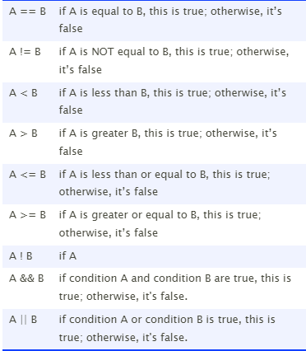
Condtions

Slide 4
Content
for loop
while loop
do while

Slide 5
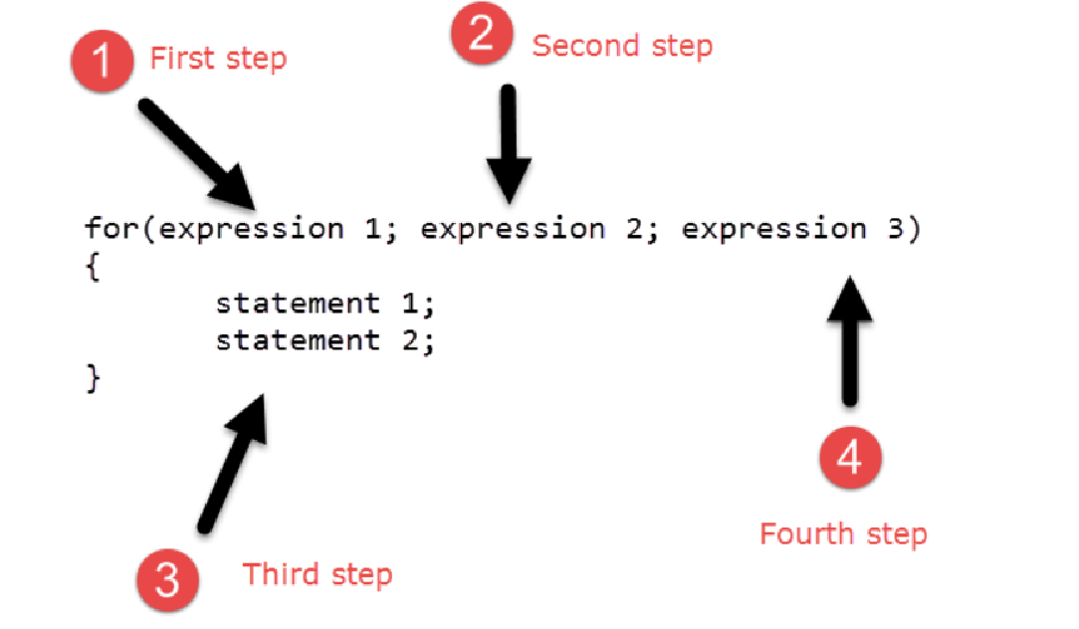
for Loop syntax

Slide 6
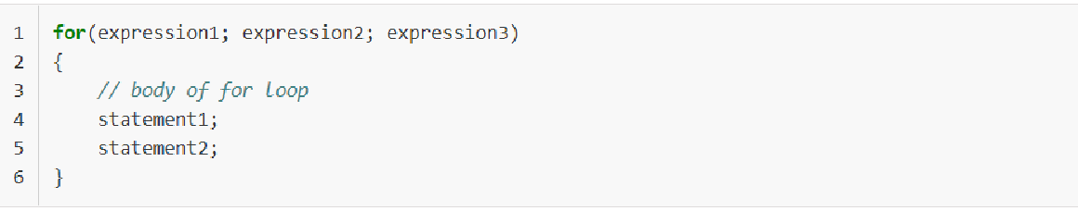
For Loop
The expression1 is the initialization expression.
The expression2 is the test expression or condition.
The expression3 is the update expression.
First, the initialization expression is executed (i.e expression1 ) to initialize loop variables. The expression1 executes only once when the loop starts.
the condition is checked (i.e expression2 ), if it is true, then the body of the loop is executed.
After executing the loop body the program control is transferred to the update expression ( expression3).
The expression3 modifies the loop variables. Then the condition (i.e expression2) is checked again. If the condition is still true the body of the loop is executed once more. This process continues until the expression2 becomes false.

Slide 7
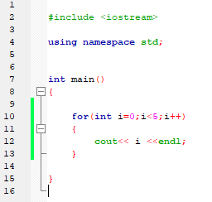
for loop example
output:
0
1
2
3
4

Slide 8
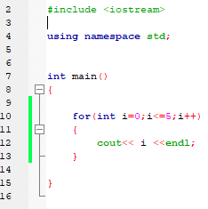
for loop example
output:
0
1
2
3
4

Slide 9
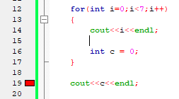
Important note:
if you created a variable inside a loop you can’t use it outside the loop .

Slide 10
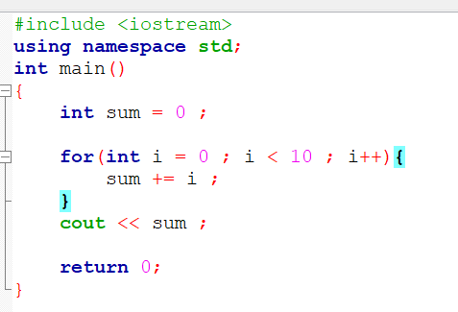

Write a program that computes and prints the sum of all integers from 0 to 9

Slide 11
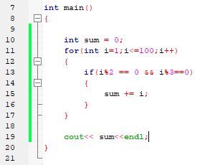

Slide 12
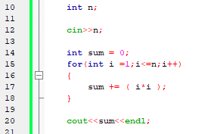

Slide 13
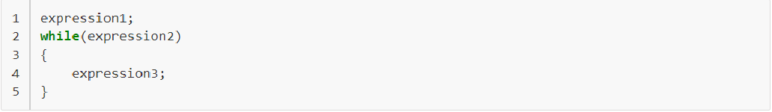
While Loop
the while loop starts with a condition. First, the condition is evaluated, if it is true then the statements in the body of the while are executed.
After executing the body of the while loop, the condition is checked again, if it is still true then once again statements in the body of the while are executed.
This process keeps repeating until the condition becomes false. Therefore, you must always include a statement which alters the value of the condition so that it ultimately becomes false at some point. Each execution of the loop body is known as iteration.

Slide 14
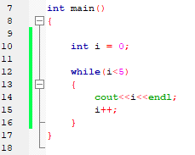
while Loop example
output:
0
1
2
3
4
remeber:
you must write a statement that terminate the while loop

Slide 15
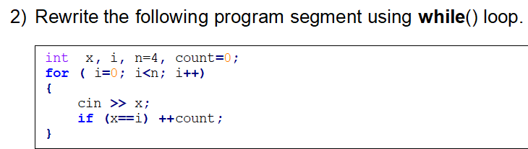
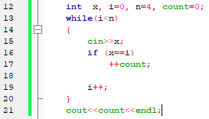

Slide 16
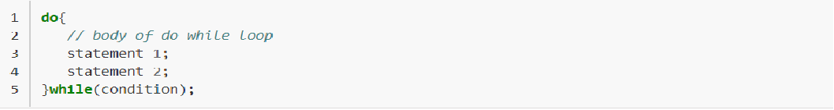
do… while loop
In do while loop first the statements in the body are executed then the condition is checked.
This process keeps repeating until the condition becomes false.
The do while loop differs significantly from the while loop because in do while loop statements in the body are executed at least once even if the condition is false. In the case of while loop the condition is checked first and if it true only then the statements in the body of the loop are executed.

Slide 17
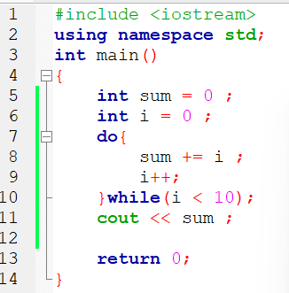
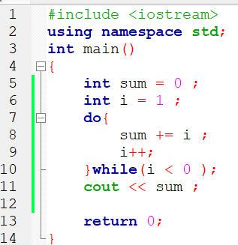
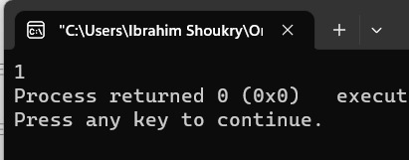

Slide 18
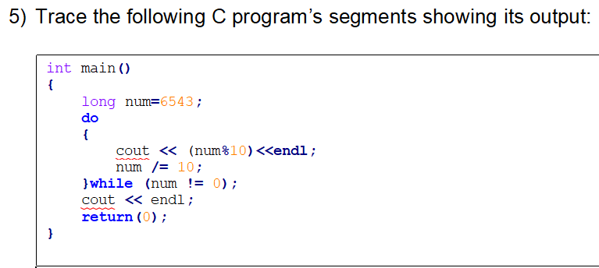
output:
3
4
5
6

Slide 19
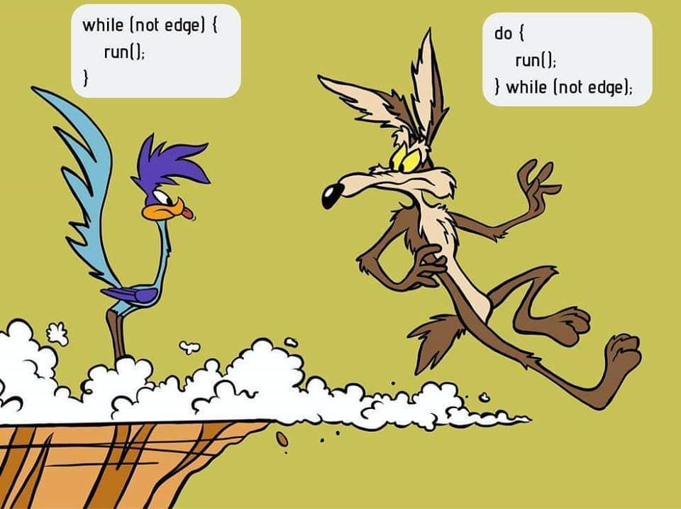
Difference between while and do while

Slide 20
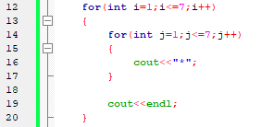
write a program to draw this Shape
*******
*******
*******
*******
*******
*******
*******

Slide 21
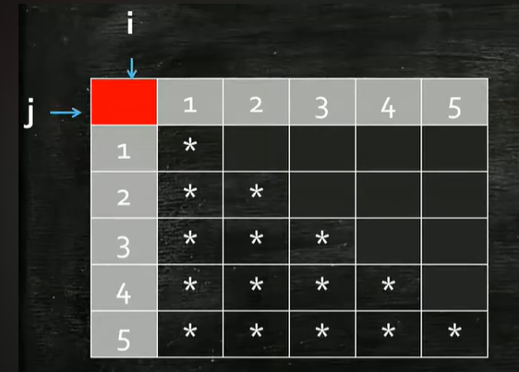

Try to think how to make this shape

Slide 22
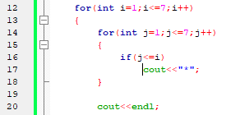
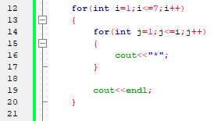
answer1 : answer 2: remeber we changed the condition inside 2nd for loop

Slide 23
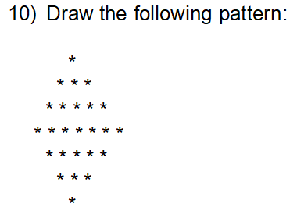
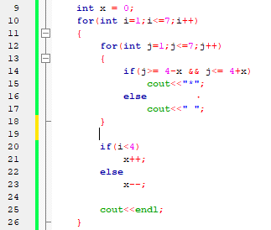

Slide 24
Thank you 😊😊😊

