Slide 1
Foundations of Software Development
LAB 04 : Functions
27/12/2025

Slide 2
Recall : Loops
break; //end the loop
continue; // leave the current iteration, and go to next iteration

Slide 3


Ex1:
output:
1
2
Ex2:
output:
1
2
4

Slide 4
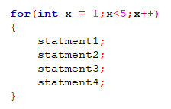
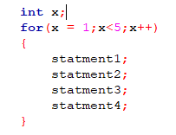
Remeber
you can’t use “x” outside the for loop
you can use “x” outside the for loop

Slide 5

Ex3 :
you can write any statement
output:
0
Yes

Slide 6
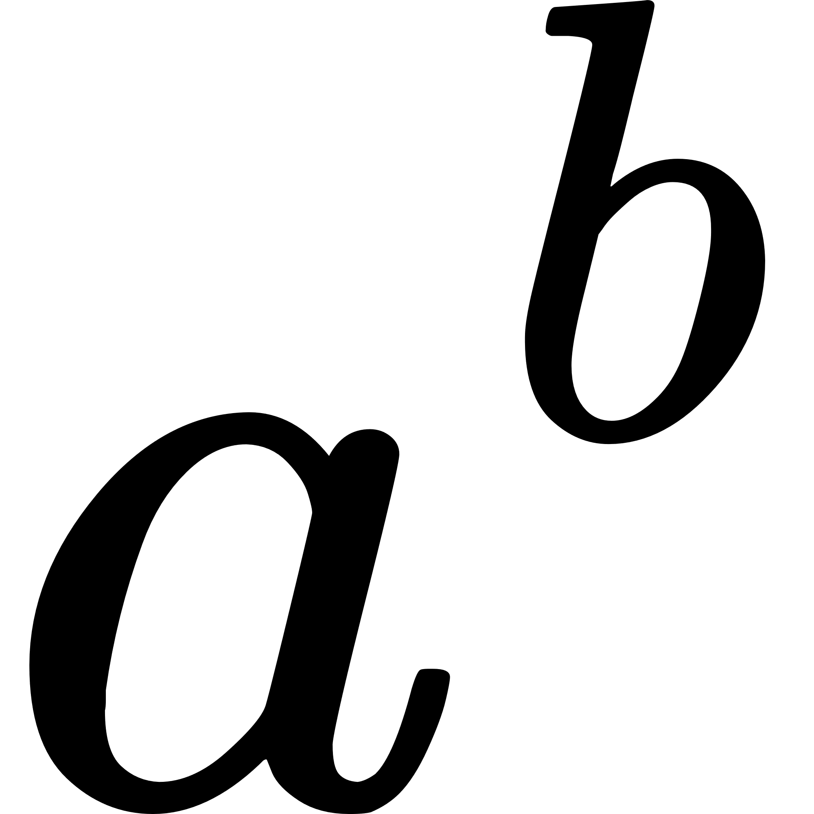
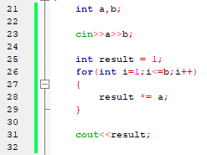
Ex4
write a program that calculates

Slide 7
Content
Why Function ?
Function Definition
function call
Function parameters
void Function and return Function
steps of calling a function

Slide 8
Function
It is a group of statments that perform a Task
Every C/C++ program has at least one function -----> main()
Modular style, breaks your code into separate blocks of code
Benefits:
Don’t have to repeat the same block of code
Function re-usability
Easy to modify and expand

Slide 9
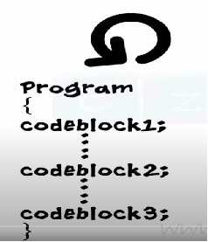
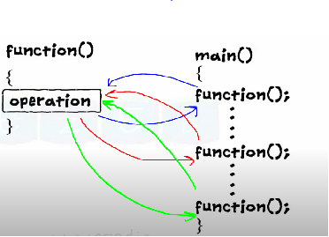

Why the need to use function ?
👍If we want to repeat a block of code several times
👎Increase the length & complexity of the program
👍But if we used functions we can call then as much we need

Slide 10
function
Parameters
Outputs
Black box

Slide 11
Function Definition
returnType functionName (parameter1, parameter2,...) {
// function body
}
returnType (int,string,bool,char,void,float,....).
FunctionName like variable Name.
Parameter variables passed to Function to use.

Slide 12
Call a Function
Declared functions are not executed immediately. They are "saved for later use", and will be executed later, when they are called.
To call a function, write the function's name followed by two parentheses () and a semicolon ;

Slide 13
Function Syntax
Function Definition
Function Call
return_data_type function_name(param1,param2)
{
//statements
//return
}
int main()
{
int total = Add(3,4);
cout<<total<<endl;
}
int Add(int x,int y)
{
//statements
int result = x + y;
//return
return result;
}

Slide 14
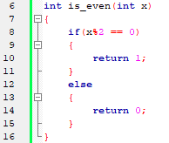
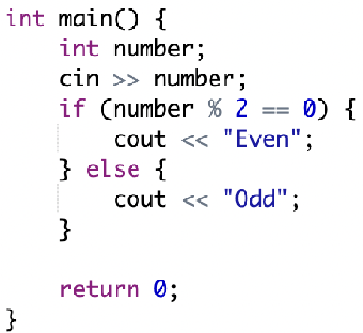
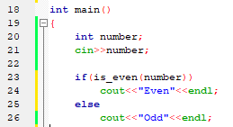
Think about this code:

Slide 15
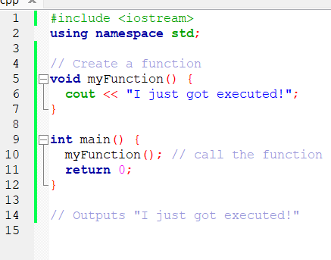
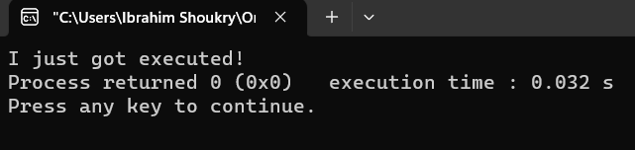
Example (void datatype) doesn’t return any value

Slide 16
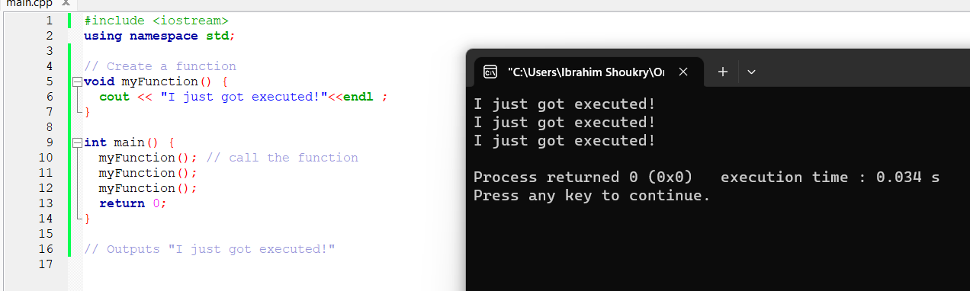
Example [call many times]:

Slide 17
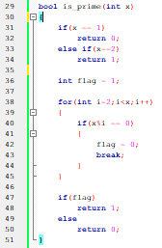

Slide 18
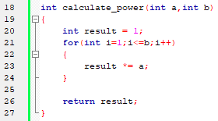

Ex2
write a function that calculates

Slide 19
Functions you can use directly
ex1 :
#include <cmath>
sqrt(25); pow(2,3);

Slide 20
void add(int x,y,z) WrongSyntax {
}
void add(int x , int y ,int z)
{
//statments
//return
}

Slide 21
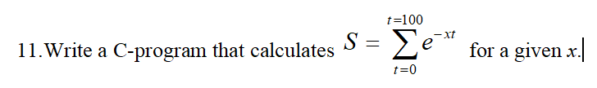
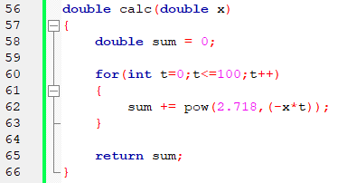

Slide 22
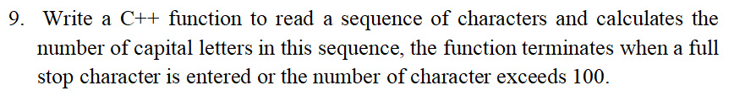
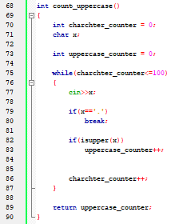
you can use isupper(char) function
returns 1 if the c is in Upper case
else retruns 0

Slide 23
Hint:
int add(int x=0; int y=1)
{
return x+y;
}
inside main()
cout<<add(10,2)<<endl; //12
cout<<add(10)<<endl; //11
cout<<add()<<endl; //1

Slide 24
Thank you 😊😊😊

