Slide 1



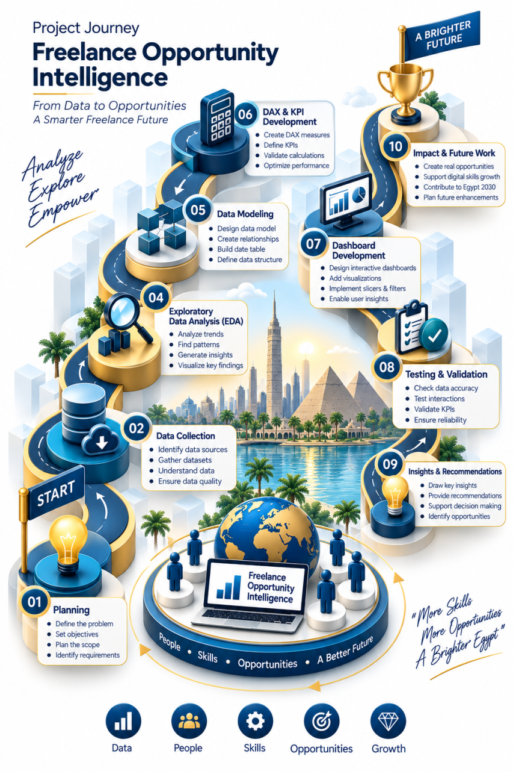


Digital Pioneers Initiative
DiGiLiANS — Nano Degree Program
Capstone Project Defense — September 2026
Capstone Project: SkillBridge
Alaa Hussien Mohamed
Rasha Wael Ramadan
Esraa Metwally Abo Elnasr
Fatma Ibrahim Morsy
Supervisor : Prof. Dr. Rania Elgohary
Track Head: Dr. Ahmed Zakaria
Academic Team: Dr. Yasser Ali
Instructor / Company Name: Eng.Haidy Seada / EYTH
Track: Data Analytics Track / Junior Data Analyst
ABSTRACT
Methodology & Approach
Results & Key Outcomes
We sincerely thank our Executive Director, Academic Director, Track Head, Academic Team, the Ministry of Communications and Information Technology (MCIT), Egypt, and the Egyptian Military Academy for their invaluable guidance, support, and dedication throughout our learning journey and the successful completion of this project.
This project presents a data-driven analytical framework to evaluate the global and Egyptian freelance market (Gig Economy). By establishing an integrated Star-Schema pipeline using Python and Power BI, we measure skill demand-supply gaps, identify high-value skills ($/hr), and quantify the impact of early K-12 educational coding initiatives on job acceptance and graduate earning potential.
System Architecture: A 5-tier pipeline: Data Integration, Python Cleaning/EDA, Machine learning Engine, Relational Star Schema, Interactive Power BI dashboards.
Datasets & Data Pipeline:
Unstructured job postings and freelancer profiles extracted from Upwork, Mostaql, Khamsat, and Kaggle datasets
Educational records mapping pre-university (K-12) technical training metrics.
Python pipeline (Pandas, Numpy) for missing-value handling, schema normalization, and primary/foreign key alignment.
Tools & Technologies: Excel, Python, Jupyter Notebook, SQL, Power BI Desktop (Star Schema & DAX), Git/GitHub.
Machine Learning Engine: Trained a CatBoost Regressor on 109,470 validated job rows to forecast fair market rates ( Estimated_Hourly_Rate ) based on skills, region, and experience ($R^{2}$ = 0.682, MAE = $2.64/hr).
Core Analytical Method: Multi-dimensional Star Schema modeling paired with custom DAX measures to calculate dynamic metrics:
Skill Gap Index, Market Rate Gap %, Competition Ratio, and Post-Initiative Acceptance Uplift.
100% Skill Mapping: Identified high-paying technical skill deficits versus over-saturated entry-level categories.
Predictive Pricing Accuracy: Deployed a Salary Predictor model achieving $R^{2}$ score of 0.682 and a low MAE of $2.64/hr, establishing objective wage standards for both Hourly and Fixed-Price jobs.
Educational ROI Uplift: Quantified a measurable increase in candidate acceptance rates (Post_Acceptance_Rate) and hourly earnings following pre-university (K-12) technical training interventions.
Pricing & Wage Benchmarking: Identified a key gap between market offer rates and freelancer ask rates (Market Rate Gap%), establishing optimized hourly rate benchmarks for beginners and professionals.
Strategic BI Suite: Developed a 7-dashboard interactive Power BI framework delivering sub-second query performance and dynamic filtering across geographic, skill, and client dimensions.
Background & Introduction
Insert diagram, architecture figure,
screenshot, or chart here
Use a clear, high-quality image
that represents your project
Conclusion & Recommendations
The Freelance Economy Surge: The global Gig Economy has transformed remote work, offering Egyptian digital talents direct exposure to international markets and serving as a key driver for foreign currency remittances.
The Structural Skill Disconnect: Despite high registration rates on major platforms (e.g., Upwork, Mostaql, Khamsat), a severe mismatch persists between local candidate capabilities and global high-paying technical requirements. This gap results in low proposal acceptance rates and market underpricing.
K-12 & Early Education Role: Pre-university technical and coding initiatives are vital for building early talent pipelines. However, decision-makers currently lack empirical data to quantify which educational interventions yield the highest return on investment (ROI) in the freelance market.
Motivation for SkillBridge: Current tools offer fragmented job listings without actionable market intelligence. SkillBridge bridges this gap by unifying multi-platform market data with pre-university educational metrics into a single, data-driven analytical framework.
Core Value Delivered: Provided market transparency for freelancers while establishing an empirical feedback loop for MCIT to optimize educational ROI.
Future Work & Platform Enhancements:
Skill-Match Job Aggregator: Deploy a smart search feature allowing users to input their skills to automatically discover matching jobs and aggregate direct application URLs across platforms
Real-Time Data Streaming: Integrate Apache Airflow pipelines for live market job streaming.
Predictive Rate Modeling: Deploy NLP machine learning models to automatically forecast project budget ranges from job descriptions.
NLP-Enhanced Rate Modeling: Expand the current CatBoost pricing model using Natural Language Processing (NLP) to analyze contextual job descriptions.
Problem Statement
Acknowledgement
Market Asymmetry: Entry-level freelancers face price undercutting and low acceptance rates due to saturated, unguided skill choices.
Educational Alignment: Built on MCIT’s strong K-12 coding foundation, SkillBridge adds a data-driven feedback loop to directly map early skills to active market demands.
Target Stakeholders: Digital talents, tech recruiters, and national educational policymakers.
Cost of Inaction: Sub-optimal talent utilization, reduced foreign currency inflows, and unaligned educational investments.
The team extends its deepest gratitude to the DiGiLiANS Program, the Ministry of Communications and Information Technology (MCIT), the Egyptian Military Academy, and our academic supervisor “Prof. Dr. Rania Elgohary” , for their invaluable guidance, continuous support, and strategic leadership throughout the development of SkillBridge.
References:
[1] MCIT Egypt, "Digital Pioneers Initiative & Freelance Market Strategies," 2026. . [2] World Bank Group, "Youth Employment and the Gig Economy in Developing Countries," 2025. [3] Upwork & Freelancer Market Reports, "Global Remote Skills Index & Pricing Gaps," 2026.

