Slide 1
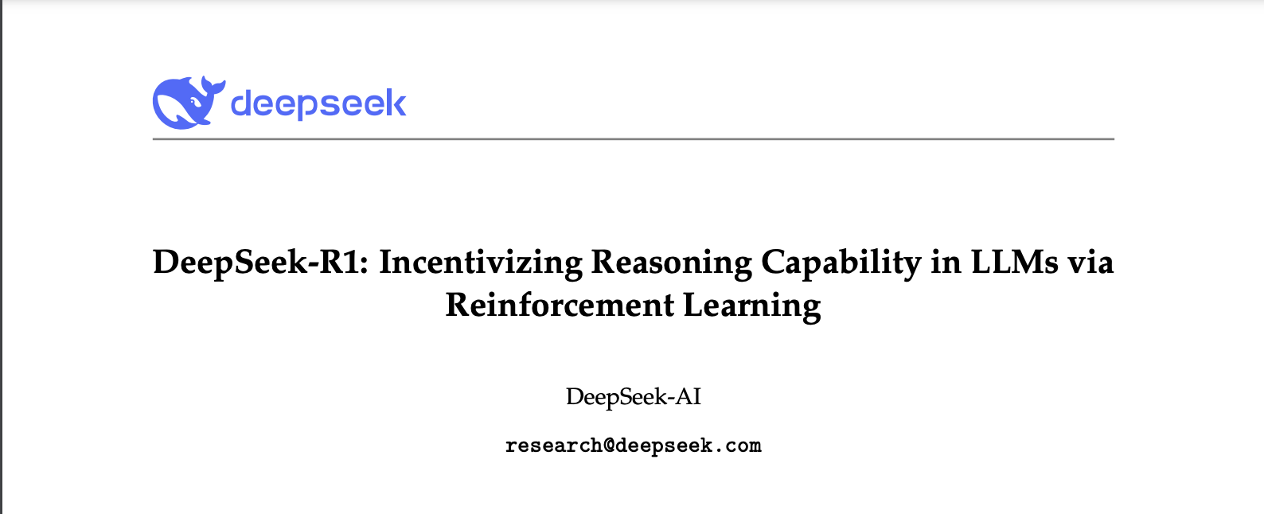

Slide 2
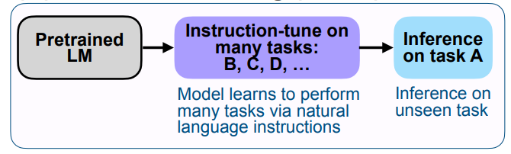
Supervised Fine-tuning (SFT) in LLMs
Augments input-output examples with instructions, which enables instruction-tuned models to generalize more easily to new tasks.

Slide 3
Supervised Fine-tuning (SFT) in LLMs
Augments input-output examples with instructions, which enables instruction-tuned models to generalize more easily to new tasks.
Instruction: Translate the following English text to French.
Input-output: The weather is nice today. → Le temps est agréable aujourd'hui.
Instruction: Determine the sentiment of the following review.
Input-output: I love this product! It works perfectly. → Positive

Slide 4
DeepSeek-R1 models
DeepSeek-R1-Zero, a model trained via large-scale reinforcement learning (RL) without supervised fine-tuning (SFT) as a preliminary step.
However, it encounters challenges such as poor readability, and language mixing.
DeepSeek-R1addresses these challenges by incorporating a multi-stage training and cold-start data before RL.

Slide 5
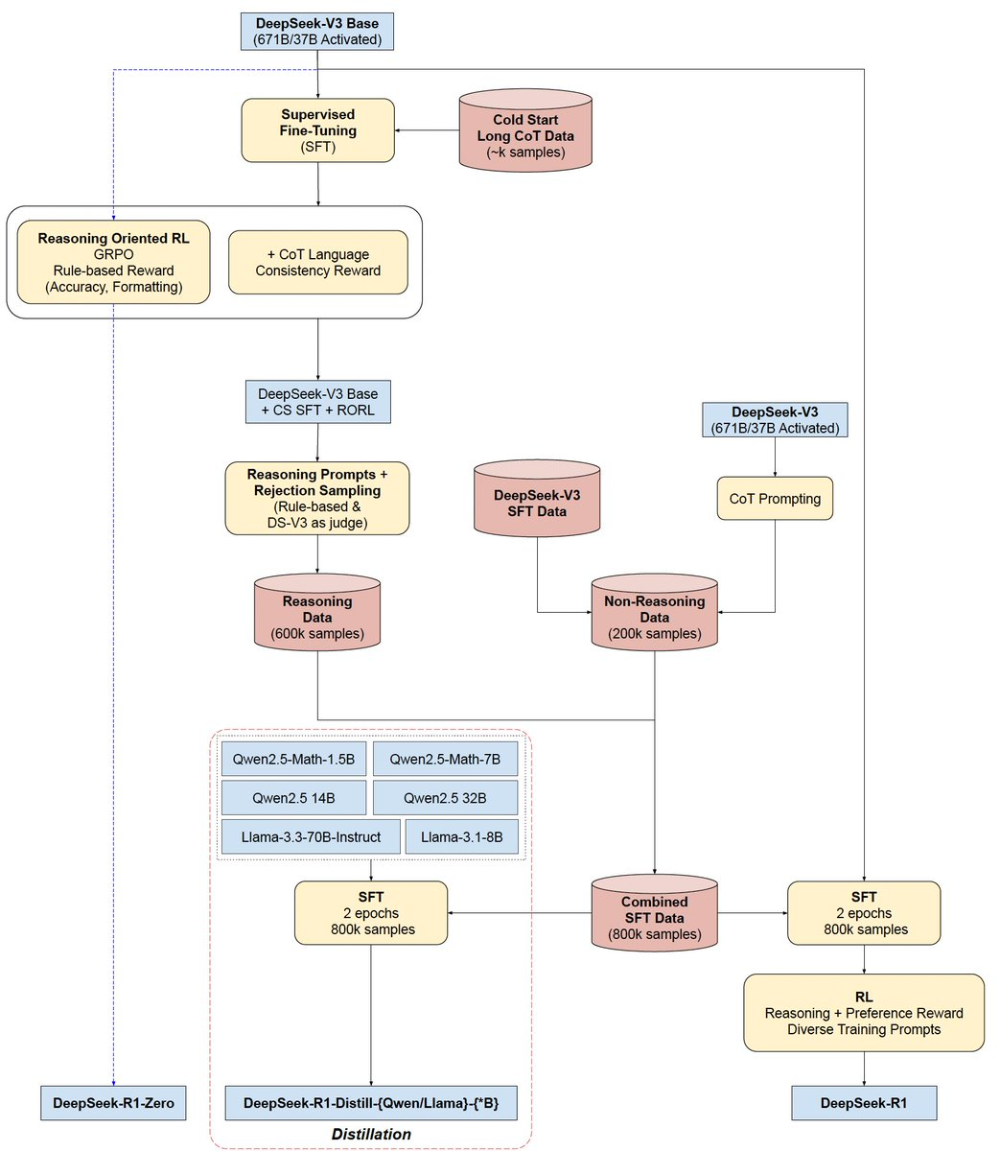
DeepSeek Training Paradigm
https://x.com/SirrahChan/status/1881488738473357753/photo/1
https://www.youtube.com/watch?v=QdEuh2UVbu0&list=WL&index=10

Slide 6
DeepSeek-R1-Zero
DeepSeek-V3 (DeepSeek-AI 24 ) is used as the starting checkpoint model.
DeepSeek-V3 is a Transformer and Mixture of Experts (MoE) based model.

Slide 7
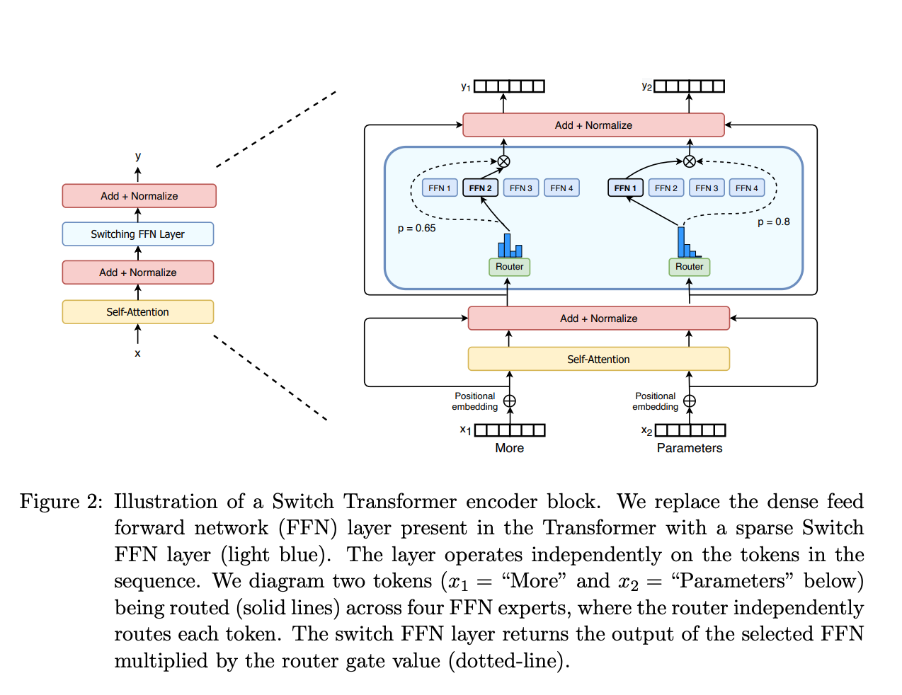
Revisiting Mixture of Experts (MoE)
Consists of two parts:
Sparse MoE layers instead of dense feed-forward network (FFN) layers.
Routers determines which tokens are sent to which expert.
https://huggingface.co/blog/moe
Shazeer et al. 2022

Slide 8
DeepSeek-R1-Zero
Develop reasoning capabilities without any supervised data, via reinforcement learning finetuning.
Group Relative Policy Optimization (GRPO)¹ algorithm was utilized to fine-tune the V3 base model.
¹Shao et al., 2024: DeepSeekMath

Slide 9
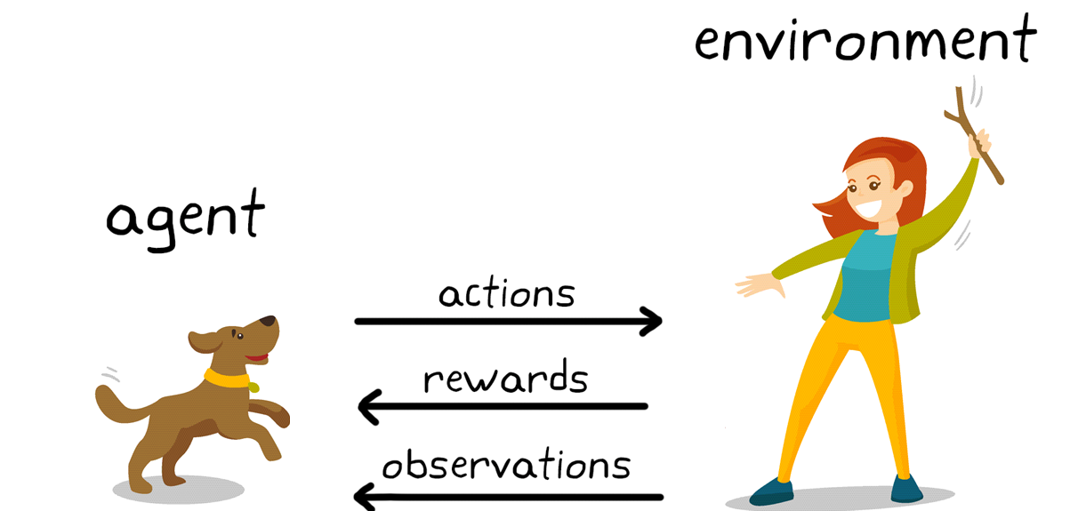
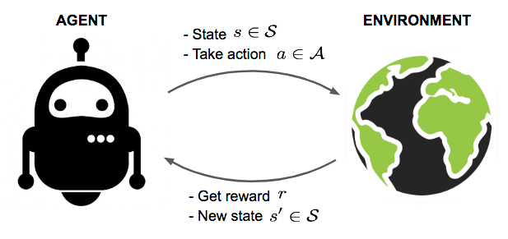
Revisiting Reinforcement Learning (RL)
State is a round of stick throwing.
Action: the dog moving toward the stick.
Reward: a treat.
Policy defines how an agent behave at a certain state. How to assign the reward.
The objective is to find the policy that maximizes the reward.

Slide 10
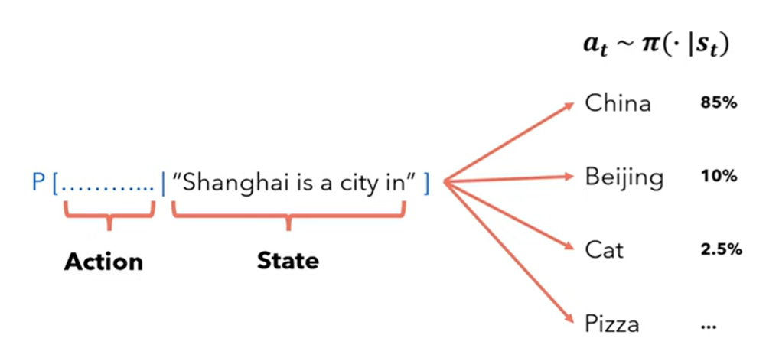
Analogy to LLMs
Agent: the LLM itself.
State: the initial input.
Action: next token prediction.
Policy: defines the behavior of the LLM. In other words, define the word distribution.
Reward: a numerical value to identify the correctness of the chosen action.

Slide 11
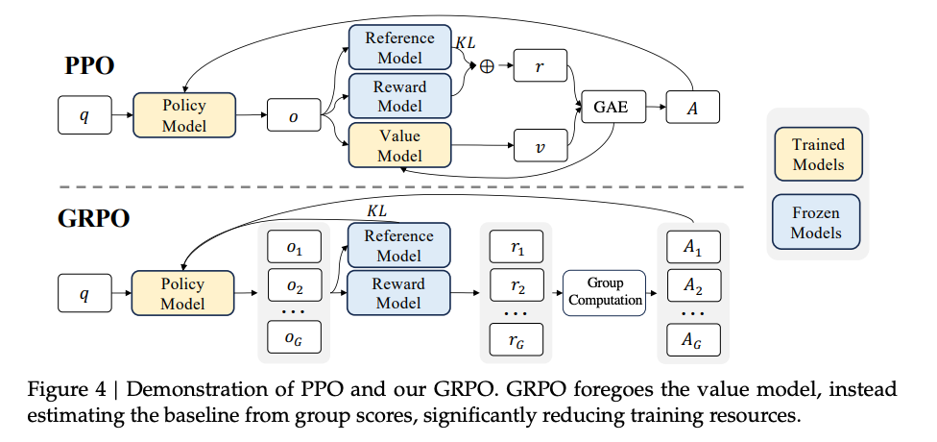
Group Relative Policy Optimization (GRPO)
GRPO algorithm is based on the Proximal Policy Optimization (PPO) algorithm¹².
Reward model is a trained model that assigns rewards.
Value model estimates the long-term expected future reward from a given state.
¹ Schulman et al 2017: Proximal Policy Optimization Algorithms
² Shao et al., 2024: DeepSeekMath

Slide 12
Group Relative Policy Optimization (GRPO)
GRPO generates multiple responses at once and generates multiple rewards.
Group computation decides the advantage of the response based on other responses in the group.
The value model is removed since it’s expensive to evaluate multiple actions every state.

Slide 13
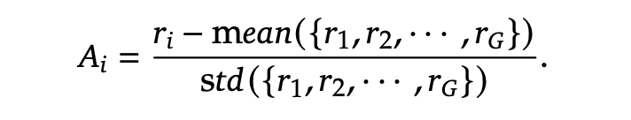
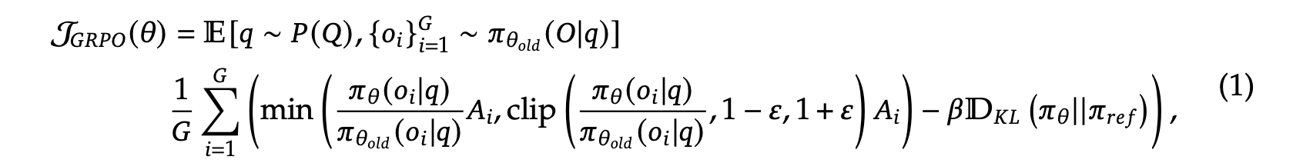
Group Relative Policy Optimization (GRPO)
Optimizes the policy to maximize the objective J_{GRPO}.
For every question (q), the model generates multiple outputs (o_{i}).
Scale the reward by the ratio or clipped ratio (conservative updates).
Maintain divergence from the ref model (base model).

Slide 14
Reward Modeling in GRPO
Uses a rule-based reward system with two types:
Accuracy rewards: Ensures correct responses (e.g., math, LeetCode).
Format rewards: Employ a format reward model that enforces the model to put its thinking process between ‘<think>’ and ‘</think>’ tags.

Slide 15
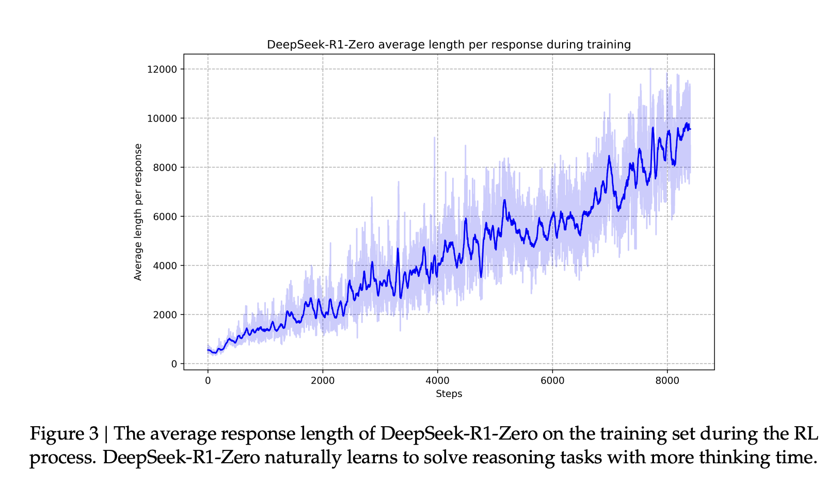
DeepSeek-R1-Zero Response Length

Slide 16
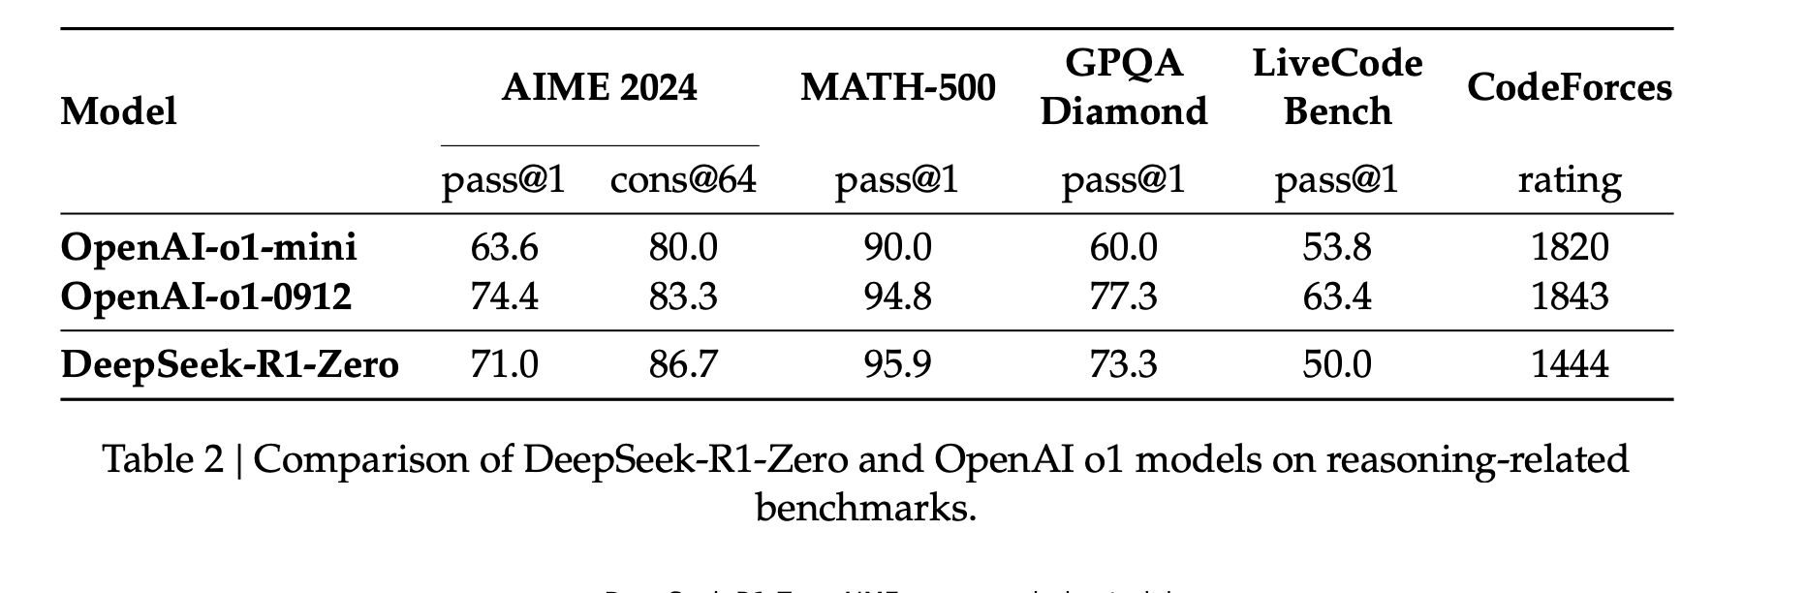
DeepSeek-R1-Zero outperforms O1-mini in math and coding benchmarks

Slide 17
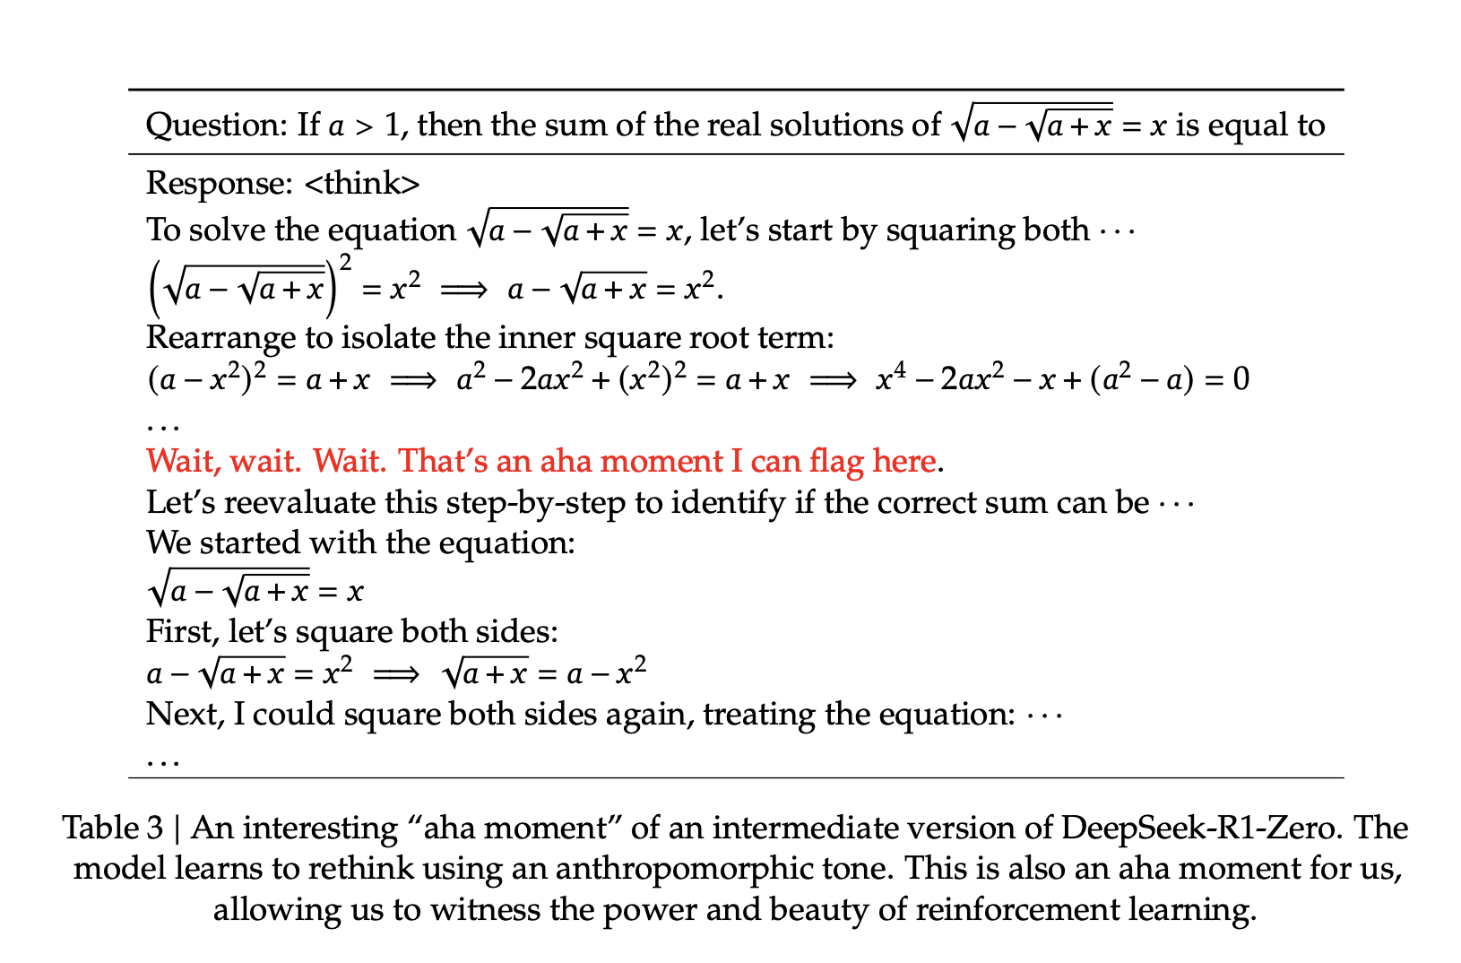
Aha Moment of DeepSeek-R1-Zero

Slide 18
Drawback of DeepSeek-R1-Zero
DeepSeek-R1-Zero struggles with challenges like
poor readability, and
language mixing.
“To make reasoning processes more readable, we explore DeepSeek-R1, a method that utilizes RL with human-friendly cold-start data.”

Slide 19
DeepSeek-R1
Start again from V3 Base.
Cold start chain of thought (CoT) data.
Reinforcement L
Group Relative Policy Optimization (GRPO)¹ algorithm was utilized to fine-tune the V3 base model.
¹Shao et al., 2024: DeepSeekMath

Slide 20
DeepSeek-R1
Start again from the V3 Base model.
Perform supervised fine-tuning (SFT) for 2 epochs.
Perform Reinforcement Learning (RL) to improve helpfulness and harmlessness.

Slide 21
DeepSeek-R1 SFT data

Slide 22
DeepSeek-R1 Distillation

Slide 23
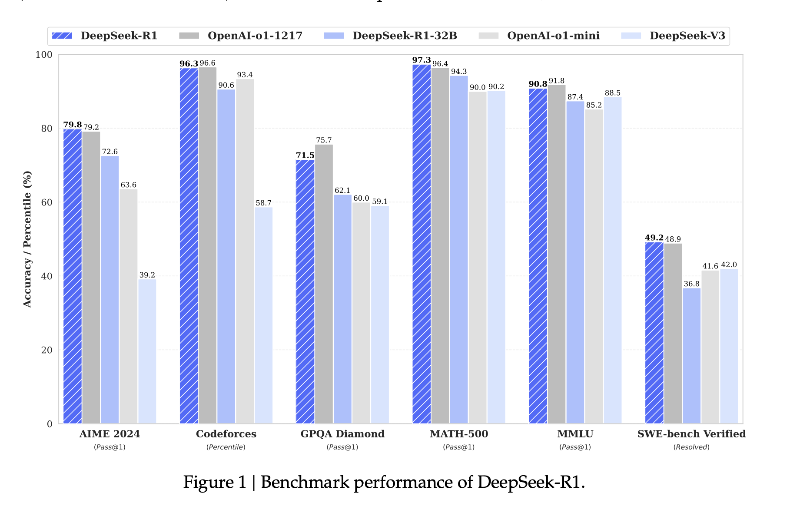
DeepSeek-R1 achieves OpenAI O1 in math and coding benchmarks

Slide 24
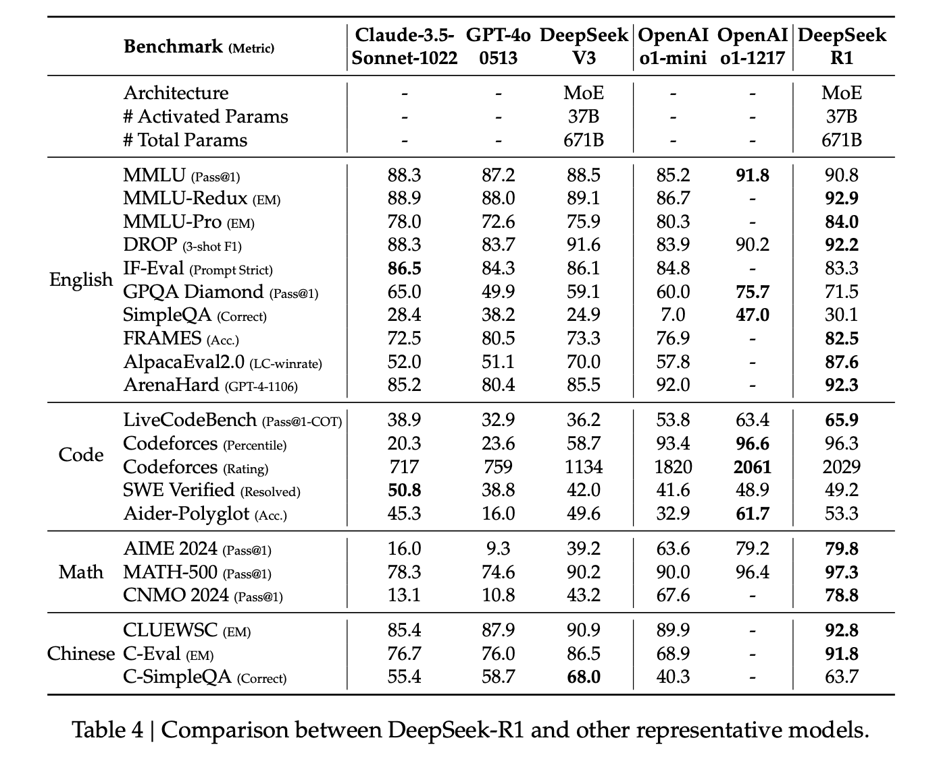
DeepSeek-R1 achieves SOTA* LLMs in different benchmarks
*SOTA: State-Of-The-Art

Slide 25
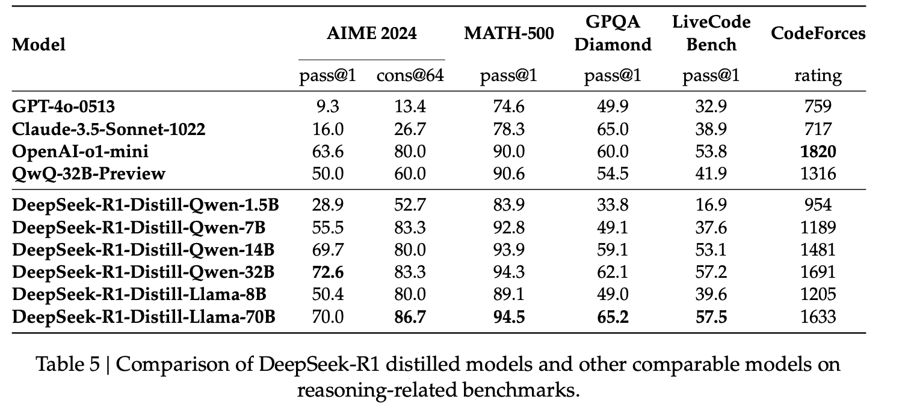
Distilled Model Evaluation

Slide 26
Takeaways
DeepSeek-R1 matches OpenAI o1 in complex reasoning tasks.
DeepSeek-R1-zero achieves strong logical reasoning without supervised fine-tuning.
Distillation enables smaller models to inherit advanced reasoning capabilities from DeepSeek-R1.

Slide 27
Questions

