Slide 1




BIOMEDICAL RESEARCH DATABASE
Presented by: Alaa Khaled ELhabibi ID: 231002125
Jana Mahmoud Abdallah ID:231001245
Mariam Wassem Abdelatif ID:231001582

Slide 2
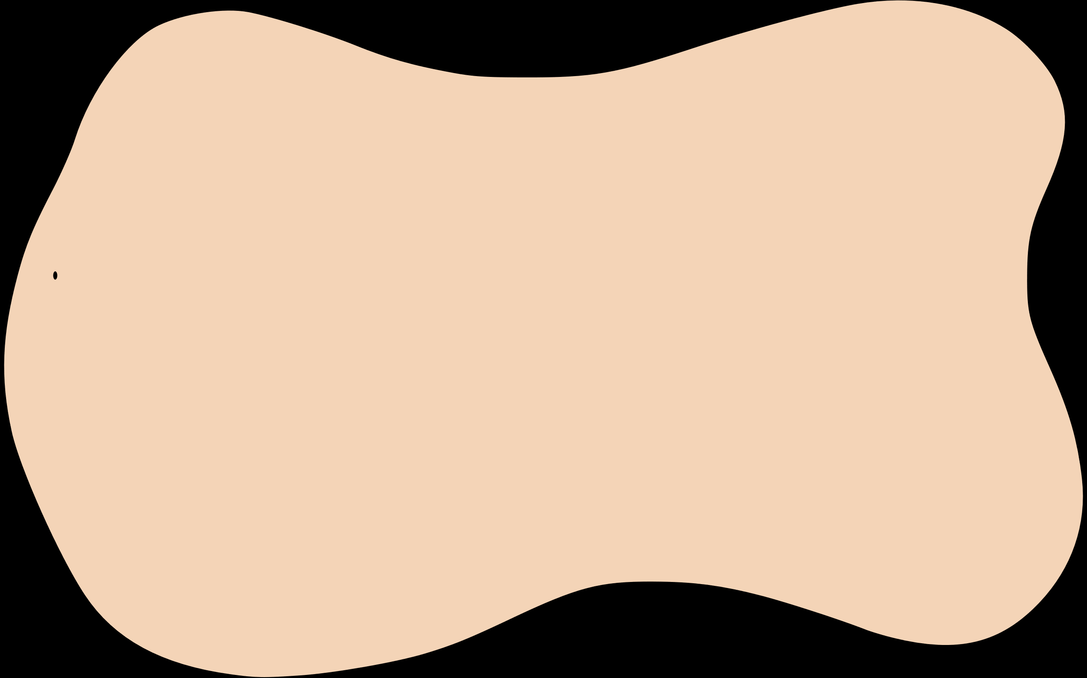
INTRODUCTION
This project is a complete biomedical research database system consisting of a structured MySQL relational schema and a Python-based GUI. The system was built to store, manage, and explore detailed information about biomedical research in Egypt and beyond, including authors, journals, articles, research fields, and publishers.
Developed by four biotechnology students, the project bridges bioinformatics and software engineering through practical application in data curation and visualization.

Slide 3


PROCESS
designing the ERD
4.Establishing Table Relationships
2. Writing the SQL Schema
5. making queries
6.Developing the Python GUI
3. Inserting Data into Tables
7.Testing and Validation

Slide 4
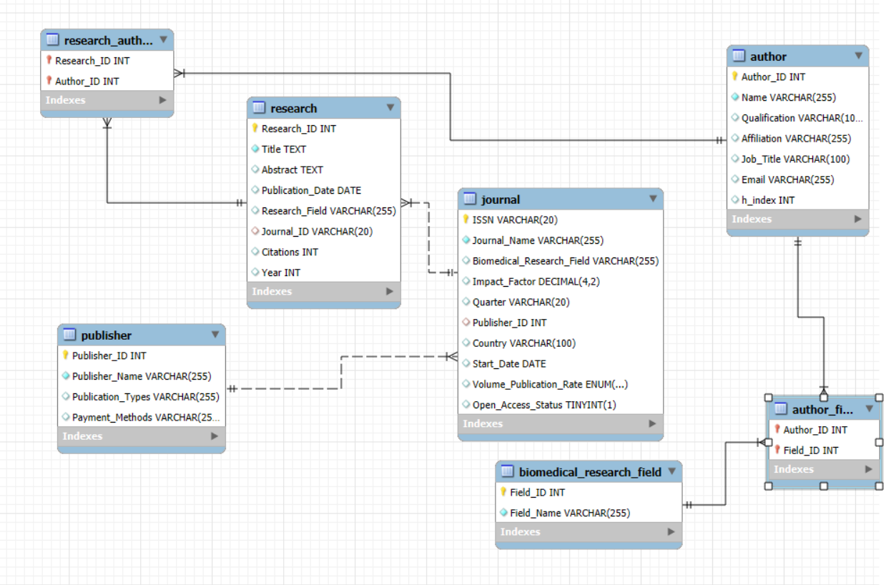
THE ERD

Slide 5
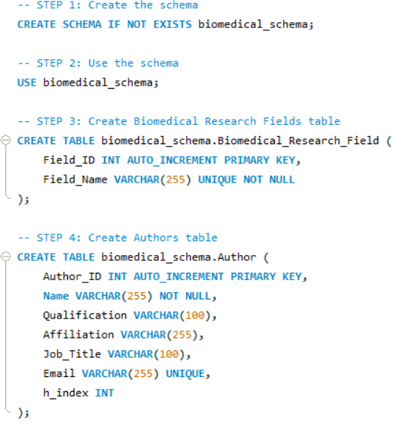
example for Writing the SQL Schema

Slide 6
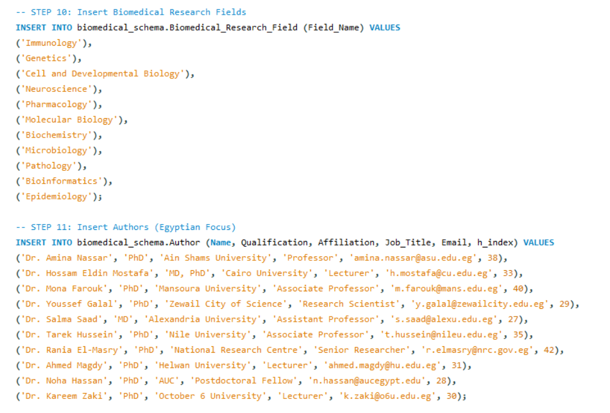
example for Inserting Data into Tables

Slide 7
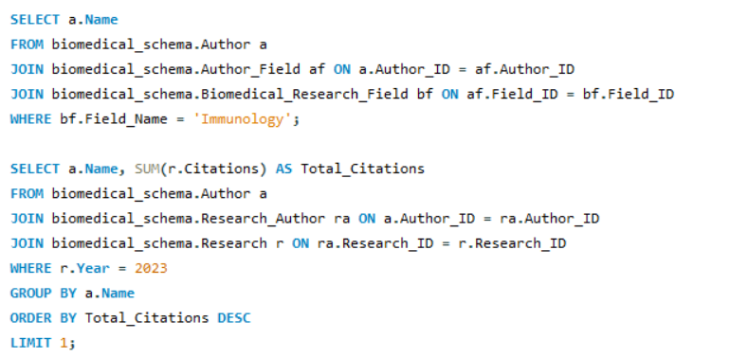
example for making queries

Slide 8
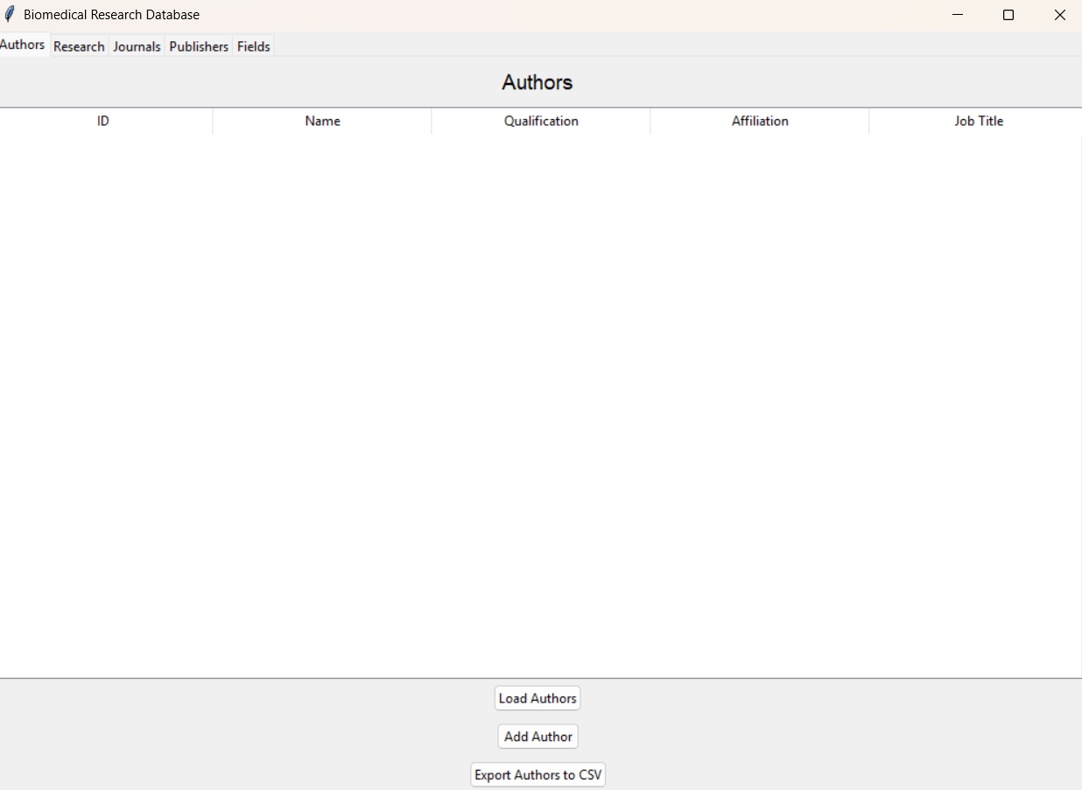
the GUI for the database

Slide 9
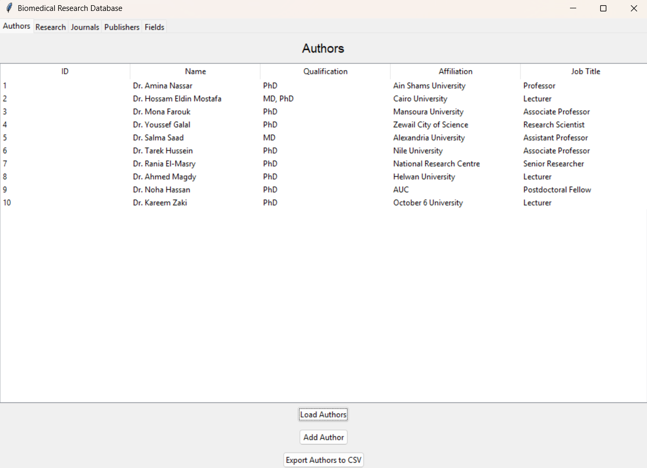
adding features that can be used

Slide 10
THANK YOU

