Slide 1



PIXCRAWLER
The AI Image Datasets Generator
“PIXCRAWLER”
Presented by:
Amr Mohamed
Aya Ahmed
Ganna Tarek
Marwan Hatem
Mohamed Hassan
Osama Mohamed

Slide 2
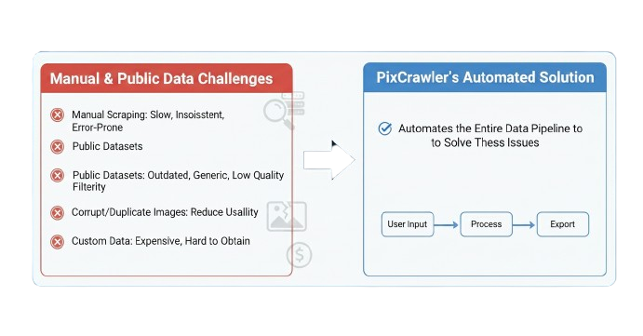
PIXCRAWLER
Problem Statement
  Manual scraping is slow, inconsistent, and error-prone
  Public datasets are outdated, generic, or low quality
  Corrupt or duplicate images reduce usability
  Custom datasets are expensive and difficult to obtain
PixCrawler automates the entire pipeline to solve these issues.

Slide 3
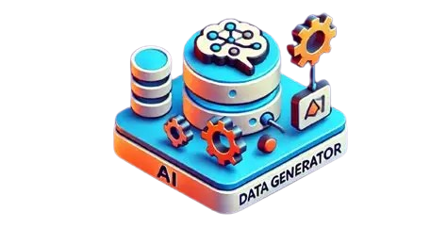
PIXCRAWLER
Executive Summary
PixCrawler revolutionizes automated image dataset creation. It is an end-to-end AI platform that streamlines the entire process—crawling, validating, deduplicating, organizing, and exporting high-quality, diverse images for AI training. By eliminating slow manual scraping, PixCrawler significantly reduces costs and time while enhancing the accuracy and reliability of machine learning and computer vision models.

Slide 4
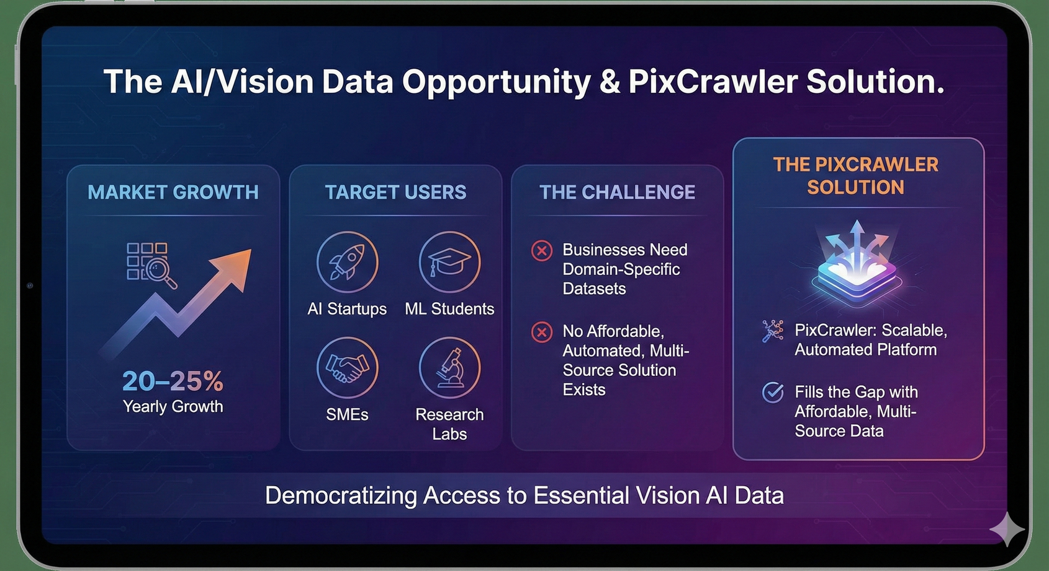
PIXCRAWLER
Market Opportunity

Slide 5
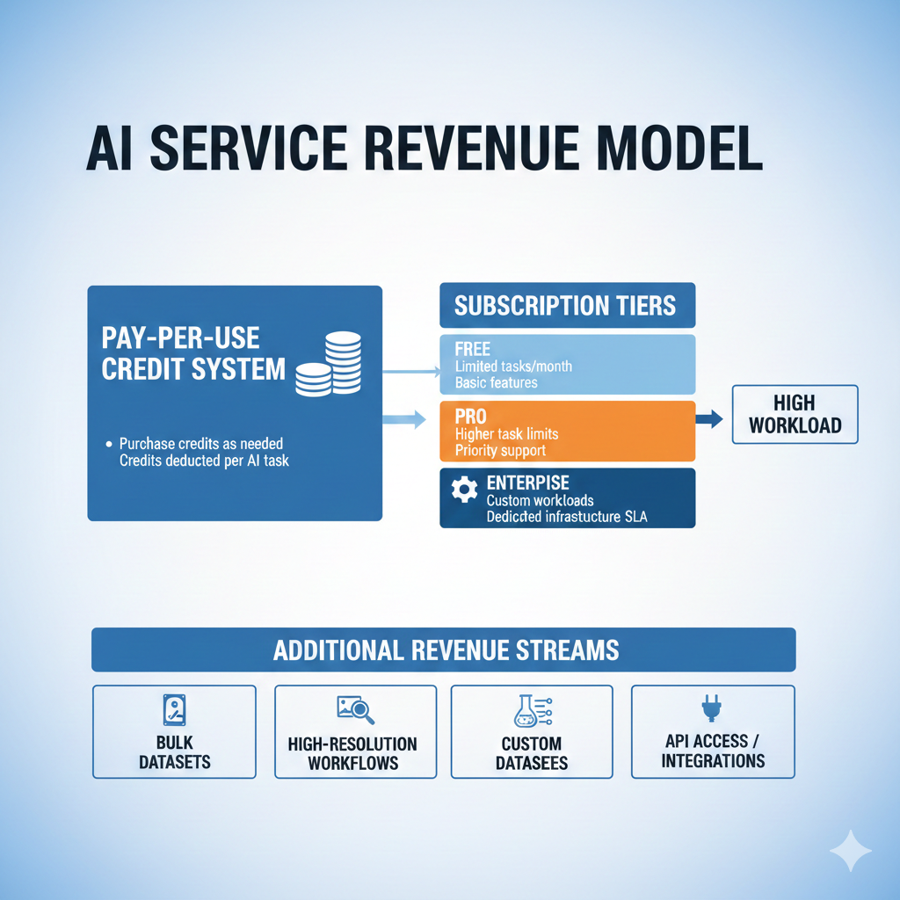
PIXCRAWLER
Business Model Overview

Slide 6

PIXCRAWLER
Competitive Advantages
  Fully automated ML-grade pipeline
  Multi-source crawling + AI keyword expansion
  Validation & deduplication
  Checkpointing (rare feature)
  Real-time monitoring
  Modern, maintainable architecture
  Faster, cheaper, flexible than alternatives

Slide 7
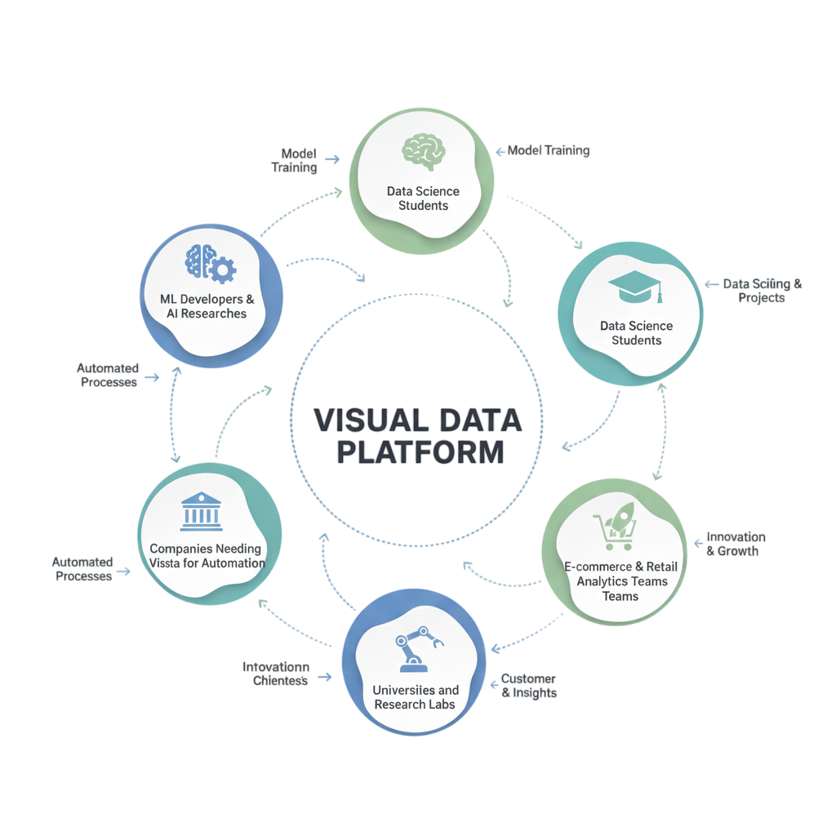
PIXCRAWLER
Target Users & Customers

Slide 8
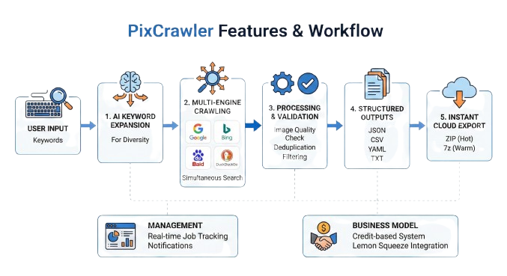
PIXCRAWLER
Product & Service Description
PixCrawler offers:
  Automated dataset generation from keywords
  AI-based keyword expansion for diversity
  Multi-engine crawling (Google, Bing, Baidu, DuckDuckGo, ...etc.)
  Image quality validation & deduplication
  Structured outputs (JSON/CSV/YAML/TXT)
  Cloud export (ZIP hot / 7z Cold)
  Real-time job tracking
  Credit-based model using Lemon Squeeze

Slide 9
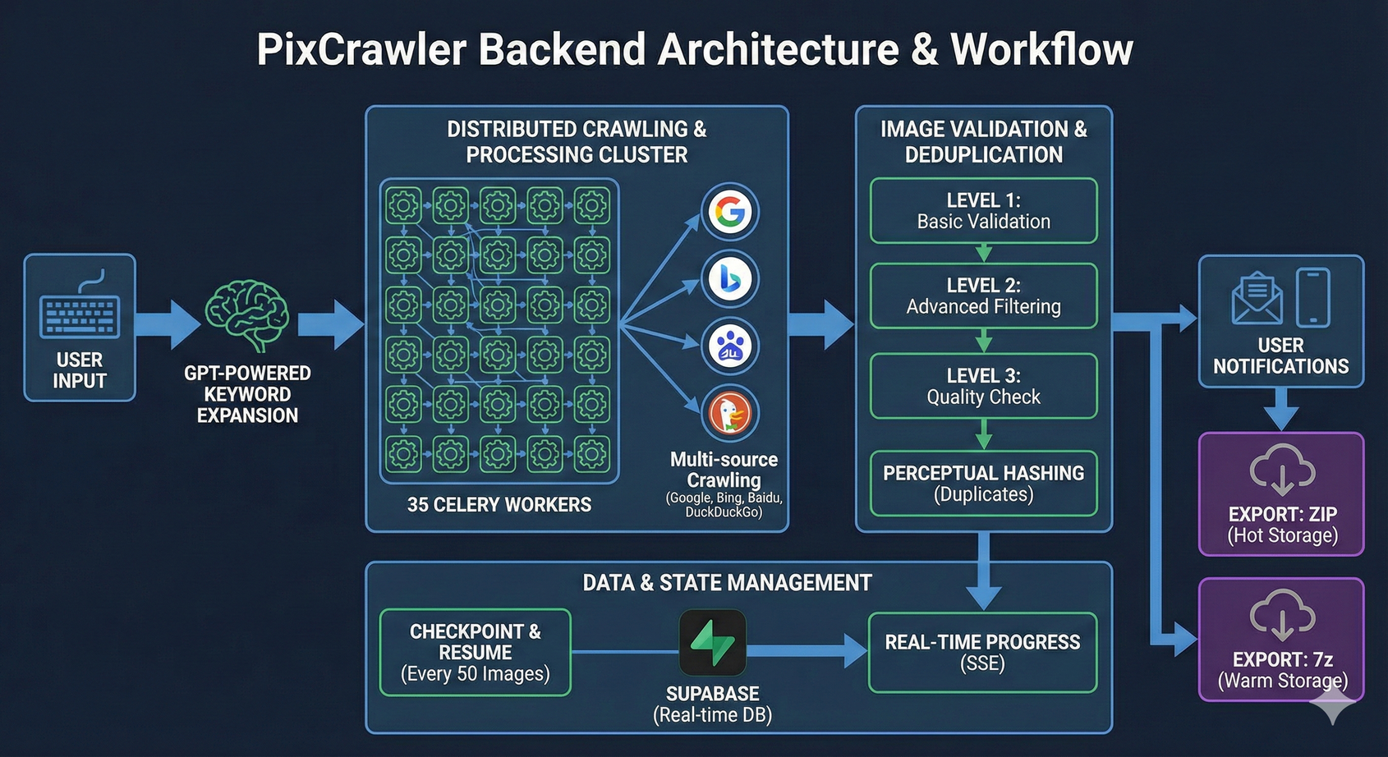
PIXCRAWLER
Key Features
  Multi-source crawling
  Smart randomization and AI support keyword expansion
  35 distributed Celery workers
  Image validation (3 levels)
  Perceptual hashing for duplicates
  Checkpoint & resume every 50 images
  Real-time progress (SSE + Supabase)
  Export: ZIP (hot), 7z (Cold)

Slide 10
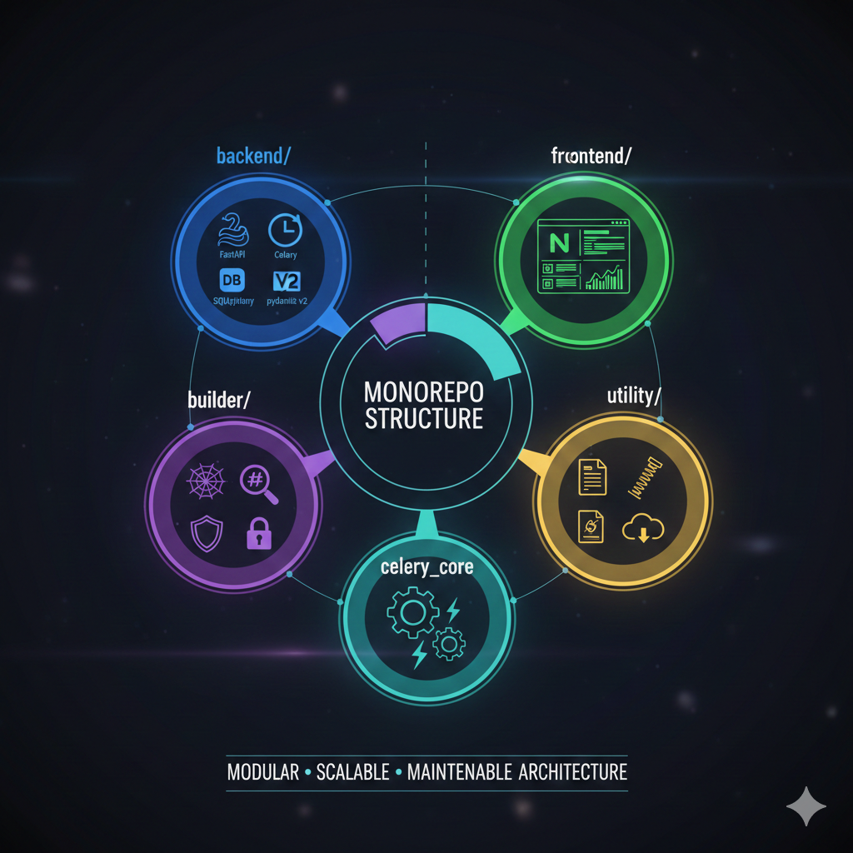
PIXCRAWLER
Architecture Overview
Monorepo Structure:
  backend/ → FastAPI + Celery + SQLAlchemy + pydantic v2
  builder/ → Crawling engine
  validator/ → Validation & hashing
  celery_core/ → Distributed execution
  utility/ → Logging, compression
  frontend/ → Next.js 15 dashboard
Features: Modular, scalable, maintainable architecture

Slide 11
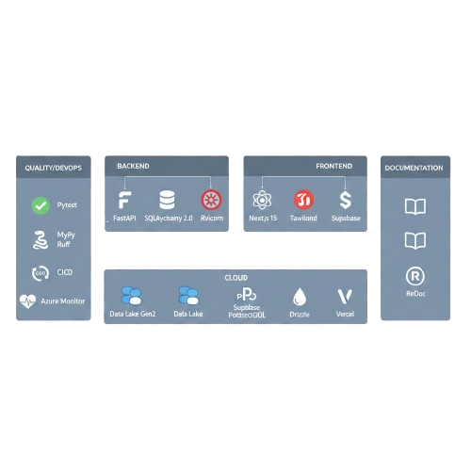
PIXCRAWLER
Technology Stack
  Backend: FastAPI, SQLAlchemy 2.0, Celery, Redis, UV
  Validation: Pydantic v2, Pillow (PIL)
  Quality/DevOps: Pytest
  Documentation: OpenAPI, ReDoc

Slide 12
PIXCRAWLER
Technology Stack
  Frontend: Next.js 15, React 19, Tailwind, Drizzle, Supabase
  Cloud: Data lake Blobs, Supabase PostgreSQL, Azure Static Pages

Slide 13
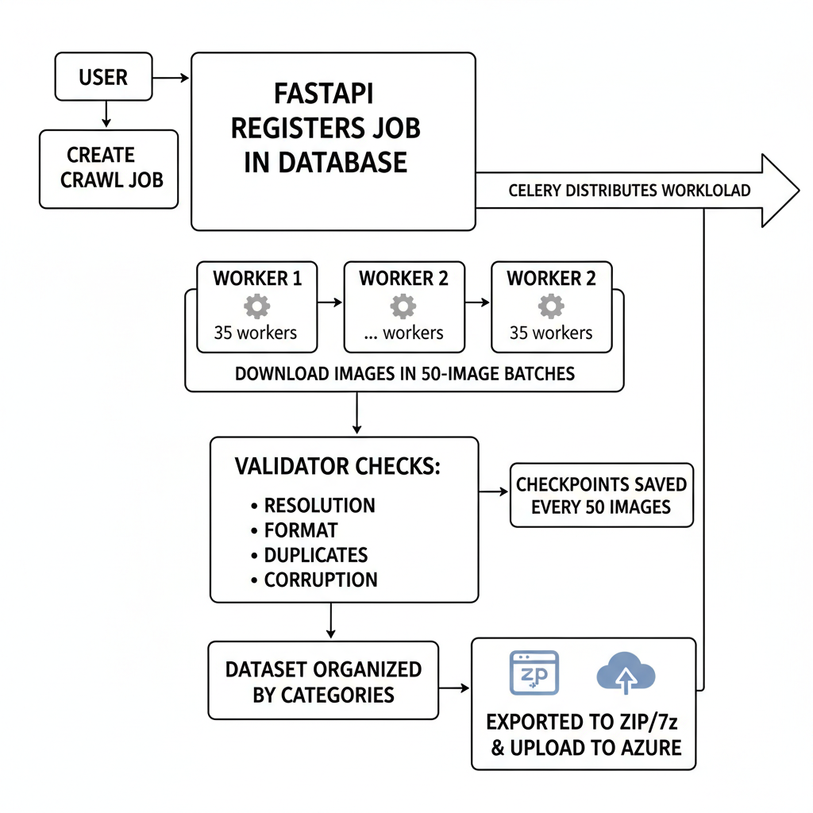
PIXCRAWLER
Data Pipeline Overview
  User creates a crawl job
  FastAPI registers job in database
  Celery distributes workload across 35 workers
  Workers download images in 50-image batches
  Validator checks resolution, format, duplicates, corruption
  Checkpoints saved every 50 images
  Dataset organized by categories
  Exported to ZIP/7z and uploaded to Azure
  User receives notifications

Slide 14

PIXCRAWLER
Dataset Organization Structure
  dataset_name/
  ├── images/
  │ ├── category/
  │ │ ├── image_001.jpg
  │ │ └── image_002.jpg
  └── labels/
  ├── category/
  ├── image_001.txt
  └── image_002.txt
  Labels: JSON, CSV, YAML, TXT
  Metadata includes validation logs, crawl source (Celery), and file info

Slide 15
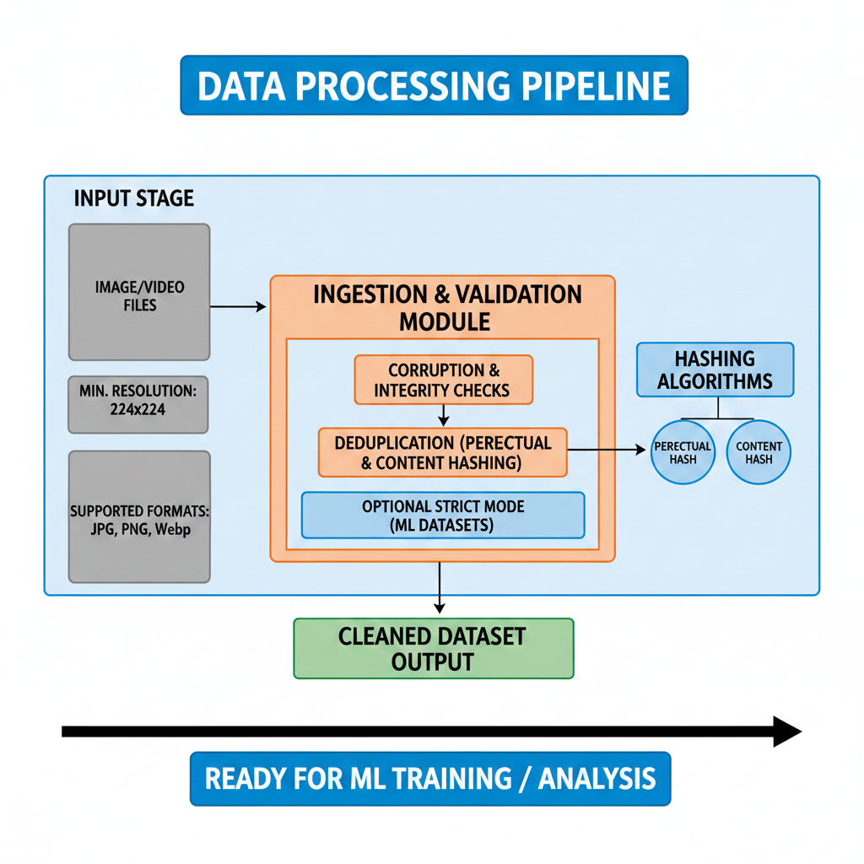
PIXCRAWLER
Image Quality & Validation
  Minimum resolution: 224×224
  Supported formats: JPG, PNG, WebP
  Corruption & integrity checks
  Deduplication via perceptual & content hashing
  Optional strict mode for ML datasets

Slide 16
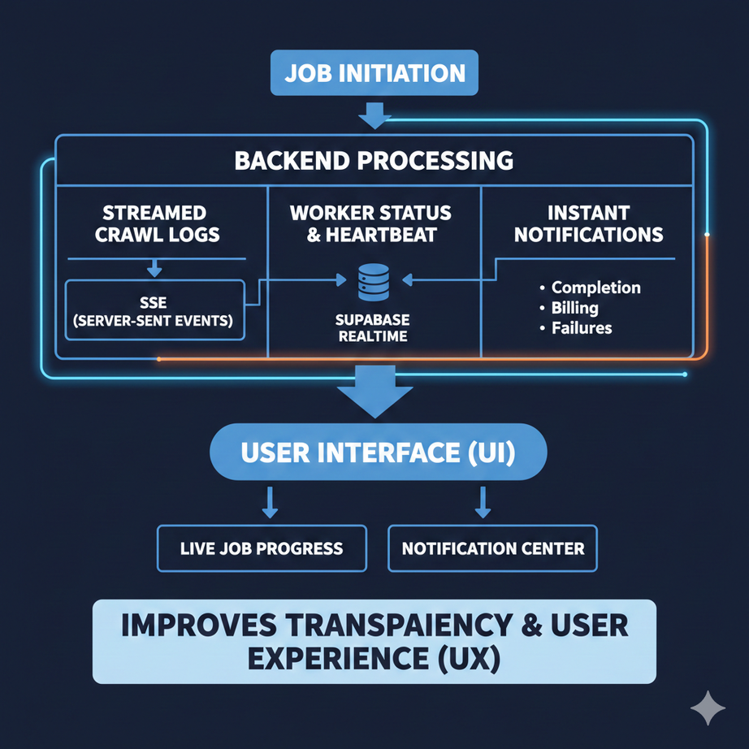
PIXCRAWLER
Real-Time Monitoring & Updates
  Live job progress (SSE + Supabase Realtime)
  Streamed crawl logs
  Worker status tracking & heartbeat
  Instant notifications: completion, billing, failures
  Improves transparency and UX

Slide 17
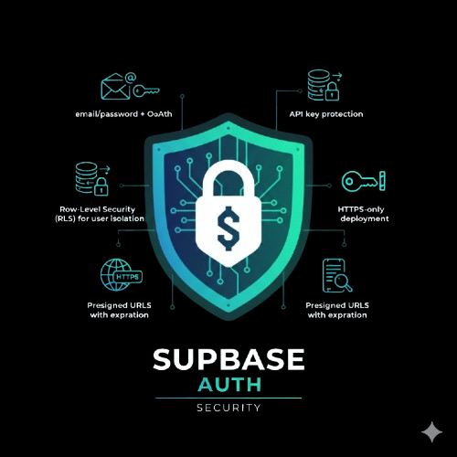
PIXCRAWLER
Security Model
  Supabase Auth (email/password + OAuth)
  Row-Level Security (RLS) for user isolation
  API key protection using Middleware
  Presigne0d URLs with expiration (Used only with azure)
  Full audit logging

Slide 18

PIXCRAWLER
Safe & Restricted Dataset
Our image datasets are fully safe and restricted. All images are filtered to remove harmful or adult content, ensuring high-quality, AI-ready datasets for machine learning projects.

Slide 19

PIXCRAWLER
Rate Limiting & Billing
  FREE → 1 job
  Hobby→ 3 jobs
  Pro → 10 jobs
  Credit-based model
  Auto-refill thresholds
  Usage metrics: images, storage, bandwidth
  Transaction history ensures predictable cost

Slide 20
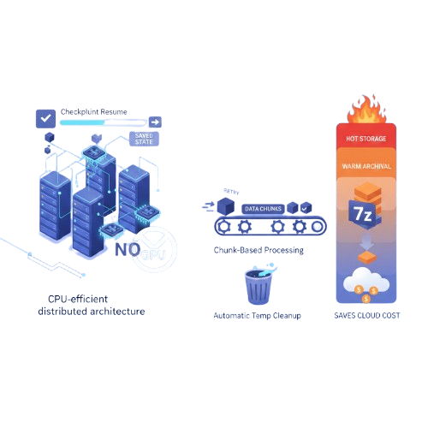
PIXCRAWLER
Operations & Sustainability
  CPU-efficient distributed architecture (no GPU needed)
  Checkpoint resume reduces wasted compute
  Chunk-based processing minimizes retries
  Automatic temp cleanup
  Hot → Cold archival, 7z compression saves cloud cost

Slide 21
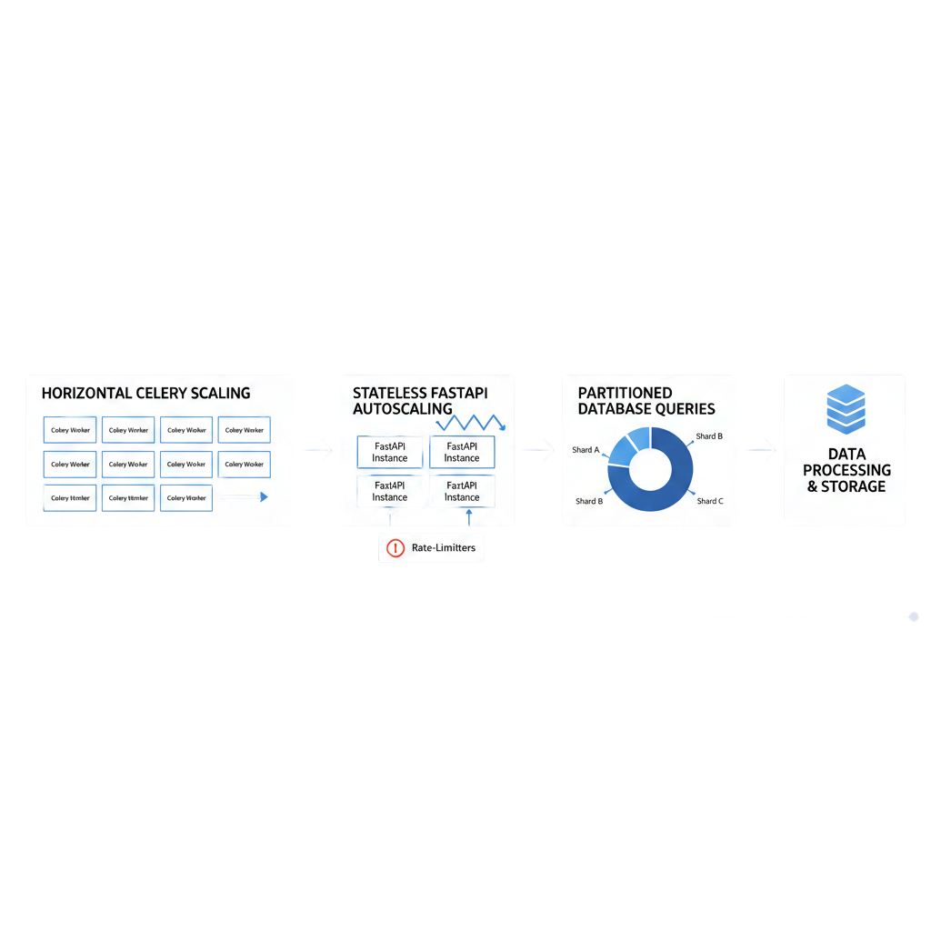
PIXCRAWLER
Streamlined Scalability

Slide 22
PIXCRAWLER
Conclusion
PixCrawler combines intelligence, automation, scalability, and strong engineering to deliver high-quality image datasets at scale.
Transforms simple keywords into structured, validated, and instantly downloadable datasets.
A complete, enterprise-ready platform for modern ML and AI workflows.

Slide 23
PIXCRAWLER
THANK YOU!

