Slide 1
Traffic Theory
2017-2018
F. Borgonovo

Slide 2
Telephone Networks
Traffic Theory begins in early 1900 with the development of Telephone networks
F. Borgonovo: Traffic Theory

Slide 3
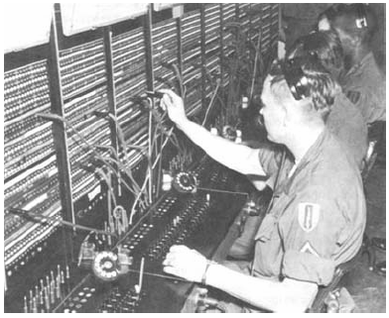
Telephone Networks
Need for the statistical sizing of switches and trunks
F. Borgonovo: Traffic Theory

Slide 4
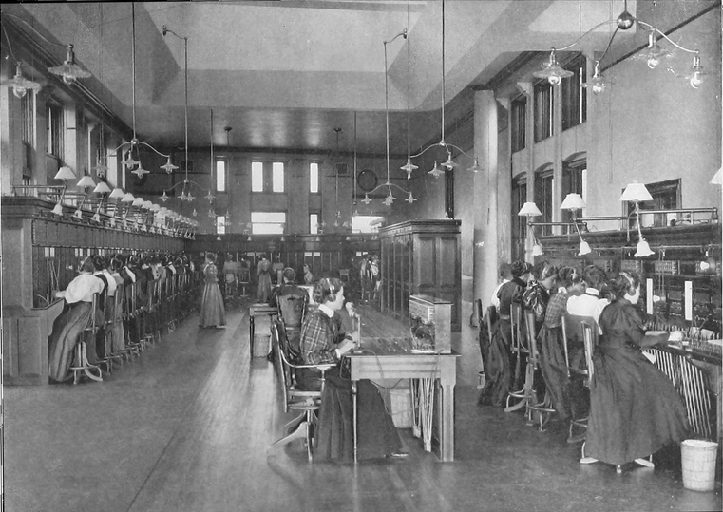
Manual Switches
F. Borgonovo: Traffic Theory

Slide 5
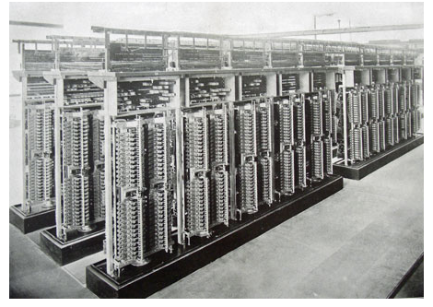
Electro-mechanical switches
F. Borgonovo: Traffic Theory

Slide 6
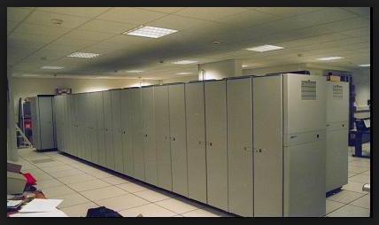
Electronic switches
F. Borgonovo: Traffic Theory

Slide 7
Telephone Networks
  Example: say Milan and Rome have 1 million telephone users each
  How many channels should be provided for the Milan-to-Rome trunk?
F. Borgonovo: Traffic Theory

Slide 8
Telephone Networks
Too many lines turn out in
  Very high cost
  Very low use of each line
Too few lines turn out in
  User discontent
  Few revenues
There is an optimal size
F. Borgonovo: Traffic Theory

Slide 9
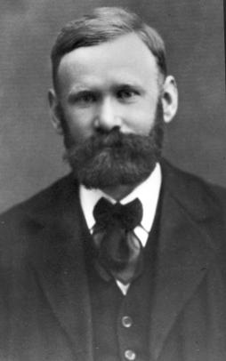
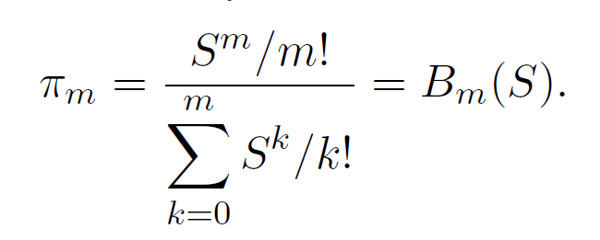
Blocking Formula
  A. K. Erlang 1878 – 1929
F. Borgonovo: Traffic Theory

Slide 10
Telephone Networks
Same problem in other modern fields
  How many servers within a server farm?
  How many lines within a call center?
  How many windows/clerks in a bank?
  How many beds in a hospital?
  How many machines in a workshop?
  ……………..
F. Borgonovo: Traffic Theory

Slide 11
Packet Switching Networks
1960s
Are based on the asynchronous transmission of data packets
That are switched and forwarded at routers
PC
PC
F. Borgonovo: Traffic Theory

Slide 12
Packet Switching Networks
In routers contentions occur when packets from different input lines goes to the same output link
Queues are needed
Queues introduce delays
F. Borgonovo: Traffic Theory

Slide 13
Queues
We need to charachterize
  Occupancy
  Delays
  Blocking probabilities
  Stability issues (Congestion)
F. Borgonovo: Traffic Theory

Slide 14
Queues
Other applications to more general serving facilities with queues at
  counters
  call centers
  Server farm
  Workshop machines
  ……
F. Borgonovo: Traffic Theory

Slide 15
Service disciplines
Not all the service requests are the same
  Urgent/non-urgent
  Delay tolerant vs real time
  Voice/data
  Long/short requests
Hence the need for service disciplines
F. Borgonovo: Traffic Theory

Slide 16
Service disciplines
Include service admission disciplines
  First in First out
  Last in First out
  Processor and time sharing
  Preemption
Scheduler
F. Borgonovo: Traffic Theory

Slide 17
Service disciplines
The managing of different queues
  Exaustive service
  Gated service
  Fair queing
  Priorities
Scheduler
F. Borgonovo: Traffic Theory

Slide 18
Routing in Networks
Send packets along one path
We need to determine the size and position of routers and links
F. Borgonovo: Traffic Theory

Slide 19
Routing in Networks
We need to know
  How requirements traduces into network flows
  How routing techniques affect network delay and capacity
Network of queues
F. Borgonovo: Traffic Theory

Slide 20
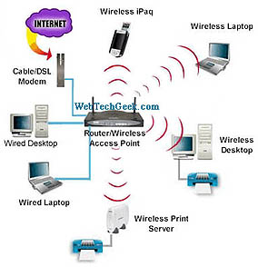

Multiple access protocols
Used when different users must transmit on the same communication channel
Radio
Base
F. Borgonovo: Traffic Theory

Slide 21
Multiple access protocols
Problems
  Different users transmissions must be cohordinated to avoid contentions on the shared channel
  Cohordination must be achieved using the same channel!
  Queing and Service disciplines
F. Borgonovo: Traffic Theory

Slide 22
Cellular Systems
We cannot assign a voice channel to each terminal (not enough channels)
Channels are assigned on demand
How to ask for a channel?
There is a common channel to be shared
By a random access protocol
F. Borgonovo: Traffic Theory

Slide 23
Slotted Aloha
Abramson 1969, University of Hawaii
Terminals transmit with no coordination in the first available slot
Collisions
On no response, terminals retry
If all repeat the same, they collide again
Random decoupling is needed
F. Borgonovo: Traffic Theory

Slide 24
Slotted Aloha
To avoid further collisions the time to the next transmission is extracted RANDOMLY by each terminal
Does this method work?
If YES, which is the throughput (successful transmission/slot)?
F. Borgonovo: Traffic Theory

Slide 25
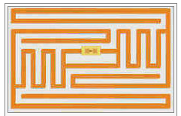
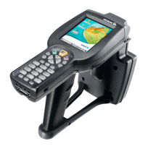
Radio Frequency ID
The reader must identify all tags:
releases a command
N passive tags
reader
Common interrogation
F. Borgonovo: Traffic Theory

Slide 26
Radio Frequency ID
Tags respond, and collide
N passive tags
reader
F. Borgonovo: Traffic Theory

Slide 27
Radio Frequency ID
A mechanism must be used to let in the end tag transmit without collision
Again, casual retransmission is used Ex Frame Aloha.
F. Borgonovo: Traffic Theory

Slide 28
Content
Probability theory is a mandatory tool for analysis and design, but ….
elementary theory cannot take into account memory.
We need a more sophisticated tool: Random Processes
F. Borgonovo: Traffic Theory

Slide 29
Basic Probability Theory
Is absolutely needed as a prerequisite
Alignment course is provided for those that don’t know
We start a brief refresh
Need MATLAB
F. Borgonovo: Traffic Theory

Slide 30
Traffic Theory: exams
Written proof in two parts
  6 theoretical questions, with open answer
  4 analytical problems
  homework
F. Borgonovo

Slide 31
Traffic Theory: material
Available on the course web-page
Class notes (password “stocproc”)
Exercises with solution (>100)
Exams with solutions
Electronic books
http://home.dei.polimi.it/borgonov/index.html
http://home.dei.polimi.it/borgonov/teoria-17.htm
F. Borgonovo

Slide 32
Traffic Theory: schedule
Classes :
  Monday , 13:15-15:15
  Wednesday , 15:15-18:15
  Thursday, 15:15-18:15
Monday class devoted to exercises
Classes: no break
F. Borgonovo

