Slide 1

System Administration-CSNW3202
Chapter 1: Introduction to System Administration and OS Installation
• Introduction to System Administration
• Why do we need to do System Administration?
• Why Do we need Linux?
Introduction to System Administration
System administration involves managing, maintaining, and securing an organization's IT
infrastructure, including hardware, software, and networks.
Roles and Responsibilities of a System Administrator.
Installing, configuring, and maintaining servers.
Managing user accounts and permissions.
Monitoring system performance and uptime.
Applying security updates and patches.
Troubleshooting and resolving technical issues.

Slide 2
Common Tasks in System Administration
User Management:
Adding, modifying, and deleting user accounts.
Configuring permissions and access controls.
Backup and Recovery:
Implementing regular data backups.
Planning for disaster recovery and restoration.
Network Management:
Configuring firewalls, DNS, and routing.
Managing VPNs and secure remote access
Why do we need to do System Administration?
System administration is essential for ensuring the smooth and efficient operation of an organization’s IT infrastructure. Below are key reasons why system administration is necessary:
System Stability and Reliability
Security and Data Protection
Resource Management
User Management and Support
Performance Monitoring and Optimization
Automation and Efficiency
Disaster Recovery
Integration of New Technologies

Slide 3
Why Do we need Linux?
1. Open-Source and Free
Cost-Effective: Linux is free to use, distribute, and modify, making it accessible to individuals, businesses, and organizations with limited budgets.
Community Development: Being open-source, Linux benefits from a global community of developers who continuously improve its performance, security, and features.
2. Stability and Reliability
Long Uptime: Linux systems are known for their ability to run for long periods without requiring a reboot, making them ideal for servers and mission-critical applications.
Consistency: Updates and upgrades are seamless and rarely disrupt operations.
3. Security
Robust Security: Linux has built-in security features such as file permissions, user access controls, and SELinux (Security-Enhanced Linux).
Fewer Vulnerabilities: Its modular design and active community help identify and patch vulnerabilities quickly.
4. Versatility and Flexibility
Runs Anywhere: Linux powers a wide range of devices, from servers, desktops, and laptops to embedded systems, IoT devices, and supercomputers.
Customizable: Users can tailor Linux to their specific needs by choosing from various distributions (distros) like Ubuntu, CentOS, Fedora, and Arch Linux.
5. Performance
Efficiency: Linux efficiently manages system resources, providing better performance on low-spec hardware compared to other operating systems.
High Scalability: It can handle tasks on small devices as well as large-scale server farms or cloud infrastructures.
6. Wide Use in Servers and Datacenters
Dominant in Web Hosting: Most web servers, including those running Apache, Nginx, and MySQL, operate on Linux.
Preferred in Cloud Computing: Linux is the backbone of popular cloud platforms like AWS, Google Cloud, and Microsoft Azure.

Slide 4
Why Do we need Linux?
7. Development Environment
Developer-Friendly: Linux provides a powerful environment for programming with built-in tools like GCC, Git, and scripting languages (Python, Bash).
Open-Source Development: Linux encourages collaborative development and learning.
8. Education and Learning
Ideal for Learning: Its transparency and open-source nature make it an excellent tool for learning operating systems, networking, and programming.
Practical Skills: Proficiency in Linux is a valuable skill in IT, cybersecurity, and software development.
9. Compatibility
Supports Multiple Architectures: Linux supports a variety of hardware architectures, from x86 and ARM to RISC and SPARC.
Interoperability: It can work seamlessly with other operating systems, file systems, and protocols.

Slide 5
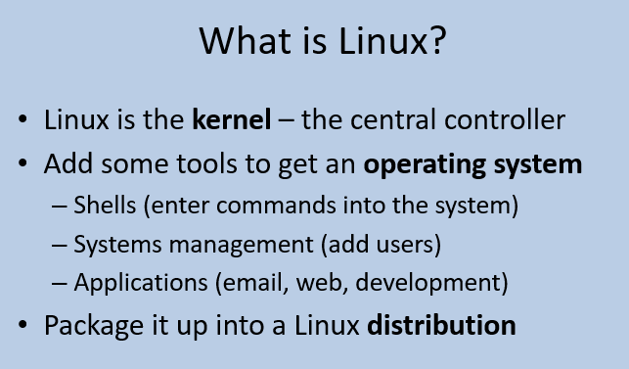

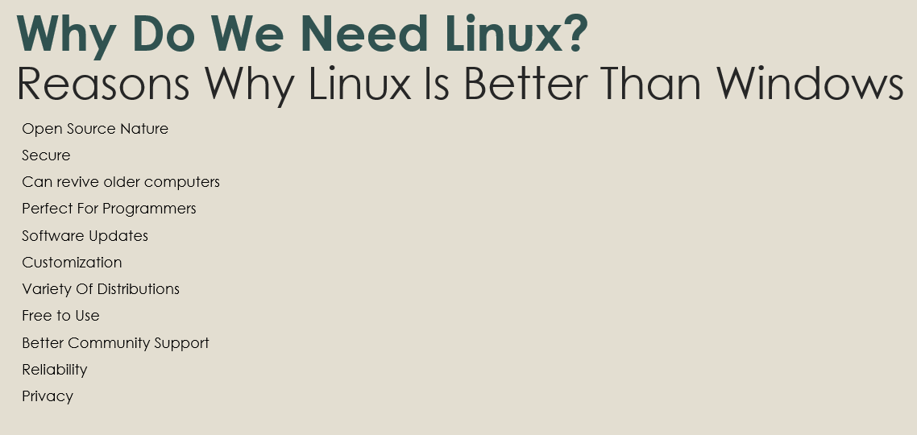
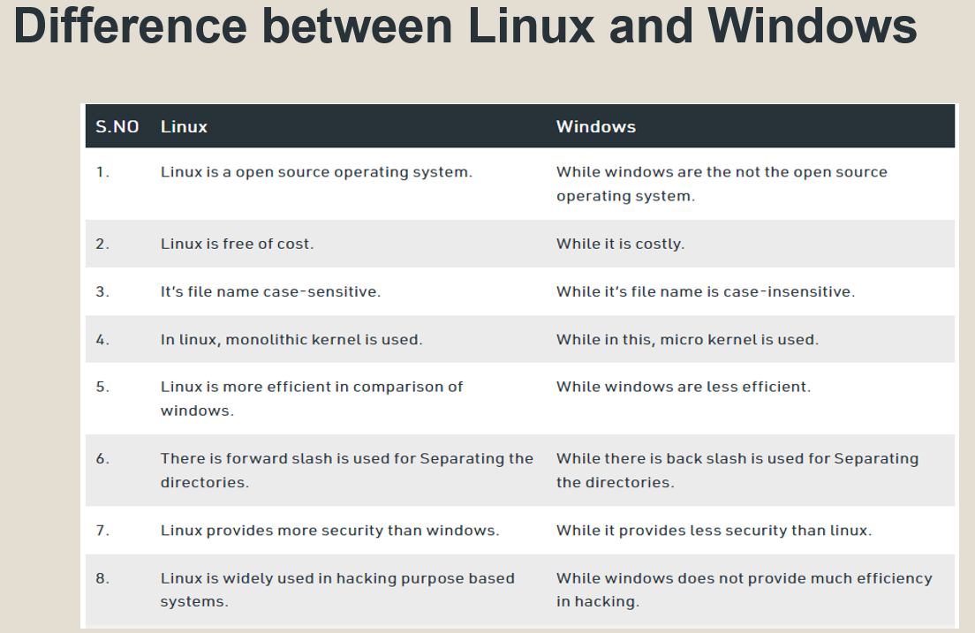
For Example,
List of Linux distributions
1 Ubuntu
2 Fedora
3 CentOS
4 Scientific Linux
5 Linux Mint
6 Fedora
7 Oracle Linux
8 Clear Linux
9 Kali Linux
10 Debian
Linux Text Editors
nano
gedit
vi
vim

Slide 6
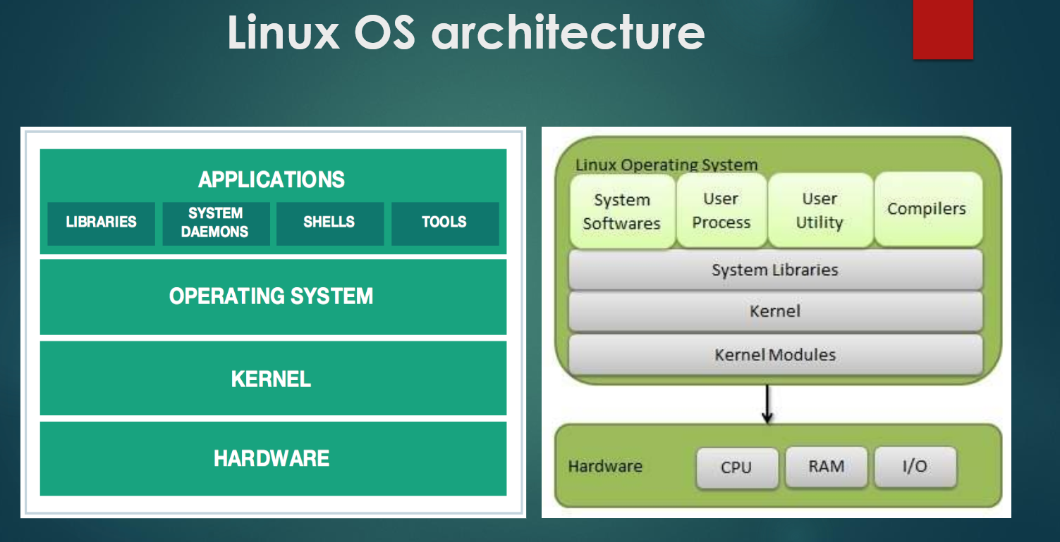
Hardware layer − Hardware consists of all peripheral devices (RAM/HDD/ CPU etc).
Kernel − It is the core component of the Operating System, interacts directly with hardware, and provides low level services to upper-layer components.
Shell − An interface to kernel, hiding the complexity of kernel's functions from users. The shell takes commands from the user and executes kernel's functions.
Utilities − Utility programs that provide the user with most of the functionalities of operating systems.

Slide 7
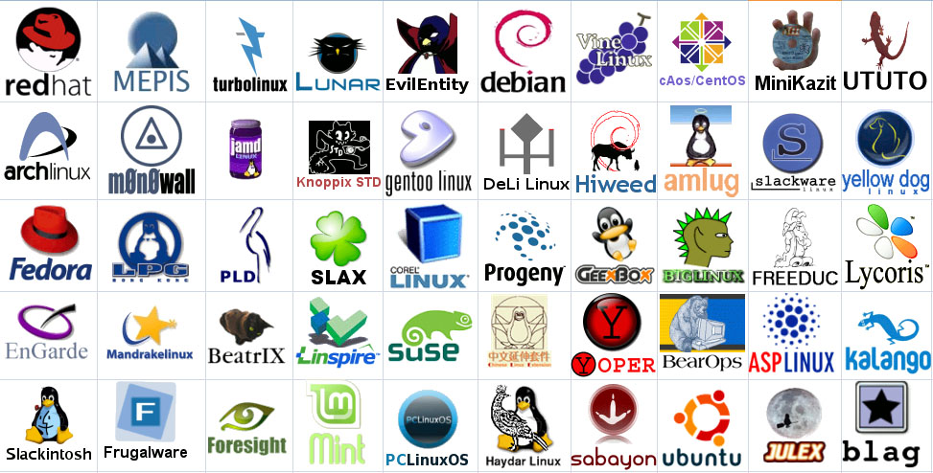
Linux Has Many Distributions

Slide 8
System Administration-CSNW3202
Chapter 2: Package Management
Package Concept
Working with Different Package management tools
In Linux, a package is a collection of files that includes software, libraries, documentation, and metadata required to install, update, or remove a program. Package management systems (PMS) are used to automate the process of handling packages efficiently.
Most software applications designed for Linux systems are distributed as packages, which are archives that contain the pre-compiled binary software files, installation scripts, configuration files, dependency requirements, and other details about the software.
Packages The most basic information that package systems maintain is information about software packages—that is, collections of files that are installed on the computer. Packages are usually distributed as single files that are similar to zip files.
Package management tools in Linux help users install, update, remove, and manage software efficiently. Software libraries, GUI apps, and command-line utilities are examples of packages.

Slide 9
Types of Packages
There are two major types of package formats in Linux:
Debian-based Packages (.deb)
Used in Debian, Ubuntu, Linux Mint, etc.
Managed using dpkg and apt package managers.
Example: firefox_92.0.1_amd64.deb
Red Hat-based Packages (.rpm)
Used in RHEL, CentOS, Fedora, etc.
Managed using rpm and dnf/yum package managers.
Example: vlc-3.0.16-1.el8.x86_64.rpm

Slide 10
Debian-Based Systems (Ubuntu, Debian, Mint)
APT (Advanced Package Tool)
Install: sudo apt install <package-name>
Remove: sudo apt remove <package-name>
Update: sudo apt update && sudo apt upgrade
DPKG (Debian Package)
Install: sudo dpkg <package.deb>
Remove: sudo dpkg <package-name>
Red Hat-Based Systems (RHEL, Fedora, CentOS)
YUM (Yellowdog Updater, Modified)
Install: sudo yum install <package-name>
Remove: sudo yum remove <package-name>
DNF (Dandified YUM)
Install: sudo dnf install <package-name>
Remove: sudo dnf remove <package-name>
RPM (Red Hat Package Manager)

Slide 11
apt-get is a command-line tool in Debian-based Linux distributions (such as Ubuntu, Debian, and Linux Mint) used for handling software packages.
Update the package database with apt-get
sudo apt-get update
Upgrade installed packages with apt-get
sudo apt-get upgrade
Install a Package
sudo apt-get install chrome
sudo apt-get install firefox
Removing a Package
sudo apt-get remove chrome
sudo apt-get remove firefox
How Do I Completely Remove Packages
To remove software packages including their configuration files, use the ‘purge‘ sub command as shown below.
sudo apt-get purge chrome
Clear Downloaded Package Cache
sudo apt-get clean

