Slide 1
Crashed Airplanes

Slide 2
INTRODUCTION..
Over the last centuries, the world has seen several airplane crashes both in the sky and on the ground. The development of technology aims to decrease technological difficulties and human errors. However, fatalities and aircraft damages caused by crashes do not cease to exist.
Our results found in this project will benefit the ongoing investigations into this important topic. Understanding what factors cause airplane crashes helps aviation industries make continuous improvement in flight safety.
Notes:
Taking these impacts into consideration, this project aims to discover and analyze correlations for airplane crashes, raise awareness of flight safety, and better understand its problems and progress.

Slide 3
Objectives:
Our objective is to perform an Exploratory Data Analysis (EDA) to determine the common cause/reason of airplane crash, countries with maximum/minimum airplane crashes, fatalities vs survived ratio and any other interesting trend. In addition, to develop a Model determining the following;
NMF
LDA

Slide 4
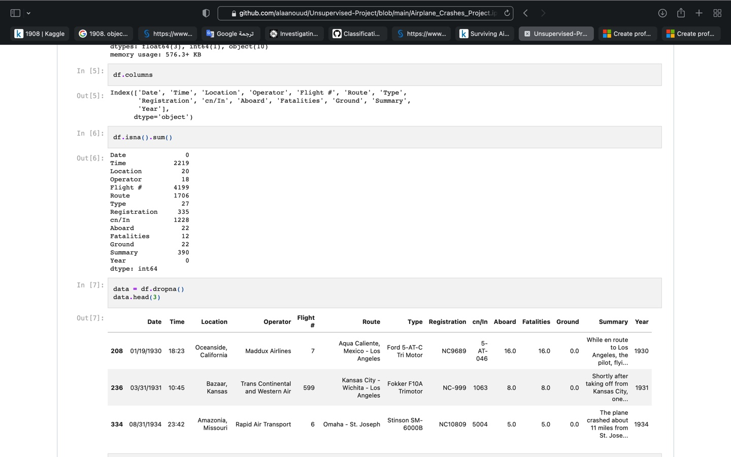
description of the data:
This dataset presents number of crashed airplanes since 1908, where we have 5268 record, Also we have 13 features in this dataset.

Slide 5
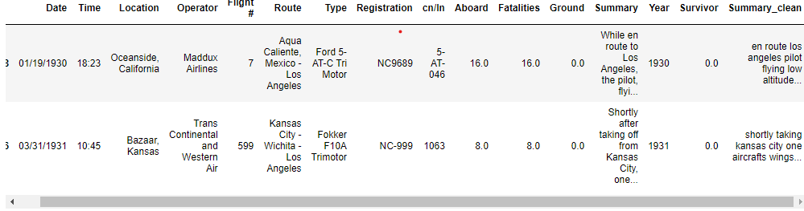
Data preparation:
First, we check for duplicated and null data and drop it
Second, add year column to the dataset.
Third add Survivor column by subtract number of Aboard and Fatalities on each airplane.
Forth, add 'summary clean' column that contain summary after text cleaning using StopWords, Stemmer.

Slide 6
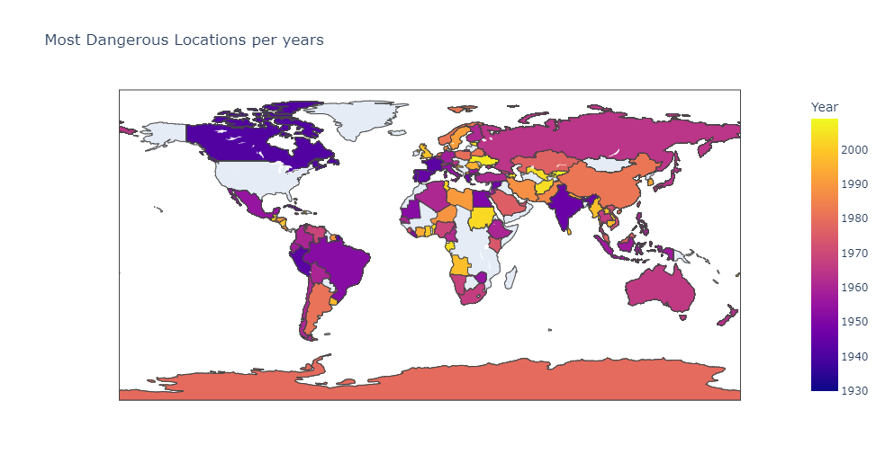
Result:

Slide 7
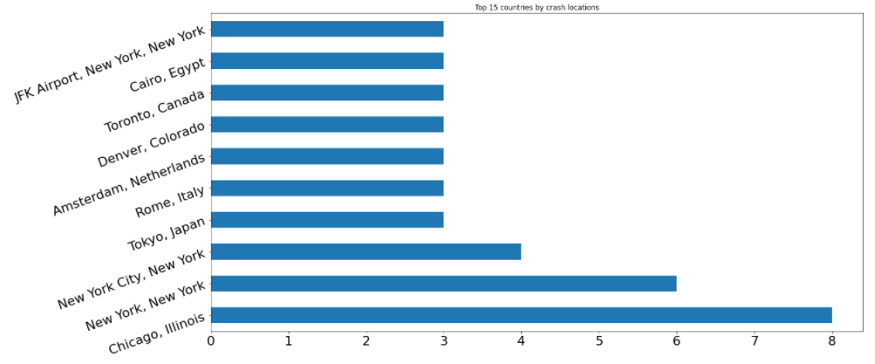
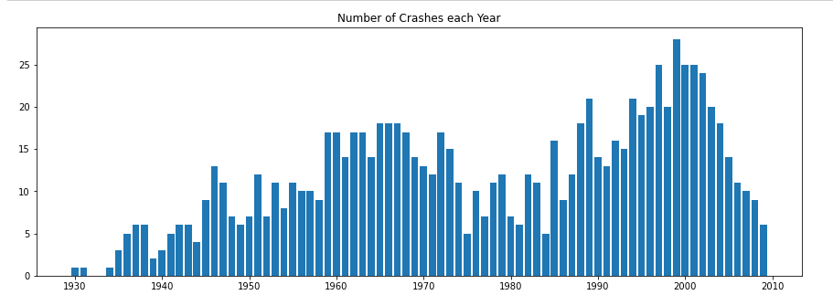
Top 15 countries by crash locations..
Number of Crashes each Year

Slide 8
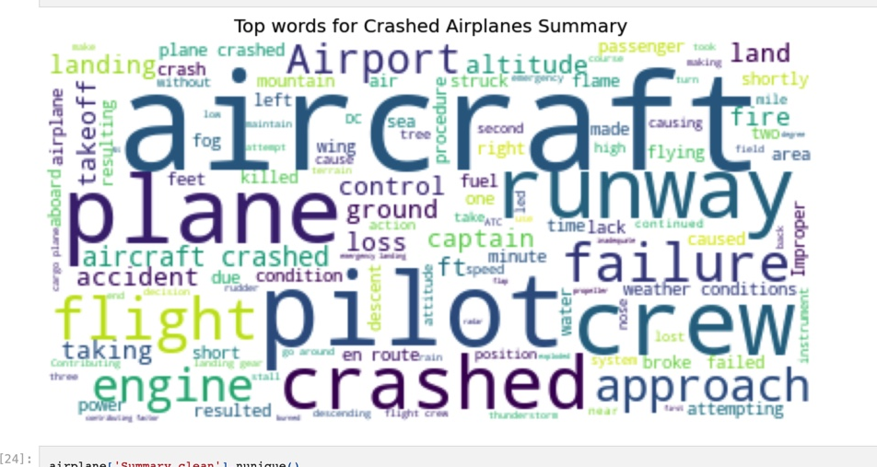
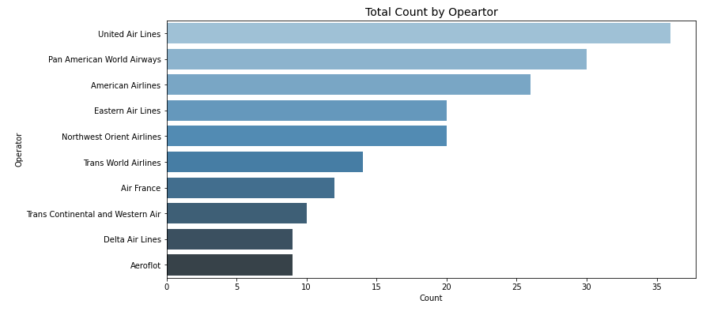
Word cloud for the most common terms
Total Count by Operator

Slide 9
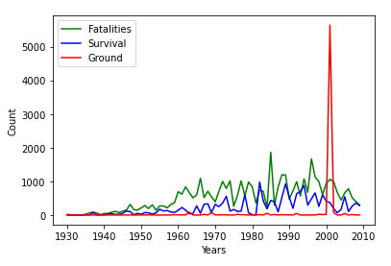
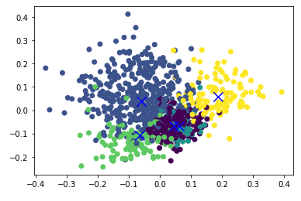
Fatalities, Survival and on Ground per year:
Clustering the most common terms:

Slide 10
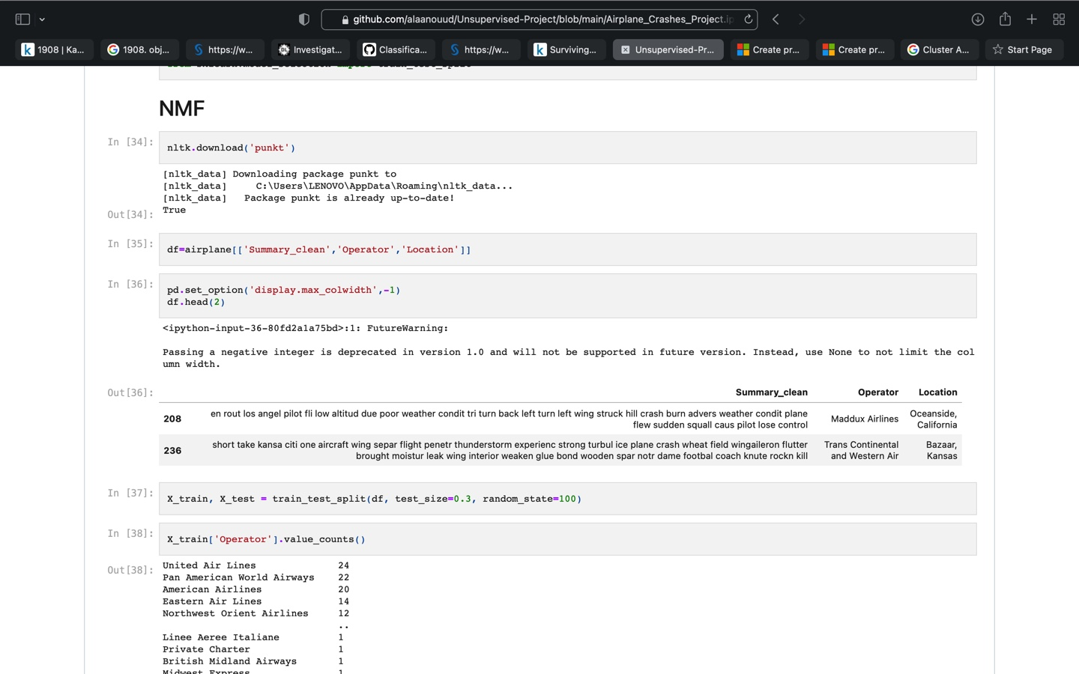
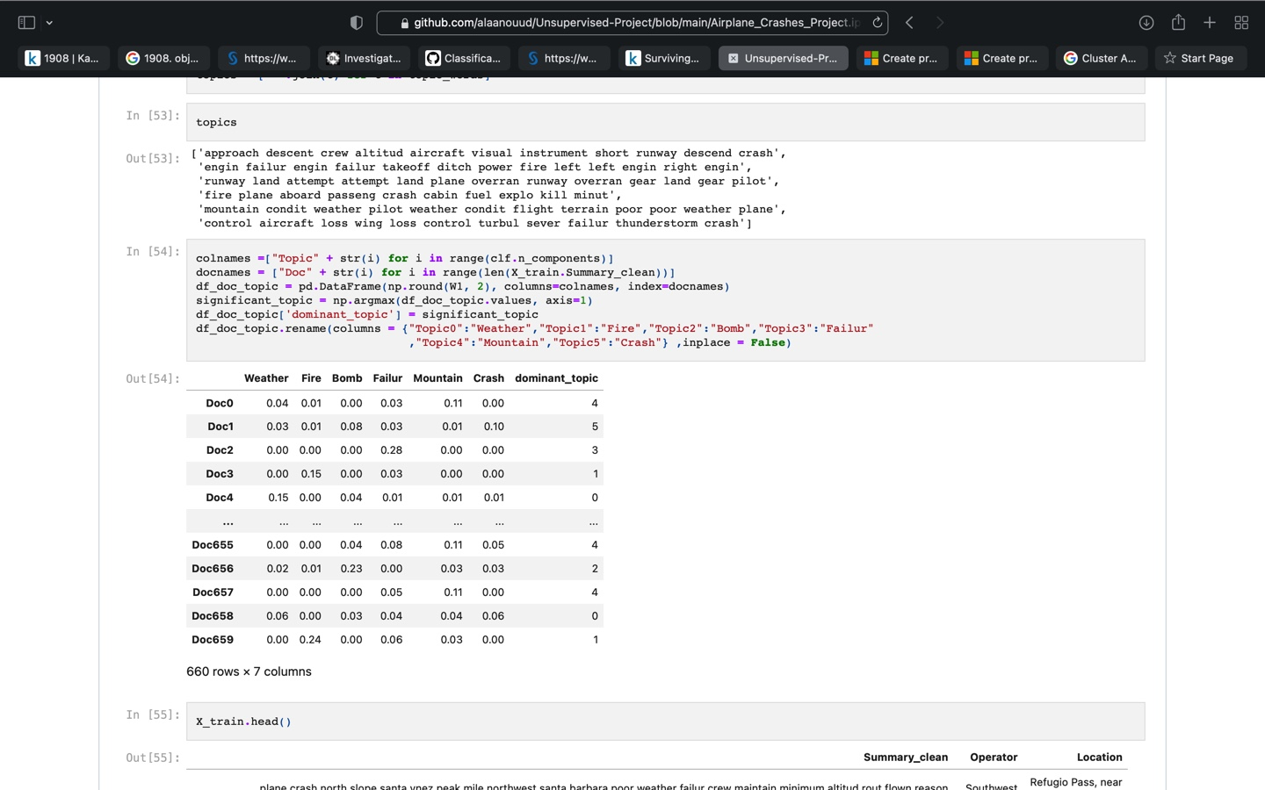
NMF -
Model

Slide 11
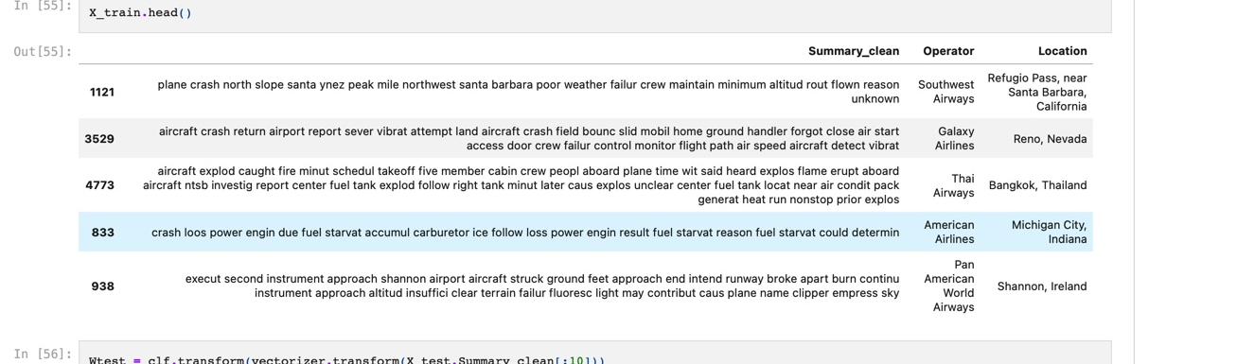
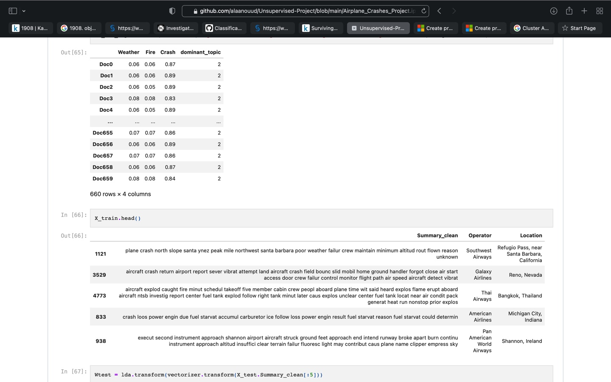
LDA- Model

Slide 12
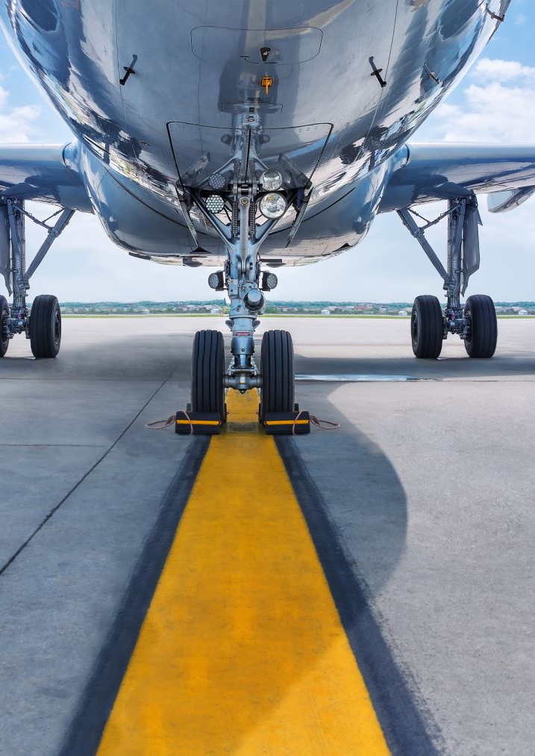
CONCLUSION..
The main objective of our project is to raise awareness of flight safety and better understand its problems and progress, so that aviation industries can continue to improve. We hope that more information understanding will lead to industry changes that save lives.

Slide 13
Thank you

